Slide 1
Motor Control
Mobile Robotics
Anthony J. Clark

Slide 2
Rule-Compliance Path Planner
Pengfei Lin, 2024

Slide 3
Today
DC Motors
H-bridge motor driver (vary motor direction)
Pulse-width modulation (PWM) (vary motor speed)
Quadrature encoders (measure motor motion)
Proportional control (control motor speed)

Slide 4
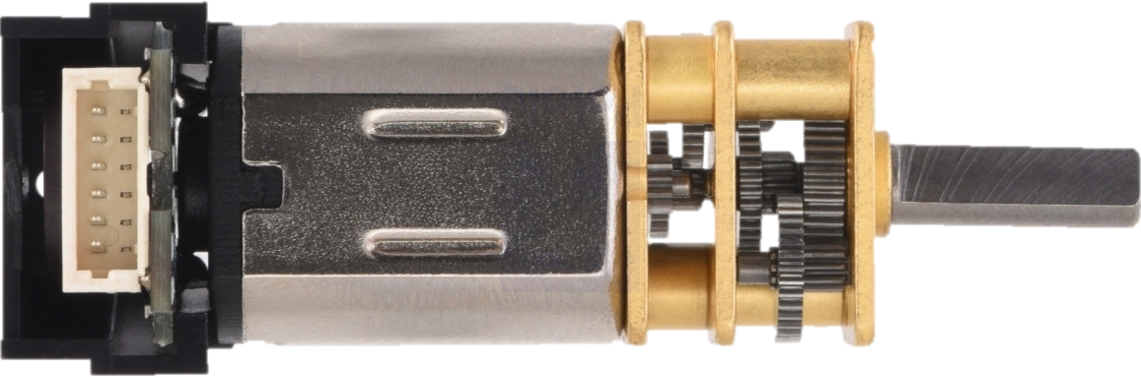
DC Motor Diagram
Lesson Explainer: Direct Current Motors | Nagwa

Slide 5
DC Motor Diagram
Lesson Explainer: Direct Current Motors | Nagwa

Slide 6
DC Motor Model
$$v=\frac{α}{K_{v}}+Ri+L\frac{di}{dt}$$

Slide 7
DC Motor Model
$$v=\frac{α}{K_{v}}+Ri+L\frac{di}{dt}$$
Where
$v$ is the voltage applied (or measured) across the motor terminals
$α$ is the angular velocity of the motor shaft
$K_{v}$ is the speed constant of the motor
$R$ is the resistance of the motor
$i$ is the current through the motor
$L$ is the motor’s inductance
$\frac{di}{dt}$ is the rate of change of current
See Kirchhoff's circuit laws - Wikipedia

Slide 8
DC Motor Speed Vs. Voltage

Slide 9
H-Bridge
“Texas Instruments’ DRV8835 is a tiny dual H-bridge motor driver IC"

Slide 10
H-Bridge

Slide 11
Pulse-Width Modulation (PWM)
$$V_{\text{effective}}=VT_{\text{duty}\text{−}\text{cycle}}$$

Slide 12
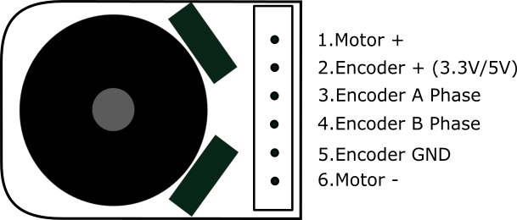
Quadrature Encoders
Micro Metal Geared motor w/Encoder

Slide 13
System Diagram
Microcontroller
Motor Driver
DC Motor
Encoder

Slide 14
System Diagram
Microcontroller
Motor Driver
DC Motor
Encoder
Controller
System
Sensor

Slide 15
Proportional Control
$$u=K_{p}e$$
Where
$u$ is the controller output
$K_{p}$ is a unitless proportional gain
$e=r−\hat{y}$ is the error between the reference and the measured values
Controller
System
Sensor

Slide 16
Proportional Control
Controller
System
Sensor
$$r$$ | $$\hat{y}$$ | $$e$$ | $$u$$ | $$y$$ | PWM

