Slide 1
Introduction and Design
Mobile Robotics
Anthony J. Clark

Slide 2
Today
Administrivia
Warm-up poll questions
Defining robot requirements
Designing the course robot
Design your robot

Slide 3
Administrivia
Mobile Robotics - Course Website
I am administering the course in a “flipped” style so that we can use class time to build and code
We’ll have
  Quizzes every class period
  Exercises every week
  You must pass all of them for an A
  See the course website for more details
Exercises will build on each other

Slide 4
Class Workflow
 |  |  | Week A |  |  |  |  | Week B
 | Mon | Tue | Wed | Thu | Fri | Mon | Tue | Wed | Thu | Fri
Reading | Read |  | Read |  |  | Read |  | Read
Quiz A1 |  | Quiz |  |  |  | Deadline
Quiz A2 |  |  |  | Quiz |  |  |  | Deadline
Exercise A |  | Exercise |  | Continue |  | Due |  |  |  | Deadline
Quiz B1 |  |  |  |  |  |  | Quiz |  |  | …
Quiz B2 |  |  |  |  |  |  |  |  | Quiz | …
Exercise B |  |  |  |  |  |  | Exercise |  | Continue | …

Slide 5
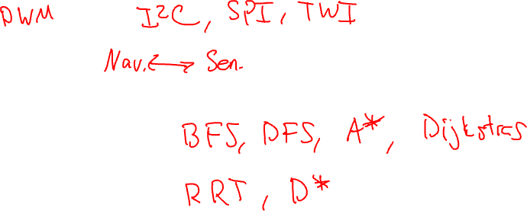
Robotics Stack
We’ll cover most of the robotics stack
  Low level: motor control, sensor interfacing
  Mid level: motion profile, coordination
  High level: AI, navigation, mapping

Slide 6

Communications Channel?
Email
Slack
Discord
Canvas
Other?

Slide 7
Polling (Sheet)
What robotics experience do you have (e.g., Vex, FIRST, etc.)?
Have you taken CS 105 (or similar “low-level” course)?
What is a robot?
What role does artificial intelligence play in robotics?
Notes:
A collection of subsystems.

Slide 8
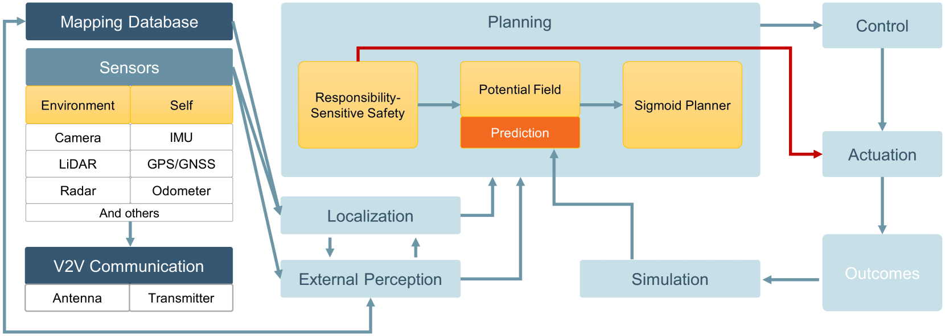
Rule-Compliance Path Planner
Pengfei Lin, 2024

Slide 9
Our Final Task

Slide 10
Requirements
What would you do if I asked you to design a robot?
What questions should we ask (and answer) to design a robot?

Slide 11
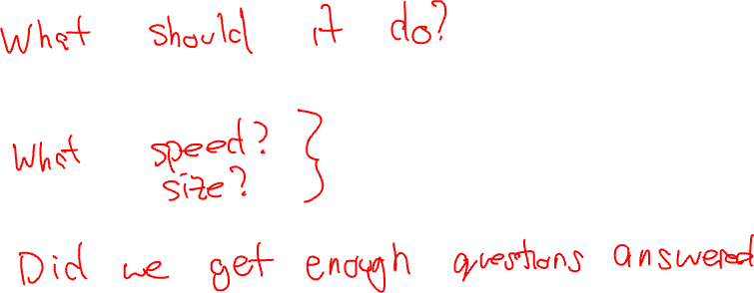
Requirements Engineering
Requirements elicitation
Requirements specification
Verification and validation
Requirements management

Slide 12
Our Requirements
Our robot should:
  Automatically halt when no longer connected via wireless communication
  Autonomously navigate around a course,
  Avoid obstacles (static and dynamic),
  Recognize and react to signs,

Slide 13
Requirements Engineering
Functional requirements and constraints
  How fast does the robot need to move?
  How maneuverable does the robot need to be?
  How small or large (footprint and mass) can the robot be?
  Will the robot interact closely with people?
  How costly is the robot to manufacture?
  What is the robot’s environment?
Nonfunctional requirements
  How easy is it to build the robot?
  How easy is it to fix the robot?
  Can the robot be reused in future semesters?
Notes:
robot characteristics
mechanisms
electronics
programming
fabrication
design considerations
power
materials
senses
strength
agility
stability
style

Slide 14
Refining the Requirements
What kind of processing speed is needed (MCU or SBC or …)?
How much memory and storage are needed?
What is the appropriate transmission (motors, drive system, etc.)?
What form of internal communication is needed (I2C, SPI, UART, etc.)?
What power and logic levels are needed?
What battery systems (type, capacity, C-rating, voltage)?
What form of external communication is useful (wired, BLE, Wi-Fi)?
How much redundancy is needed?
What are your priorities?
Notes:
motors (DC)
power
voltage
current
wheel encoders sensors
logic level
communication
motor control
peak and steady current
voltage input
voltage output
logic level
power management
power levels
charging
microcontroller
processor speed
processor word size
voltage
memory
power consumption
communication with peripherals (I2C, DIO, A2D etc.)
communication with host (USB, WiFi, etc.)
battery
capacity
voltage
current
sensors
communication
logic level
power level
current
accuracy
speed
resolution
miscellaneous
switch
fuse
LEDs
buttons
screen
breadboard/protoboard

Slide 15
My Process for This Course
Decide on a drive system (direct drive).
Decide roughly on a linear robot velocity (about 50 cm/s).
Roughly pick a wheel diameter (about 7 cm).
Compute the needed motor RPMs (about 140 rpm).
Find motors (select 310 rpm @ 6 V, 170 mA; including encoders).
Notes:
A bit of chicken and egg problem between power systems and drive/compute.

Slide 16
Motor Search
Walking speed | 1.34 m/s (3 mph)
Wheel radius | 5 cm
RPM | 100 rpm
Angular velocity | 10.47 rad/s
Linear velocity | 0.52 m/s
Motor | Manufacturer | Cost | No Load RPM | Ratio | Voltage | No-Load Current | Stall Current | Torque oz-in | Logic | Notes
ROB-16413 | Sparkfun | $ 6.88 | 90 @ 4.5V | 48:1 | 3-9V | ? | ? | ? | 3.3-5V
FIT0458 | DFRobot | $ 7.40 | 160 @ 6V | 120:1 | 3-7.5V | 170mA | 2.8A | 2.78 | 4.5-7.5V | L-Shape
FIT0450 | DFRobot | $ 7.40 | 160 @ 6V | 120:1 | 3-7.5V | 170mA | 2.8A | 2.78 | 4.5-7.5V | Same as above, but flat
FIT0482 | DFRobot | $ 11.90 | 310 @ 6V | 50:1 | 3-12v | 60mA |  | 4.8 | 3.3-5V
4638 | Adafruit | $ 12.50 | 200 @ 6V | 50:1 |  | 100mA | 200mA | 2.78 |  | 120 RPM rated speed
DC 6V 300RPM | ASLONG | $ 8.85 | 300 @ 6V | 30:1 | 3-12V |  |  |  | 3.3-5V | SHIPPING!!!
MiniQ | DFRobot | $ 33.00 | 260 @ 6v | 50:1 |  |  | 360mA | 10 | 3.3-5V | Includes 2 motors (5.90), encoders (4.50) wheels (2.90), and mounts (3.50)

Slide 17
My Process for This Course
Decide on a drive system (direct drive).
Decide roughly on a linear robot velocity (about 50 cm/s).
Roughly pick a wheel diameter (about 7 cm).
Compute the needed motor RPMs (about 140 rpm).
Find motors (select 310 rpm @ 6 V, 170 mA; including encoders).
Select motor driver (select 0-11 V, 1.2 A per channel).
Decide on sensor modalities (inertial, distance, compass, camera).
Decide on communication needs (BLE and Wi-Fi).
Find compute devices (select ESP32-S3).
Design power system (1S 3.7 V battery; estimate 190 rpm).
Notes:
A bit of chicken and egg problem between power systems and drive/compute.

Slide 18
Parts Search
Part | Source | Cost | # | Total | Note | Options | B | C | D | E | F
Chassis | Cardboard | $ - | 1 | $ - | Makerspace
Caster Wheel | RobotsShop/Pololu | $ 2.29 | 1 | $ 2.29 | Could go without, but cheap | Pololu Ball Caster with 1/2″ Plastic Ball
Wheels (x2) | Cardboard | $ - | 2 | $ - | Makerspace
Motor w/ Encoder (x2) | DigiKey/SparkFun | $ 6.88 | 2 | $ 13.76 | Probably want faster than 1st option | ROB-16413 | FIT0458 | FIT0450 | 4638 | RM-ASMO-01B | MiniQ Motor Wheel Set with Encoder
Motor Mount (x2) | 3D Print | $ - | 2 | $ - | Makerspace
Motor Driver |  | $ 15.00 | 1 | $ 15.00 | Dual H-bridge matching motors; provide power for MCU?
Microcontroller | Seeed Studio | $ 30.88 | 1 | $ 30.88 | Maybe the Seeed Xiao ESP32S3 Sense | Grove - Vision AI Module V2 | Grove - Vision AI Module with Himax | Grove module + camera + esp32 ? Includes imu, cam, mic
IMU | Inc |  | 1 | $ -
Camera | Inc |  | 1 | $ - |  | Gravity: Huskylens
Microphone | Inc |  | 1 | $ -
Distance Sensor |  | $ 10.00 | 1 | $ 10.00 | ToF | VL53L0X Time-of-Flight Distance Sensor | Skip to the beginning of the images gallery Grove - IR Distance Interrupter v1.2
Power Switch |  | $ 3.00 | 1 | $ 3.00 | Rated for all parts
Power Fuse |  | $ 2.00 | 1 | $ 2.00 | Rated for all parts
Voltage Regulator |  |  |  | $ - | Maybe use motor driver?
Battery |  | $ 5.00 | 1 | $ 5.00
Battery Monitor |  |  | 1 | $ - | Similar to Duckiebot
SD Card |  |  | 1 | $ -
MoCap Marker |  |  | 1 | $ -
USB Cable |  | $ 2.00 | 1 | $ 2.00 | USB-C for programming and charging?
Charger |  |  | 1 | $ - | Built-in?
OLED Display |  | $ 7.00 |  | $ -
 |  |  |  | $ 83.93

Slide 19
Finalized List
Category | Per Unit | Note | Status | Source
Robot Kit | $ 16.40 | Expansion Board Base for XIAO | Delivered | Seeed Studio
Robot Kit | $ 31.38 | Grove Vision AI v2 Kit (AI Module + Camera + Micro) | Delivered | Seeed Studio
Robot Kit | $ 18.62 | SATEL-VL53L7CX | Delivered | Digikey
Robot Kit | $ 2.00 | QMC5883L Triple Axis Compass (x10) | Delivered | Amazon
Robot Kit | $ 3.00 | MPU6050 6DOF IMU (x5) | Delivered | Amazon
Robot Kit | $ 4.95 | BALL CASTER WITH 3/4" PLASTIC | Delivered | Pololu
Robot Kit | $ 23.80 | Gearmotor with Encoder Pair | Delivered | Digikey
Robot Kit | $ 4.95 | DRV8835 DUAL MTR DRIVER CARRIER | Delivered | Pololu
Robot Kit | $ 4.80 | 32GB Class 10 MicroSDHC Flash Memory Card | Delivered | Amazon
Robot Kit | $ 2.25 | BREADBRD DBL STRIP 70TIE-PTS | Delivered | Digikey
Robot Kit | $ 3.69 | Protected 2600mAh 10A 18650 Button Top Battery | Delivered | Liion Wholesale
Robot Kit | $ 1.12 | BATT CONTACT CLIP 18650 1CEL SMD | Delivered | Digikey
Robot Kit | $ 2.00 | Voltage Tester | Delivered | Amazon
Robot Kit | $ 1.10 | Extra-Long Break-Away 0.1" 16-pin Strip Male Header | Delivered | Amazon
Robot Kit | $ 0.82 | N20 Micro Motor Mount Set | Delivered | Amazon
Robot Kit | $ 20.00 | Cables, straps, brackets, connectors, fasteners, etc. | N/A | N/A
Robot Kit Total | $ 140.88
Course Parts | $ 114.95 | XRP ROBOTICS PLATFORM KIT | Delivered | Digikey
Course Parts | $ 100.00 | Adeept
Course Parts | $ 100.00 | Adeept
Course Parts | $ 515.00 | Crazyflie 2.1 |  | Crazyflie?
Course Parts | $ 34.75 | XTAR VC8S Battery Charger | Delivered | Liion Wholesale
Course Parts | $ 9.99 | Anker USB C to USB C Cable | Delivered | Amazon
Course Parts | $ 32.99 | Anker USB C 715 (Nano 65W) | Delivered | Amazon
Course Parts | $ 8.99 | M3 Black Nylon Standoff Spacer With Screws Hex Nuts | Delivered | Amazon
Course Parts | $ 9.99 | M2 Black Nylon Standoff Spacer With Screws Hex Nuts | Delivered | Amazon
Course Parts | $ 7.99 | Reusable Multi-Purpose Wrap Fasteners | Delivered | Amazon
Course Parts | $ 3.78 | Rubber Bands Size #30 | Delivered | Amazon
Course Parts | $ 6.99 | Double Sided Sticky Dot | Delivered | Amazon
Course Parts | $ 28.99 | 6 Qt Clear Storage Box | Delivered | Amazon
Course Parts | $ 12.20 | JUMPER KIT VARIOUS 26AWG 65PCS | Delivered | Digikey
Course Parts | $ 3.50 | Grove - 4 pin Female Jumper to Grove | Delivered | Seeed Studio
Course Parts | $ 4.50 | GROVE2DUPONT CONVERSION CABLE 20 | Delivered | Digikey
Course Parts | $ 8.60 | GROVE 4PIN FEMALE JUMPERS 5PACK | Delivered | Digikey
Course Parts Total | $ 1,003.21
Other | $ 111.17 | Estimated | N/A | N/A
Other | $ 200.00 | Estimated | N/A | N/A
Other Total | $ 311.17
*Missing a few late additions

Slide 20
Things to Check
Power levels: voltage in Volts (V) and current in amps (A)
Logic levels: chips need to agree on what a logic “1” is in terms of voltage
Power reset: actuators should typically be powered after compute
Power monitor: don’t over discharge your batteries

Slide 21
Prototyping
Define goals
Brainstorm designs
Sketch your layout (I’ve given you all “component templates”)
Prototype with simple materials (cardboard, sticky dots, etc.)
Model with CAD and fabricate
Make notes on what works and what doesn’t
Refine (back to step 5)

Slide 22
First Quiz
Complete the first quiz on gradescope.

Slide 23
Exercise 1
Arts and crafts day at the Hive
Pair-up
Multiple pairs can work together (no more than 6)
“Design” your robot
You’ll start with electronics on Thursday

Slide 24

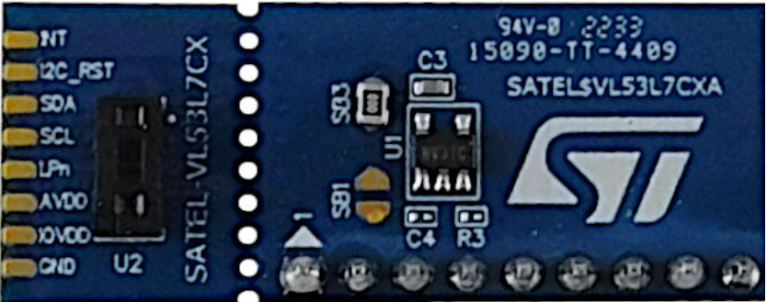
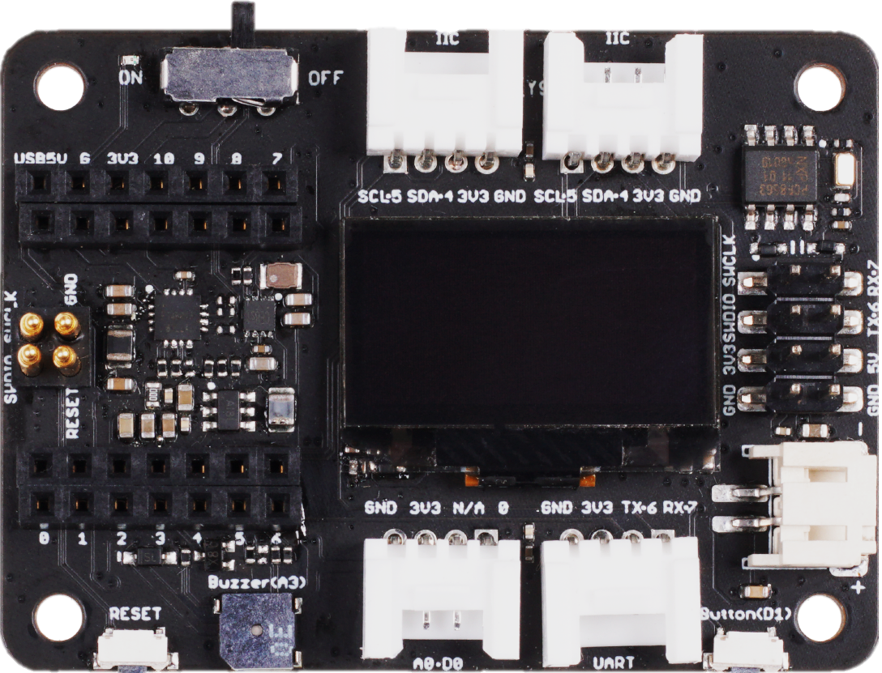
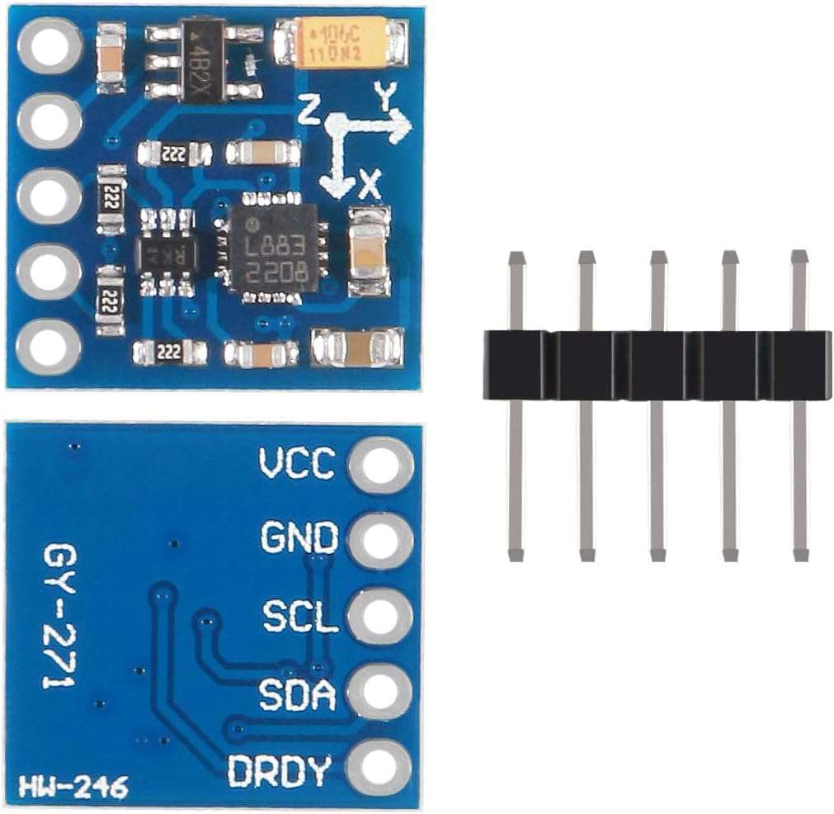
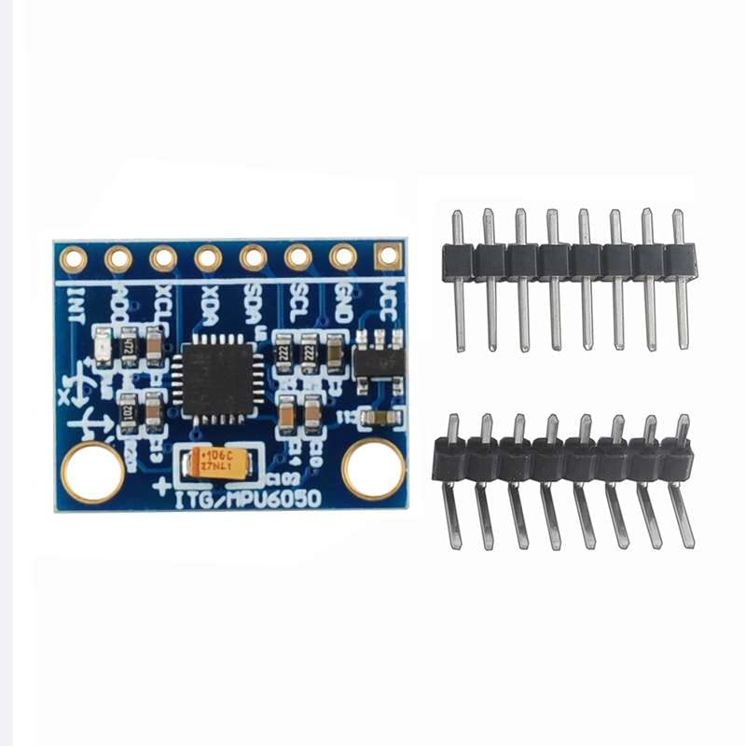

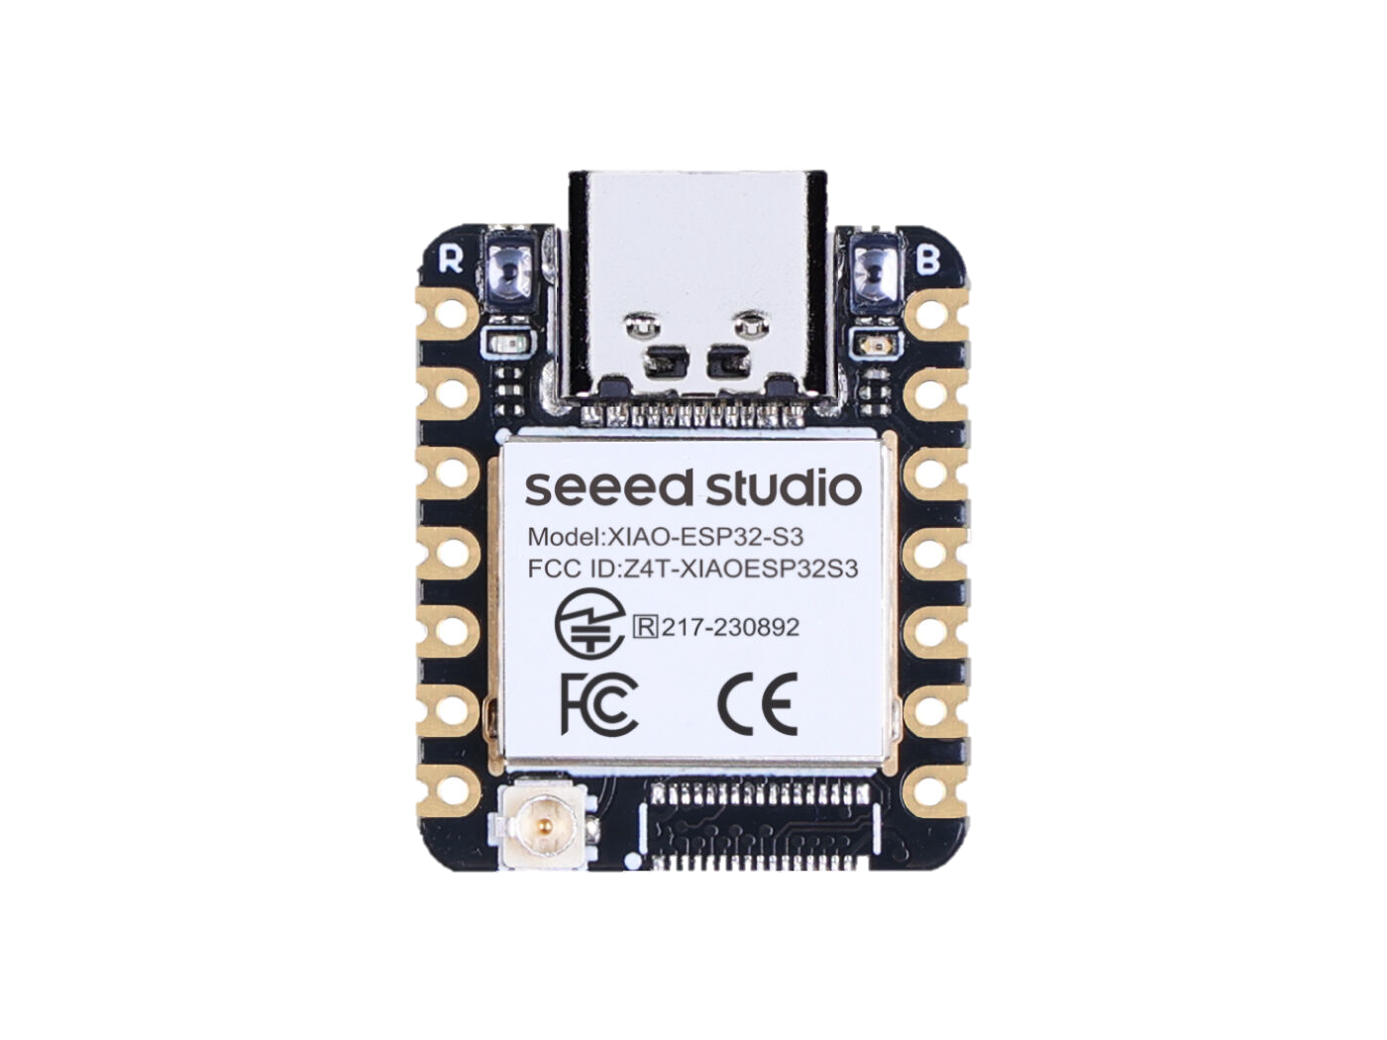
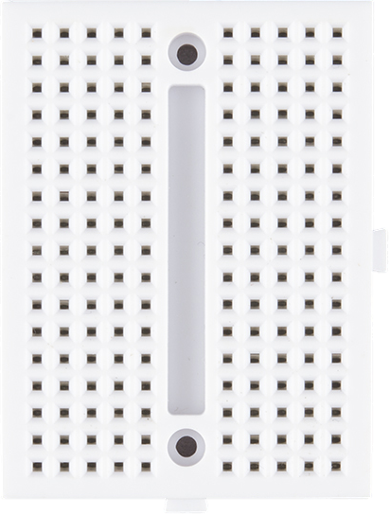
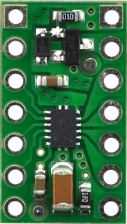
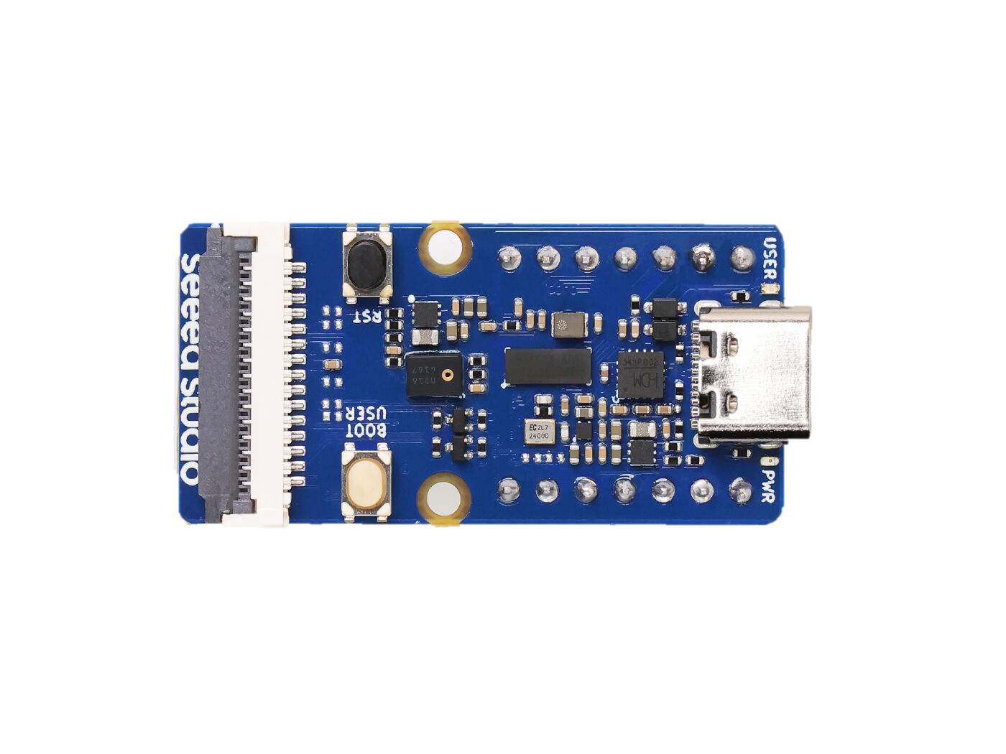
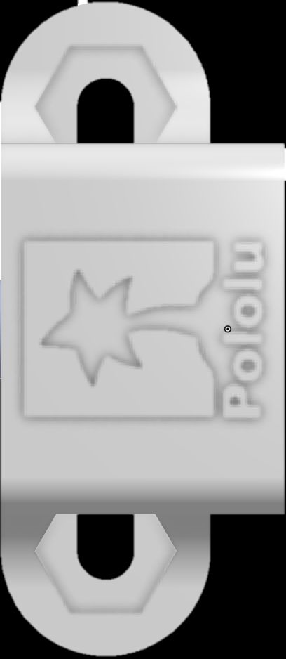
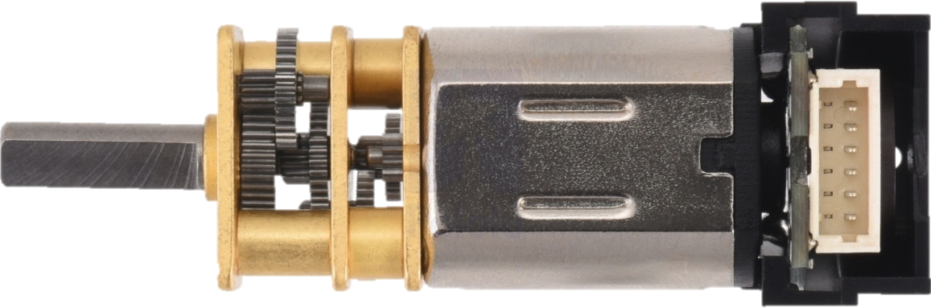
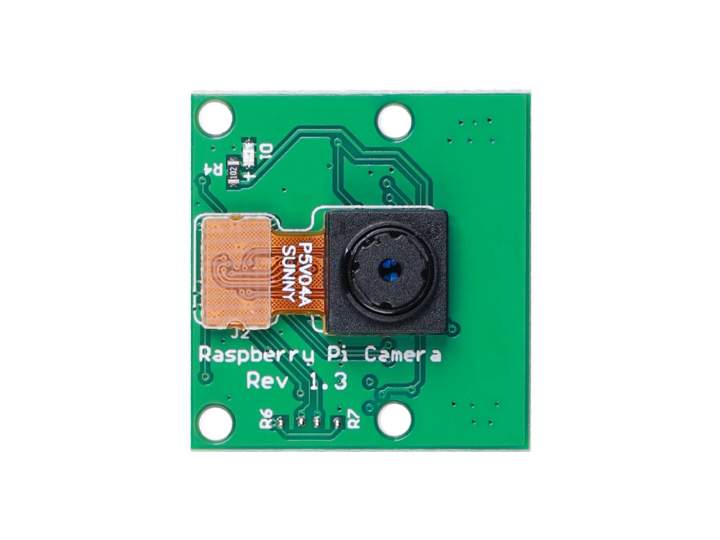
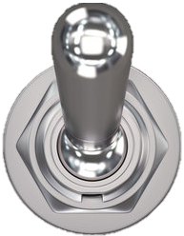

Parts (These Won’t Print Correctly)
Wheel

Slide 25
Full Layout
Wheel
Wheel
Wires
Strap
Strap

Slide 26
Top
Wheel
Wheel
Wires

Slide 27
Cross Bar

Slide 28
Bottom
Wires
Strap
Strap

