Slide 1
Index Compression
David Kauchak
cs160
Fall 2009
adapted from: http://www.stanford.edu/class/cs276/handouts/lecture5-indexcompression.ppt

Slide 2
Administrative
Homework 2
Assignment 1
Assignment 2
Pair programming?

Slide 4
RCV1 token normalization
size of | word types (terms)
 | dictionary
 | Size (K) | ∆% | cumul %
Unfiltered | 484
No numbers | 474 | -2 | -2
Case folding | 392 | -17 | -19
30 stopwords | 391 | -0 | -19
150 stopwords | 391 | -0 | -19
stemming | 322 | -17 | -33

Slide 5
TDT token normalization
normalization | terms | % change
none | 120K | -
number folding | 117K | 3%
lowercasing | 100K | 17%
stemming | 95K | 25%
stoplist | 120K | 0%
number & lower & stoplist | 97K | 20%
all | 78K | 35%
What normalization technique(s) should we use?

Slide 6
Index parameters vs. what we index
size of | word types (terms) |  |  | non-positional postings |  |  | positional postings
 | dictionary |  |  | non-positional index |  |  | positional index
 | Size (K) | ∆% | cumul % | Size (K) | ∆ % | cumul % | Size (K) | ∆ % | cumul %
Unfiltered | 484 |  |  | 109,971 |  |  | 197,879
No numbers | 474 | -2 | -2 | 100,680 | -8 | -8 | 179,158 | -9 | -9
Case folding | 392 | -17 | -19 | 96,969 | -3 | -12 | 179,158 | 0 | -9
30 stopwords | 391 | -0 | -19 | 83,390 | -14 | -24 | 121,858 | -31 | -38
150 stopwords | 391 | -0 | -19 | 67,002 | -30 | -39 | 94,517 | -47 | -52
stemming | 322 | -17 | -33 | 63,812 | -4 | -42 | 94,517 | 0 | -52

Slide 7
Index parameters vs. what we index
size of | word types (terms) |  |  | non-positional postings |  |  | positional postings
 | dictionary |  |  | non-positional index |  |  | positional index
 | Size (K) | ∆% | cumul % | Size (K) | ∆ % | cumul % | Size (K) | ∆ % | cumul %
Unfiltered | 484 |  |  | 109,971 |  |  | 197,879
No numbers | 474 | -2 | -2 | 100,680 | -8 | -8 | 179,158 | -9 | -9
Case folding | 392 | -17 | -19 | 96,969 | -3 | -12 | 179,158 | 0 | -9
30 stopwords | 391 | -0 | -19 | 83,390 | -14 | -24 | 121,858 | -31 | -38
150 stopwords | 391 | -0 | -19 | 67,002 | -30 | -39 | 94,517 | -47 | -52
stemming | 322 | -17 | -33 | 63,812 | -4 | -42 | 94,517 | 0 | -52

Slide 8
Index parameters vs. what we index
size of | word types (terms) |  |  | non-positional postings |  |  | positional postings
 | dictionary |  |  | non-positional index |  |  | positional index
 | Size (K) | ∆% | cumul % | Size (K) | ∆ % | cumul % | Size (K) | ∆ % | cumul %
Unfiltered | 484 |  |  | 109,971 |  |  | 197,879
No numbers | 474 | -2 | -2 | 100,680 | -8 | -8 | 179,158 | -9 | -9
Case folding | 392 | -17 | -19 | 96,969 | -3 | -12 | 179,158 | 0 | -9
30 stopwords | 391 | -0 | -19 | 83,390 | -14 | -24 | 121,858 | -31 | -38
150 stopwords | 391 | -0 | -19 | 67,002 | -30 | -39 | 94,517 | -47 | -52
stemming | 322 | -17 | -33 | 63,812 | -4 | -42 | 94,517 | 0 | -52

Slide 9
Corpora statistics
statistic | TDT | Reuters RCV1
documents | 16K | 800K
avg. # of tokens per doc | 400 | 200
terms | 100K | 400K
non-positional postings | ? | 100M

Slide 10
How does the vocabulary size grow with the size of the corpus?
vocabulary size
number of documents

Slide 11
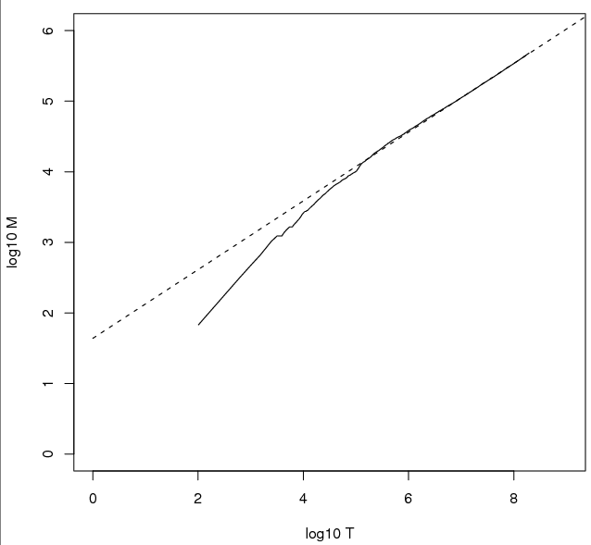
How does the vocabulary size grow with the size of the corpus?
log of the vocabulary size
log of the number of documents

Slide 12
Heaps’ law
Vocab size = k (tokens)^{b}
M = k T^{b}
Typical values: 30 ≤ k ≤ 100 and b ≈ 0.5.
Does this explain the plot we saw before?
What does this say about the vocabulary size as we increase the number of documents?
there are almost always new words to be seen: increasing the number of documents increases the vocabulary size
to get a linear increase in vocab size, need to add exponential number of documents
log M= log k + b log(T)

Slide 13
How does the vocabulary size grow with the size of the corpus?
log₁₀M = 0.49 log₁₀T + 1.64 is the best least squares fit.
M = 10^{1.64}T^{0.49}
k = 10^{1.64} ≈ 44
b = 0.49.
log of the vocabulary size
log of the number of documents

Slide 14
Discussion
How do token normalization techniques and similar efforts like spelling correction interact with Heaps’ law?

Slide 15
Heaps’ law and compression
Today, we’re talking about index compression, i.e. reducing the memory requirement for storing the index
What implications does Heaps’ law have for compression?
Dictionary sizes will continue to increase
Dictionaries can be very large

Slide 16
How does a word’s frequency relate to it’s frequency rank?
word frequency
word’s frequency rank

Slide 17
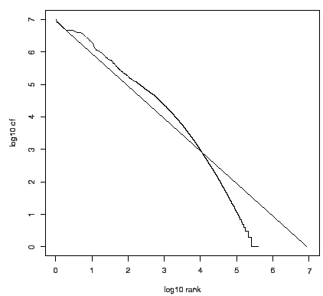
How does a word’s frequency relate to it’s frequency rank?
log of the frequency
log of the frequency rank

Slide 18
Zipf’s law
In natural language, there are a few very frequent terms and very many very rare terms
Zipf’s law: The ith most frequent term has frequency proportional to 1/i
where c is a constant
frequency_{i} ∝ c/i
log(frequency_{i}) ∝ log c – log i

Slide 19
Consequences of Zipf’s law
If the most frequent term (the) occurs cf₁ times, how often do the 2nd and 3rd most frequent occur?
then the second most frequent term (of) occurs cf₁/2 times
the third most frequent term (and) occurs cf₁/3 times …
If we’re counting the number of words in a given frequency range, lowering the frequency band linearly results in an exponential increase in the number of words

Slide 20
Zipf’s law and compression
What implications does Zipf’s law have for compression?
Some terms will occur very frequently in positional postings lists
Dealing with these well can drastically reduce the index size
word frequency
word’s frequency rank

Slide 21
Index compression
Compression techniques attempt to decrease the space required to store an index
What other benefits does compression have?
Keep more stuff in memory (increases speed)
Increase data transfer from disk to memory
[read compressed data and decompress] is faster than [read uncompressed data]
What does this assume?
Decompression algorithms are fast
True of the decompression algorithms we use

Slide 22
Inverted index
word 1
word 2
What do we need to store?
How are we storing it?
…
word n

Slide 23
Compression in inverted indexes
First, we will consider space for dictionary
Make it small enough to keep in main memory
Then the postings
Reduce disk space needed, decrease time to read from disk
Large search engines keep a significant part of postings in memory

Slide 24
Lossless vs. lossy compression
What is the difference between lossy and lossless compression techniques?
Lossless compression: All information is preserved
Lossy compression: Discard some information, but attempt to keep information that is relevant
Several of the preprocessing steps can be viewed as lossy compression: case folding, stop words, stemming, number elimination.
Prune postings entries that are unlikely to turn up in the top k list for any query
Where else have you seen lossy and lossless compresion techniques?

Slide 25
Why compress the dictionary
Must keep in memory
Search begins with the dictionary
Memory footprint competition
Embedded/mobile devices

Slide 26
What is a straightforward way of storing the dictionary?

Slide 27
What is a straightforward way of storing the dictionary?
Array of fixed-width entries
~400,000 terms; 28 bytes/term = 11.2 MB.
20 bytes
4 bytes each

Slide 28
Fixed-width terms are wasteful
Any problem with this approach?
Most of the bytes in the Term column are wasted – we allot 20 bytes for 1 letter terms
And we still can’t handle supercalifragilisticexpialidocious
Written English averages ~4.5 characters/word
Is this the number to use for estimating the dictionary size?
Ave. dictionary word in English: ~8 characters
Short words dominate token counts but not type average

Slide 29
Any ideas?
Store the dictionary as one long string
Gets ride of wasted space
If the average word is 8 characters, what is our savings over the 20 byte representation?
Theoretically, 60%
Any issues?
….systilesyzygeticsyzygialsyzygyszaibelyiteszczecinszomo….

Slide 30
Dictionary-as-a-String
Store dictionary as a (long) string of characters:
Pointer to next word shows end of current word
….systilesyzygeticsyzygialsyzygyszaibelyiteszczecinszomo….
Total string length =
400K x 8B = 3.2MB
Pointers resolve 3.2M
positions: log₂3.2M =
22bits = 3bytes
How much memory to store the pointers?

Slide 31
Space for dictionary as a string
Fixed-width
20 bytes per term = 8 MB
As a string
6.4 MB (3.2 for dictionary and 3.2 for pointers)
20% reduction!
Still a long way from 60%. Any way we can store less pointers?

Slide 32
Blocking
Store pointers to every kth term string
….systilesyzygeticsyzygialsyzygyszaibelyiteszczecinszomo….
What else do we need?

Slide 33
Blocking
Store pointers to every kth term string
Example below: k = 4
Need to store term lengths (1 extra byte)
….7systile9syzygetic8syzygial6syzygy11szaibelyite8szczecin9szomo….
⎫ Save 9 bytes
⎬ on 3
⎭ pointers.
Lose 4 bytes on
term lengths.

Slide 34
Net
Where we used 3 bytes/pointer without blocking
3 x 4 = 12 bytes for k=4 pointers,
now we use 3+4=7 bytes for 4 pointers.
Shaved another ~0.5MB; can save more with larger k.
Why not go with larger k?

Slide 35
Dictionary search without blocking
How would we search for a dictionary entry?
….systilesyzygeticsyzygialsyzygyszaibelyiteszczecinszomo….

Slide 36
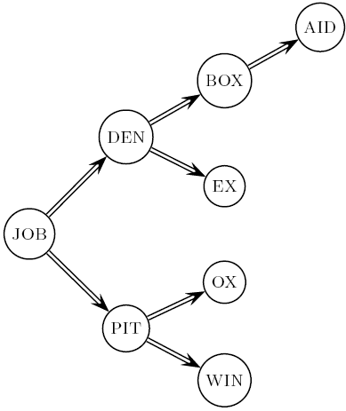
Dictionary search without blocking
Binary search
Assuming each dictionary term is equally likely in query (not really so in practice!), average number of comparisons = ?
(1+2∙2+4∙3+4)/8 ~2.6

Slide 37
Dictionary search with blocking
What about with blocking?
….7systile9syzygetic8syzygial6syzygy11szaibelyite8szczecin9szomo….

Slide 38
Dictionary search with blocking
Binary search down to 4-term block
Then linear search through terms in block.
Blocks of 4 (binary tree), avg. = ?
(1+2∙2+2∙3+2∙4+5)/8 = 3 compares

Slide 39
More improvements…
8automata8automate9automatic10automation
We’re storing the words in sorted order
Any way that we could further compress this block?

Slide 40
Front coding
Front-coding:
Sorted words commonly have long common prefix – store differences only
(for last k-1 in a block of k)
8automata8automate9automatic10automation
→8automat*a1e2ic3ion
Encodes automat
Extra length
beyond automat
Begins to resemble general string compression

Slide 41
RCV1 dictionary compression
Technique | Size in MB
Fixed width | 11.2
String with pointers to every term | 7.6
Blocking k = 4 | 7.1
Blocking + front coding | 5.9

Slide 42
Postings compression
The postings file is much larger than the dictionary, by a factor of at least 10
A posting for our purposes is a docID
Regardless of our postings list data structure, we need to store all of the docIDs
For Reuters (800,000 documents), we would use 32 bits per docID when using 4-byte integers
Alternatively, we can use log₂ 800,000 ≈ 20 bits per docID

Slide 43
Postings: two conflicting forces
Where is most of the storage going?
Frequent terms will occur in most of the documents and require a lot of space
A term like the occurs in virtually every doc, so 20 bits/posting is too expensive.
Prefer 0/1 bitmap vector in this case
A term like arachnocentric occurs in maybe one doc out of a million – we would like to store this posting using log₂ 1M ~ 20 bits.

Slide 44
Postings file entry
We store the list of docs containing a term in increasing order of docID.
computer: 33,47,154,159,202 …
Is there another way we could store this sorted data?
Store gaps: 33,14,107,5,43 …
14 = 47-33
107 = 154 – 47
5 = 159 - 154

Slide 45
Fixed-width
How many bits do we need to encode the gaps?
Does this buy us anything?

Slide 46
Variable length encoding
Aim:
For arachnocentric, we will use ~20 bits/gap entry
For the, we will use ~1 bit/gap entry
Key challenge: encode every integer (gap) with as few bits as needed for that integer
1, 5, 5000, 1, 1524723, …
for smaller integers, use fewer bits
for larger integers, use more bits

Slide 47
Variable length coding
1, 5, 5000, 1, 1124 …
1, 101, 1001110001, 1, 10001100101 …
Fixed width:
000000000100000001011001110001 …
every 10 bits
Variable width:
11011001110001110001100101 …
?

Slide 48
Variable Byte (VB) codes
Rather than use 20 bits, i.e. record gaps with the smallest number of bytes to store the gap
1, 101, 1001110001
00000001, 00000101, 00000010 01110001
1 byte
1 byte
2 bytes
00000001000001010000001001110001
?

Slide 49
VB codes
Reserve the first bit of each byte as the continuation bit
If the bit is 1, then we’re at the end of the bytes for the gap
If the bit is 0, there are more bytes to read
For each byte used, how many bits of the gap are we storing?
1, 101, 1001110001
100000011000010100000100 11110001

Slide 50
Example
docIDs | 824 | 829 | 215406
gaps |  | 5 | 214577
VB code | 00000110 10111000 | 10000101 | 00001101 00001100 10110001
Postings stored as the byte concatenation
000001101011100010000101000011010000110010110001
Key property: VB-encoded postings are
uniquely prefix-decodable.
For a small gap (5), VB
uses a whole byte.

Slide 51
Other variable codes
Instead of bytes, we can also use a different “unit of alignment”: 32 bits (words), 16 bits, 4 bits (nibbles) etc.
What are the pros/cons of a smaller/larger unit of alignment?
Larger units waste less space on continuation bits (1 of 32 vs. 1 of 8)
Smaller unites waste less space on encoding smaller number, e.g. to encode ‘1’ we waste (6 bits vs. 30 bits)

Slide 52
More codes
100000011000010100000100 11110001
Still seems wasteful
What is the major challenge for these variable length codes?
We need to know the length of the number!
Idea: Encode the length of the number so that we know how many bits to read

Slide 53
Gamma codes
Represent a gap as a pair length and offset
offset is G in binary, with the leading bit cut off
13 → 1101 → 101
17 → 10001 → 0001
50 → 110010 → 10010
length is the length of offset
13 (offset 101), it is 3
17 (offset 0001), it is 4
50 (offset 10010), it is 5

Slide 54
Encoding the length
We’ve stated what the length is, but not how to encode it
What is a requirement of our length encoding?
Lengths will have variable length (e.g. 3, 4, 5 bits)
We must be able to decode it without any ambiguity
Any ideas?
Unary code
Encode a number n as n 1’s, followed by a 0, to mark the end of it
5 → 111110
12 → 1111111111110

Slide 55
Gamma code examples
number | length | offset | γ-code
0
1
2
3
4
9
13
24
511
1025

Slide 56
Gamma code examples
number | length | offset | γ-code
0 |  |  | none
1 | 0 |  | 0
2 | 10 | 0 | 10,0
3 | 10 | 1 | 10,1
4 | 110 | 00 | 110,00
9 | 1110 | 001 | 1110,001
13 | 1110 | 101 | 1110,101
24 | 11110 | 1000 | 11110,1000
511 | 111111110 | 11111111 | 111111110,11111111
1025 | 11111111110 | 0000000001 | 11111111110,0000000001

Slide 57
Gamma code properties
Uniquely prefix-decodable, like VB
All gamma codes have an odd number of bits
What is the fewest number of bits we could expect to express a gap (without any other knowledge of the other gaps)?
log₂ (gap)
How many bits do gamma codes use?
2 ⎣log₂ (gap)⎦ +1 bits
Almost within a factor of 2 of best possible

Slide 58
Gamma seldom used in practice
Machines have word boundaries – 8, 16, 32 bits
Compressing and manipulating at individual bit-granularity will slow down query processing
Variable byte alignment is potentially more efficient
Regardless of efficiency, variable byte is conceptually simpler at little additional space cost

Slide 59
RCV1 compression
Data structure | Size in MB
dictionary, fixed-width | 11.2
dictionary, term pointers into string | 7.6
with blocking, k = 4 | 7.1
with blocking & front coding | 5.9
collection (text, xml markup etc) | 3,600.0
collection (text) | 960.0
Term-doc incidence matrix | 40,000.0
postings, uncompressed (32-bit words) | 400.0
postings, uncompressed (20 bits) | 250.0
postings, variable byte encoded | 116.0
postings, γ−encoded | 101.0

Slide 60
Index compression summary
We can now create an index for highly efficient Boolean retrieval that is very space efficient
Only 4% of the total size of the collection
Only 10-15% of the total size of the text in the collection
However, we’ve ignored positional information
Hence, space savings are less for indexes used in practice
But techniques substantially the same

Slide 61
Resources
IIR 5
F. Scholer, H.E. Williams and J. Zobel. 2002. Compression of Inverted Indexes For Fast Query Evaluation. Proc. ACM-SIGIR 2002.
V. N. Anh and A. Moffat. 2005. Inverted Index Compression Using Word-Aligned Binary Codes. Information Retrieval 8: 151–166.

