Slide 1
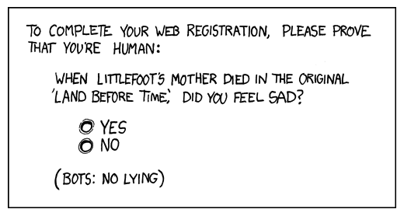
http://www.xkcd.com/233/

Slide 2
Text Clustering
David Kauchak
cs160
Fall 2009
adapted from:
http://www.stanford.edu/class/cs276/handouts/lecture17-clustering.ppt

Slide 3
Administrative
2nd status reports
Paper review

Slide 4
IR code changes
/common/cs/cs160/project/
  requires the mysql…jar
  will get into svn, but for now can look at code
TDT data set with title and paragraph breaks
  tdt.text.title or tdt.text.p.title in main data dir
TDT is in database
  you can access it from any where in the lab
  can add other data sets, but let me know
    need to write a DocumentReader class for it
    image datasets?
    page rank dataset?
http://saras.cs.pomona.edu/bursti/doc.php?id=10

Slide 5
IR code changes
broke up indexing and querying steps
  pass in an index file, instead of a set of documents
  /common/cs/cs160/project/data has one index
Document class
  added title and url fields
  added paragraph boundaries (only works for docs in database right now)
Added DB interfacing classes
  DBDocReader (a DocReader) for iterating through documents in the database
  DBDocFetcher to fetch documents based on document id for query time document fetching

Slide 6
Supervised learning
Training or learning phase
Label
Raw data
Label
features
f₁, f₂, f₃, …, f_{n}
f₁, f₂, f₃, …, f_{n}
f₁, f₂, f₃, …, f_{n}
classifier
f₁, f₂, f₃, …, f_{n}
train a
predictive
model
extract
features
f₁, f₂, f₃, …, f_{n}
User “supervision”, we’re given the labels (classes)

Slide 7
Unsupervised learning
Raw data
features
f₁, f₂, f₃, …, f_{n}
f₁, f₂, f₃, …, f_{n}
Clusters
f₁, f₂, f₃, …, f_{n}
f₁, f₂, f₃, …, f_{n}
group into classes/clusters
extract
features
f₁, f₂, f₃, …, f_{n}
No “supervision”, we’re only given data and want to find natural groupings

Slide 8
What is clustering?
Clustering: the process of grouping a set of objects into classes of similar objects
  Documents within a cluster should be similar
  Documents from different clusters should be dissimilar
How might this be useful for IR?

Slide 9
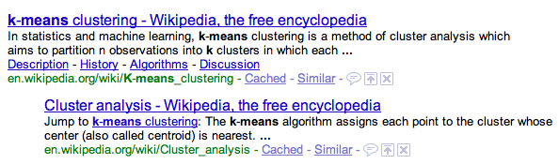
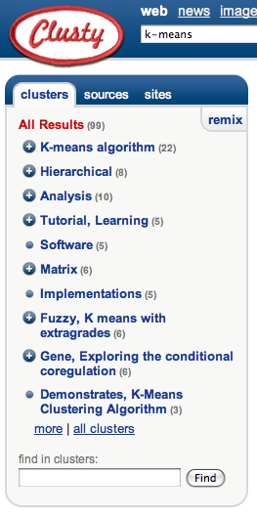
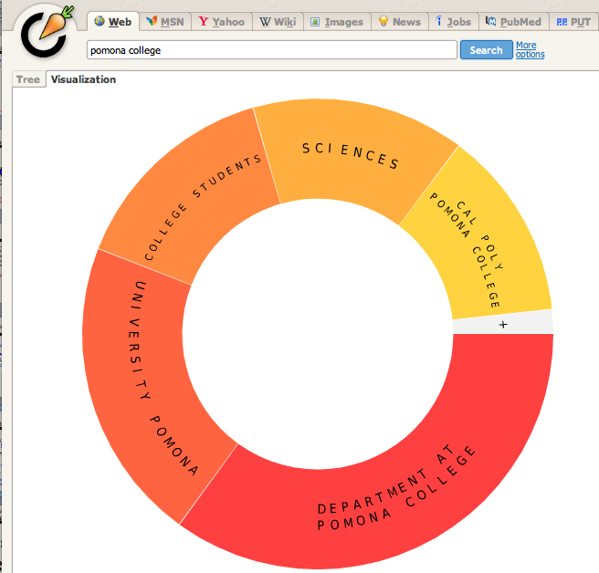
Applications of clustering in IR
group related docs
http://search.carrot2.org/

Slide 10
For improving search recall
Cluster hypothesis - Documents in the same cluster behave similarly with respect to relevance to information needs
To improve search recall:
  Cluster docs in corpus
  When a query matches a doc D, also return other docs in the cluster containing D
Hope if we do this: The query “car” will also return docs containing automobile
How is this different from the previous slide?

Slide 11
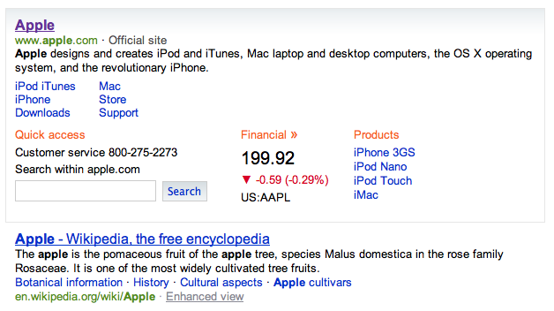
Applications of clustering in IR
vary search results over clusters/topics to improve recall

Slide 12
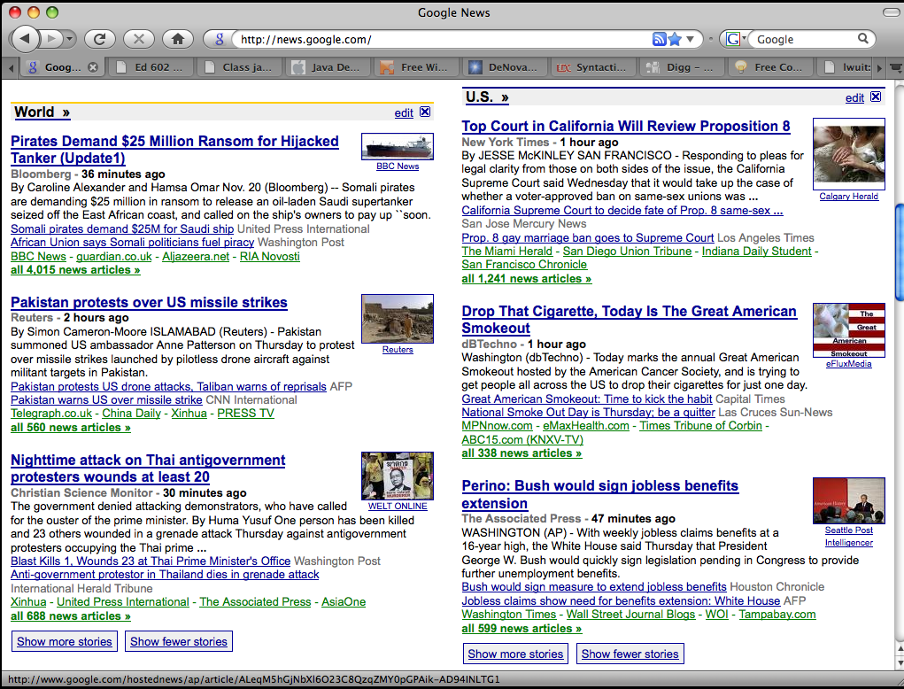
Google News: automatic clustering gives an effective news presentation metaphor

Slide 13
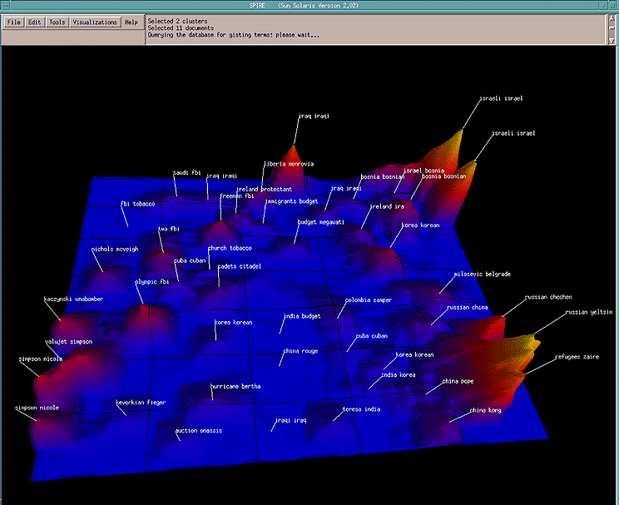
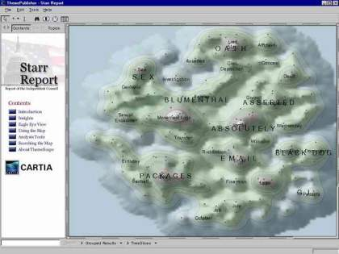
For visualizing a document collection and its themes
Wise et al, “Visualizing the non-visual” PNNL
ThemeScapes, Cartia
  [Mountain height = cluster size]

Slide 14
Faster vectors space search: cluster pruning
Query
Leader
Follower

Slide 15
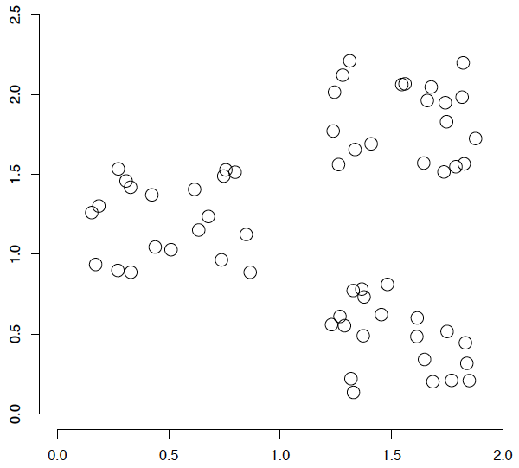
A data set with clear cluster structure
What are some of the issues for clustering?
What clustering algorithms have you seen/used?

Slide 16
Issues for clustering
Representation for clustering
  Document representation
    Vector space? Normalization?
  Need a notion of similarity/distance
Flat clustering or hierarchical
Number of clusters
  Fixed a priori
  Data driven?

Slide 17
Clustering Algorithms
Flat algorithms
  Usually start with a random (partial) partitioning
  Refine it iteratively
    K means clustering
    Model based clustering
  Spectral clustering
Hierarchical algorithms
  Bottom-up, agglomerative
  Top-down, divisive

Slide 18
Hard vs. soft clustering
Hard clustering: Each document belongs to exactly one cluster
Soft clustering: A document can belong to more than one cluster (probabilistic)
  Makes more sense for applications like creating browsable hierarchies
  You may want to put a pair of sneakers in two clusters: (i) sports apparel and (ii) shoes

Slide 19
Partitioning Algorithms
Given:
  a set of documents
  the number of clusters K
Find: a partition of K clusters that optimizes a partitioning criterion
  Globally optimal: exhaustively enumerate all partitions
  Effective heuristic methods: K-means and K-medoids algorithms

Slide 20
K-Means
Start with some initial cluster centers randomly chosen as documents/points from the data
Iterate:
  Assign/cluster each document to closest center
  Recalculate centers as the mean of the points in a cluster, c:

Slide 21
K-means: an example

Slide 22
K-means: Initialize centers randomly

Slide 23
K-means: assign points to nearest center

Slide 24
K-means: readjust centers

Slide 25
K-means: assign points to nearest center

Slide 26
K-means: readjust centers

Slide 27
K-means: assign points to nearest center

Slide 28
K-means: readjust centers

Slide 29
K-means: assign points to nearest center
No changes: Done

Slide 30
K-means variations/parameters
Initial (seed) centroids
Convergence
  A fixed number of iterations
  Doc partition unchanged
  Cluster centers don’t change
K

Slide 31
K-means: Initialize centers randomly
What would happen here?
Seed selection ideas?

Slide 32
Seed Choice
Results can vary drastically based on random seed selection
Some seeds can result in poor convergence rate, or convergence to sub-optimal clusterings
Common heuristics
  Random points in the space
  Random documents
  Doc least similar to any existing mean
  Try out multiple starting points
  Initialize with the results of another clustering method

Slide 33
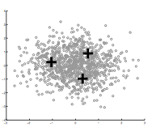
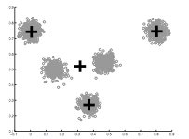
How Many Clusters?
Number of clusters K must be provided
Somewhat application dependent
How should we determine the number of clusters?
too many
too few

Slide 34
One approach
Assume data should be Gaussian (i.e. spherical)
Test for this
  Testing in high dimensions doesn’t work well
  Testing in lower dimensions does work well
ideas?

Slide 35
Project to one dimension and check
For each cluster, project down to one dimension
  Use a statistical test to see if the data is Gaussian

Slide 36
Project to one dimension and check
For each cluster, project down to one dimension
  Use a statistical test to see if the data is Gaussian

Slide 37
Project to one dimension and check
For each cluster, project down to one dimension
  Use a statistical test to see if the data is Gaussian

Slide 38
Project to one dimension and check
For each cluster, project down to one dimension
  Use a statistical test to see if the data is Gaussian
The dimension of the projection is based on the data

Slide 39
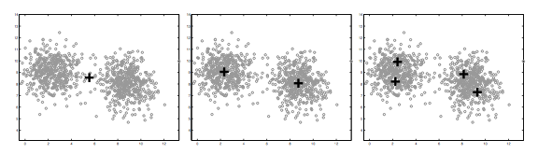
On synthetic data
pass
pass
fail

Slide 40
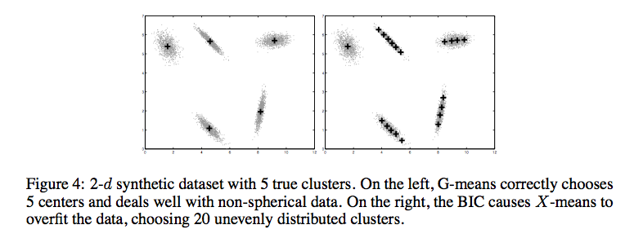
Compared to other approaches
http://cs.baylor.edu/~hamerly/papers/nips_03.pdf

Slide 41
Time Complexity
Variables: K clusters, n documents,
m dimensions, I iterations
What is the runtime complexity?
  Computing distance between two docs is O(m) where m is the dimensionality of the vectors.
  Reassigning clusters: O(Kn) distance computations, or O(Knm)
  Computing centroids: Each doc gets added once to some centroid: O(nm)
  Assume these two steps are each done once for I iterations: O(Iknm)
In practice, K-means converges quickly and is fairly fast

Slide 42
Problems with K-means
Determining K is challenging
Spherical assumption about the data (distance to cluster center)
Hard clustering isn’t always right

Slide 43
EM clustering: mixtures of Gaussians
Assume data came from a mixture of Gaussians (elliptical data), assign data to cluster with a certain probability
k-means
EM

Slide 44
EM is a general framework
Create an initial model, θ’
  Arbitrarily, randomly, or with a small set of training examples
Use the model θ’ to obtain another model θ such that
  Σ_{i} log P_{θ}(y_{i}) > Σ_{i} log P_{θ’}(y_{i})
Let θ’ = θ and repeat the above step until reaching a local maximum
  Guaranteed to find a better model after each iteration
i.e. better models data
Where else have you seen EM?

Slide 45
E and M steps
Use the current model to create a better model
Expectation: Given the current model, figure out the expected probabilities of the documents to each cluster
p(x|θ_{c})
Maximization: Given the probabilistic assignment of all the documents, estimate a new model, θ_{c}
Each iterations increases the likelihood of the data and guaranteed to converge!

Slide 46
Similar to K-Means
Iterate:
  Assign/cluster each document to closest center
  Recalculate centers as the mean of the points in a cluster
Expectation: Given the current model, figure out the expected probabilities of the documents to each cluster
p(x|θ_{c})
Maximization: Given the probabilistic assignment of all the documents, estimate a new model, θ_{c}

Slide 47
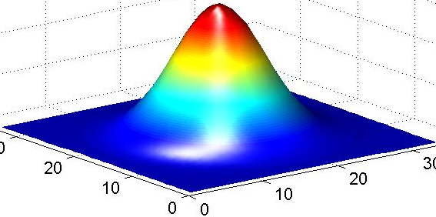
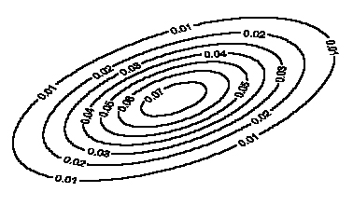
Model: mixture of Gaussians
Covariance determines
the shape of these contours
Fit these Gaussian densities to the data, one per cluster

Slide 48
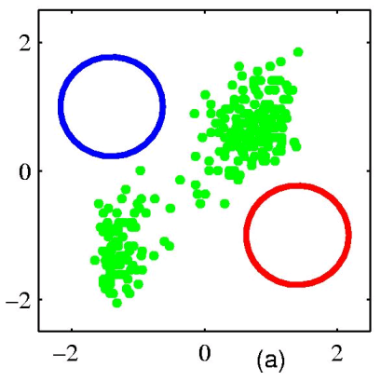
EM example
Figure from Chris Bishop

Slide 49
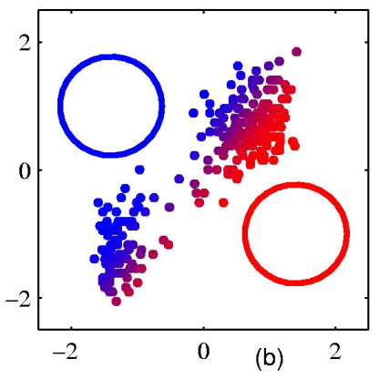
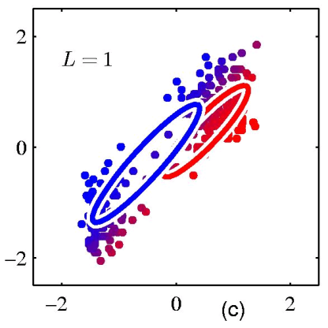
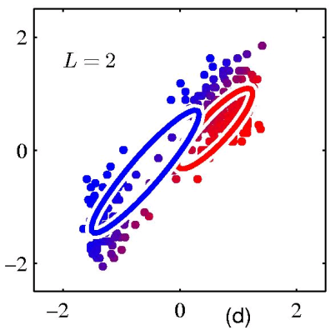
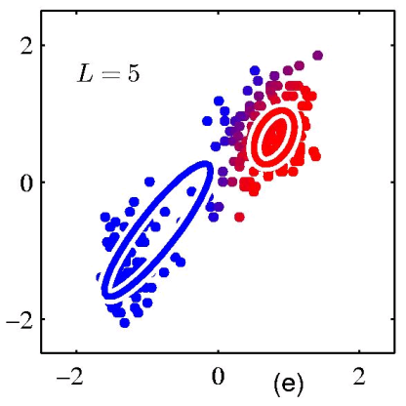
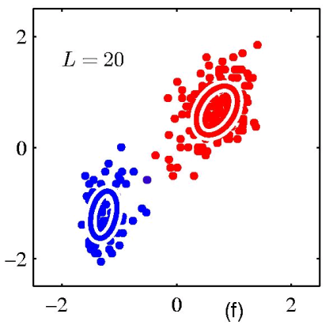
EM example
Figure from Chris Bishop

Slide 50
Other algorithms
K-means and EM-clustering are by far the most popular, particularly for documents
However, they can’t handle all clustering tasks
What types of clustering problems can’t they handle?

Slide 51
Non-gaussian data
What is the problem?
Similar to classification:
global decision vs. local decision
Spectral clustering

Slide 52
Similarity Graph
Represent dataset as a weighted graph G(V,E)
For documents
V={x_{i}} Set of n vertices representing documents/points
E={w_{ij}} Set of weighted edges indicating pair-wise similarity between documents/points
0.1
0.8
1
5
0.8
0.8
0.6
6
2
4
0.7
0.8
0.2
3
What does clustering represent?

Slide 53
Graph Partitioning
Clustering can be viewed as partitioning a similarity graph
Bi-partitioning task:
  Divide vertices into two disjoint groups (A,B)
A
B
1
5
2
4
6
3
What would define a good partition?

Slide 54
Clustering Objectives
Traditional definition of a “good” clustering:
  Points assigned to same cluster should be highly similar.
  Points assigned to different clusters should be highly dissimilar.
Apply these objectives to our graph representation
0.1
0.8
1
5
0.8
0.8
0.6
6
2
4
0.7
0.8
0.2
3
1. Maximise weight of within-group connections
2. Minimise weight of between-group connections

Slide 55
Graph Cuts
Express partitioning objectives as a function of the “edge cut” of the partition.
Cut: Set of edges with only one vertex in a group.
A
B
0.1
0.8
1
0.8
5
0.8
cut(A,B) = 0.3
0.6
6
2
4
0.8
0.2
0.7
3
Can we use the minimum cut?

Slide 56
Graph Cut Criteria
Optimal cut
Minimum cut
Problem:
  Only considers external cluster connections
  Does not consider internal cluster density

Slide 57
Graph Cut Criteria
Criterion: Normalised-cut (Shi & Malik,’97)
  Consider the connectivity between groups relative to the density of each group.
  Normalize the association between groups by volume
    Vol(A): The total weight of the edges originating from group A
Why does this work?

Slide 58
Graph Cut Criteria
Criterion: Normalised-cut (Shi & Malik,’97)
  Consider the connectivity between groups relative to the density of each group.
  Normalize the association between groups by volume
    Vol(A): The total weight of the edges originating from group A
Balance between:
Prefers cuts that cut edges on average that are smaller
Prefers cuts that cut more edges

Slide 59
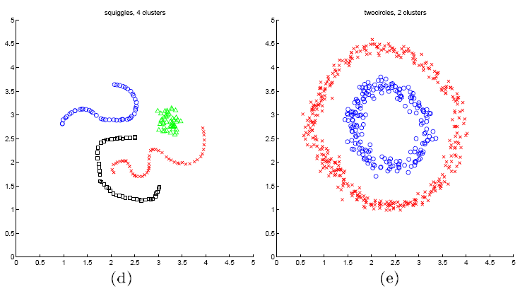
Spectral clustering examples
Ng et al On Spectral clustering: analysis and algorithm

Slide 60
Spectral clustering examples
Ng et al On Spectral clustering: analysis and algorithm

Slide 61
Spectral clustering examples
Ng et al On Spectral clustering: analysis and algorithm

Slide 62
Image GUI discussion

