Slide 1
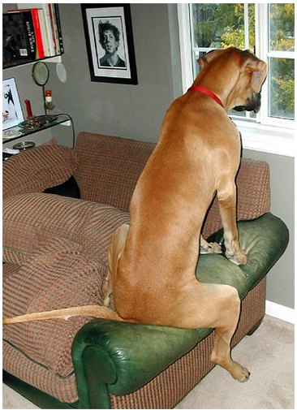
http://www.flickr.com/photos/56685562@N00/565216/

Slide 2
Document Image Retrieval
David Kauchak
cs160
Fall 2009
adapted from:
David Doermann
http://terpconnect.umd.edu/~oard/teaching/796/spring04/slides/11/796s0411.ppt

Slide 3
Assign 4 writeups
Overall, I was very happy
See how big a difference the modifications make!
Some general comments
  explain data set and characteristics
  explain your evaluation measure(s)
  think about the points you’re trying to make, then use the data to make that point
  comment on anything abnormal or surprising in the data
  dig deeper if you need to
  if you have multiple evaluation measures, use them to explain/understand different behavior
  try and explain why you got the results you obtained

Slide 4
Information retrieval systems
Spend 15 minutes playing with three different image retrieval systems
  http://en.wikipedia.org/wiki/Image_retrieval has a number
  What works well?
  What doesn’t work well?
  Anything interesting you noticed?
You won’t hand anything in, but we’ll start class on Monday with a discussion of the systems

Slide 5
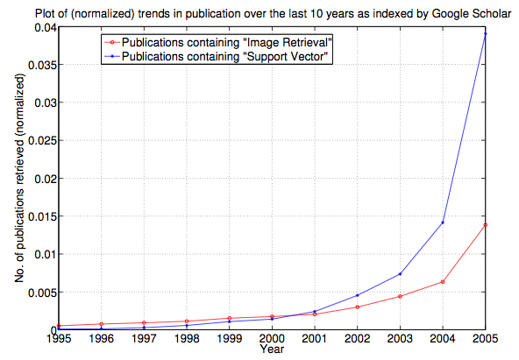
Image Retrieval
http://infolab.stanford.edu/~wangz/project/imsearch/review/JOUR/datta_TR.pdf

Slide 6
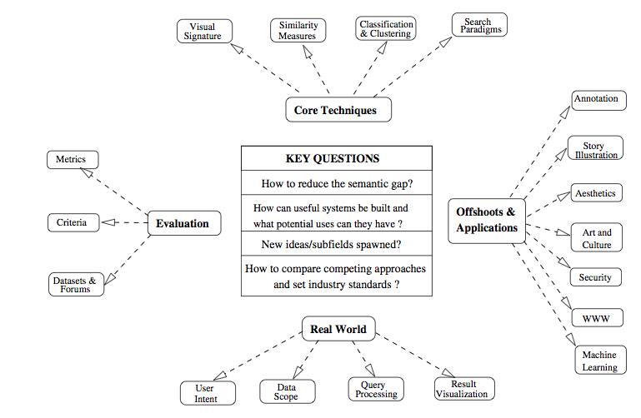
Image Retrieval Problems
http://infolab.stanford.edu/~wangz/project/imsearch/review/JOUR/datta_TR.pdf

Slide 7
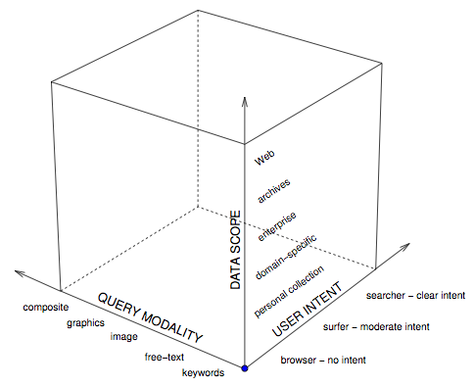
Different Systems
http://infolab.stanford.edu/~wangz/project/imsearch/review/JOUR/datta_TR.pdf

Slide 8
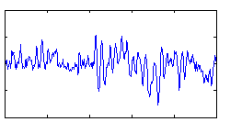

Information retrieval: data
amount of data
data characteristics
Text retrieval
trillions of web pages
user generated
some semi-structured
link structure
within an order of magnitude in “private” data
Audio retrieval
mostly professionally generated
co-occurrence statistics
order of a few billion?
last fm has 150M songs
Image retrieval
user generated
becoming more prevelant
some tagging
incorporated into web pages (context)
somewhere in between

Slide 9
Information retrieval: challenges
challenges
other dimensions?
Text retrieval
scale
ambiguity of language
link structure
spam
Audio retrieval
query language
user interface
features/pre-processing
Image retrieval
query language
user interface
features/pre-processing
ambiguity of pictures

Slide 10
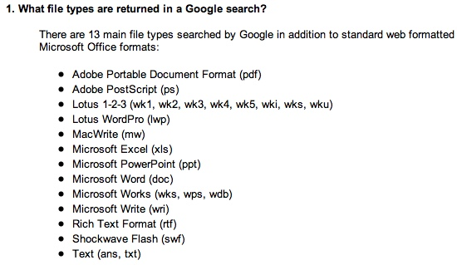





What’s in a document?
I give you a file I downloaded
You know it has text in it
What are the challenges in determining what characters are in the document?
  File format:
http://www.google.com/help/faq_filetypes.html

Slide 11
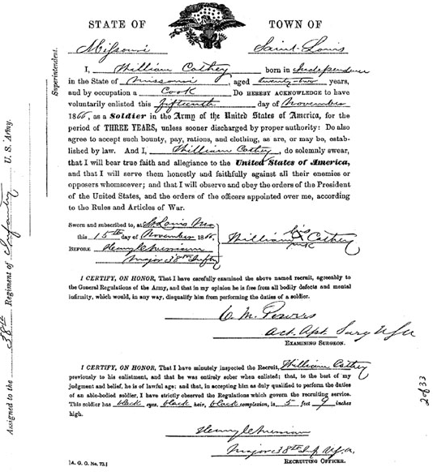
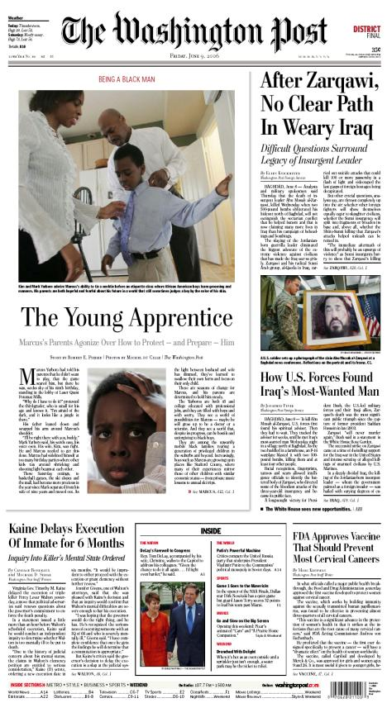
What is a document?

Slide 12
Document Images
A document image is a document that is represented as an image, rather than some predefined format
Like normal images, contain pixels
  often binary-valued (black, white)
  But greyscale or color sometimes
300 dots per inch (dpi) gives the best results
  But images are quite large (1 MB per page)
  Faxes are normally 72 dpi
Usually stored in TIFF or PDF format
Want to be able to process them like text files

Slide 13
Sources of document images
Web
  http://dli.iiit.ac.in/
  Arabic news stories are often GIF images
  Google Books, Project Gutenberg (though these are a bit different)
Library archives
Other
  Tobacco Litigation Documents
    49 million page images

Slide 14
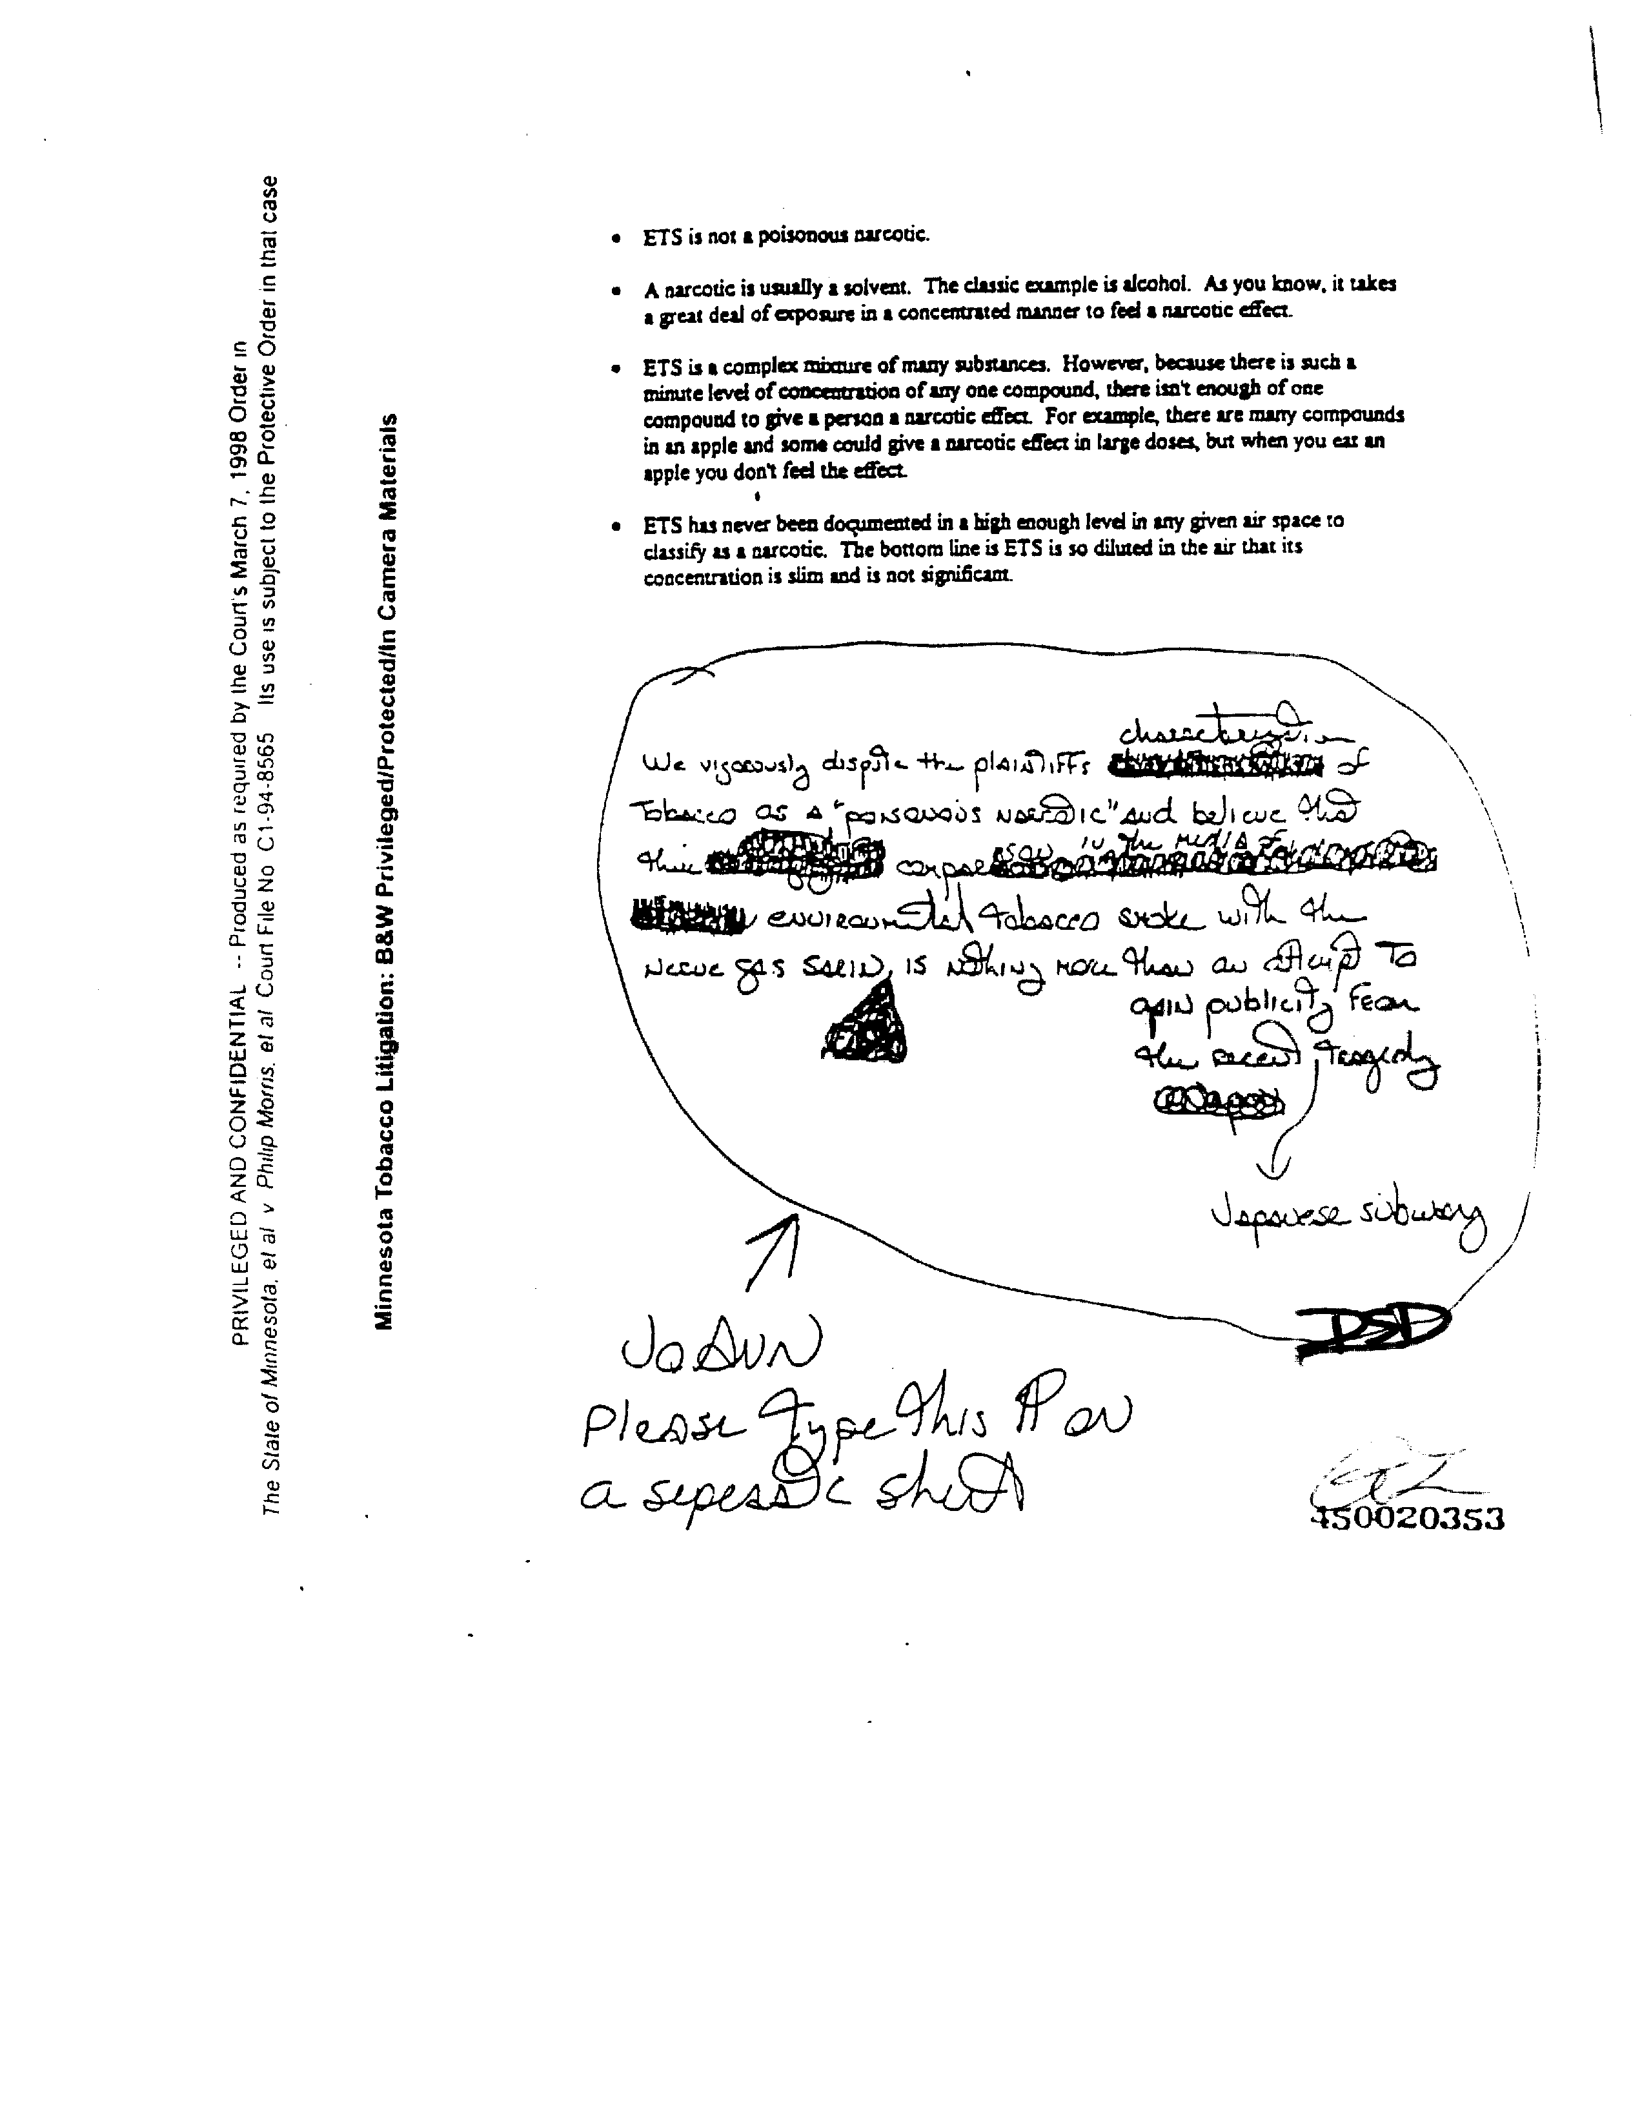
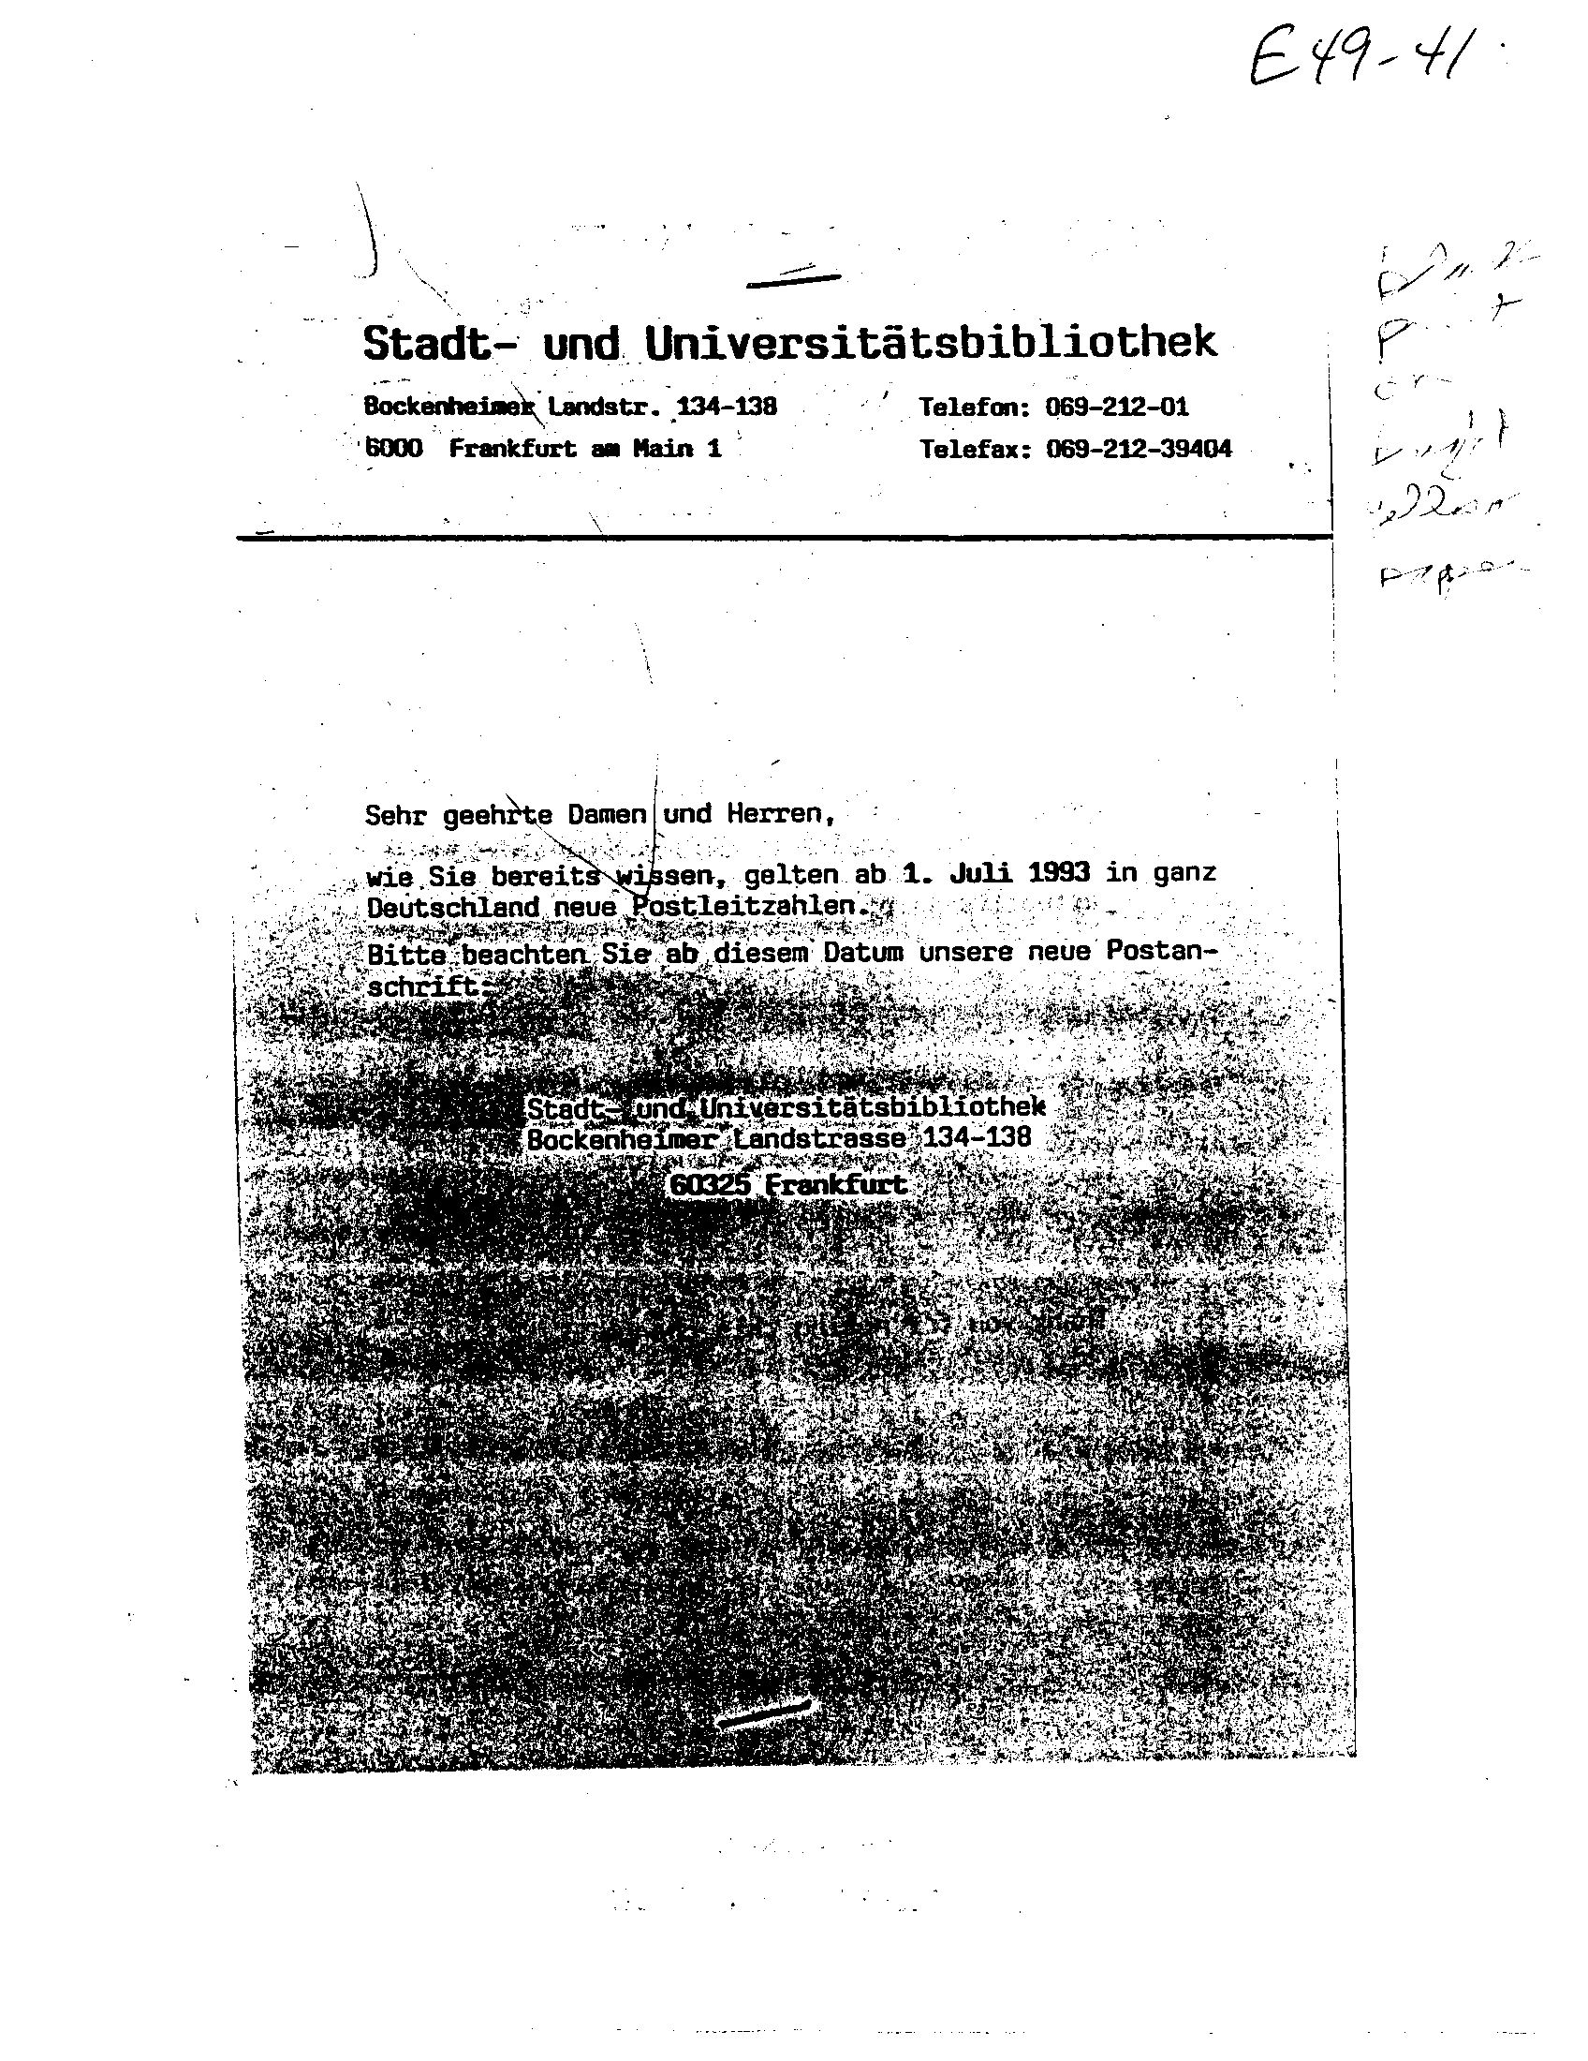
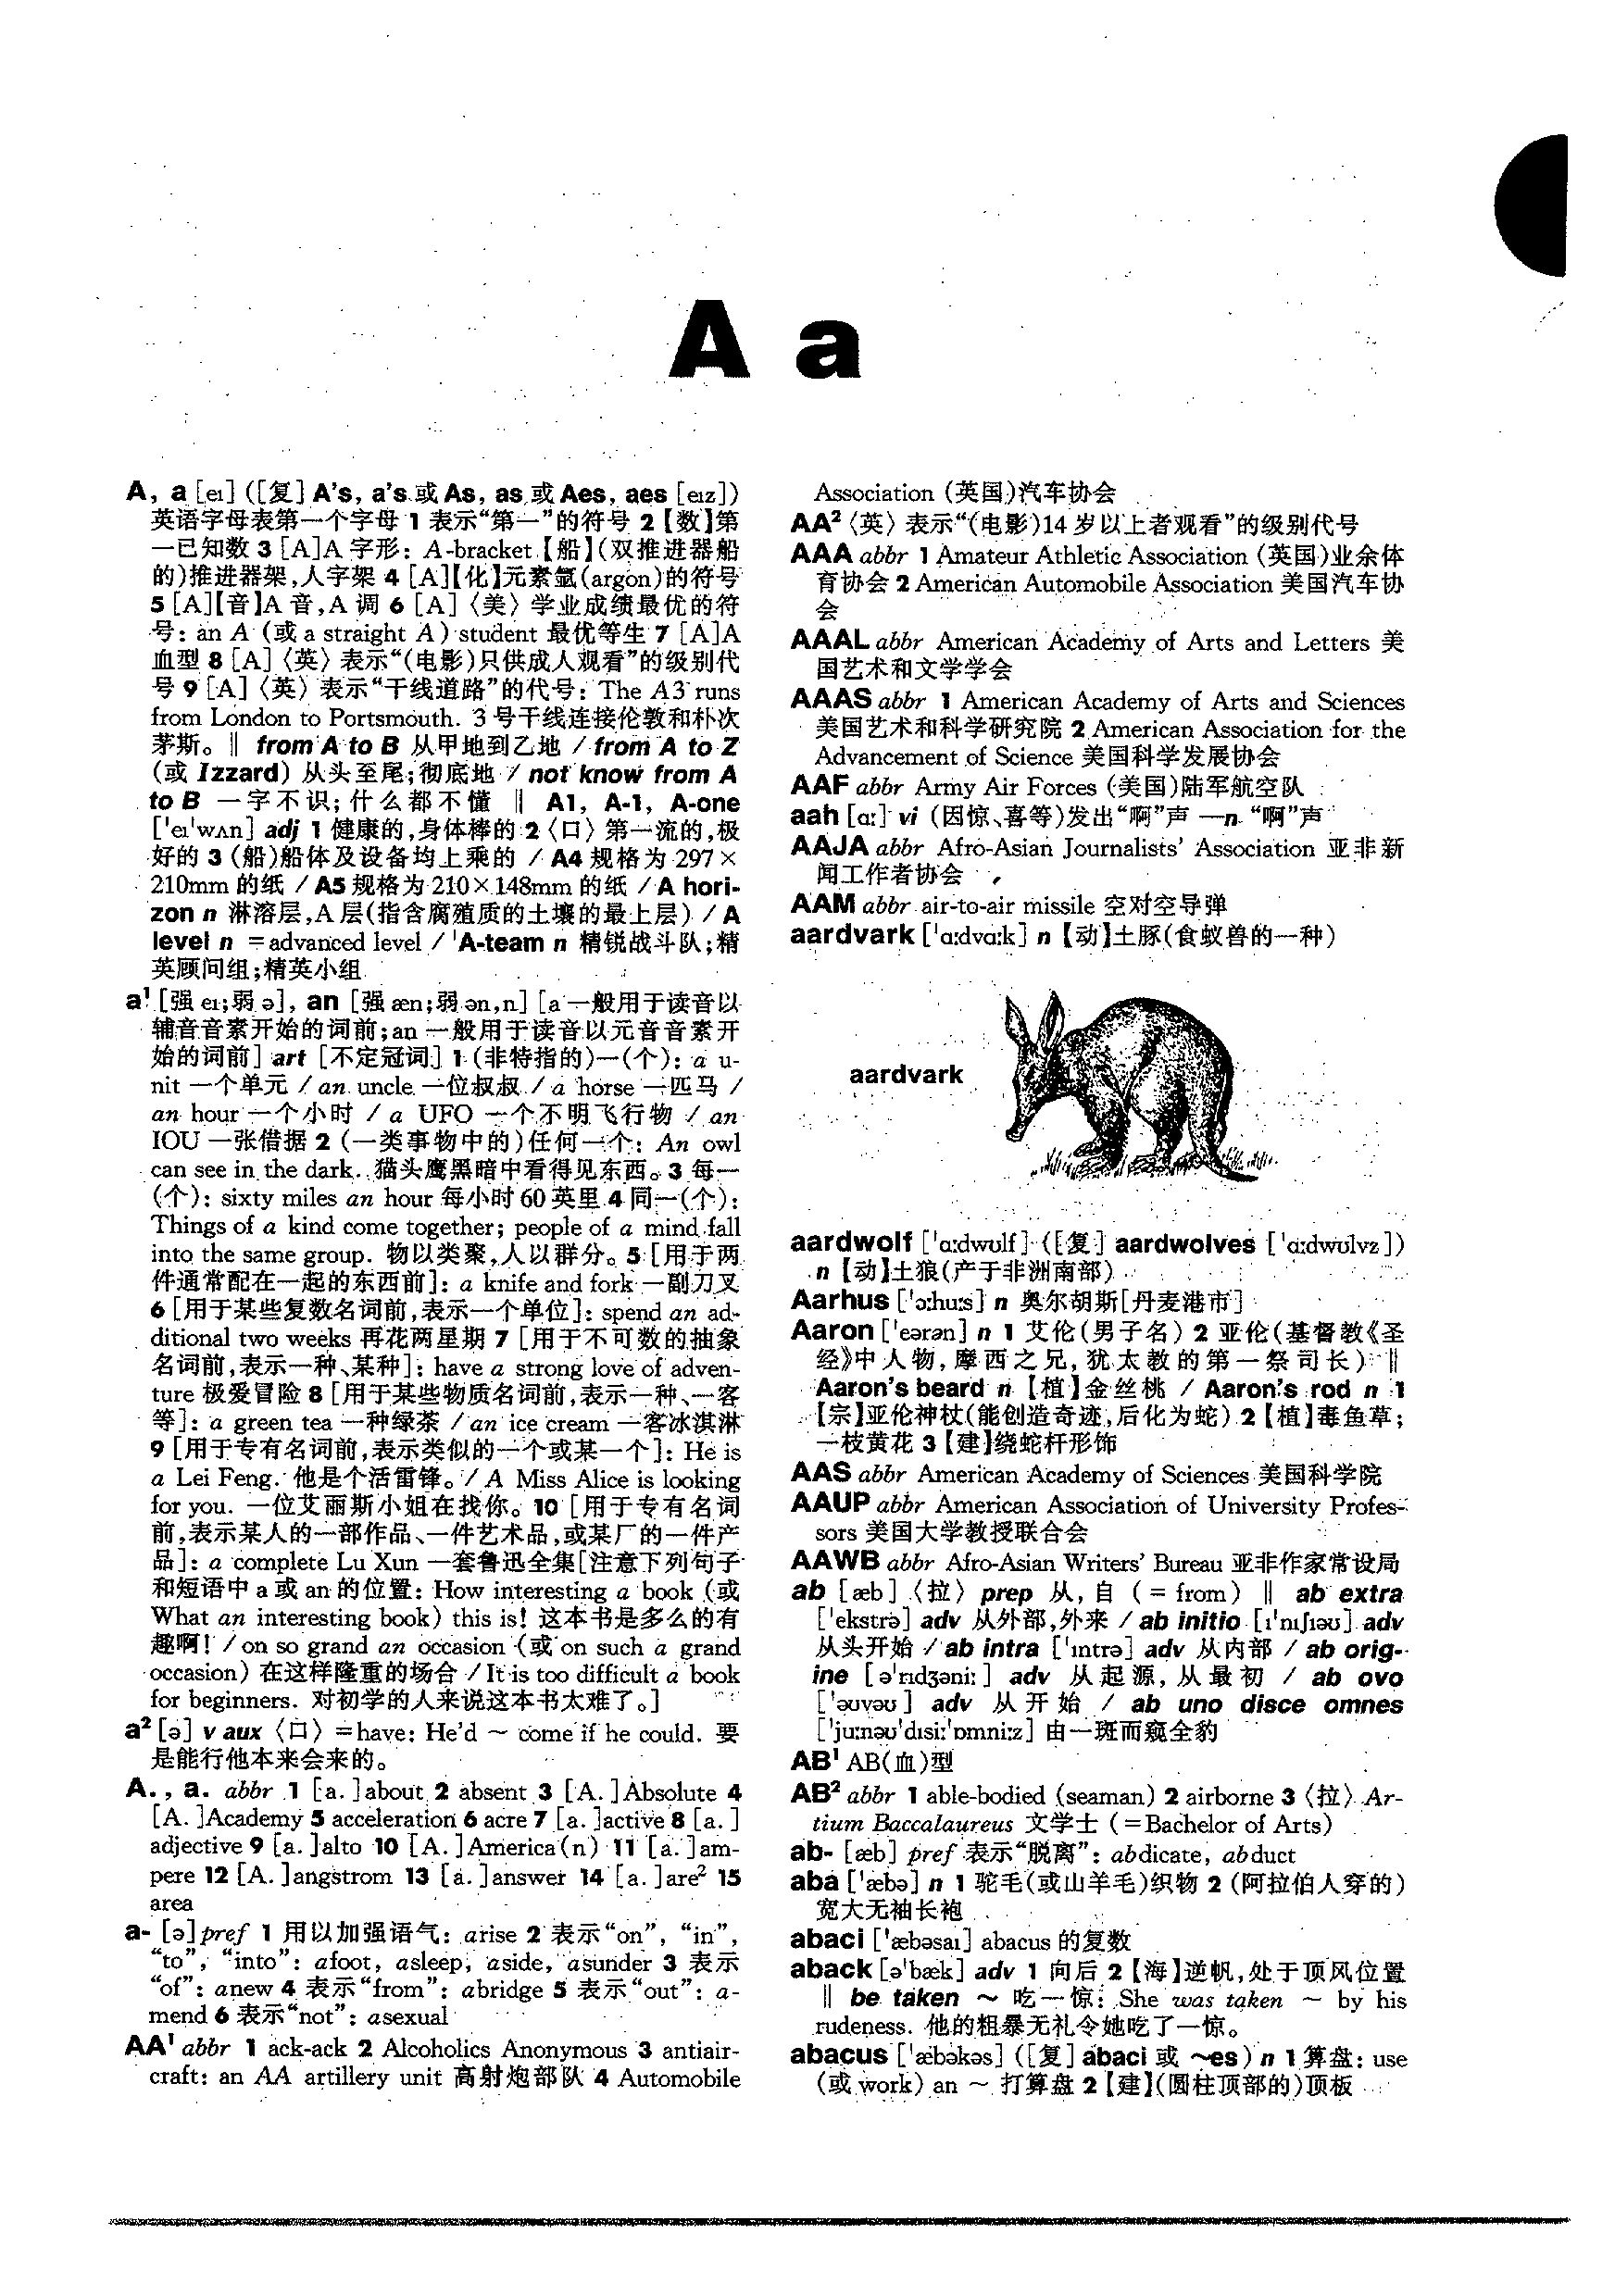
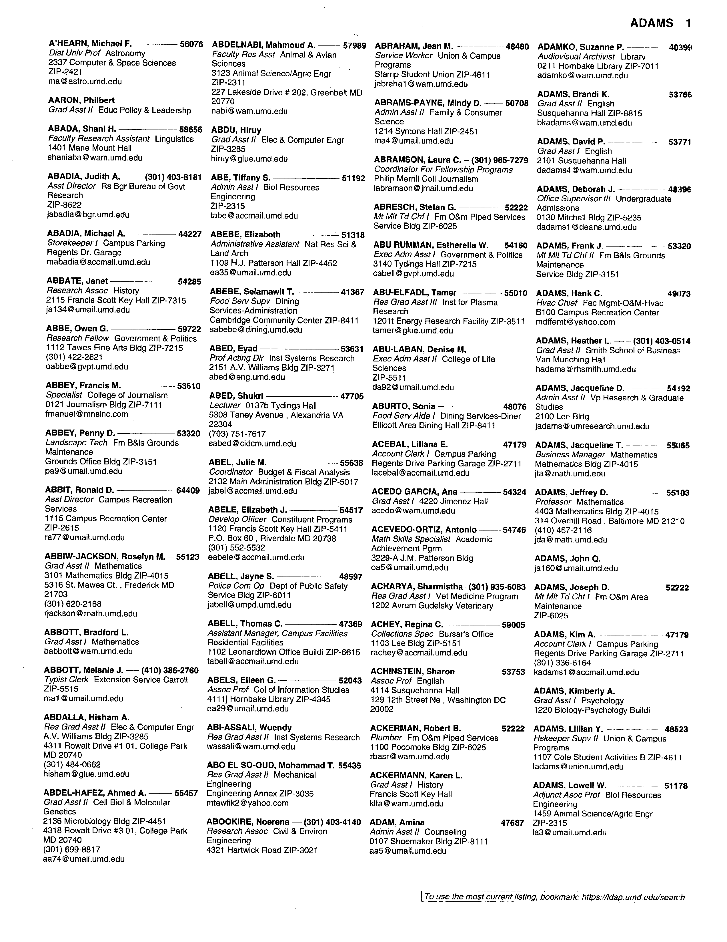
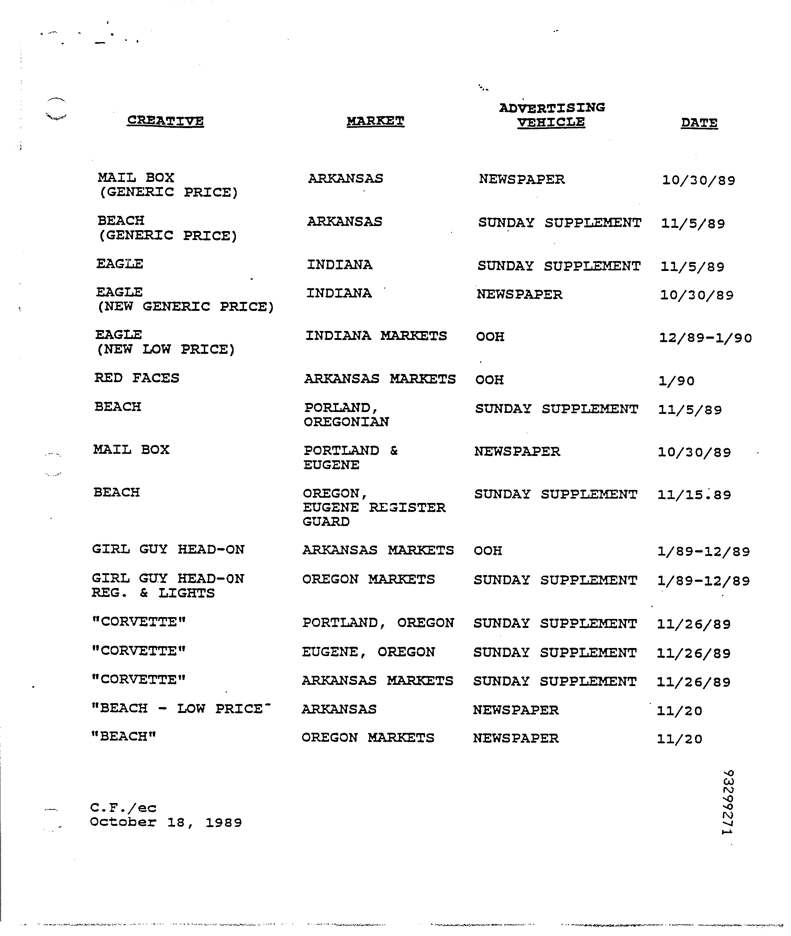
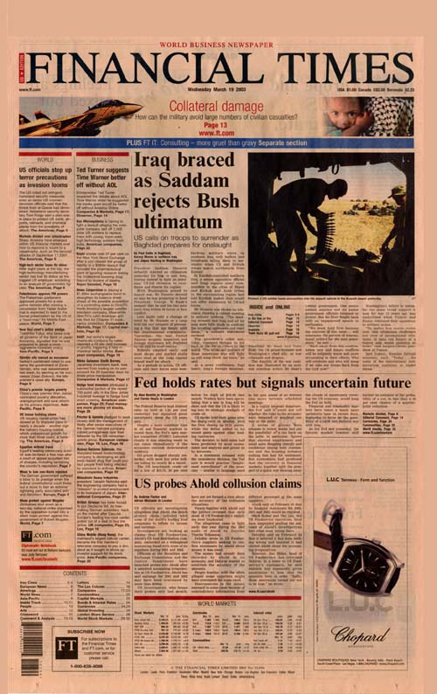
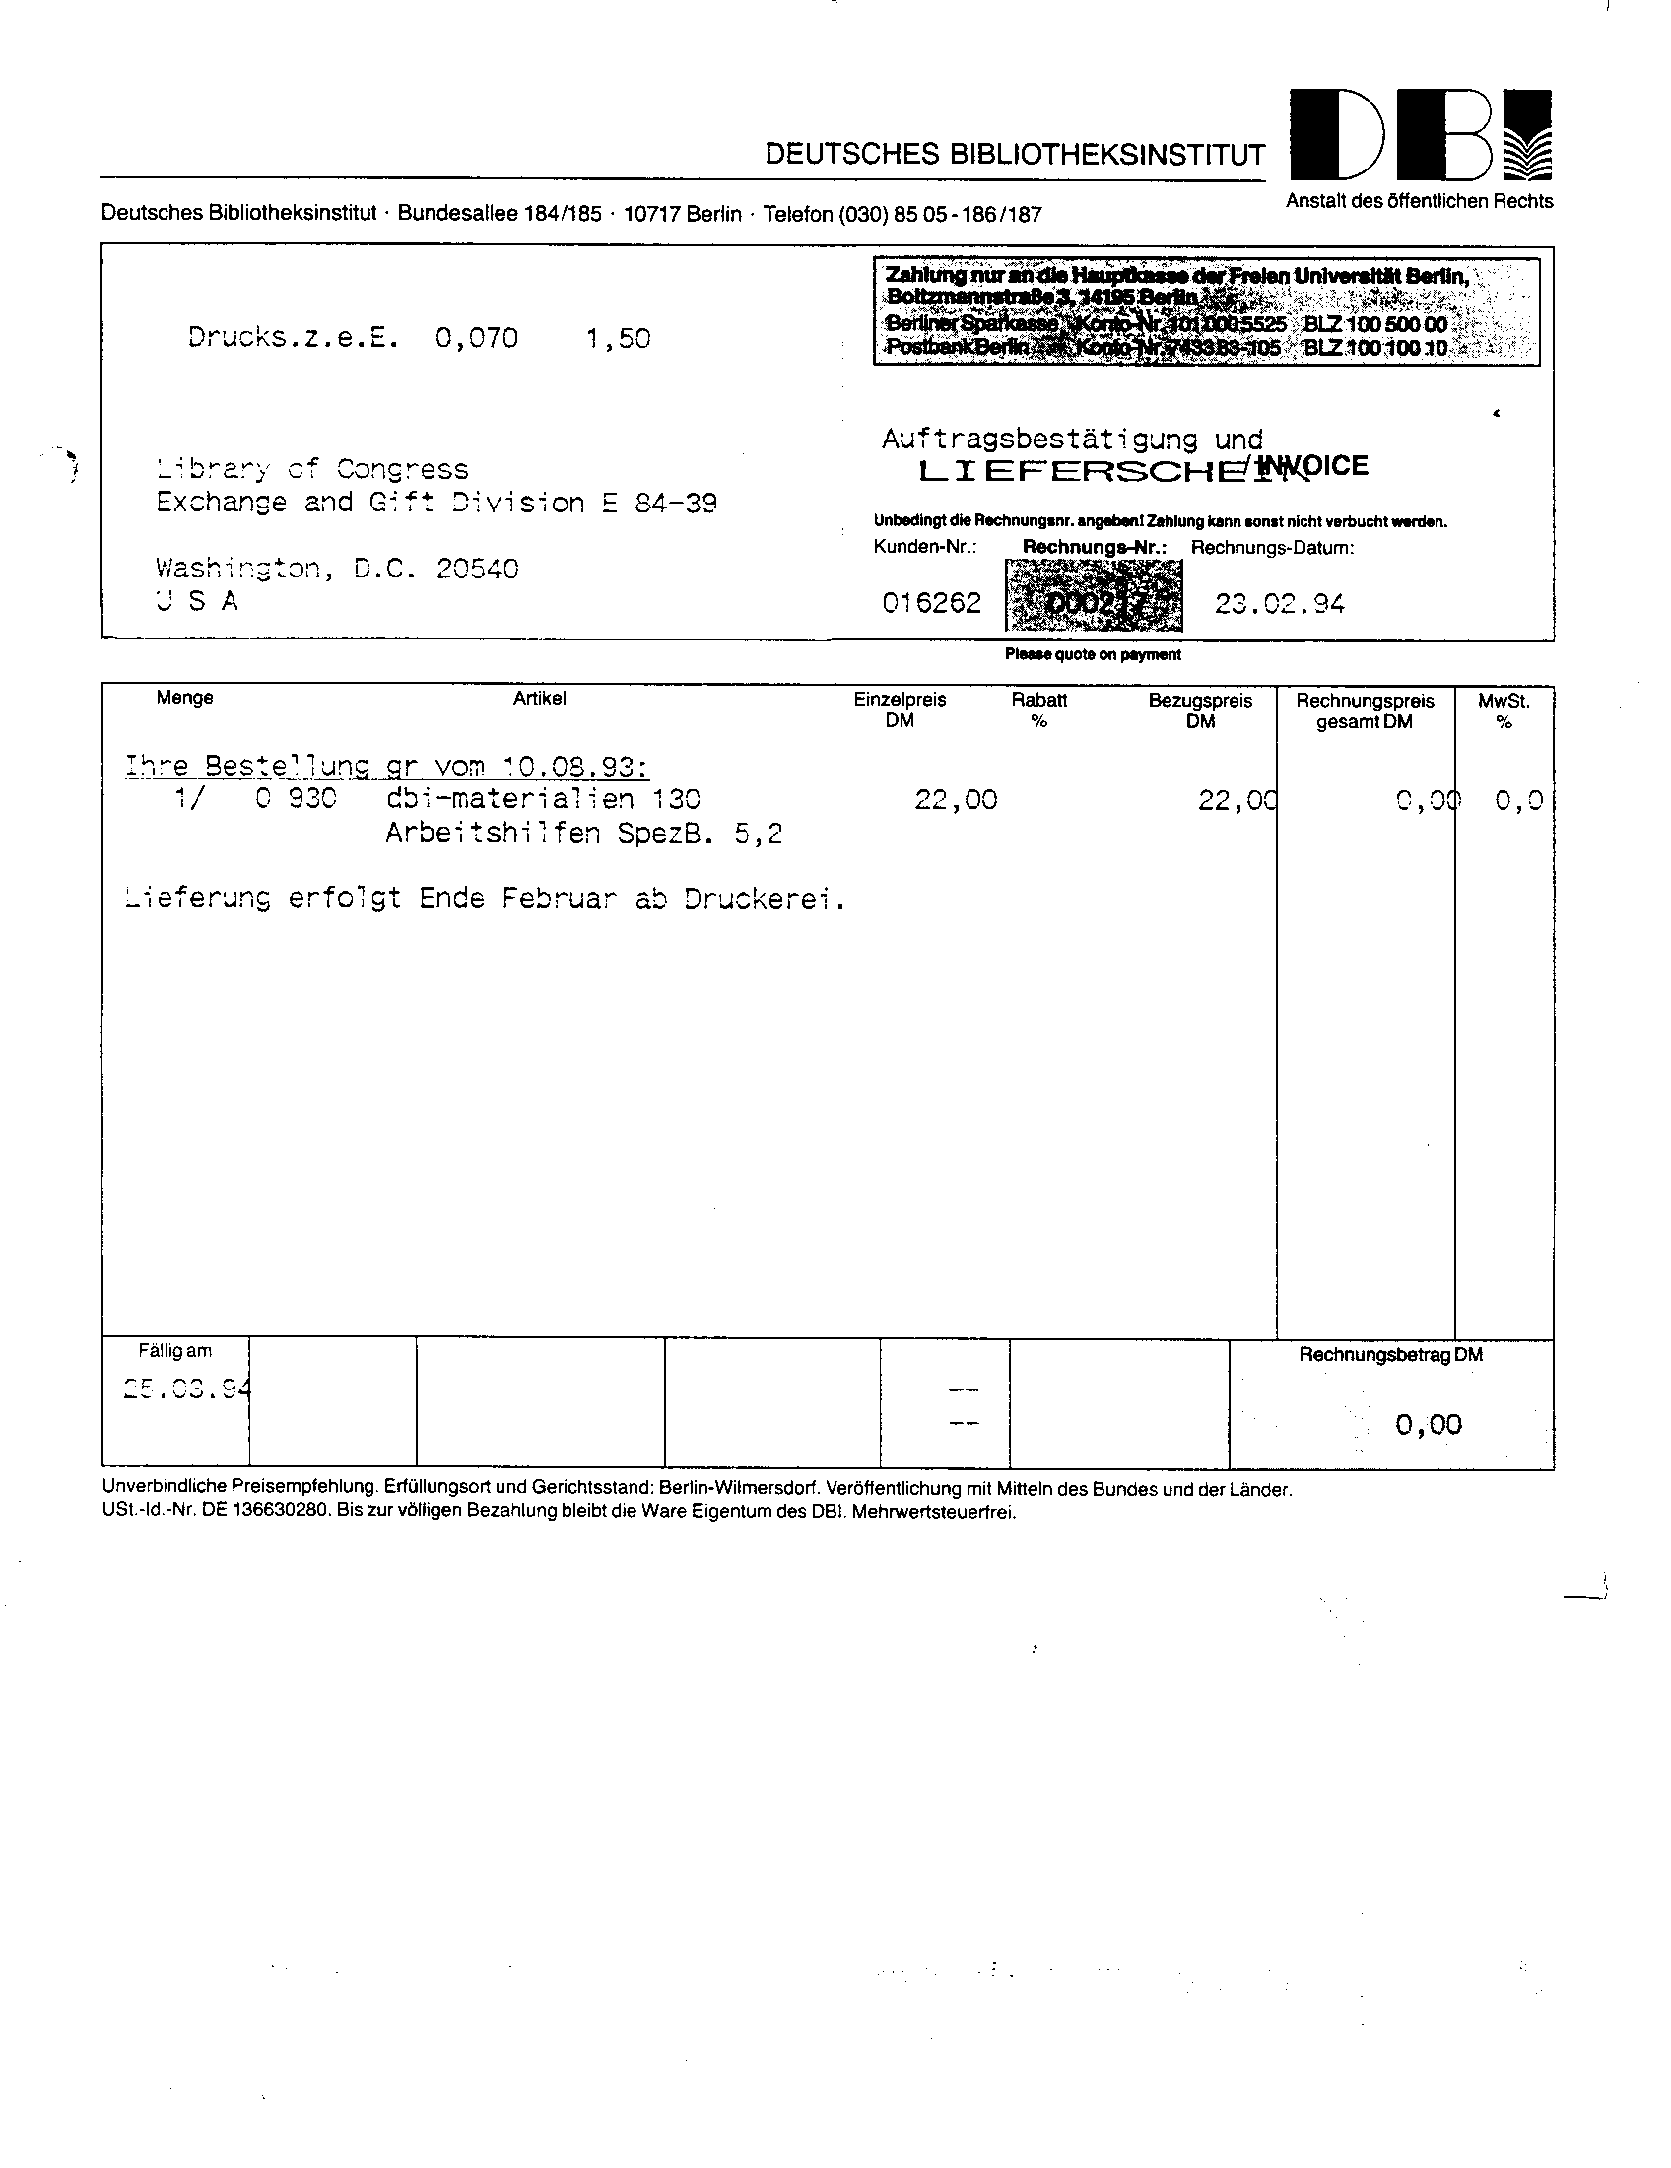

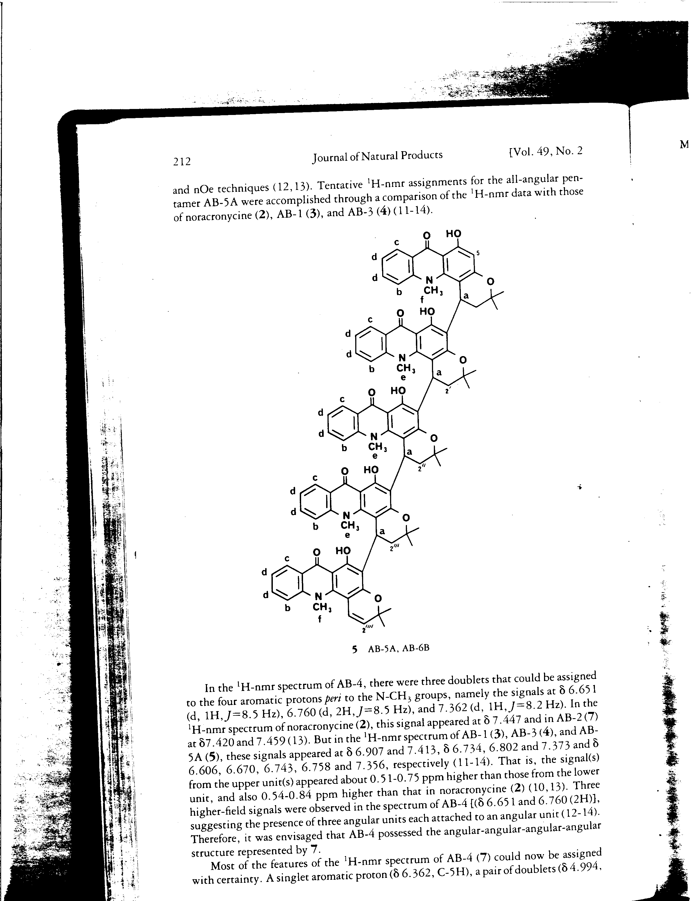

Slide 15
Document Image
Database
DOCUMENT
DATABASE
IMAGE
Collection of scanned images
Need to be available for indexing and retrieval, abstracting, routing, editing, dissemination, interpretation
NOTE: more needs than just searching!

Slide 16
What are the challenges?
What are the sub-problems?
Notes:
Handout some examples!

Slide 17
Document images
So far, we’ve only been interested in documents as strings of text
Document images introduce contain additional information
  embedded images
  formatting
  handwritten annotations
  figures/diagrams/tables
  classes of documents
    memo
    newspaper article
    book page

Slide 18
Challenges
They’re an image ☺
Quality
  scan orientation
  noise
  contrast
Hand-written text
Hand-written diagrams

Slide 19
Sub-problems
Classification - what type of document image is this?
Page segmentation
  structure
  identify images
  identify text
  identify handwritten text
  diagram identification
Meta-data identification
  title, author
  language
OCR
Reading ordering
Indexing

Slide 20
Problems we’ll discuss today…
Preprocessing issues
  Page Layer Segmentation
  OCR
  Reading order
IR issues

Slide 21
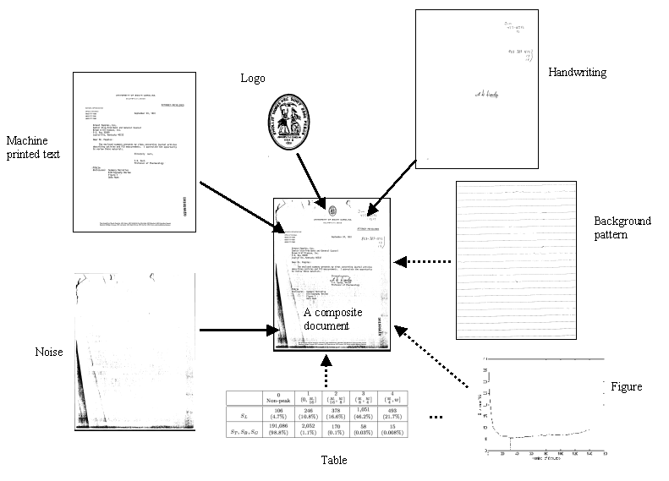
Problem: Page Layer Segmentation
A document consists of many layers, such as handwriting, machine printed text, background patterns, tables, figures, noise, etc.

Slide 22
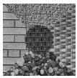
Step 1 - segmentation

Slide 23
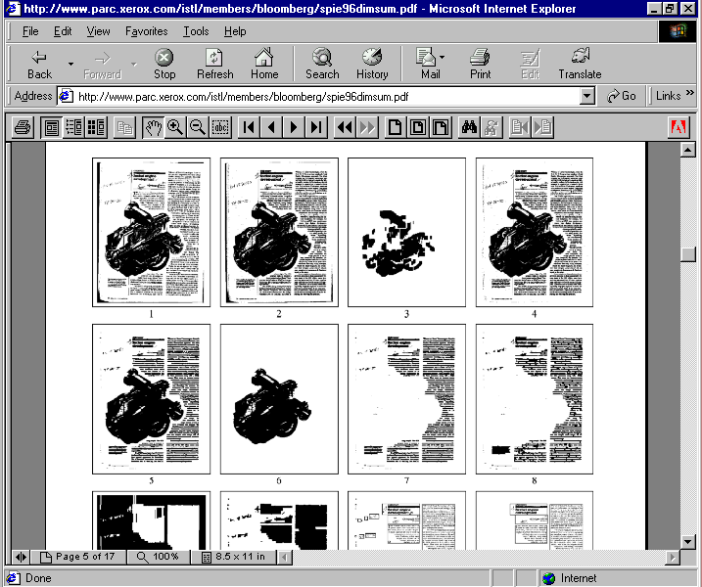
Segmentation

Slide 24
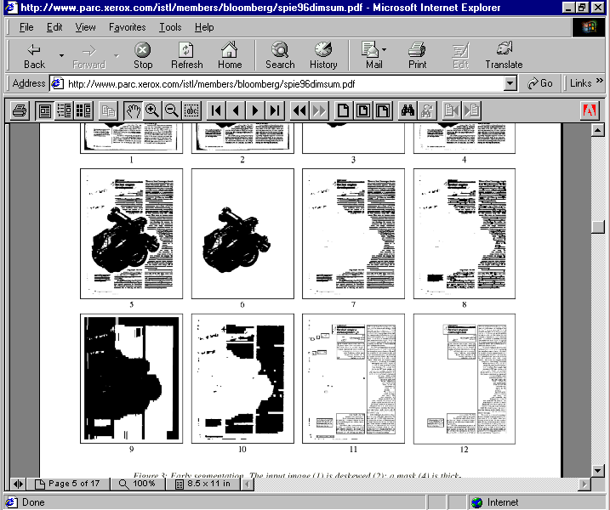
Segmentation

Slide 25
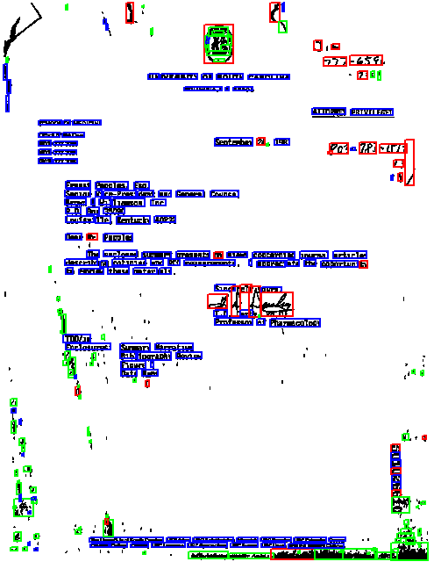
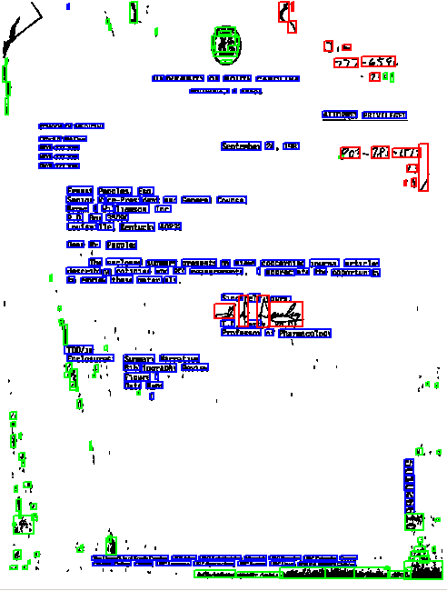
Step 2 – classify the segments
Printed text
Handwriting
Noise
We can use features of the “segment” as well as positional information about the other segments

Slide 26
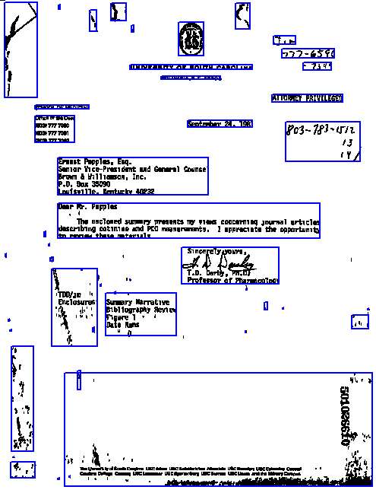
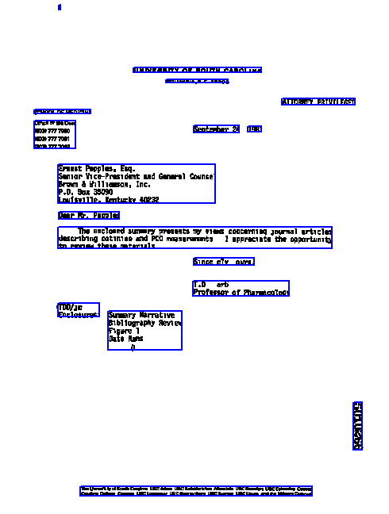
Segmentation Classification
Before enhancement
After enhancement

Slide 27
Problem: OCR
One of the more successful applications of computer vision
How does this happen?

Slide 28
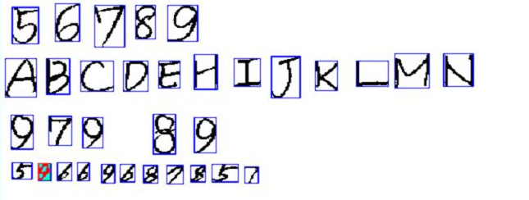
OCR: One solution
Pattern-matching approach
  Standard approach in commercial systems
  Segment individual characters
  Recognize using a neural network classifier

Slide 29
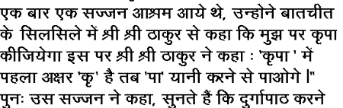
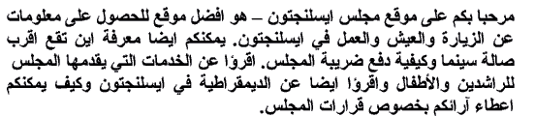
OCR
Ideas?

Slide 30

Optical Character Recognition
Hidden Markov model approach
  Experimental approach developed at BBN
  Segment into sub-character slices
  Limited lookahead to find best character choice
Uniform slices
View as a sequential prediction problem
Determining character segmentation is difficult!

Slide 31
OCR Accuracy Problems
Character segmentation errors
  In English, segmentation often changes “m” to “rn”
Character confusion
  Characters with similar shapes often confounded
OCR on copies is much worse than on originals
  Pixel bloom, character splitting, binding bend
Uncommon fonts can cause problems
  If not used to train a neural network

Slide 32
Improving OCR Accuracy
Image preprocessing
  Mathematical morphology for bloom and splitting
  Particularly important for degraded images
“Voting” between several OCR engines helps
  Individual systems depend on specific training data
Linguistic analysis can correct some errors
  Use confusion statistics, word lists, syntax, …
  But more harmful errors might be introduced

Slide 33
OCR Speed
Challenge with OCR is there is a often a trade-off between speed and accuracy
Neural networks take about 10 seconds a page
  Hidden Markov models are slower
Voting can improve accuracy
  But at a substantial speed penalty
Easy to speed things up with several machines
  For example, by batch processing - using desktop computers at night

Slide 34
Problem: Reading Order
What is the sequence of words from this document?
Ideas?

Slide 35
Logical Page Analysis
Can be hard to guess in some cases
  Newspaper columns, figure captions, appendices, …
Sometimes there are explicit guides
  “Continued on page 4” (but page 4 may be big!)
Structural cues can help
  Column 1 might continue to column 2
Content analysis is also useful
  Word co-occurrence statistics, syntax analysis

Slide 36
Traditional Approach
Page
Image
Structure, images, etc
Document
Scanner
Page
Decomposition
Text
Regions
Text
Optical Character
Recognition
Notes:
13

Slide 37
Remember our goal
Create an IR system over image documents
Challenge: OCR is not perfect
  Success for high quality OCR (Croft et al 1994, Taghva 1994)
  Limited success for poor quality OCR (1996 TREC, UNLV)
Ideas?

Slide 38
Proposed Solutions
Improve OCR ☺
Again, speed is always a concern
Similar to spelling correction
  Automatic Correction
  Characters N-grams
    Statistically robust to small numbers of errors
    Rapid indexing and retrieval
    Works from 70%-85% character accuracy where traditional IR fails

Slide 39

Matching with OCR errors
5
with confidence X%
> 80%
Keep base system answer
75% - 80%
Character n-grams
<75%
More intensive image techniques (e.g. shape codes)

Slide 40
Conversion to Text?
Full Conversion often required
Conversion is difficult!
  Noisy data
  Complex Layouts
  Non-text components
Points to Ponder
Do we really need to convert?
Can we expect to fully describe documents without assumptions?

Slide 41
Idea: do processing on images
Characteristics
  Does not require expensive OCR/Conversion
  Applicable to filtering applications
  May be more robust to noise
Possible Disadvantages
  Application domain may be very limited
  Indexing?

Slide 42
Shape Coding
Approach
  Use of Generic Character Descriptors
  Map Character based on Shape features including ascenders, descenders, punctuation and character with holes

Slide 43
Shape Codes
Group all characters that have similar shapes
  {a, c, e, n, o, r, s, u, v, x, z}
  {b, d, h, k, }
  {f, t}
  {g, p, q, y}
  {i, j, l, 1, I}
  {m, w}
Shape codes whether a subset of an image belongs to a given character set
Sub-process later based on linguistic and/or OCR

Slide 44
Why Use Shape Codes?
Can recognize shapes faster than characters
  Seconds per page, and very accurate
Preserves recall, but with lower precision
  Useful as a first pass in any system
Easily extracted from JPEG-2 images
  Because JPEG-2 uses object-based compression

Slide 45
Evaluation
The usual approach: Model-based evaluation
  Apply confusion statistics to an existing collection
A bit better: Print-scan evaluation
  Scanning is slow, but availability is no problem
Best: Scan-only evaluation
  Few existing IR collections have printed materials

Slide 46
Summary
Many applications benefit from image based indexing
  Less discriminatory features
  Features may therefore be easier to compute
  More robust to noise
  Often computationally more efficient
Many classical IR techniques have application for DIR
Structure as well as content are important for indexing
Preservation of structure is essential for in-depth understanding

Slide 47
Closing thoughts….
What else is useful?
  Document Metadata? – Logos? Signatures?
Where is research heading?
  Cameras to capture Documents?
What massive collections are out there?
  Google Books
  Other Digital Libraries

Slide 48
Additional Reading
A. Balasubramanian, et al. Retrieval from Document Image Collections, Document Analysis Systems VII, pages 1-12, 2006.
D. Doermann. The Indexing and Retrieval of Document Images: A Survey. Computer Vision and Image Understanding, 70(3), pages 287-298, 1998.

Slide 49
Fun Stuff
http://www.sr.se/P1/src/sing/#

