Slide 1
https://www.youtube.com/watch?v=bScsFi6DaoM

Slide 2
CORpus analysis
David Kauchak
NLP – Fall 2024

Slide 3
Administrivia
Assignment 0
Assignment 1 out
due Wednesday
no code submitted, but will require coding
will require some command-line work
Reading

Slide 4
NLP models
How do people learn/acquire language?

Slide 5
NLP models
A lot of debate about how human’s learn language
Rationalist (e.g. Chomsky)
Empiricist
From my perspective (and many people who study NLP)…
I don’t care :)
Strong AI vs. weak AI: don’t need to accomplish the task the same way people do, just the same task
Machine learning
Statistical NLP

Slide 6
Vocabulary
Word
a unit of language that native speakers can identify
words are the blocks from which sentences are made
Sentence
a string of words satisfying the grammatical rules of a language
Document
A collection of sentences
Corpus
A collection of related texts

Slide 7
Corpus examples
Any you’ve seen or played with before?

Slide 8
Corpus characteristics
What are some defining characteristics of corpora?

Slide 9
Corpus characteristics
monolingual vs. parallel
language
annotated (e.g. parts of speech, classifications, etc.)
source (where it came from)
size

Slide 10
Corpus examples
Linguistic Data Consortium
http://www.ldc.upenn.edu/Catalog/byType.jsp
Dictionaries
WordNet – 206K English words
CELEX2 – 365K German words
Monolingual text
Gigaword corpus
4M documents (mostly news articles)
1.7 trillion words
11GB of data (4GB compressed)
Enron e-mails
517K e-mails

Slide 11
Corpus examples
Monolingual text continued
Twitter
Chatroom
Many non-English resources
Parallel data
~10M sentences of Chinese-English and Arabic-English
Europarl
~25M sentence pairs with English with 21 different languages
260K sentences of English Wikipedia—Simple English Wikipedia

Slide 12
Corpus examples
Annotated
Brown Corpus
1M words with part of speech tag
Penn Treebank
1M words with full parse trees annotated
Other treebanks
Treebank refers to a corpus annotated with trees (usually syntactic)
Chinese: 51K sentences
Arabic: 145K words
many other languages…
BLIPP: 300M words (automatically annotated)
Notes:
Many other data

Slide 13
Corpora examples
Many others…
Spam and other text classification
Google n-grams
2006 (24GB compressed!)
13M unigrams
300M bigrams
~1B 3,4 and 5-grams
Speech
Video (with transcripts)

Slide 14
Corpus analysis
Corpora are important resources
Often give examples of an NLP task we’d like to accomplish
Much of NLP is data-driven!
A common and important first step to tackling many problems is analyzing the data you’ll be processing

Slide 15
Corpus analysis
What types of questions might we want to ask?
How many…
documents, sentences, words
On average, how long are the:
documents, sentences, words
What are the most frequent words? pairs of words?
How many different words are used?
Data set specifics, e.g. proportion of different classes?
…

Slide 16
Corpora issues
Somebody gives you a file and says there’s text in it
Issues with obtaining the text?
text encoding
language recognition
formatting (e.g. web, xml, …)
misc. information to be removed
header information
tables, figures
footnotes

Slide 17
A rose by any other name…
Word
a unit of language that native speakers can identify
words are the blocks from which sentences are made
Concretely:
We have a stream of characters
We need to break into words
What is a word?
Issues/problem cases?
Word segmentation/tokenization?

Slide 18
Tokenization issues: ‘
Finland’s capital…
?

Slide 19
Tokenization issues: ‘
Finland’s capital…
Finland
Finland ‘ s
Finland ‘s
Finlands
Finland s
Finland’s
What are the benefits/drawbacks?

Slide 20
Tokenization issues: ‘
Aren’t we …
?

Slide 21
Tokenization issues: ‘
Aren’t we …
Aren’t
Arent
Are n’t
Aren t
Are not

Slide 22
Tokenization issues: hyphens
Hewlett-Packard
state-of-the-art
co-education
lower-case
take-it-or-leave-it
26-year-old
?

Slide 23
Tokenization issues: hyphens
Hewlett-Packard
state-of-the-art
co-education
lower-case
Keep as is
merge together
HewlettPackard
stateoftheart
Split on hyphen
lower case
co education
What are the benefits/drawbacks?

Slide 24
More tokenization issues
Compound nouns: San Francisco, Los Angelos, …
One token or two?
Numbers
Examples
Dates: 3/12/91
Model numbers: B-52
Domain specific numbers: PGP key - 324a3df234cb23e
Phone numbers: (800) 234-2333
Scientific notation: 1.456 e-10

Slide 25
Tokenization: language issues
Lebensversicherungsgesellschaftsangestellter
‘life insurance company employee’
Opposite problem we saw with English (San Francisco)
German compound nouns are not segmented
German retrieval systems frequently use a compound splitter module

Slide 26
Tokenization: language issues
莎拉波娃现在居住在美国东南部的佛罗里达。
Where are the words?
thisissue
Many character based languages (e.g., Chinese characters) have no spaces between words
A word can be made up of one or more characters
There is ambiguity about the tokenization, i.e. more than one way to break the characters into words
Word segmentation problem
can also come up in speech recognition

Slide 27
Word counts: Tom Sawyer
How many words?
71,370 total
8,018 unique
Is this a lot or a little? How might we find this out?
Random sample of news articles: 11K unique words
What does this say about Tom Sawyer?
Simpler vocabulary (colloquial, audience target, etc.)

Slide 28
Word counts
Word | Frequency
the and a to of was it in that he I his you Tom with | 3332 2972 1775 1725 1440 1161 1027 906 877 877 783 772 686 679 642
What are the most frequent words?
What types of words are most frequent?

Slide 29
Word counts
Word Frequency | Frequency of frequency
1 2 3 4 5 6 7 8 9 10 11-50 51-100 > 100 | 3993 1292 664 410 243 199 172 131 82 91 540 99 102
8K words in vocab
71K total occurrences
how many occur once? twice?

Slide 30
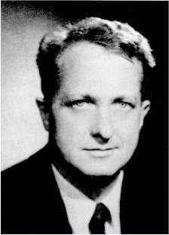
Zipf’s “Law”
The frequency of the occurrence of a word is inversely proportional to its frequency of occurrence ranking
Their relationship is log-linear, i.e. when both are plotted on a log scale, the graph is a straight line
George Kingsley Zipf
1902-1950

Slide 31
Zipf’s law
At a high level:
a few words occur very frequently
a medium number of elements have medium frequency
many words occur very infrequently

Slide 32
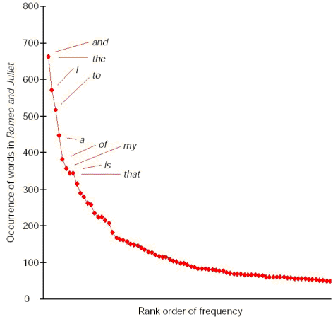
Zipf’s law
The product of the frequency of words (f) and their rank (r) is approximately constant
Constant is corpus dependent, but generally grows roughly linearly with the amount of data

Slide 33
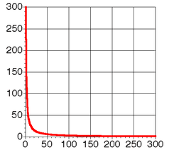
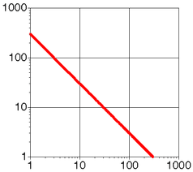
Zipf Distribution
log-scale

Slide 34
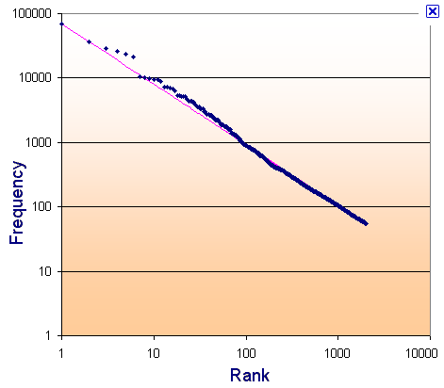
Zipf’s law: Brown corpus
log
log

Slide 35
Zipf’s law: Tom Sawyer
Word | Frequency | Rank
the and | 3332 ? | 1 2

Slide 36
Zipf’s law: Tom Sawyer
Word | Frequency | Rank
the and | 3332 2972 | 1 2

Slide 37
Zipf’s law: Tom Sawyer
Word | Frequency | Rank
the and a | ***** 2972 ? | 1 2 3

Slide 38
Zipf’s law: Tom Sawyer
Word | Frequency | Rank
the and a | ***** 2972 1775 | 1 2 3

Slide 39
Zipf’s law: Tom Sawyer
Word | Frequency | Rank
he friends | 877 ? | 10 800

Slide 40
Zipf’s law: Tom Sawyer
Word | Frequency | Rank
he friends | 877 10 | 10 800

Slide 41
Zipf’s law: Tom Sawyer
Word | Frequency | Rank | C = f * r
the and a he but be Oh two name group friends family sins Applausive | 3332 2972 1775 877 410 294 116 104 21 13 10 8 2 1 | 1 2 3 10 20 30 90 100 400 600 800 1000 3000 8000 | 3332 5944 5235 8770 8400 8820 10440 10400 8400 7800 8000 8000 6000 8000
What does this imply about C/zipf’s law? How would you pick C?
Notes:
It’s more of a “rule of thumb”, than a “law”
Often, estimate C using linear regression (fit a line to the data)

Slide 42
Sentences
Sentence
a string of words satisfying the grammatical rules of a language
Sentence segmentation
How do we identify a sentence?
Issues/problem cases?
Approach?

Slide 43
Sentence segmentation: issues
A first answer:
something ending in a: . ? !
gets 90% accuracy
Dr. Dave gives us just the right amount of homework.
Abbreviations can cause problems

Slide 44
Sentence segmentation: issues
A first answer:
something ending in a: . ? !
gets 90% accuracy
The scene is written with a combination of unbridled passion and sure-handed control: In the exchanges of the three characters and the rise and fall of emotions, Mr. Weller has captured the heartbreaking inexorability of separation.
sometimes: : ; and – might also denote a sentence split

Slide 45
Sentence segmentation: issues
A first answer:
something ending in a: . ? !
gets 90% accuracy
“You remind me,” she remarked, “of your mother.”
Quotes often appear outside the ending marks

Slide 46
Sentence segmentation
Place initial boundaries after: . ? !
Move the boundaries after the quotation marks, if they follow a break
Remove a boundary following a period if:
it is a known abbreviation that doesn’t tend to occur at the end of a sentence (Prof., vs.)
it is preceded by a known abbreviation and not followed by an uppercase word

Slide 47
Sentence length
What is the average sentence length, say for news text?
23
Length | percent | cumul. percent
1-5 6-10 11-15 16-20 21-25 26-30 31-35 36-40 41-45 46-50 51-100 101+ | 3 8 14 17 17 15 11 7 4 2 1 0.01 | 3 11 25 42 59 74 86 92 96 98 99.99 100

Slide 48
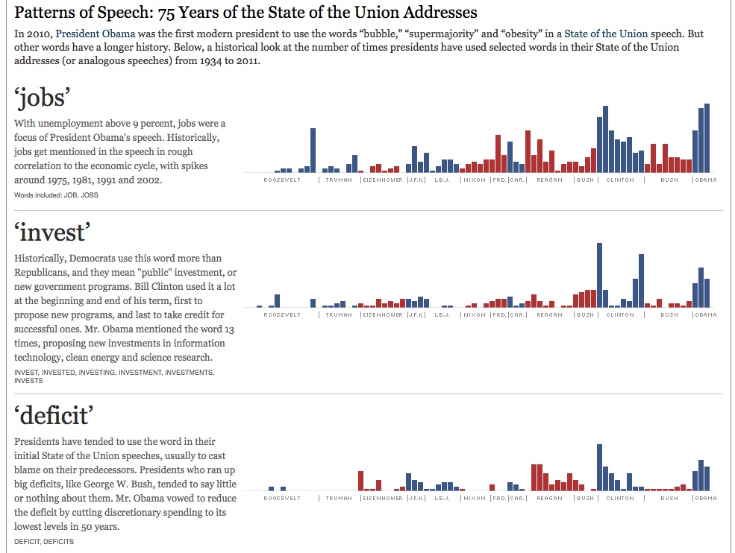
A real-world example
http://archive.nytimes.com/www.nytimes.com/interactive/2011/01/25/us/politics/state-of-the-union-words-used.html

