Slide 1
Word Alignment
David Kauchak
CS159 – Spring 2023
Some slides adapted from
Philipp Koehn
Kevin Knight
Dan Klein
School of Informatics
University of Edinburgh
USC/Information Sciences Institute
USC/Computer Science Department
Computer Science Department
UC Berkeley

Slide 2
Admin
Assignment 5
Assignment 6 out later today: due Sunday 11/13

Slide 3





Language translation
Yo quiero Taco Bell

Slide 4
Word models: IBM Model 1
NULL
Mary did not slap the green witch
p(verde | green)
Maria no dió una botefada a la bruja verde
Each foreign word is aligned to exactly one English word
This is the ONLY thing we model!

Slide 5
Training a word-level model
The old man is happy. He has fished many times.
His wife talks to him.
The sharks await.
…
El viejo está feliz porque ha pescado muchos veces.
Su mujer habla con él.
Los tiburones esperan.
…
: probability that e is translated as f
How do we learn these?
What data would be useful?

Slide 6
Thought experiment
The old man is happy. He has fished many times.
El viejo está feliz porque ha pescado muchos veces.
His wife talks to him.
The sharks await.
Su mujer habla con él.
Los tiburones esperan.
p(el | the) = ?
p(Los | the) = ?
?

Slide 7
Thought experiment
The old man is happy. He has fished many times.
El viejo está feliz porque ha pescado muchos veces.
His wife talks to him.
The sharks await.
Su mujer habla con él.
Los tiburones esperan.
p(el | the) = 0.5
p(Los | the) = 0.5
Any problems concerns?
Notes:
really, count(e aligned-to anything)

Slide 8
Thought experiment
The old man is happy. He has fished many times.
El viejo está feliz porque ha pescado muchos veces.
His wife talks to him.
The sharks await.
Su mujer habla con él.
Los tiburones esperan.
Getting data like this is expensive!
Even if we had it, what happens when we switch to a new domain/corpus
Notes:
really, count(e aligned-to anything)

Slide 9
Thought experiment #2
The old man is happy. He has fished many times.
Annotator 1
El viejo está feliz porque ha pescado muchos veces.
The old man is happy. He has fished many times.
Annotator 2
El viejo está feliz porque ha pescado muchos veces.
What do we do?

Slide 10
Thought experiment #2
The old man is happy. He has fished many times.
80 annotators
El viejo está feliz porque ha pescado muchos veces.
The old man is happy. He has fished many times.
20 annotators
El viejo está feliz porque ha pescado muchos veces.
What do we do?

Slide 11
Thought experiment #2
The old man is happy. He has fished many times.
80 annotators
El viejo está feliz porque ha pescado muchos veces.
The old man is happy. He has fished many times.
20 annotators
El viejo está feliz porque ha pescado muchos veces.
Use partial counts:
count(viejo ↔ man) 0.8
count(viejo ↔ old) 0.2

Slide 12
Training without alignments
a b
x y
How should these be aligned?
c b
z x
There is some information!
(Think of the alien translation task last time)

Slide 13
Training without alignments
a b
x y
IBM model 1: Each foreign word is aligned to 1 English word (ignore NULL for now)
What are the possible alignments?
Notes:
We’ll make the simplifying assumption that each foreign word has to be aligned to atleast 1 word.

Slide 14
Training without alignments
a b
a b
a b
a b
x y
x y
x y
x y
IBM model 1: Each foreign word is aligned to 1 English word

Slide 15
Training without alignments
a b
a b
a b
a b
x y
x y
x y
x y
0.01
0.9
0.08
0.01
IBM model 1: Each foreign word is aligned to 1 English word
If I told you how likely each of these were, does that help us with calculating p(f | e)?

Slide 16
Training without alignments
a b
a b
a b
a b
x y
x y
x y
x y
0.01
0.9
0.08
0.01
IBM model 1: Each foreign word is aligned to 1 English word
Use partial counts and sum:
count(y ↔ a) 0.9+0.01
count(x ↔ a) 0.01+0.01

Slide 17
One the one hand
a b
a b
a b
a b
x y
x y
x y
x y
0.01
0.9
0.08
0.01
If you had the likelihood of each alignment, you could calculate p(f|e)

Slide 18
One the other hand
a b
a b
a b
a b
x y
x y
x y
x y
If you had p(f|e) could you calculate the probability of the alignments?

Slide 19

One the other hand
a b
a b
a b
a b
x y
x y
x y
x y
We want to calculate the probability of the alignment, e.g.
$$p\left(alignment1 | F,E\right)=p(A1|F,E)$$
We can calculate p(A₁, F | E) using the word probabilities.

Slide 20


One the other hand
a b
a b
a b
a b
x y
x y
x y
x y
We want to calculate the probability of the alignment, e.g.
$$p\left(alignment1 | F,E\right)=p(A1|F,E)$$
We can calculate p(A₁, F | E) using the word probabilities.
?
$$p\left(A,F | E\right)$$
$$p(A|F,E)$$
How are these two probabilities related?

Slide 21
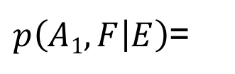
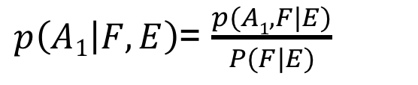

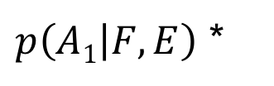
Our friend the chain rule
$p\left(A1,F | E\right)$=
$p\left(A1 | F,E\right)$ *
$p\left(F | E\right)$
$p\left(A1 | F,E\right)$= $\frac{p(A1,F|E)}{P(F|E)}$
What is P(F|E)?
Hint: how do we go from p(A,F|E) to P(F|E)?

Slide 22

Our friend the chain rule
$p\left(A1,F | E\right)$=
$p\left(A1 | F,E\right)$ *
$p\left(F | E\right)$
$p\left(A1 | F,E\right)$= $\frac{p(A1,F|E)}{P(F|E)}$
$p\left(A1 | F,E\right)$= $\frac{p(A1,F|E)}{\sum_{A}{P(A,F|E)}}$
sum over the variable!
How likely is this alignment, compared to all other alignments under the model

Slide 23




One the other hand
Alignment 1
Alignment 2
Alignment 3
Alignment 4
a b
a b
a b
a b
x y
x y
x y
x y
$$p(F, a1|E)$$
$$p(F, a2|E)$$
$$p(F, a3|E)$$
$$p(F, a4|E)$$

Slide 24
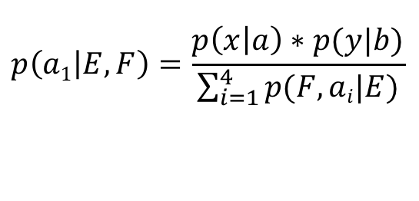
One the other hand
Alignment 1
Alignment 2
Alignment 3
Alignment 4
a b
a b
a b
a b
x y
x y
x y
x y
$$p(F, a1|E)$$
$$p(F, a2|E)$$
$$p(F, a3|E)$$
$$p(F, a4|E)$$
Normalize
$$p\left(a1 | E,F\right)=\frac{p\left(x | a\right)∗p(y|b)}{\sum_{i=1}^{4}{p(F,ai|E)}}$$

Slide 25
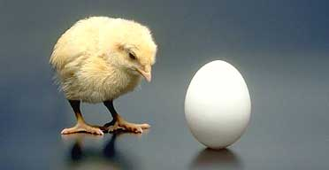
Have we gotten anywhere?

Slide 26
Training without alignments
Initially assume a p(f|e) are equally probable
Repeat:
  Enumerate all possible alignments
  Calculate how probable the alignments are under the current model (i.e. p(f|e))
  Recalculate p(f|e) using counts from all alignments, weighted by how probable they are

Slide 27
EM algorithm
(something from nothing)
General approach for calculating “hidden variables”, i.e. variables without explicit labels in the data
Repeat:
  E-step: Calculate the expected probabilities of the hidden variables based on the current model
  M-step: Update the model based on the expected counts/probabilities

Slide 28
EM alignment
E-step
  Enumerate all possible alignments
  Calculate how probable the alignments are under the current model (i.e. p(f|e))
M-step
  Recalculate p(f|e) using counts from all alignments, weighted by how probable they are

Slide 29
green house
the house
casa verde
la casa
What are the different p(f|e) that make up my model?
p( casa | green)
p( verde | green)
p( la | green )
p( casa | house)
p( verde | house)
p( la | house )
p( casa | the)
p( verde | the)
p( la | the )
Technically, all combinations of foreign and English words

Slide 30
green house
green house
the house
the house
casa verde
casa verde
la casa
la casa
green house
green house
the house
the house
casa verde
casa verde
la casa
la casa
p( casa | green) | 1/3
p( verde | green) | 1/3
p( la | green ) | 1/3
p( casa | house) | 1/3
p( verde | house) | 1/3
p( la | house ) | 1/3
p( casa | the) | 1/3
p( verde | the) | 1/3
p( la | the ) | 1/3
Start with all p(f|e) equally probable

Slide 31
green house
green house
the house
the house
1/9
1/9
1/9
1/9
casa verde
casa verde
la casa
la casa
green house
green house
the house
the house
1/9
1/9
1/9
1/9
casa verde
casa verde
la casa
la casa
p( casa | green) | 1/3
p( verde | green) | 1/3
p( la | green ) | 1/3
p( casa | house) | 1/3
p( verde | house) | 1/3
p( la | house ) | 1/3
p( casa | the) | 1/3
p( verde | the) | 1/3
p( la | the ) | 1/3
E-step: What are the probabilities of the alignments?
1. calculate:

Slide 32
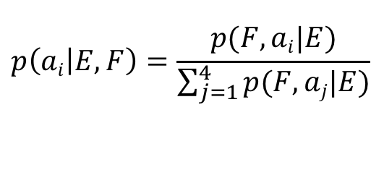
green house
green house
the house
the house
1/9
1/9
1/9
1/9
casa verde
casa verde
la casa
la casa
green house
green house
the house
the house
1/9
1/9
1/9
1/9
casa verde
casa verde
la casa
la casa
sum = 4/9
sum = 4/9
p( casa | green) | 1/3
p( verde | green) | 1/3
p( la | green ) | 1/3
p( casa | house) | 1/3
p( verde | house) | 1/3
p( la | house ) | 1/3
p( casa | the) | 1/3
p( verde | the) | 1/3
p( la | the ) | 1/3
E-step: What are the probabilities of the alignments?
2. normalize:
$$p\left(ai | E,F\right)=\frac{p(F,ai|E)}{\sum_{j=1}^{4}{p(F,aj|E)}}$$

Slide 33
green house
green house
the house
the house
1/4
1/4
1/4
1/4
casa verde
casa verde
la casa
la casa
green house
green house
the house
the house
1/4
1/4
1/4
1/4
casa verde
casa verde
la casa
la casa
p( casa | green) | 1/3
p( verde | green) | 1/3
p( la | green ) | 1/3
p( casa | house) | 1/3
p( verde | house) | 1/3
p( la | house ) | 1/3
p( casa | the) | 1/3
p( verde | the) | 1/3
p( la | the ) | 1/3
E-step: What are the probabilities of the alignments?
2. normalize:
$$p\left(ai | E,F\right)=\frac{p(F,ai|E)}{\sum_{j=1}^{4}{p(F,aj|E)}}$$

Slide 34
green house
green house
the house
the house
1/4
1/4
1/4
1/4
casa verde
casa verde
la casa
la casa
green house
green house
the house
the house
1/4
1/4
1/4
1/4
casa verde
casa verde
la casa
la casa
M-step: What are the p(f|e) given the alignments?
p( casa | green) | 1/3
p( verde | green) | 1/3
p( la | green ) | 1/3
p( casa | house) | 1/3
p( verde | house) | 1/3
p( la | house ) | 1/3
p( casa | the) | 1/3
p( verde | the) | 1/3
p( la | the ) | 1/3
c(casa,green) = ?
c(verde,green) = ?
c(la, green) = ?
c(casa,house) ?
c(verde,house) = ?
c(la,house) = ?
c(casa,the) = ?
c(verde,the) = ?
c(la,the) = ?
First, calculate the partial counts

Slide 35
green house
green house
the house
the house
1/4
1/4
1/4
1/4
casa verde
casa verde
la casa
la casa
green house
green house
the house
the house
1/4
1/4
1/4
1/4
casa verde
casa verde
la casa
la casa
M-step: What are the p(f|e) given the alignments?
p( casa | green) | ?
p( verde | green) | ?
p( la | green ) | ?
p( casa | house) | ?
p( verde | house) | ?
p( la | house ) | ?
p( casa | the) | ?
p( verde | the) | ?
p( la | the ) | ?
c(casa,green) = 1/4+1/4 = 1/2
c(verde,green) = 1/4+1/4 = 1/2
c(la, green) = 0
c(casa,house) = 1/4+1/4+
1/4+1/4 = 1
c(verde,house) = 1/4+1/4 = 1/2
c(la,house) = 1/4+1/4 = 1/2
c(casa,the) = 1/4+1/4 = 1/2
c(verde,the) = 0
c(la,the) = 1/4+1/4 = 1/2
Then, calculate the probabilities by normalizing the counts

Slide 36
green house
green house
the house
the house
casa verde
casa verde
la casa
la casa
green house
green house
the house
the house
casa verde
casa verde
la casa
la casa
p( casa | green) | 1/2
p( verde | green) | 1/2
p( la | green ) | 0
p( casa | house) | 1/2
p( verde | house) | 1/4
p( la | house ) | 1/4
p( casa | the) | 1/2
p( verde | the) | 0
p( la | the ) | 1/2
c(casa,green) = 1/4+1/4 = 1/2
c(verde,green) = 1/4+1/4 = 1/2
c(la, green) = 0
c(casa,house) = 1/4+1/4+
1/4+1/4 = 1
c(verde,house) = 1/4+1/4 = 1/2
c(la,house) = 1/4+1/4 = 1/2
c(casa,the) = 1/4+1/4 = 1/2
c(verde,the) = 0
c(la,the) = 1/4+1/4 = 1/2
Then, calculate the probabilities by normalizing the counts

Slide 37
green house
green house
the house
the house
casa verde
casa verde
la casa
la casa
green house
green house
the house
the house
casa verde
casa verde
la casa
la casa
p( casa | green) | 1/2
p( verde | green) | 1/2
p( la | green ) | 0
p( casa | house) | 1/2
p( verde | house) | 1/4
p( la | house ) | 1/4
p( casa | the) | 1/2
p( verde | the) | 0
p( la | the ) | 1/2
E-step: 1. what are the p(A,F|E)?

Slide 38
green house
green house
the house
the house
1/8
1/4
1/4
1/8
casa verde
casa verde
la casa
la casa
green house
green house
the house
the house
1/4
1/8
1/4
1/8
casa verde
casa verde
la casa
la casa
p( casa | green) | 1/2
p( verde | green) | 1/2
p( la | green ) | 0
p( casa | house) | 1/2
p( verde | house) | 1/4
p( la | house ) | 1/4
p( casa | the) | 1/2
p( verde | the) | 0
p( la | the ) | 1/2
E-step: 1. what are the p(A,F|E)?

Slide 39
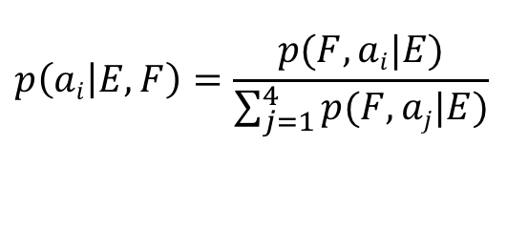
green house
green house
the house
the house
1/8
1/4
1/4
1/8
casa verde
casa verde
la casa
la casa
green house
green house
the house
the house
1/4
1/8
1/4
1/8
casa verde
casa verde
la casa
la casa
sum = (3/4)
sum = (3/4)
p( casa | green) | 1/2
p( verde | green) | 1/2
p( la | green ) | 0
p( casa | house) | 1/2
p( verde | house) | 1/4
p( la | house ) | 1/4
p( casa | the) | 1/2
p( verde | the) | 0
p( la | the ) | 1/2
$$p\left(ai | E,F\right)=\frac{p(F,ai|E)}{\sum_{j=1}^{4}{p(F,aj|E)}}$$
E-step: 2. what are the alignments, i.e. normalize?

Slide 40
green house
green house
the house
the house
1/6
1/3
1/3
1/6
casa verde
casa verde
la casa
la casa
green house
green house
the house
the house
1/3
1/6
1/3
1/6
casa verde
casa verde
la casa
la casa
sum = (3/4)
sum = (3/4)
p( casa | green) | 1/2
p( verde | green) | 1/2
p( la | green ) | 0
p( casa | house) | 1/2
p( verde | house) | 1/4
p( la | house ) | 1/4
p( casa | the) | 1/2
p( verde | the) | 0
p( la | the ) | 1/2
$$p\left(ai | E,F\right)=\frac{p(F,ai|E)}{\sum_{j=1}^{4}{p(F,aj|E)}}$$
E-step: 2. what are the alignments, i.e. normalize?

Slide 41
green house
green house
the house
the house
1/6
1/3
1/3
1/6
casa verde
casa verde
la casa
la casa
green house
green house
the house
the house
1/3
1/6
1/3
1/6
casa verde
casa verde
la casa
la casa
M-step: What are the p(f|e) given the alignments?
p( casa | green)
p( verde | green)
p( la | green )
p( casa | house)
p( verde | house)
p( la | house )
p( casa | the)
p( verde | the)
p( la | the )
c(casa,green) = ?
c(verde,green) = ?
c(la, green) = ?
c(casa,house) = ?
c(verde,house) = ?
c(la,house) = ?
c(casa,the) = ?
c(verde,the) = ?
c(la,the) = ?
First, calculate the partial counts

Slide 42
green house
green house
the house
the house
1/6
1/3
1/3
1/6
casa verde
casa verde
la casa
la casa
green house
green house
the house
the house
1/3
1/6
1/3
1/6
casa verde
casa verde
la casa
la casa
M-step: What are the p(f|e) given the alignments?
p( casa | green)
p( verde | green)
p( la | green )
p( casa | house)
p( verde | house)
( la | house )
p( casa | the)
p( verde | the)
p( la | the )
c(casa,green) = 1/6+1/3 = 3/6
c(verde,green) = 1/3+1/3 = 4/6
c(la, green) = 0
c(casa,house) = 1/3+1/6+
1/3+1/6 = 6/6
c(verde,house) = 1/6+1/6 = 2/6
c(la,house) = 1/6+1/6 = 2/6
c(casa,the) = 1/6+1/3 = 3/6
c(verde,the) = 0
c(la,the) = 1/3+1/3 = 4/6

Slide 43
green house
green house
the house
the house
1/6
1/3
1/3
1/6
casa verde
casa verde
la casa
la casa
green house
green house
the house
the house
1/3
1/6
1/3
1/6
casa verde
casa verde
la casa
la casa
M-step: What are the p(f|e) given the alignments?
p( casa | green) | ?
p( verde | green) | ?
p( la | green ) | ?
p( casa | house) | ?
p( verde | house) | ?
( la | house ) | ?
p( casa | the) | ?
p( verde | the) | ?
p( la | the ) | ?
c(casa,green) = 1/6+1/3 = 3/6
c(verde,green) = 1/3+1/3 = 4/6
c(la, green) = 0
c(casa,house) = 1/3+1/6+
1/3+1/6 = 6/6
c(verde,house) = 1/6+1/6 = 2/6
c(la,house) = 1/6+1/6 = 2/6
c(casa,the) = 1/6+1/3 = 3/6
c(verde,the) = 0
c(la,the) = 1/3+1/3 = 4/6
Then, calculate the probabilities by normalizing the counts

Slide 44
green house
green house
the house
the house
casa verde
casa verde
la casa
la casa
green house
green house
the house
the house
casa verde
casa verde
la casa
la casa
p( casa | green) | 3/7
p( verde | green) | 4/7
p( la | green ) | 0
p( casa | house) | 3/5
p( verde | house) | 1/5
p( la | house ) | 1/5
p( casa | the) | 3/7
p( verde | the) | 0
p( la | the ) | 4/7
c(casa,green) = 1/6+1/3 = 3/6
c(verde,green) = 1/3+1/3 = 4/6
c(la, green) = 0
c(casa,house) = 1/3+1/6+
1/3+1/6 = 6/6
c(verde,house) = 1/6+1/6 = 2/6
c(la,house) = 1/6+1/6 = 2/6
c(casa,the) = 1/6+1/3 = 3/6
c(verde,the) = 0
c(la,the) = 1/3+1/3 = 4/6
Then, calculate the probabilities by normalizing the counts

Slide 45
green house
3/7 *
1/5 =
3/35
(.086)
green house
4/7 *
3/5 =
12/35
(.34)
the house
4/7 *
3/5=
12/35
(.34)
the house
3/7 *
1/5 =
3/35
(.086)
casa verde
casa verde
la casa
la casa
green house
3/7*
4/7=
12/49
(.24)
green house
3/5*
1/5=
3/25
(.12)
the house
4/7 *
3/7 =
12/49
(.24)
the house
1/5 *
3/5 =
3/25
(.12)
casa verde
casa verde
la casa
la casa
p( casa | green) | 3/7
p( verde | green) | 4/7
p( la | green ) | 0
p( casa | house) | 3/5
p( verde | house) | 1/5
p( la | house ) | 1/5
p( casa | the) | 3/7
p( verde | the) | 0
p( la | the ) | 4/7
E-step: 1. what are the p(A,F|E)?

Slide 46
green house
green house
the house
the house
0.108
0.432
0.432
0.108
casa verde
casa verde
la casa
la casa
green house
green house
the house
the house
0.309
0.151
0.309
0.151
casa verde
casa verde
la casa
la casa
p( casa | green) | 3/7
p( verde | green) | 4/7
p( la | green ) | 0
p( casa | house) | 3/5
p( verde | house) | 1/5
p( la | house ) | 1/5
p( casa | the) | 3/7
p( verde | the) | 0
p( la | the ) | 4/7
E-step: 2. what are the alignments, i.e. normalize?

Slide 47
green house
green house
the house
the house
0.108
0.432
0.432
0.108
casa verde
casa verde
la casa
la casa
green house
green house
the house
the house
0.309
0.151
0.309
0.151
casa verde
casa verde
la casa
la casa
p( casa | green) | 3/7
p( verde | green) | 4/7
p( la | green ) | 0
p( casa | house) | 3/5
p( verde | house) | 1/5
p( la | house ) | 1/5
p( casa | the) | 3/7
p( verde | the) | 0
p( la | the ) | 4/7
c(casa,green) = .108+.309=0.417
c(verde,green) = .432+.309 = 0.741
c(la, green) = 0
c(casa,house) = .432+.151+
.432+.151=1.166
c(verde,house) = .108+.151=.259
c(la,house) = .108+.151=0.259
c(casa,the) = .108+.309=0.417
c(verde,the) = 0
c(la,the) = .432+.309=0.741

Slide 48
green house
green house
the house
the house
casa verde
casa verde
la casa
la casa
green house
green house
the house
the house
casa verde
casa verde
la casa
la casa
p( casa | green) | 0.36
p( verde | green) | 0.64
p( la | green ) | 0
p( casa | house) | 0.69
p( verde | house) | 0.15
p( la | house ) | 0.15
p( casa | the) | 0.36
p( verde | the) | 0
p( la | the ) | 0.64
c(casa,green) = .108+.309=0.417
c(verde,green) = .432+.309 = 0.741
c(la, green) = 0
c(casa,house) = .432+.151+
.432+.151=1.166
c(verde,house) = .108+.151=.259
c(la,house) = .108+.151=0.259
c(casa,the) = .108+.309=0.417
c(verde,the) = 0
c(la,the) = .432+.309=0.741

Slide 49
Iterate…
5 iterations
10 iterations
100 iterations
p( casa | green) | 0.24
p( verde | green) | 0.76
p( la | green ) | 0
p( casa | green) | 0.1
p( verde | green) | 0.9
p( la | green ) | 0
p( casa | green) | 0.005
p( verde | green) | 0.995
p( la | green ) | 0
p( casa | house) | 0.84
p( verde | house) | 0.08
p( la | house ) | 0.08
p( casa | house) | 0.98
p( verde | house) | 0.01
p( la | house ) | 0.01
p( casa | house) | ~1.0
p( verde | house) | ~0.0
p( la | house ) | ~0.0
p( casa | the) | 0.24
p( verde | the) | 0
p( la | the ) | 0.76
p( casa | the) | 0.1
p( verde | the) | 0
p( la | the ) | 0.9
p( casa | the) | 0.005
p( verde | the) | 0
p( la | the ) | 0.995

Slide 50
EM alignment
E-step
  Enumerate all possible alignments
  Calculate how probable the alignments are under the current model (i.e. p(f|e))
M-step
  Recalculate p(f|e) using counts from all alignments, weighted by how probable they are
Why does it work?

Slide 51

EM alignment
E-step
  Enumerate all possible alignments
  Calculate how probable the alignments are under the current model (i.e. p(f|e))
M-step
  Recalculate p(f|e) using counts from all alignments, weighted by how probable they are
Why does it work?

Slide 52
EM alignment
Intuitively:
M-step
  Recalculate p(f|e) using counts from all alignments, weighted by how probable they are
Things that co-occur will have higher probabilities
E-step
  Calculate how probable the alignments are under the current model (i.e. p(f|e))
Alignments that contain things with higher p(f|e) will be scored higher

Slide 53
An aside: estimating probabilities
What is the probability of “the” occurring in a sentence?
number of sentences with “the”
total number of sentences
Is this right?

Slide 54
Estimating probabilities
What is the probability of “the” occurring in a sentence?
number of sentences with “the”
total number of sentences
No. This is an estimate based on our data
This is called the maximum likelihood estimation. Why?

Slide 55
Maximum Likelihood Estimation (MLE)
Maximum likelihood estimation picks the values for the model parameters that maximize the likelihood of the training data
You flip a coin 100 times. 60 times you get heads.
What is the MLE for heads?
p(head) = 0.60

Slide 56
Maximum Likelihood Estimation (MLE)
Maximum likelihood estimation picks the values for the model parameters that maximize the likelihood of the training data
You flip a coin 100 times. 60 times you get heads.
What is the likelihood of the data under this model (each coin flip is a data point)?

Slide 57
MLE example
You flip a coin 100 times. 60 times you get heads.
MLE for heads: p(head) = 0.60
What is the likelihood of the data under this model (each coin flip is a data point)?
log(0.60⁶⁰ * 0.40⁴⁰) = -67.3

Slide 58
MLE example
Can we do any better?
p(heads) = 0.5
  log(0.50⁶⁰ * 0.50⁴⁰) =-69.3
p(heads) = 0.7
  log(0.70⁶⁰ * 0.30⁴⁰)=-69.5

Slide 59
EM alignment: the math
The EM algorithm tries to find parameters of the model (p(f|e)) that maximize the likelihood of the data
In our case:
Each iteration, we increase (or keep the same) the likelihood of the data

Slide 60
Implementation details
Any concerns/issues?
Anything underspecified?
Repeat:
  E-step
    Enumerate all possible alignments
    Calculate how probable the alignments are under the current model (i.e. p(f|e))
  M-step
    Recalculate p(f|e) using counts from all alignments, weighted by how probable they are

Slide 61
Implementation details
When do we stop?
Repeat:
  E-step
    Enumerate all possible alignments
    Calculate how probable the alignments are under the current model (i.e. p(f|e))
  M-step
    Recalculate p(f|e) using counts from all alignments, weighted by how probable they are

Slide 62
Implementation details
Repeat for a fixed number of iterations
Repeat until parameters don’t change (much)
Repeat until likelihood of data doesn’t change much
Repeat:
  E-step
    Enumerate all possible alignments
    Calculate how probable the alignments are under the current model (i.e. p(f|e))
  M-step
    Recalculate p(f|e) using counts from all alignments, weighted by how probable they are

Slide 63
Implementation details
For |E| English words and |F| foreign words, how many alignments are there?
Repeat:
  E-step
    Enumerate all possible alignments
    Calculate how probable the alignments are under the current model (i.e. p(f|e))
  M-step
    Recalculate p(f|e) using counts from all alignments, weighted by how probable they are

Slide 64

Implementation details
Each foreign word can be aligned to any of the English words (or NULL)
(|E|+1)^{|F|}
Repeat:
  E-step
    Enumerate all possible alignments
    Calculate how probable the alignments are under the current model (i.e. p(f|e))
  M-step
    Recalculate p(f|e) using counts from all alignments, weighted by how probable they are
Notes:
This is exponential ☹

Slide 65
Thought experiment
The old man is happy. He has fished many times.
El viejo está feliz porque ha pescado muchos veces.
His wife talks to him.
The sharks await.
Su mujer habla con él.
Los tiburones esperan.
p(el ↔ the) = 0.5
p(Los ↔ the) = 0.5
Notes:
really, count(e aligned-to anything)

Slide 66
If we had the alignments
Input: corpus of English/Foreign sentence pairs along with alignment
for (E, F) in corpus:
for aligned words (e, f) in pair (E,F):
count(e,f) += 1
count(e) += 1
for all (e,f) in count:
p(f|e) = count(e,f) / count(e)

Slide 67
If we had the alignments
Input: corpus of English/Foreign sentence pairs along with alignment
for (E, F) in corpus:
for e in E:
for f in F:
if f aligned-to e:
count(e,f) += 1
count(e) += 1
for all (e,f) in count:
p(f|e) = count(e,f) / count(e)

Slide 68
If we had the alignments
Input: corpus of English/Foreign sentence pairs along with alignment
for (E, F) in corpus:
for aligned words (e, f) in pair (E,F):
count(e,f) += 1
count(e) += 1
for all (e,f) in count:
p(f|e) = count(e,f) / count(e)
for (E, F) in corpus
for e in E:
for f in F:
if f aligned-to e:
count(e,f) += 1
count(e) += 1
Are these equivalent?

Slide 69
Thought experiment #2
The old man is happy. He has fished many times.
80 annotators
El viejo está feliz porque ha pescado muchos veces.
The old man is happy. He has fished many times.
20 annotators
El viejo está feliz porque ha pescado muchos veces.
Use partial counts:
count(viejo ↔ man) 0.8
count(viejo ↔ old) 0.2

Slide 70
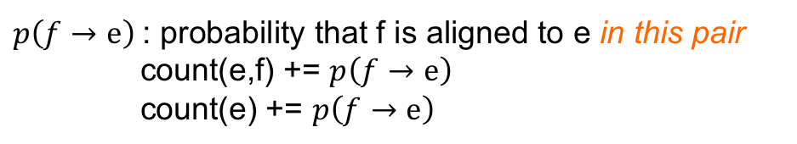
Without the alignments
if f aligned-to e:
count(e,f) += 1
count(e) += 1
$p\left(f→e\right)$: probability that f is aligned to e in this pair
count(e,f) += $p\left(f→e\right)$
count(e) += $p\left(f→e\right)$
Key: use expected counts (i.e., how likely based on the current model), rather than actual counts

Slide 71
Without the alignments
Input: corpus of English/Foreign sentence pairs along with alignment
for (E, F) in corpus:
for e in E:
for f in F:
p(f -> e): probability that f is aligned to e in this pair
count(e,f) += p( f -> e)
count(e) += p(f -> e)
for all (e,f) in count:
p(f|e) = count(e,f) / count(e)
Key: use expected counts (i.e., how likely based on the current model), rather than actual counts

Slide 72
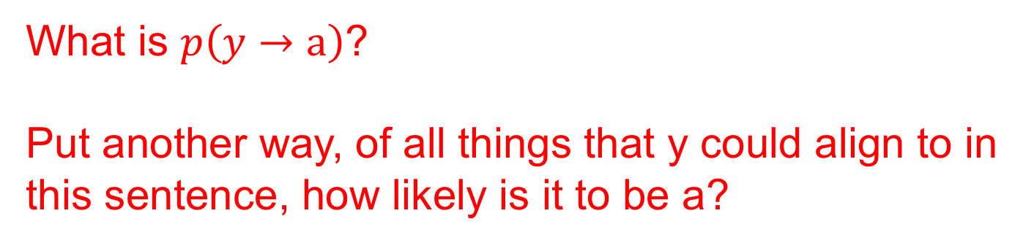
Without alignments
$p\left(f→e\right)$: probability that f is aligned to e in this pair
a b c
y z
What is $p\left(y→a\right)$?
Put another way, of all things that y could align to in this sentence, how likely is it to be a?

Slide 73
Without alignments
$p\left(f→e\right)$: probability that f is aligned to e in this pair
a b c
y z
Of all things that y could align to, how likely is it to be a:
p(y | a)
Does that do it?
No! p(y | a) is how likely y is to align to a over the whole data set.

Slide 74
Without alignments
$p\left(f→e\right)$: probability that f is aligned to e in this pair
a b c
y z
Of all things that y could align to, how likely is it to be a:
p(y | a)
p(y | a) + p(y | b) + p(y | c)

Slide 75
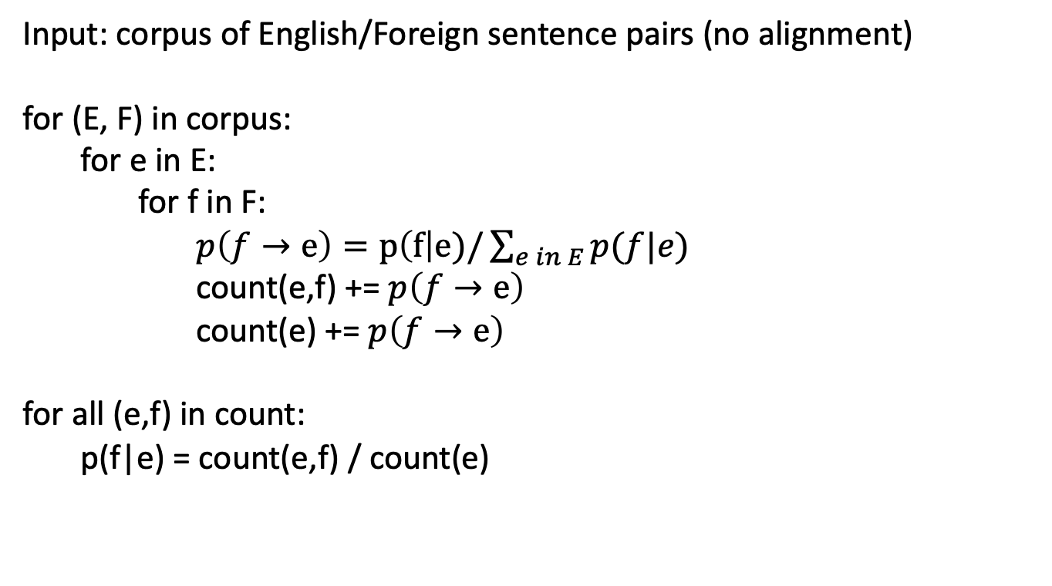
Without the alignments
Input: corpus of English/Foreign sentence pairs (no alignment)
for (E, F) in corpus:
for e in E:
for f in F:
$p\left(f→e\right)=p\left(f\right|e)/\sum_{e in E}{p(f|e)}$
count(e,f) += $p\left(f→e\right)$
count(e) += $p\left(f→e\right)$
for all (e,f) in count:
p(f|e) = count(e,f) / count(e)

Slide 76
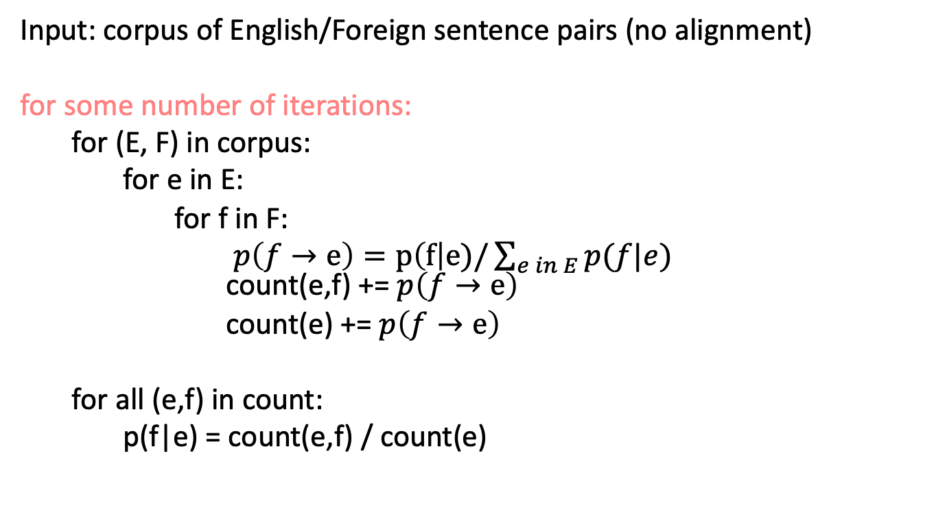
EM: without the alignments
Input: corpus of English/Foreign sentence pairs (no alignment)
for some number of iterations:
for (E, F) in corpus:
for e in E:
for f in F:
$p\left(f→e\right)=p\left(f\right|e)/\sum_{e in E}{p(f|e)}$ count(e,f) += $p\left(f→e\right)$
count(e) += $p\left(f→e\right)$
for all (e,f) in count:
p(f|e) = count(e,f) / count(e)

Slide 77
EM: without the alignments
Input: corpus of English/Foreign sentence pairs (no alignment)
for some number of iterations:
for (E, F) in corpus:
for e in E:
for f in F:
$p\left(f→e\right)=p\left(f\right|e)/\sum_{e in E}{p(f|e)}$ count(e,f) += $p\left(f→e\right)$
count(e) += $p\left(f→e\right)$
for all (e,f) in count:
p(f|e) = count(e,f) / count(e)

Slide 78
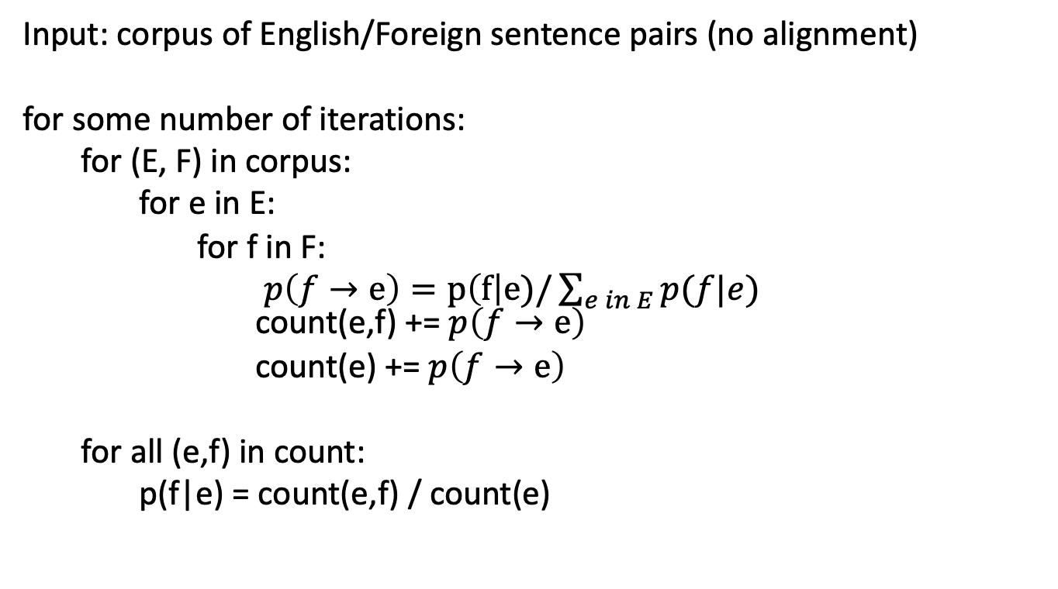
EM: without the alignments
Input: corpus of English/Foreign sentence pairs (no alignment)
for some number of iterations:
for (E, F) in corpus:
for e in E:
for f in F:
$p\left(f→e\right)=p\left(f\right|e)/\sum_{e in E}{p(f|e)}$ count(e,f) += $p\left(f→e\right)$
count(e) += $p\left(f→e\right)$
for all (e,f) in count:
p(f|e) = count(e,f) / count(e)
Where are the E and M steps?

Slide 79
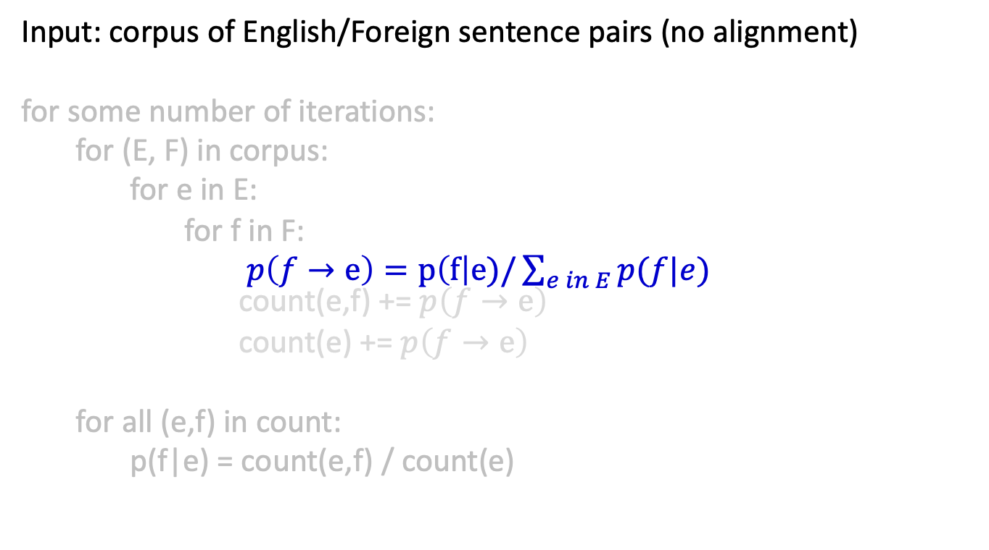
EM: without the alignments
Input: corpus of English/Foreign sentence pairs (no alignment)
for some number of iterations:
for (E, F) in corpus:
for e in E:
for f in F:
$p\left(f→e\right)=p\left(f\right|e)/\sum_{e in E}{p(f|e)}$ count(e,f) += $p\left(f→e\right)$
count(e) += $p\left(f→e\right)$
for all (e,f) in count:
p(f|e) = count(e,f) / count(e)
    Calculate how probable the alignments are under the current model (i.e. p(f|e))

Slide 80
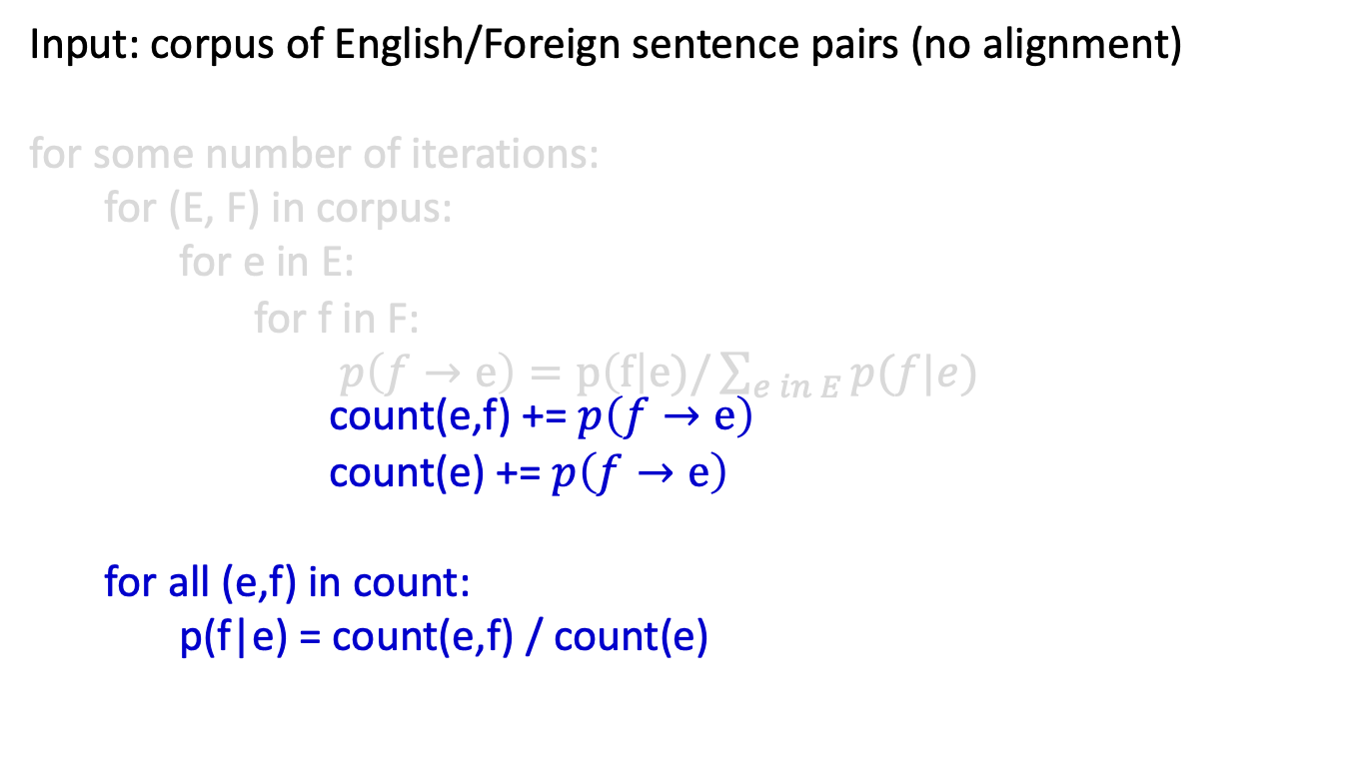
EM: without the alignments
Input: corpus of English/Foreign sentence pairs (no alignment)
for some number of iterations:
for (E, F) in corpus:
for e in E:
for f in F:
$p\left(f→e\right)=p\left(f\right|e)/\sum_{e in E}{p(f|e)}$ count(e,f) += $p\left(f→e\right)$
count(e) += $p\left(f→e\right)$
for all (e,f) in count:
p(f|e) = count(e,f) / count(e)
    Recalculate p(f|e) using counts from all alignments, weighted by how probable they are

Slide 81
NULL
Sometimes foreign words don’t have a direct correspondence to an English word
Adding a NULL word allows for p(f | NULL), i.e. words that appear, but are not associated explicitly with an English word
Implementation: add “NULL” (or some unique string representing NULL) to each of the English sentences, often at the beginning of the sentence
p( casa | NULL) | 1/3
p( verde | NULL) | 1/3
p( la | NULL ) | 1/3

Slide 82
Benefits of word-level model
Rarely used in practice for modern MT system
Mary did not slap the green witch
Maria no dió una botefada a la bruja verde
Two key side effects of training a word-level model:
  Word-level alignment
  p(f | e): translation dictionary
How do I get this?

Slide 83
Word alignment
100 iterations
green house
p( casa | green) | 0.005
p( verde | green) | 0.995
p( la | green ) | 0
casa verde
How should these be aligned?
p( casa | house) | ~1.0
p( verde | house) | ~0.0
p( la | house ) | ~0.0
the house
la casa
p( casa | the) | 0.005
p( verde | the) | 0
p( la | the ) | 0.995

Slide 84
Word alignment
100 iterations
green house
p( casa | green) | 0.005
p( verde | green) | 0.995
p( la | green ) | 0
casa verde
Why?
p( casa | house) | ~1.0
p( verde | house) | ~0.0
p( la | house ) | ~0.0
the house
la casa
p( casa | the) | 0.005
p( verde | the) | 0
p( la | the ) | 0.995

Slide 85
Word-level alignment
Which for IBM model 1 is:
Given a model (i.e. trained p(f|e)), how do we find this?
Align each foreign word (f in F) to the English word (e in E) with highest p(f|e)

Slide 86
Word-alignment Evaluation
The old man is happy. He has fished many times.
El viejo está feliz porque ha pescado muchos veces.
How good of an alignment is this?
How can we quantify this?

Slide 87
Word-alignment Evaluation
System:
The old man is happy. He has fished many times.
El viejo está feliz porque ha pescado muchos veces.
Human
The old man is happy. He has fished many times.
El viejo está feliz porque ha pescado muchos veces.
How can we quantify this?

Slide 88
Word-alignment Evaluation
System:
The old man is happy. He has fished many times.
El viejo está feliz porque ha pescado muchos veces.
Human
The old man is happy. He has fished many times.
El viejo está feliz porque ha pescado muchos veces.
Precision and recall!

Slide 89
Word-alignment Evaluation
System:
The old man is happy. He has fished many times.
El viejo está feliz porque ha pescado muchos veces.
Human
The old man is happy. He has fished many times.
El viejo está feliz porque ha pescado muchos veces.
6
6
Precision:
Recall:
7
10

Slide 90
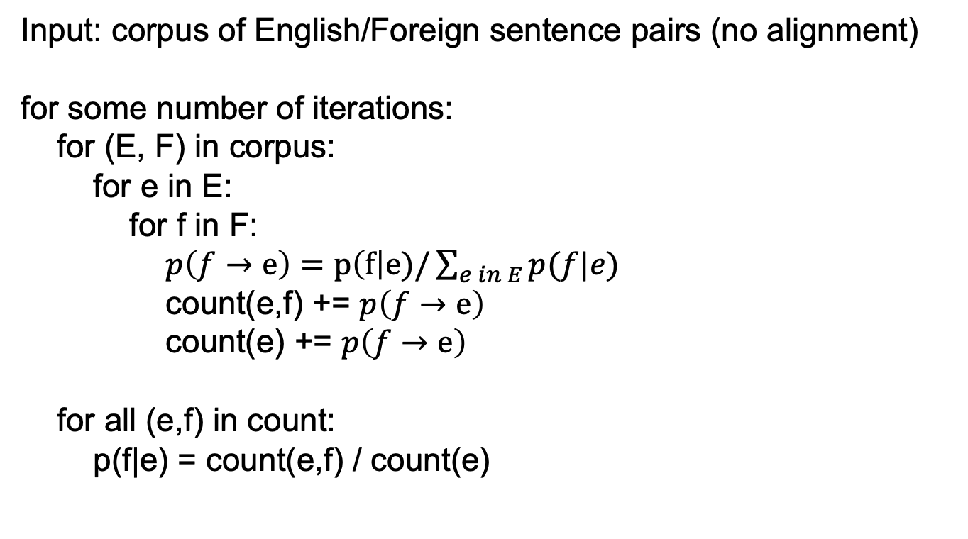
Appendix A
Input: corpus of English/Foreign sentence pairs (no alignment)
for some number of iterations:
for (E, F) in corpus:
for e in E:
for f in F:
$p\left(f→e\right)=p\left(f\right|e)/\sum_{e in E}{p(f|e)}$
count(e,f) += $p\left(f→e\right)$
count(e) += $p\left(f→e\right)$
for all (e,f) in count:
p(f|e) = count(e,f) / count(e)

Slide 91
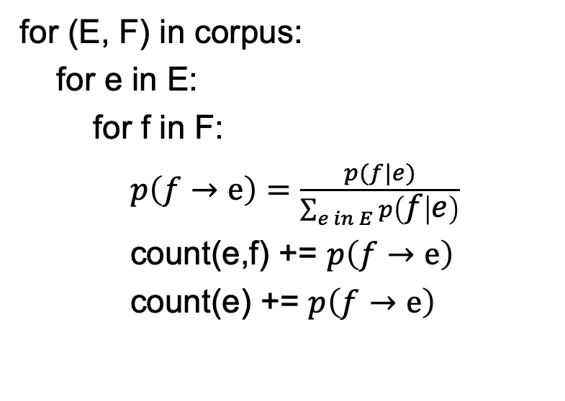
Appendix A
for (E, F) in corpus:
for e in E:
for f in F:
$p\left(f→e\right)=\frac{p(f|e)}{\sum_{e in E}{p\left(f | e\right)}}$
count(e,f) += $p\left(f→e\right)$
count(e) += $p\left(f→e\right)$
Pair 1:
E: green house
F: casa verde
Pair 2:
E: the house
F: la casa
Step 1: calculate p(f -> e) for all pairs of words in the two sentences (assume p(f|e) is a constant for all f,e)

Slide 92
Appendix A
for (E, F) in corpus:
for e in E:
for f in F:
$p\left(f→e\right)=\frac{p(f|e)}{\sum_{e in E}{p\left(f | e\right)}}$
count(e,f) += $p\left(f→e\right)$
count(e) += $p\left(f→e\right)$
Pair 1:
E: green house
F: casa verde
Pair 2:
E: the house
F: la casa
Step 2: aggregate the counts

Slide 93
Appendix A
Pair 1:
E: green house
F: casa verde
for all (e,f) in count:
p(f|e) = count(e,f) / count(e)
Pair 2:
E: the house
F: la casa
Step 3: recalculate p(e|f)

Slide 94
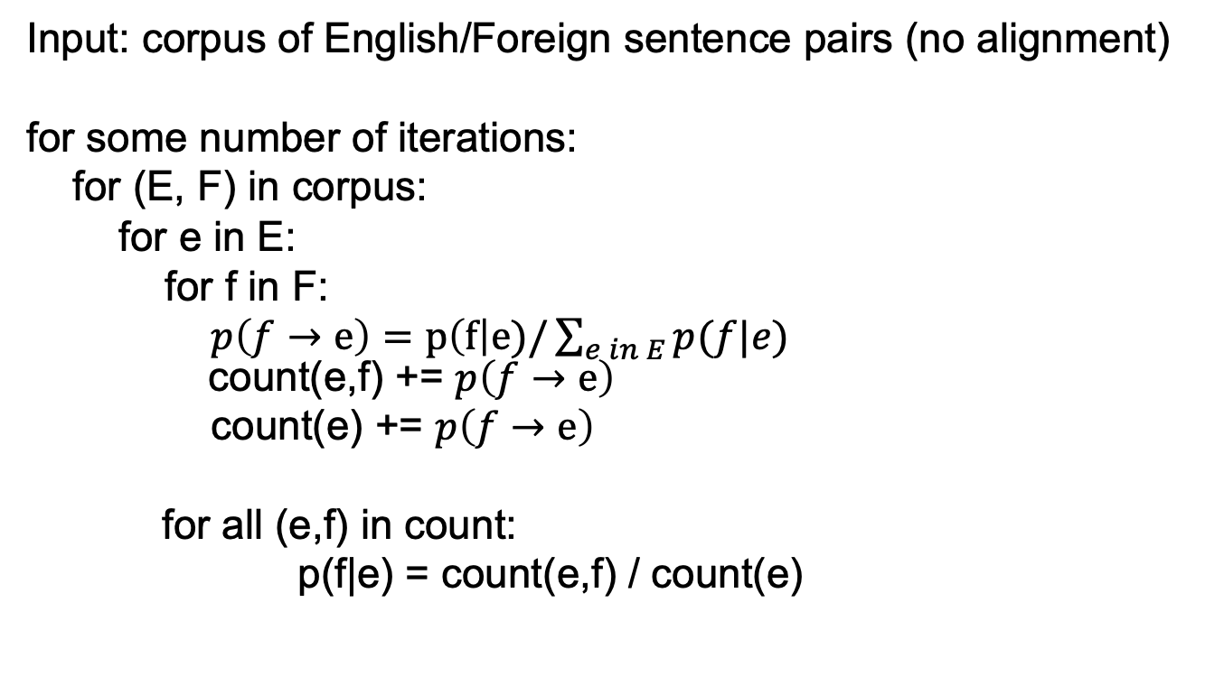
Appendix A
Input: corpus of English/Foreign sentence pairs (no alignment)
for some number of iterations:
for (E, F) in corpus:
for e in E:
for f in F:
$p\left(f→e\right)=p\left(f\right|e)/\sum_{e in E}{p(f|e)}$ count(e,f) += $p\left(f→e\right)$
count(e) += $p\left(f→e\right)$
for all (e,f) in count:
p(f|e) = count(e,f) / count(e)

Slide 95
Worksheet
Pair 1:
p(casa → green) =
p(casa → house) =
p(verde → green) =
p(verde → house =
Pair 2:
p(la → the) =
p(la → house) =
p(casa → the) =
p(casa → house =
count(green, casa) =
count(green, verde) =
count(house, casa) =
count(house, verde) =
count(house, la) =
count(the, casa) =
count(the, la) =
count(green) =
count(house) =
count(the) =
p(casa | green) =
p(verde | green) =
p(casa | house) =
p(verde | house) =
p(la | house) =
p(casa | the) =
p(la | the ) =

Slide 96
green house
green house
the house
the house
casa verde
casa verde
la casa
la casa
green house
green house
the house
the house
casa verde
casa verde
la casa
la casa
p( casa | green) | 1/2
p( verde | green) | 1/2
p( la | green ) | 0
p( casa | house) | 1/2
p( verde | house) | 1/4
p( la | house ) | 1/4
p( casa | the) | 1/2
p( verde | the) | 0
p( la | the ) | 1/2
c(casa,green) = 1/4+1/4 = 1/2
c(verde,green) = 1/4+1/4 = 1/2
c(la, green) = 0
c(casa,house) = 1/4+1/4+
1/4+1/4 = 1
c(verde,house) = 1/4+1/4 = 1/2
c(la,house) = 1/4+1/4 = 1/2
c(casa,the) = 1/4+1/4 = 1/2
c(verde,the) = 0
c(la,the) = 1/4+1/4 = 1/2
Then, calculate the probabilities by normalizing the counts

