Slide 1
NLP Linguistics 101
David Kauchak
CS159 – Spring 2023
some slides adapted from Ray Mooney

Slide 2
Admin
Assignment 2
Quiz #1
  Monday at the beginning of class (first 30 minutes)
  Open book and open notes

Slide 3
Quiz #1 material
T/F, short answer, pencil and paper work (no coding)
zipf's law
regular expressions
probability basics
language modeling
  MLE estimation/estimating from a corpus
  development set
  perplexity
  determining vocabulary
  smoothing techniques
    add 1
    add lambda
  interpolation
  backoff
    absolute discounting

Slide 4
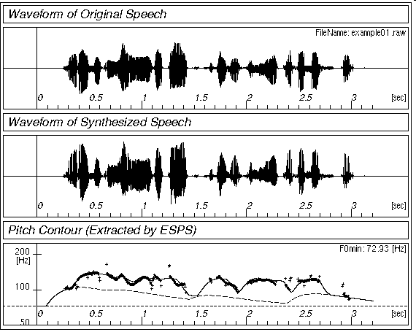
Simplified View of Linguistics
Phonology/Phonetics
/waddyasai/
Morphology
/waddyasai/ what did you say
say
Syntax
what did you say
obj
subj
say
you
what
Semantics
subj
obj
P[ λx. say(you, x) ]
you
what
Discourse
what did you say
what did you say
Notes:
Nikolai Trubetzkoy in Grundzüge der Phonologie (1939) defines phonology as "the study of sound pertaining to the system of language," as opposed to phonetics, which is "the study of sound pertaining to the act of speech."

Slide 5
Morphology
What is morphology?
  study of the internal structure of words
    morph-ology word-s jump-ing
Why might this be useful for NLP?
  generalization (runs, running, runner are related)
  additional information (it’s plural, past tense, etc)
  allows us to handle words we’ve never seen before
    smoothing?

Slide 6
New words
AP newswire stories from Feb 1988 – Dec 30, 1988
  300K unique words
New words seen on Dec 31
  compounds: prenatal-care, publicly-funded, channel-switching, …
  New words:
    dumbbells, groveled, fuzzier, oxidized, ex-presidency, puppetry, boulderlike, over-emphasized, antiprejudice
Notes:
new technology:
- googled, googling
- tweeted

Slide 7
Morphology basics
Words are built up from morphemes
  stems (base/main part of the word)
  affixes
    prefixes
      precedes the stem
    suffixes
      follows the stem
    infixes
      inserted inside the stem
    circumfixes
      surrounds the stem
  Examples?

Slide 8
Morpheme examples
prefix
  circum- (circumnavigate)
  dis- (dislike)
  mis- (misunderstood)
  com-, de-, dis-, in-, re-, post-, trans-, …
suffix
  -able (movable)
  -ance (resistance)
  -ly (quickly)
  -tion, -ness, -ate, -ful, …

Slide 9
Morpheme examples
infix
  -fucking- (cinder-fucking-rella)
  more common in other languages
circumfix
  doesn’t really happen in English
  a- -ing
    a-running
    a-jumping

Slide 10
Agglutinative: Finnish
talo 'the-house’ kaup-pa 'the-shop'
talo-ni 'my house' kaup-pa-ni 'my shop'
talo-ssa 'in the-house' kaup-a-ssa 'in the-shop'
talo-ssa-ni 'in my house’ kaup-a-ssa-ni 'in my shop'
talo-i-ssa 'in the-houses’ kaup-o-i-ssa 'in the-shops'
talo-i-ssa-ni 'in my houses’ kaup-o-i-ssa-ni 'in my shops'

Slide 11
Stemming (baby lemmatization)
Reduce a word to the main stem/morpheme
automate
automates
automatic
automation
automat
run
runs
running
run

Slide 12
Stemming example
This is a poorly constructed example using the Porter stemmer.
This is a poorli construct example us the Porter stemmer.
https://text-processing.com/demo/stem/
(or you can download versions online)

Slide 13
Porter’s algorithm (1980)
Most common algorithm for stemming English
  Results suggest it is at least as good as other stemming options
Multiple sequential phases of reductions using rules, e.g.
  sses → ss
  ies → i
  ational → ate
  tional → tion
http://tartarus.org/~martin/PorterStemmer/

Slide 14
What is Syntax?
Study of the structure of language
Examine the rules of how words interact and go together
Rules governing grammaticality
I will give you one perspective
  no single correct theory of syntax
  still an active field of research in linguistics
  we will often use it as a tool/stepping stone for other applications

Slide 15
Structure in language
The man all the way home.
what are some examples of words that can/can’t go here?

Slide 16
Structure in language
The man all the way home.
why can’t some words go here?

Slide 17
Structure in language
The man flew all the way home.
Language is bound by a set of rules
It’s not clear exactly the form of these rules, however, people can generally recognize them
This is syntax!

Slide 18
Syntax != Semantics
Colorless green ideas sleep furiously.
Syntax is only concerned with how words interact from a grammatical standpoint, not semantically (i.e. meaning)

Slide 19

Parts of speech
What are parts of speech (think 3rd grade)?

Slide 20
Parts of speech
Parts of speech are constructed by grouping words that function similarly:
- with respect to the words that can occur nearby
- and by their morphological properties
The man all the way home.
ran
forgave
ate
drove
drank
hid
learned
hurt
integrated
programmed
shot
shouted
sat
slept
understood
voted
washed
warned
walked
spoke
succeeded
survived
read
recorded

Slide 21
Parts of speech
What are the English parts of speech?
  8 parts of speech?
    Noun (person, place or thing)
    Verb (actions and processes)
    Adjective (modify nouns)
    Adverb (modify verbs)
    Preposition (on, in, by, to, with)
    Determiners (a, an, the, what, which, that)
    Conjunctions (and, but, or)
    Particles (off, up)

Slide 22
English parts of speech
Brown corpus: 87 POS tags
Penn Treebank: ~45 POS tags
  Derived from the Brown tagset
  Most common in NLP
  Many of the examples we’ll show use this one
British National Corpus (C5 tagset): 61 tags
C6 tagset: 148
C7 tagset: 146
C8 tagset: 171
Notes:
tag sets also include tags for punctuation

Slide 23
Tagsets
Brown tagset:
https://en.wikipedia.org/wiki/Brown_Corpus
C8 tagset:
http://ucrel.lancs.ac.uk/claws8tags.pdf

Slide 24
English Parts of Speech
Noun (person, place or thing)
  Singular (NN): dog, fork
  Plural (NNS): dogs, forks
  Proper (NNP, NNPS): John, Springfields
  Personal pronoun (PRP): I, you, he, she, they, it
  Wh-pronoun (WP): who, what
Verb (actions and processes)
  Base, infinitive (VB): eat
  Past tense (VBD): ate
  Gerund (VBG): eating
  Past participle (VBN): eaten
  Non 3rd person singular present tense (VBP): eat
  3rd person singular present tense: (VBZ): eats
  Modal (MD): should, can
  To (TO): to (to eat)

Slide 25
English Parts of Speech (cont.)
Adjective (modify nouns)
  Basic (JJ): red, tall
  Comparative (JJR): redder, taller
  Superlative (JJS): reddest, tallest
Adverb (modify verbs)
  Basic (RB): quickly
  Comparative (RBR): quicker
  Superlative (RBS): quickest
Preposition (IN): on, in, by, to, with
Determiner:
  Basic (DT) a, an, the
  WH-determiner (WDT): which, that
Coordinating Conjunction (CC): and, but, or,
Particle (RP): off (took off), up (put up)

Slide 26
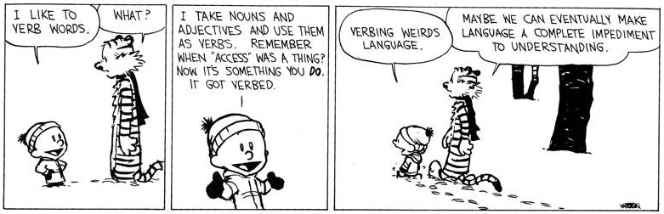
Closed vs. Open Class
Closed class categories are composed of a small, fixed set of grammatical function words for a given language.
  Pronouns, Prepositions, Modals, Determiners, Particles, Conjunctions
Open class categories have large number of words and new ones are easily invented.
  Nouns (Googler, futon, iPad), Verbs (Google, futoning), Adjectives (geeky), Abverb (chompingly)

Slide 27
https://xkcd.com/1443/

Slide 28
Part of speech tagging
Annotate each word in a sentence with a part-of-speech marker
Lowest level of syntactic analysis
John saw the saw and decided to take it to the table.
NNP VBD DT NN CC VBD TO VB PRP IN DT NN

Slide 29
Ambiguity in POS Tagging
  I like candy.
  Time flies like an arrow.
VBP
(verb, non-3rd person, singular, present)
IN
(preposition)
Does “like” play the same role (POS) in these sentences?

Slide 30
Ambiguity in POS Tagging
  I bought it at the shop around the corner.
  I never got around to getting the car.
  The cost of a new Prius is around $25K.
IN
(preposition)
RP
(particle… on, off)
RB
(adverb)
Does “around” play the same role (POS) in these sentences?

Slide 31
Ambiguity in POS tagging
Like most language components, the challenge with POS tagging is ambiguity
Brown corpus analysis
  11.5% of word types are ambiguous (this sounds promising!), but…
  40% of word appearances are ambiguous
  Unfortunately, the ambiguous words tend to be the more frequently used words

Slide 32
How hard is it?
If I told you had a POS tagger that achieved 90% accuracy would you be impressed?
  Shouldn’t be… just picking the most frequent POS for a word gets you this
What about a POS tagger that achieves 93.7%?
  Still probably shouldn’t be… only need to add a basic module for handling unknown words
What about a POS tagger that achieves 100%?
  Should be suspicious… humans only achieve ~97%
  Probably overfitting (or cheating!)

Slide 33
POS Tagging Approaches
Rule-Based: Human crafted rules based on lexical and other linguistic knowledge
Learning-Based: Trained on human annotated corpora like the Penn Treebank
  Statistical models: Hidden Markov Model (HMM), Maximum Entropy Markov Model (MEMM), Conditional Random Field (CRF), log-linear models, support vector machines (SVMs), neural networks
  Rule learning: Transformation Based Learning (TBL)
The book discusses some of the more common approaches
Many publicly available:
  http://nlp.stanford.edu/links/statnlp.html
  (lists 15 different ones mostly publicly available!)
  http://www.coli.uni-saarland.de/~thorsten/tnt/

Slide 34
Constituency
Parts of speech can be thought of as the lowest level of syntactic information
Groups words together into categories
likes to eat candy.
What can/can’t go here?

Slide 35
Constituency
likes to eat candy.
nouns
determiner nouns
Dave
Prof Kauchak
Dr. Suess
The man
The boy
The cat
determiner nouns +
pronouns
The man that I saw
The boy with the blue pants
The cat in the hat
He
She
They

Slide 36
Constituency
Words in languages tend to form into functional groups (parts of speech)
Groups of words (aka phrases) can also be grouped into functional groups
  often some relation to parts of speech
  though, more complex interactions
These phrase groups are called constituents

Slide 37
Common constituents
He likes to eat candy.
noun phrase
verb phrase
The man in the hat ran to the park.
noun phrase
verb phrase

Slide 38
Common constituents
The man in the hat ran to the park.
noun
phrase
prepositional phrase
prepositional phrase
noun phrase
verb phrase

Slide 39
Common constituents
The man in the hat ran to the park.
noun
phrase
prepositional phrase
noun
phrase
noun phrase
prepositional phrase
verb phrase

Slide 40
Syntactic structure
Hierarchical: syntactic trees
S
NP
VP
PP
PP
non-terminals
NP
NP
NP
DT NN IN DT NN VBD IN DT NN
parts of speech
The man in the hat ran to the park.
terminals (words)

Slide 41
Syntactic structure
(S (NP (NP (DT the) (NN man)) (PP (IN in) (NP (DT the) (NN hat)))) (VP (VBD ran) (PP (TO to (NP (DT the) (NN park))))))
S
NP
VP
PP
PP
NP
NP
NP
DT NN IN DT NN VBD IN DT NN
The man in the hat ran to the park.

Slide 42
Syntactic structure
(S (NP (NP (DT the) (NN man)) (PP (IN in) (NP (DT the) (NN hat)))) (VP (VBD ran) (PP (TO to (NP (DT the) (NN park))))))
(S
(NP
(NP (DT the) (NN man))
(PP (IN in)
(NP (DT the) (NN hat))))
(VP (VBD ran)
(PP (TO to)
(NP (DT the) (NN park))))))

Slide 43
Syntactic structure
A number of related problems:
  Given a sentence, can we determine the syntactic structure?
  Can we determine if a sentence is grammatical?
  Can we determine how likely a sentence is to be grammatical? to be an English sentence?
  Can we generate candidate, grammatical sentences?

Slide 44
Grammars
What is a grammar (3rd grade again…)?

Slide 45
Grammars
Grammar is a set of structural rules that govern the composition of sentences, phrases and words
Lots of different kinds of grammars:
  regular
  context-free
  context-sensitive
  recursively enumerable
  transformation grammars

Slide 46
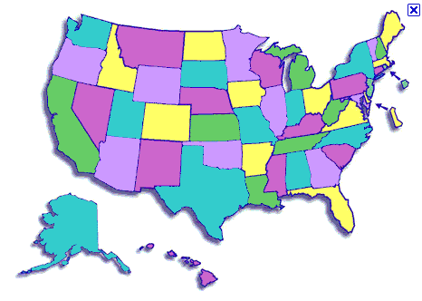
States
What is the capitol of this state?
Jefferson City (Missouri)

Slide 47
Context free grammar
How many people have heard of them?
Look like:
S → NP VP
left hand side
(single symbol)
right hand side
(one or more symbols)

Slide 48
Formally…
G = (NT, T, P, S)
NT: finite set of nonterminal symbols
T: finite set of terminal symbols, NT and T are disjoint
P: finite set of productions of the form
  A → α, A ∈ NT and α ∈ (T ∪ NT)*
S ∈ NT: start symbol

Slide 49
CFG: Example
Many possible CFGs for English, here is an example (fragment):
  S → NP VP
  VP → V NP
  NP → DetP N | DetP AdjP N
  AdjP → Adj | Adv AdjP
  N → boy | girl
  V → sees | likes
  Adj → big | small
  Adv → very
  DetP → a | the
Notes:
| is shorthand

Slide 50
CFG: Example
Many possible CFGs for English, here is an example (fragment):
  S → NP VP
  VP → V NP
  NP → DetP N | DetP AdjP N
  AdjP → Adj | Adv AdjP
  N → boy | girl
  V → sees | likes
  Adj → big | small
  Adv → very
  DetP → a | the
Formal grammar definition:
NT: {S, NP, VP, DetP, N, AdjP, Adj, Adv}
T: {boy, girl, sees, likes, big, small, very, a, the}
P:
S: S
Often just specify the production rules
Notes:
| is shorthand

Slide 51
Grammar questions
Can we determine if a sentence is grammatical?
Given a sentence, can we determine the syntactic structure?
Can we determine how likely a sentence is to be grammatical? to be an English sentence?
Can we generate candidate, grammatical sentences?
Which of these can we answer with a CFG? How?

Slide 52
Grammar questions
Can we determine if a sentence is grammatical?
  Is it accepted/recognized by the grammar
  Applying rules right to left, do we get the start symbol?
Given a sentence, can we determine the syntactic structure?
  Keep track of the rules applied…
Can we determine how likely a sentence is to be grammatical? to be an English sentence?
  Not yet… no notion of “likelihood” (probability)
Can we generate candidate, grammatical sentences?
  Start from the start symbol, randomly pick rules that apply (i.e. left hand side matches)

