Slide 1
https://xkcd.com/547/

Slide 2
Text Simplification: Improving Information Accessibility
David Kauchak Pomona College
Collaborators: Will Coster, Dan Feblowitz, Melissa Grueter, Colby Horn, Gondy Leroy, Katie Manduca and Max Schwarzer

Slide 3
Admin
Ethics discussion on Wednesday: read papers beforehand
Project status update due Wednesday
Next Monday, Quiz #4 (comprehensive)
Next Wednesday, presentations

Slide 4
Text simplification
Any intelligent fool can make things bigger, more complex, and more violent. It takes a touch of genius and a lot of courage to move in the opposite direction.
E. F. Schumacher
Goal:
Reduce the reading complexity of a sentence by incorporating more accessible vocabulary and sentence structure while maintaining the content.

Slide 5
Text simplification
Any intelligent fool can make things bigger, more complex, and more violent. It takes a touch of genius and a lot of courage to move in the opposite direction.
E. F. Schumacher
Simpler is better.

Slide 6
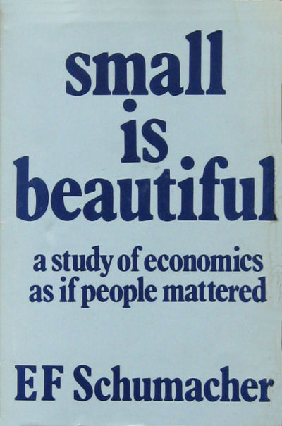
Text simplification

Slide 7
Simplify
Alfonso Perez Munoz, usually referred to as Alfonso, is a former Spanish footballer, in the striker position.
The reverse process, producing electrical energy from mechanical energy, is accomplished by a generator or dynamo.

Slide 8
Text simplification: real examples
Alfonso Perez Munoz, usually referred to as Alfonso, is a former Spanish footballer, in the striker position.
Alfonso Perez is a former Spanish football player.

Slide 9
Text simplification: real examples
Alfonso Perez Munoz, usually referred to as Alfonso, is a former Spanish footballer, in the striker position.
Alfonso Perez is a former Spanish football player.
Deletion

Slide 10
Text simplification: real examples
Alfonso Perez Munoz, usually referred to as Alfonso, is a former Spanish footballer, in the striker position.
Alfonso Perez is a former Spanish football player.
Rewording

Slide 11
Text simplification: real examples
Endemic types or species are especially likely to develop on islands because of their geographical isolation.
Endemic types are most likely to develop on islands because they are isolated.

Slide 12
Text simplification: real examples
Endemic types or species are especially likely to develop on islands because of their geographical isolation.
Endemic types are most likely to develop on islands because they are isolated.
Deletion

Slide 13
Text simplification: real examples
Endemic types or species are especially likely to develop on islands because of their geographical isolation.
Endemic types are most likely to develop on islands because they are isolated.
Rewording

Slide 14
Text simplification: real examples
The reverse process, producing electrical energy from mechanical energy, is accomplished by a generator or dynamo.
A dynamo or an electric generator does the reverse: it changes mechanical movement into electric energy.

Slide 15
Text simplification: real examples
The reverse process, producing electrical energy from mechanical energy, is accomplished by a generator or dynamo.
A dynamo or an electric generator does the reverse: it changes mechanical movement into electric energy.

Slide 16
Text simplification: real examples
The reverse process, producing electrical energy from mechanical energy, is accomplished by a generator or dynamo.
A dynamo or an electric generator does the reverse: it changes mechanical movement into electric energy.
Deletion and rewording
Insertion and reordering
Notes:
Text simplification can be challenging
-- text to text application
-- full range of text manipulation operations
-- a range of

Slide 17
Goals today
Introduce the text simplification problem
Highlight why text simplification is important
Show some examples of text simplification approaches
Give one perspective on CS research

Slide 18
Why text simplification?
A lot of text data is available
Problem: much of this content is written above the reading level of many people
Notes:
on average, half of the people read at a below average reading level ☺
numbers:
tens of billions of web pages
English Wikipedia has ~5.9 million articles
half a billion tweets/day
billions of e-mails/day

Slide 19
Adult literacy
Below Basic: no more than the most simple and concrete literacy skills
Basic: can perform simple and everyday literacy activities
Intermediate: can perform moderately challenging literacy activities
Proficient: can perform complex and challenging literacy activities
http://nces.ed.gov/naal/kf_demographics.asp
Notes:
National Center for Education Statistics: National Assessment of Adult Literacy
New study in 2013: https://nces.ed.gov/pubs2016/2016039rev.pdf
- 18% at level 1 or below: “read relatively short digital or print continuous, non-continuous, or mixed texts to locate a single piece of information that is identical to or synonymous with the information given in the question or directive.”
- 50% at level 2 or below: “Tasks at this level require respondents to make matches between the text and information, and may require paraphrasing or low-level inferences. Some competing pieces of information may be present.”

Slide 20
Why text simplification?
Broader availability of standard text resources
language learners
people with aphasia or other cognitive disabilities
children
Broader availability of domain-specific text resources
health and medical documents
90M Americans (over a quarter!) do not have sufficient health literacy to understand currently provided materials
Cost of low health literacy is estimated to be hundreds of billions
academic papers
legal documents
Notes:
~14% of Americans speak a language besides English as their native language (http://nces.ed.gov/pubs93/93275.pdf)
~20% of Americans speak a language other than English at home

Slide 21
Goals today
Introduce the text simplification problem
Highlight why text simplification is important
Show some examples of text simplification approaches
Give one perspective on CS research

Slide 22
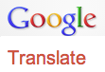
Spectrum of solutions
Focus on these types of approaches today
writer assist tools/resources
readability formulas
simple word lists
flag difficult text sections
simplification thesauruses
rule-based with human verification
…
Simplify
manual
semi-automated
fully automated

Slide 23
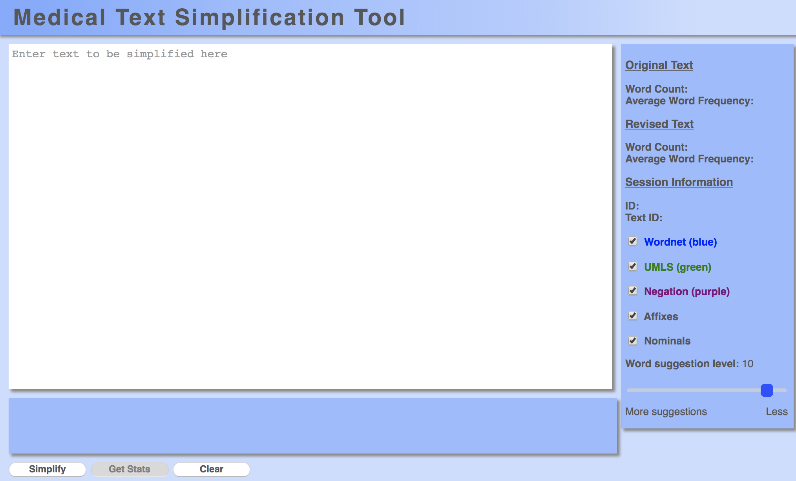
Writer assist tool
Notes:
- Web-based tool

Slide 24
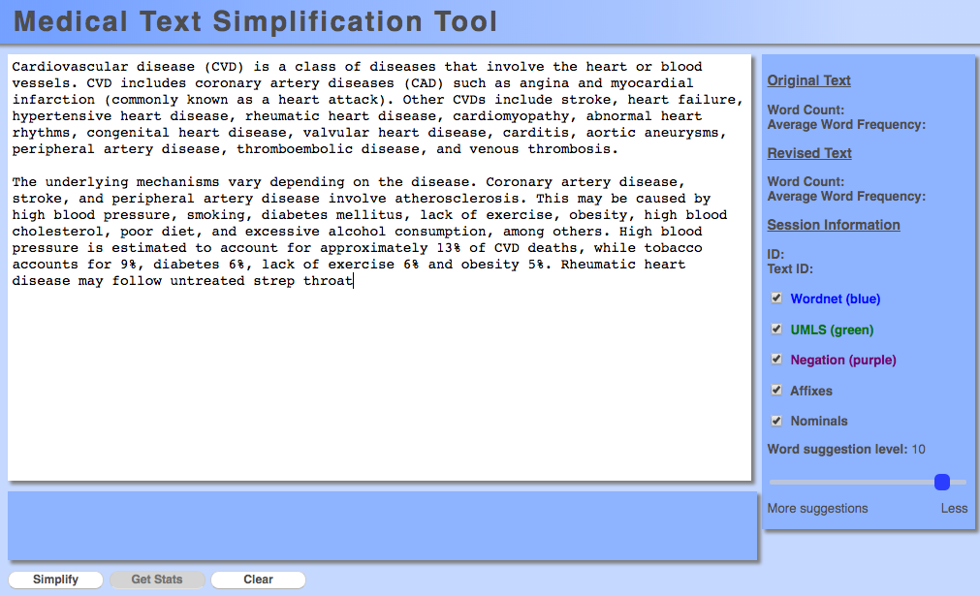
Writer assist tool

Slide 25
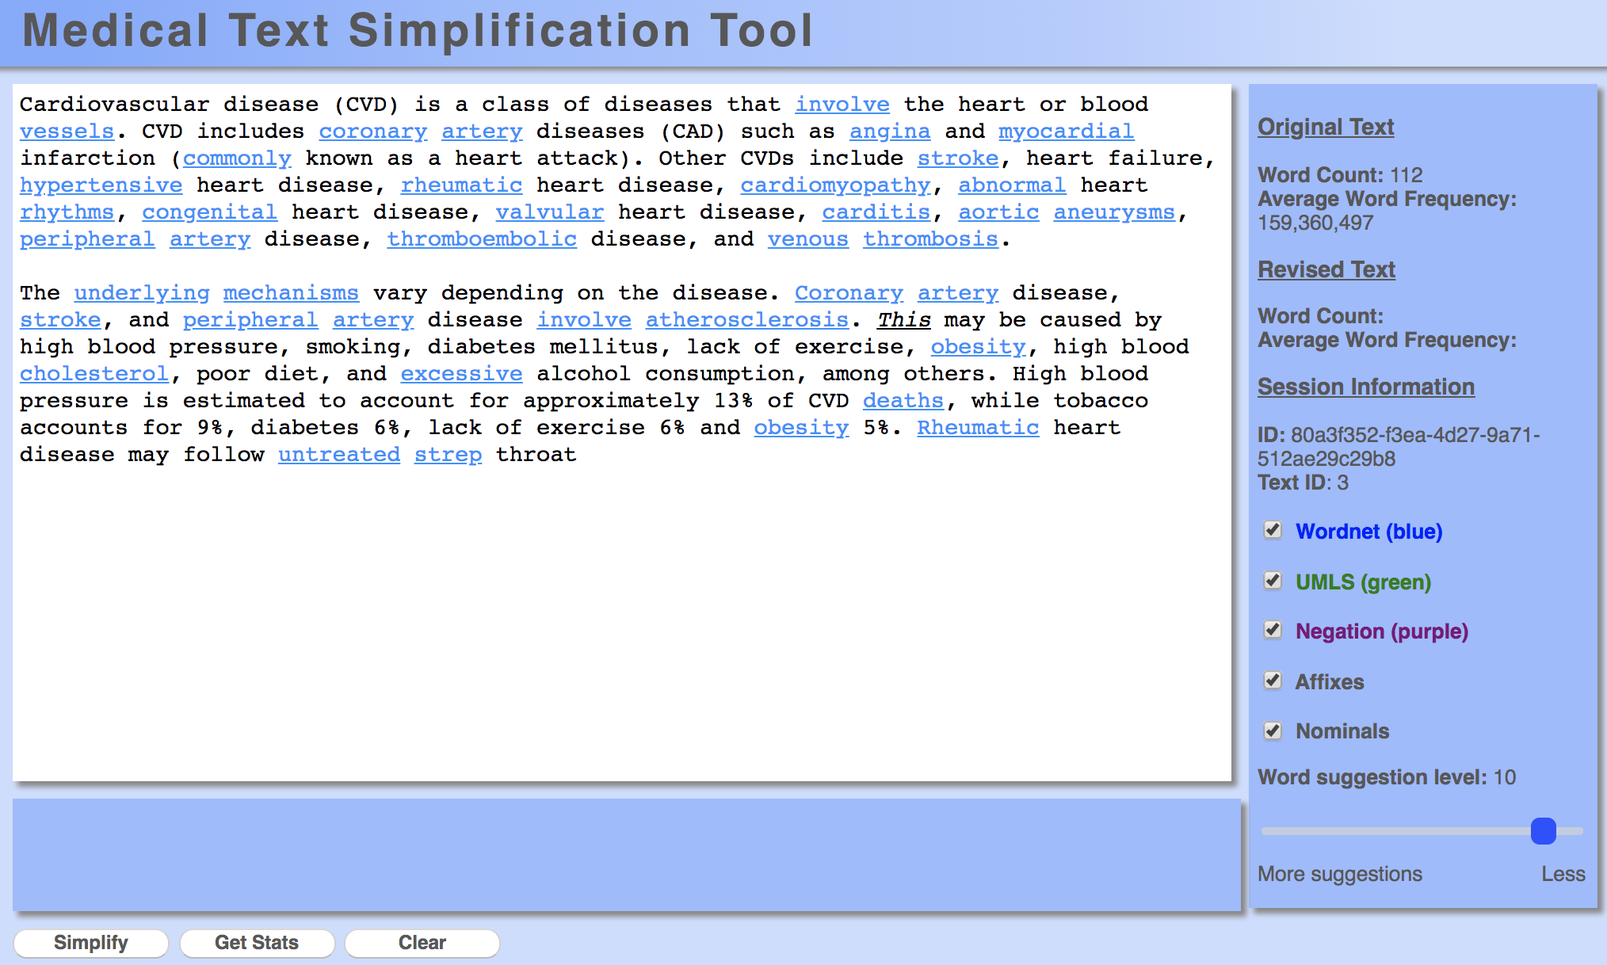
Writer assist tool

Slide 26
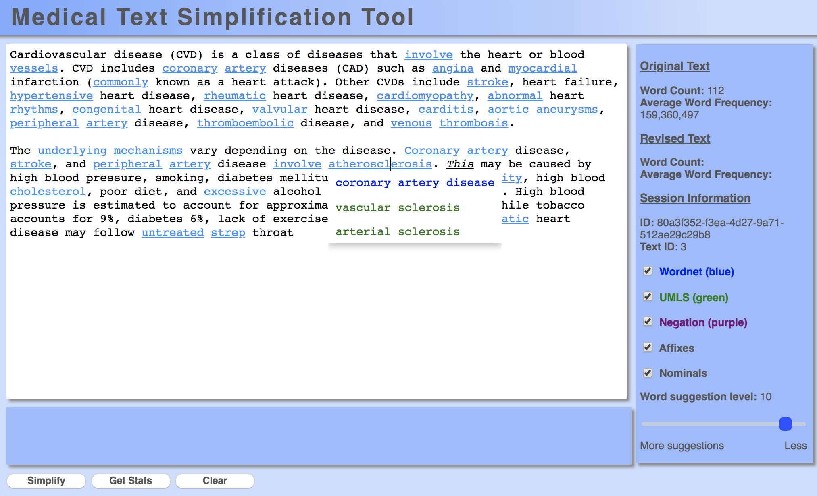
Writer assist tool

Slide 27
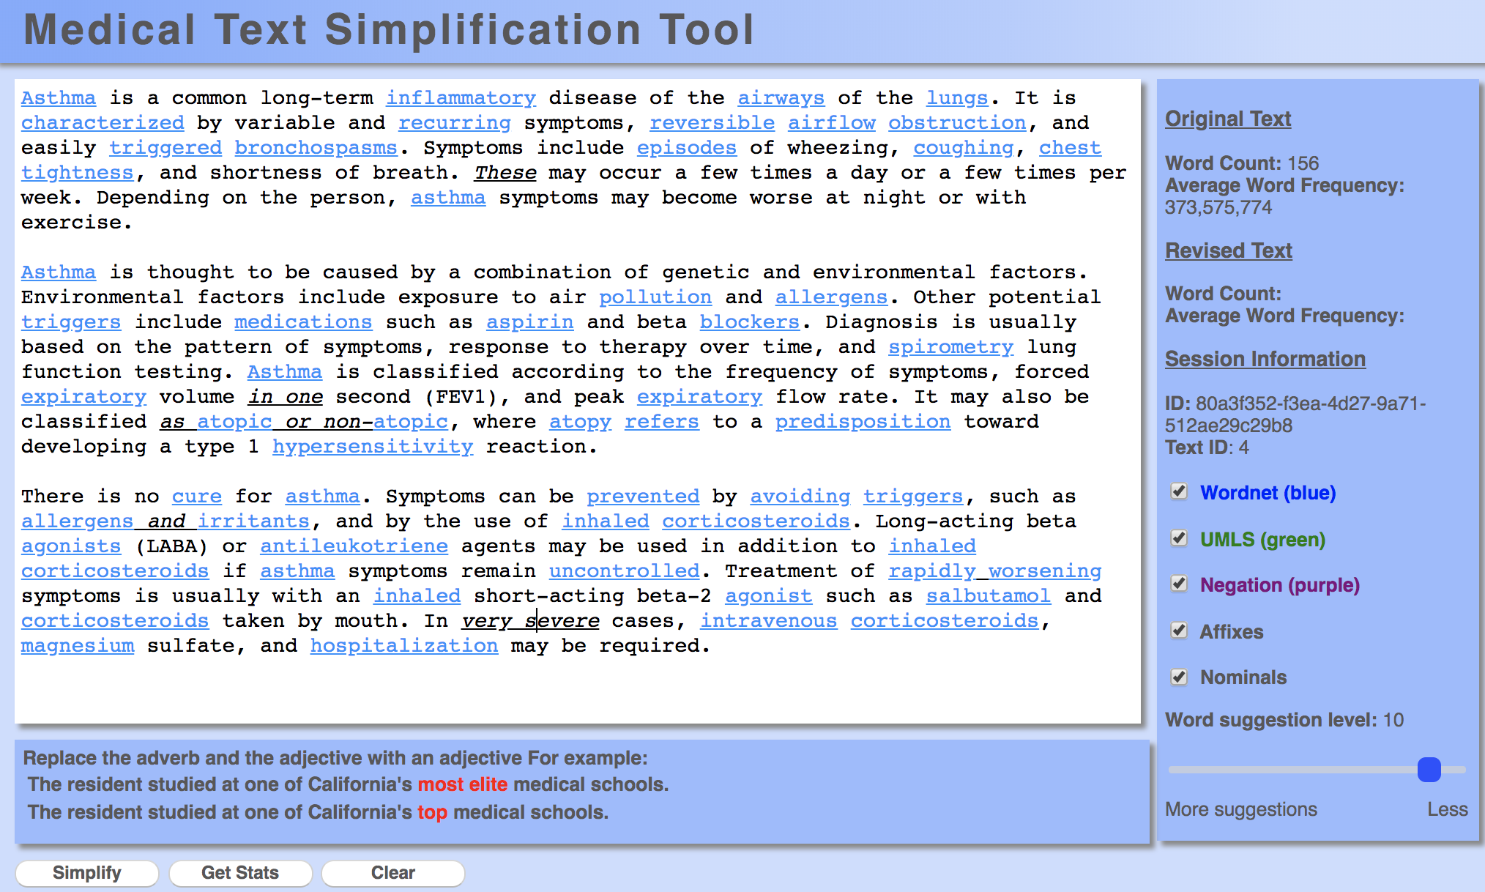
Writer assist tool

Slide 28
How do we identify difficult words?
Notes:
Historically, this has been done either by a person or using a pre-defined word list.
Every simplification component utilized in the tool has been experimentally validated with multiple types of studies, including corpus analyses and user studies.

Slide 29
Quantifying word difficulty
Hypothesis:
The more often a person sees a word, the more familiar they are with that word, and therefore the simpler it is
Proxy for “how often you see a word”:
Frequency on the web!

Slide 30
Validating the frequency hypothesis
Google: ~13M unique “words”
randomly pick 25 words from each bin
sort based on frequency
275 words
Does the frequency of these words relate to people’s knowledge/familiarity with these words?
11 bins based on frequency:
1%, 10%, 20%, …, 100%

Slide 31
Validating the frequency hypothesis
Google: ~13M unique “words”
Annotate with definition
randomly pick 25 words from each bin
275 words
11 bins based on frequency:
1%, 10%, 20%, …, 100%
Notes:
Google n-grams released in 2006
Other languages released more recently

Slide 32
Validating the frequency hypothesis
marmorean:
crimson-and-grey songbird that inhabits town walls and mountain cliffs of southern Eurasia and northern Africa
of or relating to or characteristic of marble
the most common protein in muscle
a color or shade

Slide 33
Validating the frequency hypothesis
marmorean:
crimson-and-grey songbird that inhabits town walls and mountain cliffs of southern Eurasia and northern Africa
of or relating to or characteristic of marble
the most common protein in muscle
a color or shade
random definitions from other words in data set

Slide 34
Study participants
50 participants per word * 275 words =
13,750 total annotations!

Slide 35
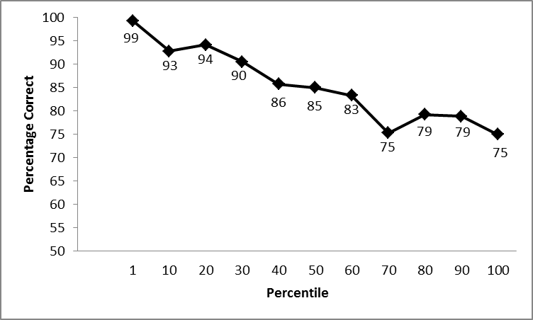
Frequency correlates with understanding!
more frequent
Frequency percentile
Notes:
results averaged per bin

Slide 36
How do we identify difficult words?
Notes:
Historically, this has been done either by a person or using a pre-defined word list.
Every simplification component utilized in the tool has been experimentally validated with multiple types of studies, including corpus analyses and user studies.

Slide 37
Spectrum of solutions
readability formulas
simple word lists
flag difficult text sections
simplification thesauruses
rule-based with human check
…
Simplify
manual
semi-automated
fully automated

Slide 38
Most modern approaches are data-driven
unsimplified
simplified
Alfonso Perez Munoz, usually referred to as Alfonso, is a former Spanish footballer, in the striker position.
Alfonso Perez is a former Spanish football player.
learning
The reverse process, producing electrical energy from mechanical, energy, is accomplished by a generator or dynamo.
A dynamo or an electric generator does the reverse: it changes mechanical movement into electric energy.
I find forest colored chicken ovum and pork rump to be dietarily disturbing.
I do not like green eggs and ham.
…
Given data (paired sentences)
learn a simplification model
Notes:
not the only way to pose the problem
-- could not require any data (for example, based on hand-written rules)
-- could also utilize monolingual text

Slide 39
Simple English Wikipedia
Notes:
150K articles

Slide 40
Example data source: Wikipedia
Automatically
aligned
60K articles pairs
~200K aligned sentence pairs

Slide 41
From aligned documents to aligned sentences

Slide 42
From aligned documents to aligned sentences

Slide 43
From aligned documents to aligned sentences
How could you do this?

Slide 44
Simplification approaches
Many different data-driven approaches
Lexical (change a word at a time)
Phrasal (change phrases)
Syntactic (use grammatical structure)
Neural networks

Slide 45
Lexical simplification
The ACL was established in 1962.
The ACL was started in 1962.
Simplification is accomplished by changing one word (or phrase) at a time.

Slide 46
Lexical simplification
The ACL was established in 1962.
The ACL was started in 1962.
How can we learn to do this from our data?

Slide 47
Preprocessing
The first school was established in 1857
The first school was started in 1857
The district was established in 1993 by merging …
The district was made in 1993 by joining …
Automatically word-align sentences
Notes:
Starting with 200K aligned sentence pairs

Slide 48
Extract candidate simplifications
The first school was established in 1857
The first school was started in 1857
The district was established in 1993 by merging …
The district was made in 1993 by joining …
extract aligned candidate word pairs:
different words
same part of speech
not in a list of common words (stoplist)

Slide 49
Simplification rules learned
word
candidate simplifications
abolish remove, replace, stop
established began, made, settled, started
merging becoming, joining
…
Learned simplification rules for 14,478 words
On average 2.25 candidate simplifications

Slide 50
Not all rules apply in all contexts
The ACL was established in 1962.
The ACL was began in 1962.
The ACL was made in 1962.
The ACL was settled in 1962.
The ACL was started in 1962.

Slide 51
Data for learning context

Slide 52
Data for learning context
?

Slide 53
Collected data for 500 words
# of people that suggested simplification
(out of 50)
simplification
obtained 17
gathered 9
gotten 8
grabbed 4
acquired 2
made 2
…
procured
Notes:
Did this for 500 words and 50 people per word

Slide 54
Learning to apply rules
500 examples
Food is procured with its suckers and then crushed using its tough “beak” of chitin.
1.
Food is obtained with its suckers and then crushed using its tough “beak” of chitin.
2.
Food is gathered with its suckers and then crushed using its tough “beak” of chitin.
3.
Food is gotten with its suckers and then crushed using its tough “beak” of chitin.
4.
Food is grabbed with its suckers and then crushed using its tough “beak” of chitin.
…

Slide 55
Learning a ranker
1.
Food is obtained with its suckers and then crushed using its tough “beak” of chitin.
2.
Food is gathered with its suckers and then crushed using its tough “beak” of chitin.
3.
Food is gotten with its suckers and then crushed using its tough “beak” of chitin.
4.
Food is grabbed with its suckers and then crushed using its tough “beak” of chitin.
ranking examples
rerank candidates in the context of the sentence
machine learning
…

Slide 56
Applying the ranker
The ACL was began in 1962.
The ACL was made in 1962.
The ACL was settled in 1962.
The ACL was started in 1962.
rerank candidates in the context of the sentence
The ACL was started in 1962.
The ACL was made in 1962.
The ACL was began in 1962.
The ACL was settled in 1962.

Slide 57
Results
Previous approach:
Coverage: 85% (of the words that could be changed)
Accuracy: 54% (of the suggestions are correct)
Our approach:
Coverage: 86%
Accuracy: 76%
Notes:
A slight bump in coverage
Significantly higher quality suggestions

Slide 58
Simplification approaches
Many different data-driven approaches
Lexical (change a word at a time)
Phrasal (change phrases)
Syntactic (use grammatical structure)
Neural networks

Slide 59
Phrase-based sentence simplification
I disdain green ham with green eggs
Notes:
this is the approach for phrase-based machine translation
the actual approach is a bit more involved, but this is the high-level idea
phrase-based approaches are roughly state of the art. Used by google’s translation approach.

Slide 60
Phrase-based sentence simplification
I disdain
green ham
with
green eggs
Unsimplified sentence is probabilistically broken into phrases
“phrase” is a sequence of words
Notes:
this is the approach for phrase-based machine translation
the actual approach is a bit more involved, but this is the high-level idea
phrase-based approaches are roughly state of the art. Used by google’s translation approach.

Slide 61
Phrase-based sentence simplification
I disdain
green ham
with
green eggs
I do not like
ham
and
green eggs
Each phrase is probabilistically simplified
Notes:
this is the approach for phrase-based machine translation
the actual approach is a bit more involved, but this is the high-level idea
phrase-based approaches are roughly state of the art. Used by google’s translation approach.

Slide 62
Phrase-based sentence simplification
I disdain
green ham
with
green eggs
I do not like
green eggs
and
ham
Phrases are probabilistically reordered
Notes:
this is the approach for phrase-based machine translation
the actual approach is a bit more involved, but this is the high-level idea
phrase-based approaches are roughly state of the art. Used by google’s translation approach.

Slide 63
Learned phrase examples
original | simple | probability
ham | ham | 0.7
ham | pork | 0.2
ham | meat | 0.1
…
like to eat a variety | like to eat a variety | 0.5
like to eat a variety | like to eat lots | 0.3
like to eat a variety | like to eat many | 0.2
Learn these aligned phrases and probabilities from the aligned sentences

Slide 64
Phrase-based sentence simplification
I disdain green ham with green eggs
I do not like green eggs and ham
I do not like ham and green eggs
I do not like green eggs and green ham
I do not like green eggs with ham
I do not like eggs with ham
…
Model is probabilistic and considers many, many variations!

Slide 65
Phrase-based sentence simplification
Problem: does not account for phrasal deletion
I disdain the food
green ham
with
green eggs
I do not like
green eggs
and
ham
Notes:
reasons are mostly historical
-- this doesn’t happen much in language translation
-- makes the model more complicated
-- and can make translation more complicated

Slide 66
Phrase-based sentence simplification
Problem: does not account for phrasal deletion
I disdain
the food green ham
with
green eggs
I do not like
green eggs
and
ham
Notes:
reasons are mostly historical
-- this doesn’t happen much in language translation
-- makes the model more complicated
-- and can make translation more complicated

Slide 67
Phrase-based sentence simplification
We add phrasal deletion
I disdain
the food
green ham
with
green eggs
I do not like
green eggs
and
ham
Each phrase is probabilistically simplified
Phrases can also be probabilistically deleted

Slide 68
Deleted phrases
0.5% of learned phrases are deletions
Phrase-table entry | probability of deletion
, the of the or however , the city of generally approximately , however , , etc | 0.057 0.033 0.0015 0.0014 0.00095 0.00034 0.00033 0.00025 0.00022 0.00013

Slide 69
Qualitatively: Phrase-based
Critical reception for The Wild has been negative.
Reviews for The Wild has been negative.
rewording

Slide 70
Qualitatively: Phrase-based
Bauska is a town in Bauska county, in the Zemgale region of southern Latvia.
Bauska is a town in Bauska county, in the region of Zemgale.
rewording/reordering, deletion

Slide 71
Qualitatively: Phrase-based
Nicolas Anelka is a French footballer who currently plays as a striker for Chelsea in the English premier league.
Nicolas Anelka is a French football player. He plays for Chelsea.
rewording, deletion, sentence splitting

Slide 72
Qualitatively: Phrase-based
Each edge of a tesseract is of the same length.
Same edge of the same length.

Slide 73
Qualitatively: Previous approach
He often recuperated at Menton, near Nice, France, where he eventually died on 1892 January 31.
He died.
Notes:
T3 in general tended to be overly aggressive with deletion
averaged 13 words per sentence, as compared to 21 words for the human simplifications

Slide 74
Quantitatively
Compared to three previous systems:
Pros:
phrase-based approach tends to be more similar to human simplifications than other approaches
deletion improves the quality
model is fairly easy to understand
Cons:
tends to only make minor changes to the sentences
some disfluencies due to long distance dependencies

Slide 75
Simplification approaches
Many different data-driven approaches
Lexical (change a word at a time)
Phrasal (change phrases)
Syntactic (use grammatical structure)
Neural networks

Slide 76
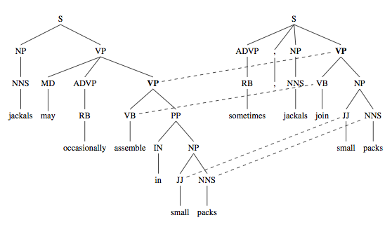
Syntax-based approach
Rather than operating on phrases, operate on grammar trees

Slide 77
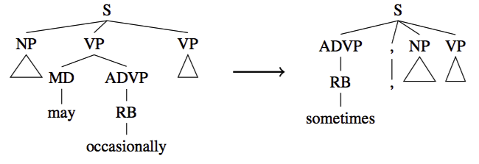
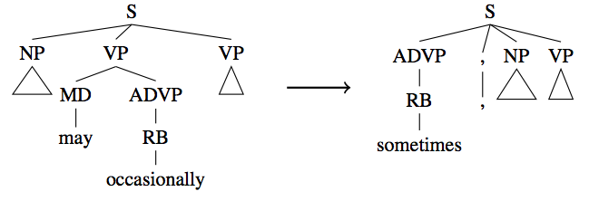
Learn probabilistic, syntax-based rules
They may occasionally eat
sometimes, they eat

Slide 78
Learn probabilistic, syntax-based rules
The scary cats from the park may occasionally walk around on two legs
sometimes, the scary cats from the park walk around on two legs

Slide 79
An aside
sometimes, the scary cats from the park walk around on two legs

Slide 80
A syntax-based approach
Our life is frittered away by detail.
Simplify, simplify.
- H.D. Thoreau
Our life is frittered away.
- Lab Machine 227-31

Slide 81
Qualitatively: syntax-based
Overall Bamberga is the tenth brightest main belt asteroid after, in order, Vesta, Pallas, Ceres, Iris, Hebe, Juno, Melpomene, Eunomia and Flora.
Syntax:
Overall Bamberga is the tenth brightest main belt asteroid.
Phrase-based: (same as input)

Slide 82
Quantitatively
Compared to phrase-based:
Pros:
Much more significant simplifications
More grammatical
Simpler
Cons:
Was sometimes aggressive about removing content

Slide 83
Goals today
Introduce the text simplification problem
Highlight why text simplification is important
Show some examples of text simplification approaches
Give one perspective on CS research
Notes:
CS is a very diverse field
All of us do very different things (we don’t even attend the same conferences!)

Slide 84
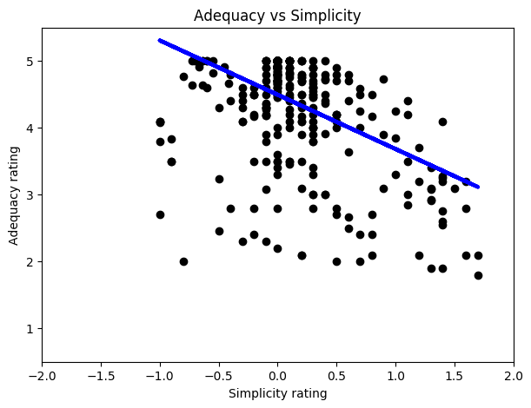
Future thoughts/challenges
What is simple?
different domains may have different notion
how do we measure/evaluate simplicity

Slide 85
Collaborators!
Will Coster (Pomona) Dan Feblowitz (Pomona) Melissa Grueter (Pomona)
Colby Horn (Middlebury)
Katie Manduca (Middlebury)
Max Schwarzer (Pomona)
Mui Tanprasert (Pomona)
Gondy Leroy (University of Arizona)

Slide 86
Course recap
Corpus analysis
Regex
Language modeling (smoothing!)
Linguistics basics
Learning grammars PCFGs
Parsing

Slide 87
Course recap
Text similarity
Word similarity
Machine translation
Word alignment
Machine learning (Naïve Bayes, SVMs)
Neural nets (basics, Word2Vec, large language models)

Slide 88
Course recap
HashMaps/dictionaries
Java
How to count words! ☺

Slide 89
Course recap
How many lines of code?
How many slides?
Notes:
1429 slides!
3646 lines of code!

