Slide 1
large language models
David Kauchak CS 159 – Spring 2023

Slide 2
Admin
Final project proposals due today
Start working on the projects!
Log hours that you work
Mentor hours this week?

Slide 3
A Single Neuron/Perceptron
Input x₁
Each input contributes:
x_{i} * w_{i}
Weight w₁
Weight w₂
Input x₂
Output y
threshold function
Input x₃
Weight w₃
Weight w₄
Input x₄

Slide 4
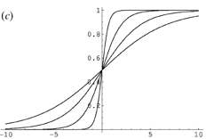
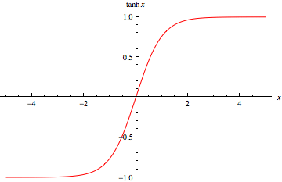
Activation functions
hard threshold:
sigmoid
tanh x
$$g\left(in\right)= \left\{\begin{matrix}1 & if in≥T \\ 0 & otherwise\end{matrix}\right.$$
Notes:
Allow us to model more than just 0/1 outputs
Differentiable! (this will come into play in a minute)

Slide 5
Many other activation functions
Rectified Linear Unit
Softmax (for probabilities)

Slide 6
Neural network
inputs
Individual perceptrons/neurons
Notes:
- often we view a slice of them

Slide 7
Neural network
some inputs are provided/entered
inputs
Notes:
- often we view a slice of them

Slide 8
Neural network
inputs
each perceptron computes and calculates an answer
Notes:
- often we view a slice of them

Slide 9
Neural network
inputs
those answers become inputs for the next level
Notes:
- often we view a slice of them

Slide 10
Neural network
inputs
finally get the answer after all levels compute
Notes:
- often we view a slice of them

Slide 11
Recurrent neural networks
inputs
hidden layer(s)
output

Slide 12
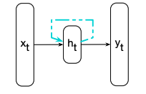
Recurrent neural nets
x_{t} = input
h_{t} = hidden layer output
y_{t} = output
Figure 9.1 from Jurafsky and Martin

Slide 13
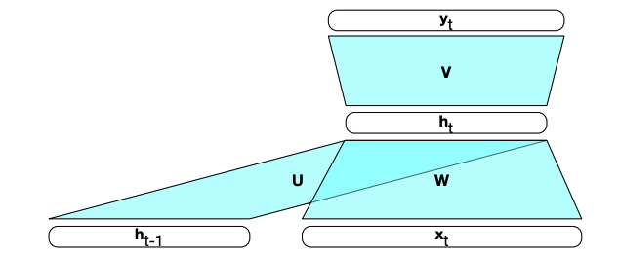
Recurrent neural networks
x_{t} = input
h_{t-1} = hidden layer output from previous input
h_{t} = hidden layer output
y_{t} = output
Figure 9.2 from Jurafsky and Martin

Slide 14
Recurrent neural networks
x₁
Say you want the output of x1, x2, x3, ….

Slide 15
Recurrent neural networks
y₁
h₁
x₁

Slide 16
Recurrent neural networks
h₁
x₂

Slide 17
Recurrent neural networks
y₂
h₂
h₁
x₂

Slide 18
Recurrent neural networks
h₂
x₃

Slide 19
Recurrent neural networks
y₃
h₃
h₂
x₃

Slide 20
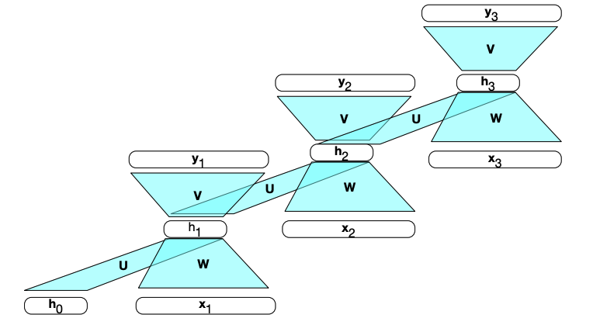
RNNs unrolled
Figure 9.2 from Jurafsky and Martin

Slide 21
Still just a single neural network
U, W and V are the weight matrices
x_{t} = input
h_{t-1} = hidden layer output from previous input
h_{t} = hidden layer output
y_{t} = output
Figure 9.2 from Jurafsky and Martin

Slide 22
RNN language models
How can we use RNNs as language models p(w1, w2, …, wn)?
How do we input a word into a NN?

Slide 23
“One-hot” encoding
For a vocabulary of V words, have V input nodes
All inputs are 0 except the for the one corresponding to the word
0
a
1
apple
apple
…
x_{t}
0
banana
…
0
zebra

Slide 24
RNN language model
…
…
…
0
a
N hidden nodes
V input nodes
1
apple
V output nodes
…
0
banana
…
0
zebra

Slide 25
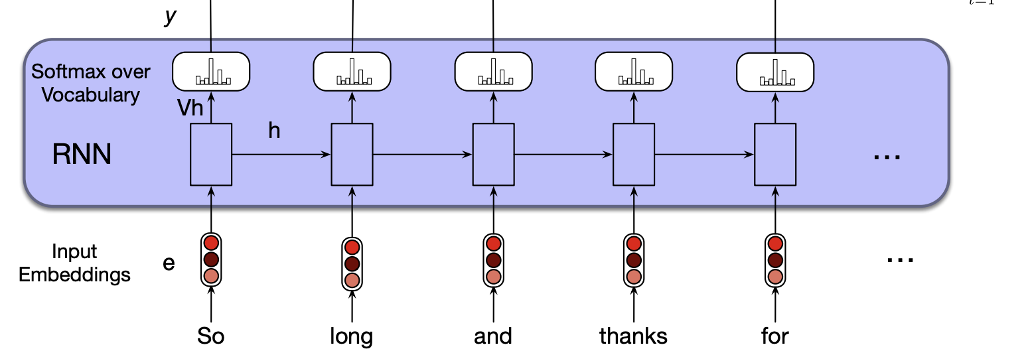
RNN language model
p(w1|<s>)
p(w2|<s> w1)
p(w3|<s> w1 w2)
p(w4|<s> w1 w2 w3)
Softmax = turn into probabilities
Figure 9.6 from Jurafsky and Martin

Slide 26
RNN language model
p(w1|<s>)
p(w2|<s> w1)
p(w3|<s> w1 w2)
p(w4|<s> w1 w2 w3)
Softmax = turn into probabilities
Figure 9.6 from Jurafsky and Martin

Slide 27
RNN language model

Slide 28
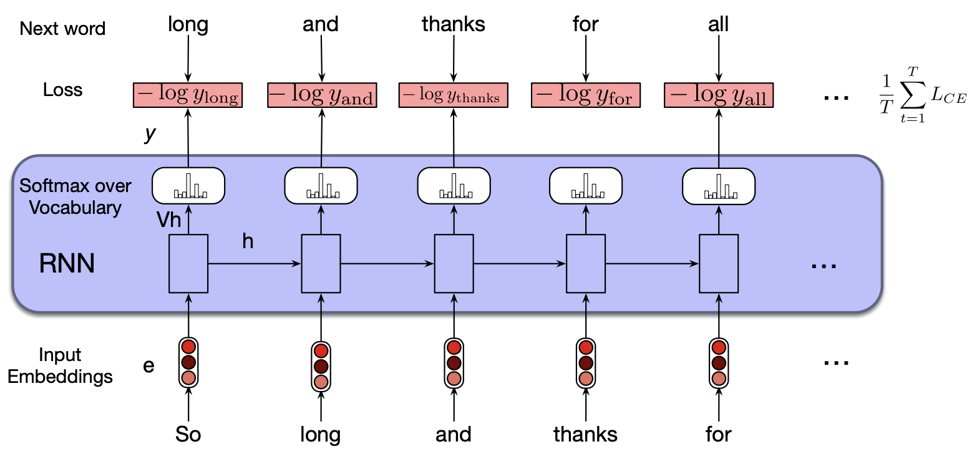
Training RNN LM
Figure 9.6 from Jurafsky and Martin

Slide 29
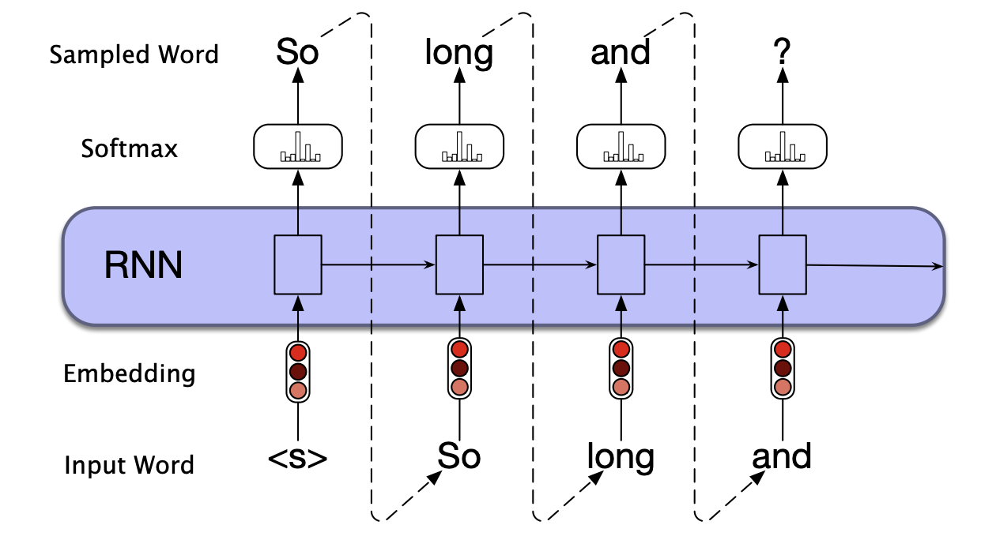
Generation with RNN LM
Figure 9.9 from Jurafsky and Martin

Slide 30
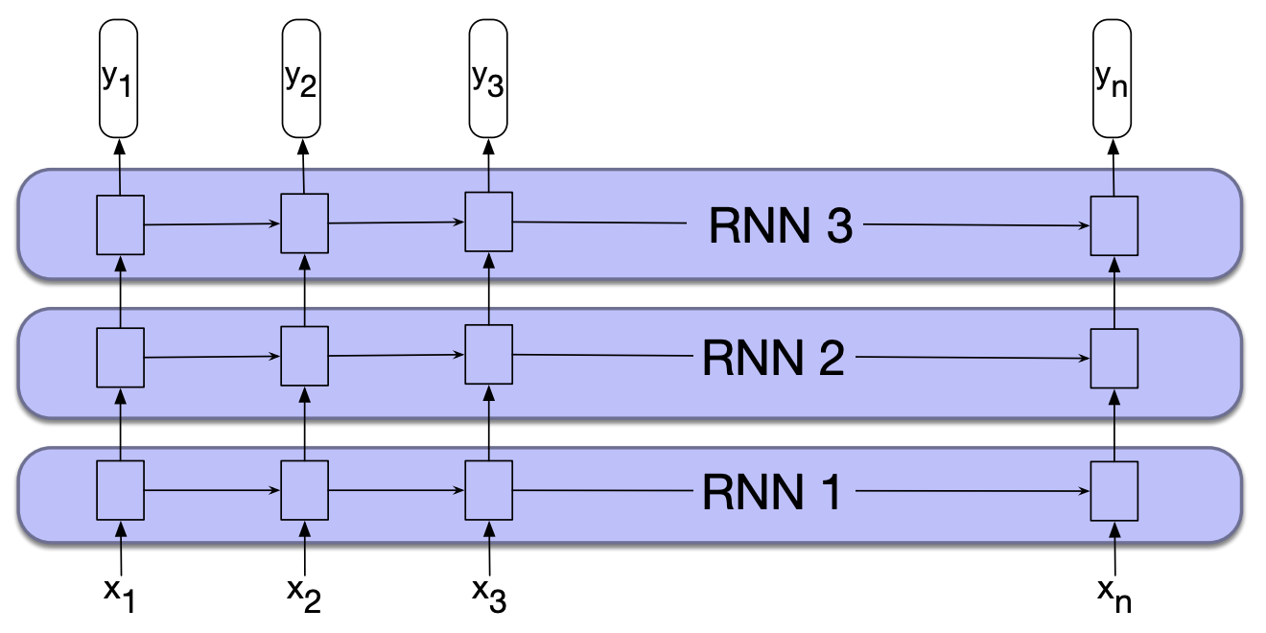
Stacked RNNs
Figure 9.10 from Jurafsky and Martin

Slide 31
Stacked RNNs
Multiple hidden layers
Still just a single network run over a sequence
Allows for better generalization, but can take longer to train and more data!

Slide 32
Challenges with RNN LMs
p(w1|<s>)
p(w2|<s> w1)
p(w3|<s> w1 w2)
p(w4|<s> w1 w2 w3)
What context is incorporated for predicting w_{i}?

Slide 33
Challenges with RNN LMs
p(w1|<s>)
p(w2|<s> w1)
p(w3|<s> w1 w2)
p(w4|<s> w1 w2 w3)
Just like with an n-gram LM, only use previous history.
What are we missing if we’re predicting p(w1, w2, …, wn)?

Slide 34
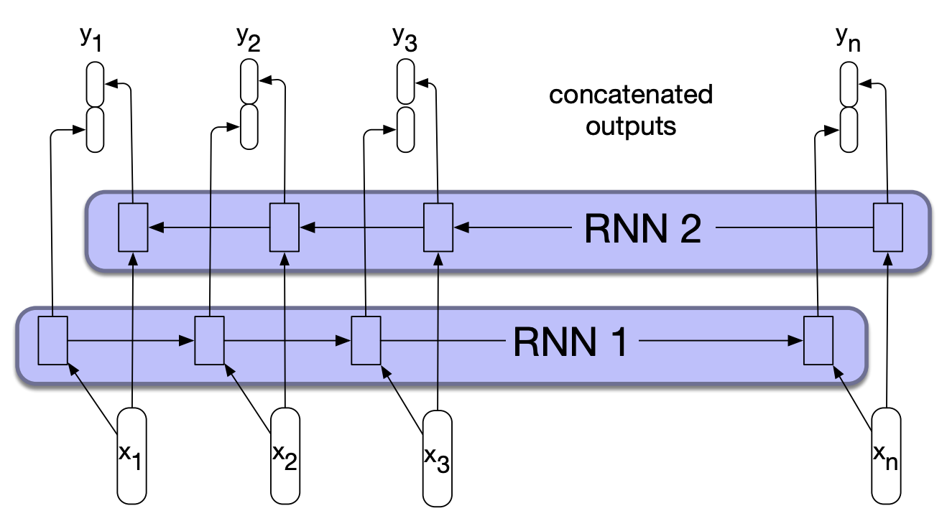
Bidirectional RNN
Normal forward RNN
Figure 9.11 from Jurafsky and Martin

Slide 35
Bidirectional RNN
Normal forward RNN
Figure 9.11 from Jurafsky and Martin

Slide 36
Bidirectional RNN
Backward RNN, starting from the last word
Figure 9.11 from Jurafsky and Martin

Slide 37
Bidirectional RNN
Prediction uses collected information from the words before (left)
and words after (right)
Figure 9.11 from Jurafsky and Martin

Slide 38
Challenges with RNN LMs
p(w1|<s>)
p(w2|<s> w1)
p(w3|<s> w1 w2)
p(w4|<s> w1 w2 w3)
Can we use them for translation (and related tasks)?
Any challenges?

Slide 39
Challenges with RNN LMs
hasta
luega
y
gracias
por
Can we use them for translation (and related tasks)?
Any challenges?

Slide 40
Challenges with RNN LMs
No laila lōʻihi a mahalo no nā mea a pau
Translation isn’t word-to-word
Worse for other tasks like summarization

Slide 41
Encoder-decoder models
Idea:
Process the input sentence (e.g., sentence to be translated) with a network
Represent the sentence as some function of the hidden states (encoding)
Use this context to generate the output
Figure 9.16 from Jurafsky and Martin

Slide 42
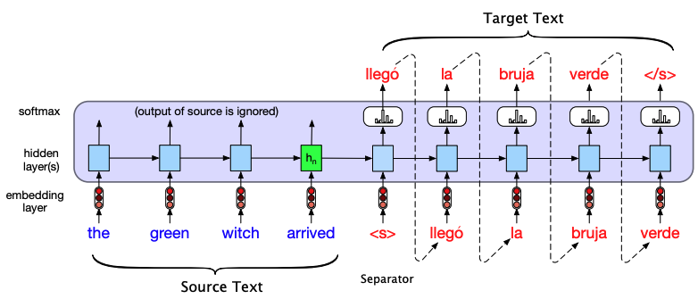
Encoder-decoder models: simple version
The context is the final hidden state of the encoder and is provided as input to the first step of the decoder
Figure 9.17 from Jurafsky and Martin

Slide 43
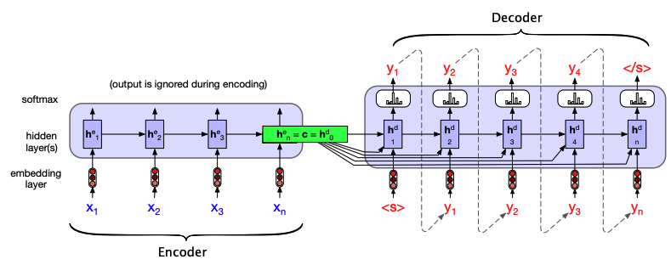
Encoder-decoder models: improved
The context is some combination of all of the hidden states of the encoder
How is this better?
Figure 9.18 from Jurafsky and Martin

Slide 44
Encoder-decoder models: improved
The context is some combination of all of the hidden states of the encoder
Each step of decoding has access to the original, full encoding/context
Figure 9.18 from Jurafsky and Martin

Slide 45
Encoder-decoder models: improved
Even with this model, different encoding steps may care about different parts of the context
Figure 9.18 from Jurafsky and Martin

Slide 46
Encoder-decoder models: improved
Even with this model, different encoding steps may care about different parts of the context
Figure 9.18 from Jurafsky and Martin

Slide 47
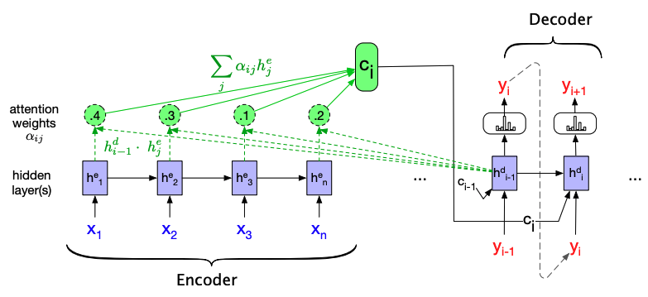
Attention
Context is dependent on where we are in decoding step and the relationship between encoder and decoder hidden states

Slide 48
Attention
Simple version attention is static, but can learn attention mechanism (i.e., relationship between encoder and decoder hidden states)
Figure 9.23 from Jurafsky and Martin

Slide 49
Attention
Key RNN challenge: computation is sequential
This prevents parallelization
Harder to model contextual dependencies
Figure 9.23 from Jurafsky and Martin

Slide 50
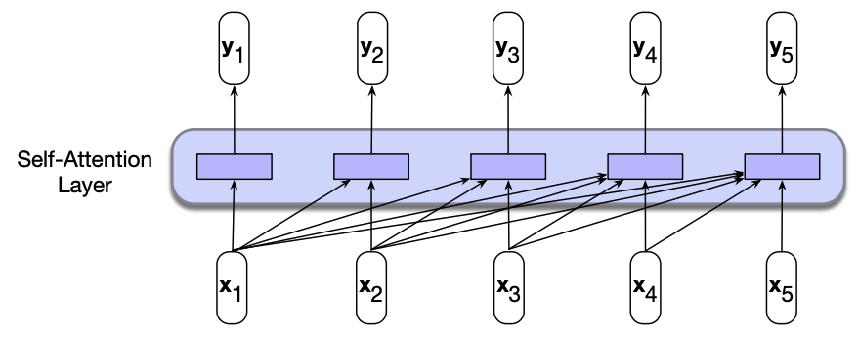
Another model
How is this setup different from the RNN?
Figure 10.1 from Jurafsky and Martin

Slide 51
Another model
Do not rely on the hidden states for context information
Parallel: computation can all happen at once
Figure 10.1 from Jurafsky and Martin

Slide 52
Self-attention
Self-attention:
Input is some context (for LMs, the previous words)
Learn what parts of the context are important based
Figure 10.1 from Jurafsky and Martin

Slide 53
Self-attention
Figure 10.1 from Jurafsky and Martin

Slide 54
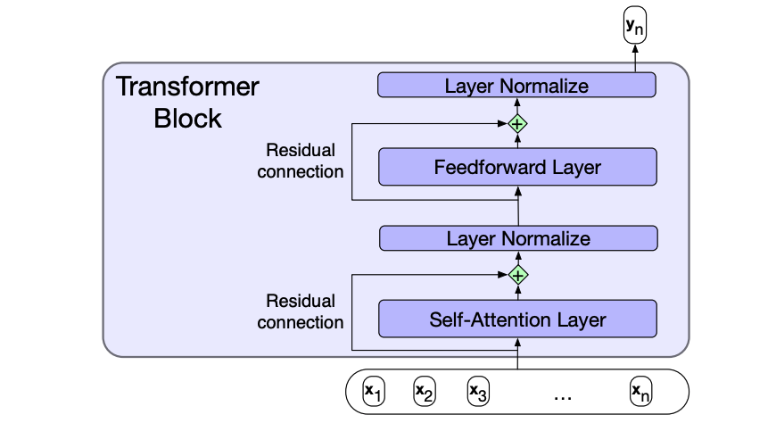
Transformer block
Figure 10.4 from Jurafsky and Martin

Slide 55
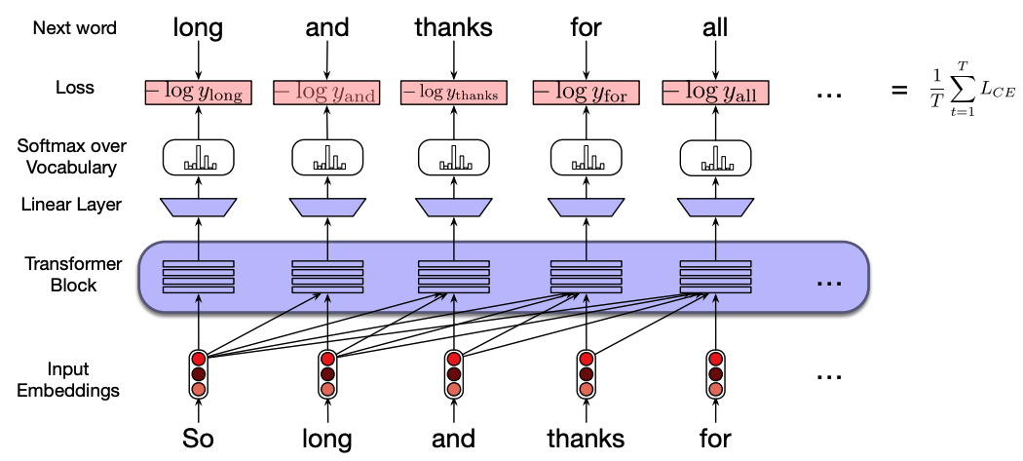
Transformer network

Slide 56
Transformer network vs. RNN

Slide 57
GPT
Generative: outputs things
Pre-trained: previously trained on a large corpus
Transformer: uses the transformer network

Slide 58
Pre-trained language models
Pre-trained language models are general purpose and are trained on a very large corpus
They can be used as/is to:
Ask p(w1 w2 … wn)
Generate text given some seed, p(wi | w1 w2 … wi-1
They can also be “fine-tuned” for particular tasks: take the current weights and update them based on a specific application

Slide 59
ChatGPT

Slide 60
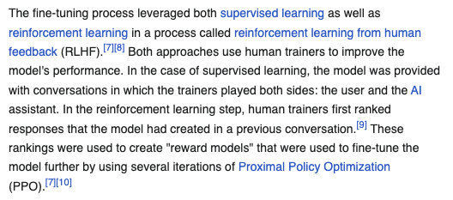
ChatGPT

