Slide 1
Regular expressions
David Kauchak
NLP – Spring 2023

Slide 2
Regular expressions
Regular expressions are a very powerful tool to do string matching and processing
Allows you to do things like:
Tell me if a string starts with a lowercase letter, then is followed by 2 numbers and ends with “ing” or “ion”
Replace all occurrences of one or more spaces with a single space
Split up a string based on whitespace or periods or commas or …
Give me all parts of the string where a digit is proceeded by a letter and then the ‘#’ sign

Slide 3
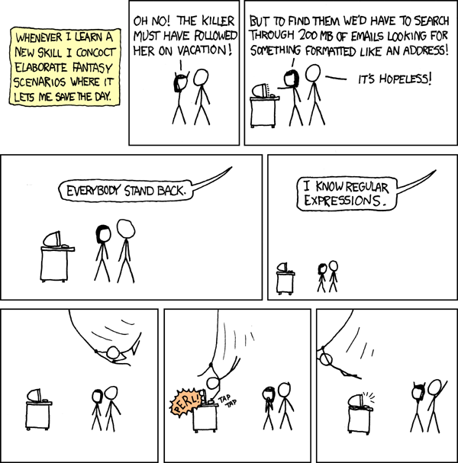
http://xkcd.com/208/

Slide 4
Regular expressions: literals
We can put any string in a regular expression
/test/
matches any string that has “test” in it
/this class/
matches any string that has “this class” in it
/Test/
case sensitive: matches any string that has “Test” in it

Slide 5
Regular expressions: character classes
A set of characters to match:
put in brackets: []
[abc] matches a single character a or b or c
What would the following match?
/[Tt]est/
any string with “Test” or “test” in it

Slide 6
Regular expressions: character classes
A set of characters to match:
put in brackets: []
[abc] matches a single character a or b or c
Can use - to represent ranges
[a-z] is equivalent to
[A-D] is equivalent to
[0-9] is equivalent to

Slide 7
Regular expressions: character classes
A set of characters to match:
put in brackets: []
[abc] matches a single character a or b or c
Can use - to represent ranges
[a-z] is equivalent to [abcdefghijklmnopqrstuvwxyz]
[A-D] is equivalent to [ABCD]
[0-9] is equivalent to [0123456789]

Slide 8
Regular expressions: character classes
For example:
/[0-9][0-9][0-9][0-9]/
matches any four digits, e.g. a year
Can also specify a set NOT to match: ^ means all characters EXCEPT those specified
[^a] all characters except ‘a’
[^0-9] all characters except numbers
[^A-Z] ???

Slide 9
Regular expressions: character classes
For example:
/[0-9][0-9][0-9][0-9]/
matches any four digits, e.g. a year
Can also specify a set NOT to match: ^ means all characters EXCEPT those specified
[^a] all characters except ‘a’
[^0-9] all characters except numbers
[^A-Z] not an upper case letter (be careful, this will match any character that’s not uppercase, not just letters

Slide 10
Regular expressions: character classes
Meta-characters (not always available)
\w - word character (a-zA-Z_0-9)
\W - non word-character (i.e. everything else)
\d - digit (0-9)
\s - whitespace character (space, tab, endline, …)
\S - non-whitespace
\b matches a word boundary (whitespace, beginning or end of line)
. matches any character

Slide 11
What would the following match?
/19\d\d/
would match any 4 digits starting with 19
/\s\s/
matches anything with two adjacent whitespace characters (spaces, tabs, etc)
/\s[aeiou]..\s/
any three letter word that starts with a vowel

Slide 12
Regular expressions: repetition
* matches zero or more of the preceding character
/ba*d/
matches any string with:
bd
bad
baad
baaad
/A.*A/
matches any string starts and ends with A
+ matches one or more of the preceding character
/ba+d/
matches any string with
bad
baad
baaad
baaaad

Slide 13
Regular expressions: repetition
? zero or 1 occurrence of the preceding
/fights?/
matches any string with “fight” or “fights” in it
{n,m} matches n to m inclusive
/ba{3,4}d/
matches any string with
baaad
baaaad

Slide 14
Regular expressions: beginning and end
^ marks the beginning of the line
$ marks the end of the line
/test/ test can occur anywhere
/^test/ must start with test
/test$/ must end with test
/^test$/ ???

Slide 15
Regular expressions: beginning and end
^ marks the beginning of the line
$ marks the end of the line
/test/ test can occur anywhere
/^test/ must start with test
/test$/ must end with test
/^test$/ must be exactly test

Slide 16
Regular expressions: repetition revisited
What if we wanted to match:
This is very interesting
This is very very interesting
This is very very very interesting
Would /This is very+ interesting/ work?
No… + only corresponds to the ‘y’
/This is (very )+interesting/
Repetition operators only apply to a single character.
Use parentheses to group a string of characters.

Slide 17
Regular expressions: disjunction
| has the lowest precedence and can be used
/cats|dogs/
matches:
cats
dogs
does NOT match:
catsogs

Slide 18
Regular expressions: disjunction
We want to match:
I like cats
I like dogs
Does /^I like cats|dogs$/ work?
No! Matches:
I like cats
dogs
Solution?

Slide 19
Regular expressions: disjunction
We want to match:
I like cats
I like dogs
/^I like (cats|dogs)$/
matches:
I like cats
I like dogs

Slide 20
Some examples
All strings that start with a capital letter
IP addresses
255.255.122.122
Matching a decimal number
All strings that end in ‘ing’
All strings that end in ‘ing’ or ‘ed’
All strings that begin and end with the same character

Slide 21
Some examples
All strings that start with a capital letter
/^[A-Z]/
IP addresses
/\b\d{1,3}\.\d{1,3}\.\d{1,3}\.\d{1,3}\b/
Matching a decimal number
/[-+]?[0-9]*\.?[0-9]+/
All strings that end in ‘ing’
/ing$/
All strings that end in ‘ing’ or ‘ed’
/ing|ed$/
Notes:
To match an actual ‘.’ you need to escape the character.

Slide 22
Regular expressions: memory
All strings that begin and end with the same character
Requires us to know what we matched already
()
used for precedence
also records a matched grouping, which can be referenced later
/^(.).*\1$/
all strings that begin and end with the same character

Slide 23
Regular expression: memory
/She likes (\w+) and they like \1/
What would this match?

Slide 24
Regular expression: memory
/She likes (\w+) and they like \1/
She likes bananas and they like bananas
She likes movies and they like movies
…

Slide 25
Regular expression: memory
/She likes (\w+) and they like \1/
We can use multiple matches
/She likes (\w+) and (\w+) and they also like \1 and \2/

Slide 26
Regular expressions: substitution
Most languages also allow for substitution
s/banana/apple/
substitute first occurrence banana for apple
s/banana/apple/g
substitute all occurrences (globally)
s/^(.*)$/\1 \1/
???
s/\s+/ /g
???

Slide 27
Regular expressions: substitution
Most languages also allow for substitution
s/banana/apple/
substitute first occurrence banana for apple
s/banana/apple/g
substitute all occurrences (globally)
s/^(.*)$/\1 \1/
duplicate the string, separated by a space
s/\s+/ /g
substitute multiple spaces to a space

Slide 28
Regular expressions by language
Java: as part of the String class
String s = “this is a test”
s.matches(“test”)
s.matches(“.*test.*”)
s.matches(“this\\sis .* test”)
s.split(“\\s+”)
s.replaceAll(“\\s+”, “ “);
Be careful, matches must match the whole string (i.e. an implicit ^ and $)

Slide 29
Regular expressions by language
Java: java.util.regex
Full regular expression capabilities
Matcher class: create a matcher and then can use it
String s = “this is a test”
Pattern pattern = Pattern.compile(“is\\s+”)
Matcher matcher = pattern.matcher(s)
matcher.matches()
matcher.find()
matcher.replaceAll(“blah”)
matcher.group()

Slide 30
Regular expressions by language
Python:
import re
s = “this is a test”
p = re.compile(“test”)
p.match(s)
p = re.compile(“.*test.*”)
re.split(‘\s+’, s)
re.sub(‘\s+’, ‘ ‘, s)

Slide 31
Regular expressions by language
perl:
$s = “this is a test”
$s =~ /test/
$s =~ /^test$/
$s =~ /this\sis .* test/
split /\s+/, $s
$s =~ s/\s+/ /g

Slide 32
Regular expression by language
grep
command-line tool for regular expressions (general regular expression print/parser)
returns all lines that match a regular expression
grep “@” twitter.posts
grep “http:” twiter.posts
can’t used metacharacters (\d, \w), use [] instead
Often want to use “grep –E” (for extended syntax)

Slide 33
Regular expression by language
sed
another command-line tool that uses regular expressions to print and manipulate strings
very powerful, though we’ll just play with it
Most common is substitution:
sed “s/ is a / is not a /g” twitter.posts
sed “s/ */ /g” twitter.posts
sed doesn’t have +, but does have *
Can also do things like delete all that match, etc.

Slide 34
Regular expression resources
General regular expressions:
Ch 2.1 of the book
http://www.regular-expressions.info/
good general tutorials
many language specific examples as well
Java
http://download.oracle.com/javase/tutorial/essential/regex/
See also the documentation for java.util.regex
Python
http://docs.python.org/howto/regex.html
http://docs.python.org/library/re.html

Slide 35
Regular expression resources
Perl
http://perldoc.perl.org/perlretut.html
http://perldoc.perl.org/perlre.html
grep
See the write-up at the end of Assignment 1
http://www.panix.com/~elflord/unix/grep.html
sed
See the write-up at the end of Assignment 1
http://www.grymoire.com/Unix/Sed.html
http://www.panix.com/~elflord/unix/sed.html

