Slide 1
MT – Final thoughts
David Kauchak
CS159 – Spring 2023
Some slides adapted from
Philipp Koehn
Kevin Knight
Dan Klein
School of Informatics
University of Edinburgh
USC/Information Sciences Institute
USC/Computer Science Department
Computer Science Department
UC Berkeley

Slide 2
Admin
Assignment 6

Slide 3
Language translation
Yo quiero Taco Bell
https://www.youtube.com/watch?v=Q6jzl_Oy2IQ
https://www.youtube.com/watch?v=vV1SkTdizZI

Slide 4
Word-alignment Evaluation
The old man is happy. He has fished many times.
El viejo está feliz porque ha pescado muchos veces.
How good of an alignment is this?
How can we quantify this?

Slide 5
Word-alignment Evaluation
System:
The old man is happy. He has fished many times.
El viejo está feliz porque ha pescado muchos veces.
Human
The old man is happy. He has fished many times.
El viejo está feliz porque ha pescado muchos veces.
How can we quantify this?

Slide 6
Word-alignment Evaluation
System:
The old man is happy. He has fished many times.
El viejo está feliz porque ha pescado muchos veces.
Human
The old man is happy. He has fished many times.
El viejo está feliz porque ha pescado muchos veces.
Precision and recall!

Slide 7
Word-alignment Evaluation
System:
The old man is happy. He has fished many times.
El viejo está feliz porque ha pescado muchos veces.
Human
The old man is happy. He has fished many times.
El viejo está feliz porque ha pescado muchos veces.
6
6
Precision:
Recall:
7
10

Slide 8
What kind of Translation Model?
Mary did not slap the green witch
Word-level models
Phrasal models
Syntactic models
Semantic models
Maria no dió una botefada a la bruja verde

Slide 9
Phrasal translation model
The models define probabilities over inputs
Morgen
fliege
ich
nach Kanada
zur Konferenz
1. Sentence is divided into phrases

Slide 10
Phrasal translation model
The models define probabilities over inputs
Morgen
fliege
ich
nach Kanada
zur Konferenz
Tomorrow
will fly
I
In Canada
to the conference
Sentence is divided into phrases
Phrases are translated (avoids a lot of weirdness from word-level model)

Slide 11
Phrasal translation model
The models define probabilities over inputs
Morgen
fliege
ich
nach Kanada
zur Konferenz
Tomorrow
I
will fly
to the conference
In Canada
Sentence is divided into phrases
Phrase are translated (avoids a lot of weirdness from word-level model)
Phrases are reordered

Slide 12
Phrase table
natuerlich
Translation | Probability
of course | 0.5
naturally | 0.3
of course , | 0.15
, of course , | 0.05

Slide 13
Phrase table
den Vorschlag
Translation | Probability
the proposal | 0.6227
‘s proposal | 0.1068
a proposal | 0.0341
the idea | 0.0250
this proposal | 0.0227
proposal | 0.0205
of the proposal | 0.0159
the proposals | 0.0159
the suggestions | 0.0114
…

Slide 14
Phrasal translation model
The models define probabilities over inputs
Morgen
fliege
ich
nach Kanada
zur Konferenz
Tomorrow
I
will fly
to the conference
In Canada
Advantages?

Slide 15
Advantages of Phrase-Based
Many-to-many mappings can handle non-compositional phrases
Easy to understand
Local context is very useful for disambiguating
“Interest rate” → …
“Interest in” → …
The more data, the longer the learned phrases
Sometimes whole sentences!

Slide 16
Syntax-based models
S
Benefits?
VP
NP
VP
PP
NP
NP
NP
NP
NP
DT
CD
NNS
VBP
NNS
VBG
IN
NNP
CC
NNP
PUNC
These
7
people
include
astronauts
coming
from
France
and
Russia
.

Slide 17
Syntax-based models
Benefits
Can use syntax to motivate word/phrase movement
Could ensure grammaticality
Two main types:
p(foreign string | English parse tree)
p(foreign parse tree | English parse tree)
Why always English parse tree?
Notes:
More data and better parsers for English.
Problem was often formulated as translating to English; it’s important that the output language be syntactically correct.

Slide 18
Tree to string rule
S
ADVP
,
x0:NP
x1:VP
->
x0:NP “*” x1:VP
RB
“,”
“therefore”

Slide 19
Tree to string rules examples
DT(these) → 这
VBP(include) → 中包括
VBP(includes) → 中包括
NNP(France) → 法国
CC(and) → 和
NNP(Russia) → 俄罗斯
IN(of) → 的
NP(NNS(astronauts)) → 宇航 , 员
PUNC(.) → .
NP(x0:DT, CD(7), NNS(people) → x0 , 7人
VP(VBG(coming), PP(IN(from), x0:NP)) → 来自 ,x0
IN(from) → 来自
NP(x0:NNP, x1:CC, x2:NNP) → x0 , x1 , x2
VP(x0:VBP, x1:NP) → x0 , x1
S(x0:NP, x1:VP, x2:PUNC) → x0 , x1, x2
NP(x0:NP, x1:VP) → x1 , 的 , x0
NP(DT(“the”), x0:JJ, x1:NN) → x0 , x1
Contiguous phrase pair
substitution rules
Higher-level rules

Slide 20
Tree to string rules examples
DT(these) → 这
VBP(include) → 中包括
VBP(includes) → 中包括
NNP(France) → 法国
CC(and) → 和
NNP(Russia) → 俄罗斯
IN(of) → 的
NP(NNS(astronauts)) → 宇航 , 员
PUNC(.) → .
NP(x0:DT, CD(7), NNS(people) → x0 , 7人
VP(VBG(coming), PP(IN(from), x0:NP)) → 来自 ,x0
IN(from) → 来自
NP(x0:NNP, x1:CC, x2:NNP) → x0 , x1 , x2
VP(x0:VBP, x1:NP) → x0 , x1
S(x0:NP, x1:VP, x2:PUNC) → x0 , x1, x2
NP(x0:NP, x1:VP) → x1 , 的 , x0
NP(DT(“the”), x0:JJ, x1:NN) → x0 , x1
Both VBP(“include”) and
VBP(“includes”) will translate
to “中包括” in Chinese.
Contiguous phrase pair
substitution rules
Higher-level rules

Slide 21
Tree Transformations
DT(these) → 这
VBP(include) → 中包括
VBP(includes) → 中包括
NNP(France) → 法国
CC(and) → 和
NNP(Russia) → 俄罗斯
IN(of) → 的
NP(NNS(astronauts)) → 宇航 , 员
PUNC(.) → .
NP(x0:DT, CD(7), NNS(people) → x0 , 7人
VP(VBG(coming), PP(IN(from), x0:NP)) → 来自 ,x0
IN(from) → 来自
NP(x0:NNP, x1:CC, x2:NNP) → x0 , x1 , x2
VP(x0:VBP, x1:NP) → x0 , x1
S(x0:NP, x1:VP, x2:PUNC) → x0 , x1, x2
NP(x0:NP, x1:VP) → x1 , 的 , x0
NP(DT(“the”), x0:JJ, x1:NN) → x0 , x1
The phrase “coming from”
translates to “来自” only if
followed by an NP (whose
translation is then placed to
the right of “来自”).
Contiguous phrase pair
Substitution rules
(alignment templates)
Higher-level rules

Slide 22
Tree Transformations
Translate an English NP (“astronauts”)
modified by a gerund VP (“coming
from France and Russia”) as follows:
(1) translate the VP,
(2) type the Chinese word “的”,
(3) translate the NP.
DT(these) → 这
VBP(include) → 中包括
VBP(includes) → 中包括
NNP(France) → 法国
CC(and) → 和
NNP(Russia) → 俄罗斯
IN(of) → 的
NP(NNS(astronauts)) → 宇航 , 员
PUNC(.) → .
NP(x0:DT, CD(7), NNS(people) → x0 , 7人
VP(VBG(coming), PP(IN(from), x0:NP)) → 来自 ,x0
IN(from) → 来自
NP(x0:NNP, x1:CC, x2:NNP) → x0 , x1 , x2
VP(x0:VBP, x1:NP) → x0 , x1
S(x0:NP, x1:VP, x2:PUNC) → x0 , x1, x2
NP(x0:NP, x1:VP) → x1 , 的 , x0
NP(DT(“the”), x0:JJ, x1:NN) → x0 , x1
Contiguous phrase pair
Substitution rules
(alignment templates)
Higher-level rules

Slide 23
Tree Transformations
DT(these) → 这
VBP(include) → 中包括
VBP(includes) → 中包括
NNP(France) → 法国
CC(and) → 和
NNP(Russia) → 俄罗斯
IN(of) → 的
NP(NNS(astronauts)) → 宇航 , 员
PUNC(.) → .
NP(x0:DT, CD(7), NNS(people) → x0 , 7人
VP(VBG(coming), PP(IN(from), x0:NP)) → 来自 ,x0
IN(from) → 来自
NP(x0:NNP, x1:CC, x2:NNP) → x0 , x1 , x2
VP(x0:VBP, x1:NP) → x0 , x1
S(x0:NP, x1:VP, x2:PUNC) → x0 , x1, x2
NP(x0:NP, x1:VP) → x1 , 的 , x0
NP(DT(“the”), x0:JJ, x1:NN) → x0 , x1
Contiguous phrase pair
Substitution rules
(alignment templates)
To translate “the JJ NN”,
translate the JJ and NN (and drop “the”).
Higher-level rules

Slide 24
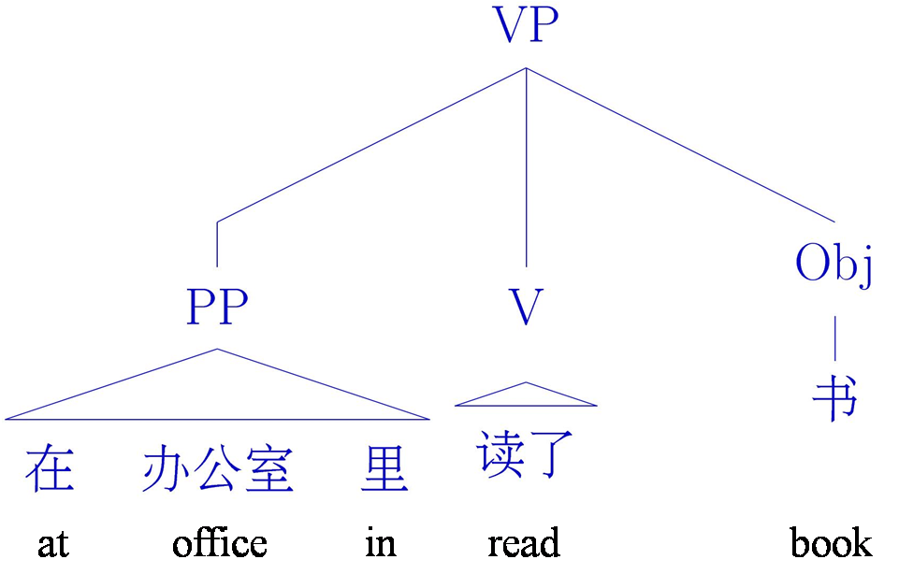
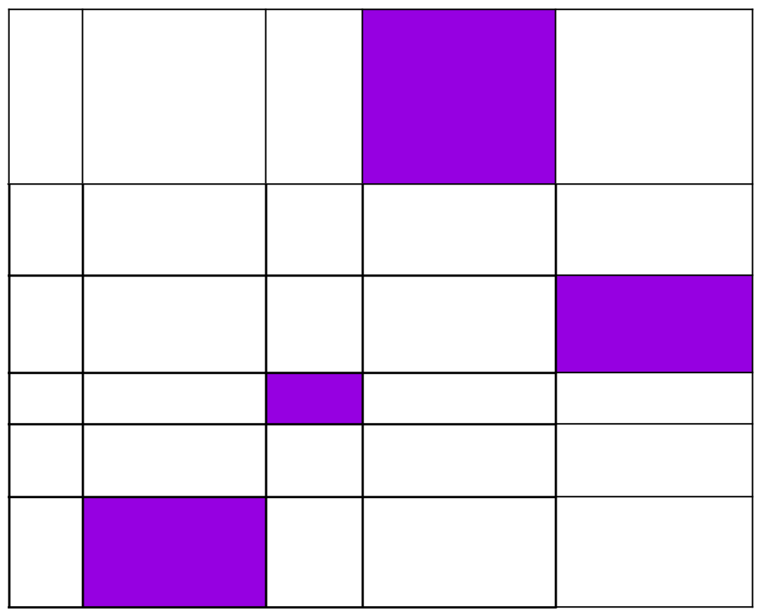
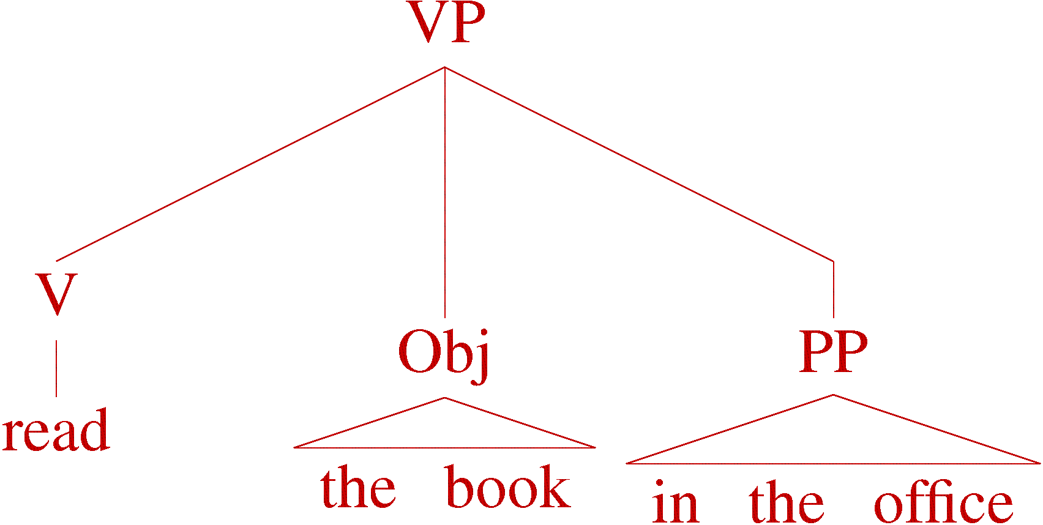
Tree to tree example

Slide 25
MT Evaluation
How do we do it?
What data might be useful?

Slide 26
MT Evaluation
Source only
Manual:
SSER (subjective sentence error rate)
Correct/Incorrect
Error categorization
Extrinsic:
Objective usage testing
Automatic:
WER (word error rate)
BLEU (Bilingual Evaluation Understudy)
NIST

Slide 27
MT Evaluation exercise
Play with an MT system
Find a few examples of the system doing interesting (surprising?) ”good” translations.
Find some examples of the system making mistakes (consider, idioms and common expressions)

Slide 28
Automatic Evaluation
Common NLP/machine learning/AI approach
Training sentence pairs
All sentence pairs
Testing sentence pairs
Notes:
“train” a model on the training sentences (that is learn the probabilities)
then evaluate on the test sentences (which the model has never seen before)

Slide 29
Automatic Evaluation
Reference (human) translation: The U.S. island of Guam is maintaining a high state of alert after the Guam airport and its offices both received an e-mail from someone calling himself the Saudi Arabian Osama bin Laden and threatening a biological/chemical attack against public places such as the airport .
Machine translation: The American [?] international airport and its the office all receives one calls self the sand Arab rich business [?] and so on electronic mail , which sends out ; The threat will be able after public place and so on the airport to start the biochemistry attack , [?] highly alerts after the maintenance.
Machine translation 2:
United States Office of the Guam International Airport and were received by a man claiming to be Saudi Arabian businessman Osama bin Laden, sent emails, threats to airports and other public places will launch a biological or chemical attack, remain on high alert in Guam.
Ideas?

Slide 30
BLEU Evaluation Metric
(Papineni et al, ACL-2002)
Reference (human) translation: The U.S. island of Guam is maintaining a high state of alert after the Guam airport and its offices both received an e-mail from someone calling himself the Saudi Arabian Osama bin Laden and threatening a biological/chemical attack against public places such as the airport .
Basic idea:
Combination of n-gram precisions of varying size
What percentage of machine n-grams can be found in the reference translation?
Machine translation: The American [?] international airport and its the office all receives one calls self the sand Arab rich business [?] and so on electronic mail , which sends out ; The threat will be able after public place and so on the airport to start the biochemistry attack , [?] highly alerts after the maintenance.

Slide 31
Multiple Reference Translations
Reference translation 1: The U.S. island of Guam is maintaining a high state of alert after the Guam airport and its offices both received an e-mail from someone calling himself the Saudi Arabian Osama bin Laden and threatening a biological/chemical attack against public places such as the airport .
Reference translation 1: The U.S. island of Guam is maintaining a high state of alert after the Guam airport and its offices both received an e-mail from someone calling himself the Saudi Arabian Osama bin Laden and threatening a biological/chemical attack against public places such as the airport .
Reference translation 2: Guam International Airport and its offices are maintaining a high state of alert after receiving an e-mail that was from a person claiming to be the wealthy Saudi Arabian businessman Bin Laden and that threatened to launch a biological and chemical attack on the airport and other public places .
Reference translation 2: Guam International Airport and its offices are maintaining a high state of alert after receiving an e-mail that was from a person claiming to be the wealthy Saudi Arabian businessman Bin Laden and that threatened to launch a biological and chemical attack on the airport and other public places .
Machine translation: The American [?] international airport and its the office all receives one calls self the sand Arab rich business [?] and so on electronic mail , which sends out ; The threat will be able after public place and so on the airport to start the biochemistry attack , [?] highly alerts after the maintenance.
Machine translation: The American [?] international airport and its the office all receives one calls self the sand Arab rich business [?] and so on electronic mail , which sends out ; The threat will be able after public place and so on the airport to start the biochemistry attack , [?] highly alerts after the maintenance.
Reference translation 3: The US International Airport of Guam and its office has received an email from a self-claimed Arabian millionaire named Laden , which threatens to launch a biochemical attack on such public places as airport . Guam authority has been on alert .
Reference translation 3: The US International Airport of Guam and its office has received an email from a self-claimed Arabian millionaire named Laden , which threatens to launch a biochemical attack on such public places as airport . Guam authority has been on alert .
Reference translation 4: US Guam International Airport and its office received an email from Mr. Bin Laden and other rich businessman from Saudi Arabia . They said there would be biochemistry air raid to Guam Airport and other public places . Guam needs to be in high precaution about this matter .
Reference translation 4: US Guam International Airport and its office received an email from Mr. Bin Laden and other rich businessman from Saudi Arabia . They said there would be biochemistry air raid to Guam Airport and other public places . Guam needs to be in high precaution about this matter .

Slide 32
N-gram precision example
Candidate 1: It is a guide to action which ensures that the military always obey the commands of the party.
Reference 1: It is a guide to action that ensures that the military will forever heed Party commands.
Reference 2: It is the guiding principle which guarantees the military forces always being under the command of the Party.
Reference 3: It is the practical guide for the army always to heed directions of the party.
What percentage of machine n-grams can be found in the reference translations? Do unigrams, bigrams and trigrams.

Slide 33
N-gram precision example
Candidate 1: It is a guide to action which ensures that the military
always obey the commands of the party.
Reference 1: It is a guide to action that ensures that the military will forever heed Party commands.
Reference 2: It is the guiding principle which guarantees the military forces always being under the command of the Party.
Reference 3: It is the practical guide for the army always to heed directions of the party.
Unigrams: 17/18

Slide 34
N-gram precision example
Candidate 1: It is a guide to action which ensures that the military
always obey the commands of the party.
Reference 1: It is a guide to action that ensures that the military will forever heed Party commands.
Reference 2: It is the guiding principle which guarantees the military forces always being under the command of the Party.
Reference 3: It is the practical guide for the army always to heed directions of the party.
Unigrams: 17/18
Bigrams: 10/17

Slide 35
N-gram precision example
Candidate 1: It is a guide to action which ensures that the military
always obey the commands of the party.
Reference 1: It is a guide to action that ensures that the military will forever heed Party commands.
Reference 2: It is the guiding principle which guarantees the military forces always being under the command of the Party.
Reference 3: It is the practical guide for the army always to heed directions of the party.
Unigrams: 17/18
Bigrams: 10/17
Trigrams: 7/16

Slide 36
N-gram precision example 2
Candidate 2: It is to ensure the army forever hearing the directions guide that party commands.
Reference 1: It is a guide to action that ensures that the military will forever heed Party commands.
Reference 2: It is the guiding principle which guarantees the military forces always being under the command of the Party.
Reference 3: It is the practical guide for the army always to heed directions of the party.

Slide 37
N-gram precision example 2
Candidate 2: It is to ensure the army forever hearing the directions guide that party commands.
Reference 1: It is a guide to action that ensures that the military will forever heed Party commands.
Reference 2: It is the guiding principle which guarantees the military forces always being under the command of the Party.
Reference 3: It is the practical guide for the army always to heed directions of the party.
Unigrams: 12/14

Slide 38
N-gram precision example 2
Candidate 2: It is to ensure the army forever hearing the directions
guide that party commands.
Reference 1: It is a guide to action that ensures that the military will forever heed Party commands.
Reference 2: It is the guiding principle which guarantees the military forces always being under the command of the Party.
Reference 3: It is the practical guide for the army always to heed directions of the party.
Unigrams: 12/14
Bigrams: 4/13

Slide 39
N-gram precision example 2
Candidate 2: It is to ensure the army forever hearing the directions
guide that party commands.
Reference 1: It is a guide to action that ensures that the military will forever heed Party commands.
Reference 2: It is the guiding principle which guarantees the military forces always being under the command of the Party.
Reference 3: It is the practical guide for the army always to heed directions of the party.
Unigrams: 12/14
Bigrams: 4/13
Trigrams: 1/12

Slide 40
N-gram precision
Candidate 1: It is a guide to action which ensures that the military always obey the commands of the party.
Unigrams: 17/18
Bigrams: 10/17
Trigrams: 7/16
Candidate 2: It is to ensure the army forever hearing the directions guide that party commands.
Unigrams: 12/14
Bigrams: 4/13
Trigrams: 1/12
Any problems/concerns?

Slide 41
N-gram precision example
Candidate 3: the
Candidate 4: It is a
Reference 1: It is a guide to action that ensures that the military will forever heed Party commands.
Reference 2: It is the guiding principle which guarantees the military forces always being under the command of the Party.
Reference 3: It is the practical guide for the army always to heed directions of the party.
What percentage of machine n-grams can be found in the reference translations? Do unigrams, bigrams and trigrams.

Slide 42
BLEU Evaluation Metric
(Papineni et al, ACL-2002)
Reference (human) translation: The U.S. island of Guam is maintaining a high state of alert after the Guam airport and its offices both received an e-mail from someone calling himself the Saudi Arabian Osama bin Laden and threatening a biological/chemical attack against public places such as the airport .
N-gram precision (score is between 0 & 1)
What percentage of machine n-grams can be found in the reference translation?
Not allowed to use same portion of reference translation twice (can’t cheat by typing out “the the the the the”)
Brevity penalty
Can’t just type out single word “the” (precision 1.0!)
*** Amazingly hard to “game” the system (i.e., find a way to change machine output so that BLEU goes up, but quality doesn’t)
Machine translation: The American [?] international airport and its the office all receives one calls self the sand Arab rich business [?] and so on electronic mail , which sends out ; The threat will be able after public place and so on the airport to start the biochemistry attack , [?] highly alerts after the maintenance.

Slide 43
BLEU Tends to Predict Human Judgments
(variant of BLEU)
slide from G. Doddington (NIST)

Slide 44
BLEU in Action
枪手被警方击毙。 (Foreign Original)
the gunman was shot to death by the police . (Reference Translation)
the gunman was police kill . #1 wounded police jaya of #2 the gunman was shot dead by the police . #3 the gunman arrested by police kill . #4 the gunmen were killed . #5 the gunman was shot to death by the police . #6
gunmen were killed by police ?SUB>0 ?SUB>0 #7
al by the police . #8 the ringer is killed by the police . #9 police killed the gunman . #10

Slide 45
BLEU in Action
枪手被警方击毙。 (Foreign Original)
the gunman was shot to death by the police . (Reference Translation)
the gunman was police kill . #1 wounded police jaya of #2 the gunman was shot dead by the police . #3 the gunman arrested by police kill . #4 the gunmen were killed . #5 the gunman was shot to death by the police . #6
gunmen were killed by police ?SUB>0 ?SUB>0 #7
al by the police . #8 the ringer is killed by the police . #9 police killed the gunman . #10
green = 4-gram match (good!)
red = word not matched (bad!)

Slide 46
BLEU in Action
枪手被警方击毙。 (Foreign Original)
the gunman was shot to death by the police . (Reference Translation)
the gunman was police kill . #1 Machine wounded police jaya of #2 Machine the gunman was shot dead by the police . #3 Human the gunman arrested by police kill . #4 Machine the gunmen were killed . #5 Machine the gunman was shot to death by the police . #6 Human
gunmen were killed by police ?SUB>0 ?SUB>0 #7 Machine
al by the police . #8 Machine the ringer is killed by the police . #9 Machine police killed the gunman . #10 Human
green = 4-gram match (good!)
red = word not matched (bad!)

Slide 47
BLEU: Problems?
Doesn’t care if an incorrectly translated word is a name or a preposition
gave it to Albright (reference)
gave it at Albright (translation #1)
gave it to altar (translation #2)
What happens when a program reaches human level performance in BLEU but the translations are still bad?
maybe sooner than you think …

Slide 48
Appendix A
Input: corpus of English/Foreign sentence pairs (no alignment)
for some number of iterations:
for (E, F) in corpus:
for e in E:
for f in F:
$p\left(f→e\right)=p\left(f\right|e)/\sum_{e in E}{p(f|e)}$
count(e,f) += $p\left(f→e\right)$
count(e) += $p\left(f→e\right)$
for all (e,f) in count:
p(f|e) = count(e,f) / count(e)

Slide 49
Appendix A
for (E, F) in corpus:
for e in E:
for f in F:
$p\left(f→e\right)=\frac{p(f|e)}{\sum_{e in E}{p\left(f | e\right)}}$
count(e,f) += $p\left(f→e\right)$
count(e) += $p\left(f→e\right)$
Pair 1:
E: green house
F: casa verde
Pair 2:
E: the house
F: la casa
Step 1: calculate p(f -> e) for all pairs of words in the two sentences (assume p(f|e) is a constant for all f,e)

Slide 50
Appendix A
for (E, F) in corpus:
for e in E:
for f in F:
$p\left(f→e\right)=\frac{p(f|e)}{\sum_{e in E}{p\left(f | e\right)}}$
count(e,f) += $p\left(f→e\right)$
count(e) += $p\left(f→e\right)$
Pair 1:
E: green house
F: casa verde
Pair 2:
E: the house
F: la casa
Step 2: aggregate the counts

Slide 51
Appendix A
Pair 1:
E: green house
F: casa verde
for all (e,f) in count:
p(f|e) = count(e,f) / count(e)
Pair 2:
E: the house
F: la casa
Step 3: recalculate p(e|f)

Slide 52
Appendix A
Input: corpus of English/Foreign sentence pairs (no alignment)
for some number of iterations:
for (E, F) in corpus:
for e in E:
for f in F:
$p\left(f→e\right)=p\left(f\right|e)/\sum_{e in E}{p(f|e)}$ count(e,f) += $p\left(f→e\right)$
count(e) += $p\left(f→e\right)$
for all (e,f) in count:
p(f|e) = count(e,f) / count(e)

Slide 53
Worksheet
Pair 1:
p(casa → green) =
p(casa → house) =
p(verde → green) =
p(verde → house =
Pair 2:
p(la → the) =
p(la → house) =
p(casa → the) =
p(casa → house =
count(green, casa) =
count(green, verde) =
count(house, casa) =
count(house, verde) =
count(house, la) =
count(the, casa) =
count(the, la) =
count(green) =
count(house) =
count(the) =
p(casa | green) =
p(verde | green) =
p(casa | house) =
p(verde | house) =
p(la | house) =
p(casa | the) =
p(la | the ) =

Slide 54
green house
green house
the house
the house
casa verde
casa verde
la casa
la casa
green house
green house
the house
the house
casa verde
casa verde
la casa
la casa
p( casa | green) | 1/2
p( verde | green) | 1/2
p( la | green ) | 0
p( casa | house) | 1/2
p( verde | house) | 1/4
p( la | house ) | 1/4
p( casa | the) | 1/2
p( verde | the) | 0
p( la | the ) | 1/2
c(casa,green) = 1/4+1/4 = 1/2
c(verde,green) = 1/4+1/4 = 1/2
c(la, green) = 0
c(casa,house) = 1/4+1/4+
1/4+1/4 = 1
c(verde,house) = 1/4+1/4 = 1/2
c(la,house) = 1/4+1/4 = 1/2
c(casa,the) = 1/4+1/4 = 1/2
c(verde,the) = 0
c(la,the) = 1/4+1/4 = 1/2
Then, calculate the probabilities by normalizing the counts

