Slide 1
Word Similarity
David Kauchak CS159 Spring 2023

Slide 2
Admin
Assignment 4
Quiz #2 Thursday
45 minutes
Open book and notes
Done with class after that
Assignment 5
Two part assignment
A due before spring break
Have a proper spring break!
B due a week after spring break

Slide 3
Quiz #2
Topics
Linguistics 101
Parsing
Grammars, CFGs, PCFGs
Top-down vs. bottom-up
CKY algorithm
Grammar learning
Evaluation
Improved models
Text similarity (conceptual coverage)
Will also be covered on Quiz #3, though

Slide 4
Text Similarity
A common question in NLP is how similar are texts
sim(
,
) = ?
score:
rank:
?

Slide 5
Bag of words representation
For now, let’s ignore word order:
Obama said banana repeatedly last week on tv, “banana, banana, banana”
“Bag of words representation”: multi-dimensional vector, one dimension per word in our vocabulary
(4, 1, 1, 0, 0, 1, 0, 0, …)
obama
said
california
across
tv
wrong
banana
capital
Frequency of word occurrence

Slide 6
Vector based word
A
a₁: When 1
a₂: the 2
a₃: defendant 1
a₄: and 1
a₅: courthouse 0
…
Multi-dimensional vectors, one dimension per word in our vocabulary
B
b₁: When 1
b₂: the 2
b₃: defendant 1
b₄: and 0
b₅: courthouse 1
…

Slide 7
TF-IDF
One of the most common weighting schemes
TF = term frequency
IDF = inverse document frequency
TF
IDF (word importance weight )
We can then use this with any of our similarity measures!

Slide 8
Normalized distance measures
Cosine
L2
L1
a’ and b’ are length normalized versions of the vectors

Slide 9
Our problems
Which of these have we addressed?
word order
length
synonym
spelling mistakes
word importance
word frequency
A model of word similarity!

Slide 10
Word overlap problems
A: When the defendant and his lawyer walked into the court, some of the victim supporters turned their backs to him.
B: When the defendant walked into the courthouse with his attorney, the crowd truned their backs on him.

Slide 11
Word similarity
How similar are two words?
score:
sim(w₁, w₂) = ?
w₁
w₂
w₃
applications?
w
rank:
?
list: w₁ and w₂ are synonyms

Slide 12
Word similarity applications
General text similarity
Thesaurus generation
Automatic evaluation
Text-to-text
paraphrasing
summarization
machine translation
information retrieval (search)

Slide 13
Word similarity
How similar are two words?
score:
sim(w₁, w₂) = ?
w₁
w₂
w₃
ideas? useful resources?
w
rank:
?
list: w₁ and w₂ are synonyms

Slide 14
Word similarity
Four categories of approaches (maybe more)
Character-based
turned vs. truned
cognates (night, nacht, nicht, natt, nat, noc, noch)
Semantic web-based (e.g. WordNet)
Dictionary-based
Distributional similarity-based
similar words occur in similar contexts

Slide 15
Character-based similarity
sim(turned, truned) = ?
How might we do this using only the words (i.e. no outside resources?

Slide 16
Edit distance (Levenshtein distance)
The edit distance between w₁ and w₂ is the minimum number of operations to transform w₁ into w₂
Operations:
insertion
deletion
substitution
EDIT(turned, truned) = ?
EDIT(computer, commuter) = ?
EDIT(banana, apple) = ?
EDIT(wombat, worcester) = ?

Slide 17
Edit distance
EDIT(turned, truned) = 2
delete u
insert u
EDIT(computer, commuter) = 1
replace p with m
EDIT(banana, apple) = 5
delete b
replace n with p
replace a with p
replace n with l
replace a with e
EDIT(wombat, worcester) = 6

Slide 18
Better edit distance
Are all operations equally likely?
No
Improvement: give different weights to different operations
replacing a for e is more likely than z for y
Ideas for weightings?
Learn from actual data (known typos, known similar words)
Intuitions: phonetics
Intuitions: keyboard configuration

Slide 19
Vector character-based word similarity
sim(turned, truned) = ?
Any way to leverage our vector-based similarity approaches from last time?

Slide 20
Vector character-based word similarity
sim(turned, truned) = ?
Generate a feature vector based on the characters
(or could also use the set based measures at the character level)
a: 0
b: 0
c: 0
d: 1
e: 1
f: 0
g: 0
…
a: 0
b: 0
c: 0
d: 1
e: 1
f: 0
g: 0
…
problems?

Slide 21
Vector character-based word similarity
sim(restful, fluster) = ?
Character level loses a lot of information
a: 0
b: 0
c: 0
d: 1
e: 1
f: 0
g: 0
…
a: 0
b: 0
c: 0
d: 1
e: 1
f: 0
g: 0
…
ideas?

Slide 22
Vector character-based word similarity
sim(restful, fluster) = ?
Use character bigrams or even trigrams
aa: 0
ab: 0
ac: 0
…
es: 1
…
fu: 1
…
re: 1
…
aa: 0
ab: 0
ac: 0
…
er: 1
…
fl: 1
…
lu: 1
…

Slide 23
Word similarity
Four general categories
Character-based
turned vs. truned
cognates (night, nacht, nicht, natt, nat, noc, noch)
Semantic web-based (e.g. WordNet)
Dictionary-based
Distributional similarity-based
similar words occur in similar contexts

Slide 24
WordNet
Lexical database for English
155,287 words
206,941 word senses
117,659 synsets (synonym sets)
~400K relations between senses
Parts of speech: nouns, verbs, adjectives, adverbs
Word graph, with word senses as nodes and edges as relationships
Psycholinguistics
WN attempts to model human lexical memory
Design based on psychological testing
Created by researchers at Princeton
http://wordnet.princeton.edu/
Lots of programmatic interfaces

Slide 25
WordNet relations
synonym
antonym
hypernyms
hyponyms
holonym
meronym
troponym
entailment
(and a few others)
Notes:
hypernym: word whose meaning includes the meaning of another word
hyponym: opposite (e.g. “is-a” relationship) a bike is-a vehicle (vehicle is a hypernym of bike)
holonym/meronym: X is a holonym of Y if Ys are parts of Xs (bike is a holonym of tire)
troponym: (verbs) verb Y is a troponym of verb X if the activity Y is doing X in some manner (saunter is a troponym of walk)
entailment: (verbs) verby Y is entailed by X if by doing X you must be doing Y (sleep is entailed by snore)

Slide 26
WordNet relations
synonym – X and Y have similar meaning
antonym – X and Y have opposite meanings
hypernyms – subclass
beagle is a hypernym of dog
hyponyms – superclass
dog is a hyponym of beagle
holonym – contains part
car is a holonym of wheel
meronym – part of
wheel is a meronym of car

Slide 27
WordNet relations
troponym – for verbs, a more specific way of doing an action
run is a troponym of move
dice is a troponym of cut
entailment – for verbs, one activity leads to the next
sleep is entailed by snore
(and a few others)

Slide 28
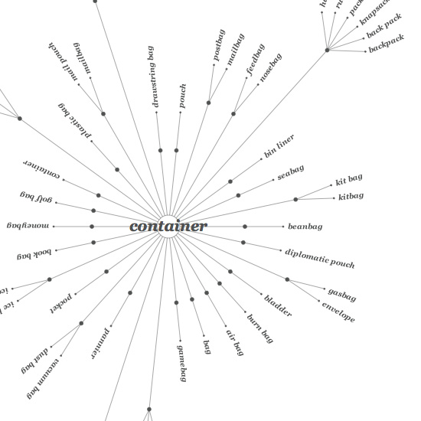
WordNet
Graph, where nodes are words and edges are relationships
There is some hierarchical information, for example with
hyp-er/o-nomy

Slide 29
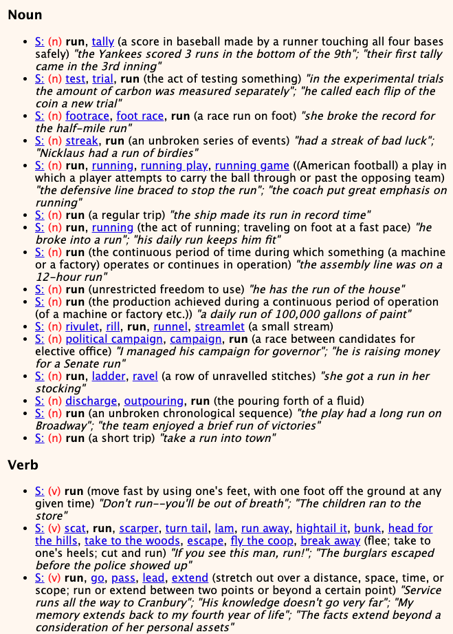
WordNet: run

Slide 30
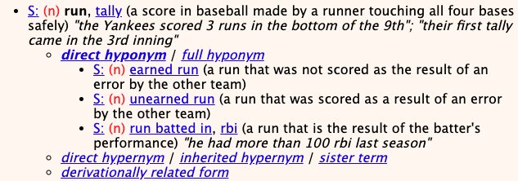
WordNet: run

Slide 31
WordNet-like Hierarchy
animal
fish
mammal
reptile
amphibian
wolf
horse
dog
cat
mare
stallion
hunting dog
dachshund
terrier
To utilize WordNet, we often want to think about some graph-based measure.

Slide 32
WordNet-like Hierarchy
animal
fish
mammal
reptile
amphibian
wolf
horse
dog
cat
mare
stallion
hunting dog
dachshund
terrier
Rank the following based on similarity:
SIM(wolf, dog)
SIM(wolf, amphibian)
SIM(terrier, wolf)
SIM(dachshund, terrier)

Slide 33
WordNet-like Hierarchy
animal
fish
mammal
reptile
amphibian
wolf
horse
dog
cat
SIM(dachshund, terrier)
SIM(wolf, dog)
SIM(terrier, wolf)
SIM(wolf, amphibian)
mare
stallion
hunting dog
dachshund
terrier
What information/heuristics did you use to rank these?

Slide 34
WordNet-like Hierarchy
animal
fish
mammal
reptile
amphibian
wolf
horse
dog
cat
SIM(dachshund, terrier)
SIM(wolf, dog)
SIM(terrier, wolf)
SIM(wolf, amphibian)
mare
stallion
hunting dog
dachshund
terrier
path length is important (but not the only thing)
words that share the same ancestor are related
words lower down in the hierarchy are finer grained and therefore closer

Slide 35
WordNet similarity measures
path length doesn’t work very well
Some ideas:
path length scaled by the depth (Leacock and Chodorow, 1998)
With a little cheating:
Measure the “information content” of a word using a corpus: how specific is a word?
words higher up tend to have less information content
more frequent words (and ancestors of more frequent words) tend to have less information content

Slide 36
WordNet similarity measures
Utilizing information content:
information content of the lowest common parent (Resnik, 1995)
information content of the words minus information content of the lowest common parent (Jiang and Conrath, 1997)
information content of the lowest common parent divided by the information content of the words (Lin, 1998)

Slide 37
Word similarity
Four general categories
Character-based
turned vs. truned
cognates (night, nacht, nicht, natt, nat, noc, noch)
Semantic web-based (e.g. WordNet)
Dictionary-based
Distributional similarity-based
similar words occur in similar contexts

Slide 38
Dictionary-based similarity
Word
Dictionary blurb
a large, nocturnal, burrowing mammal, Orycteropus afer, ofcentral and southern Africa, feeding on ants and termites andhaving a long, extensile tongue, strong claws, and long ears.
aardvark
One of a breed of small hounds having long ears, short legs, and a usually black, tan, and white coat.
beagle
Any carnivore of the family Canidae, having prominent canine teeth and, in the wild state, a long and slender muzzle, a deep-chested muscular body, a bushy tail, and large, erect ears. Compare canid.
dog

Slide 39
Dictionary-based similarity
Utilize our text similarity measures
sim(dog, beagle) =
sim( ,
One of a breed of small hounds having long ears, short legs, and a usually black, tan, and white coat.
Any carnivore of the family Canidae, having prominent canine teeth and, in the wild state, a long and slender muzzle, a deep-chested muscular body, a bushy tail, and large, erect ears. Compare canid.
)

Slide 40
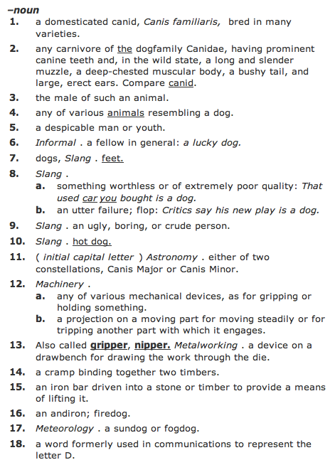
Dictionary-based similarity
What about words that have multiple senses/parts of speech?

Slide 41
Dictionary-based similarity
part of speech tagging
word sense disambiguation
most frequent sense
average similarity between all senses
max similarity between all senses
sum of similarity between all senses

Slide 42
Dictionary + WordNet
WordNet also includes a “gloss” similar to a dictionary definition
Other variants include the overlap of the word senses as well as those word senses that are related (e.g. hypernym, hyponym, etc.)
incorporates some of the path information as well
Banerjee and Pedersen, 2003

Slide 43
Word similarity
Four general categories
Character-based
turned vs. truned
cognates (night, nacht, nicht, natt, nat, noc, noch)
Semantic web-based (e.g. WordNet)
Dictionary-based
Distributional similarity-based
similar words occur in similar contexts

Slide 44
Corpus-based approaches
Word
ANY blurb with the word
aardvark
Ideas?
beagle
dog

Slide 45
Corpus-based
The Beagle is a breed of small to medium-sized dog. A member of the Hound Group, it is similar in appearance to the Foxhound but smaller, with shorter leg
Beagles are intelligent, and are popular as pets because of their size, even temper, and lack of inherited health problems.
Dogs of similar size and purpose to the modern Beagle can be traced in Ancient Greece[2] back to around the 5th century BC.
From medieval times, beagle was used as a generic description for the smaller hounds, though these dogs differed considerably from the modern breed.
In the 1840s, a standard Beagle type was beginning to develop: the distinction between the North Country Beagle and Southern

Slide 46
Corpus-based: feature extraction
The Beagle is a breed of small to medium-sized dog. A member of the Hound Group, it is similar in appearance to the Foxhound but smaller, with shorter leg
We’d like to utilize our vector-based approach
How could we we create a vector from these occurrences?
collect word counts from all documents with the word in it
collect word counts from all sentences with the word in it
collect all word counts from all words within X words of the word
collect all words counts from words in specific relationship: subject-object, etc.

Slide 47
Word-context co-occurrence vectors
The Beagle is a breed of small to medium-sized dog. A member of the Hound Group, it is similar in appearance to the Foxhound but smaller, with shorter leg
Beagles are intelligent, and are popular as pets because of their size, even temper, and lack of inherited health problems.
Dogs of similar size and purpose to the modern Beagle can be traced in Ancient Greece[2] back to around the 5th century BC.
From medieval times, beagle was used as a generic description for the smaller hounds, though these dogs differed considerably from the modern breed.
In the 1840s, a standard Beagle type was beginning to develop: the distinction between the North Country Beagle and Southern

Slide 48
Word-context co-occurrence vectors
The Beagle is a breed
Beagles are intelligent, and
to the modern Beagle can be traced
From medieval times, beagle was used as
1840s, a standard Beagle type was beginning
the: 2
is: 1
a: 2
breed: 1
are: 1
intelligent: 1
and: 1
to: 1
modern: 1
…
Often do some preprocessing like lowercasing and removing stop words

Slide 49
Corpus-based similarity
sim(dog, beagle) =
sim(context_vector(dog), context_vector(beagle))
the: 5
is: 1
a: 4
breeds: 2
are: 1
intelligent: 5
…
the: 2
is: 1
a: 2
breed: 1
are: 1
intelligent: 1
and: 1
to: 1
modern: 1
…

Slide 50
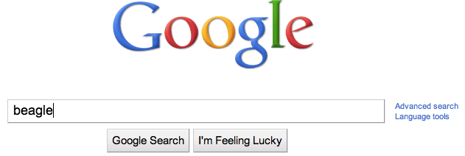
Web-based similarity
Ideas?
Notes:
yahoo and some others allow you API access to their search engine

Slide 51
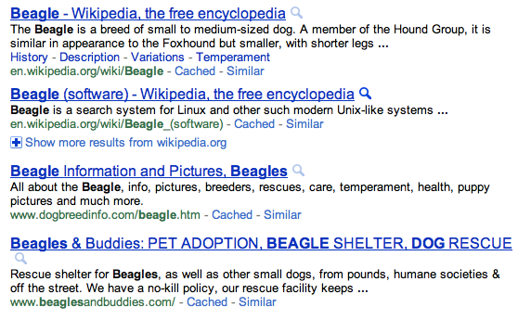
Web-based similarity
beagle
Notes:
yahoo and some others allow you API access to their search engine

Slide 52
Web-based similarity
Concatenate the snippets for the top N results
Concatenate the web page text for the top N results

Slide 53
Another feature weighting
TF- IDF weighting takes into account the general importance of a feature
For distributional similarity, we have the feature (f_{i}), but we also have the word itself (w) that we can use for information
sim(context_vector(dog), context_vector(beagle))
the: 5
is: 1
a: 4
breeds: 2
are: 1
intelligent: 5
…
the: 2
is: 1
a: 2
breed: 1
are: 1
intelligent: 1
and: 1
to: 1
modern: 1
…

Slide 54
Another feature weighting
Feature weighting ideas given this additional information?
sim(context_vector(dog), context_vector(beagle))
the: 5
is: 1
a: 4
breeds: 2
are: 1
intelligent: 5
…
the: 2
is: 1
a: 2
breed: 1
are: 1
intelligent: 1
and: 1
to: 1
modern: 1
…

Slide 55
Another feature weighting
count how likely feature f_{i} and word w are to occur together
incorporates co-occurrence
but also incorporates how often w and f_{i} occur in other instances
sim(context_vector(dog), context_vector(beagle))
Does IDF capture this?
Not really. IDF only accounts for f_{i} regardless of w

Slide 56
Mutual information
A bit more probability ☺
When will this be high and when will this be low?
What happens if x and y are independent/dependent?

Slide 57
Mutual information
A bit more probability ☺
if x and y are independent (i.e. one occurring doesn’t impact the other occurring) then:

Slide 58
Mutual information
A bit more probability ☺
if x and y are independent (i.e. one occurring doesn’t impact the other occurring) then:
What does this do to the sum?

Slide 59
Mutual information
A bit more probability ☺
if they are dependent then:

Slide 60
Mutual information
What is this asking?
When is this high?
How much more likely are we to see y given x has a particular value!

Slide 61
Point-wise mutual information
Mutual information
How related are two variables (i.e. over all possible values/events)
Point-wise mutual information
How related are two particular events/values

Slide 62
PMI weighting
Mutual information is often used for feature selection in many problem areas
PMI weighting weights co-occurrences based on their correlation (i.e. high PMI)
context_vector(beagle)
the: 2
is: 1
a: 2
breed: 1
are: 1
intelligent: 1
and: 1
to: 1
modern: 1
…
How do we calculate these?

