Slide 1
Text Similarity
David Kauchak
CS159 Spring 2023

Slide 2
Admin
Assignment 4a
  Solutions posted
  If you’re still unsure about questions 3 and 4, come talk to me.
Assignment 4b
Quiz #2 next Wednesday covering material through 3/1

Slide 3
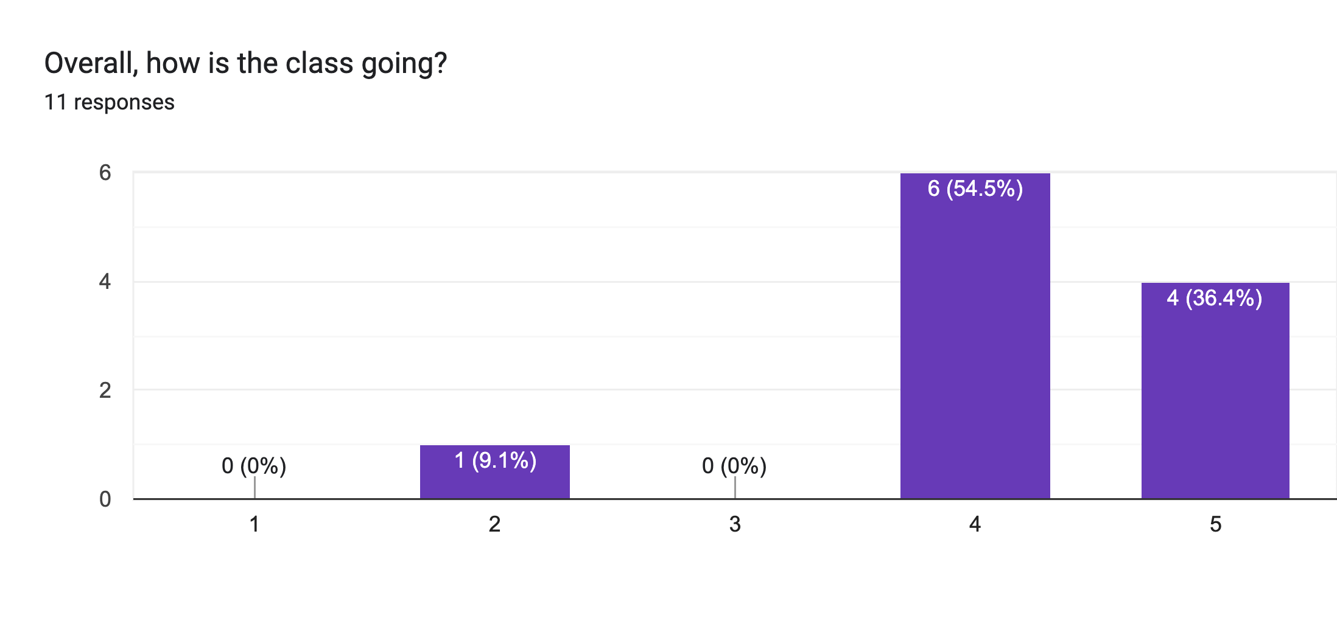
Course feedback

Slide 4
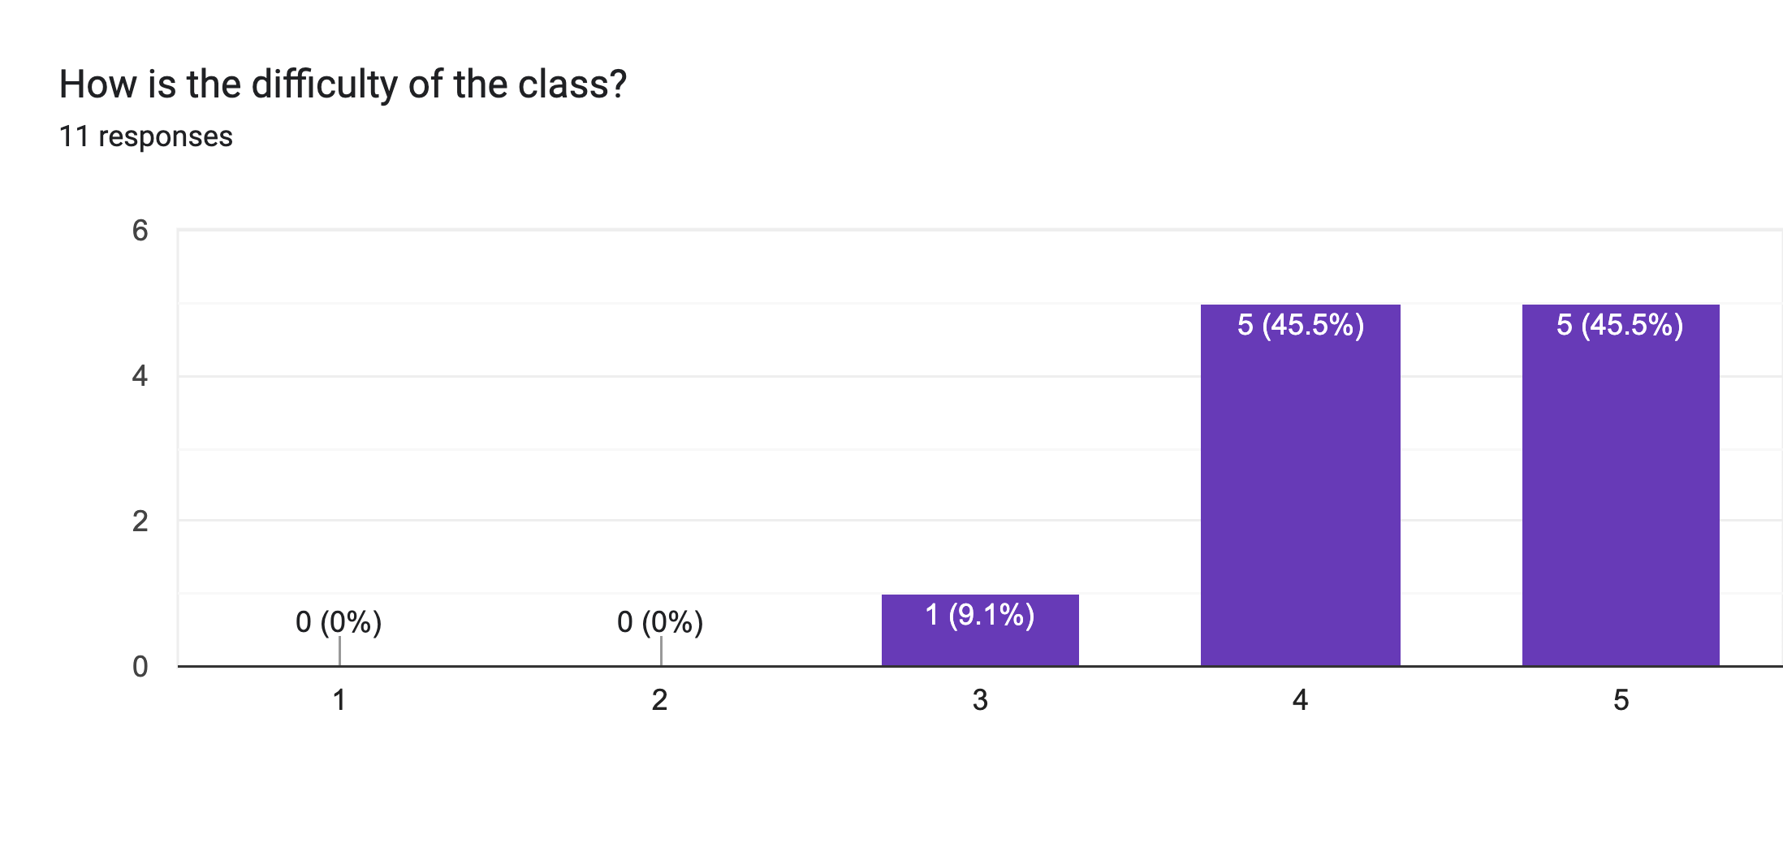
Course feedback

Slide 5
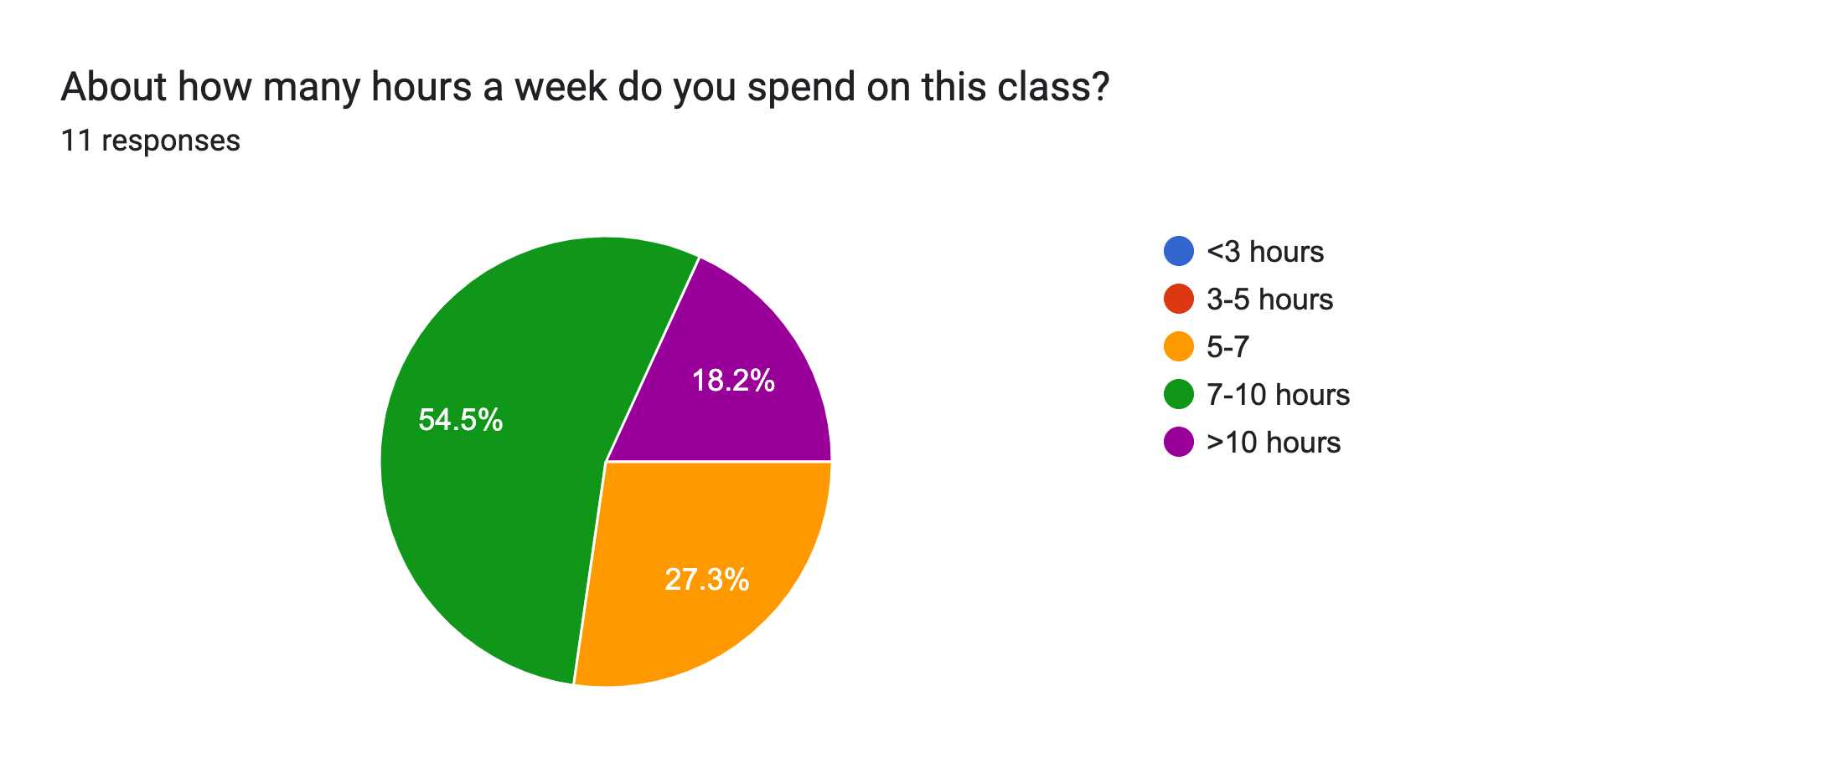
Course feedback

Slide 6
Course feedback
Completing the coding assignments and playing with the algorithms.
I do like how we really get into the trenches about implementing the algorithms.
It's very engaging and the homeworks are good for my coding skills
I am ambivalent towards the assignments. On one hand, they are extremely time intensive, but on the other, I feel proud after having completed them, and I feel I strengthened myself as a programmer.

Slide 7
Course feedback
Maybe including some content related to more recent NLP stuff would be interesting

Slide 8
Course feedback
Assignments need to be less vague, more detail on how we actually implement it. They are very interesting, but also very difficult.
Assignments could be more detailed

Slide 9
Course feedback
Not gonna lie, this class feels a lot harder than most of my other cs classes. The structure of the class feels less intuitive, and though related to the class material, the homeworks seem much harder than what we go over in class
way too much workload
the homeworks are veeery hard and time consuming

Slide 10
Course feedback
Maybe if we had a constant due date for assignments (like same day every week), we'd be able to organize time better. There have been times I was less free before deadlines which made completing the assignment and attending mentor sessions harder. If it was the same time every week, I feel like I would eventually find a routine for getting things done in time.

Slide 11
Text Similarity
A common question in NLP is how similar are texts
sim(
,
) = ?
score:
?
How could these be useful? Applications?
rank:

Slide 12
Text similarity: applications
Information retrieval (search)
Data set (e.g. web)
query

Slide 13
Text similarity: applications
Text classification
sports
These “documents” could be actual documents, for example using k-means or pseudo-documents, like a class centroid/average
politics
business

Slide 14
Text similarity: applications
Text clustering
Notes:
need some notion of the distance between text documents if we’re going to cluster them

Slide 15
Text similarity: applications
Automatic evaluation
human answer
sim
text to text
output
(machine translation,
summarization,
simplification)

Slide 16
Text similarity: applications
Word similarity
Word-sense disambiguation
sim( banana, apple ) = ?
I went to the bank to get some money.
financial bank
river bank

Slide 17
Text similarity: application
Automatic grader
Question: what is a variable?
Answer: a location in memory that can store a value
How good are:
a variable is a location in memory where a value can be stored
a named object that can hold a numerical or letter value
it is a location in the computer 's memory where it can be stored for use by a program
a variable is the memory address for a specific type of stored data or from a mathematical perspective a symbol representing a fixed definition with changing values
a location in memory where data can be stored and retrieved

Slide 18
Text similarity
There are many different notions of similarity depending on the domain and the application
Today, we’ll look at some different tools
There is no one single tool that works in all domains

Slide 19
Text similarity approaches
sim(
,
) = ?
A: When the defendant and his lawyer walked into the court, some of the victim supporters turned their backs to him.
B: When the defendant walked into the courthouse with his attorney, the crowd truned their backs on him.
How can we do this?

Slide 20
The basics: text overlap
Texts that have overlapping words are more similar
A: When the defendant and his lawyer walked into the court, some of the victim supporters turned their backs to him.
B: When the defendant walked into the courthouse with his attorney, the crowd truned their backs on him.

Slide 21
Word overlap: a numerical score
Idea 1: number of overlapping words
A: When the defendant and his lawyer walked into the court, some of the victim supporters turned their backs to him.
B: When the defendant walked into the courthouse with his attorney, the crowd truned their backs on him.
sim( T1, T2 ) = 11
problems?

Slide 22
Word overlap problems
Doesn’t take into account word order
Related: doesn’t reward longer overlapping sequences
A: defendant his the When lawyer into walked backs him the court, of supporters and some the victim turned their backs him to.
B: When the defendant walked into the courthouse with his attorney, the crowd truned their backs on him.
sim( T1, T2 ) = 11

Slide 23
Word overlap problems
Doesn’t take into account length
A: When the defendant and his lawyer walked into the court, some of the victim supporters turned their backs to him.
B: When the defendant walked into the courthouse with his attorney, the crowd truned their backs on him. I ate a large banana at work today and thought it was great!
sim( T1, T2 ) = 11

Slide 24
Word overlap problems
Doesn’t take into account synonyms
A: When the defendant and his lawyer walked into the court, some of the victim supporters turned their backs to him.
B: When the defendant walked into the courthouse with his attorney, the crowd truned their backs on him.
sim( T1, T2 ) = 11

Slide 25
Word overlap problems
Doesn’t take into account spelling mistakes
A: When the defendant and his lawyer walked into the court, some of the victim supporters turned their backs to him.
B: When the defendant walked into the courthouse with his attorney, the crowd truned their backs on him.
sim( T1, T2 ) = 11

Slide 26
Word overlap problems
Treats all words the same
A: When the defendant and his lawyer walked into the court, some of the victim supporters turned their backs to him.
B: When the defendant walked into the courthouse with his attorney, the crowd truned their backs on him.

Slide 27
Word overlap problems
May not handle frequency properly
A: When the defendant and his lawyer walked into the court, some of the victim supporters turned their backs to him. I ate a banana and then another banana and it was good!
B: When the defendant walked into the courthouse with his attorney, the crowd truned their backs on him. I ate a large banana at work today and thought it was great!

Slide 28
Word overlap: sets
A
and
backs
court
defendant
him
…
A: When the defendant and his lawyer walked into the court, some of the victim supporters turned their backs to him.
B: When the defendant walked into the courthouse with his attorney, the crowd truned their backs on him.
B
and
backs
courthouse
defendant
him
…
Notes:
View the text as a set of words.

Slide 29
Word overlap: sets
What is the overlap, using set notation?
  |A ∩ B| the size of the intersection
How can we incorporate length/size into this measure?

Slide 30
Word overlap: sets
What is the overlap, using set notation?
  |A ∩ B| the size of the intersection
How can we incorporate length/size into this measure?
Jaccard index (Jaccard similarity coefficient)
Dice’s coefficient

Slide 31
Word overlap: sets
How are these related?
Hint: break them down in terms of
words in A but not B
words in B but not A
words in both A and B

Slide 32
Word overlap: sets
in A but not B
in B but not A
Dice’s coefficient gives twice the weight to overlapping words

Slide 33
Set overlap
Our problems:
  word order
  length
  synonym
  spelling mistakes
  word importance
  word frequency
Set overlap measures can be good in some situations, but often we need more general tools

Slide 34
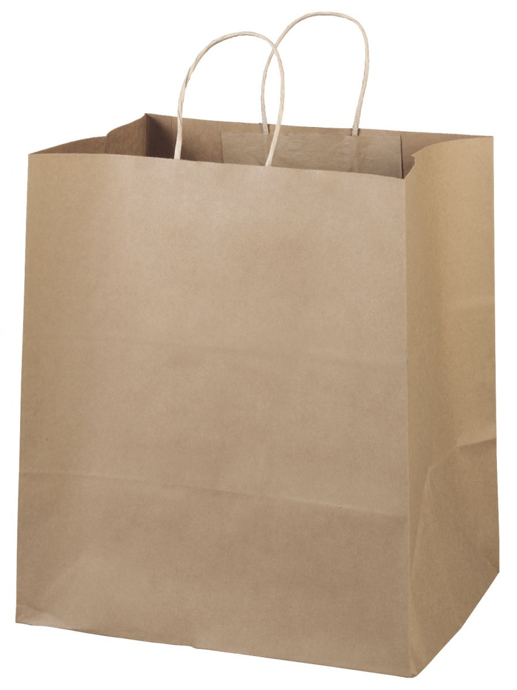
Bag of words representation
When the defendant and his lawyer walked into the court, some of the victim supporters turned their backs to him.
When the defendant and his lawyer walked into the court, some of the victim supporters turned their backs to him.
What information do we lose?

Slide 35
Bag of words representation
For now, let’s ignore word order:
Obama said banana repeatedly last week on tv, “banana, banana, banana”
“Bag of words representation”: multi-dimensional vector, one dimension per word in our vocabulary
(4, 1, 1, 0, 0, 1, 0, 0, …)
obama
said
california
across
tv
wrong
banana
capital
Frequency of word occurrence

Slide 36
Bag of words representation
http://membercentral.aaas.org/blogs/member-spotlight/tom-mitchell-studies-human-language-both-man-and-machine

Slide 37
Vector based word
A
a₁: When 1
a₂: the 2
a₃: defendant 1
a₄: and 1
a₅: courthouse 0
…
Multi-dimensional vectors, one dimension per word in our vocabulary
B
b₁: When 1
b₂: the 2
b₃: defendant 1
b₄: and 0
b₅: courthouse 1
…
How do we calculate the similarity based on these vectors?

Slide 38
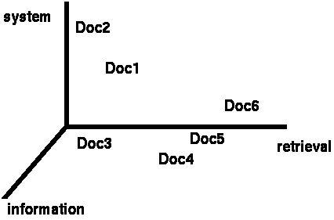
Vector based similarity
We have a |V|-dimensional vector space
Terms are axes of the space
Documents are points or vectors in this space
Very high-dimensional
This is a very sparse vector - most entries are zero
What question are we asking in this space for similarity?

Slide 39
Vector based similarity
Similarity relates to distance
We’d like to measure the similarity of documents in the |V| dimensional space
What are some distance measures?

Slide 40
Distance measures
Euclidean (L2)
Manhattan (L1)
What do these mean for our bag of word vectors?

Slide 41
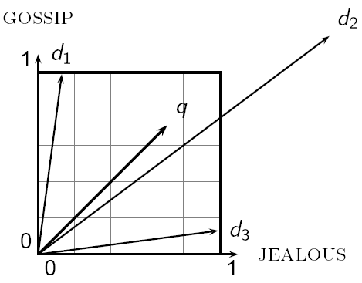
Distance can be problematic
Which d is closest to q using one of the previous distance measures?
Which do you think should be closer?

Slide 42
Distance can be problematic
The Euclidean (or L1) distance between q and d₂ is large even though the distribution of words is similar

Slide 43
Use angle instead of distance
Thought experiment:
  take a document d
  make a new document d’ by concatenating two copies of d
  “Semantically” d and d’ have the same content
What is the Euclidean distance between d and d’? What is the angle between them?
  The Euclidean distance can be large
  The angle between the two documents is 0

Slide 44
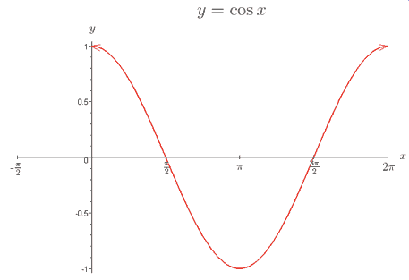
From angles to cosines
Cosine is a monotonically decreasing function for the interval [0º, 180º]
decreasing angle is equivalent to increasing cosine of that angle
(larger cosine means more similar)
0º: close together
180º: far apart

Slide 45
Near and far
https://youtu.be/E9IuXEwpU7U

Slide 46
cosine
How do we calculate the cosine between two vectors?

Slide 47
Cosine of two vectors
Dot product
Dot product between unit length vectors

Slide 48
Cosine as a similarity
ignoring length normalization
Just another distance measure, like the others:

Slide 49
Cosine as a similarity
ignoring length normalization
For bag of word vectors, what does this do?

Slide 50
Cosine as a similarity
ignoring length normalization
Only words that occur in both documents count towards similarity
Words that occur more frequently in both receive more weight

Slide 51
Length normalization
A vector can be length-normalized by dividing each of its components by its length
Often, we’ll use L₂ norm (could also normalize by other norms):
Dividing a vector by its L₂ norm makes it a unit (length) vector

Slide 52
Unit length vectors
1
1
1
1
In many situations, normalization improves similarity, but not in all situations

Slide 53
Normalized distance measures
Cosine
L2
L1
a’ and b’ are length normalized versions of the vectors

Slide 54
Distance measures
Cosine
L2
L1
Cosine is the most common measure. Why do you think?

Slide 55
Distance measures
Cosine
L2
L1
L1 and L2 penalize sentences for not having words, i.e. if a has it but b doesn’t
Cosine can be significantly faster since it only calculates over the intersection

Slide 56
Our problems
Which of these have we addressed?
  word order
  length
  synonym
  spelling mistakes
  word importance
  word frequency

Slide 57
Our problems
Which of these have we addressed?
  word order
  length
  synonym
  spelling mistakes
  word importance
  word frequency

Slide 58
Word overlap problems
Treats all words the same
A: When the defendant and his lawyer walked into the court, some of the victim supporters turned their backs to him.
B: When the defendant walked into the courthouse with his attorney, the crowd truned their backs on him.
Ideas?

Slide 59
Word importance
Include a weight for each word/feature
A
a₁: When 1
a₂: the 2
a₃: defendant 1
a₄: and 1
a₅: courthouse 0
…
w₁
w₂
w₃
w₄
w₅
…
B
b₁: When 1
b₂: the 2
b₃: defendant 1
b₄: and 0
b₅: courthouse 1
…
w₁
w₂
w₃
w₄
w₅
…

Slide 60
Distance + weights
We can incorporate the weights into the distances
Think of it as either (both work out the same):
  preprocessing the vectors by multiplying each dimension by the weight
  incorporating it directly into the similarity measure

Slide 61
Idea: use corpus statistics
the
defendant
What would be a quantitative measure of word importance?

Slide 62
Document frequency
document frequency (DF) is one measure of word importance
Terms that occur in many documents are weighted less, since overlapping with these terms is very likely
  In the extreme case, take a word like the that occurs in almost EVERY document
Terms that occur in only a few documents are weighted more

Slide 63
Document vs. overall frequency
The overall frequency of a word is the number of occurrences in a dataset, counting multiple occurrences
Example:
Word | Overall frequency | Document frequency
insurance | 10440 | 3997
try | 10422 | 8760
Which word is a more informative (and should get a higher weight)?

Slide 64
Document frequency
Word | Collection frequency | Document frequency
insurance | 10440 | 3997
try | 10422 | 8760
Document frequency is often related to word importance, but we want an actual weight. Problems?

Slide 65
From document frequency to weight
Word | Collection frequency | Document frequency
insurance | 10440 | 3997
try | 10422 | 8760
weight and document frequency are inversely related
  higher document frequency should have lower weight and vice versa
document frequency is unbounded
document frequency will change depending on the size of the data set (i.e. the number of documents)

Slide 66
Inverse document frequency
# of documents in dataset
document frequency of w
IDF is inversely correlated with DF
  higher DF results in lower IDF
N incorporates a dataset dependent normalizer
log dampens the overall weight

Slide 67
IDF example, suppose N=1 million
term | df_{t} | idf_{t}
calpurnia | 1
animal | 100
sunday | 1,000
fly | 10,000
under | 100,000
the | 1,000,000
What are the IDFs assuming log base 10?

Slide 68
IDF example, suppose N=1 million
term | df_{t} | idf_{t}
calpurnia | 1 | 6
animal | 100 | 4
sunday | 1,000 | 3
fly | 10,000 | 2
under | 100,000 | 1
the | 1,000,000 | 0
There is one idf value/weight for each word

Slide 69
IDF example, suppose N=1 million
term | df_{t} | idf_{t}
calpurnia | 1
animal | 100
sunday | 1,000
fly | 10,000
under | 100,000
the | 1,000,000
What if we didn’t use the log to dampen the weighting?

Slide 70
IDF example, suppose N=1 million
term | df_{t} | idf_{t}
calpurnia | 1 | 1,000,000
animal | 100 | 10,000
sunday | 1,000 | 1,000
fly | 10,000 | 100
under | 100,000 | 10
the | 1,000,000 | 1
What if we didn’t use the log to dampen the weighting?

Slide 71
TF-IDF
One of the most common weighting schemes
TF = term frequency
IDF = inverse document frequency
TF
IDF (word importance weight )
We can then use this with any of our similarity measures!

Slide 72
Stoplists: extreme weighting
Some words like ‘a’ and ‘the’ will occur in almost every document
  IDF will be 0 for any word that occurs in all documents
  For words that occur in almost all of the documents, they will be nearly 0
A stoplist is a list of words that should not be considered (in this case, similarity calculations)
  Sometimes this is the n most frequent words
  Often, it’s a list of a few hundred words manually created

Slide 73
Stoplist
I
a
aboard
about
above
across
after
afterwards
against
agin
ago
agreed-upon
ah
alas
albeit
all
all-over
almost
along
alongside
altho
although
amid
amidst
among
amongst
an
and
another
any
anyone
anything
around
as
aside
astride
at
atop
avec
away
back
be
because
before
beforehand
behind
behynde
below
beneath
beside
besides
between
bewteen
beyond
bi
both
but
by
ca.
de
des
despite
do
down
due
durin
during
each
eh
either
en
every
ever
everyone
everything
except
far
fer
for
from
go
goddamn
goody
gosh
half
have
he
hell
her
herself
hey
him
himself
his
ho
how
If most of these end up with low weights anyway, why use a stoplist?

Slide 74
Stoplists
Two main benefits
  More fine grained control: some words may not be frequent, but may not have any content value (alas, teh, gosh)
  Often does contain many frequent words, which can drastically reduce our storage and computation
Any downsides to using a stoplist?
  For some applications, some stop words may be important

Slide 75
Text similarity so far…
Set based – easy and efficient to calculate
  word overlap
  Jaccard
  Dice
Vector based
  create a feature vector based on word occurrences (or other features)
  Can use any distance measures
    L1 (Manhattan)
    L2 (Euclidean)
    Cosine (most common)
  Normalize the length
  Feature/dimension weighting
    inverse document frequency (IDF)

