Slide 1
Neural networks
David Kauchak
CS159 – Fall 2020

Slide 2
Admin
Assignment 7
Final project proposal

Slide 3
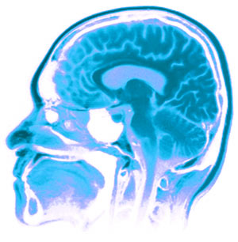
Neural Networks
Neural Networks try to mimic the structure and function of our nervous system
People like biologically motivated approaches

Slide 4
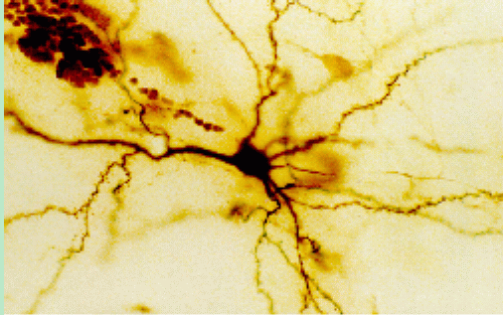
Our Nervous System
Neuron
What do you know?

Slide 5
Our nervous system: the computer science view
the human brain is a large collection of interconnected neurons
a NEURON is a brain cell
  they collect, process, and disseminate electrical signals
  they are connected via synapses
  they FIRE depending on the conditions of the neighboring neurons

Slide 6
Artificial Neural Networks
Node (Neuron)
Edge (synapses)
our approximation

Slide 7
Node A
Weight w
Node B
(neuron)
(neuron)
W is the strength of signal sent between A and B.
If A fires and w is positive, then A stimulates B.
If A fires and w is negative, then A inhibits B.

Slide 8
…
Neurons often have many, many connected input neurons
If a neuron is stimulated enough, then it also fires
How much stimulation is required is determined by its threshold

Slide 9
A Single Neuron/Perceptron
Input x₁
Each input contributes:
x_{i} * w_{i}
Weight w₁
Weight w₂
Input x₂
Output y
threshold function
Input x₃
Weight w₃
Weight w₄
Input x₄

Slide 10
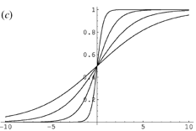
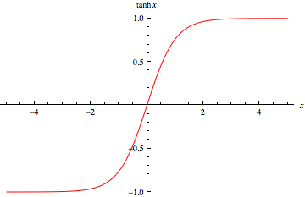
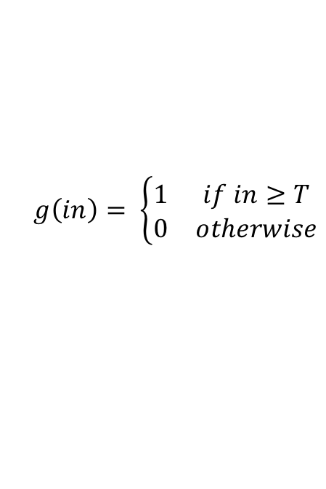
Activation functions
hard threshold:
sigmoid
tanh x
$$g\left(in\right)= \left\{\begin{matrix}1 & if in≥T \\ 0 & otherwise\end{matrix}\right.$$
why other threshold functions?
Notes:
Allow us to model more than just 0/1 outputs
Differentiable! (this will come into play in a minute)

Slide 11
A Single Neuron/Perceptron
1
1
1
-1
?
0
1
Threshold of 1
0.5
1

Slide 12
A Single Neuron/Perceptron
1
1
1
-1
?
0
1
Threshold of 1
0.5
1
1*1 + 1*-1 + 0*1 + 1*0.5 = 0.5

Slide 13
A Single Neuron/Perceptron
1
1
1
-1
0
Weighted sum is 0.5, which is not larger than the threshold
0
1
Threshold of 1
0.5
1

Slide 14
A Single Neuron/Perceptron
1
1
0
-1
?
0
1
Threshold of 1
0.5
1
1*1 + 0*-1 + 0*1 + 1*0.5 = 1.5

Slide 15
A Single Neuron/Perceptron
1
1
0
-1
1
Weighted sum is 1.5, which is larger than the threshold
0
1
Threshold of 1
0.5
1

Slide 16
Neural network
inputs
Individual perceptrons/neurons
Notes:
- often we view a slice of them

Slide 17
Neural network
some inputs are provided/entered
inputs
Notes:
- often we view a slice of them

Slide 18
Neural network
inputs
each perceptron computes and calculates an answer
Notes:
- often we view a slice of them

Slide 19
Neural network
inputs
those answers become inputs for the next level
Notes:
- often we view a slice of them

Slide 20
Neural network
inputs
finally get the answer after all levels compute
Notes:
- often we view a slice of them

Slide 21
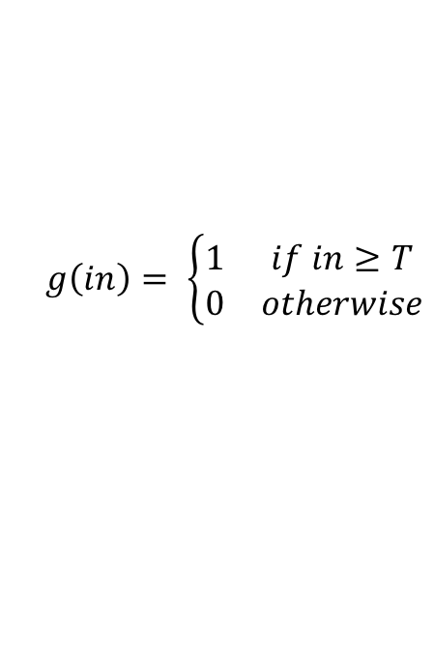
Computation (assume threshold 0)
0.5
0
0
0.5
1
-1
-0.5
1
1
0.5
1
$$g\left(in\right)= \left\{\begin{matrix}1 & if in≥T \\ 0 & otherwise\end{matrix}\right.$$

Slide 22
Computation
-0.05-0.02= -0.07
0.05
0.483
0.483*0.5+0.495=0.7365
-1
0.03
0.5
-0.02
0.676
0.01
1
1
0.495
-0.03+0.01=-0.02

Slide 23
Neural networks
Different kinds/characteristics of networks
inputs
inputs
inputs
inputs
How are these different?

Slide 24
Hidden units/layers
inputs
inputs
hidden units/layer
Feed forward networks

Slide 25
Hidden units/layers
inputs
Can have many layers of hidden units of differing sizes
To count the number of layers, you count all but the inputs
…

Slide 26
Hidden units/layers
inputs
inputs
2-layer network
3-layer network

Slide 27
Alternate ways of visualizing
Sometimes the input layer will be drawn with nodes as well
inputs
inputs
2-layer network
2-layer network

Slide 28
Multiple outputs
inputs
0
1
Can be used to model multiclass datasets or more interesting predictors, e.g. images

Slide 29
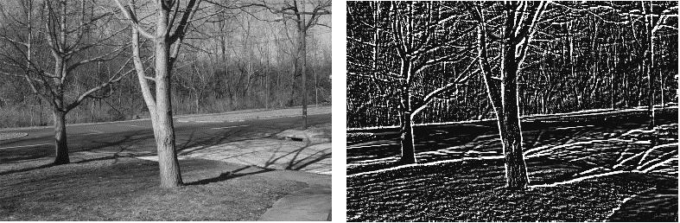
Multiple outputs
input
output
(edge detection)

Slide 30
Neural networks
inputs
Recurrent network
Output is fed back to input
Can support memory!
Good for temporal data

Slide 31
History of Neural Networks
McCulloch and Pitts (1943) – introduced model of artificial neurons and suggested they could learn
Hebb (1949) – Simple updating rule for learning
Rosenblatt (1962) - the perceptron model
Minsky and Papert (1969) – wrote Perceptrons
Bryson and Ho (1969, but largely ignored until 1980s--Rosenblatt) – invented back-propagation learning for multilayer networks

