Slide 1
Naïve bayes continued
David Kauchak
CS159 Fall 2020

Slide 2
Admin
Assignment 6b
No class Tuesday
Assignment 7 out Monday

Slide 3
Final project
Your project should relate to something involving NLP
Your project must include a solid experimental evaluation
Your project should be in a group of 2-4. If you’d like to do it solo, please come talk to me.

Slide 4
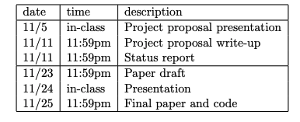
Final project
Read the final project handout ASAP!
Start forming groups and thinking about what you want to do

Slide 5
Final project ideas
pick a text classification task
  evaluate different machine learning methods
  implement a machine learning method
  analyze different feature categories
n-gram language modeling
  implement and compare other smoothing techniques
  implement alternative models
parsing
  lexicalized PCFG (with smoothing)
  n-best list generation
  parse output reranking
  implement another parsing approach and compare
  parsing non-traditional domains (e.g. twitter)
EM
  try and implement IBM model 2
  word-level translation models

Slide 6
Final project application areas
spelling correction
part of speech tagger
text chunker
dialogue generation
pronoun resolution
compare word similarity measures (more than the ones we looked at)
word sense disambiguation
machine translation
information retrieval
information extraction
question answering
summarization
speech recognition

Slide 7
Basic steps for probabilistic modeling
Probabilistic models
Step 1: pick a model
Step 2: figure out how to estimate the probabilities for the model
Step 3 (optional): deal with overfitting
Which model do we use, i.e. how do we calculate p(feature, label)?
How do train the model, i.e. how to we we estimate the probabilities for the model?
How do we deal with overfitting?

Slide 8
Naïve Bayes assumption
Assumes feature i is independent of the the other features given the label

Slide 9

Generative Story
To classify with a model, we’re given an example and we obtain the probability
We can also ask how a given model would generate an example
This is the “generative story” for a model
Looking at the generative story can help understand the model
We also can use generative stories to help develop a model
Notes:
- although we don’t generally “generate” a document from a model, it’s often useful to look at the generative story of a model (i.e. how the model says a document was generate) to help us understand why the model assigns certain probabilities

Slide 10
Bernoulli NB generative story
Pick a label according to p(y)
  roll a biased, num_labels-sided die
For each feature:
  Flip a biased coin:
    if heads, include the feature
    if tails, don’t include the feature
What does this mean for text classification, assuming unigram features?

Slide 11
Bernoulli NB generative story
Pick a label according to p(y)
  roll a biased, num_labels-sided die
For each word in your vocabulary:
  Flip a biased coin:
    if heads, include the word in the text
    if tails, don’t include the word

Slide 12
Bernoulli NB
Pros
  Easy to implement
  Fast!
  Can be done on large data sets
Cons
  Naïve Bayes assumption is generally not true
  Performance isn’t as good as other models
  For text classification (and other sparse feature domains) the p(x_{i}=0|y) can be problematic

Slide 13
Another generative story
Randomly draw words from a “bag of words” until document length is reached
w₁
w₃
w₂
w₁
w₁
w₁
w₃

Slide 14
Draw words from a fixed distribution
Selected:
w₁
w₃
w₂
w₁
w₁
w₁
w₃

Slide 15
Draw words from a fixed distribution
Selected:
w₁
Put a copy of w₁ back
w₁
w₃
sampling with replacement
w₂
w₁
w₁
w₁
w₃

Slide 16
Draw words from a fixed distribution
Selected:
w₁
w₁
w₁
w₃
w₂
w₁
w₁
w₃

Slide 17
Draw words from a fixed distribution
Selected:
w₁
w₁
Put a copy of w₁ back
w₁
w₃
sampling with replacement
w₂
w₁
w₁
w₁
w₃

Slide 18
Draw words from a fixed distribution
Selected:
w₁
w₁
w₂
w₁
w₃
w₁
w₁
w₁
w₃

Slide 19
Draw words from a fixed distribution
Selected:
w₁
w₁
w₂
Put a copy of w₂ back
w₁
w₃
sampling with replacement
w₂
w₁
w₁
w₁
w₃

Slide 20
Draw words from a fixed distribution
Selected:
w₁
w₁
w₂
…
w₁
w₃
w₂
w₁
w₁
w₁
w₃

Slide 21
Draw words from a fixed distribution
Is this a NB model, i.e. does it assume each individual word occurrence is independent?
w₁
w₃
w₂
w₁
w₁
w₁
w₃

Slide 22
Draw words from a fixed distribution
Yes! Doesn’t matter what words were drawn previously, still the same probability of getting any particular word
w₁
w₃
w₂
w₁
w₁
w₁
w₃

Slide 23
Draw words from a fixed distribution
Does this model handle multiple word occurrences?
w₁
w₃
w₂
w₁
w₁
w₁
w₃

Slide 24
Draw words from a fixed distribution
Selected:
w₁
w₁
w₂
…
w₁
w₃
w₂
w₁
w₁
w₁
w₃

Slide 25
NB generative story
Bernoulli NB
Multinomial NB
Pick a label according to p(y)
  roll a biased, num_labels-sided die
For each word in your vocabulary:
  Flip a biased coin:
    if heads, include the word in the text
    if tails, don’t include the word
Pick a label according to p(y)
  roll a biased, num_labels-sided die
Keep drawing words from p(words|y) until text length has been reached.

Slide 26
Probabilities
Bernoulli NB
Multinomial NB
Pick a label according to p(y)
  roll a biased, num_labels-sided die
For each word in your vocabulary:
  Flip a biased coin:
    if heads, include the word in the text
    if tails, don’t include the word
Pick a label according to p(y)
  roll a biased, num_labels-sided die
Keep drawing words from p(words|y) until document length has been reached
?
(1, 1, 1, 0, 0, 1, 0, 0, …)
(4, 1, 2, 0, 0, 7, 0, 0, …)
w₁
w₂
w₄
w₈
w₇
w₆
w₁
w₂
w₄
w₈
w₃
w₅
w₇
w₆
w₃
w₅

Slide 27
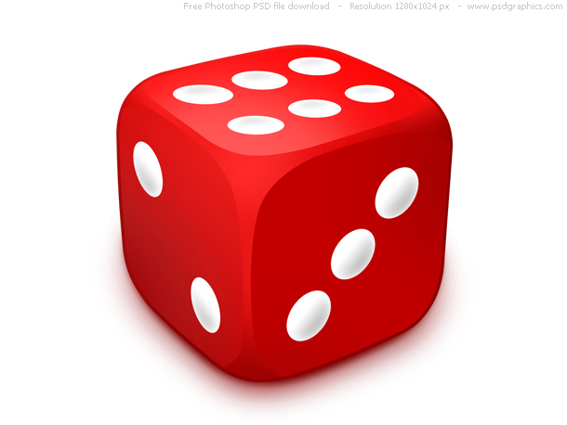
A digression: rolling dice
What’s the probability of getting a 3 for a single roll of this dice?
1/6

Slide 28
A digression: rolling dice
What is the probability distribution over possible single rolls?
1/6
1/6
1/6
1/6
1/6
1/6
1
2
3
4
5
6

Slide 29
A digression: rolling dice
What if I told you 1 was twice as likely as the others?
2/7
1/7
1/7
1/7
1/7
1/7
1
2
3
4
5
6

Slide 30
A digression: rolling dice
What if I rolled 400 times and got the following number?
1: 100
2: 50
3: 50
4: 100
5: 50
6: 50
1/4
1/8
1/8
1/4
1/8
1/8
1
2
3
4
5
6

Slide 31
A digression: rolling dice
What is the probability of rolling a 1 and a 5 (in any order)?
Two 1s and a 5 (in any order)?
Five 1s and two 5s (in any order)?
1/4
1/8
1/8
1/4
1/8
1/8
1
2
3
4
5
6

Slide 32
A digression: rolling dice
What it the probability of rolling a 1 and a 5 (in any order)?
Two 1s and a 5 (in any order)?
Five 1s and two 5s (in any order)?
(1/4 * 1/8) * 2 = 1/16
number of ways that can happen
(1,5 and 5,1)
prob. of those two rolls
((1/4)² * 1/8) * 3 = 3/128
((1/4)⁵ * (1/8)³) * 21 = 21/524,288 = 0.00004
General formula?
1/4
1/8
1/8
1/4
1/8
1/8
1
2
3
4
5
6

Slide 33
Multinomial distribution
Multinomial distribution: independent draws over m possible categories
If we have frequency counts x1, x2, …, xm over each of the categories, the probability is:
number of different ways to get those counts
probability of particular counts
θ₁
θ₂
θ₃
θ₄
θ₅
θ₆
…
1
2
3
4
5
6

Slide 34
Multinomial distribution
What are θ_{j}?
Are there any constraints on the values that they can take?
θ₁
θ₂
θ₃
θ₄
θ₅
θ₆
…
1
2
3
4
5
6

Slide 35
Multinomial distribution
θ_{j}: probability of rolling “j”
θ₁
θ₂
θ₃
θ₄
θ₅
θ₆
…
1
2
3
4
5
6

Slide 36
Back to words…
Why the digression?
Drawing words from a bag is the same as rolling a die!
number of sides = number of words in the vocabulary

Slide 37
Back to words…
Why the digression?
θ_{j} for class y

Slide 38
Basic steps for probabilistic modeling
Model each class as a multinomial:
Step 2: figure out how to estimate the probabilities for the model
How do we train the model, i.e. estimate θ_{j} for each class?

Slide 39
A digression: rolling dice
What if I rolled 400 times and got the following number?
1: 100
2: 50
3: 50
4: 100
5: 50
6: 50
1/4
1/8
1/8
1/4
1/8
1/8
1
2
3
4
5
6

Slide 40
Training a multinomial
label₁
label₂
1/4
1/8
1/8
1/4
1/8
1/8
1
2
3
4
5
6

Slide 41
Training a multinomial
label₁
For each label, y:
w1: 100 times
w2: 50 times
w3: 10 times
w4: …
number of times word w_{j} occurs in label y docs
total number of words in label y docs
1/4
1/8
1/8
1/4
1/8
1/8
1
2
3
4
5
6

Slide 42
Classifying with a multinomial
(10, 2, 6, 0, 0, 1, 0, 0, …)
w₁
w₂
w₄
w₆
w₇
w₈
w₃
w₅
Any way I can make this simpler?
pick largest

Slide 43
Classifying with a multinomial
(10, 2, 6, 0, 0, 1, 0, 0, …)
w₁
w₂
w₄
w₆
w₇
w₈
w₃
w₅
Is a constant!
pick largest

Slide 44
Multinomial finalized
Training:
  Calculate p(label)
  For each label, calculate θs
Classification:
  Get word counts
  For each label you had in training, calculate:
  and pick the largest

Slide 45
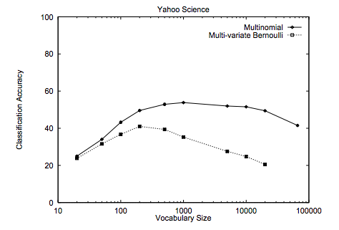
Multinomial vs. Bernoulli?
Handles word frequency
Given enough data, tends to performs better
http://www.cs.cmu.edu/~knigam/papers/multinomial-aaaiws98.pdf

Slide 46
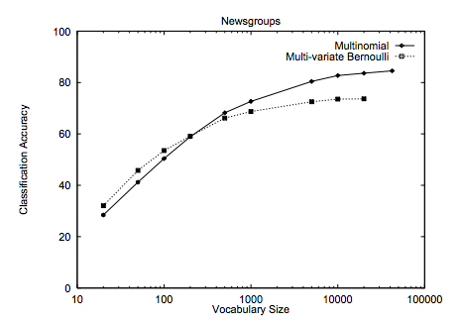
Multinomial vs. Bernoulli?
Handles word frequency
Given enough data, tends to performs better
http://www.cs.cmu.edu/~knigam/papers/multinomial-aaaiws98.pdf

Slide 47
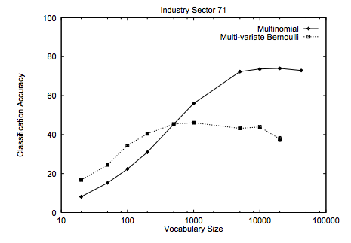
Multinomial vs. Bernoulli?
Handles word frequency
Given enough data, tends to performs better
http://www.cs.cmu.edu/~knigam/papers/multinomial-aaaiws98.pdf

Slide 48
Maximum likelihood estimation
Intuitive
Sets the probabilities so as to maximize the probability of the training data
Problems?
  Overfitting!
  Amount of data
    particularly problematic for rare events
  Is our training data representative

Slide 49
Basic steps for probabilistic modeling
Probabilistic models
Step 1: pick a model
Step 2: figure out how to estimate the probabilities for the model
Step 3 (optional): deal with overfitting
Which model do we use, i.e. how do we calculate p(feature, label)?
How do train the model, i.e. how to we we estimate the probabilities for the model?
How do we deal with overfitting?

Slide 50
Unseen events
positive
banana: 2
training data
negative
banana: 0
What will θ_{banana} be for the negative class?

Slide 51
Unseen events
positive
banana: 2
training data
negative
banana: 0
What will θ_{banana} be for the negative class?
0!
Is this a problem?

Slide 52
Unseen events
positive
banana: 2
training data
negative
banana: 0
p(“I ate a bad banana”, negative) = ?

Slide 53
Unseen events
positive
banana: 2
training data
negative
banana: 0
p(“I ate a bad banana”, negative) = 0
p(“…. banana …”, negative) = 0
Solution?

Slide 54
Add lambda smoothing
training data
for each label, pretend like we’ve seen each feature/word occur in λ additional examples

Slide 55
Different than…
positive
banana: 0
training data
negative
banana: 0
How is this problem different?

Slide 56
Different than…
positive
banana: 0
training data
negative
banana: 0
p(“I ate a bad banana”, positive)
p(“I ate a bad”, positive)
p(“I ate a bad banana”, negative)
p(“I ate a bad”, negative)
Out of vocabulary. Many ways to solve… for our implementation, we’ll just ignore them.

