Slide 1
Machine Learning basics
David Kauchak CS159 Fall 2020

Slide 2
Admin
Assignment 6a

Slide 3
Machine Learning is…
Machine learning, a branch of artificial intelligence, concerns the construction and study of systems that can learn from data.

Slide 4
Machine Learning is…
Machine learning is programming computers to optimize a performance criterion using example data or past experience.
-- Ethem Alpaydin
The goal of machine learning is to develop methods that can automatically detect patterns in data, and then to use the uncovered patterns to predict future data or other outcomes of interest.
-- Kevin P. Murphy
The field of pattern recognition is concerned with the automatic discovery of regularities in data through the use of computer algorithms and with the use of these regularities to take actions.
-- Christopher M. Bishop

Slide 5
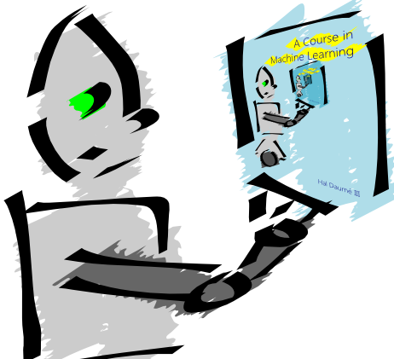
Machine Learning is…
Machine learning is about predicting the future based on the past.
-- Hal Daume III

Slide 6
Machine Learning is…
Machine learning is about predicting the future based on the past.
-- Hal Daume III
past
future
predict
learn
Training
Data
model/
predictor
Testing
Data
model/
predictor

Slide 7
Why machine learning?
Lot’s of data
Hand-written rules just don’t do it
Performance can be much better than what people can do
Why not just study machine learning?
Domain knowledge/expertise is still very important
What types of features to use
What models are important

Slide 8
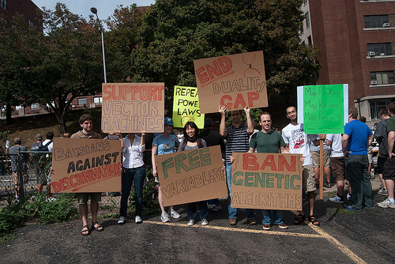
Why machine learning?
Be able to laugh at these signs

Slide 9
Machine learning problems
What high-level machine learning problems have you seen or heard of before?

Slide 10
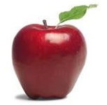
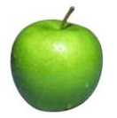
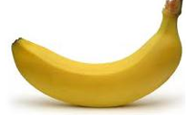
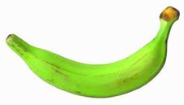
Data
examples
Data

Slide 11
Data
examples
Data

Slide 12
Data
examples
Data

Slide 13
Data
examples
Data

Slide 14
Supervised learning
examples
label
label₁
label₃
labeled examples
label₄
label₅
Supervised learning: given labeled examples

Slide 15
Supervised learning
label
label₁
model/
predictor
label₃
label₄
label₅
Supervised learning: given labeled examples

Slide 16
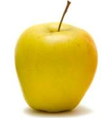
Supervised learning
model/
predictor
predicted label
Supervised learning: learn to predict new example

Slide 17
Supervised learning: classification
label
apple
Classification: a finite set of labels
apple
banana
banana
Supervised learning: given labeled examples

Slide 18
NLP classification applications
Document classification
spam
sentiment analysis
topic classification
Does linguistics phenomena X occur in text Y?
Digit recognition
Grammatically correct or not?
Word sense disambiguation
Any question you can pose as to have a discrete set of labels/answers!

Slide 19
Supervised learning: regression
label
-4.5
Regression: label is real-valued
10.1
3.2
4.3
Supervised learning: given labeled examples

Slide 20
Regression Example
Price of a used car
x : car attributes (e.g. mileage)
y : price
y = wx+w₀

Slide 21
Regression applications
How many clicks will a particular website, ad, etc. get?
Predict the readability level of a document
Predict pause between spoken sentences?
Economics/Finance: predict the value of a stock
Car/plane navigation: angle of the steering wheel, acceleration, …
…

Slide 22
Supervised learning: ranking
label
1
Ranking: label is a ranking
4
2
3
Supervised learning: given labeled examples

Slide 23
NLP Ranking Applications
reranking N-best output lists (e.g. parsing, machine translation, …)
Rank possible simplification options
flight search (search in general)
…

Slide 24
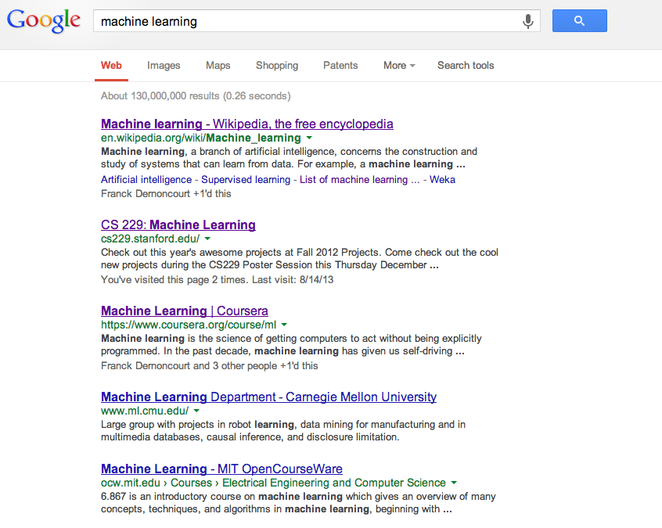
Ranking example
Given a query and
a set of web pages,
rank them according
to relevance

Slide 25
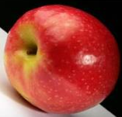
Unsupervised learning
Unsupervised learning: given data, i.e. examples, but no labels

Slide 26
Unsupervised learning applications
learn clusters/groups without any label
cluster documents
cluster words (synonyms, parts of speech, …)
compression
bioinformatics: learn motifs
…

Slide 27
Reinforcement learning
left, right, straight, left, left, left, straight
GOOD
left, straight, straight, left, right, straight, straight
BAD
left, right, straight, left, left, left, straight
18.5
left, straight, straight, left, right, straight, straight
-3
Given a sequence of examples/states and a reward after completing that sequence, learn to predict the action to take in for an individual example/state

Slide 28
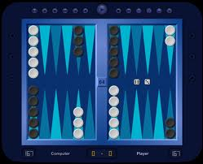
Reinforcement learning example
Backgammon
…
WIN!
…
LOSE!
Given sequences of moves and whether or not the player won at the end, learn to make good moves

Slide 29
Reinforcement learning example
https://www.youtube.com/watch?v=tXlM99xPQC8

Slide 30
Other learning variations
What data is available:
Supervised, unsupervised, reinforcement learning
semi-supervised, active learning, …
How are we getting the data:
online vs. offline learning
Type of model:
generative vs. discriminative
parametric vs. non-parametric

Slide 31
Text classification
label
spam
For this class, I’m mostly going to focus on classification
I’ll use text classification as a running example
not spam
not spam

Slide 32
Representing examples
examples
What is an example?
How is it represented?

Slide 33
Features
examples
features
How our algorithms actually “view” the data
Features are the questions we can ask about the examples
f₁, f₂, f₃, …, f_{n}
f₁, f₂, f₃, …, f_{n}
f₁, f₂, f₃, …, f_{n}
f₁, f₂, f₃, …, f_{n}

Slide 34
Features
examples
features
How our algorithms actually “view” the data
Features are the questions we can ask about the examples
red, round, leaf, 3oz, …
green, round, no leaf, 4oz, …
yellow, curved, no leaf, 4oz, …
green, curved, no leaf, 5oz, …

Slide 35
Text: raw data
Raw data
Features?

Slide 36
Feature examples
Raw data
Features
Clinton said banana repeatedly last week on tv, “banana, banana, banana”
(1, 1, 1, 0, 0, 1, 0, 0, …)
clinton
said
california
across
tv
wrong
banana
capital
Occurrence of words (unigrams)

Slide 37
Feature examples
Raw data
Features
Clinton said banana repeatedly last week on tv, “banana, banana, banana”
(4, 1, 1, 0, 0, 1, 0, 0, …)
clinton
said
california
across
tv
wrong
banana
capital
Frequency of word occurrence (unigram frequency)

Slide 38
Feature examples
Raw data
Features
Clinton said banana repeatedly last week on tv, “banana, banana, banana”
(1, 1, 1, 0, 0, 1, 0, 0, …)
clinton said
said banana
across the
tv banana
wrong way
capital city
california schools
banana repeatedly
Occurrence of bigrams

Slide 39
Feature examples
Raw data
Features
Clinton said banana repeatedly last week on tv, “banana, banana, banana”
(1, 1, 1, 0, 0, 1, 0, 0, …)
clinton said
said banana
across the
tv banana
wrong way
capital city
california schools
banana repeatedly
Other features?

Slide 40
Lots of other features
POS: occurrence, counts, sequence
Constituents
Whether ‘V1agra’ occurred 15 times
Whether ‘banana’ occurred more times than ‘apple’
If the document has a number in it
…
Features are very important, but we’re going to focus on the model

Slide 41
Classification revisited
examples
label
red, round, leaf, 3oz, …
apple
learn
green, round, no leaf, 4oz, …
apple
model/
classifier
yellow, curved, no leaf, 4oz, …
banana
green, curved, no leaf, 5oz, …
banana
During learning/training/induction, learn a model of what distinguishes apples and bananas based on the features

Slide 42
Classification revisited
predict
Apple or banana?
model/
classifier
red, round, no leaf, 4oz, …
The model can then classify a new example based on the features

Slide 43
Classification revisited
predict
model/
classifier
Apple
red, round, no leaf, 4oz, …
Why?
The model can then classify a new example based on the features

Slide 44
Classification revisited
Training data
Test set
examples
label
red, round, leaf, 3oz, …
apple
?
green, round, no leaf, 4oz, …
apple
red, round, no leaf, 4oz, …
yellow, curved, no leaf, 4oz, …
banana
green, curved, no leaf, 5oz, …
banana

Slide 45
Classification revisited
Training data
Test set
examples
label
red, round, leaf, 3oz, …
apple
?
green, round, no leaf, 4oz, …
apple
red, round, no leaf, 4oz, …
yellow, curved, no leaf, 4oz, …
banana
Learning is about generalizing from the training data
green, curved, no leaf, 5oz, …
banana
What does this assume about the training and test set?

Slide 46
Past predicts future
Training data
Test set

Slide 47
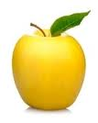
Past predicts future
Training data
Test set
Not always the case, but we’ll often assume it is!

Slide 48
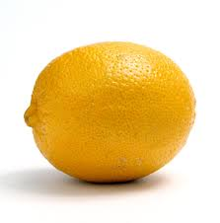
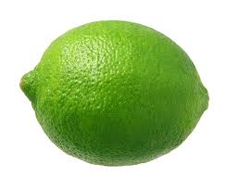
Past predicts future
Training data
Test set
Not always the case, but we’ll often assume it is!

Slide 49
More technically…
We are going to use the probabilistic model of learning
There is some probability distribution over example/label pairs called the data generating distribution
Both the training data and the test set are generated based on this distribution

Slide 50
data generating distribution
Training data
Test set
data generating distribution

Slide 51
data generating distribution
Training data
Test set
data generating distribution

Slide 52
data generating distribution
Training data
Test set
data generating distribution

