Slide 1
Advanced parsing
David Kauchak
CS159 – Fall 2020
some slides adapted from Dan Klein

Slide 2
Admin
Assignment 3?
Assignment 4 (A and B)
Lab next Tuesday

Slide 3
Parsing evaluation
You’ve constructed a parser
You want to know how good it is
Ideas?

Slide 4
Parsing evaluation
Treebank
Train
Dev
Test
Learn a model using the training set
Parse the test set without looking at the “correct” trees
Compare our generated parse tree to the “correct” tree

Slide 5
Comparing trees
Computed Tree P
Correct Tree T
S
S
S
VP
VP
NP
NP
NP
PP
NP
PP
PRP
V
PRP
V
N
IN
N
N
IN
N
I eat sushi with tuna
I eat sushi with tuna
Ideas?

Slide 6
Comparing trees
Idea 1: see if the trees match exactly
Problems?
Will have a low number of matches (people often disagree)
Doesn’t take into account getting it almost right
Idea 2: compare the constituents

Slide 7
Comparing trees
Computed Tree P
Correct Tree T
S
S
S
VP
VP
NP
NP
NP
PP
NP
PP
PRP
V
PRP
V
N
IN
N
N
IN
N
I eat sushi with tuna
I eat sushi with tuna
How many constituents match?
How can we turn this into a score?

Slide 8
Evaluation measures
Precision
Recall
F1
# of correct constituents
# of constituents in the computed tree
# of correct constituents
# of constituents in the correct tree
2 * Precision * Recall
What does this favor?
Precision + Recall
Notes:
higher precision and recall
precision and recall values that are similar, e.g.
P = .2, R = 0.8
average: 0.5
F1: 0.32
P = 0.4, R = 0.4
average: 0.4
F1: 0.4

Slide 9
Comparing trees
Computed Tree P
Correct Tree T
S
S
S
VP
VP
NP
NP
NP
PP
NP
PP
PRP
V
PRP
V
N
IN
N
N
IN
N
I eat sushi with tuna
I eat sushi with tuna
# Constituents: 11
# Correct Constituents: 9
# Constituents: 10
Precision:
9/11
Recall:
9/10
F1:
0.857

Slide 10
Parsing evaluation
Corpus: Penn Treebank, WSJ
Parsing has been fairly standardized to allow for easy comparison between systems
Training: | sections | 02-21
Development: | section | 22 (first 20 files)
Test: | section | 23

Slide 11
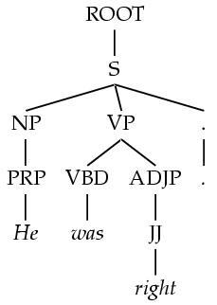
Treebank PCFGs
Use PCFGs for broad coverage parsing
Can take a grammar right off the trees (doesn’t work well):
ROOT → S
S → NP VP .
NP → PRP
VP → VBD ADJP
…..
Model | F1
Baseline | 72.0

Slide 12
Generic PCFG Limitations
PCFGs do not use any information about where the current constituent is in the tree
PCFGs do not rely on specific words or concepts, only general structural disambiguation is possible (e.g. prefer to attach PPs to Nominals)
MLE estimates are not always the best

Slide 13
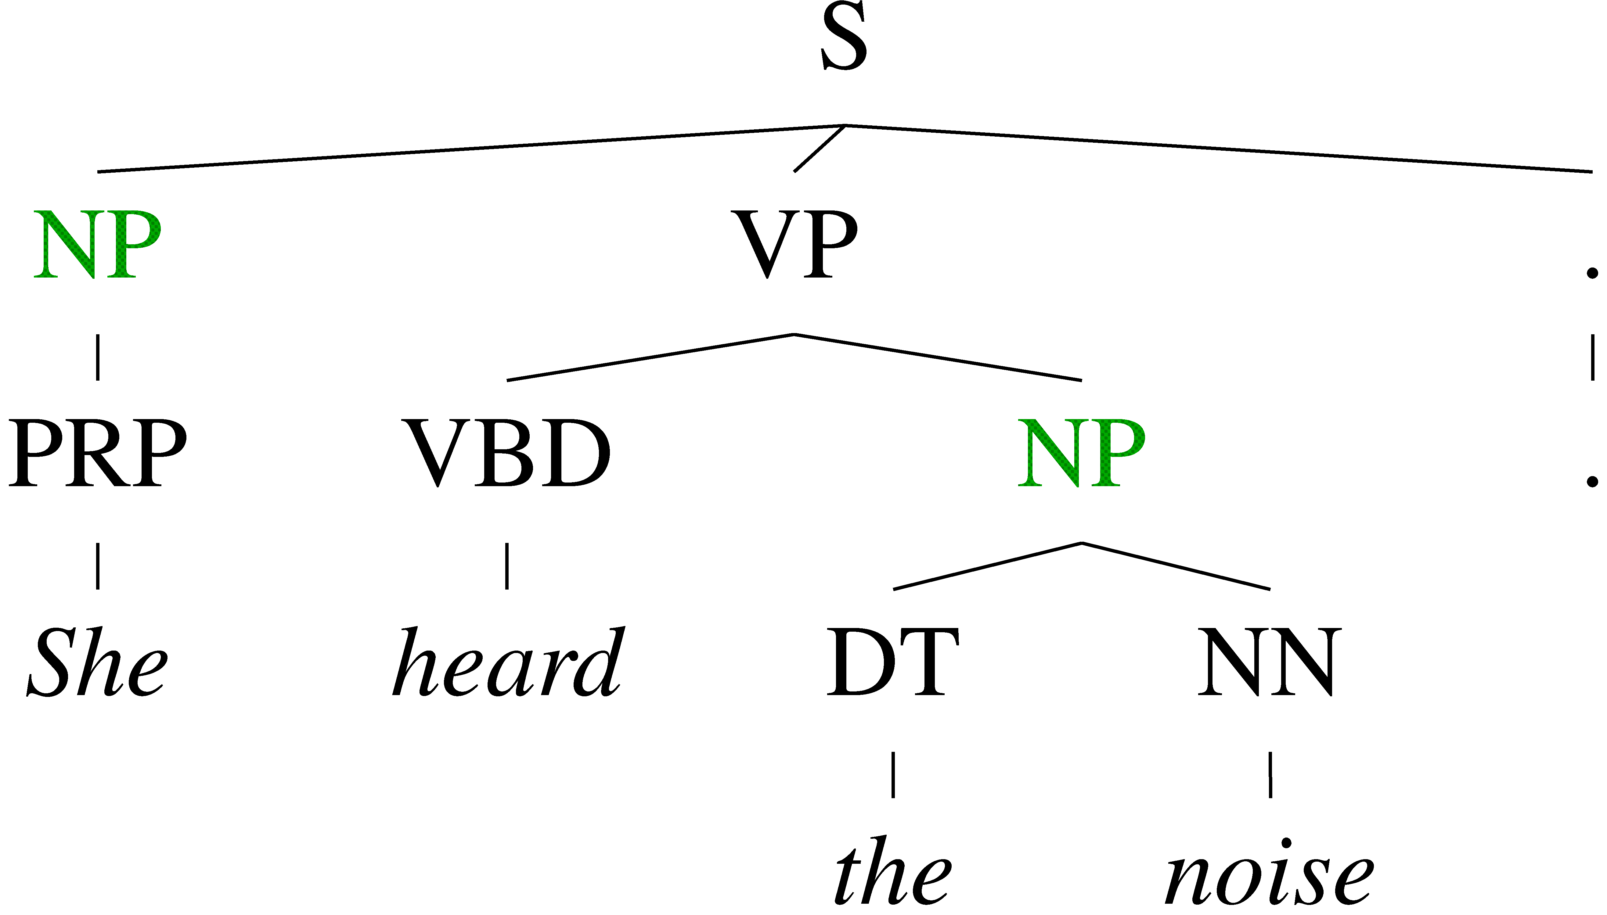
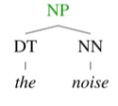
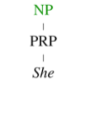
Conditional Independence?
Will a PCFG differentiate between these?
What’s the problem?

Slide 14
Conditional Independence?
It treats all NPs as equivalent… but they’re not!
A grammar with symbols like “NP” won’t be context-free
Statistically, conditional independence too strong

Slide 15
Strong independence assumption
S
S -> NP VP
NP -> PRP
PRP -> I
VP -> V NP
V -> eat
NP -> N PP
N -> sushi
PP -> IN N
IN -> with
N -> tuna
VP
NP
NP
PP
PRP
V
N
IN
N
I eat sushi with tuna
We’re making a strong independence assumption here!

Slide 16
Non-Independence
Independence assumptions are often too strong
All NPs
NPs under S
NPs under VP
Example: the expansion of an NP is highly dependent on the parent of the NP (i.e., subjects vs. objects).
Also: the subject and object expansions are correlated

Slide 17
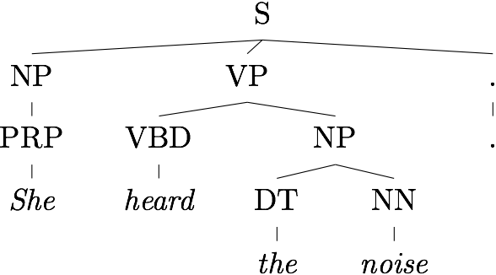
Grammar Refinement
Idea: expand/refine our grammar
Challenges:
Must refine in ways that facilitate disambiguation
Must trade-offs between too little and too much refinement.
Too much refinement -> sparsity problems
To little -> can’t discriminate (PCFG)

Slide 18
Grammar Refinement
Ideas?

Slide 19
Grammar Refinement
Structure Annotation [Johnson ’98, Klein&Manning ’03]
Differentiate constituents based on their local context
Lexicalization [Collins ’99, Charniak ’00]
Differentiate constituents based on the spanned words
Constituent splitting [Matsuzaki et al. 05, Petrov et al. ’06]
Cluster/group words into sub-constituents

Slide 20
Markovization
Except for the root node, every node in a parse tree has:
A vertical history/context
A horizontal history/context
S
NP
VP
VBD
NP
NP
Traditional PCFGs use the full horizontal context and a vertical context of 1

Slide 21
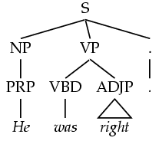
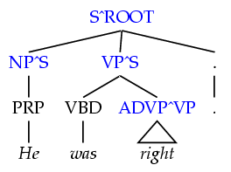
Vertical Markovization
Vertical Markov order: rewrites depend on past k ancestor nodes.
Order 1 is most common: aka parent annotation
Order 1
Order 2

Slide 22
Allows us to make finer grained distinctions
^S
^VP

Slide 23
Vertical Markovization
F1 performance
# of non-terminals
Notes:
we increase the size of the grammar, allowing us to better discriminate

Slide 24
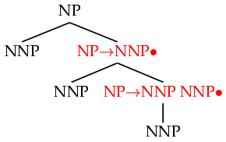
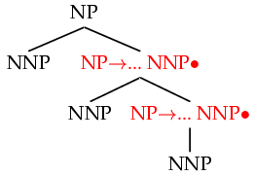
Horizontal Markovization
Horizontal Markov order: rewrites depend on past k sibling nodes
Order 1 is most common: condition on a single sibling
Order 1
Order ∞

Slide 25
Horizontal Markovization
F1 performance
# of non-terminals

Slide 26
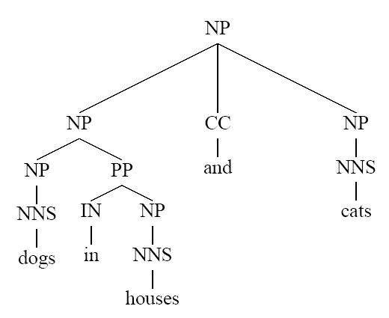
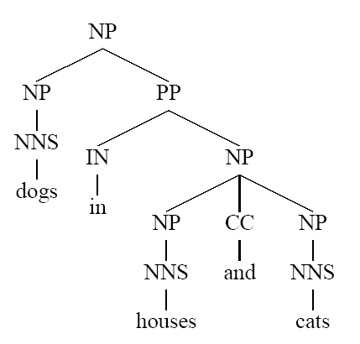
Problems with PCFGs
What’s different between basic PCFG scores here?

Slide 27
Example of Importance of Lexicalization
A general preference for attaching PPs to NPs rather than VPs can be learned by an ordinary PCFG
But the desired preference can depend on specific words
S
S
NP VP
NP VP
John V NP PP
John V NP
put the dog in the carrier
put the dog in the carrier
Which is correct?
Notes:
put expects two arguments, put something, somewhere

Slide 28
Example of Importance of Lexicalization
A general preference for attaching PPs to NPs rather than VPs can be learned by an ordinary PCFG
But the desired preference can depend on specific words
S
S
NP VP
NP VP
John V NP PP
John V NP
knew the dog in the carrier
knew the dog in the carrier
Which is correct?

Slide 29
Lexicalized Trees
How could we lexicalize the grammar/tree?

Slide 30
Lexicalized Trees
Add “headwords” to each phrasal node
Syntactic vs. semantic heads
Headship not in (most) treebanks
Usually use head rules, e.g.:
NP:
Take leftmost NP
Take rightmost N*
Take rightmost JJ
Take right child
VP:
Take leftmost VB*
Take leftmost VP
Take left child

Slide 31
Lexicalized PCFGs?
Problem: we now have to estimate probabilities like
How would we estimate the probability of this rule?
Never going to get these automatically off of a treebank
Ideas?
VP(put) → VBD(put) NP(dog) PP(in)
Count(VP(put) → VBD(put) NP(dog) PP(in))
Count(VP (put))

Slide 32
One approach
Combine this with some of the markovization techniques we saw
Collins’ (1999) parser
Models productions based on context to the left and the right of the head child.
LHS → L_{n}L_{n−1}…L₁H R₁…R_{m−1}R_{m}

Slide 33
One approach
LHS → L_{n}L_{n−1}…L₁H R₁…R_{m−1}R_{m}
First generate the head (H) given the parent
Then repeatedly generate left symbols (L_{i}) until the beginning is reached
Then right (R_{i}) symbols until the end is reached

Slide 34
Sample Production Generation
VPput → VBDput NPdog PPin
VPput →

Slide 35
Sample Production Generation
VPput → VBDput NPdog PPin
VPput →
VBDput
H
P_{H}(VBD | VPput)

Slide 36
Sample Production Generation
VPput → VBDput NPdog PPin
VPput →
STOP
VBDput
L₁
H
P_{L}(STOP | VPput)

Slide 37
Sample Production Generation
VPput → VBDput NPdog PPin
VPput →
STOP
VBDput
NPdog
L₁
H
R₁
P_{R}(NPdog | VPput)

Slide 38
Sample Production Generation
VPput → VBDput NPdog PPin
VPput →
STOP
VBDput
NPdog
PPin
L₁
H
R₁
R₂
P_{R}(PPin | VPput)

Slide 39
Sample Production Generation
VPput → VBDput NPdog PPin
VPput →
STOP
VBDput
NPdog
PPin
STOP
L₁
H
R₁
R₂
R₃
P_{R}(STOP | PPin)

Slide 40
Sample Production Generation
Note: Penn treebank tends to
have fairly flat parse trees that
produce long productions.
VPput → VBDput NPdog PPin
VPput →
STOP
VBDput
NPdog
PPin
STOP
L₁
H
R₁
R₂
R₃
P_{L}(STOP | VPput) * P_{H}(VBD | VPput)*
P_{R}(NPdog | VPput)*
P_{R}(PPin | VPput) * P_{R}(STOP | PPin)

Slide 41
Estimating Production Generation Parameters
Estimate P_{H}, P_{L}, and P_{R} parameters from treebank data
Count(PPin right of head in a VPput production)
P_{R}(PPin | VPput) =
Count(symbol right of head in a VPput)
Count(NPdog right of head in a VPput production)
P_{R}(NPdog | VPput) =
Count(symbol right of head in a VPput)
Smooth estimates by combining with simpler models conditioned on just POS tag or no lexical info
smP_{R}(PPin | VPput-) = λ₁ P_{R}(PPin | VPput)
+ (1− λ₁) (λ₂ P_{R}(PPin | VPVBD) +
(1− λ₂) P_{R}(PPin | VP))

Slide 42
Problems with lexicalization
We’ve solved the estimation problem
There’s also the issue of performance
Lexicalization causes the size of the number of grammar rules to explode!
Our parsing algorithms take too long too finish
Ideas?

Slide 43
Pruning during search
We can no longer keep all possible parses around
We can no longer guarantee that we actually return the most likely parse
Beam search [Collins 99]
In each cell only keep the K most likely hypotheses
Disregard constituents over certain spans (e.g. punctuation)
F1 of 88.6!

Slide 44
Pruning with a PCFG
The Charniak parser prunes using a two-pass approach [Charniak 97+]
First, parse with the base (non-lexicalized) grammar
For each X:[i,j] calculate P(X|i,j,s)
This isn’t trivial, and there are clever speed ups
Second, do the full CKY
Skip any X :[i,j] which had low (say, < 0.0001) posterior
Avoids almost all work in the second phase!
F1 of 89.7!

Slide 45
Final Results
 | F1 ≤ 40 words | F1 all words
Parser
Klein & Manning ’03 | 86.3 | 85.7
Matsuzaki et al. ’05 | 86.7 | 86.1
Collins ’99 | 88.6 | 88.2
Charniak & Johnson ’05 | 90.1 | 89.6
Petrov et. al. 06 | 90.2 | 89.7
Notes:
Not only that, we even outperform the fully lexicalized systems of Collins ’99 and the generative component of Charniak and Johnson ’05.

Slide 46
Human Parsing
How do humans do it?
How might you try and figure it out computationally/experimentally?

Slide 47
Human Parsing
Read these sentences
Which one was fastest/slowest?
John put the dog in the pen with a lock.
John carried the dog in the pen with a bone in the car.
John liked the dog in the pen with a bone.

Slide 48
Human Parsing
Computational parsers can be used to predict human reading time as measured by tracking the time taken to read each word in a sentence.
Psycholinguistic studies show that words that are more probable given the preceding lexical and syntactic context are read faster.
John put the dog in the pen with a lock.
John carried the dog in the pen with a bone in the car.
John liked the dog in the pen with a bone.
Modeling these effects requires an incremental statistical parser that incorporates one word at a time into a continuously growing parse tree.

Slide 49
Garden Path Sentences
People are confused by sentences that seem to have a particular syntactic structure but then suddenly violate this structure, so the listener is “lead down the garden path”.
The horse raced past the barn fell.
vs. The horse raced past the barn broke his leg.
The complex houses married students.
The old man the sea.
While Anna dressed the baby spit up on the bed.
Incremental computational parsers can try to predict and explain the problems encountered parsing such sentences.

Slide 50
More garden sentences
http://www.fun-with-words.com/ambiguous_garden_path.html
The prime number few.
Fat people eat accumulates.
The cotton clothing is usually made of grows in Mississippi.
Until the police arrest the drug dealers control the street.
The man who hunts ducks out on weekends.
When Fred eats food gets thrown.
Mary gave the child the dog bit a bandaid.
The girl told the story cried.
I convinced her children are noisy.
Helen is expecting tomorrow to be a bad day.
The horse raced past the barn fell.
I know the words to that song about the queen don't rhyme.
She told me a little white lie will come back to haunt me.
The dog that I had really loved bones.
That Jill is never here hurts.
The man who whistles tunes pianos.
The old man the boat.
Have the students who failed the exam take the supplementary.
The raft floated down the river sank.
We painted the wall with cracks.
The tycoon sold the offshore oil tracts for a lot of money wanted to kill JR.

