Slide 1
Gradient descent
David Kauchak
CS 158 – Fall 2025

Slide 2
Admin
Assignment 3 graded
No office hours Thursday morning (probably)
Assignment 5 out
  Course feedback
Midterm next week
Assignment 6 will also be out next week, but you’ll have 1.5 weeks to complete (due Friday before fall break)

Slide 3
Midterm details
Time limited take home exam (you’ll have 2 hours to complete it)
Available on Monday (9/29)
Must finish by end of the day on Friday (10/3)
You may use your notes, the class notes, the class book(s), and your assignments
You may NOT use any other resources, i.e., no searching the web, no AI, etc.

Slide 4
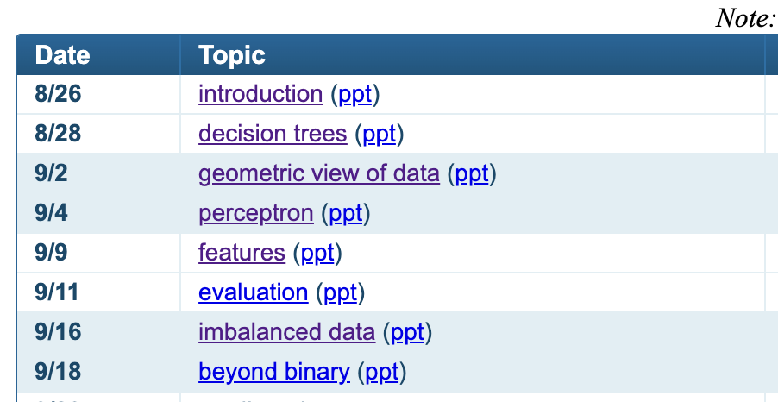
Midterm topics

Slide 5
Midterm topics
Machine learning basics
  different types of learning problems
  feature-based machine learning
  data assumptions/data generating distribution
Classification problem setup
Proper experimentation
  train/dev/test
  evaluation/accuracy/training error
  optimizing hyperparameters

Slide 6
Midterm topics
Learning algorithms
  Decision trees
  K-NN
  Perceptron
  Gradient descent
Algorithm properties
  training/learning
    rational/why it works
  classifying
  hyperparameters
  avoiding overfitting
  algorithm variants/improvements

Slide 7
Midterm topics
Geometric view of data
  distances between examples
  decision boundaries
Features
  example features
  removing erroneous features/picking good features
  challenges with high-dimensional data
  feature normalization
Other pre-processing
  outlier detection

Slide 8
Midterm topics
Comparing algorithms
  n-fold cross validation
    leave one out validation
  bootstrap resampling
  t-test
imbalanced data
  evaluation
    precision/recall, F1, AUC
  subsampling
  oversampling
  weighted binary classifiers

Slide 9
Midterm topics
Multiclass classification
  Modifying existing approaches
  Using binary classifier
    OVA
    AVA
    Tree-based
  micro- vs. macro-averaging
Ranking
  using binary classifier
  using weighted binary classifier

Slide 10
Midterm general advice
2 hours goes by fast!
  Don’t plan on looking everything up
    Lookup equations, algorithms, random details
  Make sure you understand the key concepts
  Don’t spend too much time on any one question
    Skip questions you’re stuck on and come back to them
  Watch the time as you go
Be careful on the T/F questions
For written questions
  think before you write
  make your argument/analysis clear and concise

Slide 11
An aside: text classification
Raw data
labels
Chardonnay
Pinot Grigio
Zinfandel

Slide 12
Text: raw data
Raw data
labels
Features?
Chardonnay
Pinot Grigio
Zinfandel

Slide 13
Feature examples
Raw data
labels
Features
Clinton said pinot repeatedly last week on tv, “pinot, pinot, pinot”
Chardonnay
(1, 1, 1, 0, 0, 1, 0, 0, …)
Pinot Grigio
clinton
said
california
across
tv
wrong
pinot
capital
Zinfandel
Occurrence of words

Slide 14
Feature examples
Raw data
labels
Features
Clinton said pinot repeatedly last week on tv, “pinot, pinot, pinot”
Chardonnay
(4, 1, 1, 0, 0, 1, 0, 0, …)
Pinot Grigio
clinton
said
california
across
tv
wrong
pinot
capital
Zinfandel
Frequency of word occurrences
This is the representation we’re using for assignment 5

Slide 15
Decision trees for text
Each internal node represents whether or not the text has a particular word
wheat
buschl
farm
export
commodity
Wheat
Not wheat
Not wheat
Wheat
agriculture
Wheat
Not wheat
Wheat

Slide 16
Decision trees for text
wheat is a commodity that can be found in states across the nation
wheat
buschl
farm
export
commodity
Wheat
Not wheat
Not wheat
Wheat
agriculture
Wheat
Not wheat
Wheat

Slide 17
Decision trees for text
The US views technology as a commodity that it can export by the buschl.
wheat
buschl
farm
export
commodity
Wheat
Not wheat
Not wheat
Wheat
agriculture
Wheat
Not wheat
Wheat

Slide 18
Printing out decision trees
wheat
(wheat
(buschl
predict=not wheat
(export
predict=not wheat
predict=wheat))
(farm
(commodity
(agriculture
predict=not wheat
predict=wheat)
predict=wheat)
predict=wheat))
buschl
farm
export
commodity
Wheat
Not wheat
Not wheat
Wheat
agriculture
Wheat
Not wheat
Wheat

Slide 19

Some math today (but don’t worry!)

Slide 20
Linear models
A high-bias assumption is linear separability:
  in 2 dimensions, can separate classes by a line
  in higher dimensions, need hyperplanes
A linear model is a model that assumes the data is linearly separable

Slide 21

Linear models
A linear model in n-dimensional space (i.e. n features) is define by n+1 weights:
In two dimensions, a line:
In three dimensions, a plane:
In m-dimensions, a hyperplane
(where b = -a)

Slide 22
Perceptron learning algorithm
repeat until convergence (or for some # of iterations):
for each training example (f₁, f₂, …, f_{m}, label):
if prediction * label ≤ 0: // they don’t agree
for each w_{j}:
w_{j} = w_{j} + f_{j}*label
b = b + label

Slide 23
Which line will it find?

Slide 24
Which line will it find?
Only guaranteed to find some line that separates the data

Slide 25
Linear models
Perceptron algorithm is one example of a linear classifier
Many, many other algorithms learn a line (i.e. a setting of a linear combination of weights)
Goals:
Explore a number of linear training algorithms
Understand why these algorithms work

Slide 26
Perceptron learning algorithm
repeat until convergence (or for some # of iterations):
for each training example (f₁, f₂, …, f_{m}, label):
if prediction * label ≤ 0: // they don’t agree
for each w_{i}:
w_{i} = w_{i} + f_{i}*label
b = b + label

Slide 27
A closer look at why we got it wrong
w₁
w₂
(-1, -1, positive)
We’d like this value to be positive since it’s a positive value
didn’t contribute, but could have
contributed in the wrong direction
Intuitively these make sense
Why change by 1?
Any other way of doing it?
decrease
decrease
0 -> -1
1 -> 0

Slide 28

Model-based machine learning
CS158’s
pick a model
  e.g. a hyperplane, a decision tree,…
  A model is defined by a collection of parameters
What are the parameters for DT? Perceptron?
Notes:
DT: the structure of the tree, which features each node splits on, the predictions at the leaves
perceptron: the weights and the b value

Slide 29
Model-based machine learning
CS158’s
pick a model
  e.g. a hyperplane, a decision tree,…
  A model is defined by a collection of parameters
DT: the structure of the tree, which features each node splits on, the predictions at the leaves
perceptron: the weights and the b value
Notes:
DT: the structure of the tree, which features each node splits on, the predictions at the leaves
perceptron: the weights and the b value

Slide 30
Model-based machine learning
CS158’s
pick a model
  e.g. a hyperplane, a decision tree,…
  A model is defined by a collection of parameters
pick a criterion to optimize (aka objective function)
What criteria do decision tree learning and perceptron learning optimizing?

Slide 31
Model-based machine learning
CS158’s
pick a model
  e.g. a hyperplane, a decision tree,…
  A model is defined by a collection of parameters
pick a criterion to optimize (aka objective function)
    e.g. training error
develop a learning algorithm
  the algorithm should try and minimize the criteria
  sometimes in a heuristic way (i.e. non-optimally)
  sometimes exactly

Slide 32
Linear models in general
CS158’s
pick a model
pick a criterion to optimize (aka objective function)
These are the parameters we want to learn

Slide 33
Some notation: indicator function
Convenient notation for turning T/F answers into numbers/counts:

Slide 34
Some notation: dot-product
Sometimes it is convenient to use vector notation
We represent an example (i.e., feature values) x₁, x₂, …, x_{m} as a single vector, x
  j subscript will indicate feature indexing, i.e., x_{j}
  i subscript will indicate examples indexing over a dataset, i.e., x_{i} or sometimes x_{ij}
Similarly, we can represent the weight vector w₁, w₂, …, w_{m} as a single vector, w
The dot-product between two vectors a and b is defined as:

Slide 35
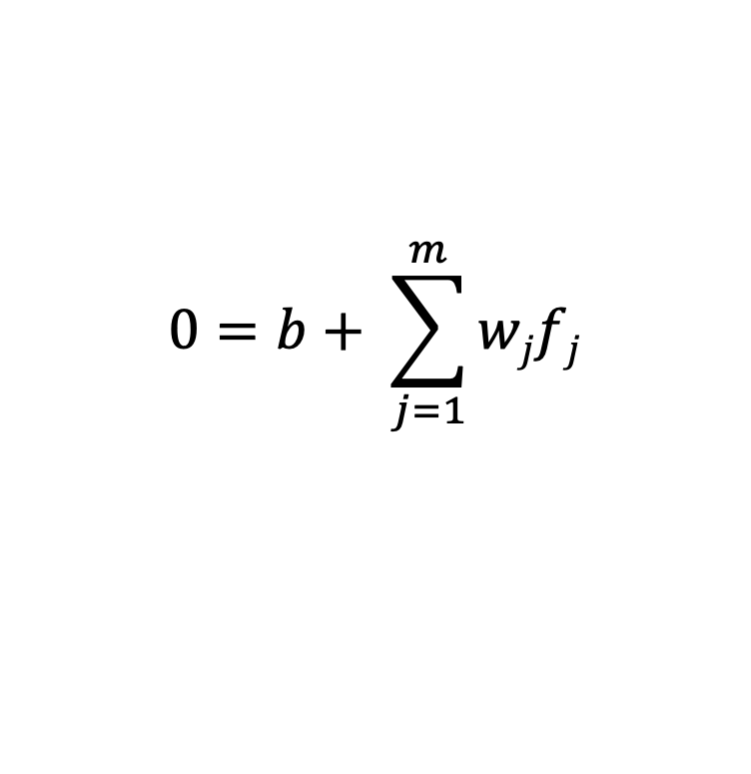
Linear models
CS158’s
pick a model
pick a criterion to optimize (aka objective function)
$$0=b+ \sum_{j=1}^{m}{wjfj}$$
These are the parameters we want to learn
What does this equation say?
Notes:
often you’ll have to be able to tell from context whether the subscript refers to the example or the feature

Slide 36
0/1 loss function
distance* from hyperplane
sign is prediction
whether or not the prediction and label agree,
true if they don’t
total number of mistakes, aka 0/1 loss

Slide 37
Model-based machine learning
pick a model
pick a criteria to optimize (aka objective function)
develop a learning algorithm
Find w and b that minimize the 0/1 loss (i.e. training error)

Slide 38
Minimizing 0/1 loss
Find w and b that minimize the 0/1 loss
How do we do this?
How do we minimize a function?
Why is it hard for this function?

Slide 39
Minimizing 0/1 in one dimension
loss
w
Each time we change w such that an example is right/wrong the loss will increase/decrease

Slide 40
Minimizing 0/1 over all w
loss
w
Each new feature we add (i.e. weights) adds another dimension to this space!

Slide 41
Minimizing 0/1 loss
Find w and b that minimize the 0/1 loss
This turns out to be hard (in fact, NP-HARD ☹)
Challenge:
small changes in any w can have large changes in the loss (the change isn’t continuous)
there can be many, many local minima
at any given point, we don’t have much information to direct us towards any minima

Slide 42
More manageable loss functions
loss
w
What property/properties do we want from our loss function?

Slide 43
More manageable loss functions
loss
w
Ideally, continuous (i.e. differentiable) so we get an indication of direction of minimization
Only one minima

Slide 44
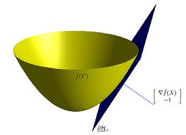
Convex functions
Convex functions look something like:
One definition: The line segment between any two points on the function is above the function

Slide 45
Surrogate loss functions
For many applications, we really would like to minimize the 0/1 loss
A surrogate loss function is a loss function that provides an upper bound on the actual loss function (in this case, 0/1)
We’d like to identify a convex surrogate loss functions to make them easier to minimize
Key to a loss function: how it scores the difference between the actual label y and the predicted label y’

Slide 46
Surrogate loss functions
0/1 loss:

Slide 47
Surrogate loss functions
0/1 loss:
Hinge:
Exponential:
Squared loss:
Why do these work? What do they penalize?

Slide 48
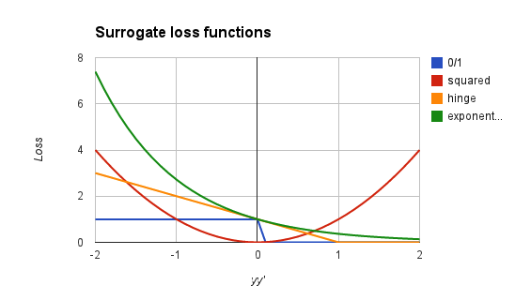
Surrogate loss functions
0/1 loss:
Hinge:
Squared loss:
Exponential:
incorrect
yy’ or
y-y’
correct
Notes:
notice, all are convex
all (except hinge) are differentiable
wrong is on the left (y and y’ don’t agree)
correct is on the right (y and y’ agree)
y axis is loss/penalty

Slide 49
Model-based machine learning
pick a model
pick a criteria to optimize (aka objective function)
develop a learning algorithm
use a convex surrogate loss function
Find w and b that minimize the surrogate loss

Slide 50


Finding the minimum
You’re blindfolded, but you can see out of the bottom of the blindfold to the ground right by your feet. I drop you off somewhere and tell you that you’re in a convex shaped valley and escape is at the bottom/minimum. How do you get out?

Slide 51
Finding the minimum
loss
w
How do we do this for a function?

Slide 52
One approach: gradient descent
Partial derivatives give us the slope (i.e. direction to move) in that dimension
loss
w

Slide 53
One approach: gradient descent
Partial derivatives give us the slope (i.e. direction to move) in that dimension
Approach:
  pick a starting point (w)
  repeat:
    pick a dimension
    move a small amount in that dimension towards decreasing loss (using the derivative)
loss
w

Slide 54
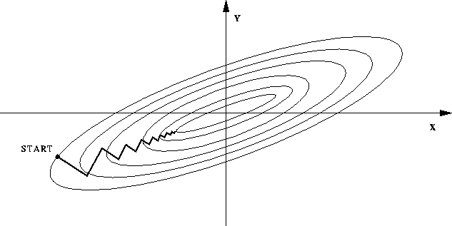
One approach: gradient descent
Partial derivatives give us the slope (i.e. direction to move) in that dimension
Approach:
  pick a starting point (w)
  repeat:
    pick a dimension
    move a small amount in that dimension towards decreasing loss (using the derivative)

Slide 55
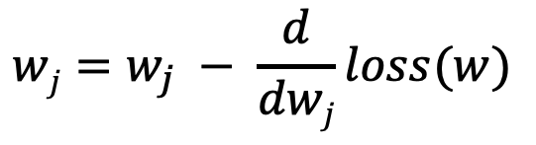
Gradient descent
  pick a starting point (w)
  repeat until loss doesn’t decrease in any dimension:
    pick a dimension
    move a small amount in that dimension towards decreasing loss (using the derivative)
$$wj=w_{j} − \frac{d}{dwj}loss(w)$$
Why negative?

Slide 56
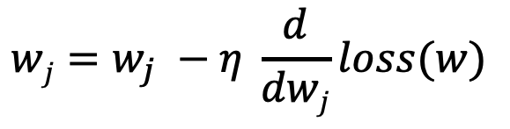
Gradient descent
  pick a starting point (w)
  repeat until loss doesn’t decrease in any dimension:
    pick a dimension
    move a small amount in that dimension towards decreasing loss (using the derivative)
$$wj=w_{j} −η \frac{d}{dwj}loss(w)$$
What does this do?

Slide 57
Gradient descent
  pick a starting point (w)
  repeat until loss doesn’t decrease in any dimension:
    pick a dimension
    move a small amount in that dimension towards decreasing loss (using the derivative)
$$wj=w_{j} −η \frac{d}{dwj}loss(w)$$
learning rate (how much we want to move in the error direction, often this will change over time)

Slide 58
Some math

Slide 59
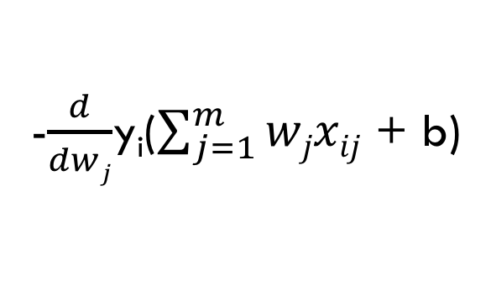
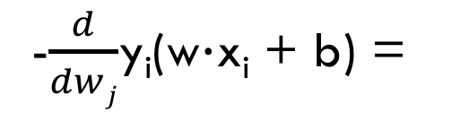
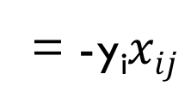
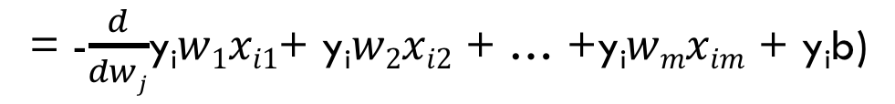
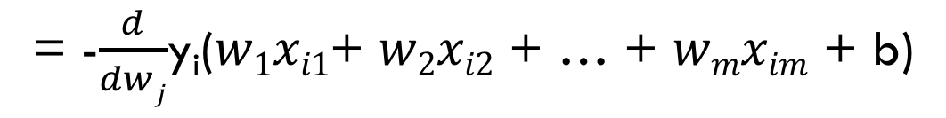
Some math
-$\frac{d}{dwj}$y_{i}(w$∙$x_{i} + b) =
-$\frac{d}{dwj}$y_{i}($\sum_{j=1}^{m}{wjxij}$ + b)
= -$\frac{d}{dwj}$y_{i}($w1xi1$+ $w2xi2$ + … + $wmxim$ + b)
= -$\frac{d}{dwj}$y_{i}$w1xi1$+ y_{i}$w2xi2$ + … +y_{i}$wmxim$ + y_{i}b)
= -y_{i}$xij$

Slide 60
Some math

Slide 61
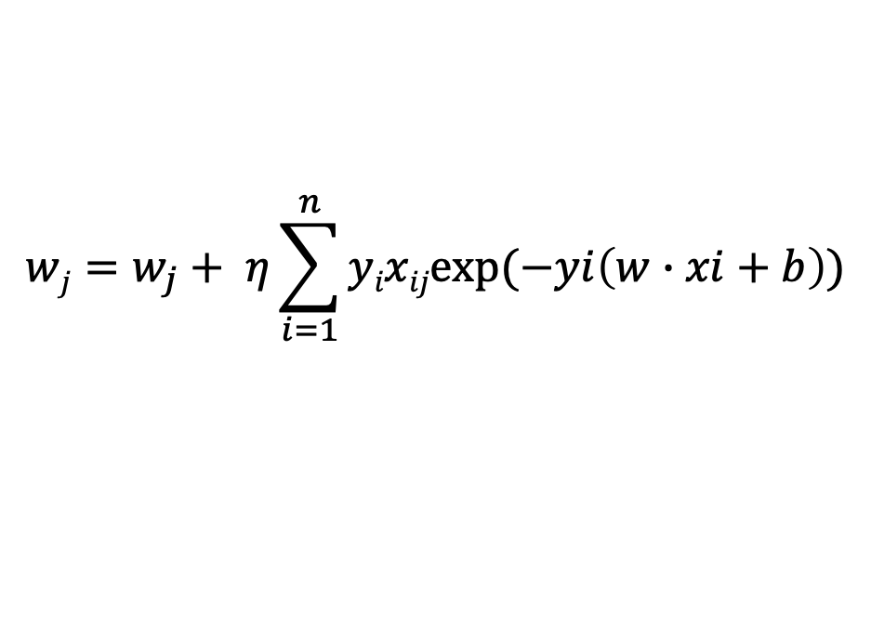
Gradient descent
  pick a starting point (w)
  repeat until loss doesn’t decrease in any dimension:
    pick a dimension
    move a small amount in that dimension towards decreasing loss (using the derivative)
$$wj=w_{j}+ η\sum_{i=1}^{n}{yixijexp⁡(−yi\left(w∙xi+b\right))}$$
What is this doing?

Slide 62
Exponential update rule
for each example x_{i}:
Does this look familiar?

Slide 63
Perceptron learning algorithm!
repeat until convergence (or for some # of iterations):
for each training example (f₁, f₂, …, f_{m}, label):
if prediction * label ≤ 0: // they don’t agree
for each w_{j}:
w_{j} = w_{j} + f_{j}*label
b = b + label
or
where

Slide 64
The constant
learning rate
label
prediction
When is this large/small?

Slide 65
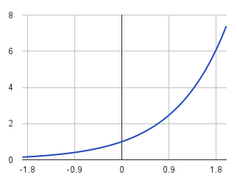
The constant
label
prediction
If they’re the same sign, as the predicted gets larger the update gets smaller
If they’re different, the more different they are, the bigger the update

Slide 66
Perceptron learning algorithm!
repeat until convergence (or for some # of iterations):
for each training example (f₁, f₂, …, f_{m}, label):
if prediction * label ≤ 0: // they don’t agree
for each w_{j}:
w_{j} = w_{j} + f_{j}*label
b = b + label
Note: for gradient descent, we always update
or
where

Slide 67
One concern
loss
We’re calculating this on the training set
We still need to be careful about overfitting!
The min w,b on the training set is generally NOT the min for the test set
w
How did we deal with this for the perceptron algorithm?

Slide 68
Summary
Model-based machine learning:
  define a model, objective function (i.e. loss function), minimization algorithm
Gradient descent minimization algorithm
  require that our loss function is convex
  make small updates towards lower losses
Perceptron learning algorithm:
  gradient descent
  exponential loss function (modulo a learning rate)

