Slide 1
Decision trees
David Kauchak CS 158 – Fall 2025

Slide 2
Admin
Assignment 1 due tomorrow (Friday)
Assignment 2 out soon: start ASAP! (due next Sunday)
Can (and are STRONGLY encouraged to) work in pairs
Slack

Slide 3
Admin
Mentor hours starting next week:
Wednesdays 6-8pm (Edmunds downstairs)
Office hours posted soon
Lecture notes posted (webpage)
Keep up with the reading
Videos before class

Slide 4

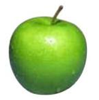


Features
examples
features
How our algorithms actually “view” the data
Features are the questions we can ask about the examples
f₁, f₂, f₃, …, f_{n}
f₁, f₂, f₃, …, f_{n}
f₁, f₂, f₃, …, f_{n}
f₁, f₂, f₃, …, f_{n}

Slide 5
A sample data set
Features |  |  |  | Label
Hour | Weather | Accident | Stall | Commute
8 AM | Sunny | No | No | Long
8 AM | Cloudy | No | Yes | Long
10 AM | Sunny | No | No | Short
9 AM | Rainy | Yes | No | Long
9 AM | Sunny | Yes | Yes | Long
10 AM | Sunny | No | No | Short
10 AM | Cloudy | No | No | Short
9 AM | Sunny | Yes | No | Long
10 AM | Cloudy | Yes | Yes | Long
10 AM | Rainy | No | No | Short
8 AM | Cloudy | Yes | No | Long
9 AM | Rainy | No | No | Short
8 AM, Rainy, Yes, No?
10 AM, Rainy, No, No?
Can you describe a “model” that could be used to make decisions in general?

Slide 6
Decision trees
Leave At
Tree with internal nodes labeled by features
Branches are labeled by tests on that feature
Leaves labeled with classes
10 AM
9 AM
8 AM
Stall?
Accident?
No
Yes
No
Yes
Long
Short
Long
Short
Long

Slide 7
Decision trees
Leave At
Tree with internal nodes labeled by features
Branches are labeled by tests on that feature
Leaves labeled with classes
10 AM
9 AM
8 AM
Stall?
Accident?
No
Yes
No
Yes
Long
Short
Long
Short
Long
Leave = 8 AM
Weather = Rainy
Accident = Yes
Stall = No

Slide 8
Decision trees
Leave At
Tree with internal nodes labeled by features
Branches are labeled by tests on that feature
Leaves labeled with classes
10 AM
9 AM
8 AM
Stall?
Accident?
No
Yes
No
Yes
Long
Short
Long
Short
Long
Leave = 8 AM
Weather = Rainy
Accident = Yes
Stall = No

Slide 9
Decision trees
Leave At
Tree with internal nodes labeled by features
Branches are labeled by tests on that feature
Leaves labeled with classes
10 AM
9 AM
8 AM
Stall?
Accident?
No
Yes
No
Yes
Long
Short
Long
Short
Long
Leave = 10 AM
Weather = Rainy
Accident = No
Stall = No

Slide 10
Decision trees
Leave At
Tree with internal nodes labeled by features
Branches are labeled by tests on that feature
Leaves labeled with classes
10 AM
9 AM
8 AM
Stall?
Accident?
No
Yes
No
Yes
Long
Short
Long
Short
Long
Leave = 10 AM
Weather = Rainy
Accident = No
Stall = No

Slide 11
To ride or not to ride, that is the question…
Terrain | Unicycle-type | Weather | Go-For-Ride?
Trail | Normal | Rainy | NO
Road | Normal | Sunny | YES
Trail | Mountain | Sunny | YES
Road | Mountain | Rainy | YES
Trail | Normal | Snowy | NO
Road | Normal | Rainy | YES
Road | Mountain | Snowy | YES
Trail | Normal | Sunny | NO
Road | Normal | Snowy | NO
Trail | Mountain | Snowy | YES
Build a decision tree

Slide 12
Recursive approach
Base case: If all data belong to the same class, create a leaf node with that label
Otherwise:
calculate the “score” for each feature if we used it to split the data
pick the feature with the highest score, partition the data based on that data value and call recursively

Slide 13
Partitioning the data
Terrain
Terrain | Unicycle-type | Weather | Go-For-Ride?
Trail | Normal | Rainy | NO
Road | Normal | Sunny | YES
Trail | Mountain | Sunny | YES
Road | Mountain | Rainy | YES
Trail | Normal | Snowy | NO
Road | Normal | Rainy | YES
Road | Mountain | Snowy | YES
Trail | Normal | Sunny | NO
Road | Normal | Snowy | NO
Trail | Mountain | Snowy | YES
Road
Trail
?

Slide 14
Partitioning the data
Terrain
Terrain | Unicycle-type | Weather | Go-For-Ride?
Trail | Normal | Rainy | NO
Road | Normal | Sunny | YES
Trail | Mountain | Sunny | YES
Road | Mountain | Rainy | YES
Trail | Normal | Snowy | NO
Road | Normal | Rainy | YES
Road | Mountain | Snowy | YES
Trail | Normal | Sunny | NO
Road | Normal | Snowy | NO
Trail | Mountain | Snowy | YES
Road
Trail
?

Slide 15
Partitioning the data
Terrain
Terrain | Unicycle-type | Weather | Go-For-Ride?
Trail | Normal | Rainy | NO
Road | Normal | Sunny | YES
Trail | Mountain | Sunny | YES
Road | Mountain | Rainy | YES
Trail | Normal | Snowy | NO
Road | Normal | Rainy | YES
Road | Mountain | Snowy | YES
Trail | Normal | Sunny | NO
Road | Normal | Snowy | NO
Trail | Mountain | Snowy | YES
Road
Trail
YES: 4
NO: 1

Slide 16
Partitioning the data
Terrain
Terrain | Unicycle-type | Weather | Go-For-Ride?
Trail | Normal | Rainy | NO
Road | Normal | Sunny | YES
Trail | Mountain | Sunny | YES
Road | Mountain | Rainy | YES
Trail | Normal | Snowy | NO
Road | Normal | Rainy | YES
Road | Mountain | Snowy | YES
Trail | Normal | Sunny | NO
Road | Normal | Snowy | NO
Trail | Mountain | Snowy | YES
Road
Trail
YES: 4
NO: 1
?

Slide 17
Partitioning the data
Terrain
Terrain | Unicycle-type | Weather | Go-For-Ride?
Trail | Normal | Rainy | NO
Road | Normal | Sunny | YES
Trail | Mountain | Sunny | YES
Road | Mountain | Rainy | YES
Trail | Normal | Snowy | NO
Road | Normal | Rainy | YES
Road | Mountain | Snowy | YES
Trail | Normal | Sunny | NO
Road | Normal | Snowy | NO
Trail | Mountain | Snowy | YES
Road
Trail
YES: 4
NO: 1
YES: 2
NO: 3

Slide 18
Partitioning the data
Terrain
Terrain | Unicycle-type | Weather | Go-For-Ride?
Trail | Normal | Rainy | NO
Road | Normal | Sunny | YES
Trail | Mountain | Sunny | YES
Road | Mountain | Rainy | YES
Trail | Normal | Snowy | NO
Road | Normal | Rainy | YES
Road | Mountain | Snowy | YES
Trail | Normal | Sunny | NO
Road | Normal | Snowy | NO
Trail | Mountain | Snowy | YES
Road
Trail
YES: 4
NO: 1
YES: 2
NO: 3
Unicycle
Mountain
Normal
?
?

Slide 19
Partitioning the data
Terrain
Terrain | Unicycle-type | Weather | Go-For-Ride?
Trail | Normal | Rainy | NO
Road | Normal | Sunny | YES
Trail | Mountain | Sunny | YES
Road | Mountain | Rainy | YES
Trail | Normal | Snowy | NO
Road | Normal | Rainy | YES
Road | Mountain | Snowy | YES
Trail | Normal | Sunny | NO
Road | Normal | Snowy | NO
Trail | Mountain | Snowy | YES
Road
Trail
YES: 4
NO: 1
YES: 2
NO: 3
Unicycle
Mountain
Normal
YES: 4
NO: 0
YES: 2
NO: 4

Slide 20
Partitioning the data
Terrain
Terrain | Unicycle-type | Weather | Go-For-Ride?
Trail | Normal | Rainy | NO
Road | Normal | Sunny | YES
Trail | Mountain | Sunny | YES
Road | Mountain | Rainy | YES
Trail | Normal | Snowy | NO
Road | Normal | Rainy | YES
Road | Mountain | Snowy | YES
Trail | Normal | Sunny | NO
Road | Normal | Snowy | NO
Trail | Mountain | Snowy | YES
Road
Trail
YES: 4
NO: 1
YES: 2
NO: 3
Unicycle
Mountain
Normal
YES: 4
NO: 0
YES: 2
NO: 4
Weather
Rainy
Snowy
Sunny
YES: 2
NO: 1
YES: 2
NO: 2
YES: 2
NO: 1

Slide 21
Partitioning the data
Terrain
Unicycle
Weather
Road
Trail
Mountain
Normal
Rainy
Snowy
Sunny
YES: 4
NO: 1
YES: 2
NO: 3
YES: 4
NO: 0
YES: 2
NO: 4
YES: 2
NO: 1
YES: 2
NO: 2
YES: 2
NO: 1
calculate the “score” for each feature if we used it to split the data
What score should we use?
If we just stopped here, which tree would be best? How could we make these into decision trees?

Slide 22
Decision trees
Terrain
Unicycle
Weather
Road
Trail
Mountain
Normal
Rainy
Snowy
Sunny
YES: 4
NO: 1
YES: 2
NO: 3
YES: 4
NO: 0
YES: 2
NO: 4
YES: 2
NO: 1
YES: 2
NO: 2
YES: 2
NO: 1
How could we make these into decision trees?

Slide 23
Decision trees
Terrain
Unicycle
Weather
Road
Trail
Mountain
Normal
Rainy
Snowy
Sunny
YES: 4
NO: 1
YES: 2
NO: 3
YES: 4
NO: 0
YES: 2
NO: 4
YES: 2
NO: 1
YES: 2
NO: 2
YES: 2
NO: 1

Slide 24
Decision trees
Terrain
Unicycle
Weather
Road
Trail
Mountain
Normal
Rainy
Snowy
Sunny
YES: 4
NO: 1
YES: 2
NO: 3
YES: 4
NO: 0
YES: 2
NO: 4
YES: 2
NO: 1
YES: 2
NO: 2
YES: 2
NO: 1
Training error: the average error over the training set
For classification, the most common “error” is the number of mistakes
Training error for each of these?

Slide 25
Decision trees
Terrain
Unicycle
Weather
Road
Trail
Mountain
Normal
Rainy
Snowy
Sunny
YES: 4
NO: 1
YES: 2
NO: 3
YES: 4
NO: 0
YES: 2
NO: 4
YES: 2
NO: 1
YES: 2
NO: 2
YES: 2
NO: 1
3/10
2/10
4/10
Training error: the average error over the training set

Slide 26
Training error vs. accuracy
Terrain
Unicycle
Weather
Road
Trail
Mountain
Normal
Rainy
Snowy
Sunny
YES: 4
NO: 1
YES: 2
NO: 3
YES: 4
NO: 0
YES: 2
NO: 4
YES: 2
NO: 1
YES: 2
NO: 2
YES: 2
NO: 1
Training
error:
3/10
2/10
4/10
Training
accuracy:
7/10
8/10
6/10
training error = 1-accuracy (and vice versa)
Training error: the average error over the training set
Training accuracy: the average proportion correct over the training set

Slide 27
Recurse
Terrain | Unicycle-type | Weather | Go-For-Ride?
Trail | Normal | Rainy | NO
Road | Normal | Sunny | YES
Trail | Mountain | Sunny | YES
Road | Mountain | Rainy | YES
Trail | Normal | Snowy | NO
Road | Normal | Rainy | YES
Road | Mountain | Snowy | YES
Trail | Normal | Sunny | NO
Road | Normal | Snowy | NO
Trail | Mountain | Snowy | YES
Unicycle
Mountain
Normal
YES: 4
NO: 0
YES: 2
NO: 4

Slide 28
Recurse
Unicycle
Mountain
Normal
YES: 4
NO: 0
YES: 2
NO: 4
Terrain | Unicycle-type | Weather | Go-For-Ride?
Trail | Mountain | Sunny | YES
Road | Mountain | Rainy | YES
Road | Mountain | Snowy | YES
Trail | Mountain | Snowy | YES
Terrain | Unicycle-type | Weather | Go-For-Ride?
Trail | Normal | Rainy | NO
Road | Normal | Sunny | YES
Trail | Normal | Snowy | NO
Road | Normal | Rainy | YES
Trail | Normal | Sunny | NO
Road | Normal | Snowy | NO

Slide 29
Recurse
Unicycle
Mountain
Normal
YES: 4
NO: 0
Terrain | Unicycle-type | Weather | Go-For-Ride?
Trail | Mountain | Sunny | YES
Road | Mountain | Rainy | YES
Road | Mountain | Snowy | YES
Trail | Mountain | Snowy | YES
What should we do?

Slide 30
Recurse
Unicycle
Mountain
Normal
YES: 4
NO: 0
Terrain | Unicycle-type | Weather | Go-For-Ride?
Trail | Mountain | Sunny | YES
Road | Mountain | Rainy | YES
Road | Mountain | Snowy | YES
Trail | Mountain | Snowy | YES
No need to examine other features since all examples have the same label.

Slide 31
Recurse
Unicycle
Mountain
Normal
YES: 4
NO: 0
YES: 2
NO: 4
Terrain | Unicycle-type | Weather | Go-For-Ride?
Trail | Normal | Rainy | NO
Road | Normal | Sunny | YES
Trail | Normal | Snowy | NO
Road | Normal | Rainy | YES
Trail | Normal | Sunny | NO
Road | Normal | Snowy | NO

Slide 32
Recurse
Unicycle
Mountain
Normal
YES: 4
NO: 0
YES: 2
NO: 4
Still two features left we can split on
Terrain | Unicycle-type | Weather | Go-For-Ride?
Trail | Normal | Rainy | NO
Road | Normal | Sunny | YES
Trail | Normal | Snowy | NO
Road | Normal | Rainy | YES
Trail | Normal | Sunny | NO
Road | Normal | Snowy | NO

Slide 33
Recurse
Terrain
Unicycle
Road
Trail
Mountain
Normal
YES: 4
NO: 0
YES: 2
NO: 4
Terrain | Unicycle-type | Weather | Go-For-Ride?
Trail | Normal | Rainy | NO
Road | Normal | Sunny | YES
Trail | Normal | Snowy | NO
Road | Normal | Rainy | YES
Trail | Normal | Sunny | NO
Road | Normal | Snowy | NO

Slide 34
Recurse
Terrain
Unicycle
Road
Trail
Mountain
Normal
YES: 2
NO: 1
YES: 0
NO: 3
YES: 4
NO: 0
YES: 2
NO: 4
Terrain | Unicycle-type | Weather | Go-For-Ride?
Trail | Normal | Rainy | NO
Road | Normal | Sunny | YES
Trail | Normal | Snowy | NO
Road | Normal | Rainy | YES
Trail | Normal | Sunny | NO
Road | Normal | Snowy | NO

Slide 35
Recurse
Terrain
Unicycle
Road
Trail
Mountain
Normal
YES: 2
NO: 1
YES: 0
NO: 3
YES: 4
NO: 0
YES: 2
NO: 4
Terrain | Unicycle-type | Weather | Go-For-Ride?
Trail | Normal | Rainy | NO
Road | Normal | Sunny | YES
Trail | Normal | Snowy | NO
Road | Normal | Rainy | YES
Trail | Normal | Sunny | NO
Road | Normal | Snowy | NO
Weather
Rainy
Snowy
Sunny
YES: 1
NO: 1
YES: 0
NO: 2
YES: 1
NO: 1

Slide 36
Recurse
Terrain
Unicycle
Road
Trail
Mountain
Normal
YES: 2
NO: 1
YES: 0
NO: 3
YES: 4
NO: 0
YES: 2
NO: 4
1/6
Terrain | Unicycle-type | Weather | Go-For-Ride?
Trail | Normal | Rainy | NO
Road | Normal | Sunny | YES
Trail | Normal | Snowy | NO
Road | Normal | Rainy | YES
Trail | Normal | Sunny | NO
Road | Normal | Snowy | NO
Weather
Rainy
Snowy
Sunny
YES: 1
NO: 1
YES: 0
NO: 2
YES: 1
NO: 1
2/6
Which should we pick?

Slide 37
Recurse
Unicycle
Mountain
Normal
YES: 4
NO: 0
Terrain
Road
Trail
YES: 2
NO: 1
YES: 0
NO: 3
Terrain | Unicycle-type | Weather | Go-For-Ride?
Road | Normal | Sunny | YES
Road | Normal | Rainy | YES
Road | Normal | Snowy | NO

Slide 38
Recurse
Unicycle
Mountain
Normal
YES: 4
NO: 0
Terrain
Road
Trail
Weather
YES: 0
NO: 3
Rainy
Snowy
Sunny
YES: 1
NO: 1
YES: 0
NO: 1
YES: 1
NO: 0

Slide 39
Recurse
Unicycle
Terrain | Unicycle-type | Weather | Go-For-Ride?
Trail | Normal | Rainy | NO
Road | Normal | Sunny | YES
Trail | Mountain | Sunny | YES
Road | Mountain | Rainy | YES
Trail | Normal | Snowy | NO
Road | Normal | Rainy | YES
Road | Mountain | Snowy | YES
Trail | Normal | Sunny | NO
Road | Normal | Snowy | NO
Trail | Mountain | Snowy | YES
Mountain
Normal
YES: 4
NO: 0
Terrain
Road
Trail
Weather
YES: 0
NO: 3
Rainy
Snowy
Sunny
YES: 1
NO: 0
YES: 0
NO: 1
YES: 1
NO: 0
Are we always guaranteed to get a training error of 0?
Training error?

Slide 40
Problematic data
Terrain | Unicycle-type | Weather | Go-For-Ride?
Trail | Normal | Rainy | NO
Road | Normal | Sunny | YES
Trail | Mountain | Sunny | YES
Road | Mountain | Snowy | NO
Trail | Normal | Snowy | NO
Road | Normal | Rainy | YES
Road | Mountain | Snowy | YES
Trail | Normal | Sunny | NO
Road | Normal | Snowy | NO
Trail | Mountain | Snowy | YES
When can this happen?
Notes:
Error/noise in the data
Missing discriminating preference, e.g. maybe we also need to know whether the person has a good jacket or not.

Slide 41
Recursive approach
Base case: If all data belong to the same class, create a leaf node with that label OR all the data has the same feature values
Do we always want to go all the way to the bottom?

Slide 42
What would the tree look like for…
Terrain | Unicycle-type | Weather | Go-For-Ride?
Trail | Mountain | Rainy | YES
Trail | Mountain | Sunny | YES
Road | Mountain | Snowy | YES
Road | Mountain | Sunny | YES
Trail | Normal | Snowy | NO
Trail | Normal | Rainy | NO
Road | Normal | Snowy | YES
Road | Normal | Sunny | NO
Trail | Normal | Sunny | NO

Slide 43
What would the tree look like for…
Unicycle
Terrain | Unicycle-type | Weather | Go-For-Ride?
Trail | Mountain | Rainy | YES
Trail | Mountain | Sunny | YES
Road | Mountain | Snowy | YES
Road | Mountain | Sunny | YES
Trail | Normal | Snowy | NO
Trail | Normal | Rainy | NO
Road | Normal | Snowy | YES
Road | Normal | Sunny | NO
Trail | Normal | Sunny | NO
Mountain
Normal
YES
Terrain
Road
Trail
Weather
NO
Rainy
Snowy
Sunny
NO
YES
NO
Is that what you would do?
Notes:
- an aside, how did we decide to pick the label for normal->road->rainy? There were no examples in the training data set.

Slide 44
What would the tree look like for…
Unicycle
Terrain | Unicycle-type | Weather | Go-For-Ride?
Trail | Mountain | Rainy | YES
Trail | Mountain | Sunny | YES
Road | Mountain | Snowy | YES
Road | Mountain | Sunny | YES
Trail | Normal | Snowy | NO
Trail | Normal | Rainy | NO
Road | Normal | Snowy | YES
Road | Normal | Sunny | NO
Trail | Normal | Sunny | NO
Mountain
Normal
YES
Terrain
Road
Trail
Weather
NO
Rainy
Snowy
Sunny
NO
YES
NO
Maybe…
Unicycle
Mountain
Normal
YES
NO

Slide 45
What would the tree look like for…
Unicycle
Terrain | Unicycle-type | Weather | Go-For-Ride?
Trail | Mountain | Rainy | YES
Trail | Mountain | Sunny | YES
Road | Mountain | Snowy | YES
Road | Mountain | Sunny | YES
Trail | Normal | Snowy | NO
Trail | Normal | Rainy | NO
Road | Normal | Snowy | YES
Road | Normal | Sunny | NO
Trail | Normal | Sunny | NO
Mountain
Normal
YES
Terrain
Road
Trail
Weather
NO
Rainy
Snowy
Sunny
NO
YES
NO
An aside: how did we decide to pick the label for normal→road→rainy?
Notes:
- an aside, how did we decide to pick the label for normal->road->rainy? There were no examples in the training data set.

Slide 46
What would the tree look like for…
Unicycle
Terrain | Unicycle-type | Weather | Go-For-Ride?
Trail | Mountain | Rainy | YES
Trail | Mountain | Sunny | YES
Road | Mountain | Snowy | YES
Road | Mountain | Sunny | YES
Trail | Normal | Snowy | NO
Trail | Normal | Rainy | NO
Road | Normal | Snowy | YES
Road | Normal | Sunny | NO
Trail | Normal | Sunny | NO
Mountain
Normal
YES
Terrain
Road
Trail
Weather
NO
Rainy
Snowy
Sunny
NO
YES
NO
An aside: how did we decide to pick the label for normal→road→rainy?
Notes:
- an aside, how did we decide to pick the label for normal->road->rainy? There were no examples in the training data set.

Slide 47
What would the tree look like for…
Unicycle
Terrain | Unicycle-type | Weather | Go-For-Ride?
Trail | Mountain | Rainy | YES
Trail | Mountain | Sunny | YES
Road | Mountain | Snowy | YES
Road | Mountain | Sunny | YES
Trail | Normal | Snowy | NO
Trail | Normal | Rainy | NO
Road | Normal | Snowy | YES
Road | Normal | Sunny | NO
Trail | Normal | Sunny | NO
Mountain
Normal
YES
Terrain
Road
Trail
Weather
NO
Rainy
Snowy
Sunny
NO
YES
NO
An aside: how did we decide to pick the label for normal→road→rainy?
Notes:
- an aside, how did we decide to pick the label for normal->road->rainy? There were no examples in the training data set.

Slide 48
What would the tree look like for…
Terrain | Unicycle-type | Weather | Jacket | ML grade | Go-For-Ride?
Trail | Mountain | Rainy | Heavy | D | YES
Trail | Mountain | Sunny | Light | C- | YES
Road | Mountain | Snowy | Light | B | YES
Road | Mountain | Sunny | Heavy | A | YES
… | Mountain | … | … | … | YES
Trail | Normal | Snowy | Light | D+ | NO
Trail | Normal | Rainy | Heavy | B- | NO
Road | Normal | Snowy | Heavy | C+ | YES
Road | Normal | Sunny | Light | A- | NO
Trail | Normal | Sunny | Heavy | B+ | NO
Trail | Normal | Snowy | Light | F | NO
… | Normal | … | … | … | NO
Trail | Normal | Rainy | Light | C | YES

Slide 49
Overfitting
Terrain | Unicycle-type | Weather | Go-For-Ride?
Trail | Mountain | Rainy | YES
Trail | Mountain | Sunny | YES
Road | Mountain | Snowy | YES
Road | Mountain | Sunny | YES
Trail | Normal | Snowy | NO
Trail | Normal | Rainy | NO
Road | Normal | Snowy | YES
Road | Normal | Sunny | NO
Trail | Normal | Sunny | NO
Unicycle
Mountain
Normal
YES
NO
Overfitting occurs when we bias our model too much towards the training data
Our goal is to learn a general model that will work on the training data as well as other data (i.e., test data)

Slide 50
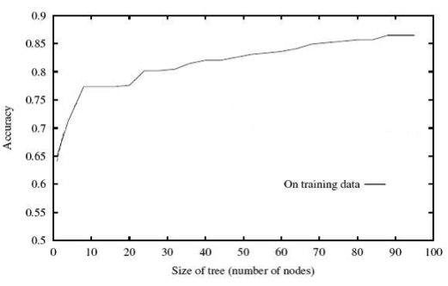
Overfitting
Our decision tree learning procedure always decreases training error
Is that what we want?

Slide 51
Test set error!
Machine learning is about predicting the future based on the past.
-- Hal Daume III
past
future
predict
learn
Training
Data
model/
predictor
Testing
Data
model/
predictor

Slide 52
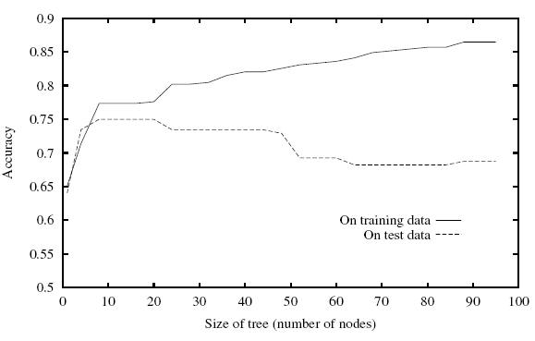
Overfitting
Even though the training error is decreasing, the testing error can go up!

Slide 53
Overfitting
Unicycle
Terrain | Unicycle-type | Weather | Go-For-Ride?
Trail | Mountain | Rainy | YES
Trail | Mountain | Sunny | YES
Road | Mountain | Snowy | YES
Road | Mountain | Sunny | YES
Trail | Normal | Snowy | NO
Trail | Normal | Rainy | NO
Road | Normal | Snowy | YES
Road | Normal | Sunny | NO
Trail | Normal | Sunny | NO
Mountain
Normal
YES
Terrain
Road
Trail
Weather
NO
Rainy
Snowy
Sunny
NO
YES
NO
How do we prevent overfitting?

Slide 54
Preventing overfitting
Base case:
If all data belong to the same class, create a leaf node with that label
OR all the data has the same feature values
OR We’ve reached a particular depth in the tree
?
One idea: stop building the tree early

Slide 55
Preventing overfitting
Base case:
If all data belong to the same class, create a leaf node with that label
OR all the data has the same feature values
OR We’ve reached a particular depth in the tree
We only have a certain number/fraction of examples remaining
We’ve reached a particular training error
Use development data (more on this later)
…

Slide 56
Preventing overfitting: pruning
Unicycle
Pruning: after the tree is built, go back and “prune” the tree, i.e. remove some lower parts of the tree
Similar to stopping early, but done after the entire tree is built
Mountain
Normal
YES
Terrain
Road
Trail
Weather
NO
Rainy
Snowy
Sunny
NO
YES
NO

Slide 57
Preventing overfitting: pruning
Unicycle
Mountain
Normal
YES
Terrain
Road
Trail
Weather
NO
Rainy
Snowy
Sunny
NO
YES
NO
Build the full tree

Slide 58
Preventing overfitting: pruning
Unicycle
Mountain
Normal
YES
Terrain
Unicycle
Road
Trail
Mountain
Normal
Weather
NO
YES
NO
Rainy
Snowy
Sunny
NO
YES
NO
Build the full tree
Prune back leaves that are too specific

Slide 59
Preventing overfitting: pruning
Unicycle
Mountain
Normal
YES
Terrain
Unicycle
Road
Trail
Mountain
Normal
Weather
NO
YES
NO
Rainy
Snowy
Sunny
NO
YES
NO
Pruning criterion?
Notes:
- many of the same things we used to “pre-prune”, i.e. stop building early

Slide 60
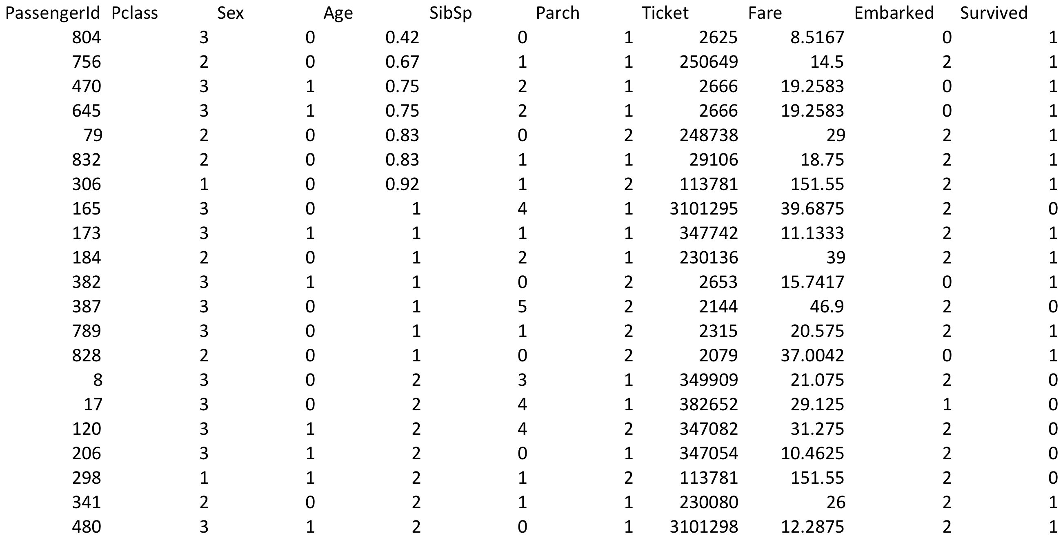
Handling non-binary attributes
What do we do with features that have multiple values? Real-values?

Slide 61
Features with multiple values
Rainy?
Rainy
not Rainy
Weather
NO
Snowy?
Rainy
Snowy
Sunny
Snowy
Sunny
NO
YES
NO
YES
NO
Treat as an n-ary split
Treat as multiple binary splits

Slide 62
Real-valued features
Use any comparison test (>, <, ≤, ≥) to split the data into two parts
Select a range filter, i.e. min < value < max
Fare < $20
Fare
Yes
No
0-10
>50
10-20
20-50

Slide 63
Other splitting criterion
Otherwise:
calculate the “score” for each feature if we used it to split the data
pick the feature with the highest score, partition the data based on that data value and call recursively
We used training error for the score. Any other ideas?

Slide 64
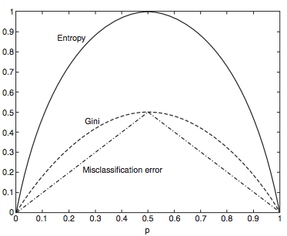
Other splitting criterion
- Entropy: how much uncertainty there is in the distribution over labels after the split
- Gini: sum of the square of the label proportions after split
- Training error = misclassification error
Notes:
All tend to perform roughly the same, so we often won’t worry too much about this

Slide 65
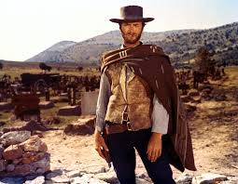
Decision trees
Good? Bad?

Slide 66
Decision trees: the good
Very intuitive and easy to interpret
Fast to run and fairly easy to implement (Assignment 2 ☺)
Historically, perform fairly well (especially with a few more tricks we’ll see later on)
No prior assumptions about the data

Slide 67
Decision trees: the bad
Be careful with features with lots of values if you’re not doing binary splits
ID | Terrain | Unicycle-type | Weather | Go-For-Ride?
1 | Trail | Normal | Rainy | NO
2 | Road | Normal | Sunny | YES
3 | Trail | Mountain | Sunny | YES
4 | Road | Mountain | Rainy | YES
5 | Trail | Normal | Snowy | NO
6 | Road | Normal | Rainy | YES
7 | Road | Mountain | Snowy | YES
8 | Trail | Normal | Sunny | NO
9 | Road | Normal | Snowy | NO
10 | Trail | Mountain | Snowy | YES
Which feature would be at the top here?
Notes:
- this is also why many decision tree learning algorithms always use binary splits

Slide 68
Decision trees: the bad
Can be problematic (slow, bad performance) with large numbers of features
Can’t learn some very simple data sets (e.g. some types of linearly separable data)
Pruning/tuning can be tricky to get right

Slide 69
Final DT algorithm
DT_train(data):
Base cases:
If all data belong to the same class, pick that label
If all the data have the same feature values, pick majority label (if tie, parent majority)
If we’re out of features to examine, pick majority label (if tie, parent majority)
If the we don’t have any data left, pick majority label of parent
If some other stopping criteria exists to avoid overfitting, pick majority label
Otherwise (i.e. if none of the base cases apply):
calculate the “score” for each feature if we used it to split the data
pick the feature with the highest score, partition the data based on that data, e.g. data_left and data_right
Recurse, i.e. DT_train(data_left) and DT_train(data_right)
Make tree with feature as the splitting criterion with the decision trees returned from the recursive calls as the children

Slide 70
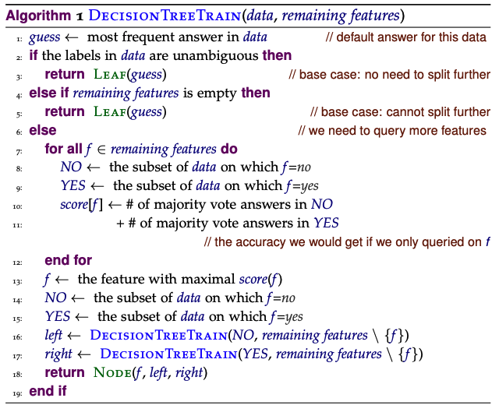
Pseudocode (from the book)

Slide 71
Base cases:
If all data belong to the same class, pick that label
If all the data have the same feature values, pick majority label (if tie, parent majority)
If we’re out of features to examine, pick majority label (if tie, parent majority)
If the we don’t have any data left, pick majority label of parent
If some other stopping criteria exists to avoid overfitting, pick majority label

Slide 72
Base cases:
If all data belong to the same class, pick that label
If all the data have the same feature values, pick majority label (if tie, parent majority)
If we’re out of features to examine, pick majority label (if tie, parent majority)
If the we don’t have any data left, pick majority label of parent
If some other stopping criteria exists to avoid overfitting, pick majority label

Slide 73
Base cases:
If all data belong to the same class, pick that label
If all the data have the same feature values, pick majority label (if tie, parent majority)
If we’re out of features to examine, pick majority label (if tie, parent majority)
If the we don’t have any data left, pick majority label of parent
If some other stopping criteria exists to avoid overfitting, pick majority label

Slide 74
Base cases:
If all data belong to the same class, pick that label
If all the data have the same feature values, pick majority label (if tie, parent majority)
If we’re out of features to examine, pick majority label (if tie, parent majority)
If the we don’t have any data left, pick majority label of parent
If some other stopping criteria exists to avoid overfitting, pick majority label
Not in this pseudocode!

Slide 75
Base cases:
If all data belong to the same class, pick that label
If all the data have the same feature values, pick majority label (if tie, parent majority)
If we’re out of features to examine, pick majority label (if tie, parent majority)
If the we don’t have any data left, pick majority label of parent
If some other stopping criteria exists to avoid overfitting, pick majority label

Slide 76
Base cases:
If all data belong to the same class, pick that label
If all the data have the same feature values, pick majority label (if tie, parent majority)
If we’re out of features to examine, pick majority label (if tie, parent majority)
If the we don’t have any data left, pick majority label of parent
If some other stopping criteria exists to avoid overfitting, pick majority label

Slide 77
Base cases:
If all data belong to the same class, pick that label
If all the data have the same feature values, pick majority label (if tie, parent majority)
If we’re out of features to examine, pick majority label (if tie, parent majority)
If the we don’t have any data left, pick majority label of parent
If some other stopping criteria exists to avoid overfitting, pick majority label

Slide 78
Base cases:
If all data belong to the same class, pick that label
If all the data have the same feature values, pick majority label (if tie, parent majority)
If we’re out of features to examine, pick majority label (if tie, parent majority)
If the we don’t have any data left, pick majority label of parent
If some other stopping criteria exists to avoid overfitting, pick majority label
Not in this pseudocode!

Slide 79
Otherwise (i.e. if none of the base cases apply):
calculate the “score” for each feature if we used it to split the data
pick the feature with the highest score, partition the data based on that data, e.g. data_left and data_right
Recurse, i.e. DT_train(data_left) and DT_train(data_right)
Make tree with feature as the splitting criterion with the decision trees returned from the recursive calls as the children

Slide 80
Otherwise (i.e. if none of the base cases apply):
calculate the “score” for each feature if we used it to split the data
pick the feature with the highest score, partition the data based on that data, e.g. data_left and data_right
Recurse, i.e. DT_train(data_left) and DT_train(data_right)
Make tree with feature as the splitting criterion with the decision trees returned from the recursive calls as the children

Slide 81
Otherwise (i.e. if none of the base cases apply):
calculate the “score” for each feature if we used it to split the data
pick the feature with the highest score, partition the data based on that data, e.g. data_left and data_right
Recurse, i.e. DT_train(data_left) and DT_train(data_right)
Make tree with feature as the splitting criterion with the decision trees returned from the recursive calls as the children

Slide 82
What would the tree look like for…
Unicycle
Terrain | Unicycle-type | Weather | Go-For-Ride?
Trail | Mountain | Rainy | YES
Trail | Mountain | Sunny | YES
Road | Mountain | Snowy | YES
Road | Mountain | Sunny | YES
Trail | Normal | Snowy | NO
Trail | Normal | Rainy | NO
Road | Normal | Snowy | YES
Road | Normal | Sunny | NO
Trail | Normal | Sunny | NO
Mountain
Normal
YES
Terrain
Road
Trail
Weather
NO
Rainy
Snowy
Sunny
NO
YES
NO
An aside: how did we decide to pick the label for normal→road→rainy?
Notes:
- an aside, how did we decide to pick the label for normal->road->rainy? There were no examples in the training data set.

Slide 83
Picking based on parent majority
Make the parent majority an extra parameter and pass it along in case you need it (get to a case where the data is empty)
Before recursing, check if the data is empty and make a leaf node before recursing
Either approach is fine!

