Slide 1
deep learning
David Kauchak
CS158 – Fall 2025

Slide 2
Admin
Assignment 8
Schedule for the rest of the semester

Slide 3

Deep learning
Deep learning is a branch of machine learning based on a set of algorithms that attempt to model high level abstractions in data by using a deep graph with multiple processing layers, composed of multiple linear and non-linear transformations.
Deep learning is part of a broader family of machine learning methods based on learning representations of data.

Slide 4
Deep learning
Key: learning better features that abstract from the “raw” data
Using learned feature representations based on large amounts of data, generally unsupervised
Using classifiers with multiple layers of learning

Slide 5
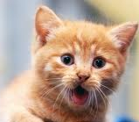
Deep learning
More abstract representation
    Train multiple layers of features/abstractions from data.
    Try to discover representation that makes decisions easy.
Low-level
Features
Mid-level
Features
High-level
Features
Classifier
“Cat”?
Deep Learning: train layers of features so that classifier works well.
Slide adapted from: Adam Coates

Slide 6
Deep learning for neural networks
Traditional NN models: 1-2 hidden layers
Deep learning NN models: 3+ hidden layers
…

Slide 7
Importance of features
  Feature quality is critical to the performance of ML methods
  Normal process = hand-crafted features
  Deep learning: find algorithms to automatically discover features from the data

Slide 8
Challenges
What makes “deep learning” hard for NNs?
…

Slide 9
Challenges
What makes “deep learning” hard for NNs?
…
…
What will happened to the modified errors further up?

Slide 10
Challenges
What makes “deep learning” hard for NNs?
…
…
Modified errors tend to get diluted as they get combined with many layers of weight corrections

Slide 11
Deep learning
Growing field
Driven by:
  Increase in data availability
  Increase in computational power
  Parallelizability of many of the algorithms
Involves more than just neural networks (though, they’re a very popular model)

Slide 12
word2vec
How many people have heard of it?
What is it?

Slide 13
Word representations
Wine data uses word occurrences as a feature
What does this miss?

Slide 14
Word representations
Wine data uses word occurrences as a feature
What does this miss?
“The wine had a dark red color” Zinfandel
“The wine was a deep crimson color” label?
“The wine was a deep yellow color” label?
Would like to recognize that words have similar meaning even though they aren’t lexically the same

Slide 15
Word representations
Key idea: project words into a multi-dimensional “meaning” space
word
[x₁, x₂, …, x_{d}]

Slide 16
Word representations
Key idea: project words into a multi-dimensional “meaning” space
word
[x₁, x₂, …, x_{d}]
red
[r₁, r₂, …, r_{d}]
[y₁, y₂, …, y_{d}]
crimson
[c₁, c₂, …, c_{d}]
[r₁, r₂, …, r_{d}]
[c₁, c₂, …, c_{d}]
yellow
[y₁, y₂, …, y_{d}]

Slide 17
Word representations
Key idea: project words into a multi-dimensional “meaning” space
word
[x₁, x₂, …, x_{d}]
The idea of word representations is not new:
Co-occurrence matrices
Latent Semantic Analysis (LSA)
New idea: learn word representation using a task-driven approach

Slide 18
A prediction problem
I like to eat bananas with cream cheese
Given a context of words
Predict what words are likely to occur in that context

Slide 19
A prediction problem
Given text, can generate lots of examples:
I like to eat bananas with cream cheese
input
prediction
___ like to eat
I ___ to eat bananas
I like ___ eat bananas with
I like to ___ bananas with cream
…
I
like
to
eat
…

Slide 20
A prediction problem
Use data like this to learn a distribution:
words before
words after

Slide 21
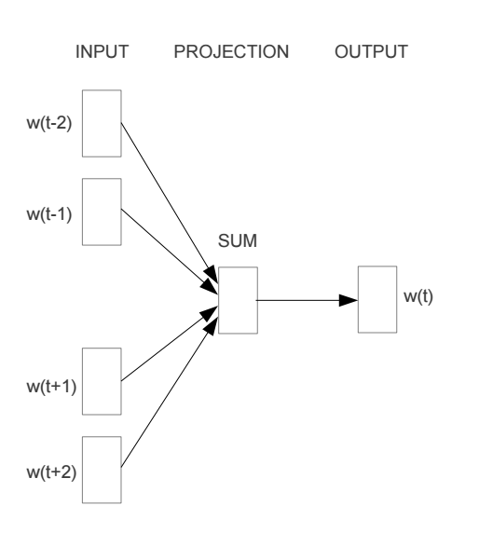
Train a neural network on this problem
https://arxiv.org/pdf/1301.3781v3.pdf

Slide 22
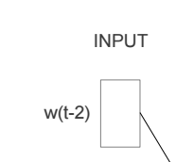
Encoding words
How can we input a “word” into a network?

Slide 23
“One-hot” encoding
For a vocabulary of V words, have V input nodes
All inputs are 0 except the for the one corresponding to the word
a
apple
…
V nodes
banana
…
zebra

Slide 24
“One-hot” encoding
For a vocabulary of V words, have V input nodes
All inputs are 0 except the for the one corresponding to the word
0
a
0
apple
banana
…
1
banana
…
0
zebra

Slide 25
“One-hot” encoding
For a vocabulary of V words, have V input nodes
All inputs are 0 except the for the one corresponding to the word
0
a
1
apple
apple
…
0
banana
…
0
zebra

Slide 26
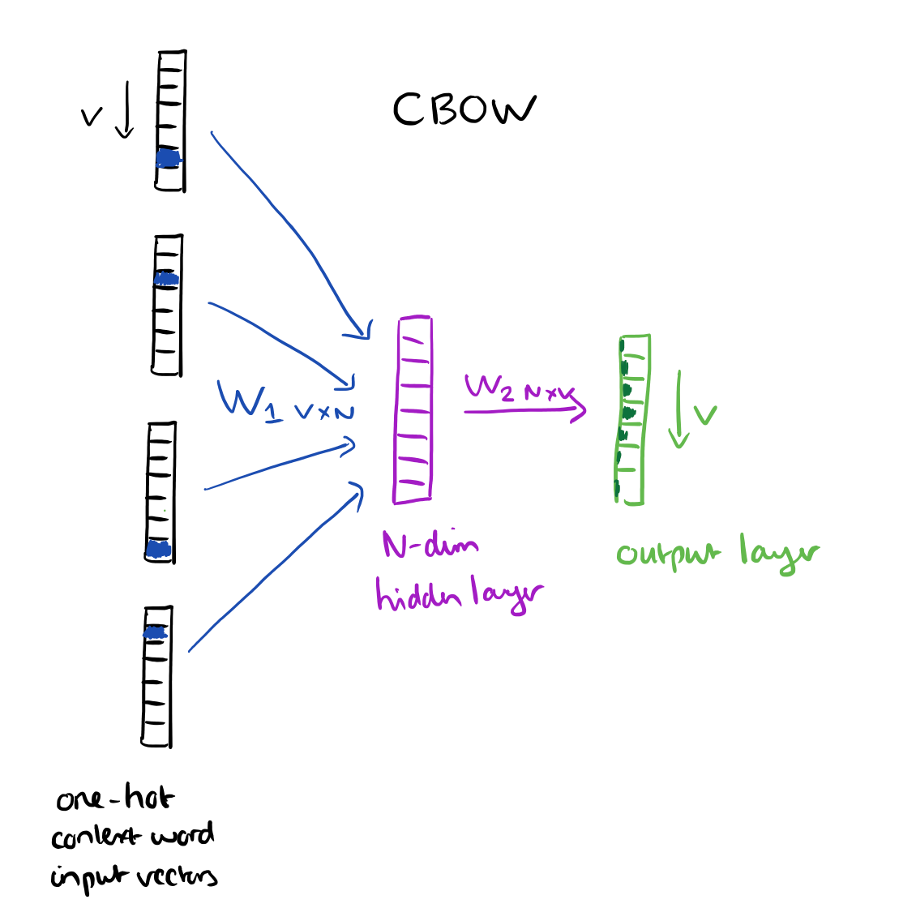
N = 100 to 1000
https://blog.acolyer.org/2016/04/21/the-amazing-power-of-word-vectors/

Slide 27
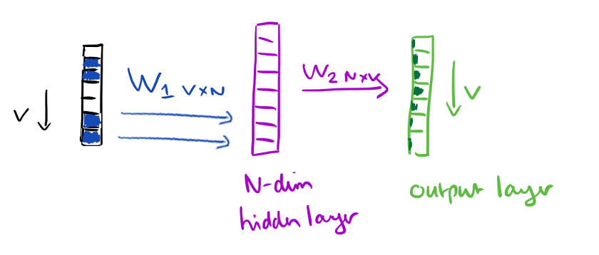
Parameter tying
N = 100 to 1000
https://blog.acolyer.org/2016/04/21/the-amazing-power-of-word-vectors/

Slide 28
Another view
…
…
…
N hidden nodes
V input nodes
V output nodes

Slide 29
Training: backpropagation
___ like to eat
I ___ to eat bananas
I like ___ eat bananas with
I like to ___ bananas with cream
…
I
like
to
eat
…
…
…
…
N hidden nodes
V input nodes
V output nodes

Slide 30
Training: backpropagation
eat
I like to ___ bananas with cream
0
0
…
1
0
…
1
0
…
1
0
…
0
0
…
1
0
…
eat
I
…
like
…
…
to
N hidden nodes
V input nodes
V output nodes

Slide 31
Word representation
VxN weights
The weights for each word provide an N dimensional mapping of the word
Words that predict similarly should have similar weights
…
…
…
Why does this work?
N hidden nodes
V input nodes
V output nodes
Notes:
Words that have similar weights, will likely predict similar outputs, i.e., are likely to occur as context for the same words

Slide 32
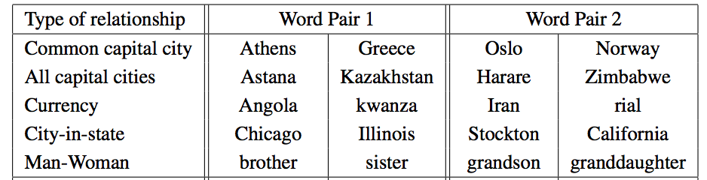
Results
vector(word1) – vector(word2) = vector(word3) - X
word1 is to word2 as word3 is to X

Slide 33
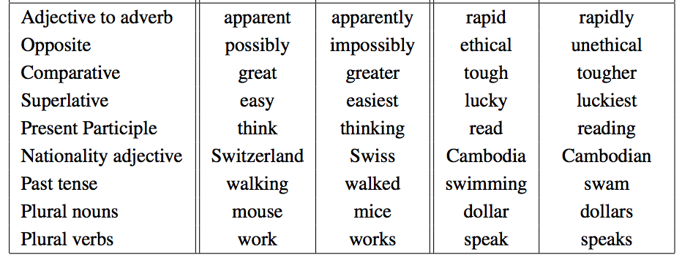
Results
vector(word1) – vector(word2) = vector(word3) - X
word1 is to word2 as word3 is to X

Slide 34
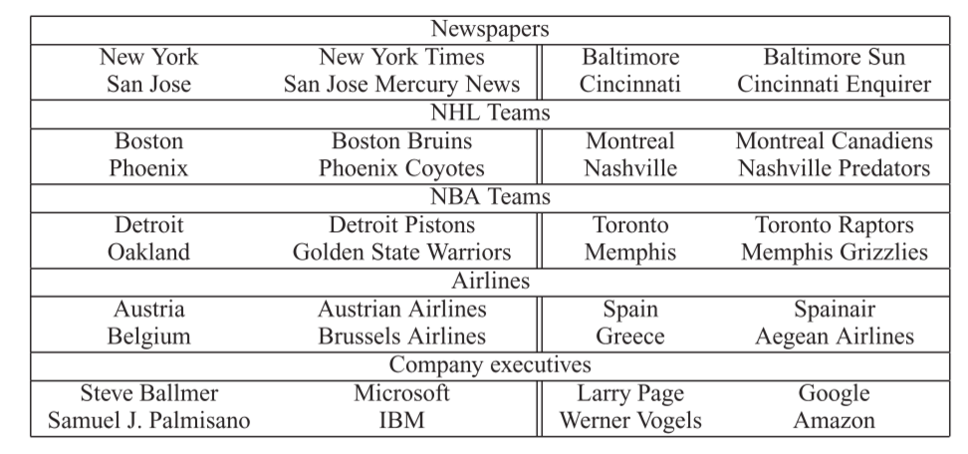
Results
vector(word1) – vector(word2) = vector(word3) - X
word1 is to word2 as word3 is to X

Slide 35
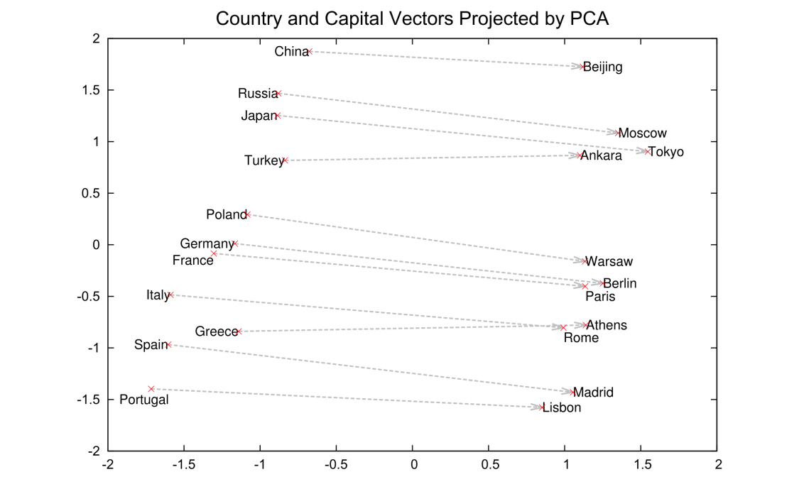
Results
2-Dimensional projection of the N-dimensional space

Slide 36
Visualized
https://projector.tensorflow.org/

Slide 37
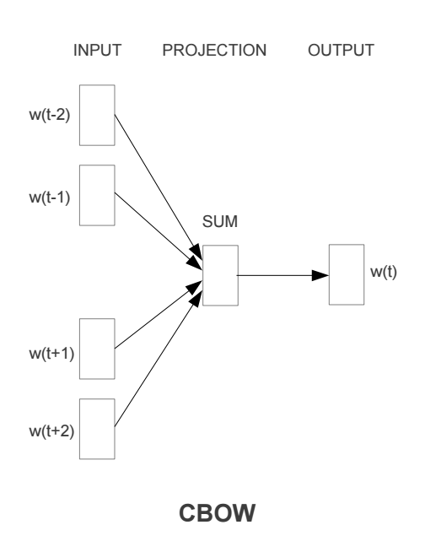
Continuous Bag Of Words

Slide 38
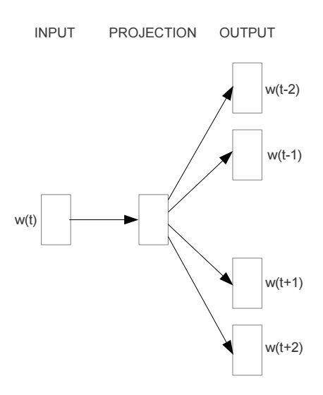
Other models: skip-gram

Slide 39
word2vec
A model for learning word representations from large amounts of data
Has become a popular pre-processing step for learning a more robust feature representation
Models like word2vec have also been incorporated into other learning approaches (e.g., translation tasks)

Slide 40
word2vec resources
https://blog.acolyer.org/2016/04/21/the-amazing-power-of-word-vectors/
https://code.google.com/archive/p/word2vec/
https://deeplearning4j.org/word2vec
https://arxiv.org/pdf/1301.3781v3.pdf

Slide 41
Language modeling
What does natural language look like?
p( sentence )
    p(“I like to eat pizza”)
    p(“pizza like I eat”)
Often is posed as: p( word | previous words ) – or some other notion of context
    p(“pizza” | “I like to eat” )
    p(“garbage” | “I like to eat”)
    p(“run” | “I like to eat”)

Slide 42
Ideas?
    p(“I like to eat pizza”)
    p(“pizza like I eat”)
    p(“pizza” | “I like to eat” )
    p(“garbage” | “I like to eat”)
    p(“run” | “I like to eat”)

Slide 43



Look at a corpus

Slide 44
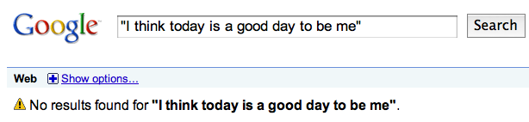
Language modeling
I think today is a good day to be me
Language modeling is about dealing with data sparsity!

Slide 45
Language modeling
Many approaches:
  n-gram language modeling
    Start at the beginning of the sentence
    Generate one word at a time based on the previous words
  syntax-based language modeling
    Construct the syntactic tree from the top down
    e.g. context free grammar
    eventually at the leaves, generate the words
  Neural language models
    Predict the likelihood of the word based on the context
    Often allows for generalization beyond the lexical strings

Slide 46
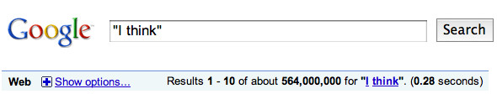
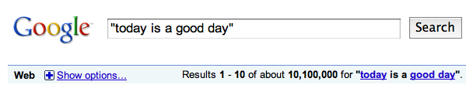

n-gram language modeling
I think today is a good day to be me

Slide 47
Our friend the chain rule
Step 1: decompose the probability
P(I think today is a good day to be me) =
P(I | <start> ) x
P(think | I) x
P(today| I think) x
P(is| I think today) x
P(a| I think today is) x
P(good| I think today is a) x
…
Notes:
this is the same as:
p(x_1, x_2, x_3, …, x_n) = p(I)

Slide 48
Recurrent neural networks
inputs
hidden layer(s)
output

Slide 49
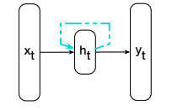
Recurrent neural nets
x_{t} = input
h_{t} = hidden layer output
y_{t} = output
Figure 9.1 from Jurafsky and Martin

Slide 50
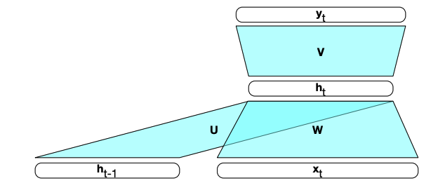
Recurrent neural networks
x_{t} = input
h_{t-1} = hidden layer output from previous input
h_{t} = hidden layer output
y_{t} = output
Figure 9.2 from Jurafsky and Martin

Slide 51
Recurrent neural networks
x₁
Say you want the output of x1, x2, x3, ….

Slide 52
Recurrent neural networks
y₁
h₁
x₁

Slide 53
Recurrent neural networks
h₁
x₂

Slide 54
Recurrent neural networks
y₂
h₂
h₁
x₂

Slide 55
Recurrent neural networks
h₂
x₃

Slide 56
Recurrent neural networks
y₃
h₃
h₂
x₃

Slide 57
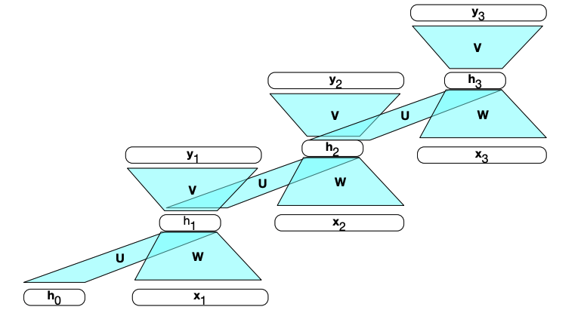
RNNs unrolled
Figure 9.2 from Jurafsky and Martin

Slide 58
Still just a single neural network
U, W and V are the weight matrices
x_{t} = input
h_{t-1} = hidden layer output from previous input
h_{t} = hidden layer output
y_{t} = output
Figure 9.2 from Jurafsky and Martin

Slide 59
RNN language models
How can we use RNNs as language models p(w1, w2, …, wn)?
How do we input a word into a NN?

Slide 60
“One-hot” encoding
For a vocabulary of V words, have V input nodes
All inputs are 0 except the for the one corresponding to the word
0
a
1
apple
apple
…
x_{t}
0
banana
…
0
zebra

Slide 61
RNN language model
…
…
…
0
a
N hidden nodes
V input nodes
1
apple
V output nodes
…
0
banana
…
0
zebra

Slide 62
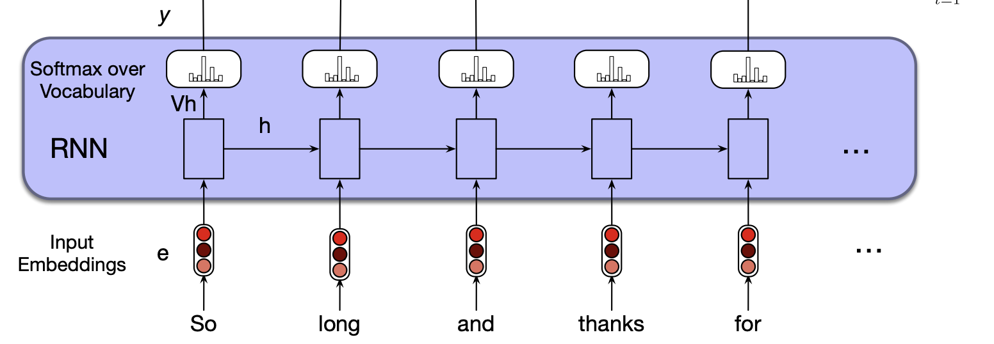
RNN language model
p(w1|<s>)
p(w2|<s> w1)
p(w3|<s> w1 w2)
p(w4|<s> w1 w2 w3)
Softmax = turn into probabilities
Figure 9.6 from Jurafsky and Martin

Slide 63
RNN language model
p(w1|<s>)
p(w2|<s> w1)
p(w3|<s> w1 w2)
p(w4|<s> w1 w2 w3)
Softmax = turn into probabilities
Figure 9.6 from Jurafsky and Martin

Slide 64
RNN language model

Slide 65
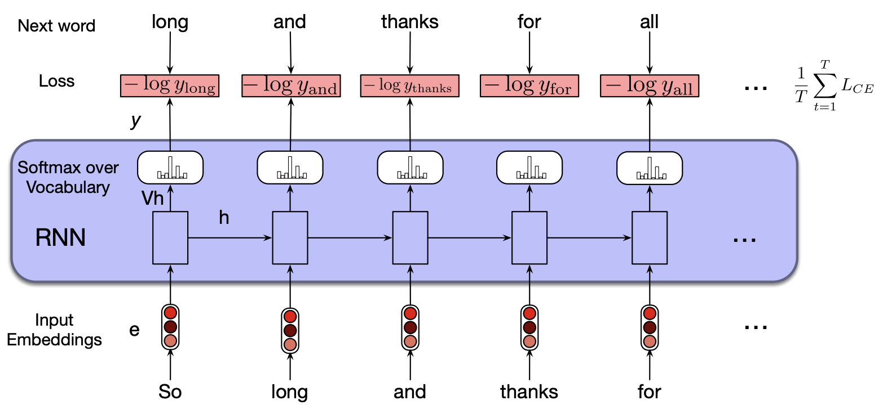
Training RNN LM
Figure 9.6 from Jurafsky and Martin

Slide 66
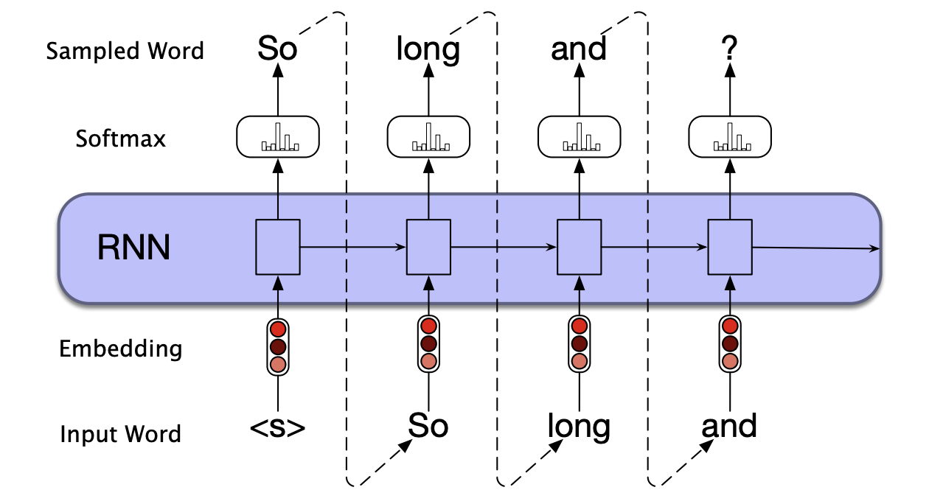
Generation with RNN LM
Figure 9.9 from Jurafsky and Martin

Slide 67
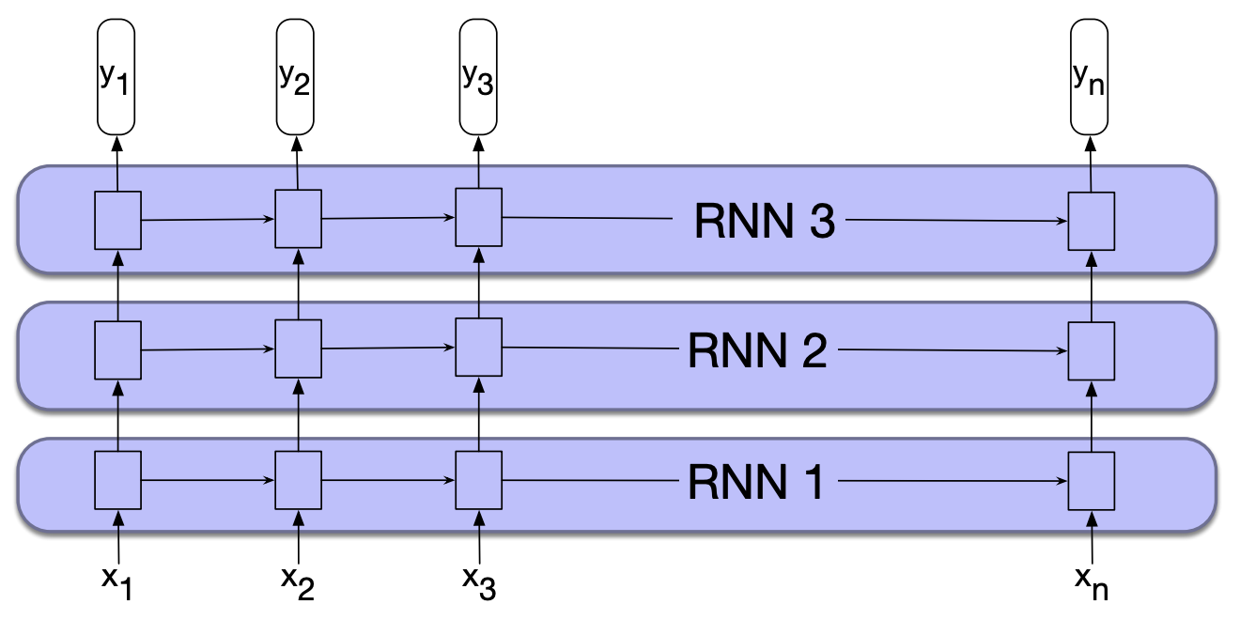
Stacked RNNs
Figure 9.10 from Jurafsky and Martin

Slide 68
Stacked RNNs
Multiple hidden layers
Still just a single network run over a sequence
Allows for better generalization, but can take longer to train and more data!

Slide 69
Challenges with RNN LMs
p(w1|<s>)
p(w2|<s> w1)
p(w3|<s> w1 w2)
p(w4|<s> w1 w2 w3)
What context is incorporated for predicting w_{i}?

Slide 70
Challenges with RNN LMs
p(w1|<s>)
p(w2|<s> w1)
p(w3|<s> w1 w2)
p(w4|<s> w1 w2 w3)
Just like with an n-gram LM, only use previous history.
What are we missing if we’re predicting p(w1, w2, …, wn)?

Slide 71
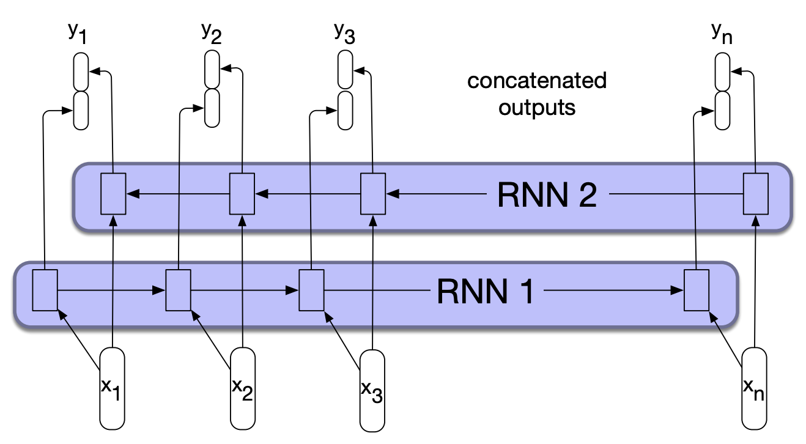
Bidirectional RNN
Normal forward RNN
Figure 9.11 from Jurafsky and Martin

Slide 72
Bidirectional RNN
Normal forward RNN
Figure 9.11 from Jurafsky and Martin

Slide 73
Bidirectional RNN
Backward RNN, starting from the last word
Figure 9.11 from Jurafsky and Martin

Slide 74
Bidirectional RNN
Prediction uses collected information from the words before (left)
and words after (right)
Figure 9.11 from Jurafsky and Martin

Slide 75
Challenges with RNN LMs
p(w1|<s>)
p(w2|<s> w1)
p(w3|<s> w1 w2)
p(w4|<s> w1 w2 w3)
Can we use them for translation (and related tasks)?
Any challenges?

Slide 76
Challenges with RNN LMs
hasta
luega
y
gracias
por
Can we use them for translation (and related tasks)?
Any challenges?

Slide 77
Challenges with RNN LMs
No laila lōʻihi a mahalo no nā mea a pau
Translation isn’t word-to-word
Worse for other tasks like summarization

Slide 78
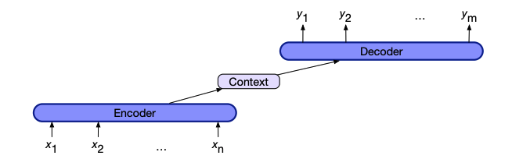
Encoder-decoder models
Idea:
Process the input sentence (e.g., sentence to be translated) with a network
Represent the sentence as some function of the hidden states (encoding)
Use this context to generate the output
Figure 9.16 from Jurafsky and Martin

Slide 79
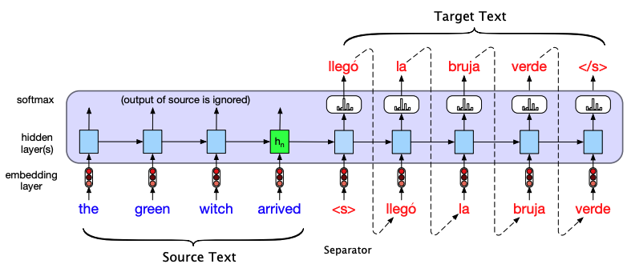
Encoder-decoder models: simple version
The context is the final hidden state of the encoder and is provided as input to the first step of the decoder
Figure 9.17 from Jurafsky and Martin

Slide 80
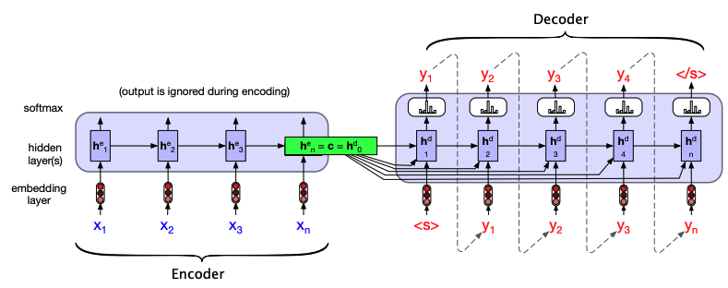
Encoder-decoder models: improved
The context is some combination of all of the hidden states of the encoder
How is this better?
Figure 9.18 from Jurafsky and Martin

Slide 81
Encoder-decoder models: improved
The context is some combination of all of the hidden states of the encoder
Each step of decoding has access to the original, full encoding/context
Figure 9.18 from Jurafsky and Martin

Slide 82
Encoder-decoder models: improved
Even with this model, different encoding steps may care about different parts of the context
Figure 9.18 from Jurafsky and Martin

Slide 83
Encoder-decoder models: improved
Even with this model, different encoding steps may care about different parts of the context
Figure 9.18 from Jurafsky and Martin

Slide 84
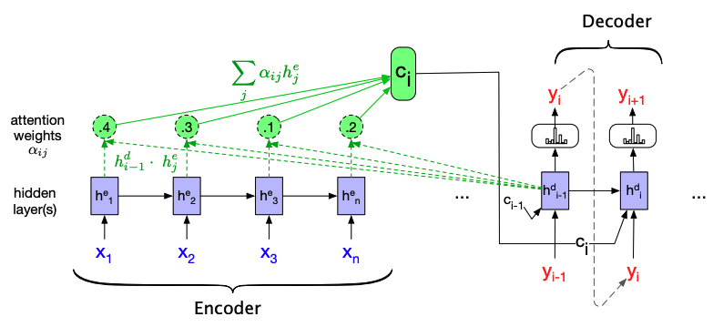
Attention
Context is dependent on where we are in decoding step and the relationship between encoder and decoder hidden states

Slide 85
Attention
Simple version attention is static, but can learn attention mechanism (i.e., relationship between encoder and decoder hidden states)
Figure 9.23 from Jurafsky and Martin

Slide 86
Attention
Key RNN challenge: computation is sequential
This prevents parallelization
Harder to model contextual dependencies
Figure 9.23 from Jurafsky and Martin

Slide 87
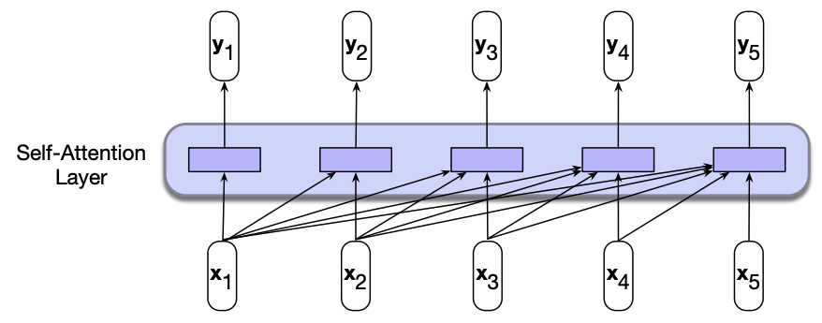
Another model
How is this setup different from the RNN?
Figure 10.1 from Jurafsky and Martin

Slide 88
Another model
Do not rely on the hidden states for context information
Parallel: computation can all happen at once
Figure 10.1 from Jurafsky and Martin

Slide 89
Self-attention
Self-attention:
Input is some context (for LMs, the previous words)
Learn what parts of the context are important based
Figure 10.1 from Jurafsky and Martin

Slide 90
Self-attention
Figure 10.1 from Jurafsky and Martin

Slide 91
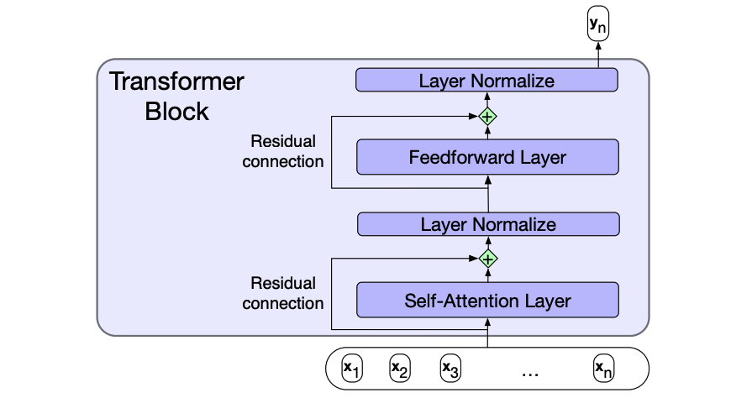
Transformer block
Figure 10.4 from Jurafsky and Martin

Slide 92
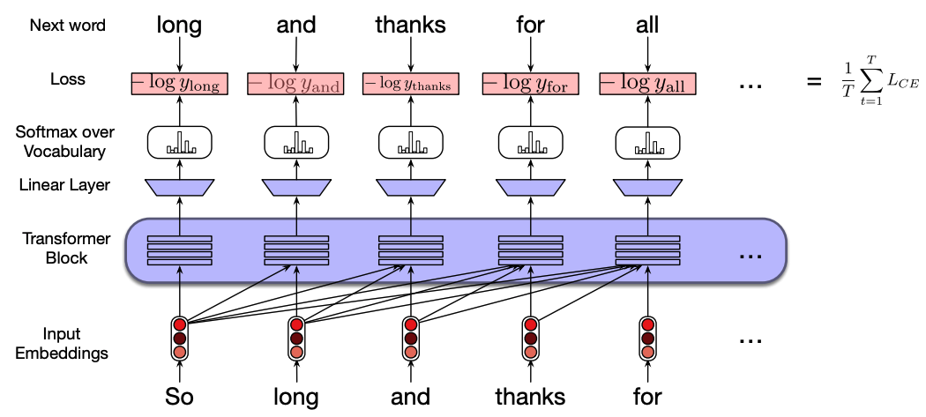
Transformer network

Slide 93
Transformer network vs. RNN

Slide 94
GPT
Generative: outputs things
Pre-trained: previously trained on a large corpus
Transformer: uses the transformer network

Slide 95
Pre-trained language models
Pre-trained language models are general purpose and are trained on a very large corpus
They can be used as/is to:
Ask p(w1 w2 … wn)
Generate text given some seed, p(wi | w1 w2 … wi-1
They can also be “fine-tuned” for particular tasks: take the current weights and update them based on a specific application

Slide 96
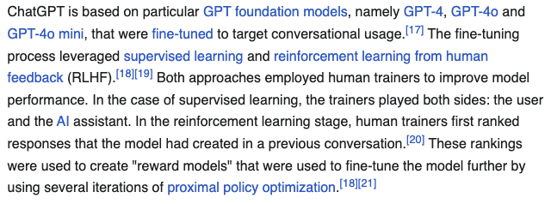
ChatGPT

Slide 97
Another example
https://adamharley.com/nn_vis/

