Slide 1
Logistic regression
David Kauchak
CS158 – Fall 2025

Slide 2
Admin
Assignment 7

Slide 3
MLE estimation for NB
train
probabilistic model
training data
What are the MLE estimates for these?

Slide 4
Maximum likelihood estimates
number of examples with label y
total number of examples
number of examples with label y with feature x_{i} = 1
number of examples with label
Notes:
just involves iterating over the data and aggregating these counts!

Slide 5
Maximum likelihood estimates
p(1) = ?
p(-1) = ?
x₁ | x₂ | label
1 | 1 | 1
1 | 0 | 1
1 | 1 | 1
0 | 1 | -1
0 | 0 | -1

Slide 6
Maximum likelihood estimates
p(1) = 3/5
p(-1) = 2/5
x₁ | x₂ | label
1 | 1 | 1
1 | 0 | 1
1 | 1 | 1
0 | 1 | -1
0 | 0 | -1

Slide 7
Maximum likelihood estimates
p(x₁ = 1 | 1) | ?
p(x₁ = 0 | 1) | ?
p(x₂ = 1| 1) | ?
p(x2 = 0| 1) | ?
x₁ | x₂ | label
1 | 1 | 1
1 | 0 | 1
1 | 1 | 1
0 | 1 | -1
0 | 0 | -1

Slide 8
Maximum likelihood estimates
p(x₁ = 1 | 1) | 3/3
p(x₁ = 0 | 1) | 0/3
p(x₂ = 1| 1) | 2/3
p(x2 = 0| 1) | 1/3
x₁ | x₂ | label
1 | 1 | 1
1 | 0 | 1
1 | 1 | 1
0 | 1 | -1
0 | 0 | -1

Slide 9

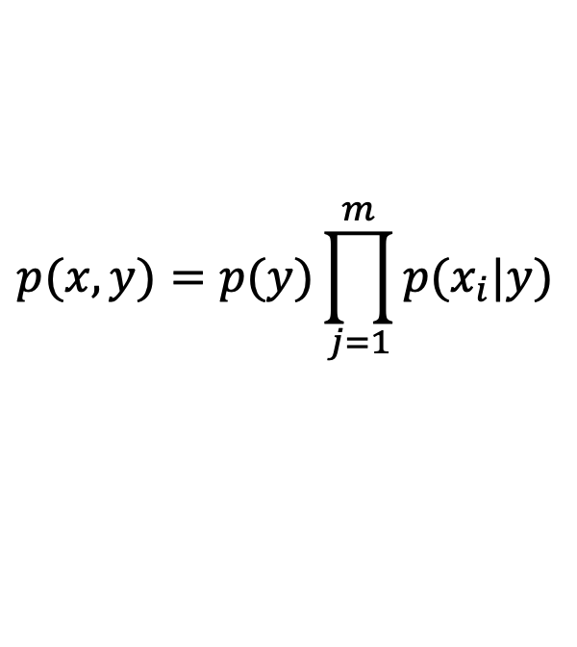
Maximum likelihood estimates
$$p(x,y)=p(y)\prod_{j=1}^{m}{p(x_{i}|y)}$$
p(x₁ = 1 | 1) | 3/3
p(x₁ = 0 | 1) | 0/3
p(x₂ = 1| 1) | 2/3
p(x2 = 0| 1) | 1/3
x₁ | x₂ | label
1 | 1 | 1
1 | 0 | 1
1 | 1 | 1
0 | 1 | -1
0 | 0 | -1
$$p(x_{1}=1,x_{2}=1,y=1)= ?$$

Slide 10
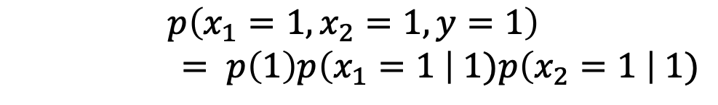
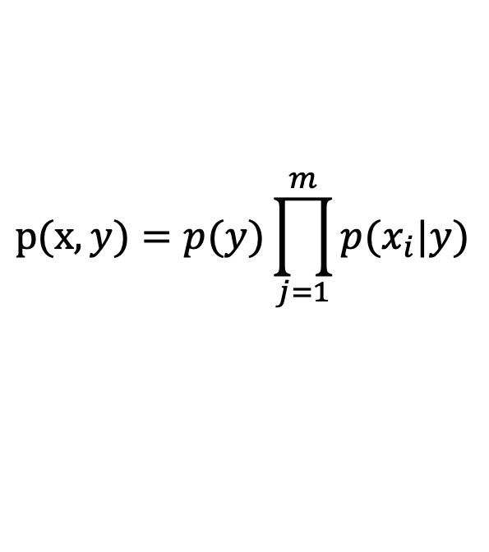
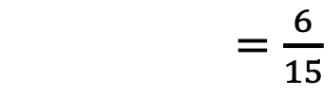
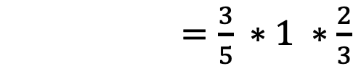
Maximum likelihood estimates
$$p(x,y)=p(y)\prod_{j=1}^{m}{p(x_{i}|y)}$$
p(x₁ = 1 | 1) | 3/3
p(x₁ = 0 | 1) | 0/3
p(x₂ = 1| 1) | 2/3
p(x2 = 0| 1) | 1/3
x₁ | x₂ | label
1 | 1 | 1
1 | 0 | 1
1 | 1 | 1
0 | 1 | -1
0 | 0 | -1
$$p\left(x_{1}=1,x_{2}=1,y=1\right)$$
$= p\left(1\right)p\left(x_{1}=1 \right| 1)p\left(x_{2}=1 \right| 1)$
$=\frac{3}{5} ∗1 ∗\frac{2}{3}$
$=\frac{6}{15}$

Slide 11

Maximum likelihood estimates
$$p(x,y)=p(y)\prod_{j=1}^{m}{p(x_{i}|y)}$$
p(x₁ = 1 | 1) | 3/3
p(x₁ = 0 | 1) | 0/3
p(x₂ = 1| 1) | 2/3
p(x2 = 0| 1) | 1/3
x₁ | x₂ | label
1 | 1 | 1
1 | 0 | 1
1 | 1 | 1
0 | 1 | -1
0 | 0 | -1
$$p(x_{1}=0,x_{2}=1,y=1)= ?$$

Slide 12
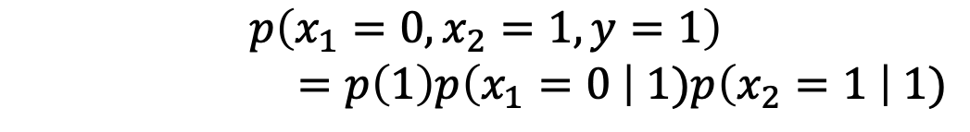

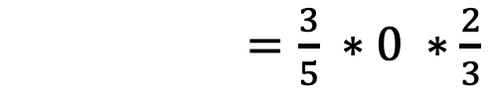
Maximum likelihood estimates
$$p(x,y)=p(y)\prod_{j=1}^{m}{p(x_{i}|y)}$$
p(x₁ = 1 | 1) | 3/3
p(x₁ = 0 | 1) | 0/3
p(x₂ = 1| 1) | 2/3
p(x2 = 0| 1) | 1/3
x₁ | x₂ | label
1 | 1 | 1
1 | 0 | 1
1 | 1 | 1
0 | 1 | -1
0 | 0 | -1
$$p\left(x_{1}=0,x_{2}=1,y=1\right)$$
$$=p\left(1\right)p\left(x_{1}=0 \right| 1)p\left(x_{2}=1 \right| 1)$$
$=\frac{3}{5} ∗0 ∗\frac{2}{3}$
$=0$
☹

Slide 13
Maximum likelihood estimates
p(1) = 3/5
p(-1) = 2/5
Full model trained!
p(x₁ = 1 | 1) | 3/3
p(x₂ = 1| 1) | 2/3
x₁ | x₂ | label
1 | 1 | 1
1 | 0 | 1
1 | 1 | 1
0 | 1 | -1
0 | 0 | -1
p(x₁ = 1 | -1) | 0/2
p(x₂ = 1| -1) | 1/2

Slide 14
Basic steps for probabilistic modeling
Probabilistic models
Step 1: pick a model
Step 2: figure out how to estimate the probabilities for the model
Step 3 (optional): deal with overfitting
Which model do we use, i.e. how do we calculate p(feature, label)?
How do train the model, i.e. how to we we estimate the probabilities for the model?
How do we deal with overfitting?

Slide 15


Likelihood distribution
The likelihood of the data, given the model parameters (Θ) is:
$$p(data|θ)$$
likelihood of the data, given the current model
Maximum Likelihood Estimation (MLE), picks the parameter as:
$$θ={argmax}_{θ}p(data|θ)$$

Slide 16
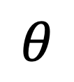

Training: MLE
train
probabilistic model
training data
$$θ={argmax}_{θ}p(data|θ)$$
$$θ$$

Slide 17

MLE problems
p(x₁ = 1 | 1) | 3/3
p(x₁ = 0 | 1) | 0/3
p(x₂ = 1| 1) | 2/3
p(x2 = 0| 1) | 1/3
$$θ={argmax}_{θ}p(data|θ)$$
The MLE is completely driven by the training data

Slide 18
Priors
Coin1 data: 3 Heads and 1 Tail
Coin2 data: 30 Heads and 10 tails
Coin3 data: 2 Tails
Coin4 data: 497 Heads and 503 tails
If someone asked you what the probability of heads was for each of these coins, what would you say?

Slide 19


Posterior distribution
We want to incorporate a prior belief of what the probabilities might be
given the data, how likely are different model parameters
$$p(θ|data)$$
Maximum a posteriori principle, pick parameters that maximize the posterior distribution:
$$θ={argmax}_{θ}p(θ|data)$$

Slide 20


MLE vs. Maximum posteriori
MLE
$$θ={argmax}_{θ}p(data|θ)$$
Maximum posteriori
$$θ={argmax}_{θ}p(θ|data)$$
Both are methods for picking model parameters

Slide 21
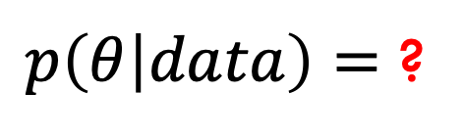
Maximum posteriori
$p\left(θ | data\right)=$ ?
(Hint: Bayes’ rule)

Slide 22
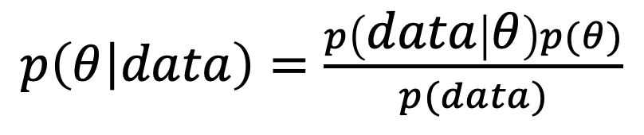
Maximum posteriori
$p\left(θ | data\right)=\frac{p\left(data | θ\right)p(θ)}{p(data)}$

Slide 23
Maximum posteriori
What are each of these probabilities?
$p\left(θ | data\right)=\frac{p\left(data | θ\right)p(θ)}{p(data)}$

Slide 24
Maximum posteriori
likelihood of the data under the model
probability of different parameters,
call the prior
$p\left(θ | data\right)=\frac{p\left(data | θ\right)p(θ)}{p(data)}$
probability of seeing the data (regardless of model)

Slide 25
Priors
Does p(data) matter for the argmax?
Notes:
no, it doesn’t very as theta changes. It’s a constant

Slide 26
Priors
likelihood of the data under the model
probability of different parameters,
call the prior
What does MLE assume for a prior on the model parameters?

Slide 27
Priors
likelihood of the data under the model
probability of different parameters,
call the prior
Assumes a uniform prior, i.e. all Θ are equally likely!
Relies solely on the likelihood

Slide 28
A better approach
We can use any distribution we’d like.
This allows us to impart addition bias into the model

Slide 29
Another view on the prior
Remember, the max is the same if we take the log:
We can use any distribution we’d like.
This allows us to impart addition bias into the model
Does this look like something we’ve seen before (Hint, think gradient descent)?

Slide 30
Regularization vs prior
likelihood based on the data
prior
fit
model bias
loss function based on the data
regularizer

Slide 31
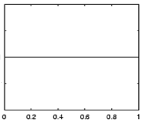
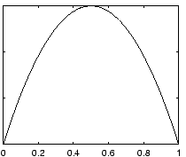
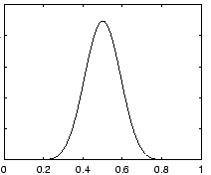
Prior for NB
Uniform prior
Dirichlet prior
λ= 0
increasing
Notes:
- as lambda gets larger we bias more and more towards

Slide 32
Prior: another view
MLE:
What happens to our likelihood if, for one of the labels, we never saw a particular feature?
Goes to 0!
Notes:
- Goes to 0!

Slide 33
Prior: another view
Adding a prior avoids this!

Slide 34
Smoothing
training data
for each label, pretend like we’ve seen each feature value occur in λ additional examples
Sometimes this is also called smoothing because it is seen as smoothing or interpolating between the MLE and some other distribution

Slide 35
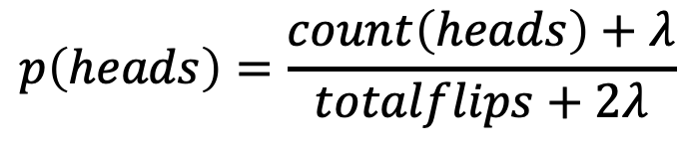
Priors
Coin1 data: 3 Heads and 1 Tail
Coin2 data: 30 Heads and 10 tails
Coin3 data: 2 Tails
Coin4 data: 497 Heads and 503 tails
$$p\left(heads\right)=\frac{count\left(heads\right)+λ}{totalflips+2λ}$$
Does this do the right thing in these cases?

Slide 36

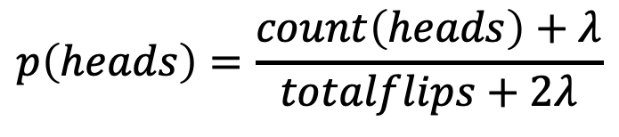



Priors
Coin1 data: 3 Heads and 1 Tail:
Coin2 data: 30 Heads and 10 tails:
Coin3 data: 2 Tails
Coin4 data: 497 Heads and 503 tails
$$p\left(heads\right)=\frac{4}{6}=0.667$$
$$p\left(heads\right)=\frac{31}{42}=0.738$$
$$p\left(heads\right)=\frac{3}{4}=0.75$$
$$p\left(heads\right)=\frac{498}{1002}=0.497$$
$$p\left(heads\right)=\frac{count\left(heads\right)+λ}{totalflips+2λ}$$

Slide 37
Maximum likelihood estimates
ƛ = 1
x₁ | x₂ | label
1 | 1 | 1
1 | 0 | 1
1 | 1 | 1
0 | 1 | -1
0 | 0 | -1
p(x₁ = 1 | 1) | ?
p(x₁ = 0 | 1) | ?
p(x₂ = 1| 1) | ?
p(x2 = 0| 1) | ?

Slide 38
Maximum likelihood estimates
ƛ = 1
x₁ | x₂ | label
1 | 1 | 1
1 | 0 | 1
1 | 1 | 1
0 | 1 | -1
0 | 0 | -1
p(x₁ = 1 | 1) | 4/5
p(x₁ = 0 | 1) | 1/5
p(x₂ = 1| 1) | 3/5
p(x2 = 0| 1) | 2/5

Slide 39
Avoids zero probability events!
p(x₁ = 1 | 1) | 3/3
p(x₁ = 0 | 1) | 0/3
p(x₂ = 1| 1) | 2/3
p(x2 = 0| 1) | 1/3
MLE
p(x₁ = 1 | 1) | 4/5
p(x₁ = 0 | 1) | 1/5
p(x₂ = 1| 1) | 3/5
p(x2 = 0| 1) | 2/5
smoothed/prior

Slide 40
Basic steps for probabilistic modeling
Probabilistic models
Step 1: pick a model
Step 2: figure out how to estimate the probabilities for the model
Step 3 (optional): deal with overfitting
Which model do we use, i.e. how do we calculate p(feature, label)?
How do train the model, i.e. how to we we estimate the probabilities for the model?
How do we deal with overfitting?

Slide 41
Joint models vs conditional models
We’ve been trying to model the joint distribution (i.e. the data generating distribution):
trying to model the data generating distribution
However, if all we’re interested in is classification, why not directly model the conditional distribution:
direct model for classification

Slide 42
A first try: linear
Any problems with this?
- Nothing constrains it to be a probability
- Could still have combination of features and weight that exceeds 1 or is below 0
Notes:
let’s try a different route this time
rather than deriving a model (the book does it that way)
let’s start with a type of model and see if we can work our way towards a working model

Slide 43
The challenge
Linear model
probability
+∞
1
We like linear models!
Can we transform the probability into a function that ranges over all values?
-∞
0

Slide 44
Odds ratio
Rather than predict the probability, we can predict the ratio of 1/0 (positive/negative)
Predict the odds that it is 1 (true): How much more likely is 1 than 0.
Does this help us?

Slide 45
Odds ratio
Linear model
odds ratio
+∞
+∞
Where is the dividing line between class 1 and
class 0 being selected?
-∞
0

Slide 46
Odds ratio
We’re trying to find some transformation that transforms the odds ratio to a number that is -∞ to +∞
Does this suggest another transformation?
odds ratio
0 1 2 3 4 5 6 7 8 9 ….

Slide 47
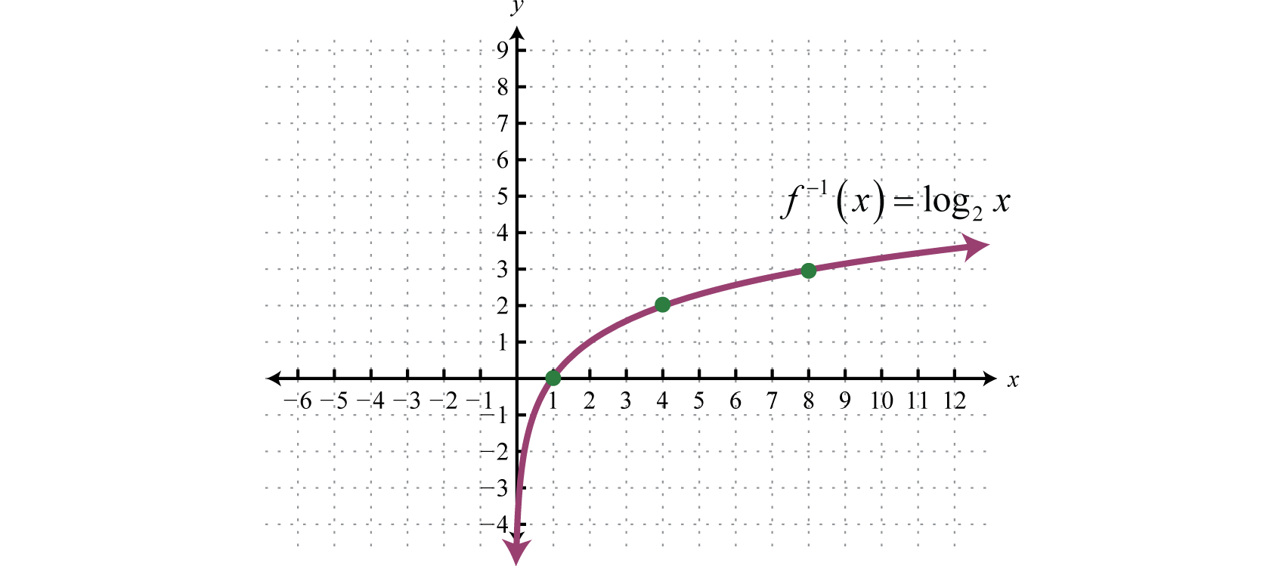
0 1 2 3 4 5 6 7 8 9 ….

Slide 48
Log odds (logit function)
=
Linear regression
odds ratio
+∞
+∞
How do we get the probability of an example?
-∞
-∞

Slide 49
Log odds (logit function)
…
anyone recognize this?

Slide 50
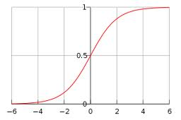
Logistic function

Slide 51
Logistic regression
How would we classify examples once we had a trained model?
If the sum > 0 then p(1)/p(0) > 1, so positive
if the sum < 0 then p(1)/p(0) < 1, so negative
Still a linear classifier (decision boundary is a line)

Slide 52
Training logistic regression models
How should we learn the parameters for logistic regression (i.e. the w’s and b)?
parameters

Slide 53
MLE logistic regression
Find the parameters that maximize the likelihood (or log-likelihood) of the data:
assume labels 1, -1

Slide 54
MLE logistic regression
We want to maximize, i.e.
Look familiar? Hint: anybody reading the book?

Slide 55
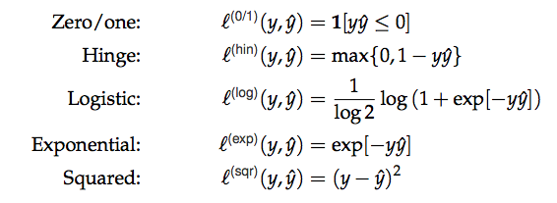
MLE logistic regression
Surrogate loss functions:

Slide 56
logistic regression: three views
linear classifier
conditional model
logistic
linear model minimizing logistic loss

Slide 57
Overfitting
If we minimize this loss function, in practice, the results aren’t great and we tend to overfit
Solution?

Slide 58
Regularization/prior
or
What are some of the regularizers we know?

Slide 59
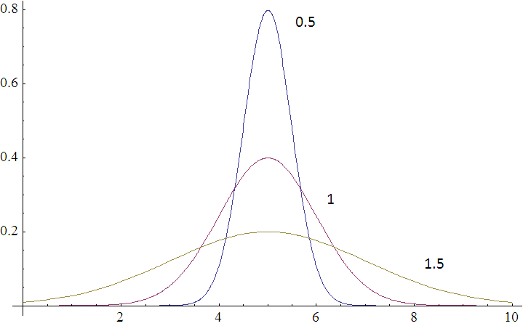
Regularization/prior
L2 regularization:
Gaussian prior:
Gaussians are defined by a mean (μ) and a variance (σ²)
p(w,b) ~

Slide 60
Regularization/prior
L2 regularization:
Gaussian prior:
Does the λ make sense?

Slide 61
Regularization/prior
L2 regularization:
Gaussian prior:
Notes:
Yes!
As the variance gets higher, the prior is weaker (more distributed probabilities). Higher variance = lower lambda.
As the variance gets lower, the prior is stronger (more peaked distribution). Lower variance = higher lambda.

Slide 62
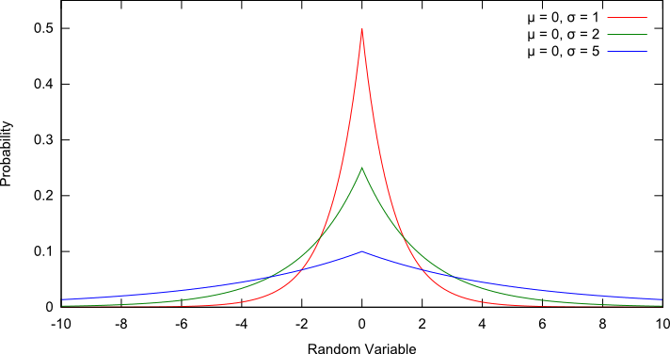
Regularization/prior
L1 regularization:
Laplacian prior:
p(w,b) ~

Slide 63
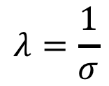
Regularization/prior
L1 regularization:
Laplacian prior:
$$λ=\frac{1}{σ}$$

Slide 64
L1 vs. L2
L1 = Laplacian prior
L2 = Gaussian prior

Slide 65
Logistic regression
Why is it called logistic regression?
It is a classifier??

Slide 66
A digression: regression vs. classification
Raw data
Label
features
Label
f₁, f₂, f₃, …, f_{n}
0
classification: discrete (some finite set of labels)
regression: real value
f₁, f₂, f₃, …, f_{n}
0
f₁, f₂, f₃, …, f_{n}
1
extract
features
f₁, f₂, f₃, …, f_{n}
1
f₁, f₂, f₃, …, f_{n}
0

Slide 67
linear regression
Given some points, find the line that best fits/explains the data
Our model is a line, i.e. we’re assuming a linear relationship between the feature and the label value
response
(y)
f₁
How can we find this line?

Slide 68
Linear regression
Learn a line h that minimizes some loss/error function:
Sum of the individual errors:
response
(y)
0/1 loss!
feature (x)
Notes:
- squared error is optimal if we assume that the data was actually generated from a line with gaussian data

Slide 69
Error minimization
How do we find the minimum of an equation?
Take the derivative, set to 0 and solve (going to be a min or a max)
Any problems here?
Ideas?

Slide 70

Linear regression
response
squared error is convex!
feature
Notes:
- squared error is optimal if we assume that the data was actually generated from a line with gaussian data

Slide 71
Linear regression
Learn a line h that minimizes an error function:
response
in the case of a 2d line:
function for a line
feature
Notes:
- squared error is optimal if we assume that the data was actually generated from a line with gaussian data

Slide 72
Linear regression
We’d like to minimize the error
  Find w₁ and w₀ such that the error is minimized
We can solve this in closed form

Slide 73
Multiple linear regression
If we have m features, then we have a line in m dimensions
weights

Slide 74
Multiple linear regression
We can still calculate the squared error like before
Still can solve this exactly!

Slide 75
Logistic function

Slide 76
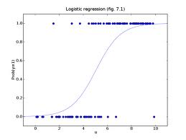
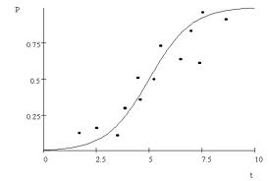
Logistic regression
Find the best fit of the data based on a logistic

Slide 77
Basic steps for probabilistic modeling
Probabilistic models
Step 1: pick a model
Step 2: figure out how to estimate the probabilities for the model
Step 3 (optional): deal with overfitting
Which model do we use, i.e. how do we calculate p(feature, label)?
How do train the model, i.e. how to we we estimate the probabilities for the model?
How do we deal with overfitting?

Slide 78
Probabilistic models summarized
Two classification models:
  Naïve Bayes (models joint distribution)
  Logistic Regression (models conditional distribution)
    In practice this tends to work better if all you want to do is classify
Priors/smoothing/regularization
  Important for both models
  In theory: allow us to impart some prior knowledge
  In practice: avoids overfitting and often tune on development data

