Slide 1
Logistic regression
David Kauchak
CS158 – Fall 2019

Slide 2
Admin
Assignment 7
Grading update

Slide 3
Priors
Coin1 data: 3 Heads and 1 Tail
Coin2 data: 30 Heads and 10 tails
Coin3 data: 2 Tails
Coin4 data: 497 Heads and 503 tails
If someone asked you what the probability of heads was for each of these coins, what would you say?

Slide 4
Basic steps for probabilistic modeling
Probabilistic models
Step 1: pick a model
Step 2: figure out how to estimate the probabilities for the model
Step 3 (optional): deal with overfitting
Which model do we use, i.e. how do we calculate p(feature, label)?
How do train the model, i.e. how to we we estimate the probabilities for the model?
How do we deal with overfitting?

Slide 5
Training revisited
What we’re really doing during training is selecting the Θ that maximizes:
i.e.
That is, we pick the most likely model parameters given the data

Slide 6
Estimating revisited
We want to incorporate a prior belief of what the probabilities might be
To do this, we need to break down our probability
(Hint: Bayes rule)

Slide 7
Estimating revisited
What are each of these probabilities?

Slide 8
Priors
likelihood of the data under the model
probability of different parameters,
call the prior
probability of seeing the data (regardless of model)

Slide 9
Priors
Does p(data) matter for the argmax?
Notes:
no, it doesn’t very as theta changes. It’s a constant

Slide 10
Priors
likelihood of the data under the model
probability of different parameters,
call the prior
What does MLE assume for a prior on the model parameters?

Slide 11
Priors
likelihood of the data under the model
probability of different parameters,
call the prior
Assumes a uniform prior, i.e. all Θ are equally likely!
Relies solely on the likelihood

Slide 12
A better approach
We can use any distribution we’d like.
This allows us to impart addition bias into the model

Slide 13
Another view on the prior
Remember, the max is the same if we take the log:
We can use any distribution we’d like.
This allows us to impart addition bias into the model
Does this look like something we’ve seen before?

Slide 14
Regularization vs prior
likelihood based on the data
prior
fit
model bias
loss function based on the data
regularizer

Slide 15
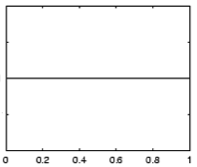
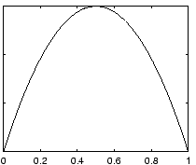
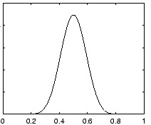
Prior for NB
Uniform prior
Dirichlet prior
λ= 0
increasing
Notes:
- as lambda gets larger we bias more and more towards

Slide 16
Prior: another view
MLE:
What happens to our likelihood if, for one of the labels, we never saw a particular feature?
Goes to 0!
Notes:
- Goes to 0!

Slide 17
Prior: another view
Adding a prior avoids this!

Slide 18
Smoothing
training data
for each label, pretend like we’ve seen each feature value occur in λ additional examples
Sometimes this is also called smoothing because it is seen as smoothing or interpolating between the MLE and some other distribution

Slide 19
Priors
Coin1 data: 3 Heads and 1 Tail
Coin2 data: 30 Heads and 10 tails
Coin3 data: 2 Tails
Coin4 data: 497 Heads and 503 tails
Does this do the right thing in these cases?

Slide 20
Basic steps for probabilistic modeling
Probabilistic models
Step 1: pick a model
Step 2: figure out how to estimate the probabilities for the model
Step 3 (optional): deal with overfitting
Which model do we use, i.e. how do we calculate p(feature, label)?
How do train the model, i.e. how to we we estimate the probabilities for the model?
How do we deal with overfitting?

Slide 21
Joint models vs conditional models
We’ve been trying to model the joint distribution (i.e. the data generating distribution):
However, if all we’re interested in is classification, why not directly model the conditional distribution:

Slide 22
A first try: linear
Any problems with this?
- Nothing constrains it to be a probability
- Could still have combination of features and weight that exceeds 1 or is below 0
Notes:
let’s try a different route this time
rather than deriving a model (the book does it that way)
let’s start with a type of model and see if we can work our way towards a working model

Slide 23
The challenge
Linear model
probability
+∞
1
We like linear models!
Can we transform the probability into a function that ranges over all values?
-∞
0

Slide 24
Odds ratio
Rather than predict the probability, we can predict the ratio of 1/0 (positive/negative)
Predict the odds that it is 1 (true): How much more likely is 1 than 0.
Does this help us?

Slide 25
Odds ratio
Linear model
odds ratio
+∞
+∞
Where is the dividing line between class 1 and class 0 being selected?
-∞
0

Slide 26
Odds ratio
We’re trying to find some transformation that transforms the odds ratio to a number that is -∞ to +∞
Does this suggest another transformation?
odds ratio
0 1 2 3 4 5 6 7 8 9 ….

Slide 27
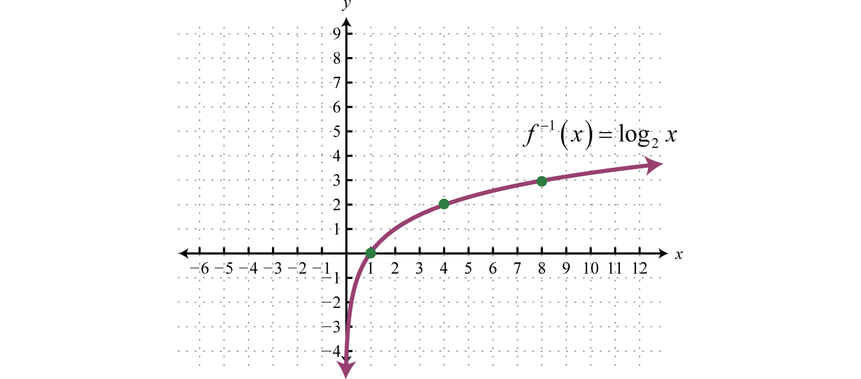
0 1 2 3 4 5 6 7 8 9 ….

Slide 28
Log odds (logit function)
=
Linear regression
odds ratio
+∞
+∞
How do we get the probability of an example?
-∞
-∞

Slide 29
Log odds (logit function)
…
anyone recognize this?

Slide 30
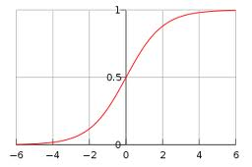
Logistic function

Slide 31
Logistic regression
How would we classify examples once we had a trained model?
If the sum > 0 then p(1)/p(0) > 1, so positive
if the sum < 0 then p(1)/p(0) < 1, so negative
Still a linear classifier (decision boundary is a line)

Slide 32
Training logistic regression models
How should we learn the parameters for logistic regression (i.e. the w’s and b)?
parameters

Slide 33
MLE logistic regression
Find the parameters that maximize the likelihood (or log-likelihood) of the data:
assume labels 1, -1

Slide 34
MLE logistic regression
We want to maximize, i.e.
Look familiar? Hint: anybody read the book?

Slide 35
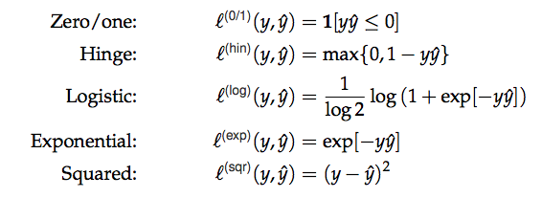
MLE logistic regression
Surrogate loss functions:

Slide 36
logistic regression: three views
linear classifier
conditional model
logistic
linear model minimizing logistic loss

Slide 37
Overfitting
If we minimize this loss function, in practice, the results aren’t great and we tend to overfit
Solution?

Slide 38
Regularization/prior
or
What are some of the regularizers we know?

Slide 39
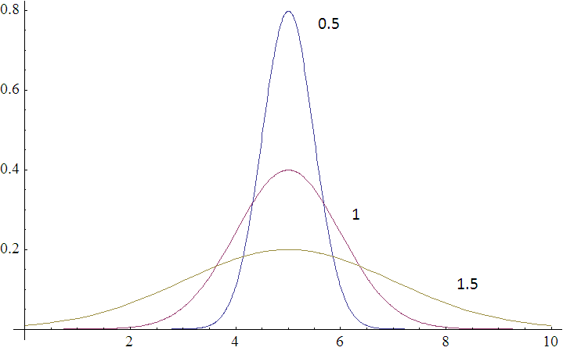
Regularization/prior
L2 regularization:
Gaussian prior:
Gaussians are defined by a mean (μ) and a variance (σ²)
p(w,b) ~

Slide 40
Regularization/prior
L2 regularization:
Gaussian prior:
Does the λ make sense?

Slide 41
Regularization/prior
L2 regularization:
Gaussian prior:
Notes:
Yes!
As the variance gets higher, the prior is weaker (more distributed probabilities). Higher variance = lower lambda.
As the variance gets lower, the prior is stronger (more peaked distribution). Lower variance = higher lambda.

Slide 42
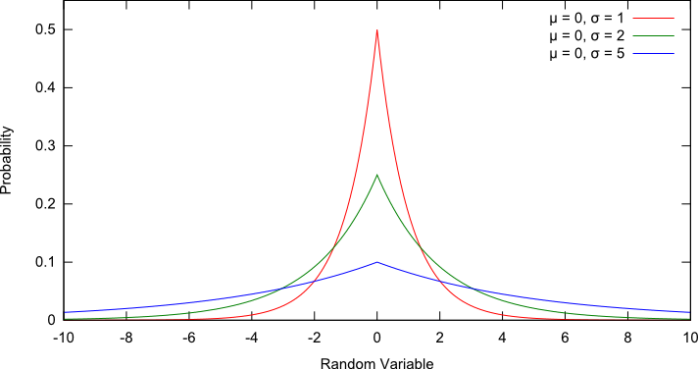
Regularization/prior
L1 regularization:
Laplacian prior:
p(w,b) ~

Slide 43
Regularization/prior
L1 regularization:
Laplacian prior:
$$λ=\frac{1}{σ}$$

Slide 44
L1 vs. L2
L1 = Laplacian prior
L2 = Gaussian prior

Slide 45
Logistic regression
Why is it called logistic regression?
It is a classifier??

Slide 46
A digression: regression vs. classification
Raw data
Label
features
Label
f₁, f₂, f₃, …, f_{n}
0
classification: discrete (some finite set of labels)
regression: real value
f₁, f₂, f₃, …, f_{n}
0
f₁, f₂, f₃, …, f_{n}
1
extract
features
f₁, f₂, f₃, …, f_{n}
1
f₁, f₂, f₃, …, f_{n}
0

Slide 47
linear regression
Given some points, find the line that best fits/explains the data
Our model is a line, i.e. we’re assuming a linear relationship between the feature and the label value
response (y)
f₁
How can we find this line?

Slide 48
Linear regression
Learn a line h that minimizes some loss/error function:
Sum of the individual errors:
response
(y)
0/1 loss!
feature (x)
Notes:
- squared error is optimal if we assume that the data was actually generated from a line with gaussian data

Slide 49
Error minimization
How do we find the minimum of an equation?
Take the derivative, set to 0 and solve (going to be a min or a max)
Any problems here?
Ideas?

Slide 50
Linear regression
response
squared error is convex!
feature
Notes:
- squared error is optimal if we assume that the data was actually generated from a line with gaussian data

Slide 51
Linear regression
Learn a line h that minimizes an error function:
response
in the case of a 2d line:
function for a line
feature
Notes:
- squared error is optimal if we assume that the data was actually generated from a line with gaussian data

Slide 52
Linear regression
We’d like to minimize the error
Find w₁ and w₀ such that the error is minimized
We can solve this in closed form

Slide 53
Multiple linear regression
If we have m features, then we have a line in m dimensions
weights

Slide 54
Multiple linear regression
We can still calculate the squared error like before
Still can solve this exactly!

Slide 55
Logistic function

Slide 56
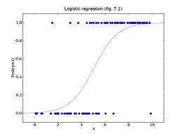
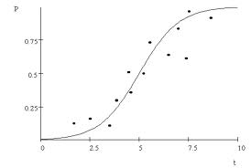
Logistic regression
Find the best fit of the data based on a logistic

Slide 57
Basic steps for probabilistic modeling
Probabilistic models
Step 1: pick a model
Step 2: figure out how to estimate the probabilities for the model
Step 3 (optional): deal with overfitting
Which model do we use, i.e. how do we calculate p(feature, label)?
How do train the model, i.e. how to we we estimate the probabilities for the model?
How do we deal with overfitting?

Slide 58
Probabilistic models summarized
Two classification models:
Naïve Bayes (models joint distribution)
Logistic Regression (models conditional distribution)
In practice this tends to work better if all you want to do is classify
Priors/smoothing/regularization
Important for both models
In theory: allow us to impart some prior knowledge
In practice: avoids overfitting and often tune on development data

