Slide 1
Lecture 25: Networking
CS 105 Spring 2026

Slide 2
CPU
register file
ALU
system bus
memory bus
main
memory
MI
I/O
bridge
Expansion slots
I/O bus
USB
controller
graphics
adapter
disk
controller
network
adapter
mouse
keyboard
monitor
disk
network
Notes:
Each host has one or more network adapters (aka network interface cards) that translate messages to/from physical network following a particular protocol and export a network abstraction

Slide 3
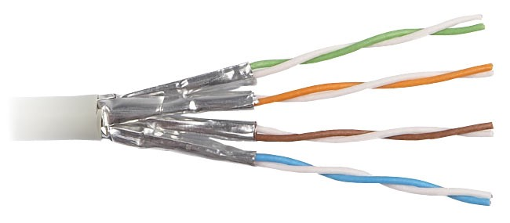
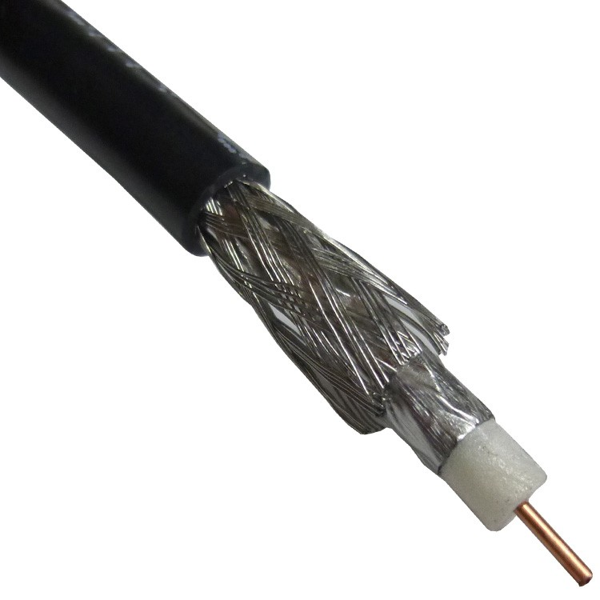
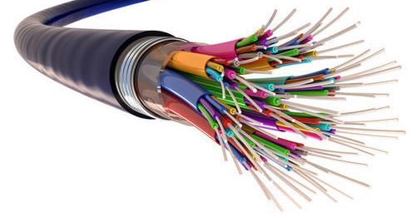
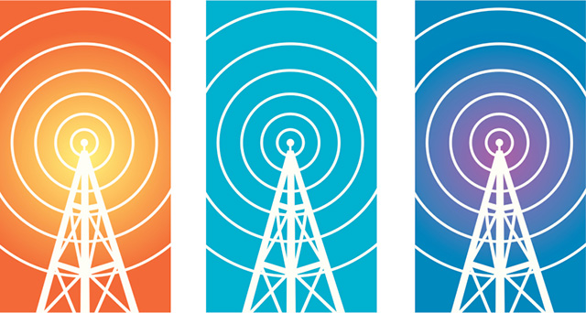
Physical Layer
Twisted Pair
Coaxial
Fiber
Radio
Notes:
Twisted-pair cable is used for wired telephones and Ethernet networks. Pair of wires forms a circuit; twisted to protect against noise from adjacent pairs. Zeros and ones encoded as low/high voltages
I think coax is basically the same thing, but it uses external shielding, and can superimpose waves of different frequencies to carry multiple signals(?)
Fiberoptic cables use light to transmit bits
Radio waves send bits by alternating the frequency or amplitude of the wave

Slide 4
Data Link Layer
Each host has one or more network adapter (aka NIC)
  handles particular physical layer and protocol

Slide 5
Data Link Layer
DSL
Ethernet
WiFi (802.11)
3G
LTE
5G
Twisted Pair
Coaxial
Fiber
Radio

Slide 6
Data Link Layer
Each host has one or more network adapter (aka NIC)
  handles particular physical layer and protocol
Each network adapter has a media access control (MAC) address
  unique to that network instance
Messages are organized as packets

Slide 7
Example: Ethernet
Developed 1976 at Xerox
Simple, scales pretty well
Very successful, still in widespread use
Example MAC address: b8:e3:56:15:6a:72
Carrier sense: listen before you speak
Multiple access: multiple hosts on network
Collision detection: detect and respond to cases where two messages collide
destination address
source address
type
payload
checksum

Slide 8
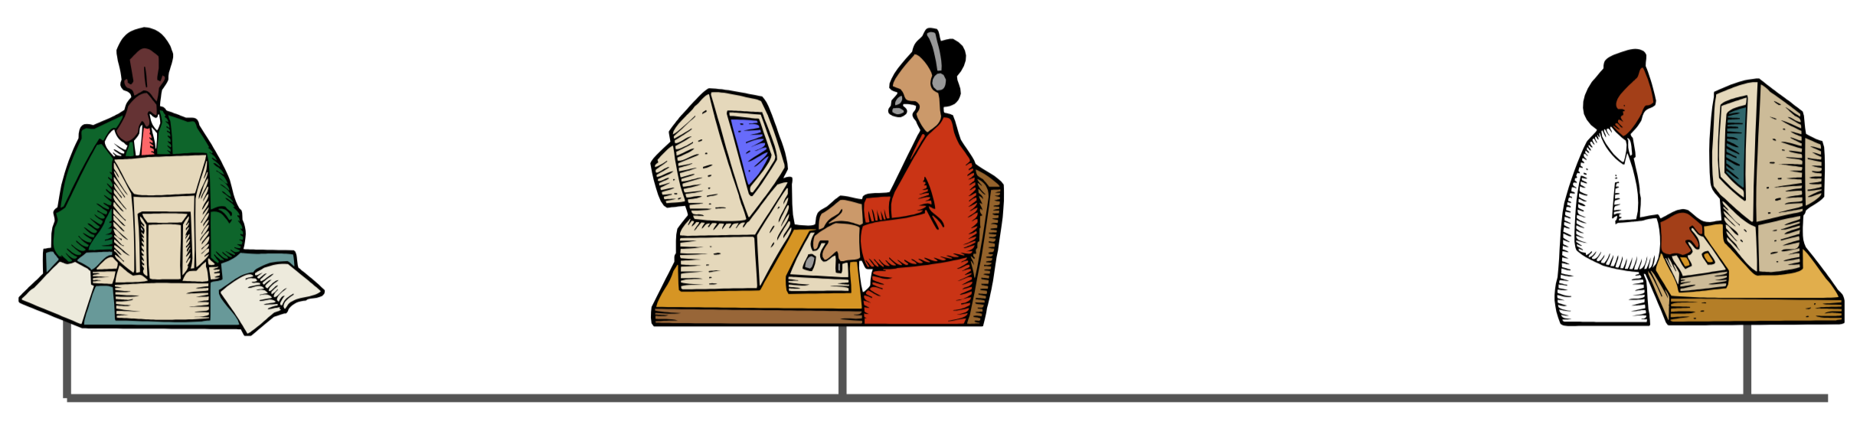
Example: Ethernet
Carrier sense: broadcast if wire is available
In case of collision: stop, sleep, retry
  sleep time is determined by collision number
  abort after 16 attempts

Slide 9
Example: Ethernet
Advantages
Disadvantages
completely decentralized
inexpensive
  no state in the network
  no arbiter
  cheap physical links
data is available for all to see
  can place ethernet card in promiscuous mode and listen to all messages
endpoints must be trusted
In large/high-traffic networks, many collisions

Slide 10
Bridged Ethernet
A
B
host
host
host
host
host
X
hub
100 Mb/s
bridge
100 Mb/s
hub
1 Gb/s
host
host
hub
100 Mb/s
bridge
100 Mb/s
hub
Y
host
host
host
host
host
C
Spans building or campus
Bridges cleverly learn which hosts are reachable from which ports and then selectively copy frames from port to port

Slide 11
Network Layer
There are lots of lots of local area networks (LANs)
  each determines its own protocols, address format, packet format
What if we wanted to connect them together?
  physically connected by specialized computers called routers
  routers with multiple network adapters can translate
  standardize address and packet formats
This is a internetwork
  aka wide-area network (WAN)
  aka internet
host
host
...
host
host
host
...
host
LAN 1
LAN 2
router
router
router
WAN
WAN

Slide 12
Logical Structure of an internet
host
host
router
router
router
router
router
router
Ad hoc interconnection of networks
  No particular topology
  Vastly different router & link capacities
Send packets from source to destination by hopping through networks
  Router forms bridge from one network to another
  Different packets may take different routes

Slide 13
Internet Protocol (IP)
Initiated by the DoD in 60s-70s
Currently transitioning (very slowly) from IPv4 to IPv6
Example address: 128.84.12.43
interoperable
network dynamically routes packets from source to destination
IHL
TOS
total length
v
Dest. Port #
identification
fs
offset
TTL
protocol
header checksum
source address
destination address
options
application message (payload)
Notes:
v = version (4 or 6)
IHL = header length in 32-bit words (usually 5 unless options present)
TOS: type of service (?)
total length = total length in bytes
id/flags/offset used for fragmentation/reassembly
TTL = time to live (decrementd each hop
Protocol = TCP, UDP, ICMP

Slide 14
Aside: IPv4 and IPv6
The original Internet Protocol, with its 32-bit addresses, is known as Internet Protocol Version 4 (IPv4)
1996: Internet Engineering Task Force (IETF) introduced Internet Protocol Version 6 (IPv6) with 128-bit addresses
  Intended as the successor to IPv4
As of April 2026, half of Internet traffic still carried by IPv4
  47-51% of users access Google services using IPv6.
We will focus on IPv4, but will show you how to write networking code that is protocol-independent.
Notes:
https://www.google.com/intl/en/ipv6/statistics.html

Slide 15
Exercise: IP addresses
What is the current IP address assigned to your computer or phone?
Notes:
ifconfig (point out ln0, focus on en0)
https://whatismyipaddress.com

Slide 16
Transferring internet Data Via Encapsulation
LAN1
Host A
Host B
LAN2
client
server
(1)
data
(8)
data
protocol
software
protocol
software
internet packet
(2)
data
PH
FH1
(7)
data
PH
FH2
LAN1 frame
LAN1
adapter
LAN2
adapter
Router
(3)
data
PH
FH1
(6)
data
PH
FH2
LAN1
adapter
LAN2
adapter
LAN2 frame
(4)
data
PH
FH1
data
PH
FH2
(5)
protocol
software
PH: Internet packet header
FH: LAN frame header
Notes:
Capture some packets in wireshark. Show layers of encapsulation

Slide 17
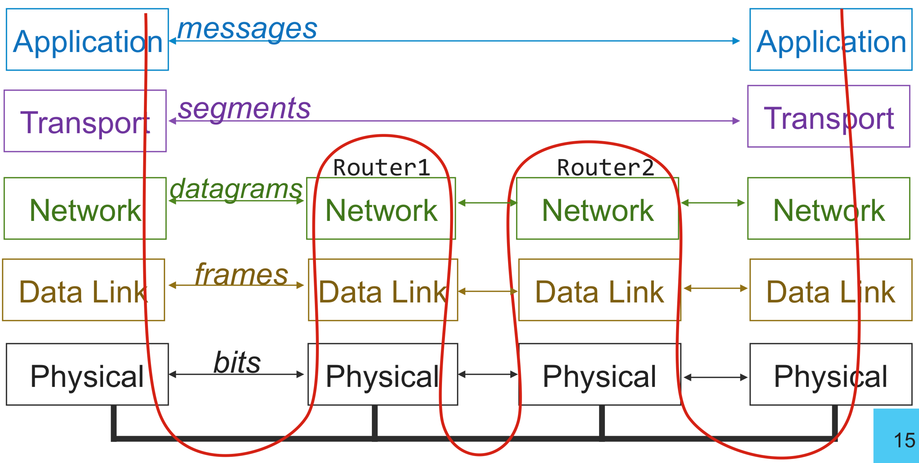
Routing

Slide 18
Transport Layer

Slide 19
Transport Layer
Clients and servers communicate by sending streams of bytes over a connection.
A transport layer endpoint is identified by an IP address and a port, a 16-bit integer that identifies a process
  Ephemeral port: Assigned automatically by client kernel when client makes a connection request.
  Well-known port: Associated with some service provided by a server (e.g., port 80 is associated with Web servers)

Slide 20
Transport Layer Segments
Source Port #
Dest. Port #
Sending application:
  specifies IP address and port
  uses socket bound to source port
Transport Layer:
  breaks application message into smaller chunks
  adds transport-layer header to each message to form a segment
Network Layer (IP):
  adds network-layer header to each datagram
length of seg.
checksum
application message (payload)
Source IP
Dest. IP
transport-layer header
application message (payload)

Slide 21
Sockets
socket = IP address + port
  To the kernel, a socket is an endpoint of communication
  To an application, a socket is a file descriptor that lets the application read/write from/to the network
    Note: All Unix I/O devices, including networks, are modeled as files
Clients and servers communicate with each other by reading from and writing to socket descriptors
The main distinction between regular file I/O and socket I/O is how the application “opens” the socket descriptors
Client
Server
clientfd
serverfd

Slide 22
Anatomy of a Connection
A connection is uniquely identified by the socket addresses of its endpoints (socket pair)
  (cliaddr:cliport, servaddr:servport)
Client socket address
128.2.194.242:51213
Server socket address
208.216.181.15:80
Client
Server
(port 80)
Connection socket pair
(128.2.194.242:51213, 208.216.181.15:80)
Client host address
128.2.194.242
Server host address
208.216.181.15
51213 is an ephemeral port
allocated by the kernel
80 is a well-known port
associated with Web servers

Slide 23
Well-known Ports and Service Names
Popular services have permanently assigned well-known ports and corresponding well-known service names:
  echo server: 7/echo
  ssh servers: 22/ssh
  email server: 25/smtp
  Web servers: 80/http or 443/https
Mappings between well-known ports and service names is contained in the file /etc/services on each Linux machine.

Slide 24
Should the transport layer guarantee packet delivery?

Slide 25
Transport Layer Protocols
User Datagram Protocol (UDP)
Transmission Control Protocol (TCP)
unreliable, unordered delivery
connectionless
best-effort, segments might be lost, delivered out-of-order, duplicated
reliability (if required) is the responsibility of the app
reliable, in-order delivery
connection setup
flow control
congestion control
Notes:
flow control = don't overwhelm the receiver
congestion control = don't swamp the network
Note: neither guarantees latency or bandwidth

Slide 26
Transport Protocols by Application
Application | Application-Level Protocol | Transport Protocol
Name Translation | DNS | Typically UDP
Routing Protocol | RIP | Typically UDP
Network Management | SNMP | Typically UDP
Remote File Server | NFS | Typically UDP
Streaming multimedia | (proprietary) | UDP or TCP
Internet telephony | (proprietary) | UDP or TCP
Remote terminal access | Telnet | TCP
File Transfer | (S)FTP | TCP
Email | SMTP | TCP
Web | HTTP(S) | TCP

Slide 27
Sockets Interface
1. Start server
socket
bind
socket
listen
Connection
request
connect
accept
Client / Server
Session
write
read
Await connection
request from
next client
read
write
close
EOF
read
close

Slide 28
Sockets Interface: socket
Clients and servers use the socket function to create a socket descriptor:
Example:
Protocol specific! Best practice is to use getaddrinfo to generate the parameters automatically, so that code is protocol independent.
int socket(int domain, int type, int protocol)
int clientfd = socket(AF_INET, SOCK_STREAM, 0);
Indicates that we are using 32-bit IPV4 addresses
Indicates that the socket will be the end point of a TCP connection

Slide 29
Sockets Interface: bind
A server uses bind to ask the kernel to associate the server’s socket address with a socket descriptor:
The process can read bytes that arrive on the connection whose endpoint is addr by reading from descriptor sockfd.
Similarly, writes to sockfd are transferred along connection whose endpoint is addr.
Best practice is to use getaddrinfo to supply the arguments addr and addrlen.
int bind(int sockfd, SA* addr, socklen_t addrlen);

Slide 30
Socket Address Structures
Internet-specific socket address:
  Must cast (struct sockaddr_in *) to (struct sockaddr *) for functions that take socket address arguments.
struct sockaddr_in {
uint16_t sin_family; /* Protocol family (always AF_INET) */
uint16_t sin_port; /* Port num in network byte order */
struct in_addr sin_addr; /* IP addr in network byte order */
unsigned char sin_zero[8]; /* Pad to sizeof(struct sockaddr) */
};
sin_port
sin_addr
AF_INET
0
0
0
0
0
0
0
0
sa_family
sin_family
Family Specific

Slide 31
Sockets Interface: listen
By default, kernel assumes that descriptor from socket function is an active socket that will be on the client end of a connection.
A server calls the listen function to tell the kernel that a descriptor will be used by a server rather than a client:
Converts sockfd from an active socket to a listening socket that can accept connection requests from clients.
backlog is a hint about the number of outstanding connection requests that the kernel should queue up before starting to refuse requests.
int listen(int sockfd, int backlog);

Slide 32
Sockets Interface: accept
Servers wait for connection requests from clients by calling accept:
Waits for connection request to arrive on the connection bound to listenfd, then fills in client’s socket address in addr and size of the socket address in addrlen.
Returns a connected descriptor that can be used to communicate with the client via Unix I/O routines.
int accept(int listenfd, SA *addr, int *addrlen);

Slide 33
Connected vs. Listening Descriptors
Listening descriptor
  End point for client connection requests
  Created once and exists for lifetime of the server
Connected descriptor
  End point of the connection between client and server
  A new descriptor is created each time the server accepts a connection request from a client
  Exists only as long as it takes to service client
Why the distinction?
  Allows for concurrent servers that can communicate over many client connections simultaneously
    E.g., Each time we receive a new request, we fork a child to handle the request

Slide 34
Sockets Interface
1. Start server
socket
bind
2. Start client
socket
listen
Connection
request
connect
accept
Client / Server
Session
write
read
Await connection
request from
next client
read
write
close
EOF
read
close

Slide 35
Sockets Interface: connect
A client establishes a connection with a server by calling connect:
Attempts to establish a connection with server at socket address addr
  If successful, then clientfd is now ready for reading and writing.
  Resulting connection is characterized by socket pair
  (x:y, addr.sin_addr:addr.sin_port)
    x is client address
    y is ephemeral port that uniquely identifies client process on client host
Best practice is to use getaddrinfo to supply the arguments addr and addrlen.
int connect(int clientfd, SA* addr, socklen_t addrlen);

Slide 36
accept Illustrated
listenfd(3)
Client
Server
1. Server blocks in accept, waiting for connection request on listening descriptor listenfd
clientfd
Connection
request
listenfd(3)
Client
Server
2. Client makes connection request by calling and blocking in connect
clientfd
listenfd(3)
3. Server returns connfd from accept. Client returns from connect. Connection is now established between clientfd and connfd
Client
Server
clientfd
connfd(4)

Slide 37
Sockets Interface
2. Start client
1. Start server
socket
socket
bind
listen
TCP Only
connect
accept
3. Exchange
data
Client / Server
Session
write
read
read
write
4. Stop sending messages
5. Stop accepting
messages
close
close

Slide 38
The Big Picture

Slide 39
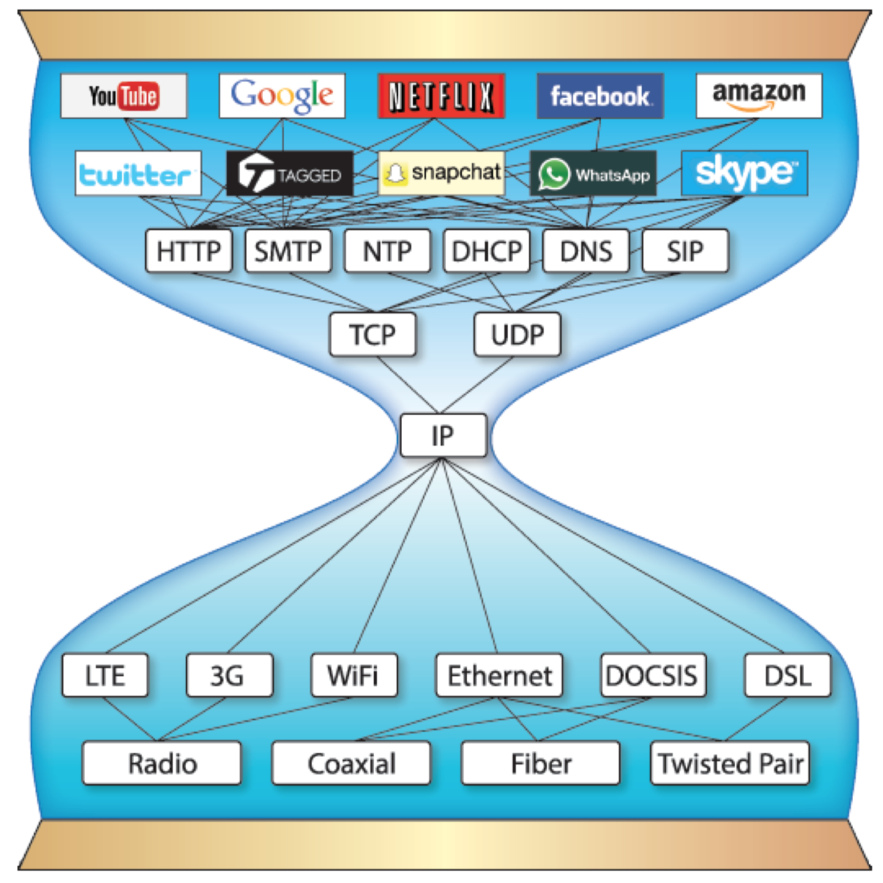
The Big Picture
Application
Transport
Network
Data Link
Physical

Slide 40
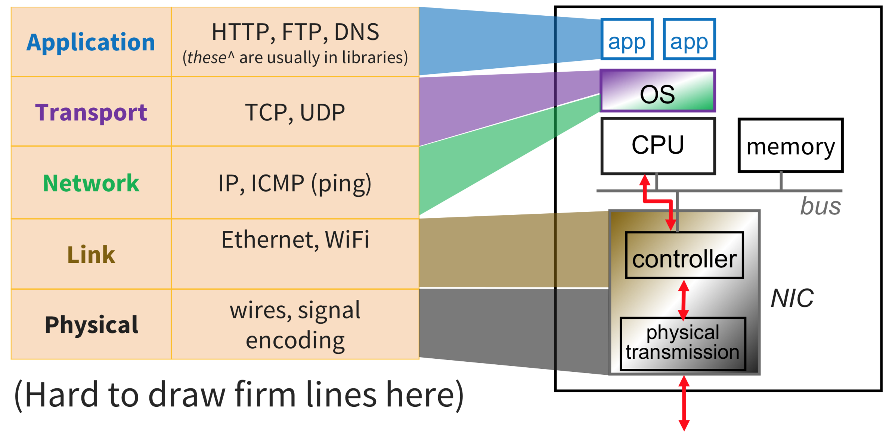
Hardware and Software Interfaces
Notes:
http://www.cs.cornell.edu/courses/cs4410/2018sp/schedule/slides/09-networking.pdf

