Slide 1
Lecture 22: File Systems
CS 105 Spring 2025

Slide 2
Review: File Systems 101
Long-term information storage goals
should be able to store large amounts of information
information must survive processes, power failures, etc.
processes must be able to find information
needs to support concurrent accesses by multiple processes
Solution: the File System Abstraction
interface that provides operations involving
files
directories (a special kind of file)

Slide 3
Review: The File System Abstraction
interface that provides operations on data stored long-term on disk
a file is a named sequence of stored bytes
name is defined on creation
processes use name to subsequently access that file
a file is comprised of two parts:
data: information a user or application puts in a file
an array of untyped bytes
metadata: information added and managed by the OS
e.g., size, owner, security info, modification time
two types of files
normal files: data is an arbitrary sequence of bytes
directories: a special type of file that provides mappings from human-readable names to low-level names (i.e., file numbers)

Slide 4
Review: The File System Stack
Application
user level
Language Libraries (e.g.,fopen, fread, fwrite, fclose,…)
POSIX API (open, read, write, close, …)
File System
Generic Block Interface (block read/write)
kernel mode
Generic Block Layer
Specific Block Interface (protocol-specific read/write)
Device Driver

Slide 5
Implementation Basics
Directories: file name -> low-level names (i.e., file numbers)

Slide 6
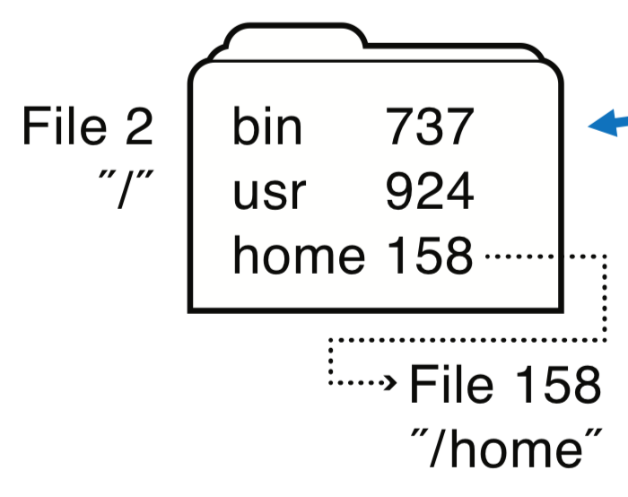
Directories
a directory is a file that provides mappings from human-readable names to low-level names (i.e., file numbers):
a list of human-readable names
a mapping from each name to a specific underlying file or directory
OS uses path name to find directories and files
ada 682
eleanor 818
rett 830
File 158
"/home"
File 818
"/home/eleanor"
music 320
work 219
foo.txt 871
File 871
"/home/eleanor/foo.txt"

Slide 7
Exercise 1: Linked Allocation
How many disk reads would be required to read (all of) a file named /foo/bar/baz.txt?
assume all files can be read will one disk read
read / directory file, find foo’s file number
read foo directory file, find bar’s file number
read bar directory file, find baz.txt’s file number
read baz.txt

Slide 8
Multiple human-readable names
Many file systems allow a given file to have multiple names
Hard links are multiple file directory entries that map different path names to the same file number
Symbolic Links or soft links are directory entries that map one name to another (effectively a redirect)

Slide 9
Implementation Basics
Directories: file name -> low-level names (i.e., file numbers)
File system index structures: file number -> block(s)

Slide 10
File System Challenges
Performance: despite limitations of disks
Flexibility: need to support diverse file types and workloads
Persistence: store data long term
Reliability: resilient to OS crashes and hardware failures

Slide 11
File System Properties
Most files are small
need strong support for small files (optimize the common case)
block size can't be too big
Directories are typically small
usually 20 or fewer entries
Some files are very large
must handle large files
large file access should be reasonably efficient
File systems are usually about half full
Notes:
Agrawal, Bolosky, Douceur, Lorch. A Five Year Study of File-System Metadata. FAST 2007.

Slide 12
Storing Files
Possible ways to allocate files:
Continuous allocation: all bytes together, in order
Linked structure: each block points to the next block
Indexed structure: index block points to many other blocks
Log structure: sequence of segments, each containing updates
Notes:
Which is best?
For sequential access?
For random access?
For small files?
For large files?

Slide 13
Continuous Allocation
 | start | size
file1 | 0 | 4
file2 | 4 | 4
file3 | 10 | 3
file4 | 13 | 4
file5 | 21 | 3
All bytes together, in order
Simple: state required per file = start block & size
Efficient: entire file can be read with one seek
Fragmentation: external is bigger problem
Usability: user needs to know size of file at time of creation
0 1 2 3 4 5 6 7 8 9 10 11 12 13 14 15 16 17 18 19 20 21 22 23 24 25 26 27
file1
file2
file3
file4
file5
Notes:
Used in CDs, DVDs

Slide 14
Linked Allocation
Each file is stored as linked list of blocks: One word of each block points to next block, rest of disk block is file data
10
9
0
X
7
X
8
X
12
11
5
3
X
4
 | start
file1 | 2
file2 | 9
file3 | 6
file4 | 13
file5 | 15

Slide 15
Decoupled Linked Allocation
Each file is stored as linked list of blocks: First word of each block points to next block, rest of disk block is file data
0 1 2 3 4 5 6 7 8 9 10 11 12 13
10
9
0
X
7
X
8
X
12
11
5
3
X
4
 | start
file1 | 2
file2 | 9
file3 | 6
file4 | 13
file5 | 15

Slide 16
Exercise 2: (Decoupled) Linked Allocation
read / directory block, find foo’s file number
read foo’s directory block, find bar’s file number
read bar’s directory block, find baz.txt’s file number
read baz.txt’s block 0
read ptr to baz.txt’s block 1 in FAT
read baz.txt’s block 1
read ptr to baz.txt’s block 2 in FAT
read baz.txt’s block 2
…
read ptr to baz.txt’s block 6 in FAT
read baz.txt’s block 6
read ptr to baz.txt’s block 7 in FAT
read baz.txt’s block 7
read EOF ptr in FAT

Slide 17
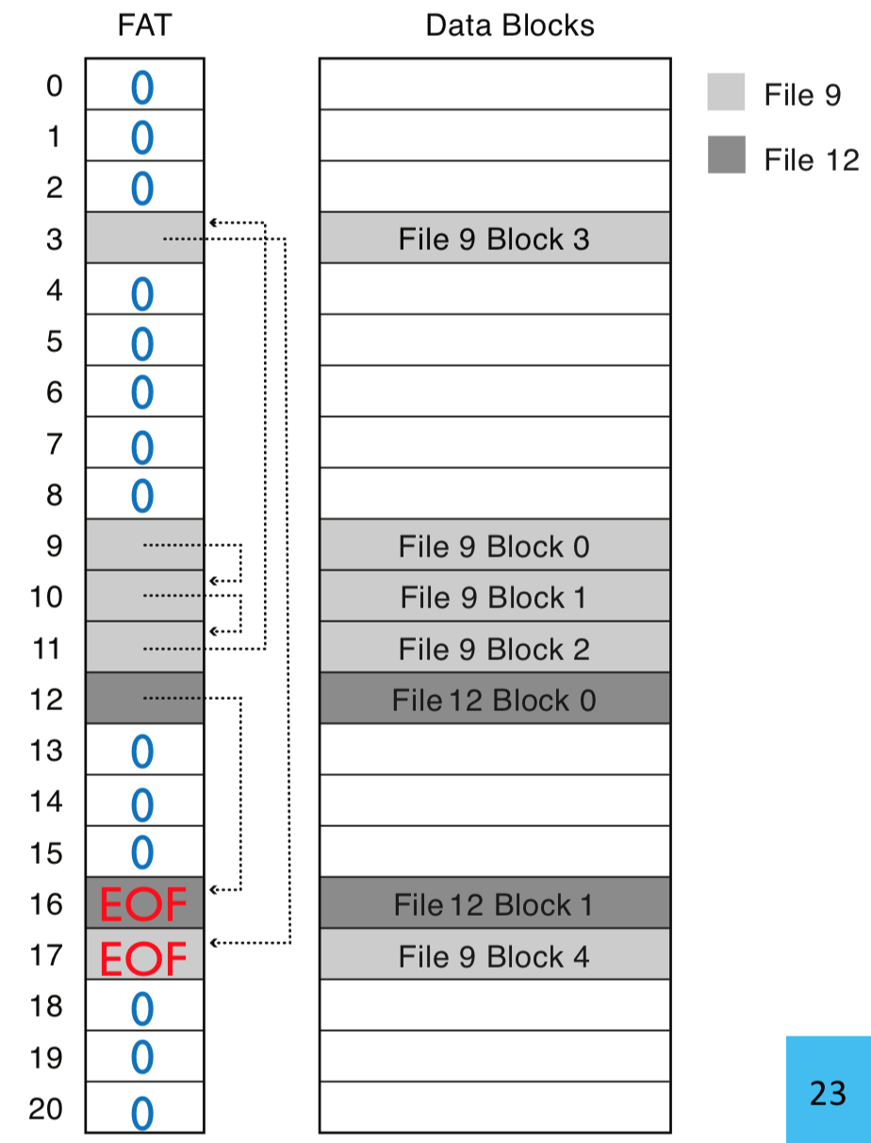
FAT File System
Developed by Microsoft for MS-DOS
decoupled linked allocation
1 FAT entry per block ("next pointer")
EOF for last block
0 indicates free block
low-level file name = FAT index of first block in file
Directory
cecil.txt | 9
eleanor.txt | 12
Notes:
FAT = File Allocation Table

Slide 18
Linked Allocation
Each file is stored as linked list of blocks: First word of each block points to next block, rest of disk block is file data
Simple: directory only need to store 1st block of
each file
Space Utilization: no space lost to external fragmentation
Performance: random access is slow
Space Utilization: overhead of pointers
0 1 2 3 4 5 6 7 8 9 10 11 12 13
10
9
0
X
7
X
8
X
12
11
5
3
X
4
 | start
file1 | 2
file2 | 9
file3 | 6
file4 | 13
file5 | 15

Slide 19
Evaluating FAT
How is FAT good?
Simple: state required per file: start block only
Widely supported
No external fragmentation
block used only for data
How is FAT bad?
Poor locality
Many file seeks (unless entire FAT in memory)
Poor random access
Limited metadata
Limited access control
Limitations on volume and file size
No support for reliability techniques

Slide 20
Indexed Allocation: Fast File System (FFS)
tree-based, multi-level index
superblock identifies file system's key parameters
inodes store metadata and pointers
datablocks store data
0 1 2 3 4 5 6 7 8 9 10 11 12 13 14 15 16 17 18 19 20 21 22 23 24 25 26 27
inode blocks
data blocks
superblock

Slide 21
FFS Superblock
Identifies file system’s key parameters:
type
block size
inode array location and size
location of free list
0 1 2 3 4 5 6 7 8 9 10 11 12 13 14 15 16 17 18 19 20 21 22 23 24 25 26 27
inode blocks
data blocks
superblock

Slide 22
FFS inodes
File Metadata
inode blocks contain an array of inodes
each inode contains:
Metadata
info about which blocks store that file
references to file blocks
0 1 2 3 4 5 6 7 8 9 10 11 12 13 14 15 16 17 18 19 20 21 22 23 24 25 26 27
inode blocks
data blocks
superblock

Slide 23
inode Metadata
File Metadata
Type
ordinary file
directory
symbolic link
special device
Size of the file (in #bytes)
# links to the i-node
Owner (user id and group id)
Protection bits
Times: creation, last accessed, last modified
references to file blocks

Slide 24
FFS Index Structures
Each "Pointer" is a block number, not a memory address
Indirect blocks contain
arrays of block numbers
Inode Array
Triple
Indirect
Blocks
Double
Indirect
Blocks
Indirect
Blocks
Data
Blocks
Inode
File Metadata
references to file blocks
Direct Pointer
Direct Pointer
Direct Pointer
Direct Pointer
Direct Pointer
Direct Pointer
Direct Pointer
Direct Pointer
Direct Pointer
Direct Pointer
Direct Pointer
Direct Pointer
Indirect Pointer
Double Ind Ptr
Triple Ind Ptr

Slide 25
Max File Size
Inode Array
Triple
Indirect
Blocks
Double
Indirect
Blocks
Indirect
Blocks
Data
Blocks
Inode
File Metadata
Direct Pointer
Direct Pointer
Direct Pointer
Direct Pointer
Direct Pointer
Direct Pointer
Direct Pointer
Direct Pointer
Direct Pointer
Direct Pointer
Direct Pointer
Direct Pointer
Indirect Pointer
Double Ind Ptr
Triple Ind Ptr
Notes:
48KB direct
4MB indirect
4GB doubly
4TB triply

Slide 26
Exercise 3: Inode Structures
the first 8 direct pointers
all 12 direct pointers, the indirect pointer,
and the doubly-indirect pointer

Slide 27
FFS Directory Structure
Originally: directory was array of 16 byte entries
14 byte file name
2 byte i-node number
Now: implicit list. Each entry contains:
4-byte inode number
Full record length
Length of filename
Filename
First entry is “.”, points to self
Second entry is “..”, points to parent inode

Slide 28
Exercise 4: Indexed Allocation
How many disk reads would be required to read (all of) file /foo/bar/baz?
inode #2 (root always has inumber 2), find root’s blocknum (912)
root directory (in block 912), find foo’s inumber (31)
inode #31, find foo’s blocknum (194)
foo (in block 194), find bar’s inumber (73)
inode #73, find bar’s blocknum (991)
bar (in block 991), find baz’s inumber (40)
inode #40, find data blocks (302, 913, 301)
data blocks 302
data block 913
data block 301
fie 23
far 81
bar 73
and.
I hear a nd I for get. I se
e and I
bin 47
foo 31
usr 98
remem
ber. I d o and I underst
baz 40
ni 80
nit 87
912
…
194
…
302
…
991
…
…
…
913
301
2
31
40
73
194
301
302
912
913
991
inodes
data blocks

Slide 29
Key Characteristics of FFS
Tree Structure
efficiently find any block of a file
High Degree (or fan out)
minimizes number of seeks
supports sequential reads & writes
Fixed Structure
implementation simplicity
Asymmetric
not all data blocks are at the same level
supports large files
small files don’t pay large overheads

Slide 30
Implementation Basics
Directories: file name -> low-level names (i.e., file numbers)
Index structures: file number -> block
Free space maps: find a free block (ideally nearby)

Slide 31
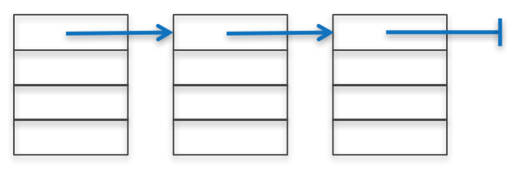
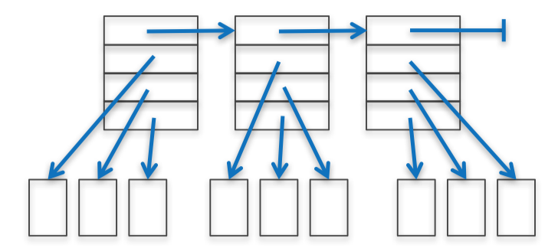
Free List
To write files, need to keep track of which blocks are currently free
How to maintain?
linked list of free blocks
inefficient (why?)
linked list of metadata blocks that in turn point to free blocks
simple and efficient
bitmap
actually used

Slide 32
Problem: Poor Performance
In a naïve implementation of FFS, performance starts bad and gets worse
One early implementation delivered only 2% disk bandwidth
The root of the problem: poor locality
data blocks of a file were often far from its inode
file system would end up highly fragmented: accessing a logically continuous file would require going back and forth across the
Notes:
Note: this early implementation also had a block size that was too small (512 bytes), increasing the number of blocks per file aka number of seeks required to read/write a file

Slide 33
Implementation Basics
Directories: file name -> low-level names (i.e., file numbers)
Index structures: file number -> block
Free space maps: find a free block (ideally nearby)
Performance optimizations (e.g., locality heuristics)

Slide 34
Performance Optimizations
Grouped Allocation: disk organized into groups that are (temporally) close, try to allocate all file blocks in same group
Defragmentation: periodically rearrange files to improve locality
Page Cache: to reduce costs of accessing files, cache file contents in memory (e.g., device data, memory-mapped files)
Copy-on-write (COW): create new, updated copy at time of update
Write Buffering: buffer writes and periodically flush to disk

