Slide 1
Lecture 21: System I/O
CS 105 Spring 2025

Slide 2
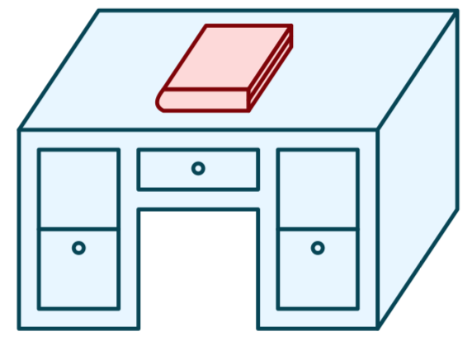
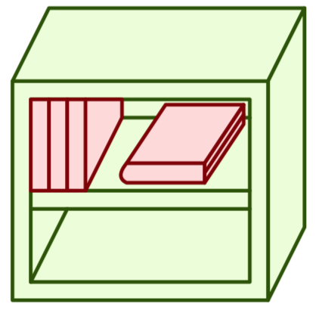
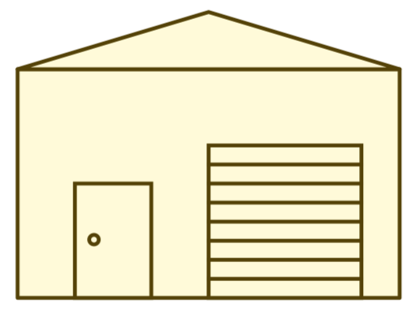
Memory Hierarchy
L0:
Regs
CPU registers hold words retrieved from the L1 cache.
L1:
L1 cache
(SRAM)
L1 cache holds cache lines retrieved from the L2 cache.
Smaller,
faster,
and
costlier
(per byte)
storage
devices
L2:
L2 cache
(SRAM)
L2 cache holds cache lines
retrieved from L3 cache
L3:
L3 cache
(SRAM)
L3 cache holds cache lines
retrieved from main memory.
L4:
Main memory
(DRAM)
Main memory holds
disk blocks retrieved
from local disks.
Larger,
slower,
and
cheaper
(per byte)
storage
devices
Local secondary storage
(local disks)
Local disks hold files retrieved from disks
on remote servers
L5:
L6:
Remote secondary storage
(e.g., cloud, web servers)

Slide 3
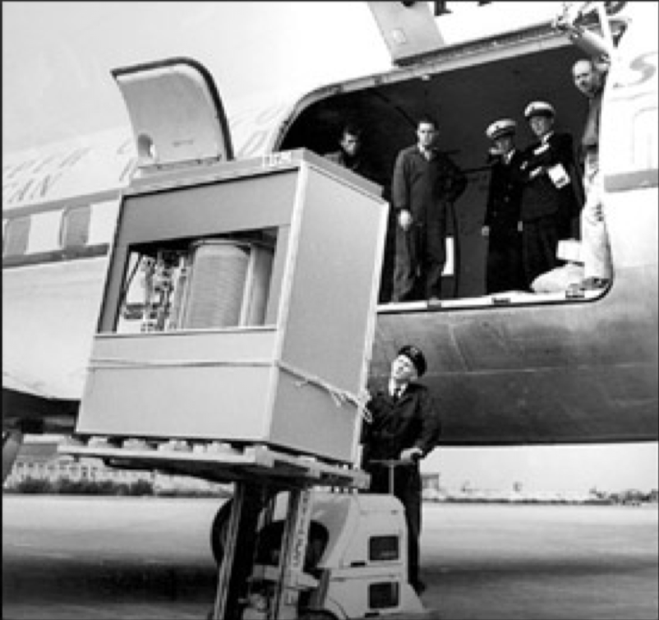
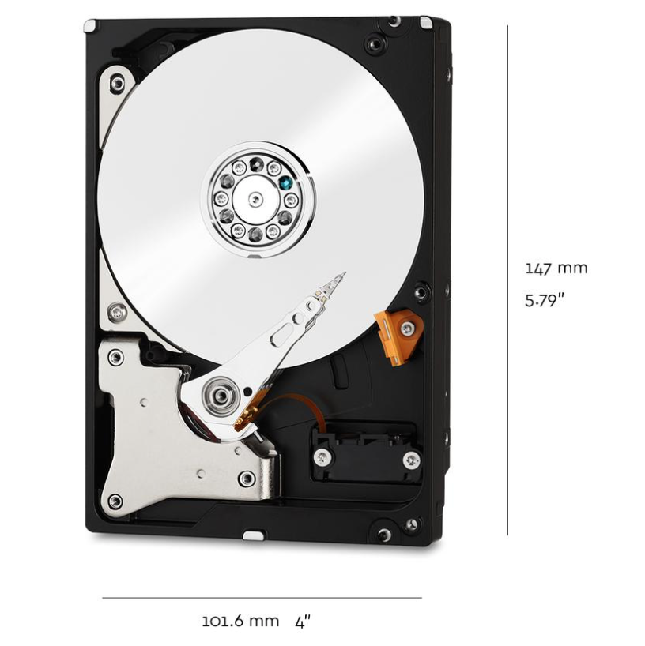
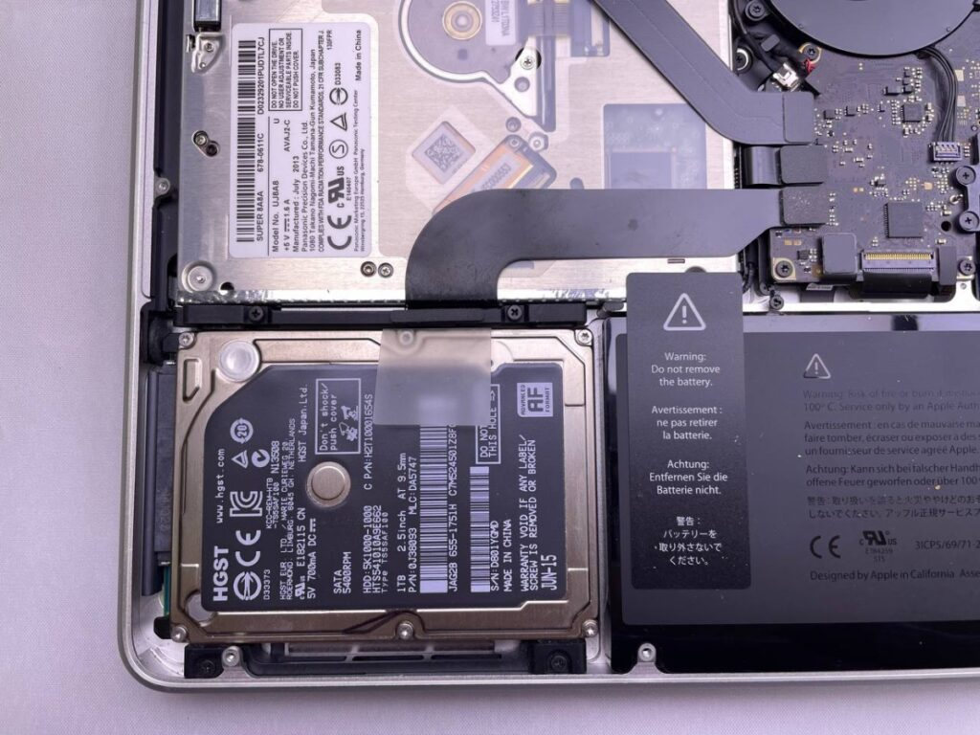
Storage Devices
1950s
IBM 350
5 MB
Magnetic Disks
Storage that rarely becomes corrupted
Large capacity at low cost
Block-level random access
Slow performance for random access
Better performance for streaming access
Solid State Disks (Flash Memory)
Storage that rarely becomes corrupted
Capacity at moderate cost (50x magnetic)
Block-level random access
Good performance for random reads
Not-as-good performance for random writes
2021
WD Red
10 TB
2024
MacBook
1TB

Slide 4
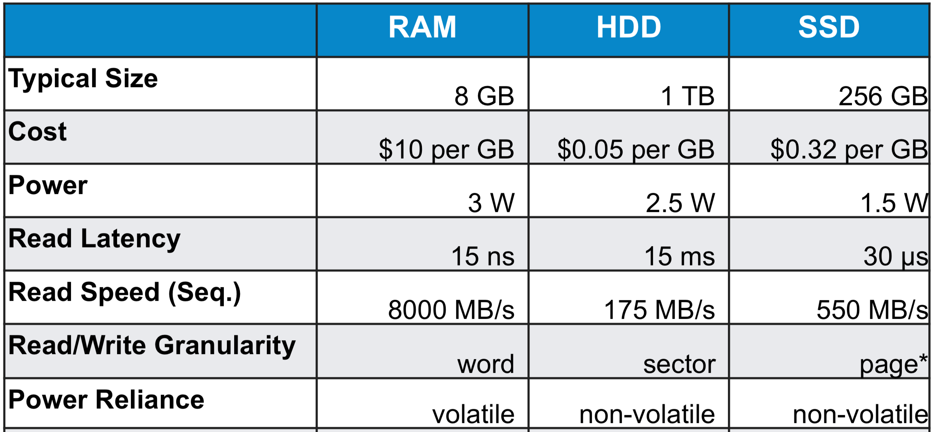
Comparing Storage Media

Slide 5
File Systems 101
Long-term information storage goals
should be able to store large amounts of information
information must survive processes, power failures, etc.
processes must be able to find information
needs to support concurrent accesses by multiple processes
Solution: the File System Abstraction
interface that provides operations involving files

Slide 6
The File System Abstraction
interface that provides operations on data stored long-term on disk
a file is a named sequence of stored bytes
name is defined on creation
processes use name to subsequently access that file
a file is comprised of two parts:
data: information a user or application puts in a file
an array of untyped bytes
metadata: information added and managed by the OS
e.g., size, owner, security info, modification time
(at least) two types of files
normal files: data is an arbitrary sequence of bytes
directories: a special type of file that provides mappings from human-readable names to low-level names (i.e., file numbers)

Slide 7
Path Names
..
.
A file system has a root directory "/"
Directories contain other files (including subdirectories)
Each UNIX directory also contains 2 special entries
"." = this directory
".." = parent directory
Each path from root is a name for a leaf
/foo.txt
/bar/baz/baz.txt
Absolute paths: path of file from the root directory
Relative paths: path from current working directory
/
..
.
foo.txt
bar
..
..
.
.
bar.txt
fun
baz
fun.txt
baz.txt
fun.txt
Notes:
current working directory stored in process control block (PCB)
Demo on server:
cd /
cd cs105
cd ..
cd .
cd ./cs105
cd ~
cd demo23
./example_executable
cd ..
./ebac20182/example_executable

Slide 8
Exercise 1: Path Names
I’ve created a file named example1.txt in the directory cs105, which is located in the root directory.
Specify an absolute path to the file example1.txt
Specify a relative path to the file example1.txt from your home directory (/home/abcd2047/).
I've created a file named example2.txt in my home directory (/home/jcoa2018/).
Specify an absolute path to the file example2.txt
Specify a relative path to the file example2.txt from your home directory
Hint: you can always get back to your home directory with cd ~
Notes:
/data/example1.txt
../../../data/example1.txt
/home/CAMPUS/ebac2018/example2.txt
./example2.txt

Slide 9
Basic File System Operations
Create a file
Delete a file
Write to a file
Read from a file
Seek to somewhere in a file
How should we implement this?

Slide 10
Unix I/O Interface
Mapping of files to devices allows kernel to export simple interface:
Opening a file
open()and close()
Reading and writing a file
read() and write()
Changing the current file position (seek)
indicates next offset into file to read or write
lseek()
B₀
B₁
• • •
B_{k-1}
B_{k}
B_{k+1}
• • •
Current file position = k

Slide 11
The File System Stack
Application
user level
Language Libraries (e.g.,fopen, fread, fwrite, fclose,…)
POSIX API (open, read, write, close, …)
File System
Generic Block Interface (block read/write)
kernel mode
Generic Block Layer
Specific Block Interface (protocol-specific read/write)
Device Driver

Slide 12
Opening Files
Opening a file informs the kernel that you are getting ready to access that file
Returns a small identifying integer file descriptor
fd == -1 indicates that an error occurred
Each process created by a Linux shell begins life with three open files associated with a terminal:
0: standard input (stdin)
1: standard output (stdout)
2: standard error (stderr)
int fd; /* file descriptor */
fd = open("/etc/hosts", O_RDONLY);
if (fd < 0) {
perror("open failed");
exit(1);
}

Slide 13
Kernel Data Structures
Descriptor table
(table created on fork(),
one table
per process)
Open file table
(entry created on open,
shared by
child processes)
v-node table
(one per file,
shared by
all processes)
File A
stdin
fd 0
File access
stdout
fd 1
File pos
File size
stderr
fd 2
fd 3
refcnt=1
File type
fd 4
...
...
File B
File access
File pos
File size
refcnt=1
File type
...
...

Slide 14
Reading Files
Reading a file copies bytes from the current file position to memory, and then updates file position
Returns number of bytes read from file fd into buf
Return type size_t is signed integer
nbytes < 0 indicates that an error occurred
Short counts (nbytes < sizeof(buf) ) are possible and are not errors!
char buf[512];
int fd; /* file descriptor */
int nbytes; /* number of bytes read */
/* Open file fd ... */
/* Then read up to 512 bytes from file fd */
nbytes = read(fd, buf, sizeof(buf));
if (nbytes < 0) {
perror("read error");
exit(1);
}

Slide 15
Kernel Data Structures
Descriptor table
(table created on fork(),
one table
per process)
Open file table
(entry created on open,
shared by
child processes)
v-node table
(one per file,
shared by
all processes)
File A
stdin
fd 0
File access
stdout
fd 1
pos=60
File size
pos=0
stderr
pos=47
fd 2
File type
fd 3
refcnt=1
fd 4
...
...
File B
File access
File pos
File size
refcnt=1
File type
...
...
read(3,buf, 47)
read(3,buf, 13)

Slide 16
Exercise 2: Reading and Writing
Assume the file foobar.txt consists of the six ASCII characters foobar. What gets printed when the following program is run?
int main(int argc, char** argv){
int fd1, fd2;
char c;
fd1 = open("foobar.txt", O_RDONLY);
fd2 = open("foobar.txt", O_RDONLY);
read(fd1, &c, 1);
read(fd2, &c, 1);
printf("c = %c\n", c);
return 0;
}

Slide 17
Exercise 2: Reading and Writing
File descriptor table
Open file table
v-node table
foobar.txt
stdin
File access
0
stdout
1
pos=0
File size
stderr
2
File type
fd1
refcnt=1
3
fd2
...
...
4
foobar.txt
File access
pos=0
File size
refcnt=1
File type
...
...

Slide 18
Writing Files
Writing a file copies bytes from memory to the current file position, and then updates current file position
Returns number of bytes written from buf to file fd
nbytes < 0 indicates that an error occurred
As with reads, short counts are possible and are not errors!
char buf[512];
int fd; /* file descriptor */
int nbytes; /* number of bytes read */
/* Open the file fd ... */
/* Then write up to 512 bytes from buf to file fd */
nbytes = write(fd, buf, sizeof(buf));
if (nbytes < 0) {
perror("write error");
exit(1);
}

Slide 19
On Short Counts
Short counts can occur in these situations:
Encountering (end-of-file) EOF on reads
Reading text lines from a terminal
Short counts never occur in these situations:
Reading from disk files (except for EOF)
Writing to disk files
Best practice is to always allow for short counts.

Slide 20
Buffered Reads/Writes
stream data is stored in a kernel buffer and returned to the application on request
enables same system call interface to handle both streaming reads (e.g., keyboard) and block reads (e.g., disk)

Slide 21
Closing Files
Closing a file informs the kernel that you are finished accessing that file
Closing an already closed file is a recipe for disaster in threaded programs
Moral: Always check return codes, even for seemingly benign functions such as close()
int fd; /* file descriptor */
int retval; /* return value */
retval = close(fd);
if (retval < 0) {
perror("close error");
exit(1);
}

Slide 22
Processes and Files
A child process inherits all file descriptors from its parent
File descriptor table
Open file table
v-node table
Parent's table
File A
fd 0
File access
fd 1
pos=0
File size
fd 2
File type
refcnt=1
fd 3
refcnt=2
fd 4
...
...
Child's table
File B
File access
fd 0
fd 1
pos=47
File size
fd 2
refcnt=1
File type
fd 3
refcnt=2
...
...
fd 4

Slide 23
Exercise 3: Processes and Files
Suppose the file foobar.txt consists of the six ASCII characters foobar. What is printed when the following program is run?
int main(int argc, char** argv){
int fd;
char c;
fd = open("foobar.txt", O_RDONLY);
if(fork() == 0){ // if child process
read(fd, &c, 1);
return 0;
} else { // if parent process
wait(); // wait for child to complete
read(fd, &c, 1);
printf("c = %c\n", c);
return 0;
}
}

Slide 24
Exercise 3: Processes and Files
File descriptor table
Open file table
v-node table
Parent's table
foobar.txt
fd 0
File access
fd 1
pos=0
File size
pos=1
fd 2
File type
refcnt=2
fd 3
refcnt=1
fd 4
...
...
Child's table
fd 0
fd 1
fd 2
fd 3
fd 4

Slide 25
I/O Redirection
Examples of I/O redirection
a program can read input from a file: ./hex2raw < exploit.txt
a program can send output to a file: ./hex2raw > exploit-raw.txt
output of one program can be input to another: cat exploit.txt | ./hex2raw | ./ctarget -q
I/O redirection uses a function called dup2
changes newfd to point to same open file table entry as oldfd
returns file descriptor if OK, -1 on error
int dup2(int oldfd, int newfd);
Notes:
a pipe is a kernel buffer with two file descriptors, one for writing (to put data into the pipe) and one for reading (to pull data out of the pipe)
output of one program can be input to another: cpp file.c | cparse | cgen | as

Slide 26
I/O Redirection
Descriptor table
(one table
per process)
Open file table
(shared by
all processes)
v-node table
(shared by
all processes)
File A
fd 0
File access
fd 1
File pos
File size
fd 2
File type
fd 3
refcnt=0
fd 4
...
...
File B
File access
File pos
File size
refcnt=2
File type
...
...
dup2(4,1)

Slide 27
Exercise 4: I/O Redirection
Suppose the file foobar.txt consists of the six ASCII characters foobar. What is printed when the following program is run?
int main(){
int fd1, fd2;
char c;
fd1 = open("foobar.txt",O_RDONLY);
fd2 = open("foobar.txt",O_RDONLY);
read(fd2, &c, 1);
dup2(fd2, fd1);
read(fd1, &c, 1);
printf("c = %c\n", c);
return 0;
}

Slide 28
Exercise 4: I/O Redirect
File descriptor table
Open file table
v-node table
foobar.txt
stdin
File access
0
stdout
1
File pos
File size
stderr
2
File type
refcnt=1
fd1
refcnt=0
3
fd2
...
...
4
foobar.txt
File pos
refcnt=2
refcnt=1
...

Slide 29
System I/O as a Uniform Interface
Operating systems use the System I/O commands as an interface for all I/O devices
The commands to read and write to an open file descriptor are the same no matter what type of "file" it is
Types of files include
file
keyboard
screen
pipe
device
network

