Slide 1
Lecture 20: Synchronization
CS 105 Spring 2025

Slide 2
Review: Alternate View of a Process
Process = thread + other state
Thread (main thread)
Other data
brk
Stack
Heap
rsp
Data
Code
Thread context:
Data registers
Stack pointer (rsp)
Condition codes
Program counter (rip)
0
Kernel context:
VM structures
File table
brk pointer

Slide 3
Review: Multi-threading
Multiple threads can be associated with a process
Each thread has its own logical control flow
Each thread has its own stack for local variables
Each thread has its own thread id (TID)
Each thread shares the same code, data, and kernel context
Thread 1 (main thread)
Thread 2 (peer thread)
Shared data
brk
Heap
Stack 1
Stack 2
rsp
rsp
Data
Thread 1 context:
Data registers
Stack pointer
Condition codes
Program counter
Thread 2 context:
Data registers
Stack pointer
Condition codes
Program counter
Code
0
Kernel context:
VM structures
File table
brk pointer

Slide 4
Review: Locks
A lock (aka a mutex) is a synchronization primitive that provides mutual exclusion. When one thread holds a lock, no other thread can hold it.
a lock can be in one of two states: locked or unlocked
a lock is initially unlocked
function acquire(&lock) waits until the lock is unlocked, then atomically sets it to locked
function release(&lock) sets the lock to unlocked

Slide 5
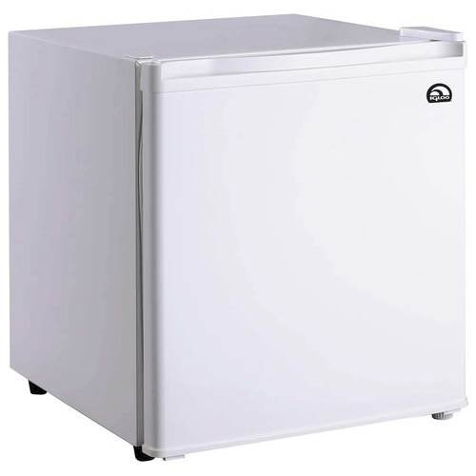
Review: use a lock
You and your roommate share a refrigerator. Being good roommates, you both try to make sure that the refrigerator is always stocked with milk.
Algorithm 6:
acquire(&lock)
if (milk == 0) { // no milk
milk++; // buy milk
}
release(&lock)
Correct!

Slide 6
Review: Locks
/* Global shared variable */
volatile long cnt = 0; /* Counter */
int main(int argc, char** argv){
long niters;
pthread_t tid1, tid2;
niters = atoi(argv[1]);
pthread_create(&tid1, NULL,
thread, &niters);
pthread_create(&tid2, NULL,
thread, &niters);
pthread_join(tid1, NULL);
pthread_join(tid2, NULL);
/* Check result */
if (cnt != (2 * niters))
printf("BOOM! cnt=%ld\n", cnt);
else
printf("OK cnt=%ld\n", cnt);
exit(0);
}
/* Thread routine */
void* count_func(void* vargp){
long i, niters;
niters = *((long*)vargp);
for (i = 0; i < niters; i++){
cnt++;
}
return NULL;
}
pthread_mutex_t lock; /* Lock */
pthread_mutex_lock(&lock);
pthread_mutex_unlock(&lock);

Slide 7
Problems with Locks
Locks are slow
threads that fail to acquire a lock on the first attempt must "spin", which wastes CPU cycles
threads get scheduled and de-scheduled while the lock is still locked
Using locks correctly is hard
hard to ensure all race conditions are eliminated
easy to introduce synchronization bugs (deadlock, livelock)

Slide 8
Blocking Lock (aka mutex)
Initial state of lock is 0 ("available")
acquire(&lock)
while value == 1, block (suspend thread)
when value == 0, set value to 1
release(&lock)
set value to 0
resume a thread waiting on lock (if any)
acquire(&lock){
while(lock == 1){
;
}
lock == 1
}
release(&lock){
lock == 0
}
Notes:
This is just a binary semaphore

Slide 9
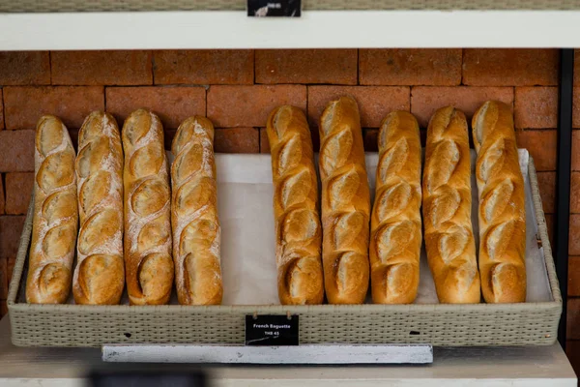
Example: Bounded Buffers
finite capacity (e.g. 20 loaves)
implemented as a queue
How do you implement a bounded buffer (0 <= count <= n)?
How do you synchronize concurrent access to a bounded buffer?
Threads A: produce loaves of bread and put them in the queue
Threads B: consume loaves by taking them off the queue

Slide 10
Example: Bounded Buffers
0 1 2 3 4 5 (n = 6)
b
3
2
2
4
1
Values wrap around!!
rear
front
Exercise: What can go wrong?
typedef struct {
int* b; // ptr to buffer containing the queue
int n; // length of array (max # slots)
int count; // number of elements in array
int front; // index of first element, 0 <= front < n
int rear; // (index of last elem)+1 % n, 0 <= rear < n
} bbuf_t
void put(bbuf_t* ptr, int val){
ptr->b[ptr->rear]= val;
ptr->rear= ((ptr->rear)+1)%(ptr->n);
ptr->count++;
}
void init(bbuf_t* ptr, int n){
ptr->b = malloc(n*sizeof(int));
ptr->n = n;
ptr->count = 0;
ptr->front = 0;
ptr->rear = 0;
}
int get(bbuf_t* ptr){
int val= ptr->b[ptr->front];
ptr->front= ((ptr->front)+1)%(ptr->n);
ptr->count--;
return val;
}
Notes:
Discussion: what can go wrong (3 problems)
Fix code w/ semaphores
Initialization: how many available?

Slide 11
Example: Bounded Buffers
0 1 2 3 4 5 (n = 6)
b
3
2
4
1
void put(bbuf_t* ptr, int val){
ptr->b[ptr->rear]= val;
ptr->rear= ((ptr->rear)+1)%(ptr->n);
ptr->count++;
}
acquire(&(ptr->lock))
while(ptr->count==ptr->n){
}
typedef struct {
int* b;
int n;
int count;
int front;
int rear;
} bbuf_t
rear
front
release(&lock)
acquire(&lock)
pthread_mutex_t lock;
release(&(ptr->lock))
int get(bbuf_t* ptr){
int val= ptr->b[ptr->front];
ptr->front= ((ptr->front)+1)%(ptr->n);
ptr->count--;
return val;
}
void init(bbuf_t* ptr, int n){
ptr->b = malloc(n*sizeof(int));
ptr->n = n;
ptr->count = 0;
ptr->front = 0;
ptr->rear = 0;
}
acquire(&(ptr->lock))
while(ptr->count==0){
release(&lock)
acquire(&lock)
}
init(&(ptr->lock));
release(&(ptr->lock))
Notes:
Discussion: what can go wrong (3 problems)
Fix code w/ semaphores
Initialization: how many available?

Slide 12
Condition Variables
A condition variable cv is a stateless synchronization primitive that is used in combination with locks (mutexes)
condition variables allow threads to efficiently wait for a change to the shared state protected by the lock
a condition variable is comprised of a waitlist
Interface:
wait(CV* cv, Lock* lock): Atomically releases the lock, suspends execution of the calling thread, and places that thread on cv's waitlist; after the thread is awoken, it re-acquires the lock before wait returns
signal(CV* cv): takes one thread off of cv's waitlist and marks it as eligible to run. (No-op if waitlist is empty.)

Slide 13
Example: Bounded Buffers
0 1 2 3 4 5 (n = 6)
b
3
2
4
1
void put(bbuf_t* ptr, int val){
ptr->b[ptr->rear]= val;
ptr->rear= ((ptr->rear)+1)%(ptr->n);
ptr->count++;
}
acquire(&(ptr->lock))
while(ptr->count == ptr->n)
wait(&(ptr->bread_bought))
if(ptr->count == ptr->n)
wait(&bread_bought)
typedef struct {
int* b;
int n;
int count;
int front;
int rear;
} bbuf_t
rear
front
signal(&(ptr->bread_added))
pthread_mutex_t lock;
release(&(ptr->lock))
CV bread_bought;
CV bread_added;
int get(bbuf_t* ptr){
int val= ptr->b[ptr->front];
ptr->front= ((ptr->front)+1)%(ptr->n);
ptr->count--;
return val;
}
void init(bbuf_t* ptr, int n){
ptr->b = malloc(n*sizeof(int));
ptr->n = n;
ptr->count = 0;
ptr->front = 0;
ptr->rear = 0;
}
acquire(&(ptr->lock))
while(ptr->count == 0)
wait(&(ptr->bread_added))
if(ptr->count == 0)
wait(&bread_added)
init(&(ptr->lock));
signal(&(ptr->bread_bought))
init(&(ptr->bread_bought));
release(&(ptr->lock))
init(&(ptr->bread_added));
Notes:
Discussion: what can go wrong (3 problems)
Fix code w/ semaphores
Initialization: how many available?

Slide 14
Using Condition Variables
Declare a lock. Each shared value needs a lock to enforce mutually exclusive access to the shared value.
Add code to acquire and release the lock. All code that accesses the shared value must hold the lock.
Identify each place something could go wrong if the next line is executed under the wrong circumstances
Declare a condition variable that corresponds to when it is safe to proceed with the function.
Add a wait for that condition to ensure the critical line is only executed under the right conditions.
Add a signal when the condition becomes true.
Add loops around your waits. Even though a condition was true when signal was called, it might not still be true when a thread resumes execution.

Slide 15
Exercise: Synchronization Barrier
With data parallel programming, a computation proceeds in parallel, with each thread operating on a different section of the data. Once all threads have completed, they can safely use each others results.
void* thread(void* args)
{ static int done_count = 0;
parallel_computation(args)
done_count++;
while(done_count < NUM_THREADS) {
}
use_results();
}
What can go wrong?
Use locks and condition variables to synchronize this code.

Slide 16
Exercise: Synchronization Barrier
With data parallel programming, a computation proceeds in parallel, with each thread operating on a different section of the data. Once all threads have completed, they can safely use each others results.
Lock lock;
void* thread(void* args)
{ static int done_count = 0;
parallel_computation(args);
acquire(&lock);
done_count++;
release(&lock);
while(done_count < NUM_THREADS) {
}
use_results();
}
What can go wrong?
Use locks and condition variables to synchronize this code.

Slide 17
Exercise: Synchronization Barrier
Lock lock;
void* thread(void* args)
{ static int done_count = 0;
parallel_computation(args);
acquire(&lock);
done_count++;
release(&lock);
acquire(&lock);
while(done_count < NUM_THREADS) {
release(&lock);
acquire(&lock);
}
release(&lock);
use_results();
}
With data parallel programming, a computation proceeds in parallel, with each thread operating on a different section of the data. Once all threads have completed, they can safely use each others results.
What can go wrong?
Use locks and condition variables to synchronize this code.

Slide 18
Exercise: Synchronization Barrier
Lock lock;
CVar ready;
void* thread(void* args)
{ static int done_count = 0;
parallel_computation(args);
acquire(&lock);
done_count++;
if (done_count == NUM_THREADS) {
signal(&ready);
}
release(&lock);
acquire(&lock);
while(done_count < NUM_THREADS) {
wait(&ready);
} release(&lock);
use_results();
}
With data parallel programming, a computation proceeds in parallel, with each thread operating on a different section of the data. Once all threads have completed, they can safely use each others results.
What can go wrong?
Use locks and condition variables to synchronize this code.

Slide 19
Condition Variables
A condition variable cv is a stateless synchronization primitive that is used in combination with locks (mutexes)
condition variables allow threads to efficiently wait for a change to the shared state protected by the lock
a condition variable is comprised of a waitlist
Interface:
wait(CV * cv, Lock * lock): Atomically releases the lock, suspends execution of the calling thread, and places that thread on cv's waitlist; after the thread is awoken, it re-acquires the lock before wait returns
signal(CV * cv): takes one thread off of cv's waitlist and marks it as eligible to run. (No-op if waitlist is empty.)
broadcast(CV * cv): takes all threads off cv's waitlist and marks them as eligible to run. (No-op if waitlist is empty.)

Slide 20
Exercise: Synchronization Barrier
Lock lock;
CVar ready;
void* thread(void* args)
{ static int done_count = 0;
parallel_computation(args);
acquire(&lock);
done_count++;
if (done_count == NUM_THREADS) {
broadcast(&ready);
}
release(&lock);
acquire(&lock);
while(done_count < NUM_THREADS) {
wait(&ready);
}
release(&lock);
use_results();
}
With data parallel programming, a computation proceeds in parallel, with each thread operating on a different section of the data. Once all threads have completed, they can safely use each others results.
What can go wrong?
Use locks and condition variables to synchronize this code.

Slide 21
Exercise: Readers/Writers
Consider a collection of concurrent threads that have access to a shared object
Some threads are readers, some threads are writers
a unlimited number of readers can access the object at same time
a writer must have exclusive access to the object
int num_readers = 0;
int num_writers = 0;
Lock lock;
CV readable;
CV writeable;
int num_readers = 0;
int num_writers = 0;
void writer(void* shared, int val){
num_writers=1;
write(shared, val);
num_writers=0;
}
int reader(void* shared){
num_readers++;
int x = read(shared);
num_readers--;
return x
}
void writer(void* shared, int val){
num_writers=1;
write(shared, val);
num_writers=0;
}
int reader(void* shared){
num_readers++;
int x = read(shared);
num_readers--;
return x
}
acquire(&lock);
release(&lock);
acquire(&lock);
release(&lock);
while(num_writers > 0)
wait(readable, &lock);
acquire(&lock);
release(&lock);
while(num_readers > 0)
wait(writeable, &lock);
if(num_readers == 0)
signal(writeable);
broadcast(readable);
signal(writeable);

Slide 22
Programming with CVs
C
Python
Initialization:
pthread_mutex_t lock =
PTHREAD_MUTEX_INITIALIZER;
pthread_cond_t cv =
PTHREAD_COND_INITIALIZER;
Lock acquire/release:
pthread_mutex_lock(&lock);
pthread_mutex_unlock(&lock);
CV operations:
pthread_cond_wait(&cv, &lock);
pthread_cond_signal(&cv);
pthread_cond_broadcast(&cv);
Initialization:
lock = Lock()
cv = Condition(lock)
Lock acquire/release:
lock.acquire()
lock.release()
V
cv.wait()
cv.notify()
cv.notify_all()

