Slide 1
Lecture 17: Virtual Memory (cont'd)
CS 105 Spring 2026

Slide 2

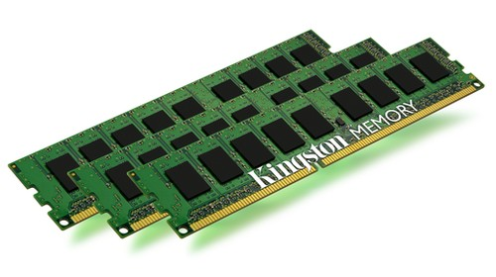
Review: Address Translation
Stack
MMU
Virtual Address
invalid
Exception
Heap
Data
Code
Physical Address
Data
Notes:
Define MMU

Slide 3
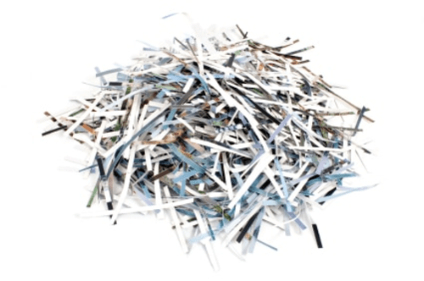
Review: Paging
Physical Memory
Frame 17
Virtual Memory
Frame 16
Page 7
Stack
Frame 15
Page 6
Frame 14
Page 5
Frame 13
Page 4
Frame 12
Page 3
Frame 11
Page 2
Heap
Frame 10
Page 1
Data
Frame 9
Page 0
Code
Frame 8
Frame 7
Frame 6
Frame 5
Frame 4
vaddr = page_num<< log(page_size) + offset
Frame 3
vaddr = page_num*page_size + offset
Frame 2
paddr = frame_num*frame_size + offset
paddr = frame_num<<log(page_size) + offset
Frame 1
Frame 0
Notes:
Walk through address translation here to motivate bits

Slide 4
Review: Virtual Pages
Stack
NULL page or
access not allowed
SegFault
page#
offset
vaddr
MMU
Heap
page table
Invalid page
Data
v | Frame | Access
1 | 47 | R,W
0 | NULL | R,W
0 | 13 | R,W
1 | 42 | R,X
Page Fault
Code
paddr =
Frame[page#]
offset
…
Data
Notes:
Define MMU

Slide 5
Review: Paging
Assume that you are currently executing a process P with the following page table on a system with 16 byte pages:
What is the physical address that corresponds to the virtual address 0xEA8B2?
What is the physical address that corresponds to the virtual address 0xEA8A7?
What is the physical address that corresponds to the virtual address 0xEA89A?
…
v | Frame | Access
1 | 0x47 | R,W
0 | NULL | R,W
0 | 0x13 | R,W
1 | 0x23 | R,X
0xEA8B
0xEA8A
0xEA89
0xEA88
…
0xEA8B
0x2
0x472
0xEA8A
0x7
segfault
0xEA89
0xA
page fault

Slide 6


Review: Evaluating Paging
Isolation: don’t want different process states collided in physical memory
Efficiency: want fast reads/writes to memory
Sharing: want option to overlap for communication
Utilization: want best use of limited resource
Virtualization: want to create illusion of more resources
Notes:
Pros: easy allocation (keep bitmap of free frames), no external fragmentation, still allows access permissions, still allows sharing, easy to grow
Cons: internal fragmentation, slower (size of page tables etc -> multiple lookups)

Slide 7
Traditional Paging
page table is stored in physical memory
implemented as array of page table entries
Page Table Base Register (PTBR) stores physical address of beginning of page table
Page table entries are accessed by using the page number as the index into the page table
0 | NULL | R,W
0 | NULL | R,W
0 | NULL | R,W
1 | 59 | R,X
1 | 47 | R,W
0 | NULL | R,W
0 | 13 | R,W
1 | 42 | R,X
PTBR

Slide 8
Problems with Paging
Memory Consumption: page table is really big
Example: consider 48-bit address space, 4KB (2^12) page size, assume each page table entry is 8 bytes.
Larger pages increase internal fragmentation
Performance: every data/instruction access requires two memory accesses:
One for the page table
One for the data/instruction
(2^36 pages) * (2^3 bytes/page table entry)
= 2^39 bytes
= 512 GB page table
Notes:
problem 1: fill up all our memory with page table 2^48 addresses/2^12 page size => 2^36 pages* 8 bytes =>2^39 byte page table = .5 terabytes

Slide 9
Two-level Page Tables
page table is stored in virtual memory pages
page directory is stored in physical memory (page table for the page table)
Implemented as array of page directory entries
Page Table Base Register (PTBR) stores physical address of beginning of page directory
0 | NULL | R,W
0 | NULL | R,W
0 | NULL | R,W
1 | 59 | R,X
0 | NULL
1 | 62
0 | 17
1 | 77
PTBR
1 | 47 | R,W
0 | NULL | R,W
0 | 13 | R,W
1 | 42 | R,X

Slide 10
Two-level Page Tables
vaddr
idx1
idx2
offset
MMU
page dir
page table page
v | PTFrame
0 | NULL
1 | 62
0 | 17
1 | 77
v | Frame | Acc
1 | 47 | R,W
0 | NULL | R,W
0 | 13 | R,W
1 | 42 | R,X
Frame[idx1]
Frame[idx2]
offset
…
…
Data
only store in-use page table entries in physical memory
easier to allocate page table
more memory accesses
Notes:
Define MMU

Slide 11
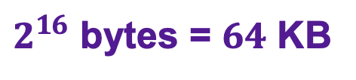
Example: Two-level Page Tables
Assume you are working on an architecture with a 32-bit virtual address space in which each page is 64 KB and a page table entry is 16 bytes.
How many bits will be in the offset?
How many bits will be in idx2?
How many bits will be in idx1?
$2^{16}$ bytes = $64$ KB
16 bits
12 bits
4 bits
4 bit idx1
12 bit idx2
16 bit offset
Notes:
Each page is 64KB, how many different bytes within a page?
Each page table entry is 16 bytes, how many PTEs fit within a page?
The virtual address space is 2^32, how many page directories do we need?

Slide 12

Exercise: Two-level Page Tables
page directory
page table
Assume you are still working on that architecture.
Compute the physical address corresponding to each of the virtual address:
0x00000013
0x20022002
0x10015555
0x10020105
v | PTFrame
1 | 0x2F
1 | 0x31
0 | NULL
0 | 0x2F
Frame 2F
v | Frame | Acc
1 | 0x0047 | R,W
0 | NULL | R,W
0 | 0x0013 | R,W
1 | 0x0042 | R,X
0x0
0x0
0x1
0x1
4 bit idx1
12 bit idx2
16 bit offset
0x2
0x2
0x3
0x3
…
…
0xF
1 | 0x23
Frame 30
0x00470013
segfault
0xCAFE5555
segfault
Frame 31
0x0
0 | 0x002A | R
1 | 0xCAFE | R,W
0 | NULL | R,W
0 | 0x2A04 | R,W
0x1
0x2
0x3
…

Slide 13
Multi-level Page Tables
Problem: How big does the page directory get?
Assume you have a 48-bit address space
Assume you have 4KB pages
Assume you have 8 byte page table entries/page directory entries
Goal: Page Table Directory should fit in one frame
Multi-level page tables: add additional level(s) to tree
1 GB
27 bit idx1
9 bit idx2
12 bit offset
48 bits
9 bit idx1
9 bit idx2
9 bit idx3
9 bit idx4
12 bit offset
48 bits
Notes:
(2^27 directory entries)*(8 bytes/entry) = 2^30 bytes = 1 GB

Slide 14
Review: Problems with Paging
Memory Consumption: page table is really big
Example: consider 64-bit address space, 4KB (2^12) page size, assume each page table entry is 8 bytes.
Larger pages increase internal fragmentation
Performance: every data/instruction access requires two memory accesses:
One for the page table
One for the data/instruction
five
each of the four levels of page table
Notes:
problem 1: fill up all our memory with page table

Slide 15
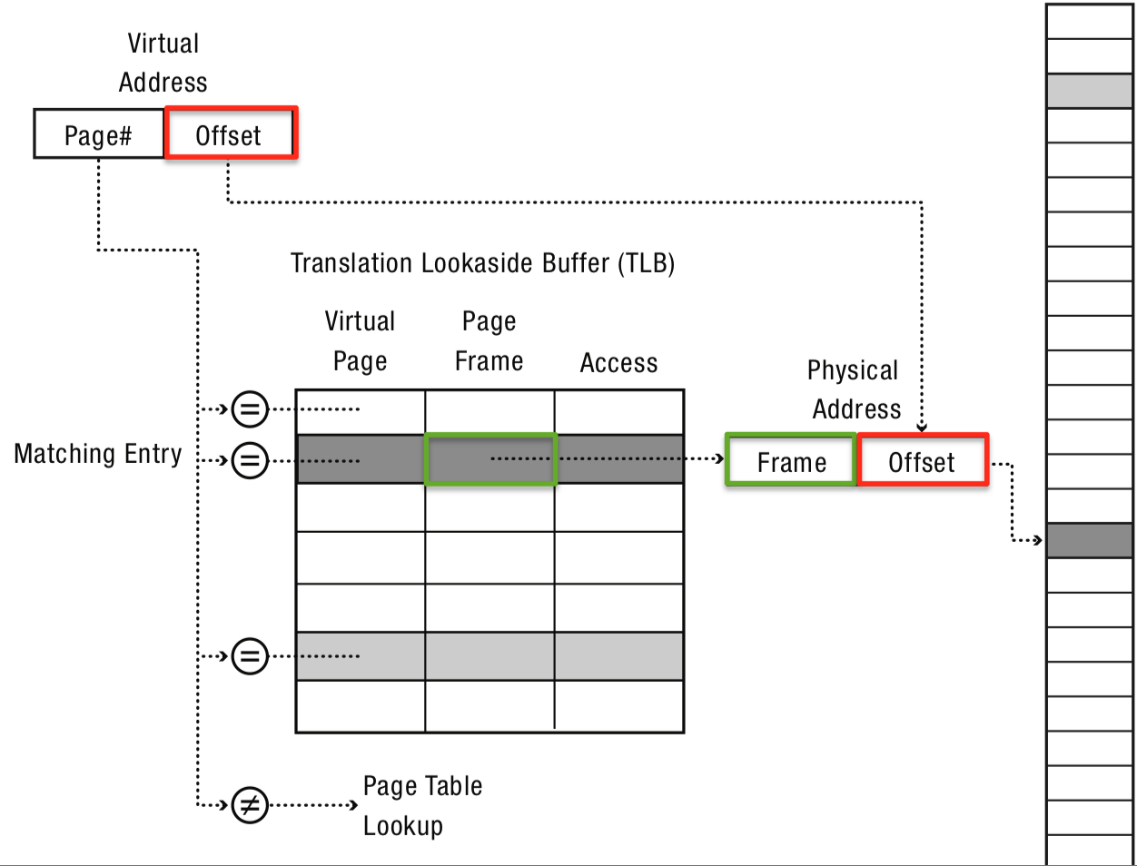
Translation-Lookaside Buffer (TLB)
General idea: if address translation is slow, cache some of the answers
Translation-lookaside buffer is an address translation cache that is built into the MMU

Slide 16
Exercise: TLB
TLB
idx | v | tag | PPN | v | tag | PPN | v | tag | PPN | v | tag | PPN
0 | 1 | 03 | B | 0 | 07 | 6 | 1 | 28 | 3 | 0 | 01 | F
1 | 1 | 31 | 0 | 0 | 12 | 3 | 1 | 3E | 4 | 1 | 0B | 1
2 | 0 | 2A | A | 0 | 11 | 1 | 1 | 1F | 8 | 1 | 07 | 5
3 | 1 | 07 | 3 | 0 | 2A | A | 0 | 1E | 2 | 0 | 21 | B
Assume you are running on an architecture with a one-level page table with 4096 byte pages. For each of the following virtual addresses, determine whether the address translation is stored in the TLB. If so, give the corresponding physical address
0x7E37C
0x16A48
0x7E
0x37c
0111 11
10
0x1F
2
0x837C
0x16
0xA48
0001 01
10
0x05
2
TLB miss

Slide 17
Example: The Linux x86 Address Space
Use "only" 48-bit addresses (top 16 bits not used)
4KB pages by default
supports larger "superpages"
Four-level page table
Physical memory stores memory pages, memory-mapped files, cached file pages
Page eviction algorithm uses variant of LRU called 2Q
approximates LRU with clock
maintains two lists (active/inactive)
Stack is marked non-executable
Virtual address of stack/heap start are randomized each time process is initialized
0xFFFFFFFFFFFF
Kernel (virtual)
Kernel (logical)
0x800000000000
Stack
Heap
Data
Code
Page 0: Invalid
0x000000000000
Notes:
The Linux kernel maps most of the virtual address space that belongs to the kernel to perform 1:1 mapping with an offset of the first part of physical memory. (slightly less then for 1Gb for 32bit x86, can be different for other processors or configurations). For example, for kernel code on x86 address 0xc00000001 is mapped to physical address 0x1.
This is called logical mapping - a 1:1 mapping (with an offset) that allows the kernel to access most of the physical memory of the machine.
But this is not enough - sometime we have more then 1Gb physical memory on a 32bit machine, sometime we want to reference non contiguous physical memory blocks as contiguous to make thing simple, sometime we want to map memory mapped IO regions which are not RAM.

Slide 18
Example: Core i7 Memory Accessing
CPU
32/64
L2, L3, and
main memory
Result
Virtual address (vaddr)
36
12
VPN
VPO
L1
hit
L1
miss
32
4
TLBT
TLBI
L1 d-cache
(64 sets, 8-way, 64-byte/ln)
TLB
hit
TLB
miss
...
...
L1 TLB (16 sets, 4 entries/set)
9
9
9
9
40
12
40
6
6
idx1
idx2
idx3
idx4
PFN
PFO
CT
CI
CO
Physical
address
(paddr)
PTBR
PDE
PDE
PDE
PTE
Page tables

