Slide 1
Lecture 18: Virtual Memory
CS 105 Spring 2026

Slide 2
Multiprocessing: The Illusion
Memory
Memory
Memory
Stack
Stack
Stack
Heap
Heap
…
Heap
Data
Data
Data
Code
Code
Code
CPU
CPU
CPU
Registers
Registers
Registers
Process provides each program with two key abstractions:
Logical control flow
Each program seems to have exclusive use of the CPU
Provided by kernel mechanism called context switching
Private address space
Each program seems to have exclusive use of main memory.
Provided by kernel mechanism called virtual memory
Notes:
Each process has its own registers, memory, I/O resources, "thread of control"

Slide 3
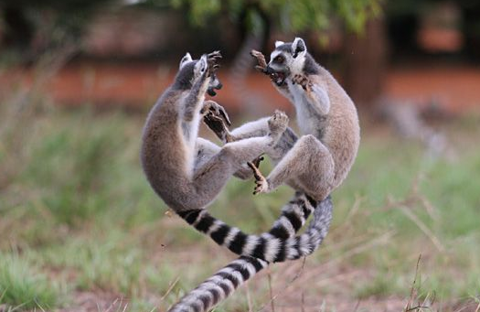
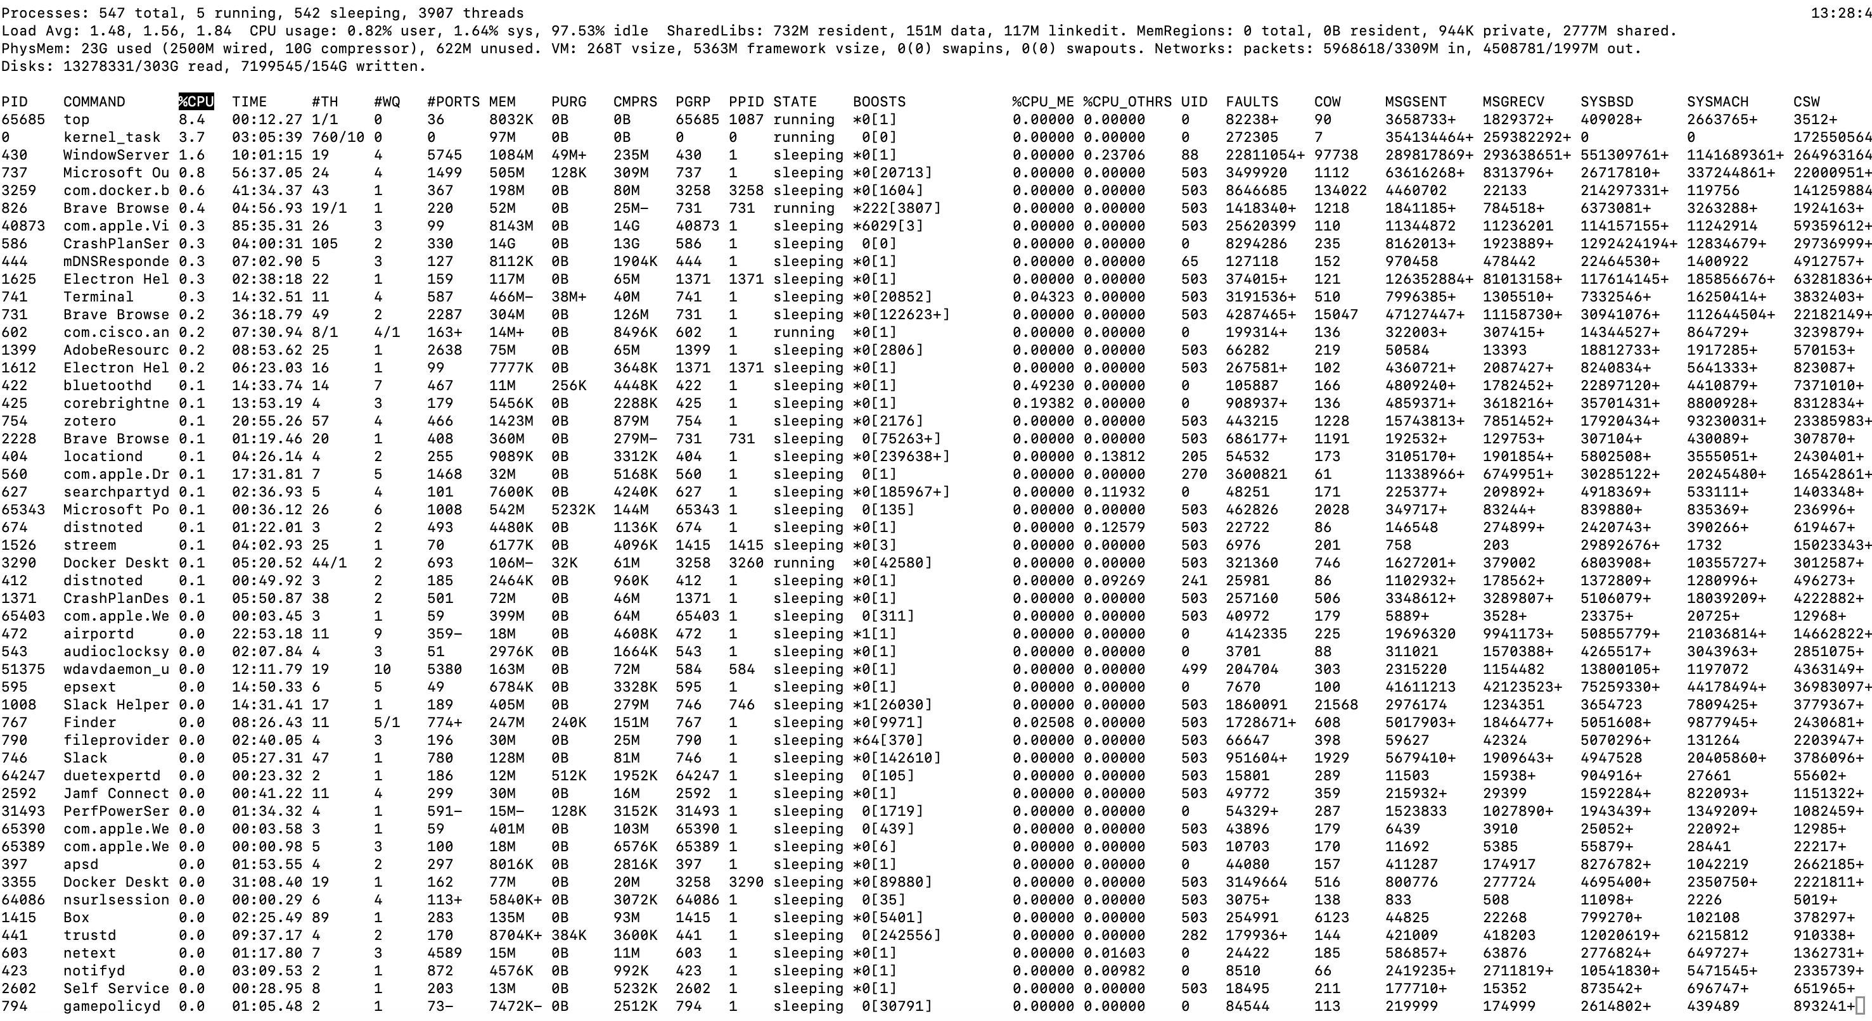
Multiprocessing: The Reality
Computer runs many processes simultaneously
Running program “top” on Mac
System has 547 processes, 5 of which are active
Identified by Process ID (PID)
Notes:
What happens when there are multiple processes/threads? OS has to manage resources
%Possible considerations:
%fairness
%efficiency/optimize resources
%security

Slide 4
Virtual Memory Goals
Stack
Isolation: don’t want different process states collided in physical memory
Efficiency: want fast reads/writes to memory
Sharing: want option to overlap for communication
Utilization: want best use of limited resource
Virtualization: want to create illusion of more resources
Heap
Data
Code

Slide 5

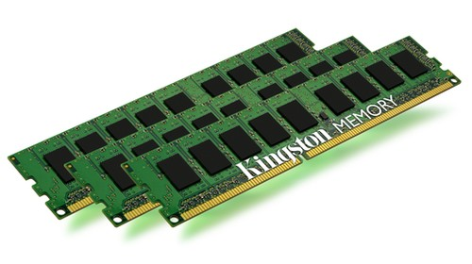
Address Translation
Stack
MMU
Virtual Address
invalid
Exception
Heap
Data
Code
Physical Address
Data
Notes:
Define MMU

Slide 6
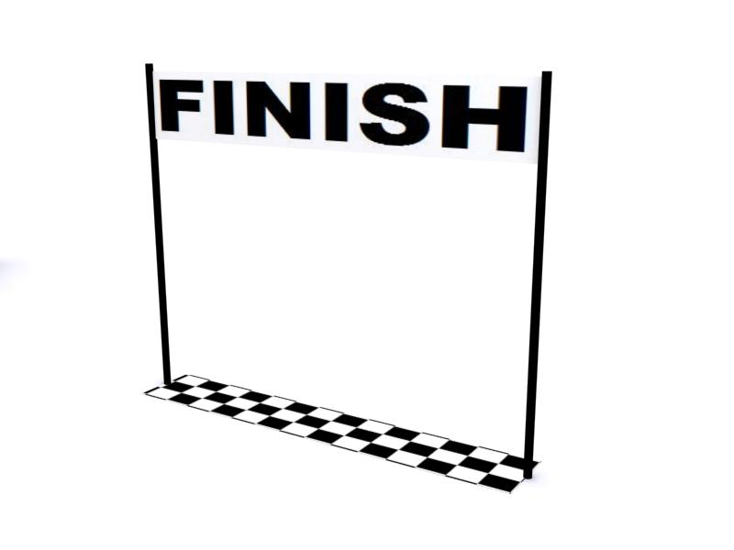

Base-and-Bound
Physical Memory
Virtual Memory
Stack
Bound
Heap
Data
Code
Base

Slide 7
Base-and-Bound
Stack
MMU
vaddr
Base | Bound
vaddr > Bound
Exception
Heap
Data
Code
paddr = vaddr + Base
Data
Notes:
Define MMU

Slide 8
Exercise 1: Base-and-Bound
Assume that you are currently executing a process P with Base 0x1234 and Bound 0x100.
What is the physical address that corresponds to the virtual address 0x47?
What is the physical address that corresponds to the virtual address 0x123?
0x127b
invalid

Slide 9


Evaluating Base-and-Bound
Isolation: don’t want different process states collided in physical memory
Efficiency: want fast reads/writes to memory
Sharing: want option to overlap for communication
Utilization: want best use of limited resource
Virtualization: want to create illusion of more resources
Notes:
UNIVAC 1100 (1962)

Slide 10

Segmentation
Physical Memory
DBound
DBase
Virtual Memory
Stack
Heap
HBound
Data
HBase
Code
SBound
SBase
CBound
CBase

Slide 11
Segmentation
MMU
Stack
Base | Bound | Access
 |  | R,W
 |  | R,W
 |  | R,W
 |  | R,X
offset > Bound[idx]
or access not allowed
idx
offset
vaddr
Exception
Heap
Data
Code
paddr = Base[idx] + offset
Data
Notes:
Define MMU

Slide 12
Exercise 2: Segmentation
Assume that you are currently executing a process P with the following segment table:
What is the physical address that corresponds to the virtual address 0x001?
What is the physical address that corresponds to the virtual address 0xD47?
Base | Bound | Access
0x4747 | 0x80 | R,W
0x2424 | 0x40 | R,W
0x0023 | 0x80 | R,W
0x1000 | 0x200 | R,X
00
0000000001
0x4748
11
0101000111
0x1147

Slide 13

Evaluating Segmentation
Isolation: don’t want different process states collided in physical memory
Efficiency: want fast reads/writes to memory
Sharing: want option to overlap for communication
Utilization: want best use of limited resource
Virtualization: want to create illusion of more resources
Notes:
Intel 80286 (1982) used segmentation and now all Intel devices can use segmentation for backwards compatibility

Slide 14
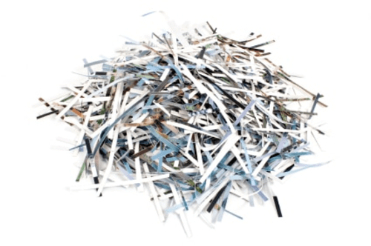
Paging
Physical Memory
Frame 17
Virtual Memory
Frame 16
Page 7
Stack
Frame 15
Page 6
Frame 14
Page 5
Frame 13
Page 4
Frame 12
Page 3
Frame 11
Page 2
Heap
Frame 10
Page 1
Data
Frame 9
Page 0
Code
Frame 8
Frame 7
Frame 6
Frame 5
Frame 4
vaddr = page_num<< log(page_size) + offset
Frame 3
vaddr = page_num*page_size + offset
Frame 2
paddr = frame_num*frame_size + offset
paddr = frame_num<<log(page_size) + offset
Frame 1
Frame 0
Notes:
Walk through address translation here to motivate bits

Slide 15
Paging
MMU
Stack
Frame | Access
47 | R,W
NULL | R,W
13 | R,W
42 | R,X
page#
offset
access not allowed
vaddr
Exception
Heap
Data
…
Code
paddr =
Frame[page#]
offset
Data
Notes:
Define MMU

Slide 16
Exercise 3: Paging
Assume that you are currently executing a process P with the following page table on a system with 16 byte pages:
What is the physical address that corresponds to the virtual address 0x147?
What is the physical address that corresponds to the virtual address 0x16E?
…
Frame | Access
0x47 | R,W
0xF4 | R,W
NULL | R,W
0x23 | R,X
0x17
0x16
0x15
0x14
…
00010100
0111
0x237
00010110
1110
0xF4E

Slide 17
Exercise 3: Paging
Assume that you are currently executing a process P with the following page table on a system with 16 byte pages:
…
Frame | Access
0x47 | R,W
0xF4 | R,W
NULL | R,W
0x23 | R,X
Physical Memory
0x17
Frame 0xF5
0x16
Page 0x16
Frame 0xF4
Frame 0xF3
0x15
Frame 0xF2
Virtual Memory
Frame 0xF1
0x14
Frame 0xF0
…
…
Page 0x17
Frame 0x48
Page 0x16
Page 0x17
Frame0x47
Page 0x15
Frame 0x46
Page 0x14
Frame 0x45
…
Frame 0x25
Frame 0x24
Page 0x14
Frame 0x23
Frame 0x22

Slide 18
Memory as a Cache
each page table entry has a valid bit
for valid entries, frame indicates physical address of page in memory
a page fault occurs when a program requests a page that is not currently in memory
handled much like a cache miss
evict another page in memory to make space (which one?)
takes time to handle, so context switch
MMU
v | Frame | Access
1 | 0x47 | R,W
0 | NULL | R,W
0 | 0x13 | R,W
1 | 0xF1 | R,X
…

Slide 19
Memory as a Cache
Assume that you are currently executing a process P with the following page table on a system with 16 byte pages:
Physical Memory
…
v | Frame | Access
1 | 0x47 | R,W
0 | NULL | R,W
0 | 0x13 | R,W
1 | 0xF1 | R,X
v | Frame | Access
0 | 0x47 | R,W
0 | NULL | R,W
1 | 0x47 | R,W
1 | 0xF1 | R,X
Frame 0xF5
0x17
Frame 0xF4
0x16
Frame 0xF3
Frame 0xF2
0x15
Virtual Memory
Page 0x14
Frame 0xF1
0x14
Frame 0xF0
…
…
Page 0x17
Frame 0x48
Page 0x17
Frame 0x47
Page 0x16
Page 0x13
Page 0x15
disk
Frame 0x46
Page 0x14
Frame 0x45
…
Frame 0x13
Frame 0x12
Page 0x2F
Frame 0x11
Frame 0x10

Slide 20
Page Replacement Algorithms
Random: Pick any page to eject at random
Used mainly for comparison
FIFO: The page brought in earliest is evicted
Ignores usage
OPT: Belady’s algorithm
Select page not used for longest time
LRU: Evict page that hasn’t been used for the longest
Past could be a good predictor of the future
MRU: Evict the most recently used page
LFU: Evict least frequently used page

Slide 21
Thrashing
working set is the collection of a pages a process requires in a given time interval
if it doesn't fit in memory, program will thrash

Slide 22
Exercise 4: Paging
Assume that you are currently executing a process P with the following page table on a system with 256 byte pages:
What is the physical address that corresponds to the virtual address 0xF947?
What is the physical address that corresponds to the virtual address 0xF700?
What is the physical address that corresponds to the virtual address 0xF813?
…
v | Frame | Access
1 | 0x47 | R,W
1 | 0x24 | R,W
0 | NULL | R,W
0 | 0x23 | R,X
0xFA
0xF9
0xF8
0xF7
…
0xF9
0x47
0x2447
0xF7
0x00
page fault
0xF8
0x13
segfault

Slide 23
Evaluating Paging
Isolation: don’t want different process states collided in physical memory
Efficiency: want fast reads/writes to memory
Sharing: want option to overlap for communication
Utilization: want best use of limited resource
Virtualization: want to create illusion of more resources
Notes:
Pros: easy allocation (keep bitmap of free frames), no external fragmentation, still allows access permissions, still allows sharing, easy to grow
Cons: internal fragmentation, slower (size of page tables etc -> multiple lookups)

