Slide 1
Lecture 18: CPU Scheduling
CS 105 Spring 2025

Slide 2
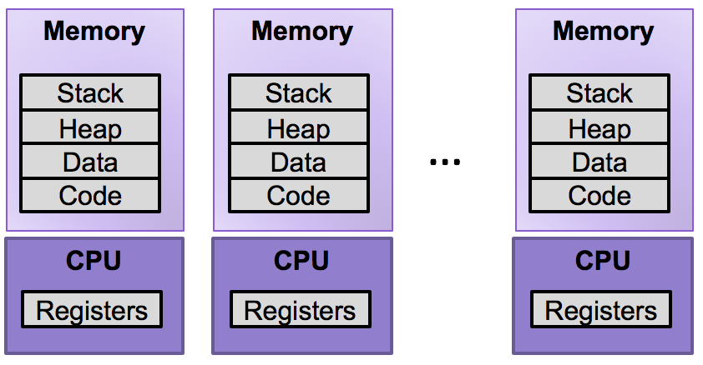
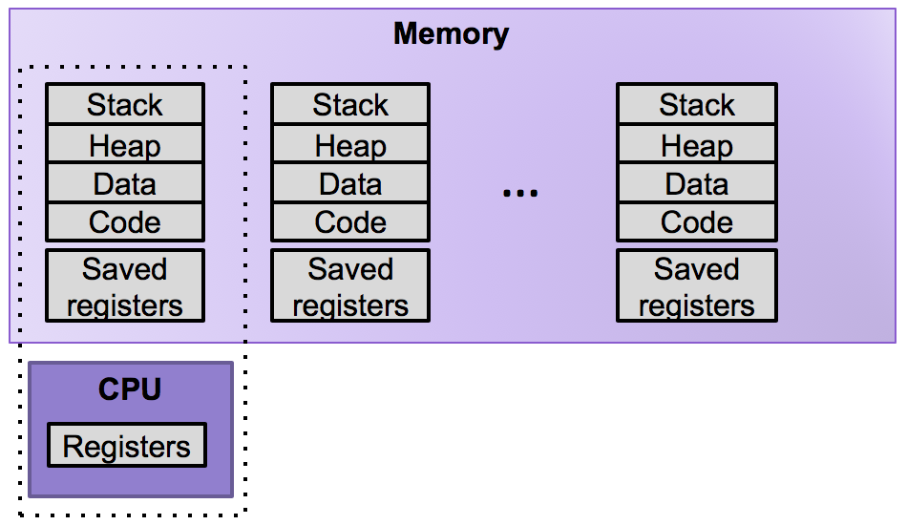
Review: Multiprocessing
The Illusion
The Reality
Abstraction: logical control flow within a process
Context switching b/n processes
User cannot predict how instructions will interleave

Slide 3
Real-world Examples
Restaurants handling orders
DMV handling customers
Students handling assignments
Hospitals handling patients

Slide 4
Possible Metrics
Latency: how much time between when a job is requested and when a job is completed
Response time: how much time between when a job is requested and when you start processing the job
Throughput: the rate at which jobs are completed

Slide 5
Simplifying Assumptions (for now)
Once you start a job, you complete that job before beginning the next job
The run-time of each job is known in advance
All jobs only use the CPU

Slide 6
First In, First Out (FIFO)
A
B
C
Time
0
20
40
60
80
100
120

Slide 7
Exercise 1: First In, First Out (FIFO)
A
B
C
Time
0
20
40
60
80
100
120

Slide 8
Shortest Job First (SJF)
A
C
B
Time
0
20
40
60
80
100
120

Slide 9
Exercise 2: Shortest Job First (SJF)
A
B
C
Time
0
20
40
60
80
100
120

Slide 10
Simplifying Assumptions (for now)
Once you start a job, you complete that job before beginning the next job
The run-time of each job is known in advance
All jobs only use the CPU

Slide 11
Shortest Time-to-Completion First (STCF)
A
B
B
C
A
Time
0
20
40
60
80
100
120
Notes:
Problems: responsiveness, fairness, starvation, assumption 4

Slide 12
Simplifying Assumptions (for now)
Once you start a job, you complete that job before beginning the next job
The run-time of each job is known in advance
All jobs only use the CPU

Slide 13
Round Robin (RR)
A
B
C
A
B
C
A
B
C
A
B
C
A
B
C
Time
0
20
40
60
80
100
120

Slide 14
Exercise 3: Round Robin (RR)
A
B
C
A
B
C
A
B
C
A
B
C
A
B
C
A
Time
0
20
40
60
80
100
120

Slide 15
Comparing Scheduling Algorithms
FIFO
works well if jobs are short
otherwise bad latency and bad response time
STCF
good latency
very uneven response time (bad fairness)
assumes run-time of each job is known in advance
RR
good response time
bad latency + overhead of context switching

Slide 16
Simplifying Assumptions (for now)
Once you start a job, you complete that job before beginning the next job
The run-time of each job is known in advance
All jobs only use the CPU

Slide 17
Processes are not all the same
CPU-bound processes use a lot of CPU
e.g., compiling, scientific computing applications, mp3 encoding
I/O-bound processes use CPU in short bursts
e.g., browsing small webpages, indexing a file system
Balanced processes are somewhere in between
e.g., playing videos, moving windows around
A
Time
0
20
40
60
80
100
120
A
A
A
A
A
A
A
Time
0
20
40
60
80
100
120

Slide 18
Comparing Scheduling Algorithms
FIFO
works well if jobs are short
otherwise bad latency and bad response time
STCF
good latency
very uneven response time (bad fairness)
assumes run-time of each job is known in advance
RR
good response time
bad latency + overhead of context switching
poor fairness for mixes of CPU-bound and I/O-bound

Slide 19
Multi-level Feedback Queues
Goal: optimize latency while minimizing response time for interactive jobs without knowing run-time of jobs in advance
General idea: maintain multiple queues, each with a different priority level
Scheduling rules:
If Priority(A) > Priority(B), run A
If Priority(A) = Priority(C), run A and C Round Robin
When a job enters the system, it is place in the highest priority queue
Once a job uses up its time allotment at current priority level, it moves down one queue
After some time period, move all jobs in the system to the highest priority queue
Q5
A
C
D
Q4
Higher Priority
Q3
B
Q2
Q1

Slide 20
Example: Multi-level Feedback Queue
Multilevel feedback queue with four levels with a time slice of 10 in the highest priority queue, 20 in the next, 40 in the next, and 80 in the lowest priority queue. Priorities reset every 200ms.
Example:
Job A arrives first at time 0 and uses the CPU for 50ms before finishing.
Job B arrives at time 1. Job B loops five times; for each iteration of the loop, B uses the CPU for 2ms and then does I/O for 8ms.
Job C arrives at time 2. Job C is identical to Job B except for arrival time.
A
B
C
A
B
C
A
B
C
A
B
C
A
B
C
A
Time
0
10
20
30
40
50
60
70

Slide 21
Schedulers in Operating Systems
CPU Scheduler selects next process to run from the runnable pool
Page Replacement Scheduler selects page to evict
Disk Scheduler selects next read/write operation to perform
Network Scheduler selects next packet to send/process

