Slide 1
Lecture 13: Optimization with Caches
CS 105 Spring 2026

Slide 2
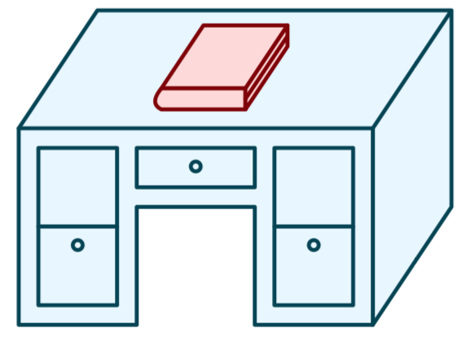
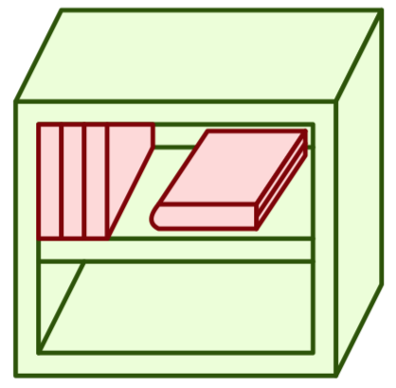

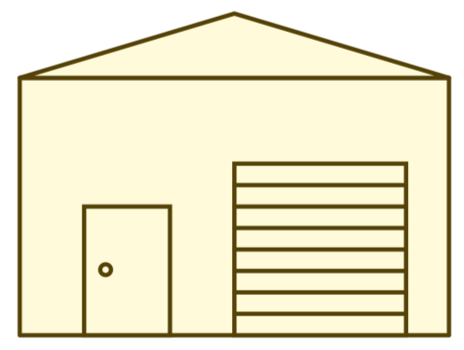
Review: Memory Hierarchy
L0:
Regs
CPU registers hold words retrieved from the L1 cache.
L1:
L1 cache
(SRAM)
L1 cache holds cache lines retrieved from the L2 cache.
Smaller,
faster,
and
costlier
(per byte)
storage
devices
L2:
L2 cache
(SRAM)
L2 cache holds cache lines
retrieved from L3 cache
L3:
L3 cache
(SRAM)
L3 cache holds cache lines
retrieved from main memory.
L4:
Main memory
(DRAM)
Main memory holds
disk blocks retrieved
from local disks.
Larger,
slower,
and
cheaper
(per byte)
storage
devices
Local secondary storage
(local disks)
Local disks hold files retrieved from disks
on remote servers
L5:
L6:
Remote secondary storage
(e.g., cloud, web servers)

Slide 3
Review: Principle of Locality
Programs tend to use data and instructions with addresses near or equal to those they have used recently
Temporal locality:
  Recently referenced items are likely
  to be referenced again in the near future
Spatial locality:
  Items with nearby addresses tend
  to be referenced close together in time

Slide 4
Review: An Example Cache
log(block size) bits
log(# sets) bits
the rest of the bits
E = 2: Two lines per set
Assume: cache block size 8 bytes
Address of data:
tag
index
offset
v
tag
0
1
2
3
4
5
6
7
v
tag
0
1
2
3
4
5
6
7
v
tag
0
1
2
3
4
5
6
7
v
tag
0
1
2
3
4
5
6
7
v
tag
0
1
2
3
4
5
6
7
v
tag
0
1
2
3
4
5
6
7
v
tag
0
1
2
3
4
5
6
7
v
tag
0
1
2
3
4
5
6
7

Slide 5
Typical Intel Core i7 Hierarchy
Processor package
Core 0
Core 3
L1 i-cache and d-cache:
  32 KB, 8-way,
  Access: 4 cycles
L2 unified cache:
  256 KB, 8-way,
  Access: 10 cycles
L3 unified cache:
  8 MB, 16-way,
  Access: 40-75 cycles
Block size: 64 bytes for all caches.
Regs
Regs
L1
d-cache
L1
i-cache
L1
d-cache
L1
i-cache
…
L2 unified cache
L2 unified cache
L3 unified cache
(shared by all cores)
Main memory

Slide 6
Cache Performance Metrics
Miss Rate
  Fraction of memory references not found in cache (misses / accesses)
  Typically 3-10% for L1
  can be quite small (e.g., < 1%) for L2, depending on size, etc.
Hit Time
  Time to deliver a line in the cache to the processor
    includes time to determine whether the line is in the cache
  Typically 4 clock cycles for L1, 10 clock cycles for L2
Miss Penalty
  Additional time required because of a miss
    typically 50-200 cycles for main memory (Trend: increasing!)

Slide 7
Memory Performance with Caching
Read throughput (aka read bandwidth): Number of bytes read from memory per second (MB/s)
Memory mountain: Measured read throughput as a function of spatial and temporal locality.
  Compact way to characterize memory system performance.

Slide 8
Memory Mountain Test Function
long data[MAXELEMS]; /* Global array to traverse */
/* test - Iterate over first "elems" elements of
* array “data” with stride of "stride", using
* using 4x4 loop unrolling.
*/
int test(int elems, int stride) {
long i, sx2=stride*2, sx3=stride*3, sx4=stride*4;
long acc0 = 0, acc1 = 0, acc2 = 0, acc3 = 0;
long length = elems, limit = length - sx4;
/* Combine 4 elements at a time */
for (i = 0; i < limit; i += sx4) {
acc0 = acc0 + data[i];
acc1 = acc1 + data[i+stride];
acc2 = acc2 + data[i+sx2];
acc3 = acc3 + data[i+sx3];
}
/* Finish any remaining elements */
for (; i < length; i++) {
acc0 = acc0 + data[i];
}
return ((acc0 + acc1) + (acc2 + acc3));
}
Call test() with many combinations of elems
and stride.
For each elems and stride:
1. Call test() once to warm up the caches.
2. Call test() again and measure the read throughput(MB/s)

Slide 9
The Memory Mountain
Core i7 Haswell
2.1 GHz
32 KB L1 d-cache
256 KB L2 cache
8 MB L3 cache
64 B block size
L1
Ridges
of temporal locality
L2
L3
Slopes
of spatial locality
Mem

Slide 10
Exercise 1: Locality
Which of the following functions is better in terms of locality with respect to array src?
void copyij(int src[2048][2048],
int dst[2048][2048])
{
int i,j;
for (i = 0; i < 2048; i++)
for (j = 0; j < 2048; j++)
dst[i][j] = src[i][j];
}
void copyji(int src[2048][2048],
int dst[2048][2048])
{
int i,j;
for (j = 0; j < 2048; j++)
for (i = 0; i < 2048; i++)
dst[i][j] = src[i][j];
}
4.3ms
81.8ms
2.0 GHz Intel Core i7 Haswell

Slide 11
Writing Cache-Friendly Code
Make the common case go fast
  Focus on the inner loops of the core functions
Minimize the misses in the inner loops
  Repeated references to variables are good (temporal locality)
  Stride-1 reference patterns are good (spatial locality)

Slide 12
Exercise: Miss Rate Analysis
int sum_array(int* array, int n){
int sum = 0;
for(int i = 0; i < n; i++){
sum += array[i];
}
return sum;
}
rd array[0]
rd array[1]
rd array[2]
rd array[3]
rd array[4]
…
rd array[8]
rd array[9]
…
rd array[12]
rd array[13]
rd array[14]
rd array[15]
rd 0x600090
rd 0x600094
rd 0x600098
rd 0x60009c
rd 0x6000a0
…
rd 0x6000b0
rd 0x6000b4
…
rd 0x6000c0
rd 0x6000c4
rd 0x6000c8
rd 0x6000cc
M
H
H
H
M
…
M
H
…
M
H
H
H
assume n, sum and i are stored in registers and only array is stored in memory, assume n=16
assume array = 0x600090
assume 256 byte direct-mapped cache w/ 16-byte cache lines
Exercise: what is the sequence of memory accesses made by this program?
1/4
Exercise: what is the hit rate of this program?

Slide 13
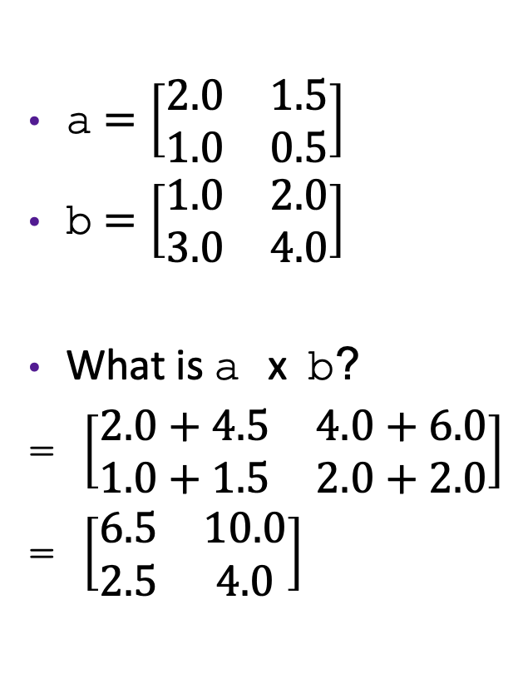
Review: Matrix Multiplication
a $=\left[\begin{matrix}2.0 & 1.5 \\ 1.0 & 0.5\end{matrix}\right]$
b $=\left[\begin{matrix}1.0 & 2.0 \\ 3.0 & 4.0\end{matrix}\right]$
What is a x b?
= $\left[\begin{matrix}2.0+4.5 & 4.0+6.0 \\ 1.0+1.5 & 2.0+2.0\end{matrix}\right]$
= $\left[\begin{matrix}6.5 & 10.0 \\ 2.5 & 4.0\end{matrix}\right]$
/* ijk */
for(int i=0; i<n; i++) {
for(int j=0; j<n; j++) {
sum = 0.0;
for(int k=0; k<n; k++){
sum += a[i][k] * b[k][j];
}
c[i][j] = sum;
}
}

Slide 14
Example: Matrix Multiplication
Multiply N x N matrices
Matrix elements are doubles (8 bytes)
O(N³) total operations
N reads per source element
N values summed per destination
/* ijk */
for(int i=0; i<n; i++) {
for(int j=0; j<n; j++) {
sum = 0.0;
for(int k=0; k<n; k++){
sum += a[i][k] * b[k][j];
}
c[i][j] = sum;
}
}

Slide 15
Miss Rate Analysis for Matrix Multiply
Assume:
  datablock size = 32 bytes (big enough for four doubles)
  Matrix dimension (N) is very large
    Approximate 1/N as 0.0
  Cache is not even big enough to hold multiple rows
Analysis Method:
  Look at access pattern of inner loop
j
=
k
x
j
i
i
k
C
A
B

Slide 16
Review: Layout of C Arrays in Memory
C arrays allocated in row-major order
  each row in contiguous memory locations
Stepping through columns in one row:
  accesses successive elements
  if data block size (B) > sizeof(a_{ij}) bytes, exploit spatial locality
    miss rate = sizeof(a_{ij}) / B
Stepping through rows in one column:
  accesses distant elements
  no spatial locality!
    miss rate = 1 (i.e. 100%)

Slide 17
Matrix Multiplication (ijk) (jik is similar)
/* ijk */
for (i=0; i<n; i++) {
for (j=0; j<n; j++) {
sum = 0.0;
for (k=0; k<n; k++)
sum += a[i][k] * b[k][j];
c[i][j] = sum;
}
}
Inner loop:
(*,j)
(i,j)
(i,*)
A
B
C
Row-wise
Column-
wise
Fixed
Average Misses per inner loop iteration:
  A B C Total
.25
1.0
0.0
1.25
2 reads, 0 writes
per inner loop iteration

Slide 18
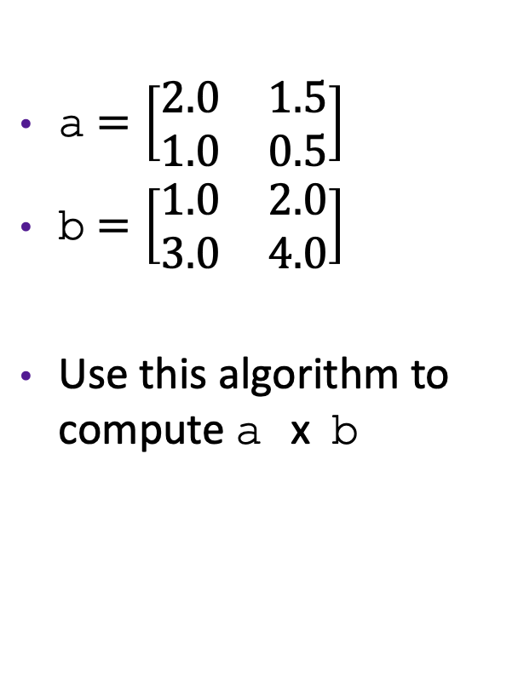
Exercise: Alternative Matrix Multiplication Algs
a $=\left[\begin{matrix}2.0 & 1.5 \\ 1.0 & 0.5\end{matrix}\right]$
b $=\left[\begin{matrix}1.0 & 2.0 \\ 3.0 & 4.0\end{matrix}\right]$
Use this algorithm to compute a x b
/* kij */
for (k=0; k<n; k++) {
for (i=0; i<n; i++) {
r = a[i][k];
for (j=0; j<n; j++)
c[i][j] += r * b[k][j];
}
}
/* jki */
for (j=0; j<n; j++) {
for (k=0; k<n; k++) {
r = b[k][j];
for (i=0; i<n; i++)
c[i][j] += a[i][k] * r;
}
}

Slide 19
Exercise: Matrix Multiplication
/* kij */
for (k=0; k<n; k++) {
for (i=0; i<n; i++) {
r = a[i][k];
for (j=0; j<n; j++)
c[i][j] += r * b[k][j];
}
}
/* jki */
for (j=0; j<n; j++) {
for (k=0; k<n; k++) {
r = b[k][j];
for (i=0; i<n; i++)
c[i][j] += a[i][k] * r;
}
}
2 reads, 1 write per inner loop iteration
Inner loop:
Inner loop:
(*,k)
(*,j)
(i,k)
(k,*)
(k,j)
(i,*)
A
B
C
A
B
C
Misses per inner loop iteration:
  A B C
  0.0 0.25 0.25
Misses per inner loop iteration:
  A B C
  1.0 0.0 1.0
2 reads, 1 write per inner loop iteration

Slide 20
Summary of Matrix Multiplication
for (i=0; i<n; i++) {
for (j=0; j<n; j++) {
sum = 0.0;
for (k=0; k<n; k++)
sum += a[i][k] * b[k][j];
c[i][j] = sum;
}
}
ijk (& jik):
  2 memory accesses (2 reads, 0 write)
  misses/iter = 1.25
  (5/4) * n3 total cache misses
for (k=0; k<n; k++) {
for (i=0; i<n; i++) {
r = a[i][k];
for (j=0; j<n; j++)
c[i][j] += r * b[k][j];
}
}
kij (& ikj):
  3 memory accesses (2 reads, 1 write)
  misses/iter = 0.5
  n3/2 total cache misses
for (j=0; j<n; j++) {
for (k=0; k<n; k++) {
r = b[k][j];
for (i=0; i<n; i++)
c[i][j] += a[i][k] * r;
}
}
jki (& kji):
  3 memory accesses (2 reads, 1 write)
  misses/iter = 2.0
  2 * n3 total cache misses

Slide 21
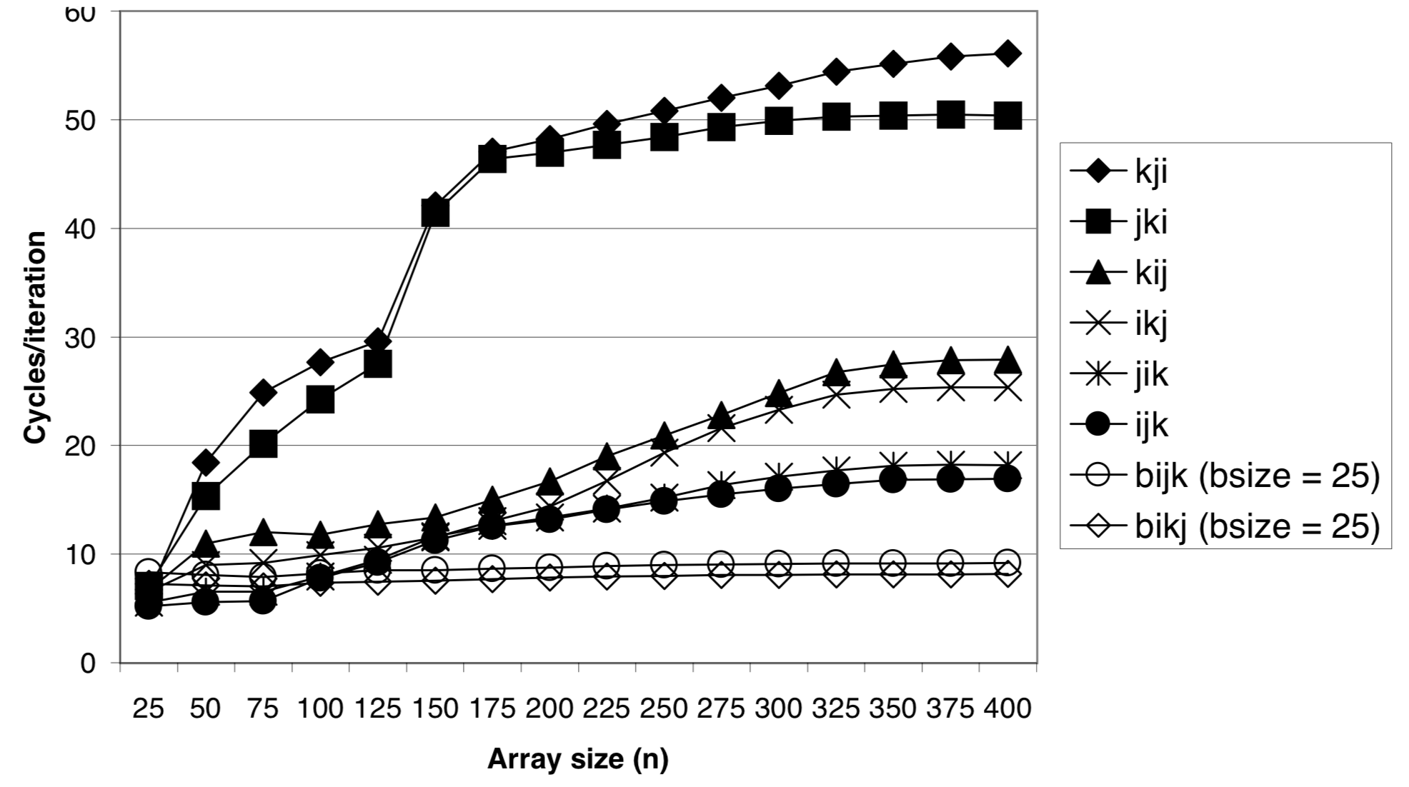
Matrix Multiply Performance
Core i7
Pentium III Xeon

Slide 22
Can we do better?
/* kij */
for (k=0; k<n; k++) {
for (i=0; i<n; i++) {
r = a[i][k];
for (j=0; j<n; j++)
c[i][j] += r * b[k][j];
}
}
Assume:
  Matrix elements are doubles
  Cache data block = 4 doubles
  Cache size C << n
k=0
k=1
c
a
b
c
a
b
i=0
+=
i=0
+=
*
*
c
a
b
c
a
b
+=
i=1
+=
*
i=1
*
…
c
a
b
c
a
b
+=
+=
*
i=n-1
*
i=n-1

Slide 23
Blocked Matrix Multiplication
c = (double *) calloc(sizeof(double), n*n);
/* Multiply n x n matrices a and b */
void mmm(double* a, double* b, double* c, int n) {
int i, j, k;
for (i = 0; i < n; i+=B)
for (j = 0; j < n; j+=B)
for (k = 0; k < n; k+=B)
/* B x B mini matrix multiplications */
for (i1 = i; i1 < i+B; i++)
for (j1 = j; j1 < j+B; j++)
for (k1 = k; k1 < k+B; k++)
c[i1*n+j1] += a[i1*n + k1]*b[k1*n + j1];
}
j1
c
a
b
+=
*
i1
Block size B x B

Slide 24
Cache Miss Analysis
Assume:
  Cache data block = 4 doubles
  Cache size C << n (much smaller than n)
  Three blocks fit into cache: 3B² < C
First (block) iteration:
  B² elements in each block, so B²/4 misses for each block
  n/B blocks in each row/col, so 2 * n/B * B²/4 = nB/2 misses in first iteration(omitting matrix c)
Total misses:
  nB/2 * (n/B)² = n³/(2B)
n/B blocks
=
*
Block size B x B

Slide 25
Blocking Summary
No blocking: n³ / 2
Blocking: n³ / (2B)
Suggest largest possible block size B, but limit 3B² < C!
Reason for dramatic difference:
  Matrix multiplication has inherent temporal locality:
    Input data: 3n², computation 2n³
    Every array elements used O(n) times!
  But program has to be written properly

Slide 26
A reality check
This analysis only holds on some machines!
Intel Core i7 does aggressive pre-fetching for one-stride programs, so blocking doesn't actually improve performance
But on a Pentium III Xeon:

Slide 27
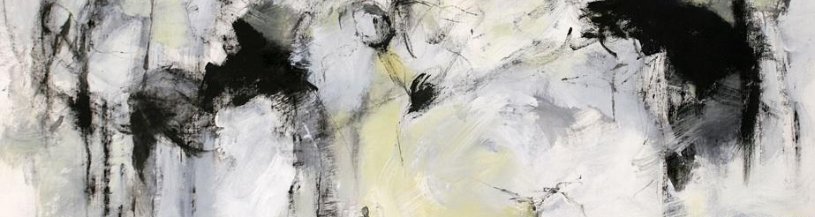
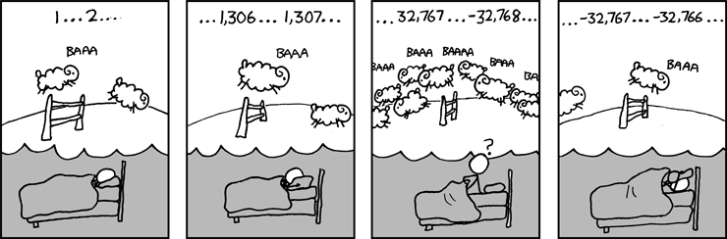

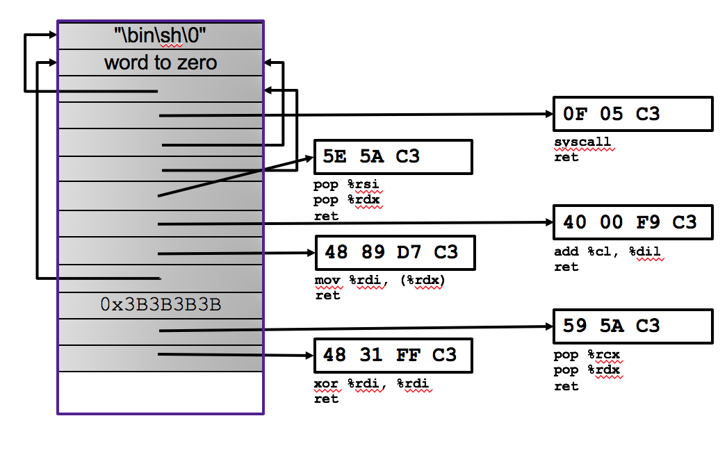


And that's the end of Part 1

