Slide 1
Lecture 16: Dynamic Memory (cont'd)
CS 105 Spring 2025

Slide 2
Review: DM Allocation Goals
Provide memory (in heap) to a running program (allocate)
Recycle memory when done (free)
High throughput: number of requests completed per time unit
Make allocator efficient
Example: if your allocator processes 5,000 malloc calls and 5,000 free calls in 10 seconds then throughput is 1,000 operations/second
High memory utilization: fraction of heap memory allocated
Minimize fragmentation

Slide 3
Challenges
Goal: maximize throughput and peak memory utilization
Implementation Challenges:
How do we know how much memory to free given just a pointer?
How do we keep track of the free blocks?
How do we pick a block to use for allocation?
What do we do with the extra space when allocating a structure that is smaller than the free block it is placed in?
How do we reinsert a freed block?

Slide 4
Summary of Key Allocator Policies
Free-block storage policy:
Implicit lists, with boundary tags (nice and simple)
Explicit lists, exclude free blocks (faster, but more overhead)
Segregated lists (different lists for different sized blocks)
Fancy data structures (red-black trees, for example)
Placement policy:
First-fit (simple, but lower throughput and higher fragmentation)
Next-fit (higher throughput, higher fragmentation)
Best-fit (lower throughput, lower fragmentation
segregated free lists approximate a best fit placement policy without having to search entire free list
Splitting policy:
When do we go ahead and split free blocks?
How much internal fragmentation are we willing to tolerate?

Slide 5
Challenges
Goal: maximize throughput and peak memory utilization
Implementation Challenges:
How do we know how much memory to free given just a pointer?
How do we keep track of the free blocks?
How do we pick a block to use for allocation?
What do we do with the extra space when allocating a structure that is smaller than the free block it is placed in?
How do we reinsert a freed block?

Slide 6
Implicit List: Freeing a Block
Simplest implementation:
Need only clear the “allocated” flag
void free_block(ptr p) { *p = *p & -2 }
But can lead to “false fragmentation”
16
17
17
8
9
free(p)
p
16
17
16
8
9
malloc(20)
Oops!
There is enough free space, but the allocator won’t be able to find it

Slide 7
Implicit List: Coalescing
Join (coalesce) with next/previous blocks, if they are free
Coalescing with next block
16
17
17
8
9
logically
gone
free(p)
p
16
17
24
8
9
But how do we coalesce with previous block?

Slide 8
Implicit List: Bidirectional Coalescing
Boundary tags [Knuth73]
Replicate size/allocated word at “bottom” (end) of free blocks
Allows us to traverse the “list” backwards, but requires extra space
Important and general technique!
16
16
17
17
24
24
17
17
Header
Size
a
a = 1: Allocated block
a = 0: Free block
Size: Total block size
Payload: Application data
(allocated blocks only)
Format of
allocated and
free blocks
Payload and
padding
Boundary tag
(footer)
Size
a

Slide 9
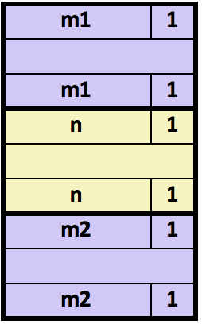
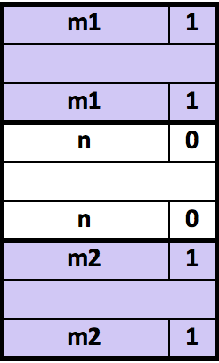
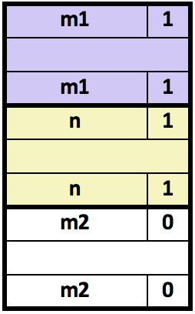
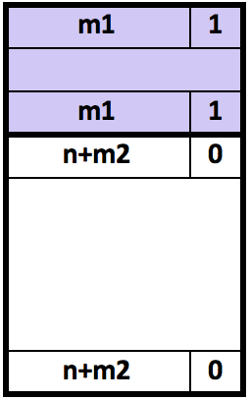
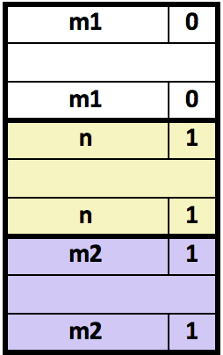
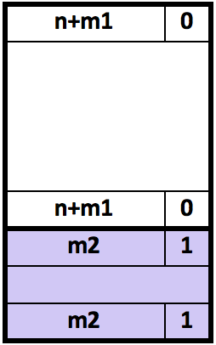
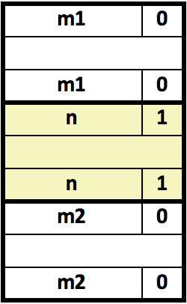
Constant-Time Coalescing
Case 1: Prev and next block allocated
Case 2: Prev block free, next block allocated
Case 2: Prev block allocated, next block free
Case 4: Prev and next block free

Slide 10
Exercise: Coalescing
Assume the current state of the heap is shown below. What would be the state of the heap after the function free(0x114) is executed?
0x00000018
0x0000000c
0x124
0x00000047
following block (free)
0x120
0x0000000c
0x11c
0x0000000d
0x118
0xdeadcafe
current block (allocated)
0x114
0x00000018
0x0000000d
0x110
0x00000011
0x10c
0x5ca1ab1e
0x108
previous block (allocated)
0x0000000d
0x104
0x00000011
0x100
0x0000000d
0x0fc

Slide 11
Summary of Key Allocator Policies
Storage policy:
what data structure will you use to keep track of the free blocks?
Placement policy:
First-fit, next-fit, best-fit, etc.
Trades off lower throughput for less fragmentation
segregated free lists approximate a best fit placement policy without having to search entire free list
Splitting policy:
When do we go ahead and split free blocks?
How much internal fragmentation are we willing to tolerate?
Coalescing policy:
Immediate coalescing: coalesce each time free is called
Deferred coalescing: try to improve performance of free by deferring coalescing until needed. Examples:
Coalesce as you scan the free list for malloc
Coalesce when the amount of external fragmentation reaches some threshold

Slide 12
Memory-Related Perils and Pitfalls
Dereferencing bad pointers
Reading uninitialized memory
Overreading memory
Overwriting memory
Referencing freed blocks
Freeing blocks multiple times
Failing to free blocks
(Correctness)
(Correctness)
(Security)
(Security)
(Security)
(Security)
(Performance)

Slide 13
Tools for Dealing With Memory Bugs
Debugger: gdb
Good for finding bad pointer dereferences
Hard to detect the other memory bugs
Heap consistency checker (e.g., mcheck)
Usually run silently, printing message only on error
Can be used to detect overreads, double-free
glibc malloc contains checking code
setenv MALLOC_CHECK_ 3
Binary translator: valgrind
Powerful debugging and analysis technique
Rewrites text section of executable object file
Checks each individual reference at runtime
Bad pointers, overwrites, refs outside of allocated block

Slide 14
But Memory Bugs Persist…
Notes:
Use-after-free in Firefox (used in wild):
https://www.theregister.co.uk/2020/04/06/mozilla_firefox_security_patches/
Use-after-free in Chrome:
https://www.theregister.co.uk/2020/02/25/google_chrome_security_bugs/
Use-after free and heap overflow in Chrome:
https://chromereleases.googleblog.com/2020/03/stable-channel-update-for-desktop_31.html
Use-after-free in Android:
https://www.theregister.co.uk/2019/10/04/android_alert_google/
Double-free in WhatsApp:
https://www.theregister.co.uk/2019/10/05/security_roundup_october_4/
https://awakened1712.github.io/hacking/hacking-whatsapp-gif-rce/
Memory Leak in Android for Pixel:
https://www.xda-developers.com/google-april-2020-android-security-bulletin-patches-pixel-4-3-3a-2-xl/
Memory Leak in Windows 10:
https://www.bleepingcomputer.com/news/microsoft/windows-10-1809-update-kb4520062-fixes-a-startup-black-screen-issue/

Slide 15
Implicit Allocators: Garbage Collection
Garbage collection: automatic reclamation of heap-allocated storage—application never has to free
Common in many dynamic languages:
Python, Java, Ruby, Perl, ML, Lisp, Mathematica
Variants (“conservative” garbage collectors) exist for C and C++
However, cannot necessarily collect all garbage
void foo() {
int *p = malloc(128);
return; /* p block is now garbage */
}

Slide 16
Garbage Collection
How does the memory manager know when memory can be freed?
In general we cannot know what is going to be used in the future since it depends on conditionals
But we can tell that certain blocks cannot be used if there are no pointers to them
Must make certain assumptions about pointers
Memory manager can distinguish pointers from non-pointers
All pointers point to the start of a block
Cannot hide pointers (e.g., by coercing them to an long, and then back again)

Slide 17
Memory as a Graph
We view memory as a directed graph
Each block is a node in the graph (called a heap node)
Extra root nodes correspond to locations not in the heap that contain pointers into the heap
registers, local stack variables, or global variables
Each pointer is an edge in the graph
Root nodes
Heap nodes

Slide 18
Memory as a Graph
A node n is reachable if there exists a directed path from some root node to n
Heap nodes that are not reachable are garbage
they can never again be used by the application
they should be freed ("garbage collected")
Root nodes
reachable
Heap nodes
Not-reachable (garbage)
Notes:
the role of a garbage collector is to (1) maintain some representation of the reachability graph and (2) periodically reclaim the unreachable notes by

Slide 19
Garbage Collection
The role of a garbage collector is
to maintain some representation of the reachability graph
to reclaim the unreachable nodes by freeing them
this can happen periodically or collector can run in parallel with application)
Languages that maintain tight control over how applications create and use pointers (e.g., Java, Python, OCaml) can maintain an exact representation of the graph
Garbage collectors for languages like C/C++ will be conservative

Slide 20
Exercise 2: Garbage Collection
Consider the following graph representation of memory. Which nodes correspond to blocks that should be freed by the garbage collector?
Root nodes
A
B
Heap nodes
C
D
E
F
G
H
I
J
K

Slide 21
Classical GC Algorithms
Mark-and-sweep collection (McCarthy, 1960)
Does not move blocks (unless you also “compact”)
Reference counting (Collins, 1960)
Does not move blocks
Copying collection (Minsky, 1963)
Moves blocks
Generational Collectors (Lieberman and Hewitt, 1983)
Collection based on lifetimes
Most allocations become garbage very soon
So focus reclamation work on zones of memory recently allocated

Slide 22
Mark and Sweep Collector
Each block header has an extra mark bit
can use one of the spare low-order bits
Two phase protocol
Mark: Start at roots and set mark bit on each reachable block
Sweep: Scan all blocks and free blocks that are not marked
root
Note: arrows here denote memory refs, not free list ptrs.
Before mark
After mark
Mark bit set
After sweep
free
free

Slide 23
Mark and Sweep Collector
Mark using depth-first traversal of the memory graph
ptr mark(ptr p) {
if (!is_ptr(p)) return; // do nothing if not pointer
if (markBitSet(p)) return; // check if already marked
setMarkBit(p); // set the mark bit
for (i=0; i < length(p); i++) // call mark on all words
mark(p[i]); // in the block
return;
}
Sweep using lengths to find next block
ptr sweep(ptr p, ptr end) {
while (p < end) {
if markBitSet(p) clearMarkBit();
else if (allocateBitSet(p))
free(p);
p += length(p);
}

Slide 24
Conservative Mark & Sweep in C
A “conservative garbage collector” for C programs
build on top of malloc/free package
allocate using malloc until you “run out of space”
is_ptr() determines if a word is a pointer by checking if it points to an allocated block of memory
But, in C pointers can point to the middle of a block
So how to find the beginning of the block?
Can use a balanced binary tree to keep track of all allocated blocks (key is start-of-block)
Balanced-tree pointers can be stored in header (use two additional words)
ptr
Header
Head
Data
Size
Left: smaller addresses
Right: larger addresses
Left
Right

