Slide 1
Lecture 12: Optimization
CS 105 Fall 2026

Slide 2
Review: Cache Performance Metrics
Miss Rate
  Fraction of memory references not found in cache (misses / accesses)
  Typically 3-10% for L1
  can be quite small (e.g., < 1%) for L2, depending on size, etc.
Hit Time
  Time to deliver a line in the cache to the processor
    includes time to determine whether the line is in the cache
  Typically 4 clock cycles for L1, 10 clock cycles for L2
Miss Penalty
  Additional time required because of a miss
    typically 50-200 cycles for main memory (Trend: increasing!)

Slide 3
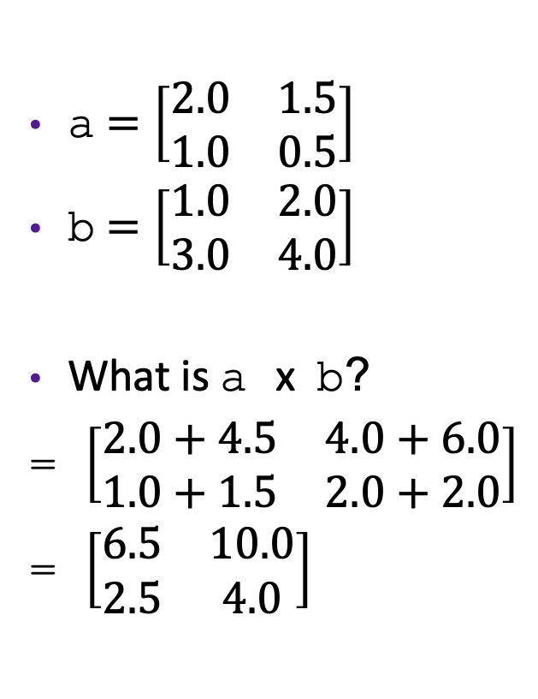
Review: Matrix Multiplication
a $=\left[\begin{matrix}2.0 & 1.5 \\ 1.0 & 0.5\end{matrix}\right]$
b $=\left[\begin{matrix}1.0 & 2.0 \\ 3.0 & 4.0\end{matrix}\right]$
What is a x b?
= $\left[\begin{matrix}2.0+4.5 & 4.0+6.0 \\ 1.0+1.5 & 2.0+2.0\end{matrix}\right]$
= $\left[\begin{matrix}6.5 & 10.0 \\ 2.5 & 4.0\end{matrix}\right]$
/* ijk */
for(int i=0; i<n; i++) {
for(int j=0; j<n; j++) {
sum = 0.0;
for(int k=0; k<n; k++){
sum += a[i][k] * b[k][j];
}
c[i][j] = sum;
}
}

Slide 4
Example: Matrix Multiplication
Multiply N x N matrices
Matrix elements are doubles (8 bytes)
O(N³) total operations
N reads per source element
N values summed per destination
/* ijk */
for(int i=0; i<n; i++) {
for(int j=0; j<n; j++) {
sum = 0.0;
for(int k=0; k<n; k++){
sum += a[i][k] * b[k][j];
}
c[i][j] = sum;
}
}

Slide 5
Miss Rate Analysis for Matrix Multiply
Assume:
  datablock size = 32 bytes (big enough for four doubles)
  Matrix dimension (N) is very large
    Approximate 1/N as 0.0
  Cache is not even big enough to hold multiple rows
Analysis Method:
  Look at access pattern of inner loop
j
=
k
x
j
i
i
k
C
A
B

Slide 6
Matrix Multiplication (ijk) (jik is similar)
/* ijk */
for (i=0; i<n; i++) {
for (j=0; j<n; j++) {
sum = 0.0;
for (k=0; k<n; k++)
sum += a[i][k] * b[k][j];
c[i][j] = sum;
}
}
Inner loop:
(*,j)
(i,j)
(i,*)
A
B
C
Row-wise
Column-
wise
Fixed
Average Misses per inner loop iteration:
  A B C Total
.25
1.0
0.0
1.25
2 reads, 0 writes
per inner loop iteration

Slide 7
Exercise: Matrix Multiplication
/* kij */
for (k=0; k<n; k++) {
for (i=0; i<n; i++) {
r = a[i][k];
for (j=0; j<n; j++)
c[i][j] += r * b[k][j];
}
}
/* jki */
for (j=0; j<n; j++) {
for (k=0; k<n; k++) {
r = b[k][j];
for (i=0; i<n; i++)
c[i][j] += a[i][k] * r;
}
}
2 reads, 1 write per inner loop iteration
Inner loop:
Inner loop:
(*,k)
(*,j)
(i,k)
(k,*)
(k,j)
(i,*)
A
B
C
A
B
C
Misses per inner loop iteration:
  A B C
  0.0 0.25 0.25
Misses per inner loop iteration:
  A B C
  1.0 0.0 1.0
2 reads, 1 write per inner loop iteration

Slide 8
Cache Miss Analysis
Assume:
  Cache data block = 4 doubles
  Cache size C << n (much smaller than n)
  Three blocks fit into cache: 3B² < C
First (block) iteration:
  B² elements in each block, so B²/4 misses for each block
  n/B blocks in each row/col, so 2 * n/B * B²/4 = nB/2 misses in first iteration(omitting matrix c)
Total misses:
  nB/2 * (n/B)² = n³/(2B)
n/B blocks
=
*
Block size B x B

Slide 9
Writing Cache-Friendly Code
Make the common case go fast
  Focus on the inner loops of the core functions
Minimize the misses in the inner loops
  Repeated references to variables are good (temporal locality)
  Stride-1 reference patterns are good (spatial locality)

Slide 10
Compiler Optimizations

Slide 11
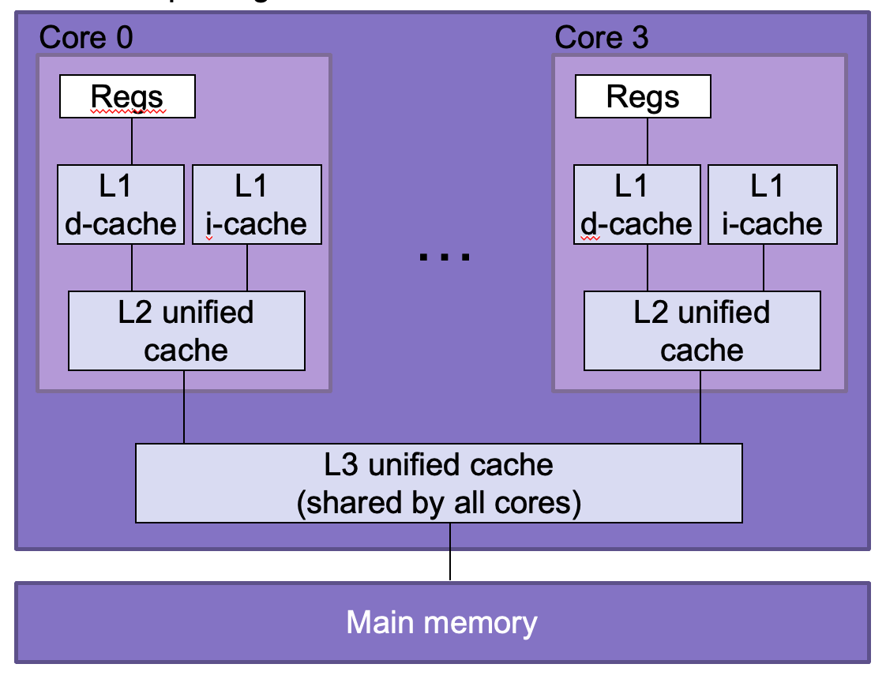
Under the Abstraction Barrier
#include<stdio.h>
int main(int argc,
char ** argv){
printf("Hello world!\n");
return 0;
}
pushq %rbp
movq %rsp, %rbp
subq $32, %rsp
leaq L_.str(%rip), %rax
movl $0, -4(%rbp)
movl %edi, -8(%rbp)
movq %rsi, -16(%rbp)
movq %rax, %rdi
movb $0, %al
callq _printf
xorl %ecx, %ecx
movl %eax, -20(%rbp)
movl %ecx, %eax
addq $32, %rsp
popq %rbp
retq
55
48 89 e5
48 83 ec 20
48 8d 05 25 00 00 00
c7 45 fc 00 00 00 00
89 7d f8
48 89 75 f0
48 89 c7
b0 00
e8 00 00 00 00
31 c9
89 45 ec
89 c8
48 83 c4 20
5d
c3

Slide 12
Techniques for Improving Performance
Use better algorithms/data structures
Compile to efficient byte code
Write code that compiles to efficient byte code
Parallelize your execution

Slide 13
Optimizing Compilers
Provide efficient mapping of program to machine code
  register allocation
  code selection and ordering (scheduling)
  eliminating minor inefficiencies
Compiler optimization flags
  -O0, -O1, -O2, -O3, -Os, -Og
Seldom improve asymptotic efficiency
  up to programmer to select best overall algorithm
  big-O savings are (often) more important than constant factors
    but constant factors also matter

Slide 14
Compiling with -O0
Produced assembly instructions most similarly resemble the source code
  Minimal compilation complexity
  Useful for debugging
Optimizations:
  Dead Code Elimination
int dead_code(int input){
if(47 > 0){
return input;
} else {
return -1 *input;
}
}
int dead_code(int input){
return input;
}
dead_code:
movl %edi, %eax
ret

Slide 15
Eliminating Dead Code (-O0)
int dead_code(int input){
if(47 > 0){
return input;
} else {
return -1 *input;
}
}
int dead_code(int input){
return input;
}
dead_code:
movl %edi, %eax
ret

Slide 16
Compiling with -O1
Produce assembly instructions with minimal optimization on top of source code
Optimizations:
  Code Motion: moving assembly instructions to reduce the frequency of redundant computations
void set_row(int* a, int* b,
int i, int n) {
for (int j = 0; j < n; j++) {
a[n*i+j] = b[j];
}
}
void set_row(int* a, int* b,
int i, int n) {
int ni = n*i;
for (int j = 0; j < n; j++){
a[ni+j] = b[j];
}
}

Slide 17
Code Motion (-O1)
Reduce frequency with which computation is performed
For example, move code out of a loop
void set_row(int* a, int* b,
int i, int n) {
for (int j = 0; j < n; j++) {
a[n*i+j] = b[j];
}
}
void set_row(int* a, int* b,
int i, int n) {
int ni = n*i;
for (int j = 0; j < n; j++){
a[ni+j] = b[j];
}
}
set_row:
testl %ecx, %ecx
jle .L1
imull %ecx, %edx
addl %edx, %ecx
.L3:
movl (%rsi), %r8d
movslq %edx, %rax
movl %r8d, (%rdi,%rax,4)
addl $1, %edx
addq $4, %rsi
cmpl %ecx, %edx
jne .L3
.L1:
rep ret

Slide 18
Compiling with -O1
Produce assembly instructions with minimal optimization on top of source code
Optimizations:
  Code Motion: moving assembly instructions to reduce the frequency of redundant computations
  Factoring out Subexpressions: produce intermediate helper variables to achieve similar computation
/* Sum neighbors of i,j */
up = val[(i-1)*n + j ];
down = val[(i+1)*n + j ];
left = val[i*n + j-1];
right = val[i*n + j+1];
sum = up + down + left + right;
long inj = i*n + j;
up = val[inj - n];
down = val[inj + n];
left = val[inj - 1];
right = val[inj + 1];
sum = up + down + left + right;
3 multiplications
1 multiplication

Slide 19
Factoring out Subexpressions (-O1)
Share common subexpressions
  Gcc will do this with –O1
/* Sum neighbors of i,j */
up = val[(i-1)*n + j ];
down = val[(i+1)*n + j ];
left = val[i*n + j-1];
right = val[i*n + j+1];
sum = up + down + left + right;
long inj = i*n + j;
up = val[inj - n];
down = val[inj + n];
left = val[inj - 1];
right = val[inj + 1];
sum = up + down + left + right;
3 multiplications
1 multiplication
imulq %rcx, %rsi
addq %rdx, %rsi
movq %rsi, %rax
subq %rcx, %rax
leaq (%rsi,%rcx), %rcx
# i*n
# i*n+j
# i*n+j-n
# i*n+j+n

Slide 20
Compiling with -O1
Produce assembly instructions with minimal optimization on top of source code
Optimizations:
  Code Motion: moving assembly instructions to reduce the frequency of redundant computations
  Factoring out Subexpressions: produce intermediate helper variables to achieve similar computation
  Loop Elimination: compute equivalent functionality without a loop
int loop_while(int a){
int b = 4;
int i = 0;
int result = 0;
while (i < 16) {
result += a;
a -= b;
i += b;
}
return result;
}
int loop_while(int a){
return 4*a-24;
}

Slide 21
Loop Elimination (-O1)
int loop_while(int a){
int b = 4;
int i = 0;
int result = 0;
while (i < 16) {
result += a;
a -= b;
i += b;
}
return result;
}
int loop_while(int a){
return 4*a-24;
}
loop_while:
leal -24(,%rdi,4), %eax
ret

Slide 22
Compiling with -O1
Produce assembly instructions with minimal optimization on top of source code
Optimizations:
  Code Motion: moving assembly instructions to reduce the frequency of redundant computations
  Factoring out Subexpressions: produce intermediate helper variables to achieve similar computation
  Loop Elimination: compute equivalent functionality without a loop
Takeaway: the compiler can transform the C source into functionally equivalent assembly code

Slide 23
Compiling with -O2
Optimize even more! Produce a much faster version of the program in assembly as compared to the original C source
Optimizations:
  All of the optimizations described in -O1
  Reduction in Strength: replace costly assembly instructions with simpler ones
void set_matrix(long* a, long* b,
long n){
for (long i = 0; i < n; i++) {
long ni = n*i;
for (long j = 0; j < n; j++){
a[ni + j] = b[j];
}
}
}
void set_matrix(long* a, long* b,
long n){
long ni = 0;
for (long i = 0; i < n; i++) {
for (long j = 0; j < n; j++){
a[ni + j] = b[j];
}
ni += n;
}
}

Slide 24
Reduction in Strength (-O2)
Replace costly operation with simpler one
For example, replace multiplication with shift or addition
void set_matrix(long* a, long* b,
long n){
for (long i = 0; i < n; i++) {
long ni = n*i;
for (long j = 0; j < n; j++){
a[ni + j] = b[j];
}
}
}
void set_matrix(long* a, long* b,
long n){
long ni = 0;
for (long i = 0; i < n; i++) {
for (long j = 0; j < n; j++){
a[ni + j] = b[j];
}
ni += n;
}
}
set_matrix:
xorl %r8d, %r8d
testq %rdx, %rdx
leaq 0(,%rdx,8), %r9
jle .L1
.L6: xorl %eax, %eax
.L3: movq (%rsi,%rax,8), %rcx
movq %rcx, (%rdi,%rax,8)
addq $1, %rax
cmpq %rax, %rdx
jne .L3
addq $1, %r8
addq %r9, %rdi
cmpq %r8, %rdx
jne .L6
.L1: rep ret

Slide 25
Machine Independent Optimization
Compilers optimize assembly code
  Dead code elimination
  Code motion
  Factoring out common subexpressions
  Loop elimination
  Reduction in Strength

Slide 26
Case Study: Vector Data Type
/* data structure for vectors */
typedef struct {
long len;
data_t* data;
} vec;
data_t will vary by example
  int
  double
/* get length of vector */
long vec_length(vec* v) {
return v->len;
}
/* get address of vector element */
data_t* get_vec_elem(vec* v, long idx) {
if (idx >= v->len){
return NULL;
}
return &(v->data[idx]);
}

Slide 27
Benchmark Computation
void combine1(vec* v, data_t* dest){
*dest = IDENT;
for(long i = 0; i < vec_length(v); i++) {
data_t* val = get_vec_elem(v, i);
*dest = *dest OP *val;
}
}
Sum or product of vector elements
IDENT/OP may be 0/+ or 1/*
Metric: CPE, cycles per element
Time = CPE * n + Overhead

Slide 28
Benchmark Performance
void combine1(vec* v, data_t* dest){
*dest = IDENT;
for(long i = 0; i < vec_length(v); i++) {
data_t* val = get_vec_elem(v, i);
*dest = *dest OP *val;
}
}
Method | Integer |  | Double FP
Operation | Add | Mult | Add | Mult
Combine1 –O0 | 22.68 | 20.02 | 19.98 | 20.18
Combine1 –O1 | 10.12 | 10.12 | 10.17 | 11.14
Question: how could you optimize this code to get even better performance?

Slide 29
Limitations of Optimizing Compilers
Must not cause any change in program behavior
  Often prevents optimizations that would only affect behavior under pathological conditions.
    Data ranges may be more limited than variable type suggests
    Compiler cannot know run-time inputs
  When in doubt, the compiler must be conservative

Slide 30
Limitations of Optimizing Compilers
void mystery1(int* xp,
int* yp){
*xp = *xp + *yp;
*yp = *xp - *yp;
*xp = *xp – *yp;
}
void mystery2(int* xp,
int* yp){
int temp = *xp;
*xp = *yp;
*yp = temp;
}
?
Exercise: What do each of these programs do? Do they do the same thing?
Notes:
Exercise: Figure out what these functions do and whether they do the same thing
Potential problem: xp and yp might be different aliases for the same value
i.e., xp == yp

Slide 31
Comparing Programs
void mystery1(int* xp,
int* yp){
*xp = *xp + *yp;
*yp = *xp - *yp;
*xp = *xp – *yp;
}
void mystery2(int* xp,
int* yp){
int temp = *xp;
*xp = *yp;
*yp = temp;
}
temp
13
47
47
60
13
13
xp
xp
47
47
13
13
yp
yp

Slide 32
Comparing Programs
void mystery1(int* xp,
int* yp){
*xp = *xp + *yp;
*yp = *xp - *yp;
*xp = *xp – *yp;
}
void mystery2(int* xp,
int* yp){
int temp = *xp;
*xp = *yp;
*yp = temp;
}
temp
13
26
0
13
13
13
xp, yp
xp, yp

Slide 33
Optimization Blocker 1
Aliasing: Two different references to a single location
  Easy to happen in C
Develop habit of introducing local variables
  To accumulate within loops, for example
  Your way of telling the compiler not to check for aliasing

Slide 34
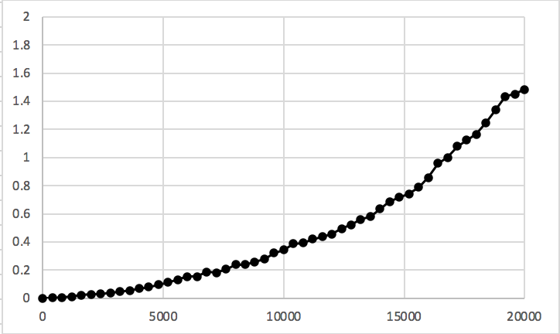
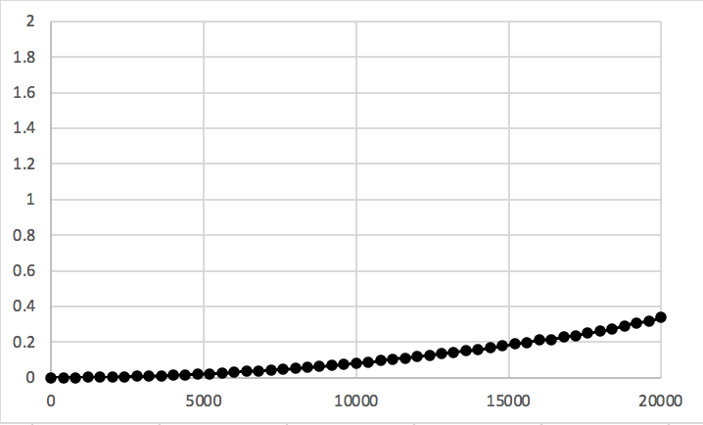
Example: Summing Matrix Rows
/* Sum rows of nxn matrix a, store
in vector sums */
void sum_rows1(int* a, int* sums,
int n) {
for (int i = 0; i < n; i++) {
sums[i] = 0;
for (long j = 0; j < n; j++){
sums[i] += a[i*n + j];
}
}
}
/* Sum rows of nxn matrix a, store
in vector sums */
void sum_rows2(int* a, int* sums,
int n) {
for (int i = 0; i < n; i++) {
int val = 0;
for (long j = 0; j < n; j++){
val += a[i*n + j];
}
sums[i] = val;
}
}
# sum_rows1 inner loop
.L4:
movl (%rax), %edx
addl %edx, (%rsi,%r10,4)
addq $4, %rax
decq %rcx
jne .L3
# sum_rows2 inner loop
.L10:
addl (%rdx), %eax
addq $4, %rdx
decq %rcx
jne .L3

Slide 35
Limitations of Optimizing Compilers
Must not cause any change in program behavior
  Often prevents optimizations that would only affect behavior under pathological conditions.
    Data ranges may be more limited than variable type suggests
    Compiler cannot know run-time inputs
  When in doubt, the compiler must be conservative
Most analysis is performed only within procedures
  Whole-program analysis is too expensive in most cases
  Newer versions of gcc do inter-procedural analysis within files

Slide 36
Exercise 2: Procedure Calls
Consider the following two functions. What do each of these programs do? Do they do the same thing?
long f1();
long f2(){
return f1() + f1();
}
?
long f1();
long f2(){
return 2*f1();
}
Notes:
problem: f1 might have side-effects
update global variables
write to file/network
UI feature

Slide 37
Optimization Blocker 2
Compiler treats procedure calls as black boxes
  Unknown side-effects
  strlen may not always return the same value
Alternatives:
  Do your own code motion (necessary here)
  Use inline keyword when declaring functions
    gcc will optimize within a single file with –O1

Slide 38
Example: Lowering Case
void lower(char* s){
int i;
for (i = 0; i < strlen(s); i++){
if (s[i] >= 'A' && s[i] <= 'Z'){
s[i] -= ('A' - 'a');
}
}
}
void lower(char* s){
int i;
int len = strlen(s);
for (i = 0; i < len; i++){
if (s[i] >= 'A' && s[i] <= 'Z'){
s[i] -= ('A' - 'a');
}
}
}

Slide 39
Machine Independent Optimization
Compilers optimize assembly code
  Dead code elimination
  Code motion
  Factoring out common subexpressions
  Loop elimination
  Reduction in Strength
Optimization blockers:
  Aliasing
    Use local variables
  Procedure calls
    Move them yourself

Slide 40
Exercise: Code-Level Optimizations
void combine1(vec* v, data_t* dest){
*dest = IDENT;
for(long i = 0; i < vec_length(v); i++) {
data_t* val = get_vec_elem(v, i);
*dest = *dest OP *val;
}
}
Method | Integer |  | Double FP
Operation | Add | Mult | Add | Mult
Combine1 –O0 | 22.68 | 20.02 | 19.98 | 20.18
Combine1 –O1 | 10.12 | 10.12 | 10.17 | 11.14
Exercise: how could you optimize this code to get even better performance?

Slide 41
Exercise: Code-Level Optimizations
void combine2(vec* v, data_t*
dest){
data_t x = IDENT;
long length = vec_length(v);
for(long i=0; i<length; i++){
data_t* val=get_vec_elem(v,i);
x = x OP val;
}
*dest = x;
}
void combine1(vec* v, data_t*
dest){
*dest = IDENT;
for(long i=0;i<vec_length(v);
i++){
data_t* val=get_vec_elem(v,i);
*dest = *dest OP *val;
}
}
void combine2(vec* v, data_t*
dest){
data_t x = IDENT;
long length = vec_length(v);
data_t *d=get_vec_elem(v,0);
for(long i=0; i<length; i++){
x = x OP d[i];
}
*dest = x;
}
void combine2(vec* v, data_t*
dest){
data_t x = IDENT;
for(long i=0; i<vec_length(v);
i++){
data_t* val=get_vec_elem(v,i);
x = x OP *val;
}
*dest = x;
}
Accumulate in temporary variable
Move vec_length out of loop
Avoid extra bounds check on each cycle

Slide 42
Code-Level Optimizations
void combine2(vec* v, data_t* dest){
data_t x = IDENT;
long length = vec_length(v);
data_t* d = get_vec_element(v,0);
for(long i = 0; i < length; i++){
x = x OP d[i];
}
*dest = x;
}
Method | Integer |  | Double FP
Operation | Add | Mult | Add | Mult
Combine1 –O0 | 22.68 | 20.02 | 19.98 | 20.18
Combine1 –O1 | 10.12 | 10.12 | 10.17 | 11.14
Combine2 | 1.27 | 3.01 | 3.01 | 5.01

Slide 43
Loop Unrolling
int psum1(int a[],int sums[],int n){
int i;
sums[0] = a[0];
for(i = 1; i < n; i++){
sums[i] = sums[i-1] + a[i];
}
}
int psum2(int a[],int sums[],int n){
int i;
sums[0] = a[0];
for(i = 1; i < n-1; i+=2){
sums[i] = sums[i-1] + a[i];
sums[i+1] = sums[i] + a[i+1];
}
if (i < n){ // handle odd #iterations
sums[i] = sum[i-1] + a[i];
}
}
Notes:
Note: it would be better to store sums[i-1]+a[i] in a local variable to reduce memory accesses
Note: unroll and jam at O3, general unroll-loops not

Slide 44
Combine with Unrolling
void unroll2_combine(vec* v, data_t* dest){
long length = vec_length(v);
long limit = length-1;
data_t* d = get_vec_element(v,0);
data_t x = IDENT;
/* Combine 2 elements at a time */
for(long i = 0; i < limit; i+=2) {
x = (x OP d[i]) OP d[i+1];
}
/* Finish any remaining elements */
for (; i < length; i++) {
x = x OP d[i];
}
*dest = x;
}
Method | Integer |  | Double FP
Operation | Add | Mult | Add | Mult
Combine1 –O0 | 22.68 | 20.02 | 19.98 | 20.18
Combine1 –O1 | 10.12 | 10.12 | 10.17 | 11.14
Combine2 | 1.27 | 3.01 | 3.01 | 5.01
Unroll 2 | 1.01 | 3.01 | 3.01 | 5.01
Latency Bound | 1.00 | 3.00 | 3.00 | 5.00

Slide 45
Reassociation
x = (x OP d[i]) OP d[i+1];
x = x OP (d[i] OP d[i+1]);
1
d₀
d₀
d₁
*
d₁
*
d₂
d₃
1
*
d₂
*
d₄
d₅
*
*
d₃
*
d₆
d₇
*
*
d₄
*
*
*
d₅
*
*
d₆
*
d₇
*
Notes:
What changed: Ops in the next iteration can be started early (no dependency)

Slide 46
Effect of Reassociation
Method | Integer |  | Double FP
Operation | Add | Mult | Add | Mult
Combine1 –O0 | 22.68 | 20.02 | 19.98 | 20.18
Combine1 –O1 | 10.12 | 10.12 | 10.17 | 11.14
Combine2 | 1.27 | 3.01 | 3.01 | 5.01
Unroll 2 | 1.01 | 3.01 | 3.01 | 5.01
Unroll 2a | 1.01 | 1.51 | 1.51 | 2.51
Latency Bound | 1.00 | 3.00 | 3.00 | 5.00
Throughput Bound | 0.50 | 1.00 | 1.00 | 0.50
Nearly 2x speedup for Int *, FP +, FP *
  Reason: Breaks sequential dependency
2 func. units for FP *
2 func. units for load
x = x OP (d[i] OP d[i+1]);
pipelined processor
4 func. units for int +
2 func. units for load

Slide 47
Separate Accumulators
void unroll2a_combine(vec_ptr v,
data_t* dest)
{
long length = vec_length(v);
long limit = length-1;
data_t* d = get_vec_element(v,0);
data_t x0 = IDENT;
data_t x1 = IDENT;
long i;
/* Combine 2 elements at a time */
for (i = 0; i < limit; i+=2) {
x0 = x0 OP d[i];
x1 = x1 OP d[i+1];
}
/* Finish any remaining elements */
for (; i < length; i++) {
x0 = x0 OP d[i];
}
*dest = x0 OP x1;
}
1
d₀
1
d₁
*
d₂
*
d₃
*
d₄
*
d₅
*
d₆
*
d₇
*
*
*
Two independent streams of operation

Slide 48
Effect of Separate Accumulators
Method | Integer |  | Double FP
Operation | Add | Mult | Add | Mult
Combine1 –O0 | 22.68 | 20.02 | 19.98 | 20.18
Combine1 –O1 | 10.12 | 10.12 | 10.17 | 11.14
Combine2 | 1.27 | 3.01 | 3.01 | 5.01
Unroll 2 | 1.01 | 3.01 | 3.01 | 5.01
Unroll 2a | 1.01 | 1.51 | 1.51 | 2.51
Unroll 2x2 | 0.81 | 1.51 | 1.51 | 2.51
Latency Bound | 1.00 | 3.00 | 3.00 | 5.00
Throughput Bound | 0.50 | 1.00 | 1.00 | 0.50
x0 = x0 OP d[i];
x1 = x1 OP d[i+1];
Int + makes use of two load units
for Int *, FP +, FP *, speedup similar to unroll with reassociation

Slide 49
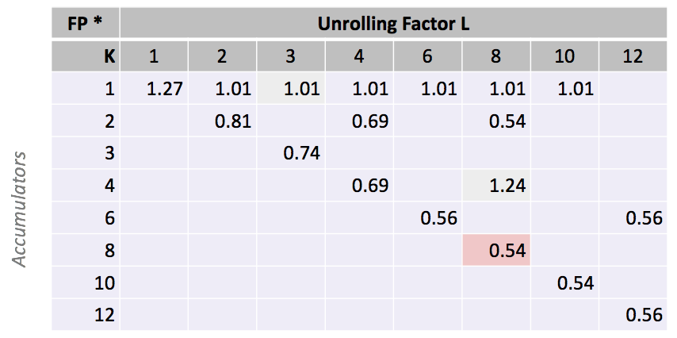
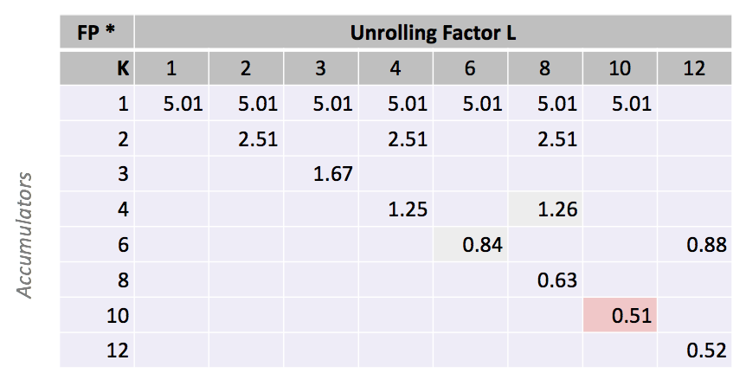
Machine-Dependent Optimization
  Integer Addition
Float Multiplication

Slide 50
Machine-Dependent Optimization
Method | Integer |  | Double FP
Operation | Add | Mult | Add | Mult
Combine1 –O0 | 22.68 | 20.02 | 19.98 | 20.18
Combine1 –O1 | 10.12 | 10.12 | 10.17 | 11.14
Combine2 | 1.27 | 3.01 | 3.01 | 5.01
Unroll 2 | 1.01 | 3.01 | 3.01 | 5.01
Unroll 2a | 1.01 | 1.51 | 1.51 | 2.51
Unroll 2x2 | 0.81 | 1.51 | 1.51 | 2.51
Optimal Unrolling | 0.54 | 1.01 | 1.01 | 0.51
Latency Bound | 1.00 | 3.00 | 3.00 | 5.00
Throughput Bound | 0.50 | 1.00 | 1.00 | 0.50
Method | Integer |  | Double FP
Operation | Add | Mult | Add | Mult
Best | 0.54 | 1.01 | 1.01 | 0.52
Latency Bound | 1.00 | 3.00 | 3.00 | 5.00
Throughput Bound | 0.50 | 1.00 | 1.00 | 0.50
Limited only by throughput of hardware
Up to 42X improvement over original, unoptimized code

