Slide 1
Lecture 11: Caches (cont'd)
CS 105 Spring 2025

Slide 2
Review: Direct-mapped Cache
log(block size) bits
log(# lines) bits
the rest of the bits
valid bit
tag
data block
Address of data:
tag
index
offset
find line
0
v
tag
0
1
2
3
4
5
6
7
identifies byte in line
1
v
tag
0
1
2
3
4
5
6
7
Checking the cache (i.e., "bookshelf"):
index tells you which line to check
Is that line valid?
If no, cache miss
Does the tag match?
If no, cache miss
If valid and tag matches, cache hit!
Read from datablock at offset
2
v
tag
0
1
2
3
4
5
6
7
n-1
v
tag
0
1
2
3
4
5
6
7
Notes:
Note: low-order bits are always zero if we assume 4-byte words (since we'll always be looking up the address of a word), but we'll just think about those bits as part of the offset

Slide 3
Review: Handling Cache Miss
Address of data:
0x74
0111 0100
011
10
100
When a cache miss occurs update cache line at that index:
Replace data block with bytes from memory
Copies all bytes with same tag + index
Update tag
Set valid bit to 1 (if not already)
3 bit tag
2 bit index
3 bit offset
0x79
0x78
0x77
0x76
0x75
0x74
23
B7
64
15
Line 0
1
110
0F
12
AB
34
FF
FF
EA
68
E0
AB
0x73
0x72
0x71
0x70
0x6F
0x6E
Line 1
1
001
00
00
00
00
00
40
06
1D
1A
47
Line 2
33
1
101
0D
00
00
00
2F
00
00
00
1
011
2F
33
47
1A
AB
E0
15
64
2F
0A
Line 3
0
001
00
11
22
33
44
55
66
77
00

Slide 4
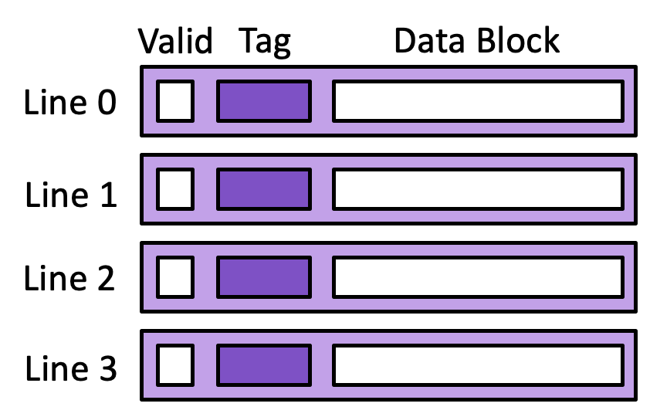
Review: Direct-mapped Cache Example
Memory
Cache
0x60
0x64
0x68
0x6c
0x70
0x74
0x78
0x7c
0x80
0x84
13
14
15
16
17
18
19
20
21
22
Assume 8 byte data blocks (fit 2 ints)
Line 0 |  |  | Line 1 |  |  | Line 2 |  |  | Line 3
0 | 0 | 47 48 | 0 | 8 | 49 50 | 0 | a | 51 52 | 0 | 1 | 53 54
Access | tag | idx | off | h/m | val
rd 0x60
rd 0x64
rd 0x80
rd 0x64
rd 0x64
rd 0x60
rd 0x80
011=0x3
00
000
Miss
13
1
3
13 14
0
8
49 50
0
a
51 52
0
1
53 54
011=0x3
00
100
Hit
14
1
3
13 14
0
8
49 50
0
a
51 52
0
1
53 54
100=0x4
00
000
Miss
21
1
4
21 22
0
8
49 50
0
a
51 52
0
1
53 54
011=0x3
00
100
Miss
14
Time
1
3
13 14
0
8
49 50
0
a
51 52
0
1
53 54
011=0x3
00
100
Hit
14
1
3
13 14
0
8
49 50
0
a
51 52
0
1
53 54
011=0x3
00
000
Hit
13
1
3
13 14
0
8
49 50
0
a
51 52
0
1
53 54
100=0x4
00
000
Miss
21
1
4
21 22
0
8
49 50
0
a
51 52
0
1
53 54
How well does this take advantage of spatial locality?
How well does this take advantage of temporal locality?
Notes:
Same setup, except now assume 8 byte data blocks, 2 cache lines

Slide 5
2-way Set Associative Cache
log(block size) bits
log(# sets) bits
the rest of the bits
E = 2: Two lines per set
Assume: cache block size 8 bytes
Address of data:
tag
index
offset
Set 0
v
tag
0
1
2
3
4
5
6
7
v
tag
0
1
2
3
4
5
6
7
Set 1
v
tag
0
1
2
3
4
5
6
7
v
tag
0
1
2
3
4
5
6
7
Set 2
v
tag
0
1
2
3
4
5
6
7
v
tag
0
1
2
3
4
5
6
7
Set n-1
v
tag
0
1
2
3
4
5
6
7
v
tag
0
1
2
3
4
5
6
7

Slide 6
Review: Direct-mapped Cache Example
Memory
Cache
0x60
0x64
0x68
0x6c
0x70
0x74
0x78
0x7c
0x80
0x84
13
14
15
16
17
18
19
20
21
22
Assume 8 byte data blocks (fit 2 ints)
Line 0 |  |  | Line 1 |  |  | Line 2 |  |  | Line 3
0 | 0 | 47 48 | 0 | 8 | 49 50 | 0 | a | 51 52 | 0 | 1 | 53 54
Access | tag | idx | off | h/m | val
rd 0x60
rd 0x64
rd 0x80
rd 0x64
rd 0x64
rd 0x60
rd 0x80
011=0x3
00
000
Miss
13
1
3
13 14
0
8
49 50
0
a
51 52
0
1
53 54
011=0x3
00
100
Hit
14
1
3
13 14
0
8
49 50
0
a
51 52
0
1
53 54
100=0x4
00
000
Miss
21
1
4
21 22
0
8
49 50
0
a
51 52
0
1
53 54
011=0x3
00
100
Miss
14
Time
1
3
13 14
0
8
49 50
0
a
51 52
0
1
53 54
011=0x3
00
100
Hit
14
1
3
13 14
0
8
49 50
0
a
51 52
0
1
53 54
011=0x3
00
000
Hit
13
1
3
13 14
0
8
49 50
0
a
51 52
0
1
53 54
100=0x4
00
000
Miss
21
1
4
21 22
0
8
49 50
0
a
51 52
0
1
53 54
How well does this take advantage of spatial locality?
How well does this take advantage of temporal locality?
Notes:
Same setup, except now assume 8 byte data blocks, 2 cache lines

Slide 7
Exercise: 2-way Set Associative Cache
Memory
Cache
0x60
0x64
0x68
0x6c
0x70
0x74
0x78
0x7c
0x80
0x84
Set 0
13
14
15
16
17
18
19
20
21
22
Set 1
Assume 8 byte data blocks (fit 2 ints)
Set 0 | Set 1
Line 0 |  |  | Line 1 |  |  | Line 0 |  |  | Line 1
0 | 0 | 47 48 | 0 | 1 | 47 48 | 0 | 0 | 47 48 | 0 | 1 | 47 48
Line 0 |  |  | Line 1 |  |  | Line 0 |  |  | Line 1
0 | 0 | 47 48 | 0 | 1 | 47 48 | 0 | 0 | 47 48 | 0 | 1 | 47 48
Access | tag | idx | off | h/m | val
rd 0x60
rd 0x64
rd 0x80
rd 0x64
rd 0x64
rd 0x60
rd 0x80
Access | tag | idx | off | h/m | val
rd 0x60
rd 0x64
rd 0x80
rd 0x64
rd 0x64
rd 0x60
rd 0x80
0110=0x6
0
000
Miss
13
1
6
13 14
0
1
47 48
0
0
47 48
0
1
47 48
0110=0x6
0
100
Hit
14
1
6
13 14
0
1
47 48
0
0
47 48
0
1
47 48
1000=0x8
0
000
Miss
21
1
6
13 14
1
8
21 22
0
0
47 48
0
1
47 48
Hit
Time
0110=0x6
0
100
14
Hit
1
6
13 14
1
8
21 22
0
0
47 48
0
1
47 48
0110=0x6
0
100
14
1
6
13 14
1
8
21 22
0
0
47 48
0
1
47 48
0110=0x6
0
000
Hit
13
1000=0x8
0
000
Hit
1
6
13 14
1
8
21 22
0
0
47 48
0
1
47 48
21
rd 0x70
1
6
13 14
1
8
21 22
0
0
47 48
0
1
47 48
0111=0x7
0
000
Miss
Notes:
Same setup, except now assume 8 byte data blocks, 2 cache lines

Slide 8
Eviction from the Cache
On a cache miss, a new block is loaded into the cache
Direct-mapped cache: A valid block at the same location must be evicted—no choice
Associative cache: If all blocks in the set are valid, one must be evicted
Random policy
FIFO
LIFO
Least-recently used; requires extra data in each set
Most-recently used; requires extra data in each set
Most-frequently used; requires extra data in each set
Least-recently used; requires extra data in each set

Slide 9
Exercise: 2-way Set Associative Cache
Memory
Cache
0x60
0x64
0x68
0x6c
0x70
0x74
0x78
0x7c
0x80
0x84
Set 0
13
14
15
16
17
18
19
20
21
22
Set 1
Assume 8 byte data blocks (fit 2 ints)
Set 0 | Set 1
Line 0 |  |  | Line 1 |  |  | Line 0 |  |  | Line 1
0 | 0 | 47 48 | 0 | 1 | 47 48 | 0 | 0 | 47 48 | 0 | 1 | 47 48
Line 0 |  |  | Line 1 |  |  | Line 0 |  |  | Line 1
0 | 0 | 47 48 | 0 | 1 | 47 48 | 0 | 0 | 47 48 | 0 | 1 | 47 48
Access | tag | idx | off | h/m | val
rd 0x60
rd 0x64
rd 0x80
rd 0x64
rd 0x64
rd 0x60
rd 0x80
Access | tag | idx | off | h/m | val
rd 0x60
rd 0x64
rd 0x80
rd 0x64
rd 0x64
rd 0x60
rd 0x80
rd 0x70
0110=0x6
0
000
Miss
13
1
6
13 14
0
1
47 48
0
0
47 48
0
1
47 48
0110=0x6
0
100
Hit
14
1
6
13 14
0
1
47 48
0
0
47 48
0
1
47 48
1000=0x8
0
000
Miss
21
1
6
13 14
1
8
21 22
0
0
47 48
0
1
47 48
Hit
Time
0110=0x6
0
100
14
Hit
1
6
13 14
1
8
21 22
0
0
47 48
0
1
47 48
0110=0x6
0
100
14
1
6
13 14
1
8
21 22
0
0
47 48
0
1
47 48
0110=0x6
0
000
Hit
13
1000=0x8
0
000
Hit
1
6
13 14
1
8
21 22
0
0
47 48
0
1
47 48
21
rd 0x70
0111=0x7
1
6
13 14
1
8
21 22
0
0
47 48
0
1
47 48
0
000
Miss
1
7
17 18
1
8
21 22
0
0
47 48
0
1
47 48
Notes:
Same setup, except now assume 8 byte data blocks, 2 cache lines

Slide 10
Caching and Writes
What to do on a write-hit?
Write-through: write immediately to memory
Write-back: defer write to memory until replacement of line
Need a dirty bit (line different from memory or not)
What to do on a write-miss?
Write-allocate: load into cache, update line in cache
Good if more writes to the location follow
No-write-allocate: writes straight to memory, does not load into cache
Typical
Write-through + No-write-allocate
Write-back + Write-allocate

Slide 11
Exercise: Write-through + No-write-allocate
Memory
0x24
0x20
0x1c
0x18
0x14
0x10
Cache
22
9
21
20
19
18
17
8
Assume 4 byte data blocks
Line 0 |  |  | Line 1 |  |  | Line 2 |  |  | Line 3 |  |  | W
0 | 0 | 47 | 0 | 1 | 47 | 0 | 2 | 47 | 0 | 3 | 47
Line 0 |  |  | Line 1 |  |  | Line 2 |  |  | Line 3 |  |  | W
0 | 0 | 47 | 0 | 1 | 47 | 0 | 2 | 47 | 0 | 3 | 47
Access | tag | idx | off | h/m
rd 0x10
wr 8,0x10
wr 9,0x24
rd 0x24
rd 0x20
Access | tag | idx | off | h/m
rd 0x10
wr 8,0x10
wr 9,0x24
rd 0x24
rd 0x20
0001
00
00
m
1
1
17
N
0001
00
00
h
1
1
8
Y
0010
01
00
m
Y
0010
01
00
m
1
2
9
N
0010
00
00
m
1
2
21
N

Slide 12
Exercise: Write-back + Write-allocate
Memory
Cache
0x60
0x64
0x68
0x6c
0x70
0x74
0x78
0x7c
0x80
0x84
0x60
0x64
0x68
0x6c
0x70
0x74
0x78
0x7c
0x80
0x84
22
18
20
21
22
14
16
17
18
19
20
21
13
14
16
17
19
13
9
15
13
15
Assume 8 byte data blocks (fit 2 ints)
Line 0 |  |  | Line 1 |  |  | Line 2 |  |  | Line 3 |  |  | W
0 | 0 | 47 48 | 0 | 8 | 49 50 | 0 | a | 51 52 | 0 | 1 | 53 54
Line 0 |  |  | Line 1 |  |  | Line 2 |  |  | Line 3 |  |  | W
0 | 0 | 47 48 | 0 | 8 | 49 50 | 0 | a | 51 52 | 0 | 1 | 53 54
Access | tag | idx | off | h/m | Val
rd 0x74
wr 8,0x70
wr 9,0x64
rd 0x64
rd 0x80
Access | tag | idx | off | h/m | Val
rd 0x74
wr 8,0x70
wr 9,0x64
rd 0x64
rd 0x80
011
10
100
m
18
0
0
47 48
0
8
49 50
1
3
17 18
0
1
53 54
N
011
10
000
h
0
0
47 48
0
8
49 50
D
1
3
8 18
0
1
53 54
N
011
00
100
m
D
D
1
3
13 9
0
8
49 50
1
3
8 18
0
1
53 54
N
011
00
100
h
9
D
D
m
21
1
3
13 9
0
8
49 50
1
3
8 18
0
1
53 54
N
100
00
000
D
1
4
21 22
0
8
49 50
1
3
8 18
0
1
53 54
Y

Slide 13
Caching Organization Summarized
A cache consists of lines
A line contains
A block of bytes, the data values from memory
A tag, indicating where in memory the values are from
A valid bit, indicating if the data are valid
Lines are organized into sets
Direct-mapped cache: one line per set
k-way associative cache: k lines per set
Fully associative cache: all lines in one set
Caches handle both reads and writes
write-through: write to both cache and memory
write-back: write only to cache, write to memory on evict,
write-allocate: alloc on any miss
no-write allocate: alloc only on read miss

Slide 14
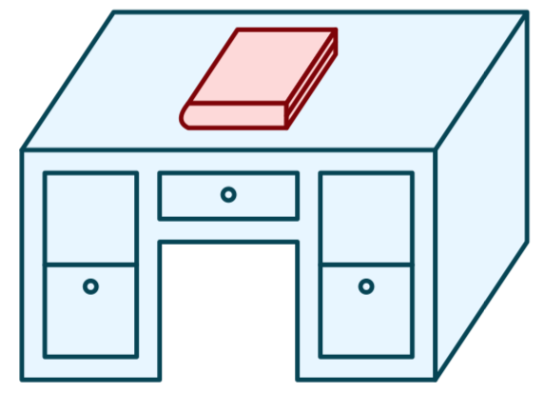
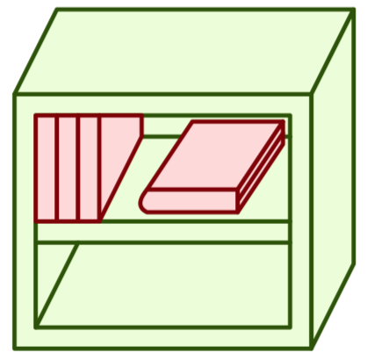
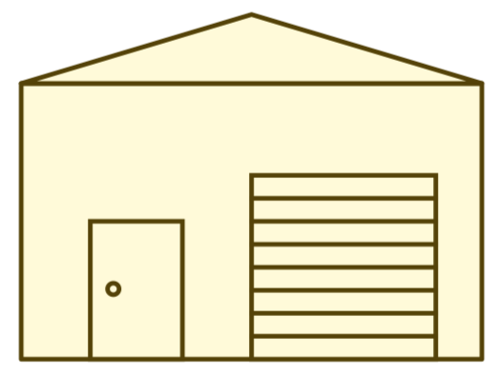
Memory Hierarchy
L0:
Regs
CPU registers hold words retrieved from the L1 cache.
L1:
L1 cache
(SRAM)
L1 cache holds cache lines retrieved from the L2 cache.
Smaller,
faster,
and
costlier
(per byte)
storage
devices
L2:
L2 cache
(SRAM)
L2 cache holds cache lines
retrieved from L3 cache
L3:
L3 cache
(SRAM)
L3 cache holds cache lines
retrieved from main memory.
L4:
Main memory
(DRAM)
Main memory holds
disk blocks retrieved
from local disks.
Larger,
slower,
and
cheaper
(per byte)
storage
devices
Local secondary storage
(local disks)
Local disks hold files retrieved from disks
on remote servers
L5:
L6:
Remote secondary storage
(e.g., cloud, web servers)

Slide 15
Typical Intel Core i7 Hierarchy
Processor package
Core 0
Core 3
L1 d-cache and i-cache:
32 KB, 8-way
Access: 4 cycles
L2 unified cache:
256 KB, 8-way
Access: 10 cycles
L3 unified cache:
8 MB, 16-way
Access: 40-75 cycles
Block size: 64 bytes for all caches.
Regs
Regs
L1
d-cache
L1
i-cache
L1
d-cache
L1
i-cache
…
L2 unified cache
L2 unified cache
L3 unified cache
(shared by all cores)
Main memory
Notes:
all use varients/approximations of LRU for eviction
All three levels of cache are write back. L1 is write no-allocate, L2 and L3 are write allocate.
https://www.edn.com/memory-hierarchy-design-part-6-the-intel-core-i7-fallacies-and-pitfalls/

Slide 16
Caching Vocabulary
Size: the total number of bytes that can be stored in the cache
Cache Hit: the desired value is in the cache and returned quickly
Cache Miss: the desired value is not in the cache and must be fetched from a more distant cache (or ultimately from main memory)
Miss rate: the fraction of accesses that are misses
Hit time: the time to process a hit
Miss penalty: the additional time to process a miss
Average access time: hit-time + miss-rate * miss-penalty

Slide 17
Categorizing Misses
Compulsory: first-reference to a block
Capacity: cache is too small to hold all of the data
Conflict: collisions in a specific set
Average access time: hit-time + miss-rate * miss-penalty
Notes:
Larger block size will reduce compulsory misses
Larger associativity will reduce conflict misses
Larger cache will reduce capacity misses
But: larger block size yields larger miss penalty (more data to copy from memory)
larger cache (and larger associativity): increased hit time
Classifying misses with a particular cache configuration:
Would this miss occur in a cache with infinite capacity? If the answer is yes, then this is a compulsory miss and we are done. If the answer is no, then consider question 2.
Would this miss occur in a fully associative cache with the desired capacity? If the answer is yes, then this is a capacity miss and we are done. If the answer is no, then consider question 3.
Would this miss occur in a cache with the desired capacity and associativity? If the answer is yes, then this is a conflict miss and we are done. If the answer is no, then this is not a miss – it is a hit!

