Slide 1
Lecture 10: Caches
CS 105 Spring 2026

Slide 2
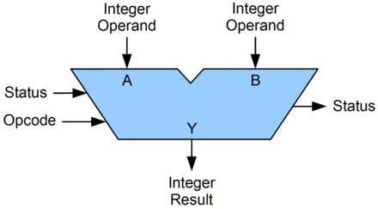
Review: Machine Code View
Memory
0x7FFF
Central Processing Unit (CPU)
Stack
PC
Registers
Float registers
Heap
Condition
Codes
ALU
Addresses
Data
Code
Instructions
0x0000
Programmer-Visible State
PC: Program counter (%rip)
Register file: 16 Registers
Float registers
Condition codes
Memory
Byte addressable array
Code and user data
Stack to support procedures

Slide 3
A Computer System
Register file
ALU
PC
System bus
Memory bus
Main
memory
Bus interface
I/O
bridge
CPU
I/O bus
Expansion slots for
other devices such
as network adapters
USB
controller
Graphics
adapter
Disk
controller
Mouse
Keyboard
Display
Disk
hello executable
stored on disk

Slide 4
The CPU-Memory Gap
DRAM
CPU
Notes:
two numbers for CPU: actual cycle time (white squares) and effective CPU cycle time (allows for parallelization, circles)

Slide 5
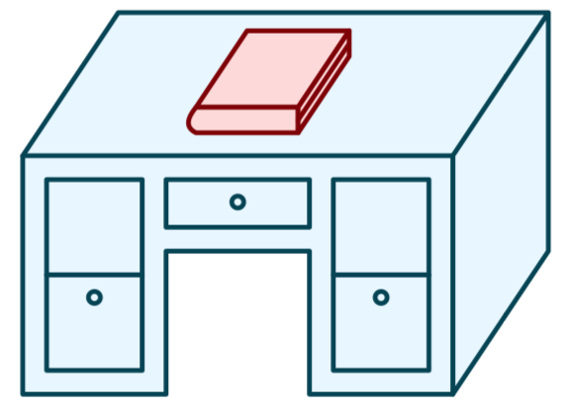

Life without caches
You decide that you want to learn more about computer systems than is covered in this course
The library contains all the books you could possibly want, but you don't like to study in libraries, you prefer to study in your dorm room.
You have the following constraints:
Desk
(can hold one book)
Library
(can hold many books)

Slide 6
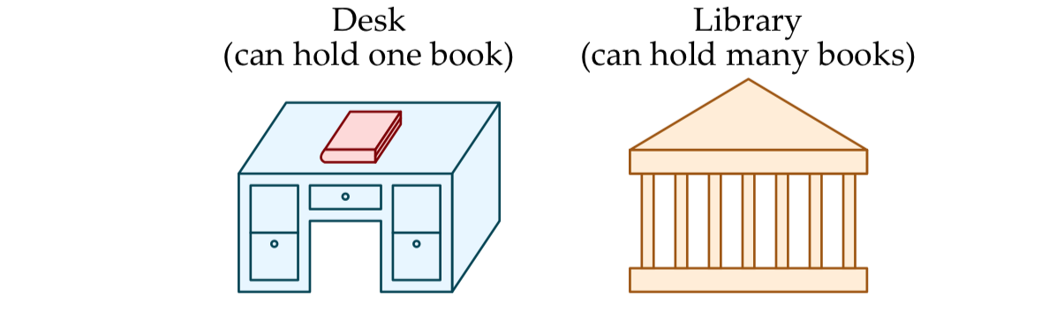
Quantifying Speed (without caches)
Need book 1
Walk to library (15mins)
Checkout book 1 (10 mins)
Average latency to access a book: 40mins
Average throughput (incl. reading time): 1.2 books/hr
Walk to dorm (15mins)
Read book 1 (10 mins)
Need book 2
Walk to library (15mins)
Return book 1
Checkout book 2 (10 mins)
Walk to dorm (15mins)
Read book 2 (10 mins)
Need book 1 again!
Walk to library (15mins)
Return book 2
Checkout book 1 (10 mins)
Walk to dorm (15mins)
Read book 1 (10 mins)
Notes:
latency: each time takes 40 mins to access book (15*2 walking + 10mins checkout) throughput: read 3 books in 2.5 hours -> 3/2.5 = 1.2 books/hour

Slide 7
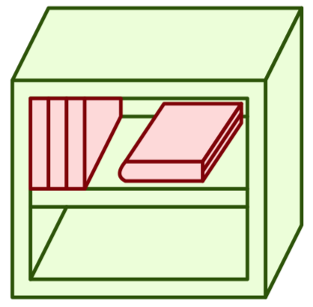
The CPU-Memory Gap
DRAM
SRAM
CPU
Notes:
SRAM: Faster (only 10 or so times slower than the CPU)
Expensive (1000x relative to DRAM)

Slide 8
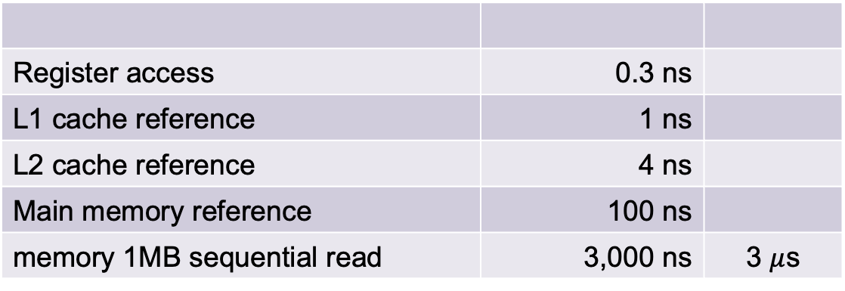
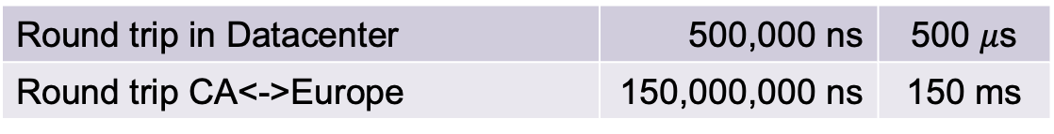
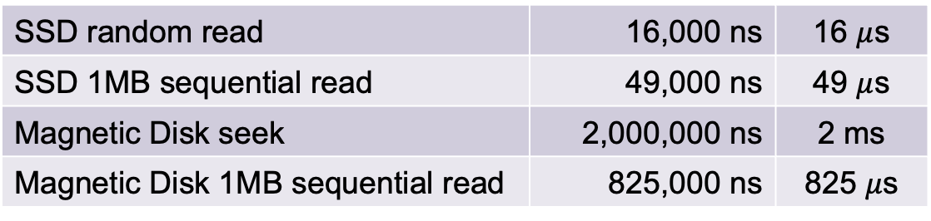
Latency numbers (2020)
Register access | 0.3 ns
L1 cache reference | 1 ns
L2 cache reference | 4 ns
Main memory reference | 100 ns
memory 1MB sequential read | 3,000 ns | 3 $μ$s
SSD random read | 16,000 ns | 16 $μ$s
SSD 1MB sequential read | 49,000 ns | 49 $μ$s
Magnetic Disk seek | 2,000,000 ns | 2 ms
Magnetic Disk 1MB sequential read | 825,000 ns | 825 $μ$s
Round trip in Datacenter | 500,000 ns | 500 $μ$s
Round trip CA<->Europe | 150,000,000 ns | 150 ms
Notes:
https://people.eecs.berkeley.edu/~rcs/research/interactive_latency.html
register access ~.2-.4ns (2.6 GHz cycle => register ~.38ns )

Slide 9
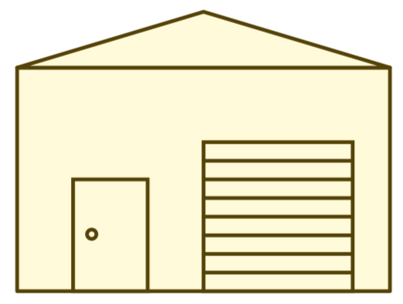
Memory Hierarchy
L0:
Regs
CPU registers hold words retrieved from the L1 cache.
L1:
L1 cache
(SRAM)
L1 cache holds cache lines retrieved from the L2 cache.
Smaller,
faster,
and
costlier
(per byte)
storage
devices
L2:
L2 cache
(SRAM)
L2 cache holds cache lines
retrieved from L3 cache
L3:
L3 cache
(SRAM)
L3 cache holds cache lines
retrieved from main memory.
L4:
Main memory
(DRAM)
Main memory holds
disk blocks retrieved
from local disks.
Larger,
slower,
and
cheaper
(per byte)
storage
devices
Local secondary storage
(local disks)
Local disks hold files retrieved from disks
on remote servers
L5:
L6:
Remote secondary storage
(e.g., cloud, web servers)

Slide 10
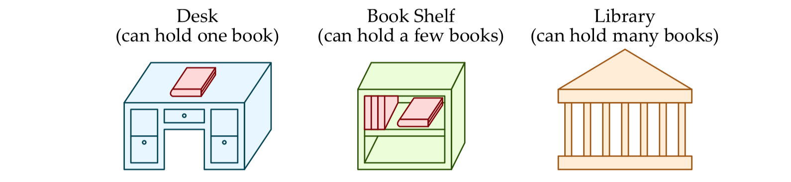
Life with caching
Need book 1
Check bookshelf (5mins)
Walk to library (15mins)
Checkout book 1 & 2 (10 mins)
Walk to dorm (15mins)
Read book 1 (10 mins)
Need book 2
Check bookshelf (5mins)
Read book 2 (10 mins)
Need book 1 again!
Find book 2!
Check bookshelf (5mins)
Read book 1 (10 mins)
Find book 1!
Average latency to access a book: <20mins
Average throughput (incl. reading time): ~2 books/hr
Notes:
average latency: (45 + 5 + 5)/3 = 18.3 minutes
throughput: read 3 books in 85 minutes = 2.1 books/hr

Slide 11
Caching—The Vocabulary
Size: the total number of bytes that can be stored in the cache
Cache Hit: the desired value is in the cache and returned quickly
Cache Miss: the desired value is not in the cache and must be fetched from a more distant cache (or ultimately from main memory)

Slide 12
Exercise 1: Caching Strategies
I want to refresh on Return-Oriented Programming. In the library, there is a book about:
C-programming,
Assembly Instructions,
Assembly Function Calls,
Register Usage,
Buffer Overflows,
and Return-Oriented Programming.
My bookshelf can hold three books at a time. How should we decide which books to keep in the bookshelf?

Slide 13
Example Access Patterns
int sum = 0;
for (int i = 0; i < n; i++){
sum += a[i];
}
return sum;
Data references
Reference array elements in succession.
Reference variable sum each iteration.
Instruction references
Reference instructions in sequence.
Cycle through loop repeatedly.

Slide 14
Principle of Locality
Programs tend to use data and instructions with addresses near or equal to those they have used recently
Temporal locality:
Recently referenced items are likely to be referenced again in the near future
Spatial locality:
Items with nearby addresses tend to be referenced close together in time

Slide 15
Cache Organization

Slide 16
Cache Lines
valid bit
tag
data block
v
tag
0
1
2
3
4
5
6
7
data block: cached data (i.e., copy of bytes from memory)
tag: uniquely identifies which data is stored in the cache line
valid bit: indicates whether or not the line contains meaningful information

Slide 17
Direct-mapped Cache
log(block size) bits
log(# lines) bits
the rest of the bits
Address of data:
tag
index
offset
find line
0
v
tag
0
1
2
3
4
5
6
7
identifies byte in line
1
v
tag
0
1
2
3
4
5
6
7
2
v
tag
0
1
2
3
4
5
6
7
n-1
v
tag
0
1
2
3
4
5
6
7
Notes:
Note: low-order bits are always zero if we assume 4-byte words (since we'll always be looking up the address of a word), but we'll just think about those bits as part of the offset

Slide 18
Example: Direct-mapped Cache
Assume: cache block size 8 bytes, total cache size 32 bytes
Assume: assume 8-bit machine
Address of data:
0xB4
Line 0
1
110
0F
12
AB
34
FF
FF
EA
68
1011 0100
Line 1
1
001
00
00
00
00
00
40
06
1D
101
10
100
Line 2
1
101
0D
00
00
00
2F
00
00
00
3 bit tag
2 bit index
3 bit offset
Line 3
0
001
00
11
22
33
44
55
66
77

Slide 19
Exercise 2: Interpreting Addresses
Consider the 12-bit address 0xA59. What would be the tag, index, and offset for this address with each of the following cache configurations?
A direct-mapped cache with 8 cache lines and 8-byte data blocks
A direct-mapped cache with 16 cache lines and 4-byte data blocks
A direct-mapped cache with 16 cache lines and 8-byte data blocks
0xA59 = 1010 0101 1001
tag = 1010 01 = 0x29
index = 011 = 0x3
offset = 001 = 0x1
tag = 1010 01 = 0x29
index = 0110 = 0x6
offset = 01 = 0x1
tag = 1010 0 = 0x14
index = 1011 = 0xB
offset = 001 = 0x1
Notes:
1. 6 tag, 3 index, 3 offset 2. 6 tag, 4 index, 2 offset 2. 5 tag, 4 index, 3 offset

Slide 20
Direct-mapped Cache
log(block size) bits
log(# lines) bits
the rest of the bits
Address of data:
tag
index
offset
valid?
check value
find line
0
v
tag
0
1
2
3
4
5
6
7
identifies byte in line
1
v
tag
0
1
2
3
4
5
6
7
Checking the cache (i.e., "bookshelf"):
index tells you which line to check
Is that line valid?
If no, cache miss
Does the tag match?
If no, cache miss
If valid and tag matches, cache hit!
Read from datablock at offset
2
v
tag
0
1
2
3
4
5
6
7
n-1
v
tag
0
1
2
3
4
5
6
7
Notes:
Note: low-order bits are always zero if we assume 4-byte words (since we'll always be looking up the address of a word), but we'll just think about those bits as part of the offset

Slide 21
Exercise 3: Cache Hits and Misses
Assume: cache block size 8 bytes, total cache size 32 bytes
Assume: assume 8-bit machine
For each address, is it a hit or
a miss? For hits, what data is at that address in memory?
0x2D
0x2E
0x74
0x3A
Line 0
1
110
0F
12
AB
34
FF
FF
EA
68
Line 1
1
001
00
00
00
00
00
40
06
1D
001
01
101
Hit 0x40
001
01
110
Hit 0x06
Line 2
1
101
0D
00
00
00
2F
00
00
00
011
10
100
Miss
001
11
010
Miss
Line 3
0
001
00
11
22
33
44
55
66
77

Slide 22
Handling a Cache Miss
Address of data:
0x74
0111 0100
011
10
100
When a cache miss occurs update cache line at that index:
Replace data block with bytes from memory
Copies all bytes with same tag + index
Update tag
Set valid bit to 1 (if not already)
3 bit tag
2 bit index
3 bit offset
0x79
0x78
0x77
0x76
0x75
0x74
23
B7
64
15
Line 0
1
110
0F
12
AB
34
FF
FF
EA
68
E0
AB
0x73
0x72
0x71
0x70
0x6F
0x6E
Line 1
1
001
00
00
00
00
00
40
06
1D
1A
47
Line 2
33
1
101
0D
00
00
00
2F
00
00
00
1
011
2F
33
47
1A
AB
E0
15
64
2F
0A
Line 3
0
001
00
11
22
33
44
55
66
77
00

Slide 23
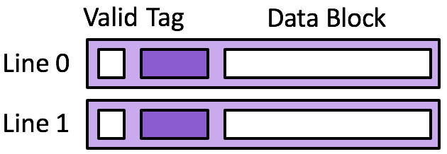
Exercise 4: Direct-mapped Cache
Memory
0x74
0x70
0x6c
0x68
0x64
0x60
Cache
18
17
16
15
14
13
Assume 8 byte data blocks
Line 0 |  |  | Line 1
0 |  | 47 48 | 0 |  | 49 50
Line 0 |  |  | Line 1
0 |  | 47 48 | 0 |  | 49 50
Access | tag | idx | off | h/m | val
rd 0x60
rd 0x64
rd 0x70
rd 0x64
rd 0x64
rd 0x60
Access | tag | idx | off | h/m | val
rd 0x60
rd 0x64
rd 0x70
rd 0x64
rd 0x64
rd 0x60
0000
0000
0110
0
000
Miss
13
1
0110
13 14
0
0000
49 50
0110
0
100
Hit
14
1
0110
13 14
0
0000
49 50
0111
0
000
Miss
17
1
0111
17 18
0
0000
49 50
Time
0110
0
100
Miss
14
1
0110
13 14
0
0000
49 50
0110
0
100
Hit
14
1
0110
13 14
0
0000
49 50
0110
0
000
Hit
13
1
0110
13 14
0
0000
49 50
How well does this take advantage of spatial locality?
How well does this take advantage of temporal locality?
Notes:
Same setup, except now assume 8 byte data blocks, 2 cache lines

