Slide 1
Lecture 9: Buffer Overflows (cont'd)
CS 105 Spring 2026

Slide 2
Buffer Overflows – Checking In
What is an attacker’s goal when exploiting a buffer overflow?
What is the vulnerability in this program?
Which behavior is the attacker exploiting (e.g., which instructions)?
What is the strategy for constructing a payload to exploit the vulnerability?
int authenticate(char *password){
char buf[4];
gets(buf);
int correct = !strcmp(password, buf);
return correct;
}
int main(int argc, char ** argv){
char * pw = "123456";
printf("Enter your password: ");
while(!authenticate(pw)){
printf("Incorrect. Try again: ");
}
printf("You are now logged in\n");
return 0;
}

Slide 3
Review: Buffer Overflow Attack
Idea: overwrite return address with address of instruction you want to execute next
  If a string: use padding to fill up space between array and saved rip
Stack Frame
for call_echo
/* Echo Line */
void echo()
{
char buf[4];
gets(buf);
puts(buf);
}
00
00
00
00
saved
%rip
Return Address
(8 bytes)
Return Address
(8 bytes)
00
40
06
09
00
40
06
f6
19
18
17
16
20 bytes unused
Stack Frame
for echo
15
14
13
12
echo:
subq $0x18, %rsp
movq %rsp, %rdi
call gets
call puts
addq $0x18, %rsp
ret
11
0f
0e
0d
0c
0b
0a
09
08
07
06
05
04
03
02
01
%rsp
[3]
[2]
[1]
[0]
buf
Notes:
Note: works on linux
Demo: crash, jump

Slide 4
Code Injection
Idea: fill the buffer with bytes that will be interpreted as code
Overwrite the return address with address of the beginning of the buffer
Stack Frame
for call_echo
/* Echo Line */
void echo()
{
char buf[4];
gets(buf);
puts(buf);
}
00
00
00
00
00
40
06
67
7f
ff
ff
ff
00
00
00
00
Return Address
(8 bytes)
saved
%rip
Return Address
(8 bytes)
ff
ff
ea
40
00
40
06
f6
33
32
31
30
20 bytes unused
Stack Frame
for echo
39
38
37
36
echo:
subq $18, %rsp
movq %rsp, %rdi
call gets
call puts
addq $18, %rsp
ret
35
34
33
32
31
30
39
38
37
36
c3
35
34
33
32
31
30
%rsp
[3]
[2]
[1]
[0]
buf

Slide 5
Exercise: Code Injection
Construct an input string that will cause this program to print 47.
int x = 13;
void echo(){
char buf[12];
gets(buf);
puts(buf);
}
int main(int argc, char ** argv){
printf("Enter a string: ");
echo();
printf("%d\n", x);
return 0;
}

Slide 6
Exercise: Code Injection
echo:
0x400616 <+0>: sub $0x18,%rsp
0x40061a <+4>: lea 0x4(%rsp),%rax
0x40061f <+9>: mov %rax,%rdi
0x400622 <+12>: mov $0x0,%eax
0x400627 <+17>: callq 0x400520 <gets>
0x40062c <+22>: lea 0x4(%rsp),%rax
0x400631 <+27>: mov %rax,%rdi
0x400634 <+30>: callq 0x400500 <puts@>
0x400639 <+35>: nop
0x40063a <+36>: add $0x18,%rsp
0x40063e <+40>: retq
main:
0x40063f <+0>: sub $0x18,%rsp
0x400643 <+4>: mov %edi,0xc(%rsp)
0x400647 <+8>: mov %rsi,(%rsp)
0x40064b <+12>: mov $0x400728,%edi
0x400650 <+17>: mov $0x0,%eax
0x400655 <+22>: callq 0x400510 <printf>
0x40065a <+27>: mov $0x0,%eax
0x40065f <+32>: callq 0x400616 <echo>
0x400664 <+37>: mov 0x601034,%eax
0x40066a <+43>: mov %eax,%esi
0x40066c <+45>: mov $0x400739,%edi
0x400671 <+50>: mov $0x0,%eax
0x400676 <+55>: callq 0x400510 <printf>
0x40067b <+60>: mov $0x0,%eax
0x400680 <+65>: add $0x18,%rsp
0x400684 <+69>: retq
Construct an input string that will cause this program to print 47.
int x = 13;
void echo(){
char buf[12];
gets(buf);
puts(buf);
}
int main(int argc, char ** argv){
printf("Enter a string: ");
echo();
printf("%d\n", x);
return 0;
}
Assume %rsp == 0x7fffffffe168 at the beginning of echo
0000000000000000 <.text>:
0: 48 c7 04 25 34 10 60 00 2f 00 00 00 movq $0x2f,0x601034
c: c3 retq

Slide 7
Defense #1: Bounds Checks
/* Echo Line */
void echo(){
char buf[12];
fgets(buf, 12, stdin);
puts(buf);
}
For example, use library routines that limit string lengths
  fgets instead of gets
  strncpy instead of strcpy
  Don’t use scanf with %s conversion specification (use fgets to read the string or use %ns where n is a suitable integer)
Or use a high-level language

Slide 8

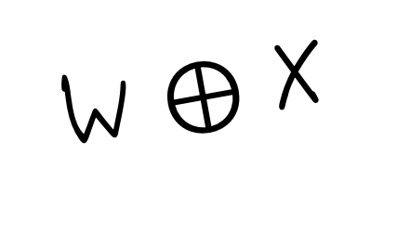
Defense #2: Memory Tagging
Memory
0x7FFF
Stack
NX
W $⊕$ X
Heap
NX
NX
Data
NW
Code
GCC Implementation
  Now the default
  Can disable with -z execstack
0x0000

Slide 9
Code Reuse Attacks
Key idea: execute instructions that already exist
Defeats memory tagging defenses
Examples:
  return to a function or line in the current program
  return to a library function (e.g., return-into-libc)
  return to some other instruction (return-oriented programming)

Slide 10
Properties of x86 Assembly
lots of instructions
variable length instructions
not word aligned
dense instruction set

Slide 11
Gadgets
void setval(unsigned* p) {
*p = 3347663060u;
}
<setval>:
4004d9: c7 07 d4 48 89 c7 movl $0xc78948d4,(%rdi)
4004df: c3 ret
gadget address: 0x4004dc
encodes: movq %rax, %rdi
ret
executes: %rdi <- %rax
Notes:
https://defuse.ca/online-x86-assembler.htm

Slide 12
Example Gadgets
Load Constant
Load from memory
48 89 C0 C3
movq (%rax), %rax
ret
0xbad01010
return addr
5a c3
Return addr
popq %rdx
ret
58 c3
popq %rax
ret
0xbad00002

Slide 13
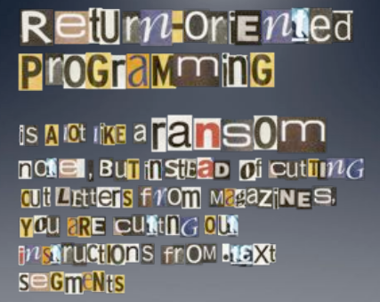
Return-oriented Programming
Notes:
Image By: Dino Dai Zovi

Slide 14
Return-oriented Programming
gadget_N_code c3
…
gadget_2_code c3
gadget_1_code c3
Final ret in each gadget sets pc (%rip) to
beginning of next gadget code

Slide 15
Return-Oriented Shellcode
%rip | %rdi | %rsi | %rax | %rdx
%rip | %rdi | %rsi | %rax | %rdx
4004b9 | 3b3b3b | ea70 | 3b | 0
%rip | %rdi | %rsi | %rax | %rdx
400666 | 3b3b3b | ea78 | 0 | 0
%rip | %rdi | %rsi | %rax | %rdx
400663 | 3b3b3b | ea78 | 0
%rip | %rdi | %rsi | %rax | %rdx
400660 | 3b3b3b | ea78 | 0
%rip | %rdi | %rsi | %rax | %rdx
40090b
%rip | %rdi | %rsi | %rax | %rdx
4004b8 | 3b3b3b | ea78 | 3b | 0
%rip | %rdi | %rsi | %rax | %rdx
400420 |  |  | 0
%rip | %rdi | %rsi | %rax | %rdx
40090e |  |  | 0
%rip | %rdi | %rsi | %rax | %rdx
4002a6 | 3b3b3b | ea78 | 3b | 0
%rip | %rdi | %rsi | %rax | %rdx
4002a3 | 3b3b3b | ea78 | 0 | 0
%rip | %rdi | %rsi | %rax | %rdx
400421 | 3b3b3b |  | 0
%rip | %rdi | %rsi | %rax | %rdx
400421 | 3b3b3b | ea78 | 0
%rip | %rdi | %rsi | %rax | %rdx
4004b9 | ea80 | ea70 | 3b | 0
"\bin\sh\0"
%rip | %rdi | %rsi | %rax | %rdx
40042a | ea80 | ea70 | 3b | 0
7fffffffea80
0
7fffffffea78
0x1122334455667788
7fffffffea70
0x7fffffffea80
7fffffffea68
0x40042a
0F 05 C3
7fffffffea60
0x7fffffffea80
5E 5F C3
syscall
ret
7fffffffea58
0x7fffffffea70
0x4004b8
pop %rsi
pop %rdi
ret
7fffffffea50
0x4002a3
40 00 F8 C3
7fffffffea48
7fffffffea40
0x400660
48 89 06 48 89 c2 C3
add %dil, %al
ret
7fffffffea38
0x7fffffffea78
mov %rax, (%rsi)
mov %rax, %rdx
ret
7fffffffea30
0x3b3b3b3b3b3b3b3b
7fffffffea28
0x400420
5F 5E C3
0x40090b
48 31 C0 C3
pop %rdi
pop %rsi
ret
7fffffffea20
xor %rax, %rax
ret
Notes:
Note: syscall: number of syscall actually passed in register %rax.
System call index: http://blog.rchapman.org/posts/Linux_System_Call_Table_for_x86_64/

Slide 16
Exercise: ROP
What are the values in the registers when the function at address 0x401a82 starts executing?
%rip | %rdi | %rsi | %rax | %rdx
401a5c |  |  | ..97ff | ..ea58
%rip | %rdi | %rsi | %rax | %rdx
401bb0 |  |  | ..97ff | ..ea58
%rip | %rdi | %rsi | %rax | %rdx
401a5b |  |  | ..97ff
%rip | %rdi | %rsi | %rax | %rdx
4002a3 |  |  | 2f | ..ea58
%rip | %rdi | %rsi | %rax | %rdx
4019e6 |  |  | ..97ff
%rip | %rdi | %rsi | %rax | %rdx
4019e5
%rip | %rdi | %rsi | %rax | %rdx
%rip | %rdi | %rsi | %rax | %rdx
401a82 | 2f |  | 2f | ..ea58
%rip | %rdi | %rsi | %rax | %rdx
401bb3 |  |  | 2f | ..ea58
%rip | %rdi | %rsi | %rax | %rdx
4002a3 | 2f |  | 2f | ..ea58
%rip | %rdi | %rsi | %rax | %rdx
7fffffffea58
0x59b997d0
7fffffffea50
0x401a82
48 89 C7 C3
7fffffffea48
0x4002a3
mov %rax, %rdi
ret
7fffffffea40
0x401bb0
48 2B 02 C3
7fffffffea38
0x7fffffffea58
sub (%rdx), %rax
ret
7fffffffea30
0x401a5b
5A C3
7fffffffea28
0x59b997ff
pop %rdx
ret
7fffffffea20
0x4019e5
58 C3
pop %rax
ret

Slide 17
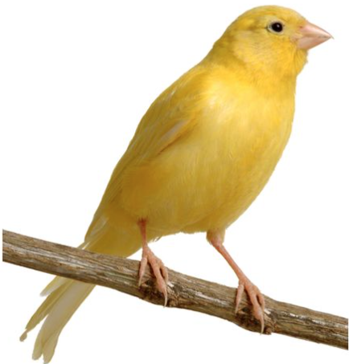
Defense #3: Compiler checks
0x7FFFFFFF
Idea
  Place special value (“canary”) on stack just beyond buffer
  Check for corruption before exiting function
GCC Implementation
  -fstack-protector
  Now the default (disabled in prior demos)
Stack
Stack Frame P
return address
Stack Frame Q
0x00000000

Slide 18
Stack Canaries
echo:
sub $0x28,%rsp
mov %fs:0x28,%rax
mov %rax,0x18(%rsp)
xor %eax,%eax
lea 0xc(%rsp),%rax
mov %rax,%rdi
mov $0x0,%eax
callq 0x400590 <gets>
lea 0xc(%rsp),%rax
mov %rax,%rdi
callq 0x400560 <puts>
nop
mov 0x18(%rsp),%rax
xor %fs:0x28,%rax
je 0x4006cf <echo+73>
callq 0x400570 <__stack_chk_fail>
add $0x28,%rsp
retq
Stack Frame
for call_echo
00
00
00
00
Return Address
(8 bytes)
saved
%rip
Return Address
(8 bytes)
00
40
06
f6
Stack Frame
for echo
canary
34
33
32
31
30
Stack Frame
for echo
39
38
37
36
[3]
[2]
[1]
[0]
35
34
33
32
buf
%rsp

Slide 19

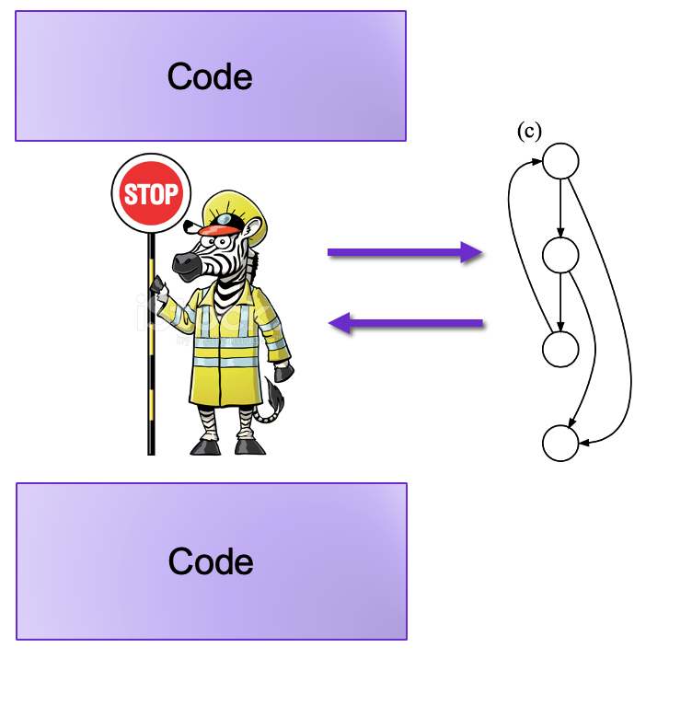


Other Defenses
Address Space Layout Randomization
Gadget Elimination
Control Flow Integrity

Slide 20
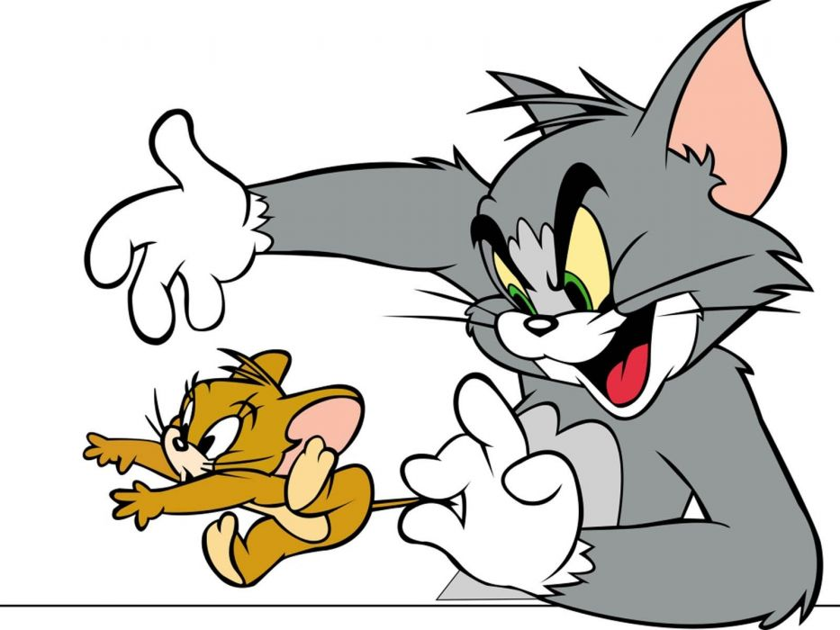
The state of the world
Defenses:
  high-level languages
  Stack Canaries
  Memory tagging
  ASLR
  continuing research and development…
But all they aren't perfect!

Slide 21
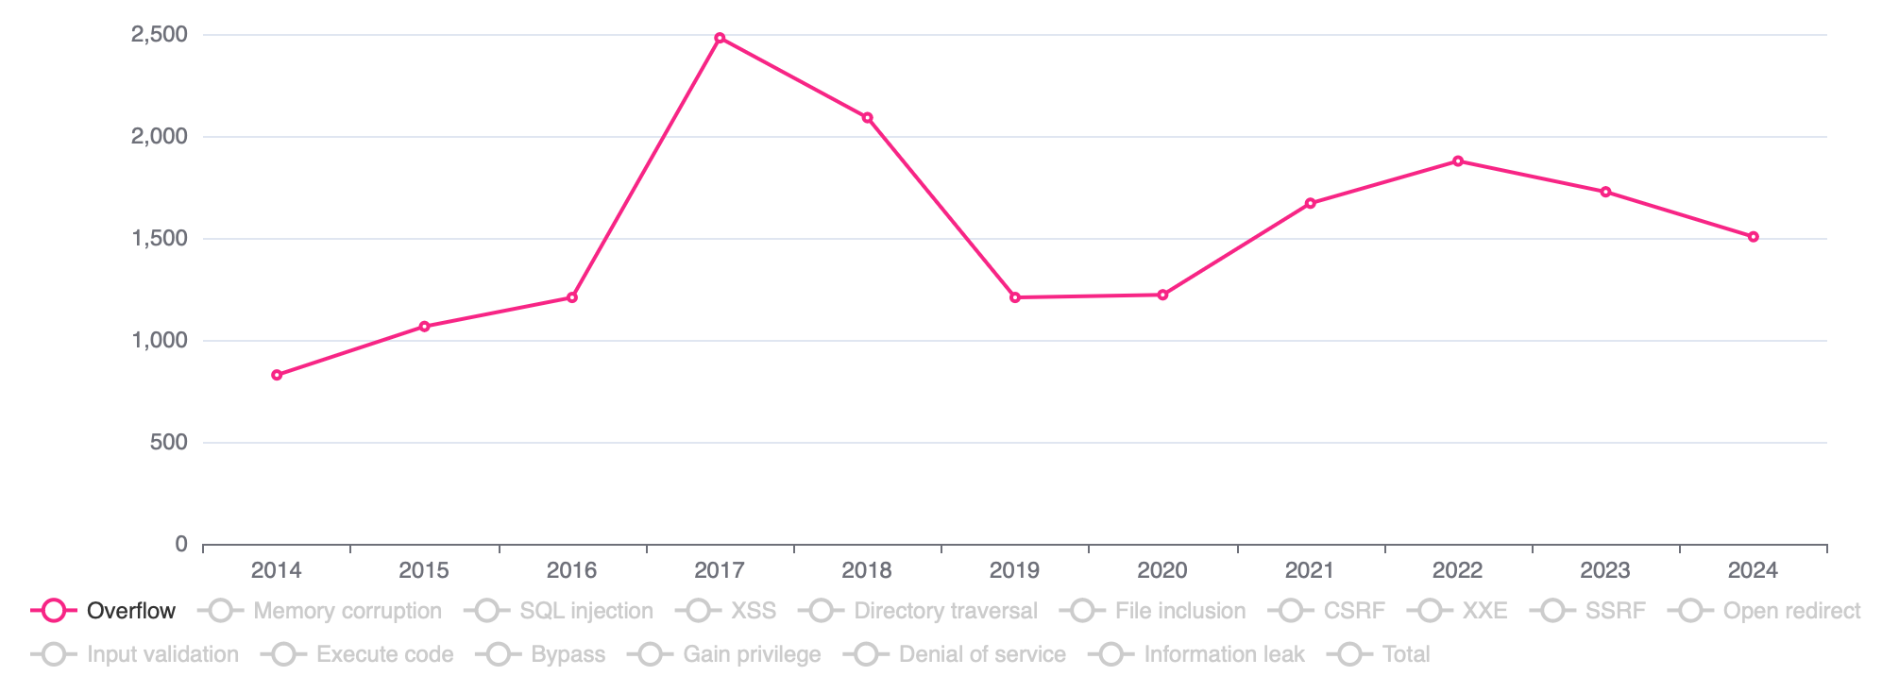



The state of the world
Notes:
https://www.cvedetails.com/vulnerabilities-by-types.php
https://thehackernews.com/2023/12/urgent-new-chrome-zero-day.html
https://www.darkreading.com/vulnerabilities-threats/rce-vulnerability-in-shim-bootloader-impacts-all-linux-distros
https://www.darkreading.com/endpoint-security/critical-bugs-canon-small-office-printers-code-execution-ddos

