Slide 1
Lecture 8: Buffer Overflows
CS 105 Spring 2025

Slide 2
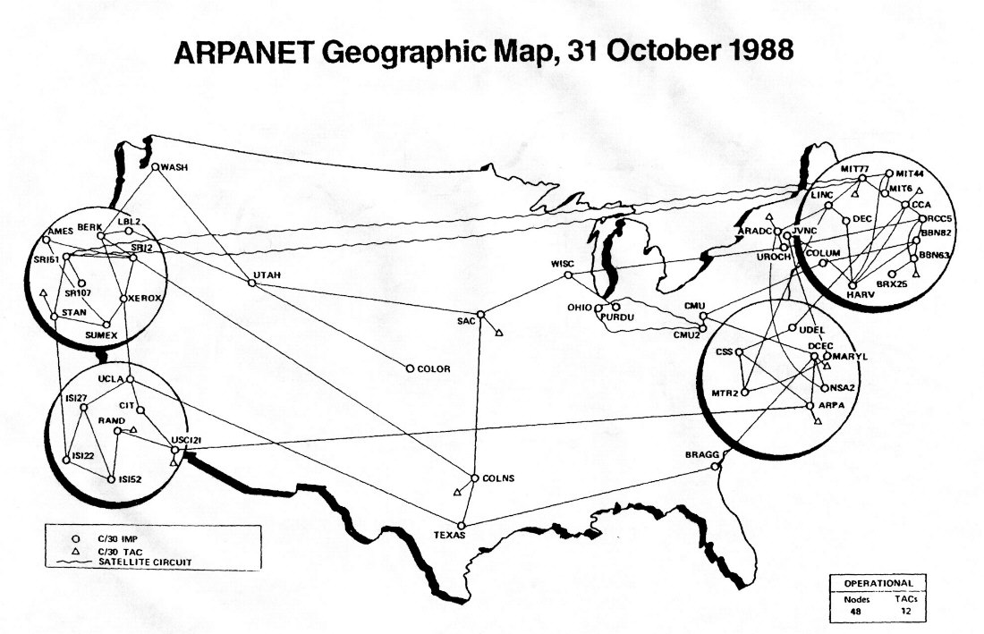
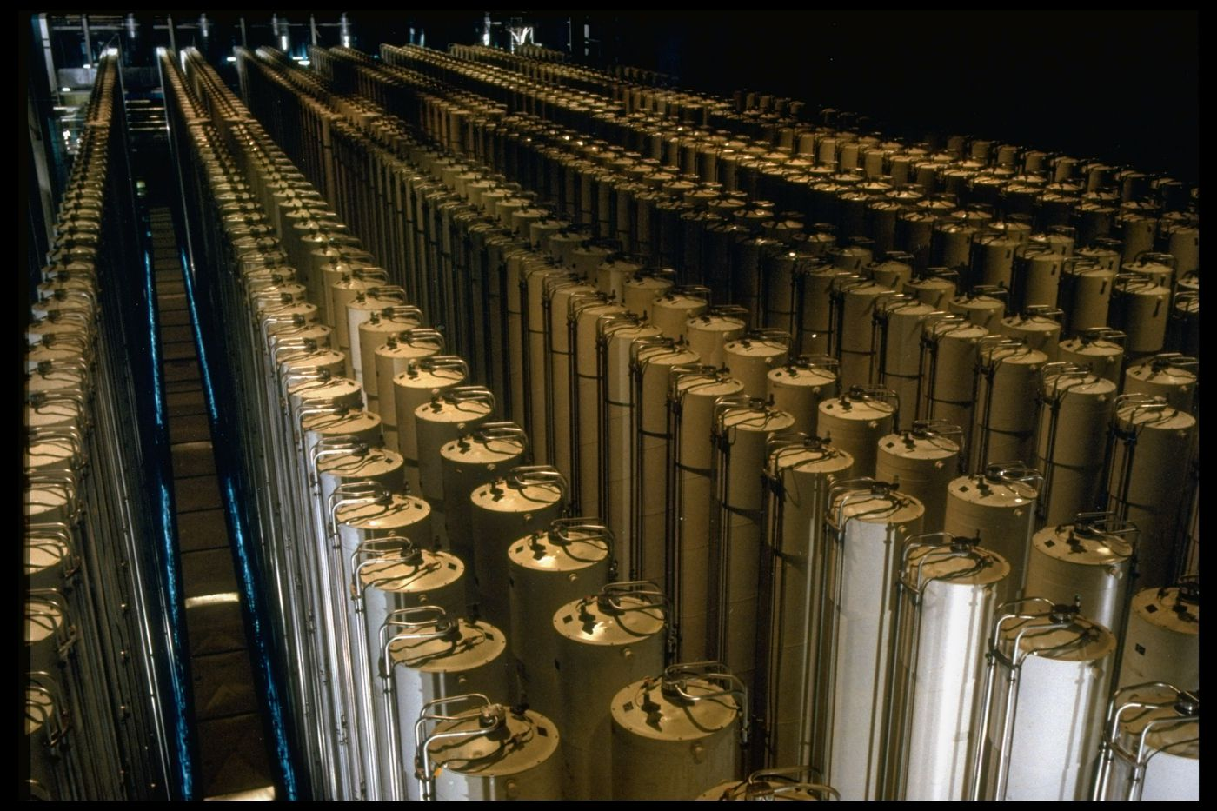
Buffer Overflow Examples
Notes:
Morris Worm (November 2, 1988), $100,000-$10mil, bugs in finger and sendmail
Stuxnet (discovered 2010): bug in functions that process files to display icons when USB connected to PC
Heartbleed (2014): bug in openssl library heartbeat
WhatsApp (2019)

Slide 3
Review: Function Calls in Assembly
void f1(){
double a2[2] = {1.0,2.0};
int a1[4] = {1,2,3,4};
}
%rsp
0x40068b
f1:
sub $0x28,%rsp
movsd 0x216(%rip),%xmm0
movsd %xmm0,0x10(%rsp)
movsd 0x210(%rip),%xmm0
movsd %xmm0,0x18(%rsp)
movl $0x1,(%rsp)
movl $0x2,0x4(%rsp)
movl $0x3,0x8(%rsp)
movl $0x4,0xc(%rsp)
add $0x28,%rsp
retq main: call f1
retq
void main(){
f1();
}
2.0
a2
1.0
4
3
a1
2
1

Slide 4
Memory Referencing Bug Example
void f1(){
double a2[2] = {1.0,2.0};
int a1[4] = {1,2,3,4};
a1[4] = 1413754136;
a1[5] = 1074340347;
}
%rsp
0x40068b
f1:
sub $0x28,%rsp
movsd 0x216(%rip),%xmm0
movsd %xmm0,0x10(%rsp)
movsd 0x210(%rip),%xmm0
movsd %xmm0,0x18(%rsp)
movl $0x1,(%rsp)
movl $0x2,0x4(%rsp)
movl $0x3,0x8(%rsp)
movl $0x4,0xc(%rsp)
movl $0x54442d18,0x10(%rsp)
movl $0x400921fb,0x14(%rsp)
add $0x28,%rsp
retq
2.0
void main(){
f1();
}
a2
0x54442d18
1.0
0x400921fb
4
3
a1
2
1
Notes:
demo: read elements a1[4], a1[5]
demo: write to those elements and then read from a2

Slide 5
Memory Referencing Bug Example
void f1(){
double a2[2] = {1.0,2.0};
int a1[4] = {1,2,3,4};
a1[10] = 47;
}
%rsp
0x40068b
0x2f
f1:
sub $0x28,%rsp
movsd 0x216(%rip),%xmm0
movsd %xmm0,0x10(%rsp)
movsd 0x210(%rip),%xmm0
movsd %xmm0,0x18(%rsp)
movl $0x1,(%rsp)
movl $0x2,0x4(%rsp)
movl $0x3,0x8(%rsp)
movl $0x4,0xc(%rsp)
movl $0x2f,0x28(%rsp)
add $0x28,%rsp
retq
2.0
void main(){
f1();
}
a2
1.0
4
3
a1
2
1
Notes:
Note: works on linux
Demo: crash, jump

Slide 6
Exercise 1: Memory Bugs
What is the state of the stack immediately before the program returns from f2?
What will happen immediately after f2 returns?
int f2(){
int a1[4] = {1,2,3,4};
a1[6] = 0x400667;
}
0x40068b
0x400667
0x40068b
%rsp
4
f2:
sub $0x18,%rsp
movl $0x1,(%rsp)
movl $0x2,0x4(%rsp)
movl $0x3,0x8(%rsp)
movl $0x4,0xc(%rsp)
movl $0x400667,0x18(%rsp)
add $0x18,%rsp
retq
3
a1
2
1

Slide 7
Buffer Overflows
Most common form of memory reference bug
Unchecked lengths on string inputs
Particularly for bounded character arrays on the stack
Stack Frame
for main
/* Echo Line */ void echo(){ char buf[4]; gets(buf); puts(buf); }
00
00
00
00
Return Address
(8 bytes)
saved
%rip
Return Address
(8 bytes)
00
40
06
00
00
40
06
f6
3f
echo:
subq $0x18, %rsp
lea 0xc(%rsp),%rdi
call gets
lea 0xc(%rsp),%rdi
call puts
addq $0x18, %rsp
ret
6c
6b
6a
69
00
6b
6a
69
8 bytes unused
6c
6b
6a
69
Stack Frame
for echo
(24 bytes)
68
67
66
65
68
67
66
65
68
67
66
65
[3]
[2]
[1]
[0]
buf
64
63
62
61
00
63
62
61
64
63
62
61
64
63
62
61
12 bytes unused
%rsp
Notes:
Note: works on linux
Demo: crash, jump

Slide 8
Exercise 2: Buffer Overflow
Construct an exploit string that will successfully cause the program to print "You are now logged in" without knowing the correct password
How many bytes of padding are in this exploit string?
What value will you overwrite the return address with?
int authenticate(char *password){
char buf[4];
gets(buf);
int correct = !strcmp(password, buf);
return correct;
}
int main(int argc, char ** argv){
char * pw = "123456";
printf("Enter your password: ");
while(!authenticate(pw)){
printf("Incorrect. Try again: ");
}
printf("You are now logged in\n");
return 0;
}

Slide 9
Exercise 2: Buffer Overflow
authenticate:
0x400666 <+0>: sub $0x28,%rsp
0x40066a <+4>: mov %rdi,0x8(%rsp)
0x40066f <+9>: lea 0x18(%rsp),%rax
0x400674 <+14>: mov %rax,%rdi
0x400677 <+17>: mov $0x0,%eax
0x40067c <+22>: callq 0x400570 <gets@plt>
0x400681 <+27>: lea 0x18(%rsp),%rdx
0x400686 <+32>: mov 0x8(%rsp),%rax
0x40068b <+37>: mov %rdx,%rsi
0x40068e <+40>: mov %rax,%rdi
0x400691 <+43>: callq 0x400560 <strcmp@plt>
0x400696 <+48>: test %eax,%eax
0x400698 <+50>: sete %al
0x40069b <+53>: movzbl %al,%eax
0x40069e <+56>: mov %eax,0x1c(%rsp)
0x4006a2 <+60>: mov 0x1c(%rsp),%eax
0x4006a6 <+64>: add $0x28,%rsp
0x4006aa <+68>: retq
main:
0x4006ab <+0>: sub $0x28,%rsp
0x4006af <+4>: mov %edi,0xc(%rsp)
0x4006b3 <+8>: mov %rsi,(%rsp)
0x4006b7 <+12>: movq $0x4007a8,0x18(%rsp)
0x4006c0 <+21>: mov $0x4007af,%edi
0x4006c5 <+26>: mov $0x0,%eax
0x4006ca <+31>: callq 0x400550 <printf@plt>
0x4006cf <+36>: jmp 0x4006e0 <main+53>
0x4006d1 <+38>: mov $0x4007c8,%edi
0x4006d6 <+43>: mov $0x0,%eax
0x4006db <+48>: callq 0x400550 <printf@plt>
0x4006e0 <+53>: mov 0x18(%rsp),%rax
0x4006e5 <+58>: mov %rax,%rdi
0x4006e8 <+61>: callq 0x400666 <authenticate>
0x4006ed <+66>: test %eax,%eax
0x4006ef <+68>: je 0x4006d1 <main+38>
0x4006f1 <+70>: mov $0x4007e8,%edi
0x4006f6 <+75>: callq 0x400540 <puts@plt>
0x4006fb <+80>: mov $0x0,%eax
0x400700 <+85>: add $0x28,%rsp
0x400704 <+89>: retq
Construct an exploit string that will successfully cause the program to print "You are now logged in" without knowing the correct password
How many bytes of padding are in this exploit string?
What value will you overwrite the return address with?
int authenticate(char *password){
char buf[4];
gets(buf);
int correct = !strcmp(password, buf);
return correct;
}
int main(int argc, char ** argv){
char * pw = "123456";
printf("Enter your password: ");
while(!authenticate(pw)){
printf("Incorrect. Try again: ");
}
printf("You are now logged in\n");
return 0;
}

Slide 10
Exercise 2: Buffer Overflow
authenticate:
0x400666 <+0>: sub $0x28,%rsp
0x40066a <+4>: mov %rdi,0x8(%rsp)
0x40066f <+9>: lea 0x18(%rsp),%rax
0x400674 <+14>: mov %rax,%rdi
0x400677 <+17>: mov $0x0,%eax
0x40067c <+22>: callq 0x400570 <gets@plt>
0x400681 <+27>: lea 0x18(%rsp),%rdx
0x400686 <+32>: mov 0x8(%rsp),%rax
0x40068b <+37>: mov %rdx,%rsi
0x40068e <+40>: mov %rax,%rdi
0x400691 <+43>: callq 0x400560 <strcmp@plt>
0x400696 <+48>: test %eax,%eax
0x400698 <+50>: sete %al
0x40069b <+53>: movzbl %al,%eax
0x40069e <+56>: mov %eax,0x1c(%rsp)
0x4006a2 <+60>: mov 0x1c(%rsp),%eax
0x4006a6 <+64>: add $0x28,%rsp
0x4006aa <+68>: retq
main:
0x4006ab <+0>: sub $0x28,%rsp
0x4006af <+4>: mov %edi,0xc(%rsp)
0x4006b3 <+8>: mov %rsi,(%rsp)
0x4006b7 <+12>: movq $0x4007a8,0x18(%rsp)
0x4006c0 <+21>: mov $0x4007af,%edi
0x4006c5 <+26>: mov $0x0,%eax
0x4006ca <+31>: callq 0x400550 <printf@plt>
0x4006cf <+36>: jmp 0x4006e0 <main+53>
0x4006d1 <+38>: mov $0x4007c8,%edi
0x4006d6 <+43>: mov $0x0,%eax
0x4006db <+48>: callq 0x400550 <printf@plt>
0x4006e0 <+53>: mov 0x18(%rsp),%rax
0x4006e5 <+58>: mov %rax,%rdi
0x4006e8 <+61>: callq 0x400666 <authenticate>
0x4006ed <+66>: test %eax,%eax
0x4006ef <+68>: je 0x4006d1 <main+38>
0x4006f1 <+70>: mov $0x4007e8,%edi
0x4006f6 <+75>: callq 0x400540 <puts@plt>
0x4006fb <+80>: mov $0x0,%eax
0x400700 <+85>: add $0x28,%rsp
0x400704 <+89>: retq
authenticate:
0x400666 <+0>: sub $0x28,%rsp
0x40066a <+4>: mov %rdi,0x8(%rsp)
0x40066f <+9>: lea 0x18(%rsp),%rax
0x400674 <+14>: mov %rax,%rdi
0x400677 <+17>: mov $0x0,%eax
0x40067c <+22>: callq 0x400570 <gets@plt>
0x400681 <+27>: lea 0x18(%rsp),%rdx
0x400686 <+32>: mov 0x8(%rsp),%rax
0x40068b <+37>: mov %rdx,%rsi
0x40068e <+40>: mov %rax,%rdi
0x400691 <+43>: callq 0x400560 <strcmp@plt>
0x400696 <+48>: test %eax,%eax
0x400698 <+50>: sete %al
0x40069b <+53>: movzbl %al,%eax
0x40069e <+56>: mov %eax,0x1c(%rsp)
0x4006a2 <+60>: mov 0x1c(%rsp),%eax
0x4006a6 <+64>: add $0x28,%rsp
0x4006aa <+68>: retq
main:
0x4006ab <+0>: sub $0x28,%rsp
0x4006af <+4>: mov %edi,0xc(%rsp)
0x4006b3 <+8>: mov %rsi,(%rsp)
0x4006b7 <+12>: movq $0x4007a8,0x18(%rsp)
0x4006c0 <+21>: mov $0x4007af,%edi
0x4006c5 <+26>: mov $0x0,%eax
0x4006ca <+31>: callq 0x400550 <printf@plt>
0x4006cf <+36>: jmp 0x4006e0 <main+53>
0x4006d1 <+38>: mov $0x4007c8,%edi
0x4006d6 <+43>: mov $0x0,%eax
0x4006db <+48>: callq 0x400550 <printf@plt>
0x4006e0 <+53>: mov 0x18(%rsp),%rax
0x4006e5 <+58>: mov %rax,%rdi
0x4006e8 <+61>: callq 0x400666 <authenticate>
0x4006ed <+66>: test %eax,%eax
0x4006ef <+68>: je 0x4006d1 <main+38>
0x4006f1 <+70>: mov $0x4007e8,%edi
0x4006f6 <+75>: callq 0x400540 <puts@plt>
0x4006fb <+80>: mov $0x0,%eax
0x400700 <+85>: add $0x28,%rsp
0x400704 <+89>: retq
0x4006f1
0x4006ed
%rsp
16 bytes
buf
password

