Slide 1
Lecture 7: Procedure Calls in Assembly
CS 105 Spring 2026

Slide 2
Review: Assembly/Machine Code View
Memory
0x7FFF
CPU
Stack
Registers
Data
PC
Condition
Codes
Heap
Data
Addresses
Code
Instructions
0x0000
Programmer-Visible State
  PC: Program counter
  16 Registers
  Condition codes
    Memory
    Byte addressable array
    Code and user data
    Stack to support procedures

Slide 3
Review: X86-64 Integer Registers
%rax
%r8
(function result)
(fifth argument)
%rbx
%r9
(sixth argument)
%rcx
%r10
(fourth argument)
%rdx
%r11
(third argument)
%rsi
%r12
(second argument)
%rdi
%r13
(first argument)
%rsp
%r14
(stack pointer)
%rbp
%r15

Slide 4
Review: Assembly Operations
Transfer data between memory and register
  Load data from memory into register
  Store register data into memory
Perform arithmetic function on register or memory data
Transfer control
  Conditional branches
  Jumps to/from procedures

Slide 5
Procedures
Procedures provide an abstraction that implements some functionality with designated arguments and (optional) return value
  e.g., functions, methods, event handlers
To support procedures at the machine level, we need mechanisms for:
  Passing Control: When procedure P calls procedure Q, program counter must be set to address of Q, when Q returns, program counter must be reset to instruction in P following procedure call
  Passing Data: Must handle parameters and return values
  Allocating memory: Q must be able to allocate (and deallocate) space for local variables

Slide 6
The Stack
0x7FFFFFFF
the stack is a region of memory (traditionally the "top" of memory)
grows "down"
provides storage for functions (i.e., space for allocating local variables)
%rsp holds address of top element of stack
Stack
%rsp
Heap
Text
%rip
Code
0x00000000

Slide 7
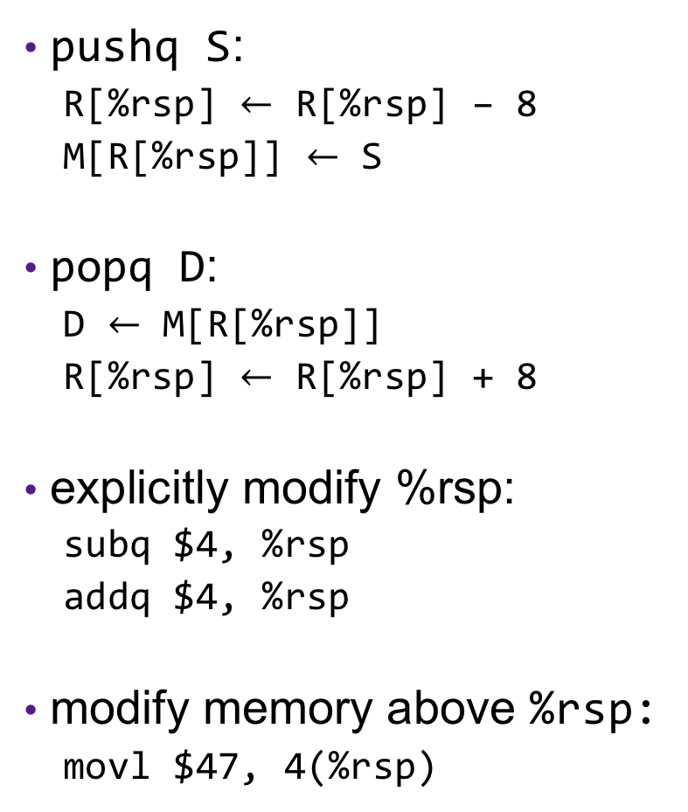
Modifying the Stack
0x7FFFFFFF
pushq S:
  R[%rsp] $←$ R[%rsp] – 8
  M[R[%rsp]] $←$ S
popq D:
  D $←$ M[R[%rsp]]
  R[%rsp] $←$ R[%rsp] + 8
explicitly modify %rsp:
  subq $4, %rsp
  addq $4, %rsp
modify memory above %rsp:
  movl $47, 4(%rsp)
Stack
%rsp
47
S
Heap
Text
%rip
Code
0x00000000

Slide 8
Modifying the Stack
0x7FFFFFFF
call f:
  pushq %rip
  movq &f, %rip
ret:
  popq %rip
Stack
47
%rsp
old %rip
Heap
Text
%rip
Code
0x00000000

Slide 9
Example: Modifying the Stack
int proc(int* p){
return p[3];
}
int example1(int x) {
int a[4];
a[0] = 13;
a[1] = 47;
a[2] = 105;
a[3] = 41;
return proc(a) + 1;
}
proc:
movl 12(%rdi), %eax
ret
example1:
subq $16, %rsp
movl $13, (%rsp)
movl $47, 4(%rsp)
movl $105, 8(%rsp)
movl $41, 12(%rsp)
movq %rsp, %rdi
call 0x400596 <proc>
addl $1, %rax
addq $16, %rsp
ret
Notes:
Walk through on board, then demo
Demo 1 - Procedure calls (note: run on linux server):
make example1
gdb example1
(gdb) b example1 # set breakpoint at beginning of function example1
(gdb) disassem example1 # show assembly code and walk through
(gdb) r
(gdb) info reg # observe values in %rsp and %rip
(gdb) stepi
(gdb) info reg # observe new values of %rsp and %rip
(gdb) x/4wd $rsp # see initial values in a as ints
(gdb) step i
(gdb) x/4wd $rsp # observe new array values (a[3] now 10)
(gdb) x/3gx $rsp # observe return address value
(gdb) disassem main # observe ret addr is next instr in main

Slide 10
Exercise 1: Modifying the Stack
0x400557 <fun>:
400557: movq $13, 16(%rsp)
40055a: ret
0x40055b <main>:
40055b: sub $8, %rsp
40055f: pushq $47
400560: callq 400557 <fun>
400565: popq %rax
400566: addq (%rsp), %rax
40056a: addq $8, %rsp
40056e: ret
0x40056f
%rsp
0xf0
13
0xe8
47
%rip
0xe0
0x400565
0xd8
0xd0
0xc8
0xc0
%rax
47
60
0xb8
What's the value in %rax immediately before the instruction at 0x40056e is executed?
What's the value in %rsp immediately before the instruction at 0x40056e is executed?

Slide 11
Procedure Calls (simplified)
Caller
Callee
Before
  Put arguments in place (if there are parameter vars)
  Make call
After
  Use result (if non-void)
Preamble
  Allocate space on stack (if needed)
Exit code
  Put return value in place (if non-void function)
  Deallocate space on stack (if allocated)
  Return

Slide 12
Example: Modifying the Stack
int example1(int x) {
int a[4];
a[0] = 13;
a[1] = 47;
a[2] = 105;
a[3] = 41;
return proc(a) + 1;
}
example1:
subq $16, %rsp
movl $13, (%rsp)
movl $47, 4(%rsp)
movl $105, 8(%rsp)
movl $41, 12(%rsp)
movq %rsp, %rdi
call 0x400596 <proc>
addl $1, %rax
addq $16, %rsp
ret
allocate
args
call
ret. val
dealloc.
return

Slide 13
Maintaining Variable state
int function(){
int x = 47;
int y = 13;
mystery(y);
// what is x?
// what is y?
}
function:
movl $47, %rbx
movl $13, %rdi
call 0x40042a <mystery>
# what is in %rbx?
# what is in %rdi?
ret
Notes:
walk through two options: caller-saved, callee-saved

Slide 14
X86-64 Register Usage Conventions
%rax
%r8
(function result)
(fifth argument)
%rbx
%r9
(sixth argument)
%rcx
%r10
(fourth argument)
%rdx
%r11
(third argument)
%rsi
%r12
(second argument)
%rdi
%r13
(first argument)
%rsp
%r14
(stack pointer)
%rbp
%r15
Callee-saved registers are shaded

Slide 15
Procedure Calls, Division of Labor
Caller
Callee
Before
  Save caller-saved registers to stack (if used after call)
  Put arguments in place (if there are parameters)
  Make call
After
  Restore caller-saved register (if used after call)
  Use result (if non-void)
Preamble
  Save callee-saved registers (if will use)
  Allocate space on stack (if needed)
Exit code
  Put return value in place (if non-void function)
  Restore callee-saved registers (if used)
  Deallocate space on stack (if allocated)
  Return

Slide 16
Exercise 2: Value Passing
0x400540 <last>:
400540: mov %rdi, %rax
400543: imul %rsi, %rax
400547: ret
0x400548 <first>:
400548: lea 0x1(%rdi),%rsi
40054c: sub $0x1, %rdi
400550: callq 400540 <last>
400555: rep; ret
0x400556 <main>:
400560: mov $4, %rdi
400563: callq 400548 <first>
400568: addq $0x13, %rax
40056c: ret
%rsp
0x400568
0x400555
%rdi
%rsi
%rax
%rip
What value gets returned by main?
5
3
15
3
34
0x40054c
0x400550
0x400543
0x400560
0x400563
0x400540
0x400548
0x400547
0x400555
0x400568
0x40056c
4
0x400560

Slide 17
Handling Extra Parameters
Conventions define 6 registers for storing arguments
If function has more than 6 parameters, additional arguments go on the stack

Slide 18
Procedure Call Example: Arguments
int func1(int x1, int x2, int x3,
int x4, int x5, int x6,
int x7, int x8){
int y1 = x1+x2;
int y2 = x3+x4;
int y3 = x5+x6;
int y4 = x7+x8;
int y5 = 4;
int y6 = 13;
int y7 = 47;
int y8 = y1 + y2 + y3 + y4 + y5
+ y6 + y7;
return y8;
}
int main(int argc, char *argv[]){
int x = func1(1,2,3,4,5,6,7,8);
return x;
}
func1:
addl %edi, %esi
addl %ecx, %edx
addl %r9d, %r8d
movl 16(%rsp), %eax
addl 8(%rsp), %eax
addl %esi, %edx
addl %r8d, %edx
leal 64(%rax,%rdx), %eax
ret
main:
movl $1, %edi
movl $2, %esi
movl $3, %edx
movl $4, %ecx
movl $5, %r8d
movl $6, %r9d
pushq $8
pushq $7
callq _function1
addq $16, %rsp
retq
Notes:
note: clang actually assembly adds pushq rax to beginning and popq rcx to end to align to 16 bytes (seen in demo)

Slide 19
Stack Frames
0x7FFFFFFF
Each function called gets a stack frame
Passing data:
  calling procedure P uses registers (and stack) to provide parameters to Q.
  Q uses register %rax for return value
Passing control:
  call <proc>
    Pushes return address (current %rip) onto stack
    Sets %rip to first instruction of proc
  ret
    Pops return address from stack and places it in %rip
Local storage:
  allocate space on the stack by decrementing stack pointer, deallocate by incrementing
…
Stack
local variables
%rsp
Arguments 7..n
return address
saved registers
local variables
Heap
Text
%rip
Code
0x00000000

Slide 20
Recursion
Handled Without Special Consideration
  Stack frames mean that each function call has private storage
    Saved registers & local variables
    Saved return pointer
  Register saving conventions prevent one function call from corrupting another’s data
    Unless the C code explicitly does so (more later!)
  Stack discipline follows call / return pattern
    If P calls Q, then Q returns before P
    Last-In, First-Out
Also works for mutual recursion
  P calls Q; Q calls P

Slide 21
Array Recursion
int sum_digits_r(int* z, int i){
if(i >= 5){
return 0;
}
int val = z[i];
int sum_r = sum_digits_r(z,i+1);
return sum + val;
}
sum_digits_r:
cmp $4, %rsi
jle L2
mov $0, %rax
ret
L2:
push %rbx
mov (%rdi,%rsi,4), %ebx
incr $1, %rsi
call sum_digits_r
add %ebx, %eax
pop %rbx
ret
Notes:
Discussion: compare the differences, then On board: work through stack for this example. then Demo: recursive function
(gdb) disassem sum_digits_r # show assembly
(gdb) b *0x400563 # set breakpoint at base case ret
(gdb) r
(gdb) bt # show stack trace
(gdb) x/10gx # show contents of stack and compare to diagram on board
(gdb) disassem sum_digits_r # find stored return address in assembly code
(gdb) c # continue to end (main prints return value)

Slide 22
Example: Array Recursion
%rsp
47
sum_digits_r:
cmp $4, %rsi
jle L2
mov $0, %rax
ret
L2:
push %rbx
mov (%rdi,%rsi,4), %ebx
incr $1, %rsi
call sum_digits_r
add %ebx, %eax
pop %rbx
ret
&add
9
&add
1
&add
7
&add
9
1
7
1
1
36
40
44
48
52
56
1
%rdi
%rsi
%rax
%rbx
9
19
4
10
5
2
9
3
9
0
1
47
36
0
1
7
&add
1
47
1
2
47
1
7
Notes:
Discussion: compare the differences, then On board: work through stack for this example. then Demo: recursive function
(gdb) disassem sum_digits_r # show assembly
(gdb) b *0x400563 # set breakpoint at base case ret
(gdb) r
(gdb) bt # show stack trace
(gdb) x/10gx # show contents of stack and compare to diagram on board
(gdb) disassem sum_digits_r # find stored return address in assembly code
(gdb) c # continue to end (main prints return value)

