Slide 1
Lecture 2: Representing Integers
CS 105 Spring 2026

Slide 2
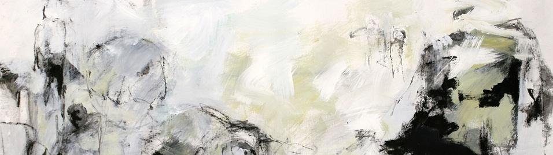



Review: Abstraction

Slide 3
Review: Memory
bytes
Memory is an array of bits
A byte is a unit of eight bits
An index into the array is an address, location, or pointer
Often expressed in hexadecimal
We speak of the value in memory at an address
The value may be a single byte …
… or a multi-byte quantity starting at that address
00110111
1
1
1
0
1
1
0
3
0
11010001
1
0
0
0
1
0
1
2
1
01010011
1
1
0
0
1
0
1
1
0
01101100
0
0
1
1
0
1
0
1
0

Slide 4
Review: Bits Require Interpretation
10001100 00001100 10101100 00000000
might be interpreted as
The integer 3,485,745
A floating point number close to 4.884569 x 10⁻³⁹
The string “105”
A portion of an image or video
An address in memory

Slide 5


Representing Integers
Arabic Numerals: 47
Roman Numerals: XLVII
Brahmi Numerals:
Tally Marks: IIII IIII IIII IIII IIII IIII IIII IIII IIII II

Slide 6
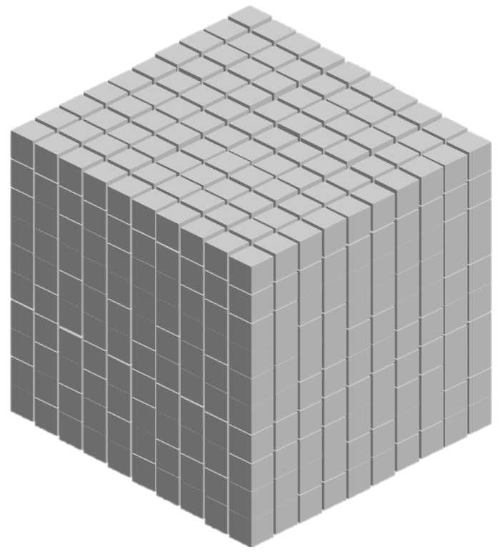
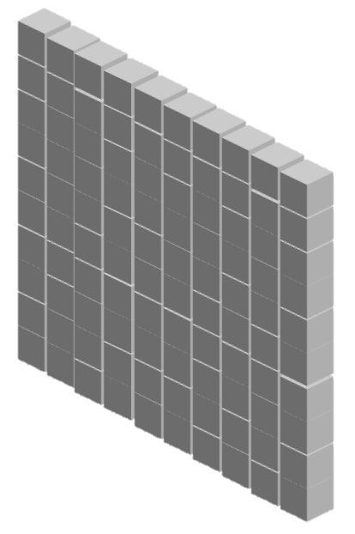

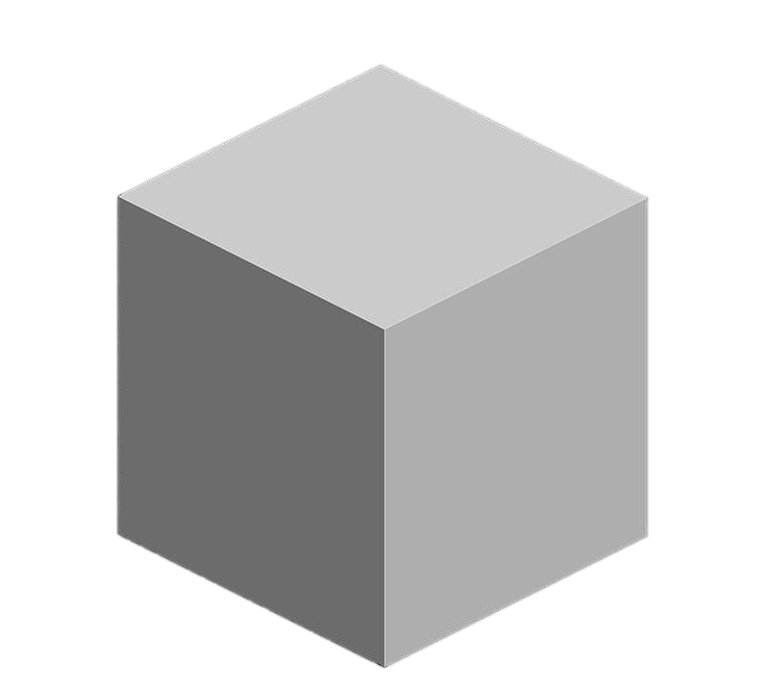
Base-10 Integers
1000 (10³) | 100 (10²) | 10 (10¹) | 1 (10⁰)
0 | 0 | 0 | 5
0 | 0 | 4 | 7
1 | 8 | 8 | 7

Slide 7
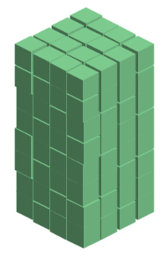
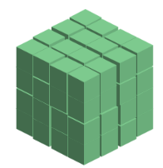
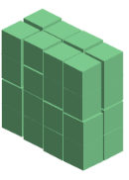
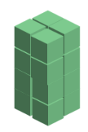



Base-2 Integers (aka Binary Numbers)
128 (2⁷) | 64 (2⁶) | 32 (2⁵) | 16 (2⁴) | 8 (2³) | 4 (2²) | 2 (2¹) | 1 (2⁰)
0 | 0 | 0 | 0 | 0 | 1 | 0 | 1
0 | 0 | 1 | 0 | 1 | 1 | 1 | 1
1 | 1 | 1 | 1 | 1 | 1 | 1 | 1

Slide 8
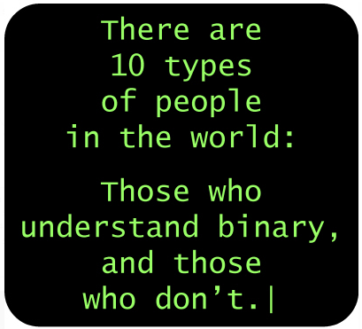
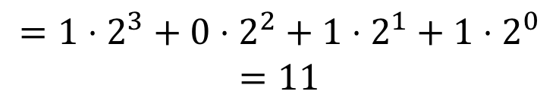
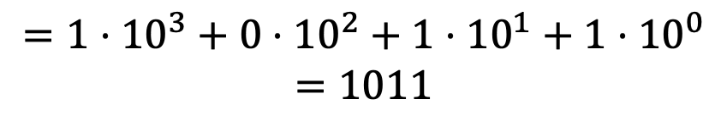
Binary Numbers
Decimal (Base-10):
Binary (Base-2):
1011
$$=1⋅{10}^{3}+0⋅{10}^{2}+1⋅{10}^{1}+1⋅{10}^{0}$$
$$=1011$$
1011
$$=1⋅2^{3}+0⋅2^{2}+1⋅2^{1}+1⋅2^{0}$$
$$=11$$

Slide 9
Exercise 1: Binary Numbers
Consider the following four-bit binary values. What is the (base-10) integer interpretation of these values?
0001
1010
0111
1111
1
10
7
15

Slide 10
Exercise 2: Binary Number Range
What are the max number and min number that can be represented by a w-bit binary number?
w = 3
w = 4
w = 8

Slide 11
Unsigned Integers in C
C Data Type | Size (bytes)
unsigned char | 1
unsigned short | 2
unsigned int | 4
unsigned long | 8
Notes:
Note: unsigned demo

Slide 12
ASCII characters
Char | Dec | Binary
! | 33 | 00100001
" | 34 | 00100010
# | 35 | 00100011
$ | 36 | 00100100
% | 37 | 00100101
& | 38 | 00100110
' | 39 | 00100111
( | 40 | 00101000
) | 41 | 00101001
* | 42 | 00101010
+ | 43 | 00101011
, | 44 | 00101100
- | 45 | 00101101
. | 46 | 00101110
/ | 47 | 00101111
0 | 48 | 00110000
Char | Dec | Binary
1 | 49 | 00110001
2 | 50 | 00110010
3 | 51 | 00110011
4 | 52 | 00110100
5 | 53 | 00110101
6 | 54 | 00110110
7 | 55 | 00110111
8 | 56 | 00111000
9 | 57 | 00111001
: | 58 | 00111010
; | 59 | 00111011
< | 60 | 00111100
= | 61 | 00111101
> | 62 | 00111110
? | 63 | 00111111
@ | 64 | 01000000
Char | Dec | Binary
A | 65 | 01000001
B | 66 | 01000010
C | 67 | 01000011
D | 68 | 01000100
E | 69 | 01000101
F | 70 | 01000110
G | 71 | 01000111
H | 72 | 01001000
I | 73 | 01001001
J | 74 | 01001010
K | 75 | 01001011
L | 76 | 01001100
M | 77 | 01001101
N | 78 | 01001110
O | 79 | 01001111
P | 80 | 01010000
Char | Dec | Binary
Q | 81 | 01010001
R | 82 | 01010010
S | 83 | 01010011
T | 84 | 01010100
U | 85 | 01010101
V | 86 | 01010110
W | 87 | 01010111
X | 88 | 01011000
Y | 89 | 01011001
Z | 90 | 01011010
[ | 91 | 01011011
\ | 92 | 01011100
] | 93 | 01011101
^ | 94 | 01011110
_ | 95 | 01011111
` | 96 | 01100000
Char | Dec | Binary
a | 97 | 01100001
b | 98 | 01100010
c | 99 | 01100011
d | 100 | 01100100
e | 101 | 01100101
f | 102 | 01100110
g | 103 | 01100111
h | 104 | 01101000
i | 105 | 01101001
j | 106 | 01101010
k | 107 | 01101011
l | 108 | 01101100
m | 109 | 01101101
n | 110 | 01101110
o | 111 | 01101111
p | 112 | 01110000

Slide 13
Hexidecimal Numbers
00101100 00110101 00110000 11100001
Dec | Hex
0
1
2
3
4
5
6
7
8
9
10
11
12
13
14
15
0
1
2
3
4
5
6
7
8
9
2
c
3
5
3
0
e
1
0x2c3530e1
a
b
c
d
e
f

Slide 14
Exercise 3: Hexidecimal Numbers
Consider the following hexidecimal values. What is the representation of each value in binary?
0x0a
0x11
0x2f
00001010 (10)
00010001 (17)
00101111 (47)

Slide 15
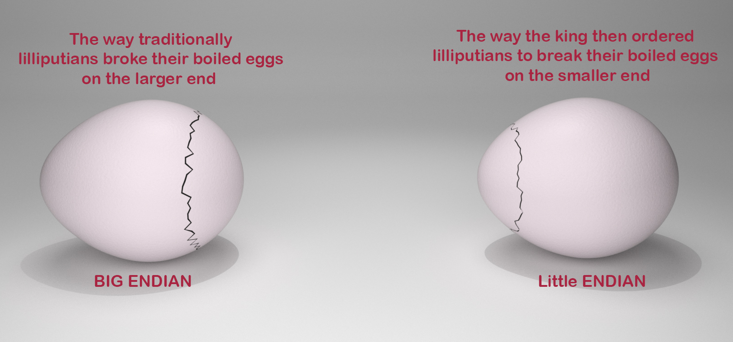
Endianness
47 vs 74

Slide 16
Endianness
Big Endian: low-order bits go on the right (47)
I tend to think in big endian numbers, so examples in class will generally use this representation
Networks generally use big endian (aka network byte order)
Little Endian: low-order bits go on the left (74)
Most modern machines use this representation
I will try to always be clear about whether I'm using a big endian or little endian representation
When in doubt, ask!

Slide 17
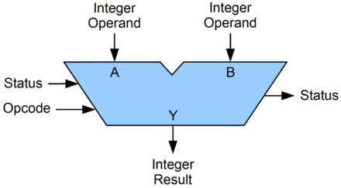
Arithmetic Logic Unit (ALU)
circuit that performs bitwise operations and arithmetic on integer binary types

Slide 18
Bitwise vs Logical Operations in C
Bitwise Operators &, |, ~, ^
View arguments as bit vectors
operations applied bit-wise in parallel
Logical Operators &&, ||, !
View 0 as “False”
View anything nonzero as “True”
Always return 0 or 1
Early termination
Shift operators <<, >>
Left shift fills with zeros
For unsigned integers, right shift is logical (fills with zeros)

Slide 19
Exercise 4: Bitwise vs Logical Operations
Assume unsigned char data type (one byte). What do each of the following expressions evaluate to (interpreted as unsigned integers and expressed base-10)?
~150
!150
150 & 51
150 | 51
150 && 51
150 || 51
150 << 2
150 >> 2
= ~(10010110) = 01101001 = 105
= !(10010110) = 00000000 = 0
= 10010110 & 00110011 = 00010010 = 18
= 10010110 | 00110011 = 10110111 = 183
= 10010110 && 00110011 = 00000001 = 1
= 10010110 || 00110011 = 00000001 = 1
= 10010110 << 2 = 01011000 = 88
= 10010110 >> 2 = 00100101 = 37

Slide 20
Addition Example
Compute 5 + 6 assuming all ints are stored as eight-bit (1 byte) unsigned values
1
0 0 0 0 0 1 0 1
+ 0 0 0 0 0 1 1 0
0
0
0
0
1
0
1
1
= 11 (Base-10)
Like you learned in grade school, only binary!
… and with a finite number of digits

Slide 21
Addition Example with Overflow
Compute 200 + 100 assuming all ints are stored as eight-bit (1 byte) unsigned values
1
1
1 1 0 0 1 0 0 0
+ 0 1 1 0 0 1 0 0
0
0
1
0
1
1
0
0
= 44 (Base-10)
Like you learned in grade school, only binary!
… and with a finite number of digits

Slide 22

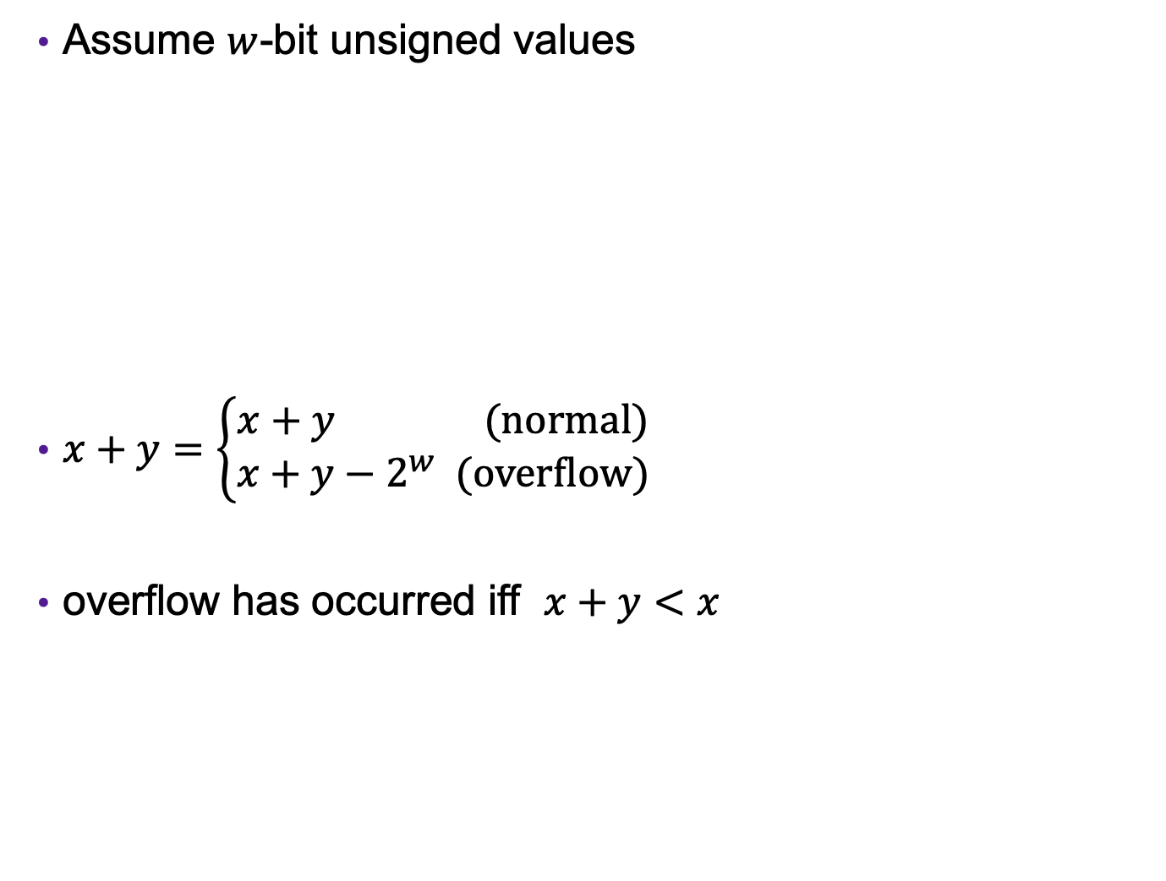



Error Cases (Unsigned Ints)
Assume $w$-bit unsigned values
$x+y=\left\{\begin{aligned}x+y (normal) \\ x+y−2^{w} (overflow)\end{aligned}\right.$
overflow has occurred iff $x+y<x$
$$0$$
$$2^{w}−1$$
$${2⋅(2}^{w}−1)$$
[ ]
representable values
[ ]
Possible values of $x+y$
modular addition

Slide 23
Exercise 5: Binary Addition
Given the following 5-bit unsigned values, compute their sum and indicate whether or not an overflow occurred
x | y | x+y | overflow?
00010 | 00101
01100 | 00100
10100 | 10001
x+y | overflow?
00111
no
10000
no
00101
yes

Slide 24
Multiplication Example
Compute 5 x 6 assuming all ints are stored as eight-bit (1 byte) unsigned values
0 0 0 0 0 1 0 1
x 0 0 0 0 0 1 1 0
0 0 0 0 0 0 0 0
0 0 0 0 0 1 0 1 0
0 0 0 0 0 1 0 1 0 0
+ _
0 0 0 1 1 1 1 0
= 30 (Base-10)
Like you learned in grade school, only binary!
… and with a finite number of digits

Slide 25
Multiplication Example
Compute 200 x 3 assuming all ints are stored as eight-bit (1 byte) unsigned values
1 1 0 0 1 0 0 0
x 0 0 0 0 0 0 1 1
1 1 0 0 1 0 0 0
1 1 0 0 1 0 0 0 0
+ _
1 0
0 1 0 1 1 0 0 0
= 88 (Base-10)
Like you learned in grade school, only binary!
… and with a finite number of digits

Slide 26




Error Cases
Assume $w$-bit unsigned values
$x∗y=\left(x⋅y\right) mod 2^{w}$
$$0$$
$$2^{w}−1$$
$${{(2}^{w}−1)⋅(2}^{w}−1)$$
[ )
representable values
[ )
Possible values of $x∗y$

Slide 27
Exercise 6: Binary Multiplication
Given the following 3-bit unsigned values, compute their product and indicate whether or not an overflow occurred
x | y | x*y | overflow?
100 | 101
010 | 011
111 | 010
x*y | overflow?
100
yes
110
no
110
yes

Slide 28
Multiplying with Shifts
Multiplication is slow
Bit shifting is kind of like multiplication, and is often faster
x * 8 = x << 3
x * 10 = x << 3 + x << 1
Most compilers will automatically replace multiplications with shifts where possible

