Slide 1
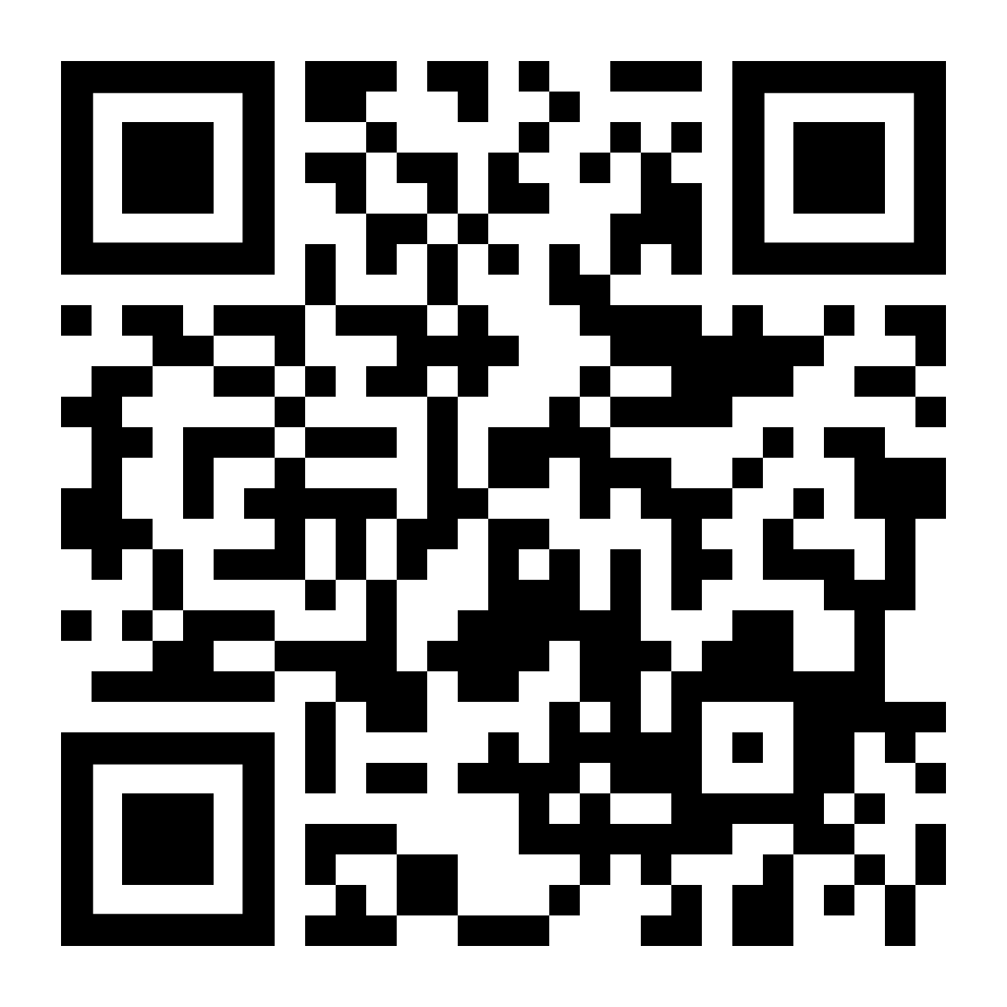
Lecture 1: Introduction to Computer Systems
CS 105
https://cs.pomona.edu/classes/cs105/

Slide 2
Programming on Computers
We are very comfortable with “coding” by now
Variables, values, conditionals, loops, functions…
But: we are interested in writing programs that run on computers
Sometimes, we need more fine-grained control (or at least more precise information) about what is happening in the actual processor and memory
This can lead to confusing situations and new subtleties
This class is to help you handle those times
Notes:
Example 1:
40000 * 40000 ➙ 1600000000
50000 * 50000 ➙ ??
Example 2:
(2^30 + -2^30) + 3.14 ➙ 3.14
2^30 + (-2^30 + 3.14) ➙ 0

Slide 3
Correctness
Example 1: Is x² ≥ 0?
Floats: Yes!
Ints: Maybe…
Example 2: Is (x + y) + z = x + (y + z)?
Ints: Yes!
Floats: Maybe…
Notes:
Example 1:
40000 * 40000 ➙ 1600000000
50000 * 50000 ➙ ??
Example 2:
(2^30 + -2^30) + 3.14 ➙ 3.14
2^30 + (-2^30 + 3.14) ➙ 0

Slide 4
Performance
void copyij(int src[2048][2048],
int dst[2048][2048]){
int i,j;
for (i = 0; i < 2048; i++){
for (j = 0; j < 2048; j++){
dst[i][j] = src[i][j];
}
}
}
void copyji(int src[2048][2048],
int dst[2048][2048]){
int i,j;
for (j = 0; j < 2048; j++){
for (i = 0; i < 2048; i++){
dst[i][j] = src[i][j];
}
}
}
4.3ms
81.8ms
Notes:
2.0 GHz Intel Core i7 Haswell
Hierarchical memory organization
Performance depends on access patterns
Including how step through multi-dimensional array

Slide 5
Security
int buggy_authenticate(){
char password[4]; // allocate space to store a string
gets(password); // initialize string from user input
return 0; // always returns False
}
void example3(){
if(buggy_authenticate()){ // equivalent to if False
printf("The answer is 42\n"); // should never happen
} else {
printf("Unauthenticated User (correct behavior)\n");
}
}

Slide 6
Bits

Slide 7
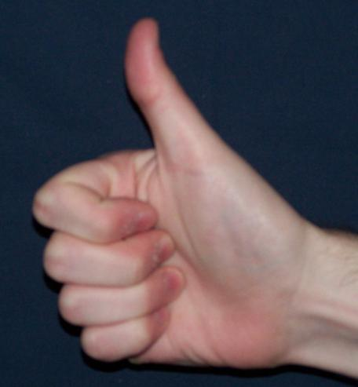
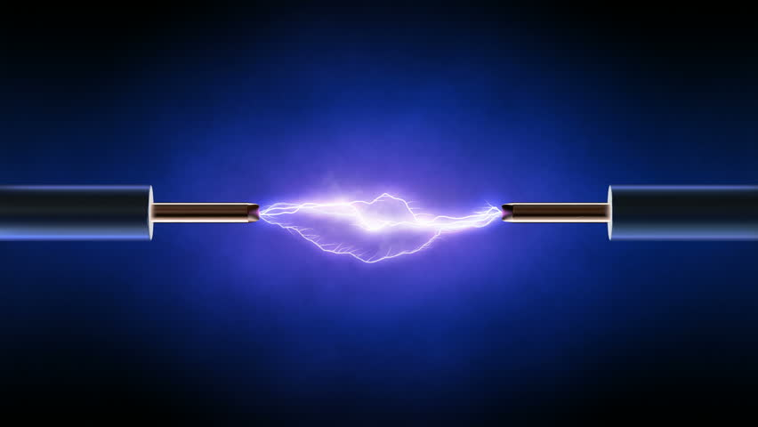
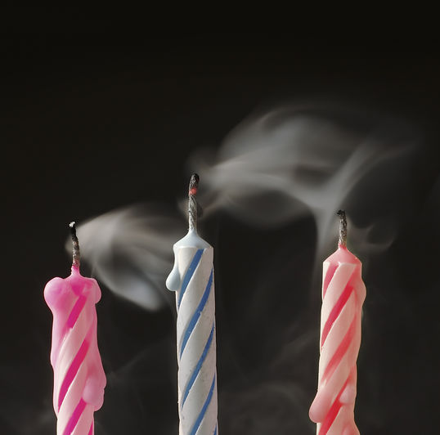
Bits
a bit is a binary digit that can have two possible values
can be physically represented with a two state device

Slide 8
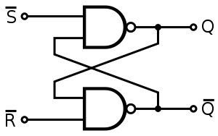
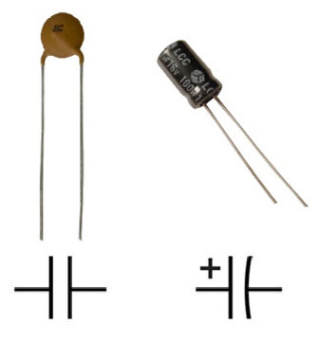
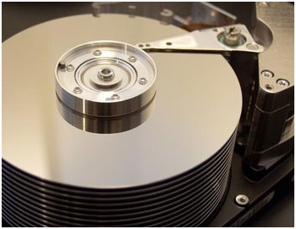
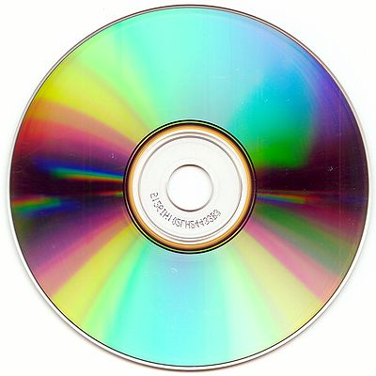
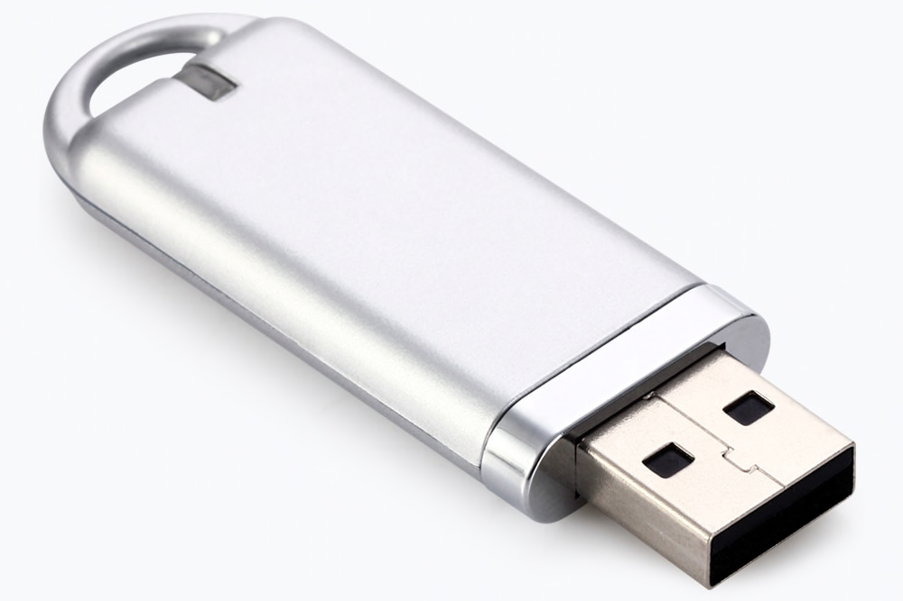
Storing bits
Static random access memory (SRAM): stores each bit of data in a flip-flop, a circuit with two stable states
Dynamic Memory (DRAM): stores each bit of data in a capacitor, which stores energy in an electric field (or not)
Magnetic Disk: regions of the platter are magnetized with either N-S polarity or S-N polarity
Optical Disk: stores bits as tiny indentations (pits) or not (lands) that reflect light differently
Flash Disk: electrons are stored in one of two gates separated by oxide layers

Slide 9
Boolean Algebra
Developed by George Boole in 19th Century
Algebraic representation of logic---encode “True” as 1 and “False” as 0
How does this map to set operations?
And
Or
Not
Exclusive-Or (Xor)

Slide 10
Exercise 1: Boolean Operations
Evaluate each of the following expressions
1 | (~1)
~( 1 | 1)
(~1) & 1
~( 1 ^ 1)
= 1 | 0 = 1
= ~ ( 1 ) = 0
= (0) & 1 = 0
= ~ ( 0 ) = 1

Slide 11
Bytes and Memory
bytes
Memory is an array of bits
A byte is a unit of eight bits
An index into the array of memory is an address, location, or pointer
We speak of the value in memory at an address
The value may be a single byte …
… or a multi-byte quantity starting at that address
1
00110111
1
1
0
1
1
0
3
0
1
11010001
0
0
0
1
0
1
2
1
1
01010011
1
0
0
1
0
1
1
0
0
01101100
0
1
1
0
1
0
1
0

Slide 12
General Boolean algebras
Bitwise operations on bytes
01101001
& 01010101
01000001
01101001
| 01010101
01111101
01101001
^ 01010101
00111100
~ 01010101
10101010
01000001
01111101
00111100
10101010

Slide 13
Exercise 2: Bitwise Operations
Assume: a = 01101100, b = 10101010
What are the results of evaluating the following Boolean operations?
~a
a & b
a | b
a ^ b
= 10010011
= 00101000
= 11101110
= 11000110

Slide 14
Bitwise vs Logical Operations
Bitwise Operators &, |, ~, ^
View arguments as bit vectors
operations applied bit-wise in parallel
Logical Operators &&, ||, !
View 0 as “False”
View anything nonzero as “True”
Always return 0 or 1
Early termination

Slide 15
Exercise 3: Bitwise vs Logical Operations
~01101100
~00000000
~~01101100
!01101100
!00000000
!!01101100
01101100 & 10101010
01101100 | 10101010
01101100 && 10101010
01101100 || 10101010
10010011
11111111
01101100
00000000
00000001
00000001
00101000
11101110
00000001
00000001

Slide 16
Bit Shifting
Left Shift: x << y
Shift bit-vector x left y positions
Throw away extra bits on left
Fill with 0’s on right
Right Shift: x >> y
Shift bit-vector x right y positions
Throw away extra bits on right
Logical shift: Fill with 0’s on left
Arithmetic shift: Replicate most significant bit on left
Undefined Behavior if you shift amount < 0 or ≥ word size
Undefined behavior if you shift too big a signed value left
Choice between logical and arithmetic depends on the type of data
Undefined behavior if you shift a negative signed integer right

Slide 17
Example: Bit Shifting
01101001 << 4
01101001 >>_{l} 2
01101001 >>_{a} 4
10010000
00011010
00000110
Notes:
Note: Shift demo

Slide 18
Exercise 4: Bit Shifting
10101010 << 4
10101010 >>_{l} 4
10101010 >>_{a} 4
10100000
00001010
11111010
Notes:
Note: Shift demo

Slide 19
Bits and Bytes Require Interpretation
10001100 00001100 10101100 00000000
might be interpreted as
The integer 3,485,745
A floating point number close to 4.884569 x 10⁻³⁹
The string “105”
A portion of an image or video
An address in memory

Slide 20
Information is Bits + Context

Slide 21
Logistics

Slide 22
The Course in a Nutshell
Textbooks (not required)
Bryant and O’Halloran, Computer Systems: A Programmer’s Perspective, third edition, Pearson, 2016
Arpaci-Dusseau and Arpaci-Dusseau, Operating Systems: Three Easy Pieces, online, 2018
Classes
Tuesday and Thursday, 1:15-2:30pm in SCOM 102
Labs
Fridays in Edmunds 105 at 1:15
Starts this Friday!
Lab nominally ends at 2:30, but we have the space longer
Office Hours Mo/Fr 9:30-11:30
Mentor Sessions TBA

Slide 23
Grading
Assignments (9)
Introduced after Thursday class, due following Thursday at 11:59pm
Tremendous fun, work in pairs during lab
10 late days
Check-ins (5)
three-question quizzes (13 topics total)
Feb 14, Mar 14, Apr 4, Apr 18, May 1
Can improve grade on any topics(s) with "Extra Chance Check-in" (may take after any later check-in or during final class period May 6)
Grades
Must successfully complete all the assignments
40% assignments, 40% check-ins, 15% quizzes, 5% participation

Slide 24
Quiz 1
What are the main resources you can use to get help in this class?
What should you do if you think you can’t complete an assignment on time?
Where will you be this Friday from 1:15-2:30?
> Take 5 minutes to answer
> Compare answers with your local group, update if need be
> Self-grade and turn in your papers
> Next quiz won’t be in the lecture slides!

Slide 25
Course website
https://cs.pomona.edu/classes/cs105
All information is on the course website
All course materials get posted on the course website
Links from the course page:
Slack (#csci105po-2425-sp), for questions and discussion
Gradescope, for submitting assignments and seeing grades
Additional resources

