Slide 1
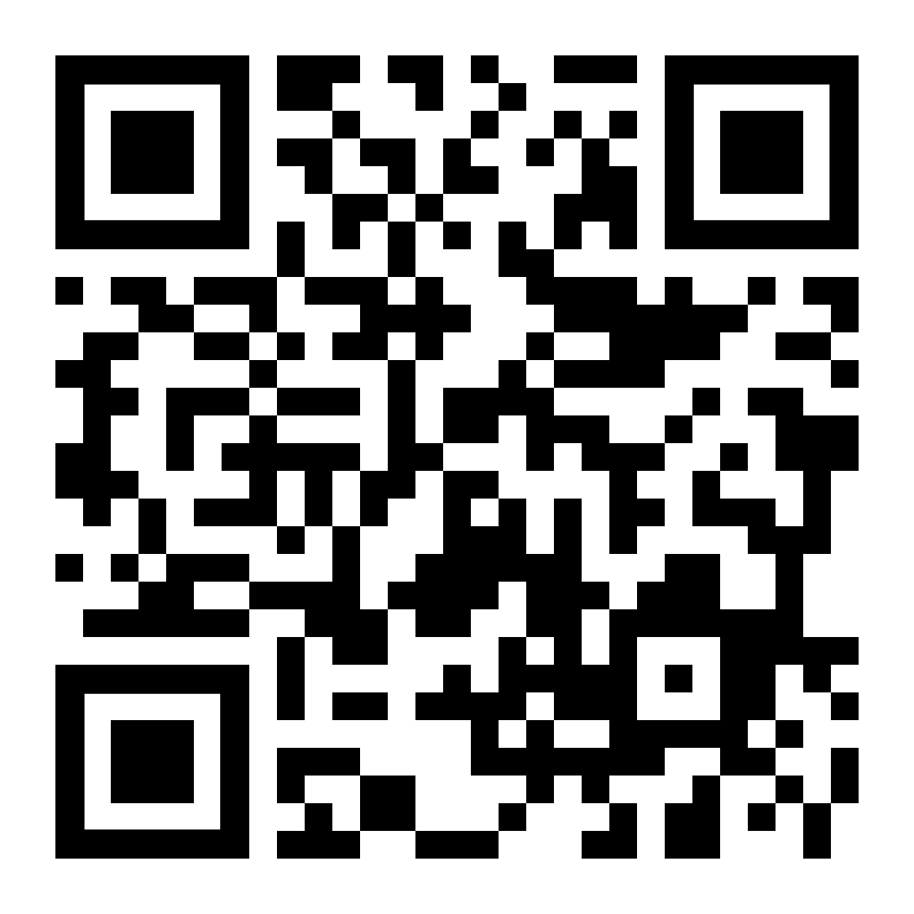
Lecture 0: Introduction to Computer Systems
CS 105 Spring 2026
https://cs.pomona.edu/classes/cs105/

Slide 2
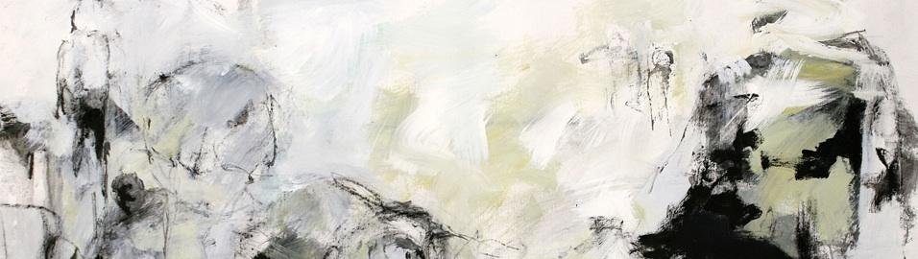



Abstraction

Slide 3
Correctness
Example 1: Is x² ≥ 0?
  Floats: Yes!
  Ints: Maybe…
Example 2: Is (x + y) + z = x + (y + z)?
  Ints: Yes!
  Floats: Maybe…
Notes:
Example 1:
40000 * 40000 ➙ 1600000000
50000 * 50000 ➙ ??
Example 2:
(2^30 + -2^30) + 3.14 ➙ 3.14
2^30 + (-2^30 + 3.14) ➙ 0

Slide 4
Performance
void copyij(int src[2048][2048],
int dst[2048][2048]){
int i,j;
for (i = 0; i < 2048; i++){
for (j = 0; j < 2048; j++){
dst[i][j] = src[i][j];
}
}
}
void copyji(int src[2048][2048],
int dst[2048][2048]){
int i,j;
for (j = 0; j < 2048; j++){
for (i = 0; i < 2048; i++){
dst[i][j] = src[i][j];
}
}
}
4.3ms
81.8ms
Notes:
2.0 GHz Intel Core i7 Haswell
Hierarchical memory organization
Performance depends on access patterns
Including how step through multi-dimensional array

Slide 5
Security
int buggy_authenticate(){
char password[4]; // allocate space to store a string
gets(password); // initialize string from user input
return 0; // always returns False
}
void example3(){
if(buggy_authenticate()){ // equivalent to if False
printf("The answer is 42\n"); // should never happen
} else {
printf("Unauthenticated User (correct behavior)\n");
}
}

Slide 6
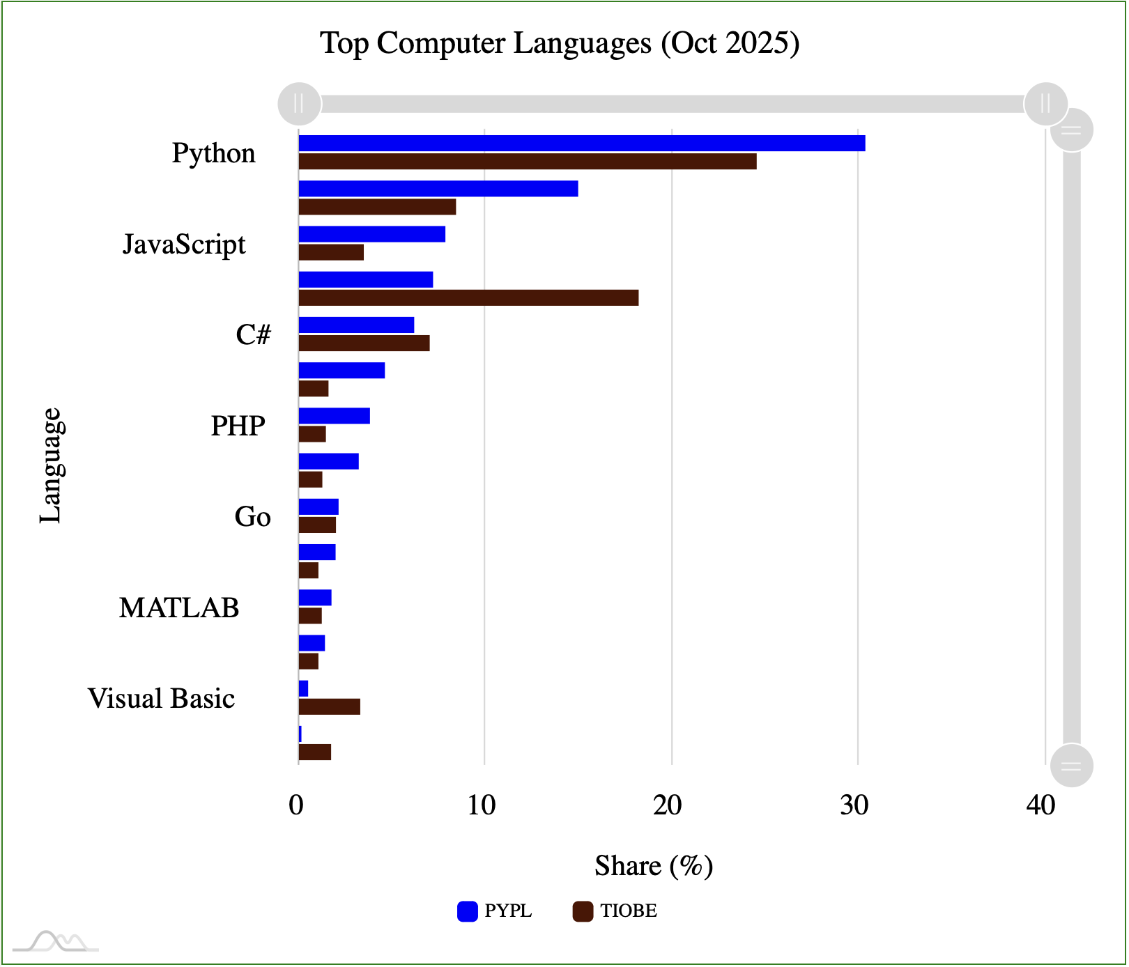
C
compiled, imperative language that provides low-level access to memory
low overhead, high performance
developed at Bell labs in the 1970s
C (and related languages) still
commonly used today
Java
C/C++
R
Rust
Kotlin
Ada
Perl
Notes:
https://statisticstimes.com/tech/top-computer-languages.php
https://pypl.github.io/PYPL.html
https://www.tiobe.com/tiobe-index/

Slide 7
Variables
Declaration
Assignment
Declaration and assignment
int myVariable;
type
name
semi-colon
myVariable = 47;
name
value
semi-colon
int myVariable = 47;

Slide 8
Operations
Arithmetic Operations: +, -, *, /, %
Boolean Operators: ==, !=, >, >=, <, <=
Logical Operations: &&, ||, !
(also bitwise operations… more on that next week)
int x = 47;
int y = x + 13;
y = (x * y) % 5;
int x = (13 == 47);
int x = 47;
int y = !x;
y = x && y;

Slide 9
Control Flow
Conditionals
While Loops
int x = 13;
int y;
if (x == 47){
y = 1;
} else {
y = 0;
}
int x = 47;
while (x > 0){
x = x – 1;
}
Do-While Loops
For Loops
int x = 47;
do {
x = x - 1;
} while (x > 0);
int x = 0;
for (int i=0; i < 47; i++){
x = x + i;
}

Slide 10
Functions
Declaring a Function
Calling a Function
int myFunction(int x, int y){
int z = x – 2*y;
return z * x;
}
int a;
a = myFunction(47, 13);

Slide 11
Exercise 1
Define a function sum_interval that takes two integers and returns an integer. If the second integer argument is greater than (or equal to) the first, it returns the sum of the integer values between those two numbers (inclusive). Otherwise it returns -1.

Slide 12
Main Functions
By convention, main functions in C take two arguments:
  int argc
  char** argv
By convention, main functions in C return an int
  0 if program exited successfully
int main(int argc, char** argv){
// do stuff
return 0;
}

Slide 13
Printing
printf("Hello world!\n");
printf("%d is a number\n", 13);
printf("%d is a number greater than %f\n”, 47, 3.14);
Notes:
More info:
https://www.tutorialspoint.com/format-specifiers-in-c
https://www.cprogramming.com/tutorial/printf-format-strings.html

Slide 14
Compilation
compiler
output name
filename
gcc -o hello hello.c
printf.o
Pre-
processor
(cpp)
Compiler
(cc1)
Assembler
(as)
Linker
(ld)
hello.c
hello.i
hello.s
hello.o
hello
Source
program
(text)
Modified
source
program
(text)
Assembly
program
(text)
Relocatable
object
programs
(binary)
Executable
object
program
(binary)
#include<stdio.h>
int main(int argc,
char ** argv){
printf("Hello
world!\n");
return 0;
}
…
int printf(const char *
restrict,
...) __attribute__((__format__ (__printf__, 1, 2)));
…
int main(int argc,
char ** argv){
printf("Hello
world!\n");
return 0;
}
pushq %rbp
movq %rsp, %rbp
subq $32, %rsp
leaq L_.str(%rip), %rax
movl $0, -4(%rbp)
movl %edi, -8(%rbp)
movq %rsi, -16(%rbp)
movq %rax, %rdi
movb $0, %al
callq _printf
xorl %ecx, %ecx
movl %eax, -20(%rbp)
movl %ecx, %eax
addq $32, %rsp
popq %rbp
retq
55
48 89 e5
48 83 ec 20
48 8d 05 25 00 00 00
c7 45 fc 00 00 00 00
89 7d f8
48 89 75 f0
48 89 c7
b0 00
e8 00 00 00 00
31 c9
89 45 ec
89 c8
48 83 c4 20
5d
c3

Slide 15
Running a Program
./hello

Slide 16
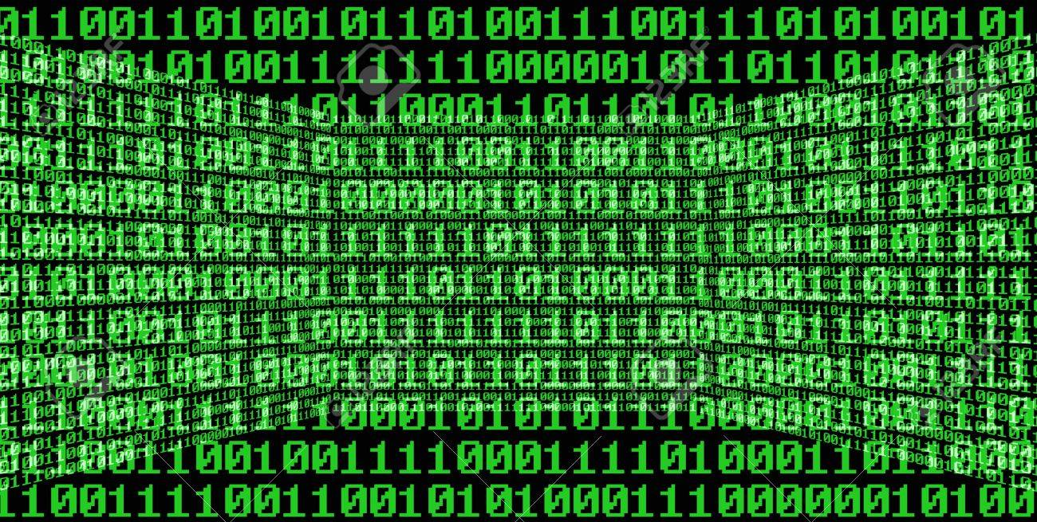
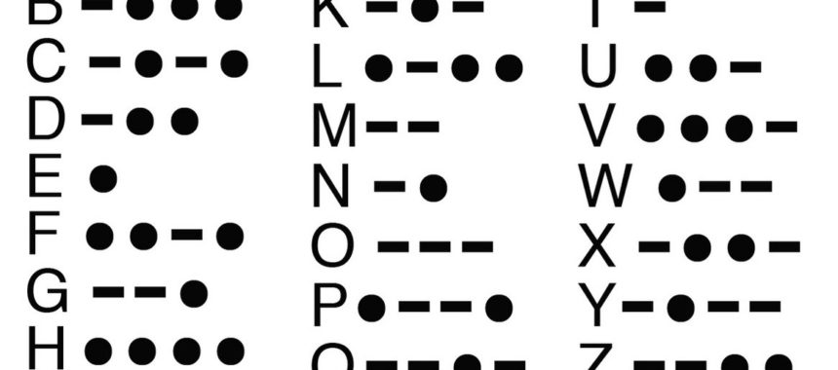




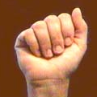
Bits
a bit is a binary digit that can have two possible values
can be physically represented with a two state device

Slide 17
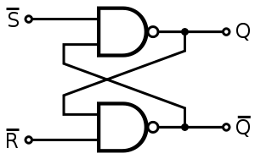
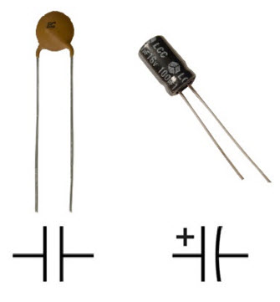
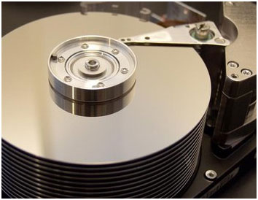
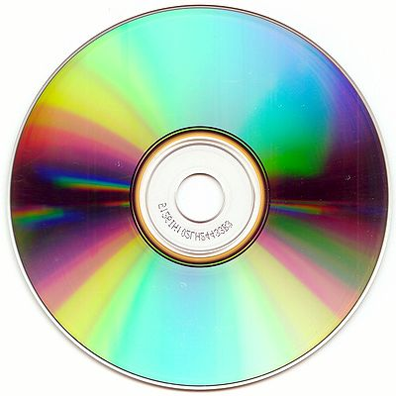

Storing bits
Static random access memory (SRAM): stores each bit of data in a flip-flop, a circuit with two stable states
Dynamic Memory (DRAM): stores each bit of data in a capacitor, which stores energy in an electric field (or not)
Magnetic Disk: regions of the platter are magnetized with either N-S polarity or S-N polarity
Optical Disk: stores bits as tiny indentations (pits) or not (lands) that reflect light differently
Flash Disk: electrons are stored in one of two gates separated by oxide layers

Slide 18
Bytes and Memory
bytes
Memory is an array of bits
A byte is a unit of eight bits
An index into the array of memory is an address, location, or pointer
  Often expressed in hexadecimal
We speak of the value in memory at an address
  The value may be a single byte …
  … or a multi-byte quantity starting at that address
00110111
1
1
1
0
1
1
0
3
0
11010001
1
0
0
0
1
0
1
2
1
01010011
1
1
0
0
1
0
1
1
0
01101100
0
0
1
1
0
1
0
1
0

Slide 19
Example C Types
C Data Type | x86-64
int | 4
double | 8
char | 1

Slide 20
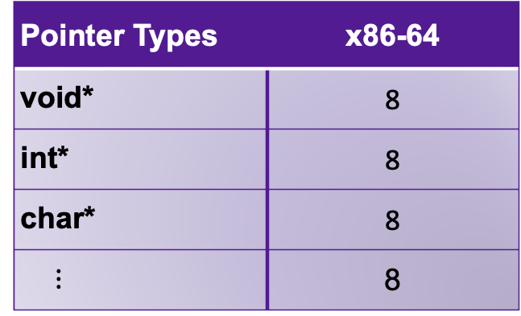
Pointers
Pointers are addresses in memory (i.e., indexes into the array of bytes)
Most pointers declare how to interpret the value at (or starting at) that address
Example:
Dereferencing pointers:
Pointer Types | x86-64
void* | 8
int* | 8
char* | 8
$⋮$ | 8
int myVariable = 47;
int* ptr = &myVariable;
& is an "address of" operator
* is a "value at" operator
int var2 = *ptr
& and * are inverses of one another

Slide 21
Exercise 2
13
What does x evaluate to in each of the following?
int* ptr = 32;
x = *ptr;
32
42
int y = 42; // assume allocated at address 28
x = &y;
y
int* ptr = 20;
x = **ptr; // same as *(*ptr)
28
0
47
int* x = 24;
*x = 47;
24
32
20

Slide 22
Casting between Pointer Types
13
You can cast values between different types
This includes between different pointer types!
Doesn't change value of address
Does change what you get when you dereference!
Example:
32
42
28
47
x
int x = 47; // assume allocated at address 24
int* ptr = &x;
24
char* ptr2 = (char*) ptr;
32
int y = *ptr;
char c = *ptr2;
20
Notes:
y = 47
c = '/'

Slide 23
Pointer Arithmetic
int* ptr = &myVariable;
char* ptr2 = (char*) ptr;
ptr += 1;
ptr2 += 1;
Location of ptr+k depends on the type of ptr
adding 1 to a pointer p adds 1*sizeof(*p) to the address

Slide 24
Exercise 3
20
What does x evaluate to in each of the following?
int* ptr = 20;
int* x = ptr+1;
32
47
int* ptr = 20;
int x = *(ptr+2)
char* ptr = 20;
char* x = ptr+1;
28
13
char* ptr = 20;
int x = *((int*)(ptr + 4));
24
32
20

Slide 25
Arrays
Contiguous block of memory
Random access by index
  Indices start at zero
Declaring an array:
Accessing an array:
Arrays are pointers!
  The array variable stores the address of the first element in the array
int array1[5]; // array of 5 ints named array1
char array2[47]; // array of 47 chars named array2
int array3[7][4]; // two dimensional array named array3
int x = array1[2]; // array[k] is the same as *(array+k)

Slide 26
Strings
Strings are just arrays of characters
  aka strings are just pointers
declared as type char*
End of string is denoted by null byte \0

Slide 27
Structs
Heterogeneous records, like objects
Typical linked list declaration:
Usage:
Usage with pointers:
struct node {
int value;
struct node* next;
};
typedef struct node {
int value;
struct node* next;
} node_t;
node_t n;
n.value = 42;
n.next = NULL;
node_t* p;
p->value = 42;
p->next = NULL;
p->next is an
abbreviation for
(*p).next
Notes:
Find the error in usage with pointers box (no allocation)

Slide 28
Logistics

Slide 29
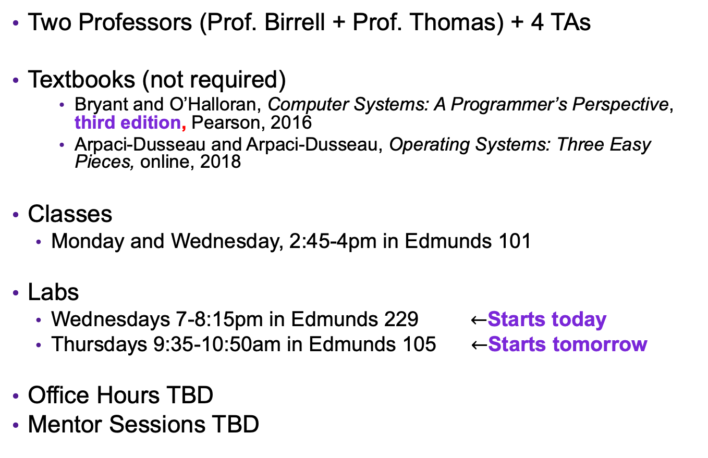
The Course in a Nutshell
Two Professors (Prof. Birrell + Prof. Thomas) + 4 TAs
Textbooks (not required)
    Bryant and O’Halloran, Computer Systems: A Programmer’s Perspective, third edition, Pearson, 2016
    Arpaci-Dusseau and Arpaci-Dusseau, Operating Systems: Three Easy Pieces, online, 2018
Classes
  Monday and Wednesday, 2:45-4pm in Edmunds 101
Labs
  Wednesdays 7-8:15pm in Edmunds 229 $←$Starts today
  Thursdays 9:35-10:50am in Edmunds 105 $←$Starts tomorrow
Office Hours TBD
Mentor Sessions TBD

Slide 30
Grading
Assignments (10)
  Introduced during labs, Due Tuesdays at 11:59pm
  Tremendous fun, work in pairs
  10 late days
Check-ins (5)
  2-3 question quizzes (13 topics total)
  February 18/19, March 11/12, April 8/9, April 23/24, May 4
  Can improve grade on any topics(s) with "Extra Chance Check-in" (may take after any later check-in or during final exam time)
  Final Exam Time: May 14 @ 2-5pm (most people), May 7 @ 2-5pm (grads)
Grades
  Must successfully complete all the assignments
  Beyond that, 50% assignments, 45% check-ins, 5% participation

Slide 31
Course website
https://cs.pomona.edu/classes/cs105
All information is on the course website
All course materials get posted on the course website
Links from the course page:
  Gradescope, for submitting assignments and seeing grades
  Additional resources

