Slide 1
Adversarial Search
CS51A
David Kauchak
Spring 2019
Some material borrowed from :
Sara Owsley Sood and others

Slide 2
Admin
  Assignment 10

Slide 3
A quick review of search
Problem solving via search:
To define the state space, define three things:
  is_goal
  next_states
  starting state
Uninformed search vs. informed search
  what’s the difference?
  what are the techniques we’ve seen?
  pluses and minuses?

Slide 4
Why should we study games?
Clear success criteria
Important historically for AI
Fun ☺
Good application of search
  hard problems (chess 35¹⁰⁰ states in search space, 10⁴⁰ legal states)
Some real-world problems fit this model
  game theory (economics)
  multi-agent problems

Slide 5
Types of games
What are some of the games you’ve played?

Slide 6
Types of games: game properties
single-player vs. 2-player vs. multiplayer
Fully observable (perfect information) vs. partially observable
Discrete vs. continuous
real-time vs. turn-based
deterministic vs. non-deterministic (chance)

Slide 7

Strategic thinking = intelligence
?
For reasons previously stated, two-player games have been a focus of AI since its inception…
Important question: Is strategic thinking the same as intelligence?

Slide 8
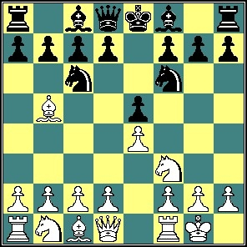
Strategic thinking = intelligence
?
Humans and computers have different relative strengths in these games:
humans
computers
?
?

Slide 9
Strategic thinking = intelligence
?
Humans and computers have different relative strengths in these games:
humans
computers
good at evaluating the strength of a board for a player
good at looking ahead in the game to find winning combinations of moves

Slide 10
Strategic thinking = intelligence
?
How could you figure out how humans approach playing chess?
humans
good at evaluating the strength of a board for a player

Slide 11
How humans play games…
An experiment was performed in which chess positions were shown to novice and expert players…
- experts could reconstruct these perfectly
- novice players did far worse…

Slide 12
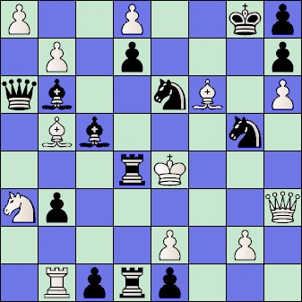
How humans play games…
Random chess positions (not legal ones) were then shown to the two groups
experts and novices did just as badly at reconstructing them!

Slide 13
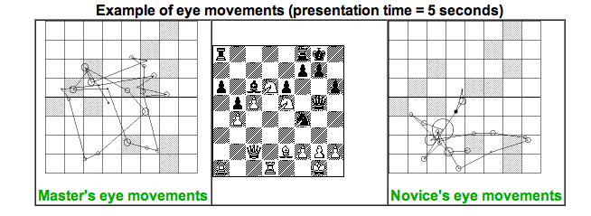
People are still working on this problem…
http://people.brunel.ac.uk/~hsstffg/frg-research/chess_expertise/

Slide 14
Tic Tac Toe as search
If we want to write a program to play tic tac toe, what question are we trying to answer?
Given a state (i.e. board configuration), what move should we make!

Slide 15
Tic Tac Toe as search
X

Slide 16
Tic Tac Toe as search
X
X
O
O
O
X
O
X
X
X
O
X
O
O
X
O
X

Slide 17
Tic Tac Toe as search
How can we pose this as a search problem?

Slide 18
Tic Tac Toe as search
X
X
…
X

Slide 19
Tic Tac Toe as search
X
X
O
X
O
X
…
O
…

Slide 20
Tic Tac Toe as search
Eventually, we’ll get to a leaf
X
X
O
X
X
O
X
X
O
X
O
O
X
X
O
…
O
X
O
X
O
X
O
O
X
X
O
WIN
TIE
LOSE
How does this help us?
Try and make moves that move us towards a win, i.e. where there are leaves with a WIN.

Slide 21
Tic Tac Toe
X’s turn
x
x
…
x
O’s turn
x
o
x
o
x
…
X’s turn
o
…
…
…
Problem: we don’t know what O will do

Slide 22
I’m X, what will ‘O’ do?
X
X
O
O
X
O
X
O’s turn
X
X
O
X
X
O
O
X
O
O
X
O
X
O
X
O

Slide 23
Minimizing risk
The computer doesn’t know what move O (the opponent) will make
It can assume that it will try and make the best move possible
Even if O actually makes a different move, we’re no worse off. Why?
X
X
O
O
X
O
X
X
X
O
X
X
O
O
X
O
O
X
O
X
O
X
O

Slide 24
Optimal Strategy
An Optimal Strategy is one that is at least as good as any other, no matter what the opponent does
  If there's a way to force the win, it will
  Will only lose if there's no other option

Slide 25
Defining a scoring function
X
X
O
X
X
O
X
X
O
X
O
O
X
X
O
…
O
X
O
X
O
X
O
O
X
X
O
WIN
TIE
LOSE
+1
0
-1
Idea:
define a function that gives us a “score” for how good each state is
higher scores mean better

Slide 26
Defining a scoring function
X
X
O
Our (X) turn
O
O
X
O
X
What should be the score of this state?
+1: we can get to a win

Slide 27
Defining a scoring function
X
X
O
Opponent’s (O) turn
O
X
O
X
What should be the score of this state?
-1: we can get to a win

Slide 28
Defining a scoring function
X
X
O
O
X
O
-1
Opponent’s (O) turn
X
X
X
O
X
X
O
O
X
O
O
X
O
X
O
X
O
+1
-1

Slide 29
Defining a scoring function
X
O
Our (X) turn
O
X
What should be the score of this state?

Slide 30
Defining a scoring function
X
O
Our (X) turn
O
X
X
O
O turn
O
What’s the score of this state?
X
X
X
O
O
X
O
X
O
X
O
X turn
+1
O
+1
O
O
+1
O
+1
O
O
X
O
X
X
X
X
X
X
X
X
O
O
X
O
X
O
X
O
O
O
O
X
O
X
O
O
+1
+1
+1
+1
X
X
O
X
X
X
X
X
X
X
X

Slide 31
Defining a scoring function
X
O
Our (X) turn
+1
O
What’s the score of this state?
X
X
O
O turn
+1
O
X
X
X
O
O
X
O
X
O
X
O
X turn
+1
O
+1
O
O
+1
O
+1
O
O
X
O
X
X
X
X
X
X
X
X
O
O
X
O
X
O
X
O
O
O
O
X
O
X
O
O
+1
+1
+1
+1
X
X
O
X
X
X
X
X
X
X
X

Slide 32
Defining a scoring function
X
Our (X) turn
O
What should be the score of this state?
0: If we play perfectly and so does O, the best we can do is a tie (could do better if O makes a mistake)

Slide 33
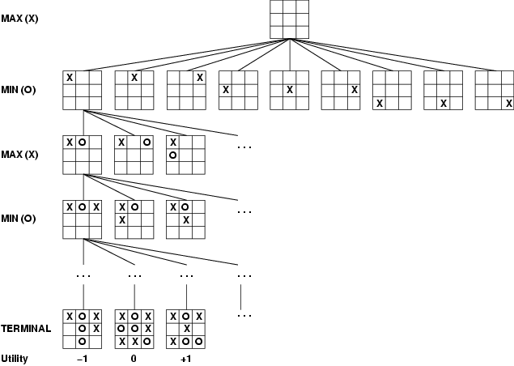
How can X play optimally?

Slide 34
How can X play optimally?
When it’s my turn, pick the highest scoring state
When it’s the opponent’s turn, assume the lowest scoring state (from my perspective)
If we can reach the end games, we can percolate these answers all the way back up

Slide 35
How can X play optimally?
Start from the leaves and propagate the score up:
  if X’s turn, pick the move that maximizes the utility
  if O’s turn, pick the move that minimizes the utility
Is this optimal?

Slide 36
Minimax Algorithm: An Optimal Strategy
minimax(state) =
if state is a terminal state
score(state)
else if MY turn
over all next states, s: return the maximum of minimax(s)
else if OPPONENTS turn
over all next states, s: return the minimum of minimax(s)
Uses recursion to compute the “value” of each state
Searches down to the leaves, then the values are “backed up” through the tree as the recursion finishes
What type of search is this?
What does this assume about how MIN will play? What if this isn’t true?
Note: We can't always search all the way down to the bottom of the tree…

Slide 37
Baby Nim
MAX
MIN
Take 1 or 2 at each turn
Goal: take the last match
MAX
What move should I take?
MIN
MAX

