Slide 1
Search algorithms
David Kauchak
CS51A – Spring 2019

Slide 2
Admin
Assignment 9
No office hours today for Dr. Dave

Slide 3
What order will BFS and DFS visit the states assuming states are added to to_visit left to right?
add the start state to to_visit
Repeat
  take a state off the to_visit list
  if it’s the goal state
    we’re done!
  if it’s not the goal state
    Add all of the successive states to the to_visit list
1
2
3
4
5
6
7
8
9
Depth first search (DFS): to_visit is a stack
Breadth first search (BFS): to_visit is a queue

Slide 4
What order will BFS and DFS visit the states?
DFS:
1, 4, 3, 8, 7, 6, 9, 2, 5
1
2
3
4
Why not 1, 2, 5?
5
6
7
8
9
Depth first search (DFS): to_visit is a stack
Breadth first search (BFS): to_visit is a queue

Slide 5
What order will BFS and DFS visit the states?
DFS:
1, 4, 3, 8, 7, 6, 9, 2, 5
1
2
3
4
5
6
7
8
1
STACK
9
Depth first search (DFS): to_visit is a stack
Breadth first search (BFS): to_visit is a queue

Slide 6
What order will BFS and DFS visit the states?
DFS:
1, 4, 3, 8, 7, 6, 9, 2, 5
1
2
3
4
4
3
5
6
7
8
2
STACK
9
Depth first search (DFS): to_visit is a stack
Breadth first search (BFS): to_visit is a queue

Slide 7
What order will BFS and DFS visit the states?
DFS:
1, 4, 3, 8, 7, 6, 9, 2, 5
1
2
3
4
3
5
6
7
8
2
STACK
9
Depth first search (DFS): to_visit is a stack
Breadth first search (BFS): to_visit is a queue

Slide 8
What order will BFS and DFS visit the states?
DFS:
1, 4, 3, 8, 7, 6, 9, 5
1
BFS:
1, 2, 3, 4, 5
2
3
4
5
6
7
8
9
Depth first search (DFS): to_visit is a stack
Breadth first search (BFS): to_visit is a queue

Slide 9
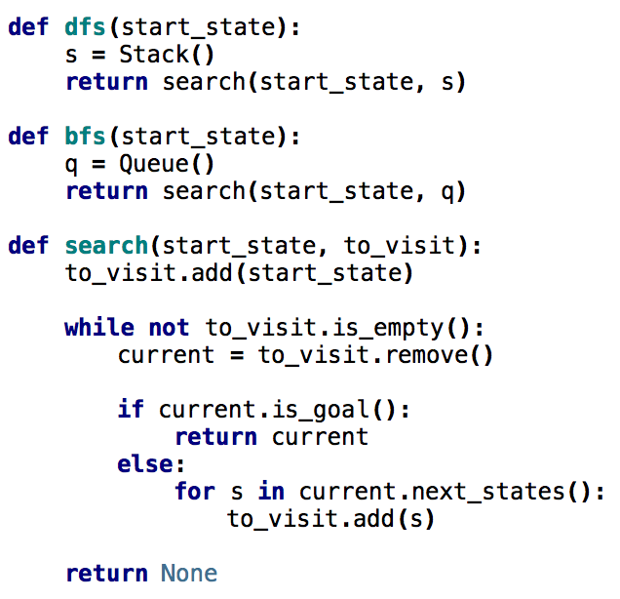
Search variants implemented
add the start state to to_visit
Repeat
  take a state off the to_visit list
  if it’s the goal state
    we’re done!
  if it’s not the goal state
    Add all of the successive states to the to_visit list

Slide 10
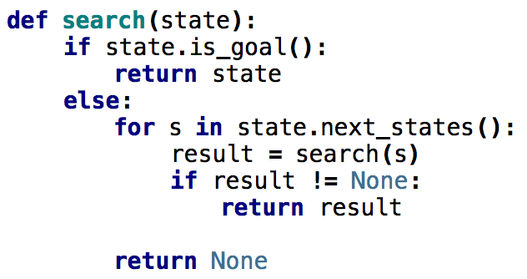
What order would this variant visit the states?
1
2
3
4
5
6
7
8
1, 2, 5
9

Slide 11
What order would this variant visit the states?
1
2
3
4
5
6
7
8
1, 2, 5, 3, 6, 9, 7, 8
9
What search algorithm is this?

Slide 12
What order would this variant visit the states?
1
2
3
4
5
6
7
8
1, 2, 5, 3, 6, 9, 7, 8
9
DFS!
Where’s the stack?

Slide 13
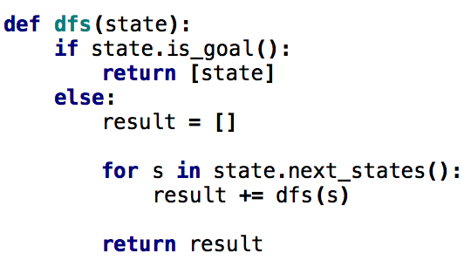
One last DFS variant
How is this different?

Slide 14
One last DFS variant
Returns ALL solutions found, not just one

Slide 15
Missionaries and Cannibals
Three missionaries and three cannibals wish to cross the river. They have a small boat that will carry up to two people. Everyone can navigate the boat. If at any time the Cannibals outnumber the Missionaries on either bank of the river, they will eat the Missionaries. Find the smallest number of crossings that will allow everyone to cross the river safely.
What is the “state” of this problem (it should capture all possible valid configurations)?

Slide 16
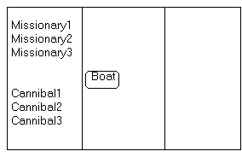
Missionaries and Cannibals
Three missionaries and three cannibals wish to cross the river. They have a small boat that will carry up to two people. Everyone can navigate the boat. If at any time the Cannibals outnumber the Missionaries on either bank of the river, they will eat the Missionaries. Find the smallest number of crossings that will allow everyone to cross the river safely.

