Slide 1
Search
David Kauchak
CS51A – Spring 2019

Slide 2
Admin
Assignment 8

Slide 3
What is AI?
Think like a human Cognitive Modeling | Think rationally Logic-based Systems
Act like a human Turing Test | Act rationally Rational Agents
"knowledge"
“reasoning”
“emotions”
perception
“learning”
language
motor skills
Next couple of weeks

Slide 4
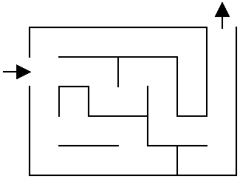
Solve the maze!

Slide 5
Solve the maze!

Slide 6
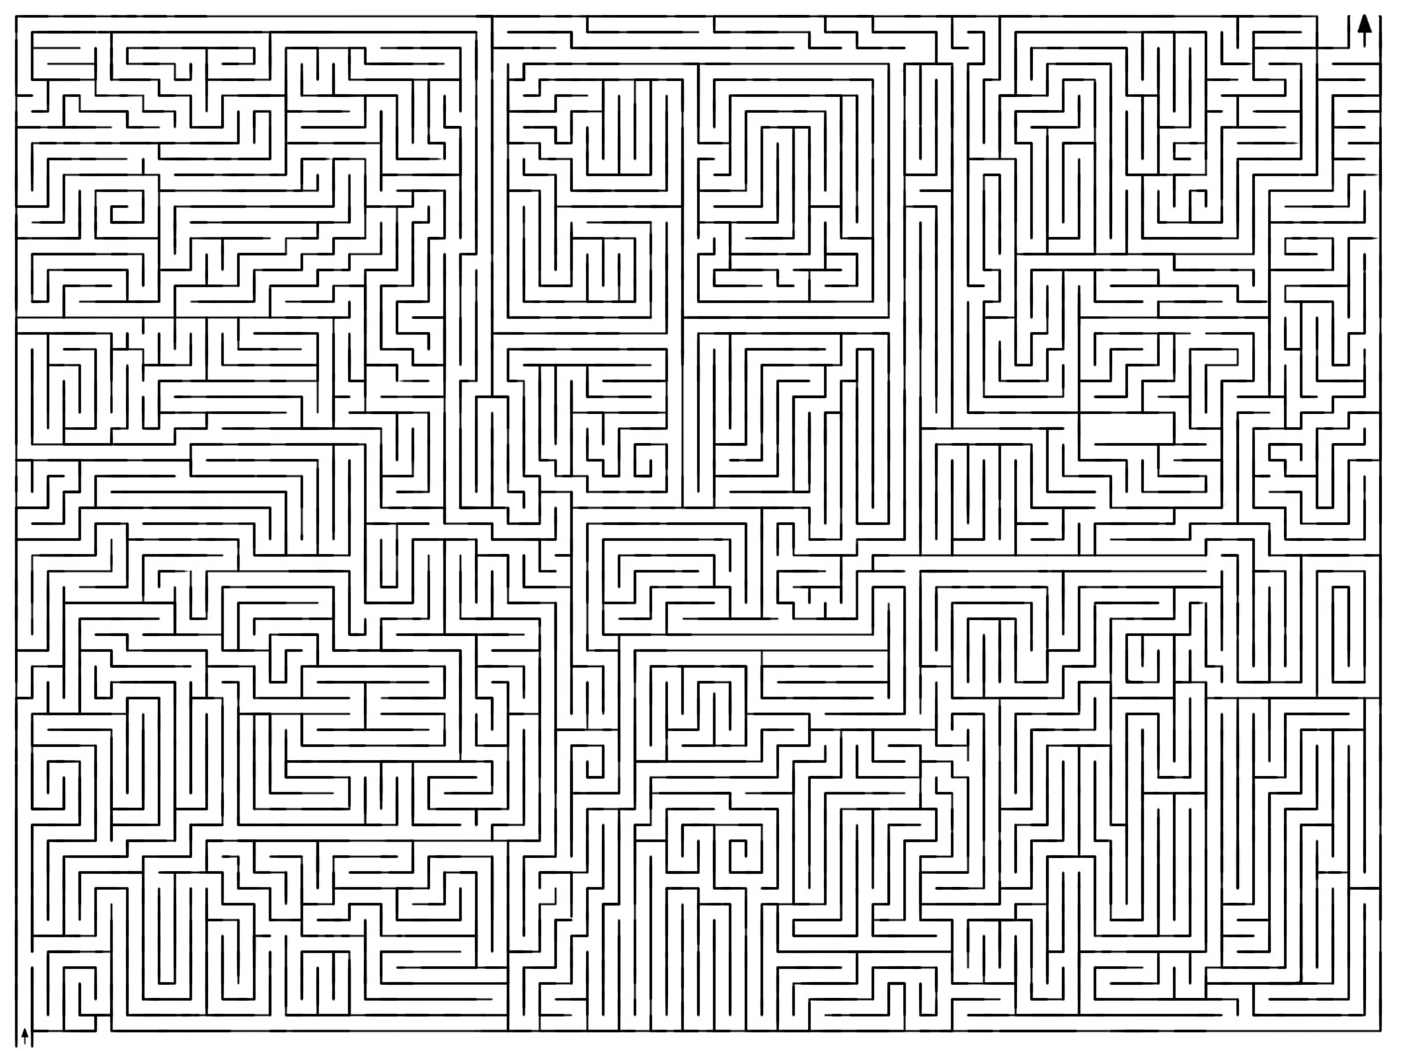
Solve the maze!

Slide 7
Solve the maze!
How did you figure it out?

Slide 8
One approach
What now?

Slide 9
One approach
Three choices

Slide 10
One approach
Pick one!
What now?

Slide 11
One approach
Still three options!
Which would you explore/pick?

Slide 12
One approach
Most people go down a single path until they realize that it’s wrong

Slide 13
One approach
Keep exploring

Slide 14
One approach
Keep exploring

Slide 15
One approach
What now?

Slide 16
One approach
Are we stuck?
No. Red positions are just possible options we haven’t explored

Slide 17
One approach
How do we know not to go left?

Slide 18
One approach
Have to be careful and keep track of where we’ve been if we can loop

Slide 19
One approach
Now what?

Slide 20
One approach
Now what?

Slide 21
One approach

Slide 22
Search problems
What information do we need to figure out a solution?

Slide 23
Search problems
Where to start
Where to finish (goal)
What the “world” (in this case a maze) looks like
We’ll define the world as a collection of discrete states
States are connected if we can get from one state to another by taking a particular action
This is called the “state space”

Slide 24
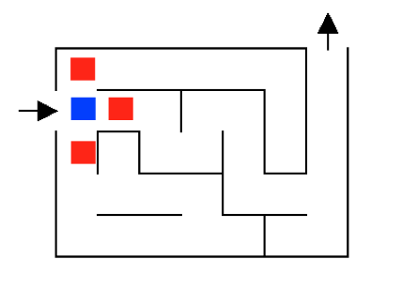
State space example

Slide 25
State space example
…
…
…

Slide 26
State space example
For a given problem, still could have different state-spaces
How many more states are there?

Slide 27
State space example

Slide 28
Solving the maze

Slide 29
Solving the maze

Slide 30
Solving the maze
How what?

Slide 31
Solving the maze

Slide 32
Solving the maze
How what?

Slide 33
Solving the maze
How what?

Slide 34
Solving the maze
Could we have found it any other way?

Slide 35
Search algorithm
Keep track of a list of states that we could visit, we’ll call it “to_visit”
General idea:
take a state off the to_visit list
if it’s the goal state
we’re done!
if it’s not the goal state
Add all of the successive states to the to_visit list
repeat

Slide 36
1
4
2
3
9
8
5
6
7
12
13
10
11
14
15
- take a state off the to_visit list
- if it’s the goal state
we’re done!
- if it’s not the goal state
Add all of the successive states to the to_visit list
repeat
to_visit
How do we start?

Slide 37
1
4
2
3
9
8
5
6
7
12
13
10
11
14
15
- take a state off the to_visit list
- if it’s the goal state
we’re done!
- if it’s not the goal state
Add all of the successive states to the to_visit list
repeat
to_visit
1
Add start not to to_visit

Slide 38
1
4
2
3
9
8
5
6
7
12
13
10
11
14
15
- take a state off the to_visit list
- if it’s the goal state
we’re done!
- if it’s not the goal state
Add all of the successive states to the to_visit list
repeat
to_visit
Add start not to to_visit

Slide 39
1
4
2
3
9
8
5
6
7
12
13
10
11
14
15
- take a state off the to_visit list
- if it’s the goal state
we’re done!
- if it’s not the goal state
Add all of the successive states to the to_visit list
repeat
to_visit
Is it a goal state?

Slide 40
1
4
2
3
9
8
5
6
7
12
13
10
11
14
15
- take a state off the to_visit list
- if it’s the goal state
we’re done!
- if it’s not the goal state
Add all of the successive states to the to_visit list
repeat
to_visit
2
3
4

Slide 41
1
4
2
3
9
8
5
6
7
12
13
10
11
14
15
- take a state off the to_visit list
- if it’s the goal state
we’re done!
- if it’s not the goal state
Add all of the successive states to the to_visit list
repeat
to_visit
2
3
4
Which one?

Slide 42
1
4
2
3
9
8
5
6
7
12
13
10
11
14
15
- take a state off the to_visit list
- if it’s the goal state
we’re done!
- if it’s not the goal state
Add all of the successive states to the to_visit list
repeat
to_visit
3
4
Is it a goal state?

Slide 43
1
4
2
3
9
8
5
6
7
12
13
10
11
14
15
- take a state off the to_visit list
- if it’s the goal state
we’re done!
- if it’s not the goal state
Add all of the successive states to the to_visit list
repeat
to_visit
3
4
Where should we add them in the list?

Slide 44
1
4
2
3
9
8
5
6
7
12
13
10
11
14
15
- take a state off the to_visit list
- if it’s the goal state
we’re done!
- if it’s not the goal state
Add all of the successive states to the to_visit list
repeat
to_visit
5
3
4
Let’s add them to the front

Slide 45
1
4
2
3
9
8
5
6
7
12
13
10
11
14
15
- take a state off the to_visit list
- if it’s the goal state
we’re done!
- if it’s not the goal state
Add all of the successive states to the to_visit list
repeat
to_visit
3
4

Slide 46
1
4
2
3
9
8
5
6
7
12
13
10
11
14
15
- take a state off the to_visit list
- if it’s the goal state
we’re done!
- if it’s not the goal state
Add all of the successive states to the to_visit list
repeat
to_visit
3
4
What do we do here?

Slide 47
1
4
2
3
9
8
5
6
7
12
13
10
11
14
15
- take a state off the to_visit list
- if it’s the goal state
we’re done!
- if it’s not the goal state
Add all of the successive states to the to_visit list
repeat
to_visit
3
4
list keeps track of where to go next, i.e. the states we know about but haven’t explored

Slide 48
1
4
2
3
9
8
5
6
7
12
13
10
11
14
15
- take a state off the to_visit list
- if it’s the goal state
we’re done!
- if it’s not the goal state
Add all of the successive states to the to_visit list
repeat
to_visit
4

Slide 49
1
4
2
3
9
8
5
6
7
12
13
10
11
14
15
- take a state off the to_visit list
- if it’s the goal state
we’re done!
- if it’s not the goal state
Add all of the successive states to the to_visit list
repeat
to_visit
6
7
4

Slide 50
1
4
2
3
9
8
5
6
7
12
13
10
11
14
15
- take a state off the to_visit list
- if it’s the goal state
we’re done!
- if it’s not the goal state
Add all of the successive states to the to_visit list
repeat
to_visit
7
4

Slide 51
1
4
2
3
9
8
5
6
7
12
13
10
11
14
15
- take a state off the to_visit list
- if it’s the goal state
we’re done!
- if it’s not the goal state
Add all of the successive states to the to_visit list
repeat
to_visit
4

Slide 52
1
4
2
3
9
8
5
6
7
12
13
10
11
14
15
- take a state off the to_visit list
- if it’s the goal state
we’re done!
- if it’s not the goal state
Add all of the successive states to the to_visit list
repeat
to_visit
5
3
4
What type of structure/list is the to_visit list?
It’s a stack!!! (LIFO)

Slide 53
1
4
2
3
9
8
5
6
7
12
13
10
11
14
15
- take a state off the to_visit list
- if it’s the goal state
we’re done!
- if it’s not the goal state
Add all of the successive states to the to_visit list
repeat
to_visit
1
What would happen if it was a queue?

Slide 54
Search algorithms
add the start state to to_visit
Repeat
take a state off the to_visit list
if it’s the goal state
we’re done!
if it’s not the goal state
Add all of the successive states to the to_visit list

Slide 55
Search algorithms
add the start state to to_visit
Repeat
take a state off the to_visit list
if it’s the goal state
we’re done!
if it’s not the goal state
Add all of the successive states to the to_visit list
Depth first search (DFS): to_visit is a stack
Breadth first search (BFS): to_visit is a queue

Slide 56
N-queens problem
Place N queens on an N by N chess board such that none of the N queens are attacking any other queen.
Solution(s)?

Slide 57
N-queens problem
Place N queens on an N by N chess board such that none of the N queens are attacking any other queen.

Slide 58
N-queens problem
Place N queens on an N by N chess board such that none of the N queens are attacking any other queen.
Solution(s)?

Slide 59
N-queens problem
Place N queens on an N by N chess board such that none of the N queens are attacking any other queen.
How do we solve this with search:
What is a state?
What is the start state?
What is the goal?
How do we transition from one state to the next?

Slide 60
Search algorithm
add the start state to to_visit
Repeat
take a state off the to_visit list
if it’s the goal state
we’re done!
if it’s not the goal state
Add all of the successive states to the to_visit list
Is this a goal state?
What states can I get to from the current state?
Any problem that we can define these three things can be plugged into the search algorithm!

Slide 61
N queens problem
http://en.wikipedia.org/wiki/Eight_queens_puzzle

