Slide 1
Backpropogation
David Kauchak
CS51A
Spring 2019

Slide 2
Perceptron learning algorithm
initialize weights of the model randomly
repeat until you get all examples right:
for each “training” example (in a random order):
  calculate current prediction on the example
  if wrong:
w_{i} = w_{i} + λ * (actual - predicted) * x_{i}

Slide 3
Perceptron learning
A few missing details, but not much more than this
Keeps adjusting weights as long as it makes mistakes
If the training data is linearly separable the perceptron learning algorithm is guaranteed to converge to the “correct” solution (where it gets all examples right)

Slide 4
Linearly Separable
x₁ | x₂ | x₁ and x₂
0 | 0 | 0
0 | 1 | 0
1 | 0 | 0
1 | 1 | 1
x₁ | x₂ | x₁ or x₂
0 | 0 | 0
0 | 1 | 1
1 | 0 | 1
1 | 1 | 1
x₁ | x₂ | x₁ xor x₂
0 | 0 | 0
0 | 1 | 1
1 | 0 | 1
1 | 1 | 0
A data set is linearly separable if you can separate one example type from the with a line other
Which of these are linearly separable?

Slide 5
Which of these are linearly separable?
x₁ | x₂ | x₁ and x₂
0 | 0 | 0
0 | 1 | 0
1 | 0 | 0
1 | 1 | 1
x₁ | x₂ | x₁ or x₂
0 | 0 | 0
0 | 1 | 1
1 | 0 | 1
1 | 1 | 1
x₁ | x₂ | x₁ xor x₂
0 | 0 | 0
0 | 1 | 1
1 | 0 | 1
1 | 1 | 0
x₁
x₁
x₁
x₂
x₂
x₂

Slide 6
XOR
?
Input x₁
T = ?
?
?
Output = x₁ xor x₂
T = ?
?
?
Input x₂
T = ?
?
x₁ | x₂ | x₁ xor x₂
0 | 0 | 0
0 | 1 | 1
1 | 0 | 1
1 | 1 | 0

Slide 7
XOR
1
Input x₁
T = 1
1
-1
Output = x₁ xor x₂
T = 1
-1
1
Input x₂
T = 1
1
x₁ | x₂ | x₁ xor x₂
0 | 0 | 0
0 | 1 | 1
1 | 0 | 1
1 | 1 | 0
Notes:
-

Slide 8
Learning in multilayer networks
Similar idea as perceptrons
Examples are presented to the network
If the network computes an output that matches the desired, nothing is done
If there is an error, then the weights are adjusted to balance the error

Slide 9
Learning in multilayer networks
Key idea for perceptron learning: if the perceptron’s output is different than the expected output, update the weights
Challenge: for multilayer networks, we don’t know what the expected output/error is for the internal nodes
expected output?
perceptron
multi-layer network

Slide 10
Backpropagation
Say we get it wrong, and we now want to update the weights
We can update this layer just as if it were a perceptron

Slide 11
Backpropagation
Say we get it wrong, and we now want to update the weights
“back-propagate” the error (actual – predicted):
Assume all of these nodes were responsible for some of the error
How can we figure out how much they were responsible for?

Slide 12
Backpropagation
Say we get it wrong, and we now want to update the weights
w₂
w₁
w₃
error (actual – predicted)
error for node i is: w_{i} error

Slide 13
Backpropagation
Say we get it wrong, and we now want to update the weights
Update these weights and continue the process back through the network

Slide 14
Backpropagation
calculate the error at the output layer
backpropagate the error up the network
Update the weights based on these errors
Can be shown that this is the appropriate thing to do based on our assumptions
That said, many neuroscientists don’t think the brain does backpropagation of errors

Slide 15
Neural network regression
Given enough hidden nodes, you can learn any function with a neural network
Challenges:
  overfitting – learning only the training data and not learning to generalize
  picking a network structure
  can require a lot of tweaking of parameters, preprocessing, etc.

Slide 16
Popular for digit recognition and many computer vision tasks
http://yann.lecun.com/exdb/mnist/

Slide 17
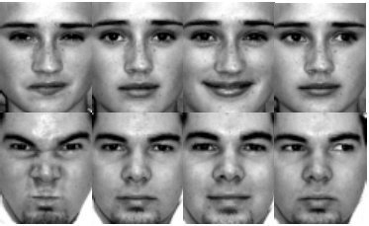
Cog sci people like NNs
Expression/emotion recognition
  Gary Cottrell et al
Language learning

Slide 18
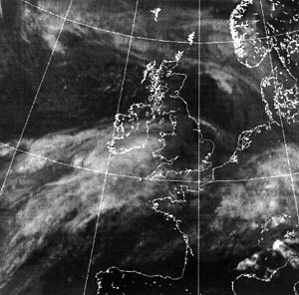
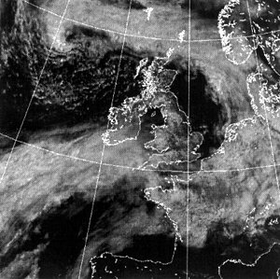
Interpreting Satellite Imagery for Automated Weather Forecasting

Slide 19

What NNs learned from youtube
http://www.nytimes.com/2012/06/26/technology/in-a-big-network-of-computers-evidence-of-machine-learning.html

Slide 20
What NNs learned from youtube
trained on 10M snapshots from youtube videos
NN with 1 billion connections
16,000 processors

Slide 21
Summary
Perceptrons, one layer networks, are insufficiently expressive
Multi-layer networks are sufficiently expressive and can be trained by error back-propogation
Many applications including speech, driving, hand written character recognition, fraud detection, driving, etc.

Slide 22
Our python NN module
Data:
x₁ | x₂ | x₃ | x₁ and x₂
0 | 0 | 0 | 1
0 | 1 | 0 | 0
1 | 0 | 0 | 1
1 | 1 | 0 | 0
0 | 0 | 1 | 1
0 | 1 | 1 | 1
1 | 0 | 1 | 1
1 | 1 | 1 | 0
table = \
[ ([0.0, 0.0, 0.0], [1.0]),
([0.0, 1.0, 0.0], [0.0]),
([1.0, 0.0, 0.0], [1.0]),
([1.0, 1.0, 0.0], [0.0]),
([0.0, 0.0, 1.0], [1.0]),
([0.0, 1.0, 1.0], [1.0]),
([1.0, 0.0, 1.0], [1.0]),
([1.0, 1.0, 1.0], [0.0]) ]

Slide 23
Data format
list of examples
table = \
[ ([0.0, 0.0, 0.0], [1.0]),
([0.0, 1.0, 0.0], [0.0]),
([1.0, 0.0, 0.0], [1.0]),
([1.0, 1.0, 0.0], [0.0]),
([0.0, 0.0, 1.0], [1.0]),
([0.0, 1.0, 1.0], [1.0]),
([1.0, 0.0, 1.0], [1.0]),
([1.0, 1.0, 1.0], [0.0]) ]
( [0.0, 0.0, 0.0], [1.0] )
input list
output list
example = tuple

Slide 24
Training on the data
Construct a new network:
>>> nn = NeuralNet(3, 2, 1)
constructor: constructs a new NN object
output nodes
input nodes
hidden nodes

Slide 25
Training on the data
Construct a new network:
>>> nn = NeuralNet(3, 2, 1)
3 input nodes
2 hidden nodes
1 output node

Slide 26
Training on the data
>>> nn.train(table)
error 0.195200
error 0.062292
error 0.031077
error 0.019437
error 0.013728
error 0.010437
error 0.008332
error 0.006885
error 0.005837
error 0.005047
by default trains 1000 iteration and prints out error values every 100 iterations

Slide 27
After training, can look at the weights
>>> nn.train(table)
>>> nn.getIHWeights()
[[-3.3435628797862624, -0.272324373735495],
[-4.846203738642956, -4.601230952566068],
[3.4233831101145973, 0.573534695637572],
[2.9388429644152128, 1.8509761272713543]]

Slide 28
After training, can look at the weights
>>> nn.train(table)
>>> nn.getIHWeights()
[[-3.3435628797862624, -0.272324373735495],
[-4.846203738642956, -4.601230952566068],
[3.4233831101145973, 0.573534695637572],
[2.9388429644152128, 1.8509761272713543]]

Slide 29
After training, can look at the weights
>>> nn.getHOWeights()
[[8.116192424400454],
[5.358094903107918],
[-4.373829543609533]]

Slide 30
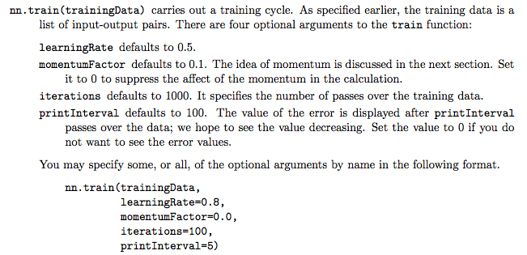
Many parameters to play with

Slide 31
Calling with optional parameters
>>> nn.train(table, iterations = 5, printInterval = 1)
error 0.005033
error 0.005026
error 0.005019
error 0.005012
error 0.005005

Slide 32
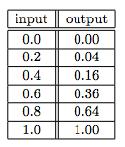
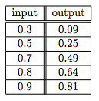
Train vs. test
TrainData
TestData
>>> nn.train(trainData)
>>> nn.test(testData)

Slide 33
http://www.sciencebytes.org/2011/05/03/blueprint-for-the-brain/

