Slide 1
Naïve bayes
David Kauchak
CS 51A – Spring 2019

Slide 2
Longest word code
http://www.cs.pomona.edu/~dkauchak/classes/cs51a/examples/for_for.txt

Slide 3

Relationship between distributions
$$P\left(X,Y\right)=P\left(Y\right)∗P(X|Y)$$
joint distribution
conditional distribution
unconditional distribution
Can think of it as describing the two events happening in two steps:
The likelihood of X and Y happening:
How likely it is that Y happened?
Given that Y happened, how likely is it that X happened?
Notes:
Called the chain rule

Slide 4
Relationship between distributions
$$P\left(51Pass, EngPass\right)=P\left(EngPass\right)∗P(51Pass|EngPass)$$
The probability of passing CS51 and English is:
Probability of passing English *
Probability of passing CS51 given that you passed English
Notes:
Called the chain rule

Slide 5
Relationship between distributions
$$P\left(51Pass, EngPass\right)=P\left(51Pass\right)∗P(EngPass|51Pass)$$
The probability of passing CS51 and English is:
Probability of passing CS51 *
Probability of passing English given that you passed CS51
Can also view it with the other event happening first
Notes:
Called the chain rule

Slide 6
Back to probabilistic modeling
train
probabilistic model:
p(label|data)
Build a model of the conditional distribution:
P(label | data)
How likely is a label given the data
training data

Slide 7
Back to probabilistic models
For each label, calculate the probability of the label given the data
yellow, curved, no leaf, 6oz, banana
probabilistic model:
p(label|data)
yellow, curved, no leaf, 6oz, apple
features
label

Slide 8
Back to probabilistic models
Pick the label with the highest probability
yellow, curved, no leaf, 6oz, banana
probabilistic model:
p(label|data)
0.004
0.00002
yellow, curved, no leaf, 6oz, apple
MAX
features
label

Slide 9
Naïve Bayes model
Two parallel ways of breaking down the joint distribution
$$P\left(data, label\right)=P\left(label\right)∗P(data|label)$$
$$P\left(data, label\right)=P\left(data\right)∗P(label|data)$$
$$P\left(label\right)∗P(data|label) =P\left(data\right)∗P(label|data)$$
What is P(label|data)?

Slide 10
Naïve Bayes
$$P\left(label\right)∗P(data|label) =P\left(data\right)∗P(label|data)$$
$$P\left(label | data\right)=\frac{P\left(label\right)∗P\left(data | label\right)}{P\left(data\right)}$$
(This is called Bayes’ rule!)

Slide 11

Naïve Bayes
$$P\left(label | data\right)=\frac{P\left(label\right)∗P\left(data | label\right)}{P\left(data\right)}$$
$$\frac{P\left(positive\right)∗P\left(data | positive\right)}{P\left(data\right)}$$
probabilistic model:
p(label|data)
MAX
$$\frac{P\left(negative\right)∗P\left(data | negative\right)}{P\left(data\right)}$$

Slide 12

One observation
$$\frac{P\left(positive\right)∗P\left(data | positive\right)}{P\left(data\right)}$$
MAX
$$\frac{P\left(negative\right)∗P\left(data | negative\right)}{P\left(data\right)}$$
For picking the largest P(data) doesn’t matter!

Slide 13
One observation
$$P\left(positive\right)∗P\left(data | positive\right)$$
MAX
$$P\left(negative\right)∗P\left(data | negative\right)$$
For picking the largest P(data) doesn’t matter!

Slide 14
A simplifying assumption (for this class)
$$P\left(positive\right)∗P\left(data | positive\right)$$
MAX
$$P\left(negative\right)∗P\left(data | negative\right)$$
If we assume P(positive) = P(negative) then:
$$P\left(data | positive\right)$$
MAX
$$P\left(data | negative\right)$$
Notes:
This is generally not true, but will make our life simpler for this class.

Slide 15

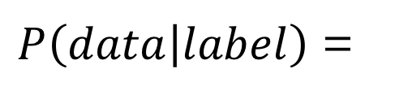
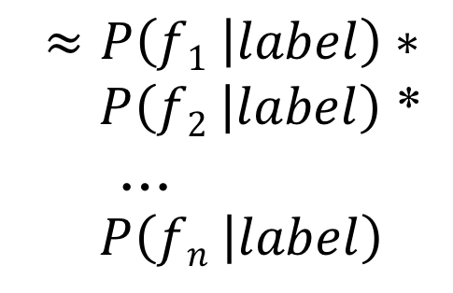
P(data|label)
$P\left(data | label\right)$ =
$P\left(f1,f2, …,fn | label\right)$
$$≈P\left(f1 | label\right)∗$$
$P\left(f2 | label\right)$ *
…
$P\left(fn | label\right)$
This is generally not true!
However…, it makes our life easier.
This is why the model is called Naïve Bayes

Slide 16
Naïve Bayes
$P\left(f1 | positive\right)∗P\left(f2 | positive\right)$ *…* $P\left(fn | positive\right)$
MAX
$P\left(f1 | negative\right)$ * $P\left(f2 | negative\right)$ *…* $P\left(fn | negative\right)$
Where do these come from?

Slide 17
Training Naïve Bayes
train
probabilistic model:
p(label|data)
training data

Slide 18
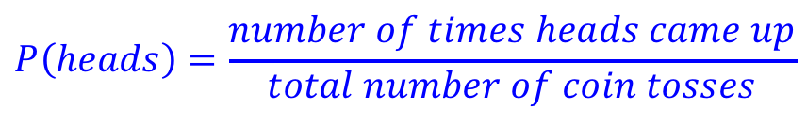
An aside: P(heads)
What is the P(heads) on a fair coin?
  0.5
What if you didn’t know that, but had a coin to experiment with?
  Flip it a bunch of times and count how many times it comes up heads
$$P\left(heads\right)=\frac{number of times heads came up}{total number of coin tosses}$$

Slide 19
Try it out…

Slide 20
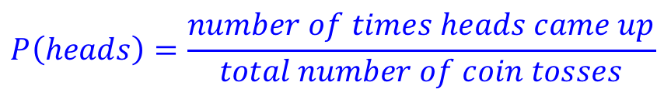

P(feature|label)
$$P\left(heads\right)=\frac{number of times heads came up}{total number of coin tosses}$$
Can we do the same thing here? What is the probability of a feature given positive, i.e. the probability of a feature occurring in in the positive label?
$$P\left(feature | positive\right)= ?$$

Slide 21
P(feature|label)
$$P\left(heads\right)=\frac{number of times heads came up}{total number of coin tosses}$$
Can we do the same thing here? What is the probability of a feature given positive, i.e. the probability of a feature occurring in in the positive label?
$$P\left(feature | positive\right)=\frac{number of positive examples with that feature}{total number of positive examples}$$

Slide 22
Training Naïve Bayes
train
Count how many examples have each label
For all examples with a particular label, count how many times each feature occurs
Calculate the conditional probabilities of each feature for all labels:
probabilistic model:
p(label|data)
training data
$$P\left(feature | label\right)= \frac{number of ``label^{′′}examples with that feature}{total number of examples with that label}$$

Slide 23
Classifying with Naïve Bayes
For each label, calculate the product of p(feature|label) for each label
P(yellow|banana)*…*P(6oz|banana)
yellow, curved, no leaf, 6oz
MAX
P(yellow|apple)*…*P(6oz|apple)

Slide 24
Naïve Bayes Text Classification
Positive
Negative
I loved it
I loved that movie
I hated that I loved it
I hated it
I hated that movie
I loved that I hated it
Given examples of text in different categories, learn to predict the category of new examples
Sentiment classification: given positive/negative examples of text (sentences), learn to predict whether new text is positive/negative

Slide 25
Text classification training
Positive
Negative
I loved it
I loved that movie
I hated that I loved it
I hated it
I hated that movie
I loved that I hated it
We’ll assume words just occur once in any given sentence

Slide 26
Text classification training
Positive
Negative
I loved it
I loved that movie
I hated that loved it
I hated it
I hated that movie
I loved that hated it
We’ll assume words just occur once in any given sentence

Slide 27
Training the model
Positive
Negative
I loved it
I loved that movie
I hated that loved it
I hated it
I hated that movie
I loved that hated it
For each word and each label, learn:
p(word | label)

Slide 28
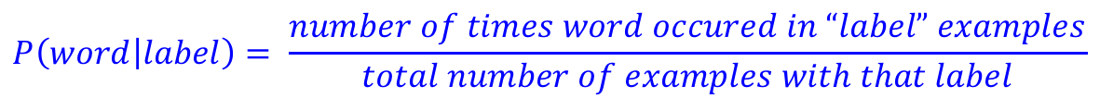
Training the model
Positive
Negative
I loved it
I loved that movie
I hated that loved it
I hated it
I hated that movie
I loved that hated it
P(I | positive) = ?
$$P\left(word | label\right)= \frac{number of times word occured in “label” examples}{total number of examples with that label}$$

Slide 29
Training the model
Positive
Negative
I loved it
I loved that movie
I hated that loved it
I hated it
I hated that movie
I loved that hated it
P(I | positive) = 3/3 = 1.0
$$P\left(word | label\right)= \frac{number of times word occured in “label” examples}{total number of examples with that label}$$

Slide 30
Training the model
Positive
Negative
I loved it
I loved that movie
I hated that loved it
I hated it
I hated that movie
I loved that hated it
P(I | positive) = 1.0
P(loved | positive) = ?
$$P\left(word | label\right)= \frac{number of times word occured in “label” examples}{total number of examples with that label}$$

Slide 31
Training the model
Positive
Negative
I loved it
I loved that movie
I hated that loved it
I hated it
I hated that movie
I loved that hated it
P(I | positive) = 1.0
P(loved | positive) = 3/3
$$P\left(word | label\right)= \frac{number of times word occured in “label” examples}{total number of examples with that label}$$

Slide 32
Training the model
Positive
Negative
I loved it
I loved that movie
I hated that loved it
I hated it
I hated that movie
I loved that hated it
P(I | positive) = 1.0
P(loved | positive) = 3/3
P(hated | positive) = ?
$$P\left(word | label\right)= \frac{number of times word occured in “label” examples}{total number of examples with that label}$$

Slide 33
Training the model
Positive
Negative
I loved it
I loved that movie
I hated that loved it
I hated it
I hated that movie
I loved that hated it
P(I | positive) = 1.0
P(loved | positive) = 2/3
P(hated | positive) = 1/3
…
P(I | negative) = ?
$$P\left(word | label\right)= \frac{number of times word occured in “label” examples}{total number of examples with that label}$$

Slide 34
Training the model
Positive
Negative
I loved it
I loved that movie
I hated that loved it
I hated it
I hated that movie
I loved that hated it
P(I | positive) = 1.0
P(loved | positive) = 2/3
P(hated | positive) = 1/3
…
P(I | negative) = 1.0
$$P\left(word | label\right)= \frac{number of times word occured in “label” examples}{total number of examples with that label}$$

Slide 35
Training the model
Positive
Negative
I loved it
I loved that movie
I hated that loved it
I hated it
I hated that movie
I loved that hated it
P(I | positive) = 1.0
P(loved | positive) = 2/3
P(hated | positive) = 1/3
…
P(I | negative) = 1.0
P(movie | negative) = ?
$$P\left(word | label\right)= \frac{number of times word occured in “label” examples}{total number of examples with that label}$$

Slide 36
Training the model
Positive
Negative
I loved it
I loved that movie
I hated that loved it
I hated it
I hated that movie
I loved that hated it
P(I | positive) = 1.0
P(loved | positive) = 2/3
P(hated | positive) = 1/3
…
P(I | negative) = 1.0
P(movie | negative) = 1/3
…
$$P\left(word | label\right)= \frac{number of times word occured in “label” examples}{total number of examples with that label}$$

Slide 37
Classifying
P(I | positive) = 1.0
P(loved | positive) = 1.0
p(it | positive) = 2/3
p(that | positive) = 2/3
p(movie|positive) = 1/3
P(hated | positive) = 1/3
P(I | negative) = 1.0
p(hated | negative) = 1.0
p(that | negative) = 2/3
P(movie | negative) = 1/3
p(it | negative) = 2/3
p(loved | negative) = 1/3
Notice that each of this is it’s own probability distribution
P(loved| positive)
P(loved | positive) = 2/3
P(no loved|positive) = 1/3

Slide 38
Trained model
P(I | positive) = 1.0
P(loved | positive) = 2/3
p(it | positive) = 2/3
p(that | positive) = 2/3
p(movie|positive) = 1/3
P(hated | positive) = 1/3
P(I | negative) = 1.0
p(hated | negative) = 1.0
p(that | negative) = 2/3
P(movie | negative) = 1/3
p(it | negative) = 2/3
p(loved | negative) = 1/3
How would we classify: “I hated movie”?

Slide 39
Trained model
P(I | positive) = 1.0
P(loved | positive) = 2/3
p(it | positive) = 2/3
p(that | positive) = 2/3
p(movie|positive) = 1/3
P(hated | positive) = 1/3
P(I | negative) = 1.0
p(hated | negative) = 1.0
p(that | negative) = 2/3
P(movie | negative) = 1/3
p(it | negative) = 2/3
p(loved | negative) = 1/3
P(I | positive) * P(hated | positive) * P(movie | positive) = 1.0 * 1/3 * 1/3 = 1/9
P(I | negative) * P(hated | negative) * P(movie | negative) = 1.0 * 1.0 * 1/3 = 1/3

Slide 40
Trained model
P(I | positive) = 1.0
P(loved | positive) = 2/3
p(it | positive) = 2/3
p(that | positive) = 2/3
p(movie|positive) = 1/3
P(hated | positive) = 1/3
P(I | negative) = 1.0
p(hated | negative) = 1.0
p(that | negative) = 2/3
P(movie | negative) = 1/3
p(it | negative) = 2/3
p(loved | negative) = 1/3
How would we classify: “I hated the movie”?

Slide 41
Trained model
P(I | positive) = 1.0
P(loved | positive) = 2/3
p(it | positive) = 2/3
p(that | positive) = 2/3
p(movie|positive) = 1/3
P(hated | positive) = 1/3
P(I | negative) = 1.0
p(hated | negative) = 1.0
p(that | negative) = 2/3
P(movie | negative) = 1/3
p(it | negative) = 2/3
p(loved | negative) = 1/3
P(I | positive) * P(hated | positive) * P(the | positive) * P(movie | positive) =
P(I | negative) * P(hated | negative) * P(the | negative) * P(movie | negative) =

Slide 42
Trained model
P(I | positive) = 1.0
P(loved | positive) = 2/3
p(it | positive) = 2/3
p(that | positive) = 2/3
p(movie|positive) = 1/3
P(hated | positive) = 1/3
P(I | negative) = 1.0
p(hated | negative) = 1.0
p(that | negative) = 2/3
P(movie | negative) = 1/3
p(it | negative) = 2/3
p(loved | negative) = 1/3
P(I | positive) * P(hated | positive) * P(the | positive) * P(movie | positive) =
P(I | negative) * P(hated | negative) * P(the | negative) * P(movie | negative) =
What are these?

Slide 43
Trained model
P(I | positive) = 1.0
P(loved | positive) = 2/3
p(it | positive) = 2/3
p(that | positive) = 2/3
p(movie|positive) = 1/3
P(hated | positive) = 1/3
P(I | negative) = 1.0
p(hated | negative) = 1.0
p(that | negative) = 2/3
P(movie | negative) = 1/3
p(it | negative) = 2/3
p(loved | negative) = 1/3
P(I | positive) * P(hated | positive) * P(the | positive) * P(movie | positive) =
P(I | negative) * P(hated | negative) * P(the | negative) * P(movie | negative) =
0! Is this a problem?

Slide 44
Trained model
P(I | positive) = 1.0
P(loved | positive) = 2/3
p(it | positive) = 2/3
p(that | positive) = 2/3
p(movie|positive) = 1/3
P(hated | positive) = 1/3
P(I | negative) = 1.0
p(hated | negative) = 1.0
p(that | negative) = 2/3
P(movie | negative) = 1/3
p(it | negative) = 2/3
p(loved | negative) = 1/3
P(I | positive) * P(hated | positive) * P(the | positive) * P(movie | positive) =
P(I | negative) * P(hated | negative) * P(the | negative) * P(movie | negative) =
Yes. They make the entire product go to 0!

Slide 45
Trained model
P(I | positive) = 1.0
P(loved | positive) = 2/3
p(it | positive) = 2/3
p(that | positive) = 2/3
p(movie|positive) = 1/3
P(hated | positive) = 1/3
P(I | negative) = 1.0
p(hated | negative) = 1.0
p(that | negative) = 2/3
P(movie | negative) = 1/3
p(it | negative) = 2/3
p(loved | negative) = 1/3
P(I | positive) * P(hated | positive) * P(the | positive) * P(movie | positive) =
P(I | negative) * P(hated | negative) * P(the | negative) * P(movie | negative) =
Our solution: assume any unseen word has a small, fixed probability, e.g. in this example 1/10

Slide 46
Trained model
P(I | positive) = 1.0
P(loved | positive) = 2/3
p(it | positive) = 2/3
p(that | positive) = 2/3
p(movie|positive) = 1/3
P(hated | positive) = 1/3
P(I | negative) = 1.0
p(hated | negative) = 1.0
p(that | negative) = 2/3
P(movie | negative) = 1/3
p(it | negative) = 2/3
p(loved | negative) = 1/3
P(I | positive) * P(hated | positive) * P(the | positive) * P(movie | positive) = 1/90
P(I | negative) * P(hated | negative) * P(the | negative) * P(movie | negative) = 1/30
Our solution: assume any unseen word has a small, fixed probability, e.g. in this example 1/10

Slide 47
Full disclaimer
I’ve fudged a few things on the Naïve Bayes model for simplicity
Our approach is very close, but it takes a few liberties that aren’t technically correct, but it will work just fine ☺
If you’re curious, I’d be happy to talk to you offline

