Slide 1
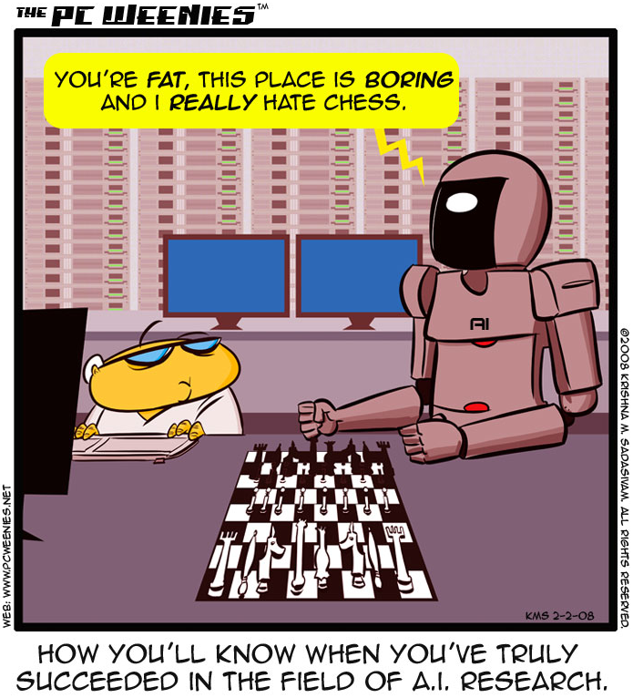
http://www.bbspot.com/comics/PC-Weenies/2008/02/3248.php

Slide 2
Intro to AI
CS51A
David Kauchak
Spring 2019
Adapted from notes from:
Sara Owsley Sood

Slide 3
Admin
Tuesday mentor hours back to 5-7pm
My office hours:
M: 3-3:50pm
T: 11am-12
Th: 11am-12:30
F: 10-11am

Slide 4
AI is a huge field
What is AI (artificial intelligence)…

Slide 5
AI is a huge field
What is AI…
One definition:
“Building programs that enable computers to do what humans can do.”
For example:
read, walk around, drive, play games, solve problems, learn, have conversations…

Slide 6
A broader definition
“Building programs that enable computers to do do intelligent things”
human vs. rational
Think like a human Cognitive Modeling | Think rationally Logic-based Systems
Act like a human Turing Test | Act rationally Rational Agents
thinking
vs.
acting

Slide 7
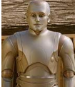

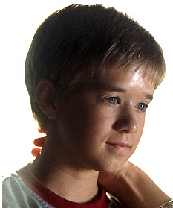
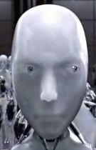

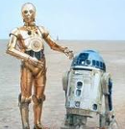

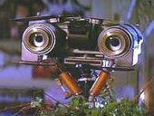
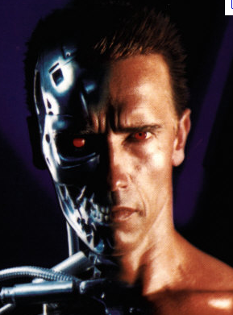
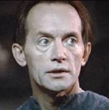
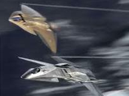
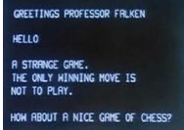
How is AI viewed in popular media?

Slide 8

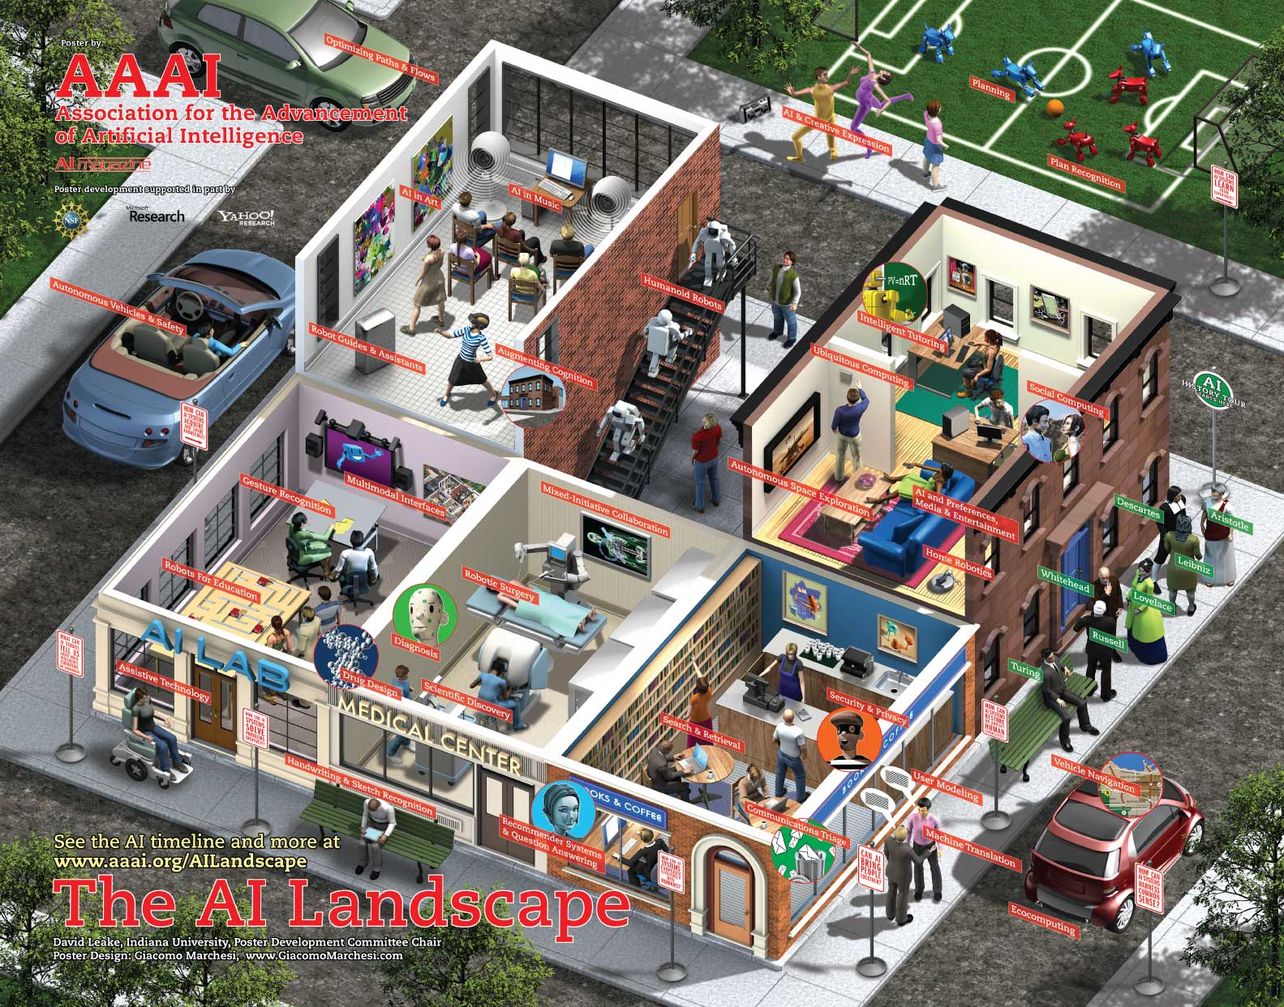
What challenges are there?

Slide 9
What challenges are there?
Perception
  perceive the environment via sensors
Computer vision (perception via images/video)
  process visual information
  object identification, face recognition, motion tracking
Natural language processing and generation
  speech recognition, language understanding
  language translation, speech generation, summarization

Slide 10
What challenges are there?
Knowledge representation
  encode known information
  water is wet, the sun is hot, Dave is a person, …
Learning
  learn from environment
  What type of feedback? (supervised vs. unsupervised vs. reinforcement vs …)
Reasoning/problem solving
  achieve goals, solve problems
  planning
  How do you make an omelet? I’m carrying an umbrella and it’s raining… will I get wet?
Robotics
  How can computers interact with the physical world?

Slide 11
What can we currently do?

Slide 12
What can we currently do?
Understand spoken language?
speech recognition is really good, if:
  restricted vocabulary
  specific speaker with training
Gotten quite good in the last few years and shows up in lots of places:
  Mobile: Siri, Ok Google, etc.
  Home assistants: Alexa, Google Home
What does the spoken language actually mean (language understanding)?
  much harder problem!
  many advances in NLP in small things, but still far away from a general solution

Slide 13
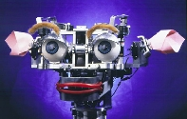

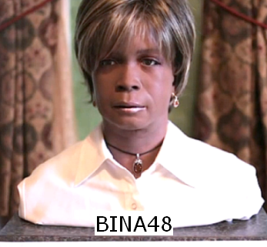
What can we currently do?
Speak?
  Understandable, but you wouldn’t confuse it for a person
  Can do accents, intonations, etc.
  Better with restricted vocabulary
  Loquendo
    https://www.nuance.com/omni-channel-customer-engagement/voice-and-ivr/text-to-speech.html
    Dealing with facial expression is challenging
Kismet (MIT)

Slide 14
What can we currently do?
Drive a car?

Slide 15
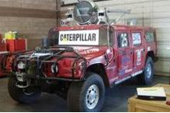
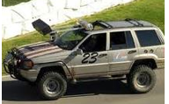
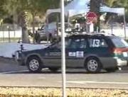
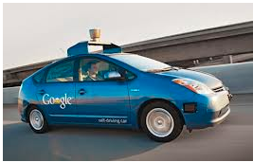
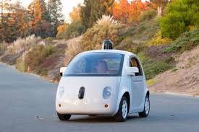
What can we currently do?
Drive a car?
  Freeway driving is relatively straightforward
  Off-road a bit harder
    see DARPA grand challenges (2004, 2005)
  And urban driving is even trickier
    See DARPA urban challenge (2007)
    Google’s autonomous vehicle
Hint: there’s a connection here

Slide 16
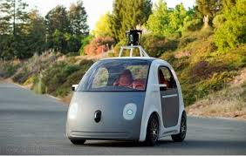
What can we currently do?
Drive a car?
https://www.google.com/selfdrivingcar/
https://www.tesla.com/autopilot
Uber
…

Slide 17
What can we currently do?
Drive a car?
Many driver assist technologies:
Automatic breaking
Automatic pedestrian detection
Lane drift avoidance
”smart” cruise control
Blind spot warning
…

Slide 18

What can we currently do?
Identify emotion?
This is hard!
Some success in text
  movie reviews (assignment 7!)
  blogs
  twitter
  dealing with sarcasm is hard
Some success with faces
  strongly biased by training data
  works best when exaggerated

Slide 19
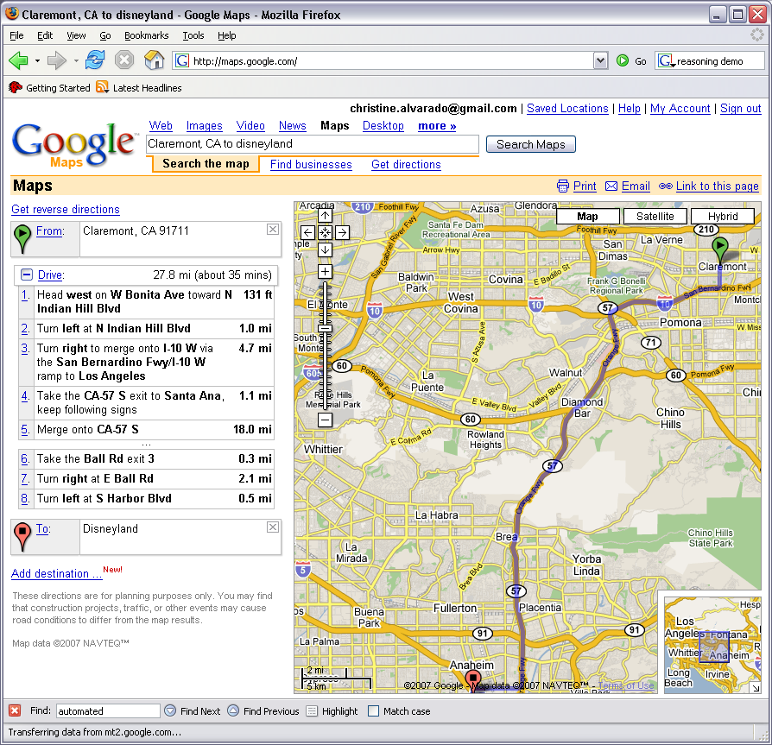
What can we currently do?
Reasoning?
  Success on small sub-problems
  General purpose reasoning is harder
    Wolfram Alpha
    OpenCyc

Slide 20
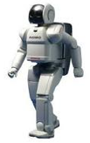
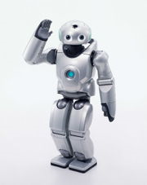
What can we currently do?
Walk?
  Robots have had a variety of locomotion methods
  Walking with legs, is challenging
    Differing terrains, stairs, running, ramps, etc.
  Recently, a number of successes
    Honda’s Asimo
      https://www.youtube.com/watch?v=SARB9Ol_Wz4
    Sony QRIO
      http://www.youtube.com/watch?v=9vwZ5FQEUFg
    Boston Dynamic’s Atlas
      https://www.youtube.com/watch?v=hSjKoEva5bg

Slide 21
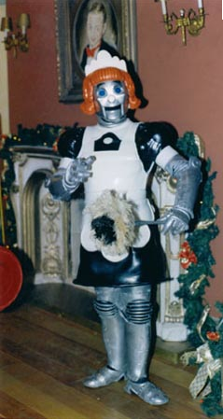
When will I have my robot helper?
What can we currently do?

Slide 22
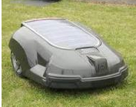
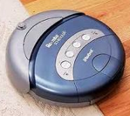
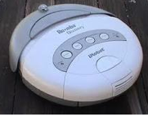
What can we currently do?

Slide 23
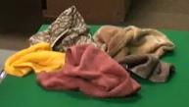
What can we currently do?
Fold a pile of towels?
UC Berkeley towel folding robot:
http://www.youtube.com/watch?v=gy5g33S0Gzo

Slide 24
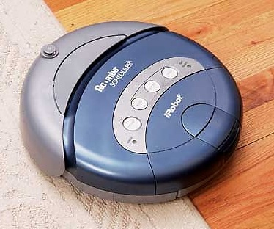
How do we make computers ”intelligent?"
Computer,
clean the house!
Um… OK…??
This one's got no chance…
Notes:
Assume that we want this vacuum to clean this house
To us - if someone told us to use a vacuum to clean a house, the sequence of events that should follow are pretty clear
We’d walk into the house, figure out what rooms needed to be vacuumed and start vacuuming
We’d methodically go through the room, not vacuuming over places we’ve already been, until we cover the whole room, then move to the next room

Slide 25
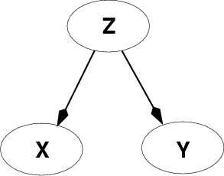
Fundamental problem of AI
Reasoning with knowledge
and uncertainty
Search
Many different ways of making an agent intelligent
Learning
Reasoning with
Utility

