Slide 1
Induction
David Kauchak
CS52 – Spring 2016

Slide 2
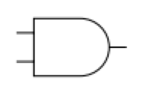
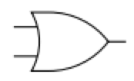
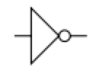
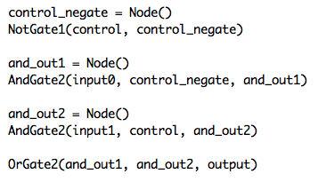
2-to-1 multiplexer
and_out2
input1
and_out1
output
input0
control_negate
control

Slide 3
A useful identity
What is the sum of the powers of 2 from from 0 to n?
?

Slide 4
A useful identity
The sum of the powers of 2 from from 0 to n is:
For example, what is:
?
?
1 + 2 + 4 + 8 + 16 = 31 = 2⁵-1
1 + 2 + 4 + 8 + … + 2⁹ = 2¹⁰ -1=1023

Slide 5
A useful identity
The sum of the powers of 2 from from 0 to n is:
How would you prove this?

Slide 6
Proof by induction
State what you’re trying to prove!
State and prove the base case
What is the smallest possible case you need to consider?
Should be fairly easy to prove
Assume it’s true for k (or k-1). Write out specifically what this assumption is (called the inductive hypothesis).
Prove that it then holds for k+1 (or k)
State what you’re trying to prove (should be a variation on step 1)
Prove it. You will need to use inductive hypothesis.

Slide 7
An example
State what you’re trying to prove!

Slide 8
An example
1.
2. Base case:
What is the smallest possible case you need to consider?

Slide 9
An example
1.
2. Base case:
n = 0
What does the identity say the answer should be?

Slide 10
An example
1.
2. Base case:
n = 0
Is that right?

Slide 11
An example
1.
2. Base case:
n = 0
Base case proved!

Slide 12
An example
1.
3. Assume it’s true for some k
Assume:
(inductive hypothesis)
4. Prove that it’s true for k+1
a. State what you’re trying to prove:

Slide 13
Prove it!
Assuming:
Prove:
Ideas?

Slide 14
Prove it!
Assuming:
Prove:
by the inductive hypothesis
by math (combine the two 2^{k+1})
by math
Done!

Slide 15
Proof like I’d like to see it on paper (part 1)
Prove:
Base case: n = 0
Prove:
LHS:
by math
LHS = RHS
RHS:
by math

Slide 16
Proof like I’d like to see it on paper (part 2)
3. Assuming it’s true for n = k, i.e.
4. Show that it holds for k+1, i.e.

Slide 17
Proof like I’d like to see it on paper (part 3)
by the inductive hypothesis
by math (combine the two 2^{k+1})
by math
Done!

Slide 18
Proof by induction
State what you’re trying to prove!
State and prove the base case
Assume it’s true for k (or k-1)
Show that it holds for k+1 (or k)
Why does this prove anything?

Slide 19
Proof by induction
We proved the base case is true, e.g.
If k = 0 is true (the base case) then k = 1 is true
If k = 1 is true then k = 2 is true
…
If n-1 is true then n is true

Slide 20
Another useful identity
What is the sum of the numbers from 1 to n?
?

Slide 21
A useful identity
The sum of the numbers from 1 to n is:
For example, what is sum from 1 to 5? 1 to 100?
1 + 2 + 3 + 4 + 5 = 15 = 5*6/2
1 + 2 + 3 + … + 100 = 100 * 101/2 = 10100/2 = 5050

Slide 22
Prove it!
State what you’re trying to prove!
State and prove the base case
What is the smallest possible case you need to consider?
Should be fairly easy to prove
Assume it’s true for k (or k-1). Write out specifically what this assumption is (called the inductive hypothesis).
Prove that it holds for k+1 (or k)
State what you’re trying to prove (should be a variation on step 1)
Prove it. You will need to use the inductive hypothesis.

