Slide 1
Search
David Kauchak
CS30 – Spring 2015

Slide 2
Admin
Assignment 7 due tomorrow
Assignment 8 out soon
Talk today
4:15 in Rose Hills Theatre

Slide 3
A few last things about classes
Look at rectangle3.py code
Taking objects of the same type as parameters (e.g. equals)
Calling methods inside the class
Instance variables do NOT have to be the same thing as the parameters for the constructor

Slide 4
Assignment 7 comments
Think about how you want to use the objects (i.e. your program) and let that motivate the class design, i.e. the methods, etc.
Class names should be capitalized
CamelCase class names that are multiple words
class PomonaStudent
class WalkieTalkie
class StarWarsCreature
“pass”

Slide 5
Assignment 7 comments
If your program requires a file to work (i.e. to read data from):
create a folder: first-last-assign7
put both the .py file and the .txt file in there
zip of the folder and submit that
Be careful about filenames!
files have extensions (that are sometimes hidden by the OS). On mac, you can do CMD+i to get information about the file, including the full filename
We’re only reading .txt file (other files have formatting information!)
Wing saves files just as text files automatically (though you’ll need to make sure to include the .txt extension)
TextEdit: Format -> Make Plain Text
Windows: Use notepad (or in Word, “Save as…” and select .txt

Slide 6
Other ways of reading from a file
reader = open(“myfile.txt”, “r”)
Read the whole file:
for line in reader:
# do something with each line of the file
Read one line of the file:
next_line = reader.readline()
Do dictionary example!

Slide 7
What is AI?
Think like a human Cognitive Modeling | Think rationally Logic-based Systems
Act like a human Turing Test | Act rationally Rational Agents
"knowledge"
“reasoning”
“emotions”
perception
“learning”
language
motor skills
Rest of the semester

Slide 8
What is AI?
Think like a human Cognitive Modeling | Think rationally Logic-based Systems
Act like a human Turing Test | Act rationally Rational Agents
"knowledge"
“reasoning”
“emotions”
perception
“learning”
language
motor skills
Next couple of weeks

Slide 9
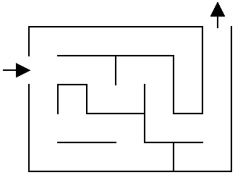
Solve the maze!

Slide 10
Solve the maze!

Slide 11
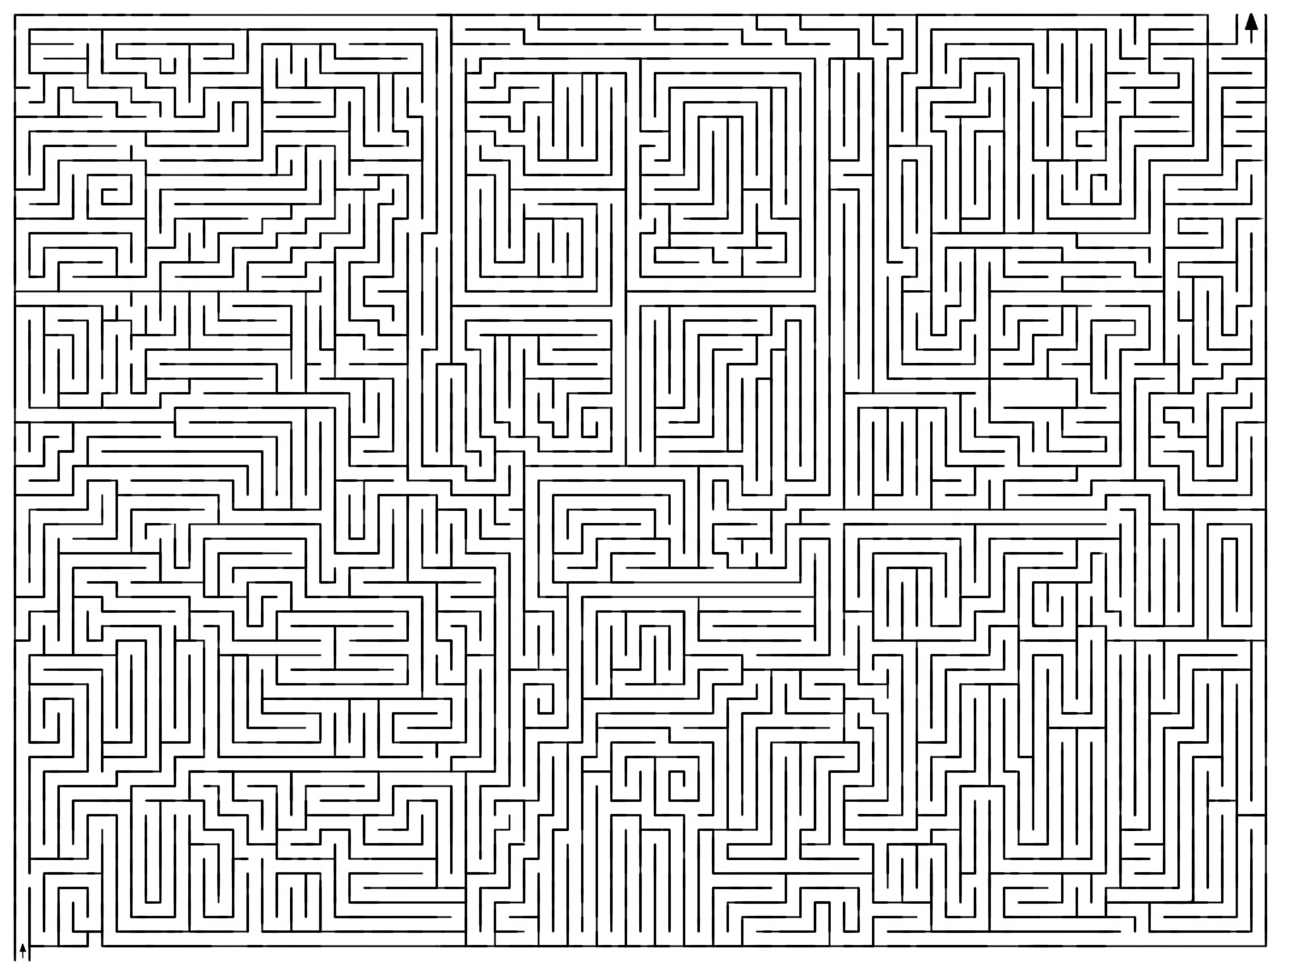
Solve the maze!

Slide 12
Solve the maze!
How did you figure it out?

Slide 13
One approach
What now?

Slide 14
One approach
Three choices

Slide 15
One approach
Pick one!
What now?

Slide 16
One approach
Still three options!
Which would you explore/pick?

Slide 17
One approach
Most people go down a single path until they realize that it’s wrong

Slide 18
One approach
Keep exploring

Slide 19
One approach
Keep exploring

Slide 20
One approach
What now?

Slide 21
One approach
Are we stuck?
No. Red positions are just possible options we haven’t explored

Slide 22
One approach
How do we know not to go left?

Slide 23
One approach
Have to be careful and keep track of where we’ve been if we can loop

Slide 24
One approach
Now what?

Slide 25
One approach
Now what?

Slide 26
One approach
Now what?

Slide 27
One approach

Slide 28
Search problems
What information do we need to know to figure out a solution?

Slide 29
Search problems
Where to start
Where to finish (goal)
What the “world” (in this case a maze) looks like
We’ll define the world as a collection of discrete states
States are connected if we can get from one state to another by taking a particular action
This is called the “state space”

Slide 30
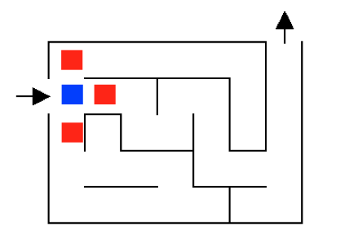
State space example

Slide 31
State space example
…
…
…

Slide 32
State space example
For a given problem, still could have different state-spaces
How many more states are there?

Slide 33
State space example

Slide 34
Solving the maze

Slide 35
Solving the maze

Slide 36
Solving the maze
How what?

Slide 37
Solving the maze

Slide 38
Solving the maze
How what?

Slide 39
Solving the maze
How what?

Slide 40
Solving the maze
Could we have found it any other way?

Slide 41
Search algorithm
Keep track of a list of states that we could visit, we’ll call it “to_visit”
General idea:
take a state off the to_visit list
if it’s the goal state
we’re done!
if it’s not the goal state
Add all of the successive states to the to_visit list
repeat

Slide 42
1
4
2
3
9
8
5
6
7
12
13
10
11
14
15
- take a state off the to_visit list
- if it’s the goal state
we’re done!
- if it’s not the goal state
Add all of the successive states to the to_visit list
repeat
to_visit
How do we start?

Slide 43
1
4
2
3
9
8
5
6
7
12
13
10
11
14
15
- take a state off the to_visit list
- if it’s the goal state
we’re done!
- if it’s not the goal state
Add all of the successive states to the to_visit list
repeat
to_visit
1
Add start not to to_visit

Slide 44
1
4
2
3
9
8
5
6
7
12
13
10
11
14
15
- take a state off the to_visit list
- if it’s the goal state
we’re done!
- if it’s not the goal state
Add all of the successive states to the to_visit list
repeat
to_visit
Add start not to to_visit

Slide 45
1
4
2
3
9
8
5
6
7
12
13
10
11
14
15
- take a state off the to_visit list
- if it’s the goal state
we’re done!
- if it’s not the goal state
Add all of the successive states to the to_visit list
repeat
to_visit
Is it a goal state?

Slide 46
1
4
2
3
9
8
5
6
7
12
13
10
11
14
15
- take a state off the to_visit list
- if it’s the goal state
we’re done!
- if it’s not the goal state
Add all of the successive states to the to_visit list
repeat
to_visit
2
3
4

Slide 47
1
4
2
3
9
8
5
6
7
12
13
10
11
14
15
- take a state off the to_visit list
- if it’s the goal state
we’re done!
- if it’s not the goal state
Add all of the successive states to the to_visit list
repeat
to_visit
2
3
4
Which one?

Slide 48
1
4
2
3
9
8
5
6
7
12
13
10
11
14
15
- take a state off the to_visit list
- if it’s the goal state
we’re done!
- if it’s not the goal state
Add all of the successive states to the to_visit list
repeat
to_visit
3
4
Is it a goal state?

Slide 49
1
4
2
3
9
8
5
6
7
12
13
10
11
14
15
- take a state off the to_visit list
- if it’s the goal state
we’re done!
- if it’s not the goal state
Add all of the successive states to the to_visit list
repeat
to_visit
3
4
Where should we add them in the list?

Slide 50
1
4
2
3
9
8
5
6
7
12
13
10
11
14
15
- take a state off the to_visit list
- if it’s the goal state
we’re done!
- if it’s not the goal state
Add all of the successive states to the to_visit list
repeat
to_visit
5
3
4
Let’s add them to the front

Slide 51
1
4
2
3
9
8
5
6
7
12
13
10
11
14
15
- take a state off the to_visit list
- if it’s the goal state
we’re done!
- if it’s not the goal state
Add all of the successive states to the to_visit list
repeat
to_visit
3
4

Slide 52
1
4
2
3
9
8
5
6
7
12
13
10
11
14
15
- take a state off the to_visit list
- if it’s the goal state
we’re done!
- if it’s not the goal state
Add all of the successive states to the to_visit list
repeat
to_visit
3
4
What do we do here?

Slide 53
1
4
2
3
9
8
5
6
7
12
13
10
11
14
15
- take a state off the to_visit list
- if it’s the goal state
we’re done!
- if it’s not the goal state
Add all of the successive states to the to_visit list
repeat
to_visit
3
4
list keeps track of where to go next (and the states we know about but haven’t explored

Slide 54
1
4
2
3
9
8
5
6
7
12
13
10
11
14
15
- take a state off the to_visit list
- if it’s the goal state
we’re done!
- if it’s not the goal state
Add all of the successive states to the to_visit list
repeat
to_visit
4

Slide 55
1
4
2
3
9
8
5
6
7
12
13
10
11
14
15
- take a state off the to_visit list
- if it’s the goal state
we’re done!
- if it’s not the goal state
Add all of the successive states to the to_visit list
repeat
to_visit
6
7
4

Slide 56
1
4
2
3
9
8
5
6
7
12
13
10
11
14
15
- take a state off the to_visit list
- if it’s the goal state
we’re done!
- if it’s not the goal state
Add all of the successive states to the to_visit list
repeat
to_visit
7
4

Slide 57
1
4
2
3
9
8
5
6
7
12
13
10
11
14
15
- take a state off the to_visit list
- if it’s the goal state
we’re done!
- if it’s not the goal state
Add all of the successive states to the to_visit list
repeat
to_visit
4

Slide 58
1
4
2
3
9
8
5
6
7
12
13
10
11
14
15
- take a state off the to_visit list
- if it’s the goal state
we’re done!
- if it’s not the goal state
Add all of the successive states to the to_visit list
repeat
to_visit
5
3
4
What type of structure/list is the to_visit list?
It’s a stack!!! (LIFO)

Slide 59
1
4
2
3
9
8
5
6
7
12
13
10
11
14
15
- take a state off the to_visit list
- if it’s the goal state
we’re done!
- if it’s not the goal state
Add all of the successive states to the to_visit list
repeat
to_visit
1
What would happen if it was a queue?

Slide 60
Search algorithm
add the start state to to_visit
Repeat
take a state off the to_visit list
if it’s the goal state
we’re done!
if it’s not the goal state
Add all of the successive states to the to_visit list

Slide 61
Search algorithms
add the start state to to_visit
Repeat
take a state off the to_visit list
if it’s the goal state
we’re done!
if it’s not the goal state
Add all of the successive states to the to_visit list
Depth first search (DFS): to_visit is a stack
Breadth first search (BFS): to_visit is a queue

