Slide 1
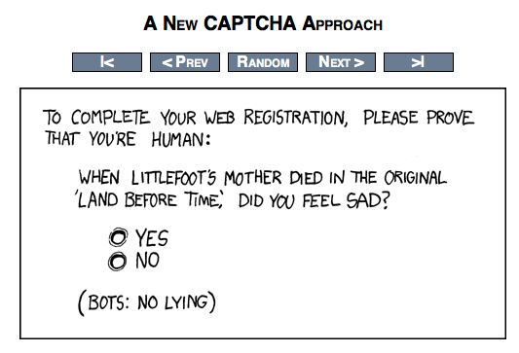

Slide 2
Natural Language Processing
CS311, Spring 2013
David Kauchak

Slide 3
Administrivia
Status report 1 due tomorrow
Look at written problems 3 by Monday
  Recall we do have quizzes for this class
Exam 2 will be available early next week
Upcoming schedule
  Today: NLP
  Tuesday: Robotics
  Thursday: Computer Vision
  Last week: Philosophy and ethics of AI

Slide 4
What is NLP?
Natural language processing (NLP) is a field of computer science and linguistics concerned with the interactions between computers and human (natural) languages.
- Wikipedia

Slide 5
What is NLP?
The goal of this new field is to get computers to perform useful tasks involving human language…
- Dan Jurafsky

Slide 6

Key: Natural text
“A growing number of businesses are making Facebook an indispensible part of hanging out their shingles. Small businesses are using …”
Natural text is written by people, generally for people
Why do we even care about natural text in computer science?

Slide 7
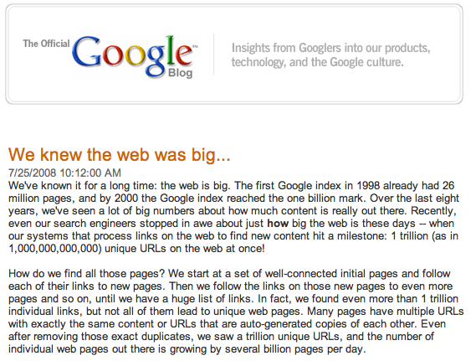
Why do we need computers for dealing with natural text?
Notes:
besides being a complex problem, there’s a lot of data! (which is a good thing and a bad thing)
some people may say… outsource it (India, the Philippines, etc.). And there are frameworks, like mechanical Turk
world population: ~7M
let’s say you had a simple task to perform on each web page that only took 10 seconds to do. If every single person in the world worked on this non-stop, they would have to work for 20 days straight.
what if it’s a task like translating the page or finding information that requires specialization?

Slide 8

Why do we need computers?
~7 billion people in the world
Hire them all:
  Task that takes 10 seconds per page
    1 trillion * 10 seconds = 23 minutes
  Task that takes 1 min per page
    2 hours
  Task that takes 5 min per page
    10 hours

Slide 9
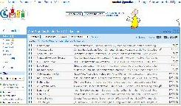

Web is just the start…
e-mail
27 million tweets a day
247 billion e-mails a day
corporate
databases
Blogs:
126 million different blogs
http://royal.pingdom.com/2010/01/22/internet-2009-in-numbers/
Notes:
- web pages are just the beginning…

Slide 10
Why is NLP hard?
Iraqi Head Seeks Arms
Juvenile Court to Try Shooting Defendant
Stolen Painting Found by Tree
Kids Make Nutritious Snacks
Local HS Dropouts Cut in Half
Obesity Study Looks for Larger Test Group
British Left Waffles on Falkland Islands
Red Tape Holds Up New Bridges
Hospitals Are Sued by 7 Foot Doctors
Notes:
Iraqi Head (

Slide 11
Why is NLP hard?
User: Where is Contagion playing in the Middlebury Area?
System: Contagion is playing at the Marquis Theatre.
User: When is it playing there?
System: It’s playing at 2pm, 5pm and 8pm
User: I’d like 1 adult and 2 children for the first show. How much would that cost?

Slide 12
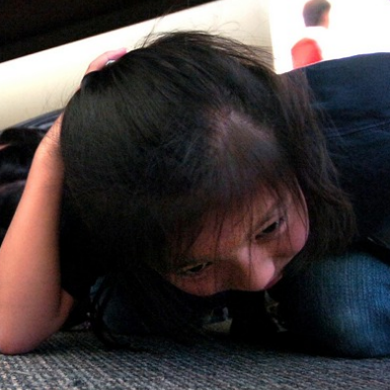
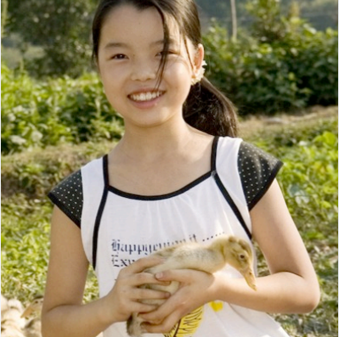
Why is NLP hard?
I saw her duck

Slide 13

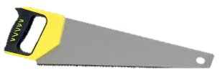
Why is NLP hard?
I saw her duck

Slide 14
Why is NLP hard?
Natural language:
  is highly ambiguous at many different levels
  is complex and contains subtle use of context to convey meaning
  is probabilistic?
  involves reasoning about the world
  is highly social
  is a key part in how people interact
However, some NLP problems can be surprisingly easy

Slide 15
Different levels of NLP
pragmatics/discourse: how does the context affect the interpretation?
semantics: what does it mean?
syntax: phrases, how do words interact
words: morphology, classes of words

Slide 16
NLP problems and applications
What are some places where you have seen NLP used?
What are NLP problems?

Slide 17
NLP problems and applications
Lots of problems of varying difficulty
Easier
  Word segmentation: where are the words?
I would’ve liked Prof. Kauchak to finish early. But he didn’t.

Slide 18


NLP problems and applications
Lots of problems of varying difficulty
Easier
  Word segmentation: where are the words?

Slide 19
NLP problems and applications
Lots of problems of varying difficulty
Easier
  Speech segmentation
  Sentence splitting (aka sentence breaking, sentence boundary disambiguation)
  Language identification
I would’ve liked Prof. Kauchak to finish early. But he didn’t.
Soy un maestro con queso.

Slide 20

NLP problems and applications
Easier continued
  truecasing
  spell checking
  OCR
i would’ve liked prof. kauchak to finish early. but he didn’t.
Identifying mispellings is challenging especially in the dessert.

Slide 21


NLP problems and applications
Moderately difficult
  morphological analysis/stemming
  speech recognition
  text classification
smarter
smarter
smartly
smartest
smart
smart
☺
☹
SPAM
sentiment analysis

Slide 22
NLP problems and applications
moderately difficult continued
  text segmentation: break up the text by topics
  part of speech tagging (and inducing word classes)
  parsing
S
VP
NP
NP
PP
PRP
V
N
IN
N
I eat sushi with tuna

Slide 23

NLP problems and applications
moderately difficult continued
  word sense disambiguation
  grammar correction
  speech synthesis
As he walked along the side of the stream, he spotted some money by the bank. The money had gotten muddy from being so close to the water.

Slide 24
NLP problems and applications
Hard (many of these contain many smaller problems)
  Machine translation
美国关岛国际机场及其办公室均接获一名自称沙地阿拉伯富商拉登等发出的电子邮件，威胁将会向机场等公众地方发动生化袭击後，关岛经保持高度戒备。
The U.S. island of Guam is maintaining a high state of alert after the Guam airport and its offices both received an e-mail from someone calling himself the Saudi Arabian Osama bin Laden and threatening a biological/chemical attack against public places such as the airport .

Slide 25

NLP problems and applications
Information extraction
IBM hired Fred Smith as president.

Slide 26
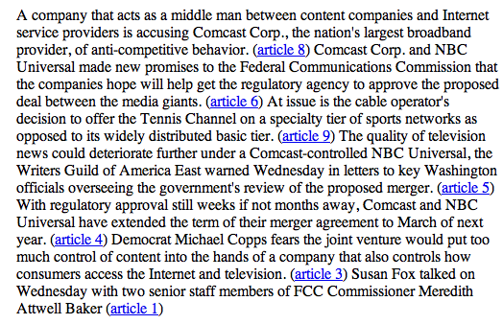
NLP problems and applications
Summarization

Slide 27
NLP problems and applications
Natural language understanding
  Text => semantic representation (e.g. logic, probabilistic relationships)
Information retrieval and question answering
"How many programmers in the child care department make over $50,000?”
“Who was the fourteenth president?”
“How did he die?”

Slide 28
NLP problems and applications
Text simplification
Alfonso Perez Munoz, usually referred to as Alfonso, is a former Spanish footballer, in the striker position.
Alfonso Perez is a former Spanish football player.

Slide 29
Where are we now?
Many of the “easy” and “medium” problems have reasonable solutions
  spell checkers
  sentence splitters
  word segementers/tokenizers

Slide 30
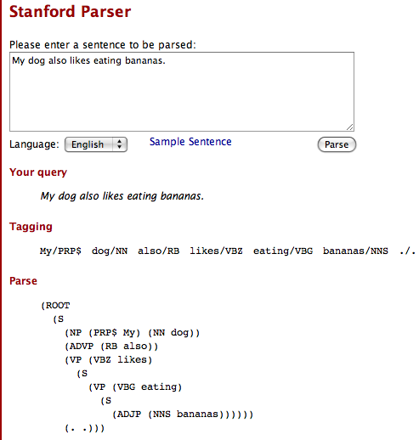
Where are we now?
Parsing
  Stanford Parser (http://nlp.stanford.edu:8080/parser/)

Slide 31
Where are we now?
Machine translation
  Getting better every year
  enough to get the jist of most content, but still no where near a human translation
  better for some types of text
http://translate.google.com
Many commercial versions…
  systran
  language weaver

Slide 32
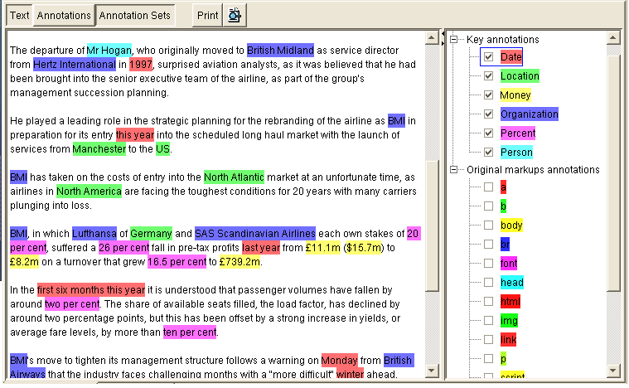
Where are we now?
Information extraction
  Structured documents (very good!)
    www.dealtime.com
    www.froogle.com
  AKT technologies
  Lots of these
    FlipDog
    WhizBang! Labs
    …
    work fairly well

Slide 33
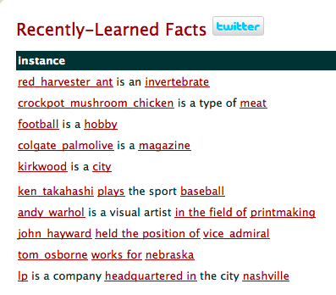
Where are we now?
CMU’s NELL (Never Ending Language Learner)
http://rtw.ml.cmu.edu/rtw/

Slide 34
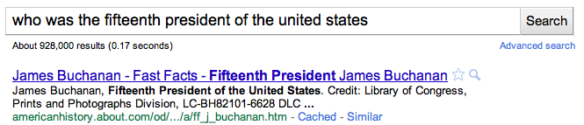
Where are we now?
Information retrieval/query answering
  search engines:
    pretty good for some things
    does mostly pattern matching and ranking
      no deep understanding
      still requires user to “find” the answer

Slide 35
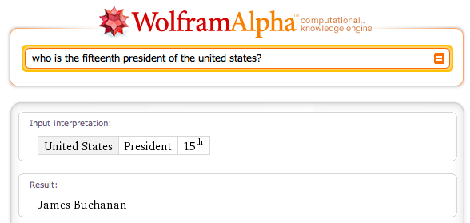
Where are we now?
Question answering
  wolfram alpha

Slide 36
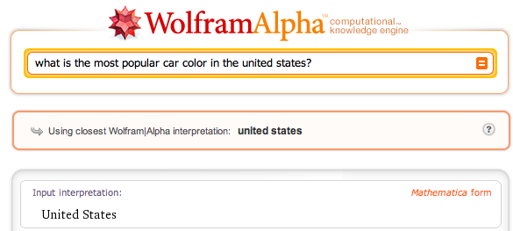
Where are we now?
Question answering
  wolfram alpha

Slide 37

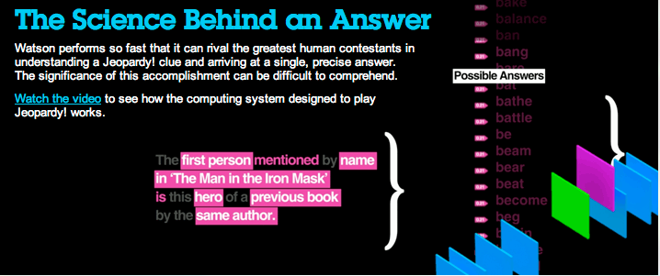
Question answering

Slide 38
Where are we now?
Question answering
  Many others…
    TREC question answering competition
    language computer corp
    answerbus
    …

Slide 39
Where are we now?
Summarization
  NewsBlaster (Columbia)
    http://newsblaster.cs.columbia.edu/

Slide 40
Where are we now?
Voice recognition
  pretty good, particularly with speaker training
    Apple OS has one built in:
      “What time is it?”
      “Switch to finder”
      “Hide this application”
    IBM ViaVoice
    Dragon Naturally Speaking
Speech generation
  The systems can generate the words, but getting the subtle nuances right is still tricky
    Apple OS
    translate.google.com

Slide 41
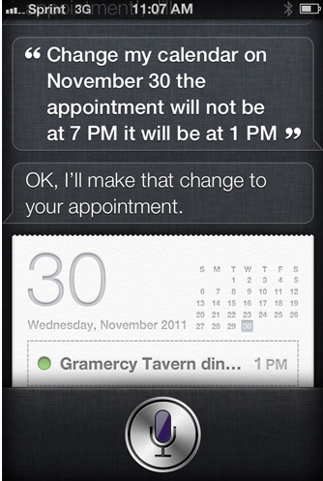
A combination of problems…

Slide 42
Other problems
Many problems untackled/undiscovered
“That’s What She Said: Double Entendre Identiﬁcation”
  ACL 2011
  http://www.cs.washington.edu/homes/brun/pubs/pubs/Kiddon11.pdf

Slide 43





Language translation
Yo quiero Taco Bell

Slide 44
MT Systems
Where have you seen machine translation systems?

Slide 45
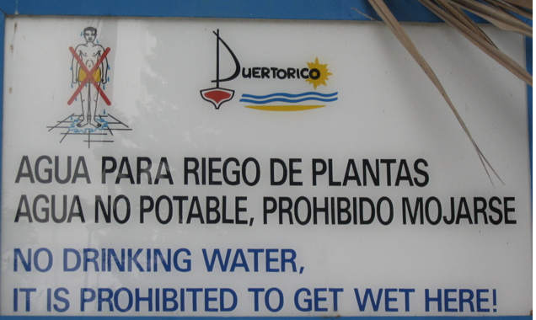

Slide 46
Machine Translation
美国关岛国际机场及其办公室均接获一名自称沙地阿拉伯富商拉登等发出的电子邮件，威胁将会向机场等公众地方发动生化袭击後，关岛经保持高度戒备。
The U.S. island of Guam is maintaining a high state of alert after the Guam airport and its offices both received an e-mail from someone calling himself the Saudi Arabian Osama bin Laden and threatening a biological/chemical attack against public places such as the airport .
The classic acid test for natural language processing.
Requires capabilities in both interpretation and generation.
People around the world stubbornly refuse to write
everything in English.

Slide 47
Machine Translation
美国关岛国际机场及其办公室均接获一名自称沙地阿拉伯富商拉登等发出的电子邮件，威胁将会向机场等公众地方发动生化袭击後，关岛经保持高度戒备。
Machine translation is becoming very prevalent
Even PowerPoint has translation built into it!
The U.S. island of Guam is maintaining a high state of alert after the Guam airport and its offices both received an e-mail from someone calling himself the Saudi Arabian Osama bin Laden and threatening a biological/chemical attack against public places such as the airport .
United States Guam International Airport and the Office received one claiming to be a wealthy Saudi Arabia an email such as Osama bin Laden, threats to the airport after biochemical attacks in public places such as Guam remain on high alert.

Slide 48
Which is the human?
Beijing Youth Daily said that under the Ministry of Agriculture, the beef will be destroyed after tests.
The Beijing Youth Daily pointed out that the seized beef would be disposed of after being examined according to advice from the Ministry of Agriculture.
?

Slide 49
Which is the human?
Pakistan President Pervez Musharraf Wins Senate Confidence Vote
Pakistani President Musharraf Won the Trust Vote in Senate and Lower House
?

Slide 50
Which is the human?
There was not a single vote against him."
No members vote against him. "
?

Slide 51

Data-Driven Machine Translation
Hmm, every time he sees
“banco”, he either types
“bank” or “bench” … but if
he sees “banco de…”,
he always types “bank”,
never “bench”…
Man, this is so boring.
Translated documents

Slide 52
Welcome to the Chinese Room
Chinese texts with
English translations
New
Chinese
Document
English
Translation
You can teach yourself to translate Chinese
using only bilingual data (without grammar books,
dictionaries, any people to answer your questions…)

Slide 53
Centauri/Arcturan [Knight, 1997]
Your assignment, translate this to Arcturan: farok crrrok hihok yorok clok kantok ok-yurp
1a. ok-voon ororok sprok .
1b. at-voon bichat dat .
7a. lalok farok ororok lalok sprok izok enemok .
7b. wat jjat bichat wat dat vat eneat .
2a. ok-drubel ok-voon anok plok sprok .
2b. at-drubel at-voon pippat rrat dat .
8a. lalok brok anok plok nok .
8b. iat lat pippat rrat nnat .
3a. erok sprok izok hihok ghirok .
3b. totat dat arrat vat hilat .
9a. wiwok nok izok kantok ok-yurp .
9b. totat nnat quat oloat at-yurp .
4a. ok-voon anok drok brok jok .
4b. at-voon krat pippat sat lat .
10a. lalok mok nok yorok ghirok clok .
10b. wat nnat gat mat bat hilat .
5a. wiwok farok izok stok .
5b. totat jjat quat cat .
11a. lalok nok crrrok hihok yorok zanzanok .
11b. wat nnat arrat mat zanzanat .
6a. lalok sprok izok jok stok .
6b. wat dat krat quat cat .
12a. lalok rarok nok izok hihok mok .
12b. wat nnat forat arrat vat gat .

Slide 54
Centauri/Arcturan [Knight, 1997]
Your assignment, translate this to Arcturan: farok crrrok hihok yorok clok kantok ok-yurp
1a. ok-voon ororok sprok .
1b. at-voon bichat dat .
7a. lalok farok ororok lalok sprok izok enemok .
7b. wat jjat bichat wat dat vat eneat .
2a. ok-drubel ok-voon anok plok sprok .
2b. at-drubel at-voon pippat rrat dat .
8a. lalok brok anok plok nok .
8b. iat lat pippat rrat nnat .
3a. erok sprok izok hihok ghirok .
3b. totat dat arrat vat hilat .
9a. wiwok nok izok kantok ok-yurp .
9b. totat nnat quat oloat at-yurp .
4a. ok-voon anok drok brok jok .
4b. at-voon krat pippat sat lat .
10a. lalok mok nok yorok ghirok clok .
10b. wat nnat gat mat bat hilat .
5a. wiwok farok izok stok .
5b. totat jjat quat cat .
11a. lalok nok crrrok hihok yorok zanzanok .
11b. wat nnat arrat mat zanzanat .
6a. lalok sprok izok jok stok .
6b. wat dat krat quat cat .
12a. lalok rarok nok izok hihok mok .
12b. wat nnat forat arrat vat gat .

Slide 55
Centauri/Arcturan [Knight, 1997]
Your assignment, translate this to Arcturan: farok crrrok hihok yorok clok kantok ok-yurp
1a. ok-voon ororok sprok .
1b. at-voon bichat dat .
7a. lalok farok ororok lalok sprok izok enemok .
7b. wat jjat bichat wat dat vat eneat .
2a. ok-drubel ok-voon anok plok sprok .
2b. at-drubel at-voon pippat rrat dat .
8a. lalok brok anok plok nok .
8b. iat lat pippat rrat nnat .
3a. erok sprok izok hihok ghirok .
3b. totat dat arrat vat hilat .
9a. wiwok nok izok kantok ok-yurp .
9b. totat nnat quat oloat at-yurp .
4a. ok-voon anok drok brok jok .
4b. at-voon krat pippat sat lat .
10a. lalok mok nok yorok ghirok clok .
10b. wat nnat gat mat bat hilat .
5a. wiwok farok izok stok .
5b. totat jjat quat cat .
11a. lalok nok crrrok hihok yorok zanzanok .
11b. wat nnat arrat mat zanzanat .
6a. lalok sprok izok jok stok .
6b. wat dat krat quat cat .
12a. lalok rarok nok izok hihok mok .
12b. wat nnat forat arrat vat gat .

Slide 56
Centauri/Arcturan [Knight, 1997]
Your assignment, translate this to Arcturan: farok crrrok hihok yorok clok kantok ok-yurp
1a. ok-voon ororok sprok .
1b. at-voon bichat dat .
7a. lalok farok ororok lalok sprok izok enemok .
7b. wat jjat bichat wat dat vat eneat .
2a. ok-drubel ok-voon anok plok sprok .
2b. at-drubel at-voon pippat rrat dat .
8a. lalok brok anok plok nok .
8b. iat lat pippat rrat nnat .
3a. erok sprok izok hihok ghirok .
3b. totat dat arrat vat hilat .
9a. wiwok nok izok kantok ok-yurp .
9b. totat nnat quat oloat at-yurp .
4a. ok-voon anok drok brok jok .
4b. at-voon krat pippat sat lat .
10a. lalok mok nok yorok ghirok clok .
10b. wat nnat gat mat bat hilat .
5a. wiwok farok izok stok .
5b. totat jjat quat cat .
11a. lalok nok crrrok hihok yorok zanzanok .
11b. wat nnat arrat mat zanzanat .
???
6a. lalok sprok izok jok stok .
6b. wat dat krat quat cat .
12a. lalok rarok nok izok hihok mok .
12b. wat nnat forat arrat vat gat .

Slide 57
Centauri/Arcturan [Knight, 1997]
Your assignment, translate this to Arcturan: farok crrrok hihok yorok clok kantok ok-yurp
1a. ok-voon ororok sprok .
1b. at-voon bichat dat .
7a. lalok farok ororok lalok sprok izok enemok .
7b. wat jjat bichat wat dat vat eneat .
2a. ok-drubel ok-voon anok plok sprok .
2b. at-drubel at-voon pippat rrat dat .
8a. lalok brok anok plok nok .
8b. iat lat pippat rrat nnat .
3a. erok sprok izok hihok ghirok .
3b. totat dat arrat vat hilat .
9a. wiwok nok izok kantok ok-yurp .
9b. totat nnat quat oloat at-yurp .
4a. ok-voon anok drok brok jok .
4b. at-voon krat pippat sat lat .
10a. lalok mok nok yorok ghirok clok .
10b. wat nnat gat mat bat hilat .
5a. wiwok farok izok stok .
5b. totat jjat quat cat .
11a. lalok nok crrrok hihok yorok zanzanok .
11b. wat nnat arrat mat zanzanat .
6a. lalok sprok izok jok stok .
6b. wat dat krat quat cat .
12a. lalok rarok nok izok hihok mok .
12b. wat nnat forat arrat vat gat .

Slide 58
Centauri/Arcturan [Knight, 1997]
Your assignment, translate this to Arcturan: farok crrrok hihok yorok clok kantok ok-yurp
1a. ok-voon ororok sprok .
1b. at-voon bichat dat .
7a. lalok farok ororok lalok sprok izok enemok .
7b. wat jjat bichat wat dat vat eneat .
2a. ok-drubel ok-voon anok plok sprok .
2b. at-drubel at-voon pippat rrat dat .
8a. lalok brok anok plok nok .
8b. iat lat pippat rrat nnat .
3a. erok sprok izok hihok ghirok .
3b. totat dat arrat vat hilat .
9a. wiwok nok izok kantok ok-yurp .
9b. totat nnat quat oloat at-yurp .
4a. ok-voon anok drok brok jok .
4b. at-voon krat pippat sat lat .
10a. lalok mok nok yorok ghirok clok .
10b. wat nnat gat mat bat hilat .
5a. wiwok farok izok stok .
5b. totat jjat quat cat .
11a. lalok nok crrrok hihok yorok zanzanok .
11b. wat nnat arrat mat zanzanat .
6a. lalok sprok izok jok stok .
6b. wat dat krat quat cat .
12a. lalok rarok nok izok hihok mok .
12b. wat nnat forat arrat vat gat .

Slide 59
Centauri/Arcturan [Knight, 1997]
Your assignment, translate this to Arcturan: farok crrrok hihok yorok clok kantok ok-yurp
1a. ok-voon ororok sprok .
1b. at-voon bichat dat .
7a. lalok farok ororok lalok sprok izok enemok .
7b. wat jjat bichat wat dat vat eneat .
2a. ok-drubel ok-voon anok plok sprok .
2b. at-drubel at-voon pippat rrat dat .
8a. lalok brok anok plok nok .
8b. iat lat pippat rrat nnat .
3a. erok sprok izok hihok ghirok .
3b. totat dat arrat vat hilat .
9a. wiwok nok izok kantok ok-yurp .
9b. totat nnat quat oloat at-yurp .
4a. ok-voon anok drok brok jok .
4b. at-voon krat pippat sat lat .
10a. lalok mok nok yorok ghirok clok .
10b. wat nnat gat mat bat hilat .
5a. wiwok farok izok stok .
5b. totat jjat quat cat .
11a. lalok nok crrrok hihok yorok zanzanok .
11b. wat nnat arrat mat zanzanat .
6a. lalok sprok izok jok stok .
6b. wat dat krat quat cat .
12a. lalok rarok nok izok hihok mok .
12b. wat nnat forat arrat vat gat .

Slide 60
Centauri/Arcturan [Knight, 1997]
Your assignment, translate this to Arcturan: farok crrrok hihok yorok clok kantok ok-yurp
1a. ok-voon ororok sprok .
1b. at-voon bichat dat .
7a. lalok farok ororok lalok sprok izok enemok .
7b. wat jjat bichat wat dat vat eneat .
2a. ok-drubel ok-voon anok plok sprok .
2b. at-drubel at-voon pippat rrat dat .
8a. lalok brok anok plok nok .
8b. iat lat pippat rrat nnat .
3a. erok sprok izok hihok ghirok .
3b. totat dat arrat vat hilat .
9a. wiwok nok izok kantok ok-yurp .
9b. totat nnat quat oloat at-yurp .
4a. ok-voon anok drok brok jok .
4b. at-voon krat pippat sat lat .
10a. lalok mok nok yorok ghirok clok .
10b. wat nnat gat mat bat hilat .
???
5a. wiwok farok izok stok .
5b. totat jjat quat cat .
11a. lalok nok crrrok hihok yorok zanzanok .
11b. wat nnat arrat mat zanzanat .
6a. lalok sprok izok jok stok .
6b. wat dat krat quat cat .
12a. lalok rarok nok izok hihok mok .
12b. wat nnat forat arrat vat gat .

Slide 61
Centauri/Arcturan [Knight, 1997]
Your assignment, translate this to Arcturan: farok crrrok hihok yorok clok kantok ok-yurp
1a. ok-voon ororok sprok .
1b. at-voon bichat dat .
7a. lalok farok ororok lalok sprok izok enemok .
7b. wat jjat bichat wat dat vat eneat .
2a. ok-drubel ok-voon anok plok sprok .
2b. at-drubel at-voon pippat rrat dat .
8a. lalok brok anok plok nok .
8b. iat lat pippat rrat nnat .
3a. erok sprok izok hihok ghirok .
3b. totat dat arrat vat hilat .
9a. wiwok nok izok kantok ok-yurp .
9b. totat nnat quat oloat at-yurp .
4a. ok-voon anok drok brok jok .
4b. at-voon krat pippat sat lat .
10a. lalok mok nok yorok ghirok clok .
10b. wat nnat gat mat bat hilat .
5a. wiwok farok izok stok .
5b. totat jjat quat cat .
11a. lalok nok crrrok hihok yorok zanzanok .
11b. wat nnat arrat mat zanzanat .
6a. lalok sprok izok jok stok .
6b. wat dat krat quat cat .
12a. lalok rarok nok izok hihok mok .
12b. wat nnat forat arrat vat gat .

Slide 62
Centauri/Arcturan [Knight, 1997]
Your assignment, translate this to Arcturan: farok crrrok hihok yorok clok kantok ok-yurp
1a. ok-voon ororok sprok .
1b. at-voon bichat dat .
7a. lalok farok ororok lalok sprok izok enemok .
7b. wat jjat bichat wat dat vat eneat .
2a. ok-drubel ok-voon anok plok sprok .
2b. at-drubel at-voon pippat rrat dat .
8a. lalok brok anok plok nok .
8b. iat lat pippat rrat nnat .
3a. erok sprok izok hihok ghirok .
3b. totat dat arrat vat hilat .
9a. wiwok nok izok kantok ok-yurp .
9b. totat nnat quat oloat at-yurp .
4a. ok-voon anok drok brok jok .
4b. at-voon krat pippat sat lat .
10a. lalok mok nok yorok ghirok clok .
10b. wat nnat gat mat bat hilat .
process of
elimination
5a. wiwok farok izok stok .
5b. totat jjat quat cat .
11a. lalok nok crrrok hihok yorok zanzanok .
11b. wat nnat arrat mat zanzanat .
6a. lalok sprok izok jok stok .
6b. wat dat krat quat cat .
12a. lalok rarok nok izok hihok mok .
12b. wat nnat forat arrat vat gat .

Slide 63
Centauri/Arcturan [Knight, 1997]
Your assignment, translate this to Arcturan: farok crrrok hihok yorok clok kantok ok-yurp
1a. ok-voon ororok sprok .
1b. at-voon bichat dat .
7a. lalok farok ororok lalok sprok izok enemok .
7b. wat jjat bichat wat dat vat eneat .
2a. ok-drubel ok-voon anok plok sprok .
2b. at-drubel at-voon pippat rrat dat .
8a. lalok brok anok plok nok .
8b. iat lat pippat rrat nnat .
3a. erok sprok izok hihok ghirok .
3b. totat dat arrat vat hilat .
9a. wiwok nok izok kantok ok-yurp .
9b. totat nnat quat oloat at-yurp .
4a. ok-voon anok drok brok jok .
4b. at-voon krat pippat sat lat .
10a. lalok mok nok yorok ghirok clok .
10b. wat nnat gat mat bat hilat .
5a. wiwok farok izok stok .
5b. totat jjat quat cat .
11a. lalok nok crrrok hihok yorok zanzanok .
11b. wat nnat arrat mat zanzanat .
cognate?
6a. lalok sprok izok jok stok .
6b. wat dat krat quat cat .
12a. lalok rarok nok izok hihok mok .
12b. wat nnat forat arrat vat gat .

Slide 64
Centauri/Arcturan [Knight, 1997]
Your assignment, put these words in order: { jjat, arrat, mat, bat, oloat, at-yurp }
1a. ok-voon ororok sprok .
1b. at-voon bichat dat .
7a. lalok farok ororok lalok sprok izok enemok .
7b. wat jjat bichat wat dat vat eneat .
2a. ok-drubel ok-voon anok plok sprok .
2b. at-drubel at-voon pippat rrat dat .
8a. lalok brok anok plok nok .
8b. iat lat pippat rrat nnat .
3a. erok sprok izok hihok ghirok .
3b. totat dat arrat vat hilat .
9a. wiwok nok izok kantok ok-yurp .
9b. totat nnat quat oloat at-yurp .
4a. ok-voon anok drok brok jok .
4b. at-voon krat pippat sat lat .
10a. lalok mok nok yorok ghirok clok .
10b. wat nnat gat mat bat hilat .
5a. wiwok farok izok stok .
5b. totat jjat quat cat .
11a. lalok nok crrrok hihok yorok zanzanok .
11b. wat nnat arrat mat zanzanat .
zero
fertility
6a. lalok sprok izok jok stok .
6b. wat dat krat quat cat .
12a. lalok rarok nok izok hihok mok .
12b. wat nnat forat arrat vat gat .

Slide 65
It’s Really Spanish/English
Clients do not sell pharmaceuticals in Europe => Clientes no venden medicinas en Europa
1a. Garcia and associates .
1b. Garcia y asociados .
7a. the clients and the associates are enemies .
7b. los clients y los asociados son enemigos .
2a. Carlos Garcia has three associates .
2b. Carlos Garcia tiene tres asociados .
8a. the company has three groups .
8b. la empresa tiene tres grupos .
3a. his associates are not strong .
3b. sus asociados no son fuertes .
9a. its groups are in Europe .
9b. sus grupos estan en Europa .
4a. Garcia has a company also .
4b. Garcia tambien tiene una empresa .
10a. the modern groups sell strong pharmaceuticals .
10b. los grupos modernos venden medicinas fuertes .
5a. its clients are angry .
5b. sus clientes estan enfadados .
11a. the groups do not sell zenzanine .
11b. los grupos no venden zanzanina .
6a. the associates are also angry .
6b. los asociados tambien estan enfadados .
12a. the small groups are not modern .
12b. los grupos pequenos no son modernos .

Slide 66
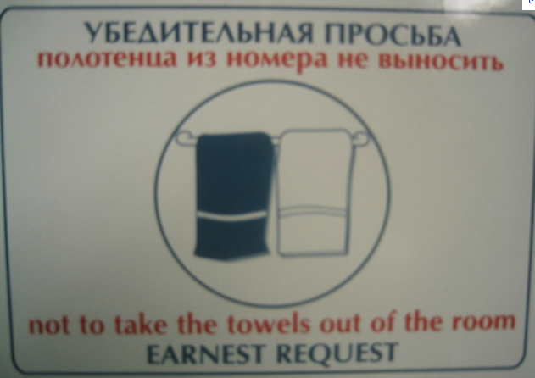

Slide 67
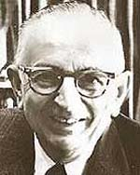
Warren Weaver (1947)
ingcmpnqsnwf cv fpn owoktvcv
hu ihgzsnwfv rqcffnw cw owgcnwf
kowazoanv ...

Slide 68
Warren Weaver (1947)
e e e e
ingcmpnqsnwf cv fpn owoktvcv
e e e
hu ihgzsnwfv rqcffnw cw owgcnwf
e
kowazoanv ...

Slide 69
Warren Weaver (1947)
e e e the
ingcmpnqsnwf cv fpn owoktvcv
e e e
hu ihgzsnwfv rqcffnw cw owgcnwf
e
kowazoanv ...

Slide 70
Warren Weaver (1947)
e he e the
ingcmpnqsnwf cv fpn owoktvcv
e e e t
hu ihgzsnwfv rqcffnw cw owgcnwf
e
kowazoanv ...

Slide 71
Warren Weaver (1947)
e he e of the
ingcmpnqsnwf cv fpn owoktvcv
e e e t
hu ihgzsnwfv rqcffnw cw owgcnwf
e
kowazoanv ...

Slide 72
Warren Weaver (1947)
e he e of the fof
ingcmpnqsnwf cv fpn owoktvcv
e f o e o oe t
hu ihgzsnwfv rqcffnw cw owgcnwf
ef
kowazoanv ...

Slide 73
Warren Weaver (1947)
e he e of the
ingcmpnqsnwf cv fpn owoktvcv
e e e t
hu ihgzsnwfv rqcffnw cw owgcnwf
e
kowazoanv ...

Slide 74
Warren Weaver (1947)
e he e is the sis
ingcmpnqsnwf cv fpn owoktvcv
e s i e i ie t
hu ihgzsnwfv rqcffnw cw owgcnwf
es
kowazoanv ...

Slide 75
Warren Weaver (1947)
decipherment is the analysis
ingcmpnqsnwf cv fpn owoktvcv
of documents written in ancient
hu ihgzsnwfv rqcffnw cw owgcnwf
languages ...
kowazoanv ...

Slide 76
Warren Weaver (1947)
Maybe this can be done for translation of languages. All I need is a pair-wise word frequencies between two languages…
Can this be
computerized?
Collected automatically…

Slide 77
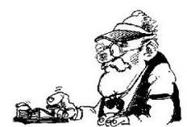

Noisy channel model
some message
is sent
along the way the message gets changed/mutated
What was originally sent?
We have the mutated message, but would like to recover the original
Notes:
- think about the message passing game…

Slide 78
Noisy channel model
sent
received
model: p(sent | received)

Slide 79
Noisy channel model
Probabilistic model:
p(English| Foreign)
Given sentence pairs, gives us the probability
p(English| speech)
p(simplified| unsimplified)
Notes:
general idea started with information theory and Shannon in the 40s
used in the early 90s by IBM team for machine translation
- started to become a prevalent model for text-to-text approaches in the late 1990s

Slide 80
Noisy channel model: training
Input: aligned sentence pairs
Chinese sentence fragment
English sentence fragment
learning

Slide 81
Noisy channel model: applying
Conditioned on the input, what is the most-likely output
美国关岛国际机场及其办公室均接获一名自称沙地阿拉伯富商拉登等发出的电子邮件，威胁将会向机场等公众地方发动生化袭击後，关岛经保持高度戒备。

Slide 82
Noisy channel model
Bayes’ rule

Slide 83
Noisy channel model
Bayes’ rule
probability of the received message
language model: what are likely word sequences?
translation model: how does the mutation/translation process happen? what operations are valid?

Slide 84
Noisy channel model
why?
probability of the received message
language model: what are likely word sequences?
translation model: how does the translation process happen? what operations are valid?

Slide 85
Machine translation
model
channel model
translation model
language model
how do English words/phrases translate to Chinese?
what are likely English words/word sequences?

Slide 86
One way to think about it…
Translation
model
Broken
English
language
model
Spanish
(foreign)
English
What hunger have I,
Hungry I am so,
I am so hungry,
Have I that hunger …
Que hambre tengo yo
I am so hungry

Slide 87
Data available
Many languages
  Europarl corpus has all European languages
    http://www.statmt.org/europarl/
    From a few hundred thousand sentences to a few million
  French/English from French parliamentary proceedings
  Lots of Chinese/English and Arabic/English from government projects/interests
    Chinese-English: 440 million words (15-20 million sentence pairs)
    Arabic-English: 790 million words (30-40 million sentence pairs)
  Smaller corpora in many, many other languages
Lots of monolingual data available in many languages
Even less data with multiple translations available
Available in limited domains
  most data is either news or government proceedings
  some other domains recently, like blogs

Slide 88
Statistical MT Overview
training
learned parameters
Bilingual data
model
monolingual data
Find the best
translation given the foreign sentence and the model
Translation
Foreign sentence
English
sentence

Slide 89
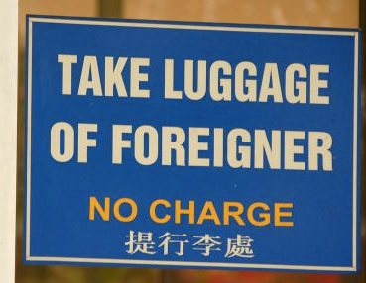

Slide 90
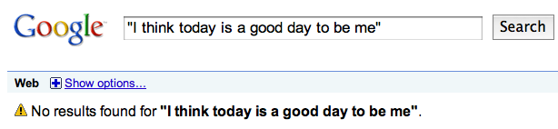
Language modeling
Answers the question of how likely a sentence is to be an English sentence
I think today is a good day to be me

Slide 91
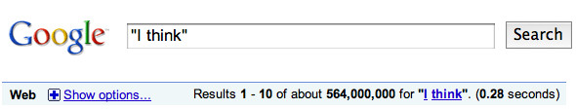
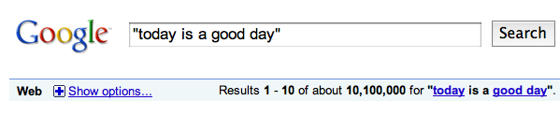
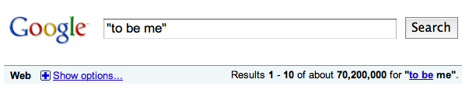
Language modeling
I think today is a good day to be me

Slide 92
Language modeling
I think today is a good day to be me
Must also worry about the ordering of the words
How likely is “I think” to be preceded by “today is a good day”?
The main challenge with language modeling is dealing with data sparsity

Slide 93
Language modeling
Most common: n-gram language models
p(word | previous words)
More data the better (Google n-grams)
Domain is important!

Slide 94
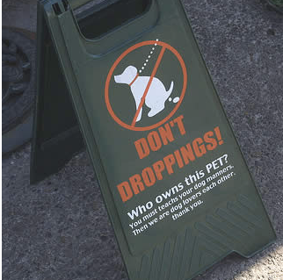

Slide 95
Translation models: MT Pyramid
interlingua
semantics
semantics
syntax
syntax
phrases
phrases
words
words
SOURCE
TARGET

Slide 96
Phrase-Based Statistical MT
Morgen fliege ich nach Kanada zue Konferenze

Slide 97
Phrase-Based Statistical MT
Morgen
fliege
ich
nach Kanada
zur Konferenz
Foreign input segmented in to phrases
  “phrase” is any sequence of words

Slide 98
Phrase-Based Statistical MT
Morgen
fliege
ich
nach Kanada
zur Konferenz
Tomorrow
will fly
I
In Canada
to the conference
Each phrase is probabilistically translated into English
  P(to the conference | zur Konferenz)
  P(into the meeting | zur Konferenz)

Slide 99
Phrase-Based Statistical MT
Morgen
fliege
ich
nach Kanada
zur Konferenz
Tomorrow
I
will fly
to the conference
In Canada
Phrases are probabilistically re-ordered
See [Koehn et al, 2003] for an intro.

Slide 100
Advantages of Phrase-Based
Many-to-many mappings can handle non-compositional phrases
Easy to understand
Local context is very useful for disambiguating
  “Interest rate” → …
  “Interest in” → …
The more data, the longer the learned phrases
  Sometimes whole sentences

Slide 101
Available Resources
Bilingual corpora
  100m+ words of Chinese/English and Arabic/English, LDC (www.ldc.upenn.edu)
  Lots of French/English, Spanish/French/English, LDC
  European Parliament (sentence-aligned), 11 languages, Philipp Koehn, ISI
    (www.isi.edu/~koehn/publications/europarl)
  20m words (sentence-aligned) of English/French, Ulrich Germann, ISI
    (www.isi.edu/natural-language/download/hansard/)
Sentence alignment
  Dan Melamed, NYU (www.cs.nyu.edu/~melamed/GMA/docs/README.htm)
  Xiaoyi Ma, LDC (Champollion)
Word alignment
  GIZA, JHU Workshop ’99 (www.clsp.jhu.edu/ws99/projects/mt/)
  GIZA++, RWTH Aachen (www-i6.Informatik.RWTH-Aachen.de/web/Software/GIZA++.html)
  Manually word-aligned test corpus (500 French/English sentence pairs), RWTH Aachen
  Shared task, NAACL-HLT’03 workshop
Decoding
  ISI ReWrite Model 4 decoder (www.isi.edu/licensed-sw/rewrite-decoder/)
  ISI Pharaoh phrase-based decoder
Statistical MT Tutorial Workbook, ISI (www.isi.edu/~knight/)
Annual common-data evaluation, NIST (www.nist.gov/speech/tests/mt/index.htm)

Slide 102
Some Papers Referenced on Slides
ACL
  [Och, Tillmann, & Ney, 1999]
  [Och & Ney, 2000]
  [Germann et al, 2001]
  [Yamada & Knight, 2001, 2002]
  [Papineni et al, 2002]
  [Alshawi et al, 1998]
  [Collins, 1997]
  [Koehn & Knight, 2003]
  [Al-Onaizan & Knight, 2002]
  [Och & Ney, 2002]
  [Och, 2003]
  [Koehn et al, 2003]
EMNLP
  [Marcu & Wong, 2002]
  [Fox, 2002]
  [Munteanu & Marcu, 2002]
AI Magazine
  [Knight, 1997]
www.isi.edu/~knight
  [MT Tutorial Workbook]
AMTA
  [Soricut et al, 2002]
  [Al-Onaizan & Knight, 1998]
EACL
  [Cmejrek et al, 2003]
Computational Linguistics
  [Brown et al, 1993]
  [Knight, 1999]
  [Wu, 1997]
AAAI
  [Koehn & Knight, 2000]
IWNLG
  [Habash, 2002]
MT Summit
  [Charniak, Knight, Yamada, 2003]
NAACL
  [Koehn, Marcu, Och, 2003]
  [Germann, 2003]
  [Graehl & Knight, 2004]
  [Galley, Hopkins, Knight, Marcu, 2004]

